Slide 1
Publication about Flickr data Looking for examples and ideas
What I did and what I found

Slide 2
Rationale
I was interested to find out how I might use SPSS to analyse Flickr data
At the same time I was curious as to what sort of research was being conducted with Flickr data

Slide 3
Search, skim and review
Simple google search (other search engines may be used)
looked through ALL of the returns…
Followed a few false turns…

Slide 4
More skimming and reviewing
Identified something which sounded likely
By title
By snapshot of text

Slide 5
Took a look
Open google book
Repeat skim and review
This time the contents

Slide 6
Felt confident that it might be useful

Slide 7
Used the title to do a google scholar search
Found the PDF ☺ downloaded it

Slide 8
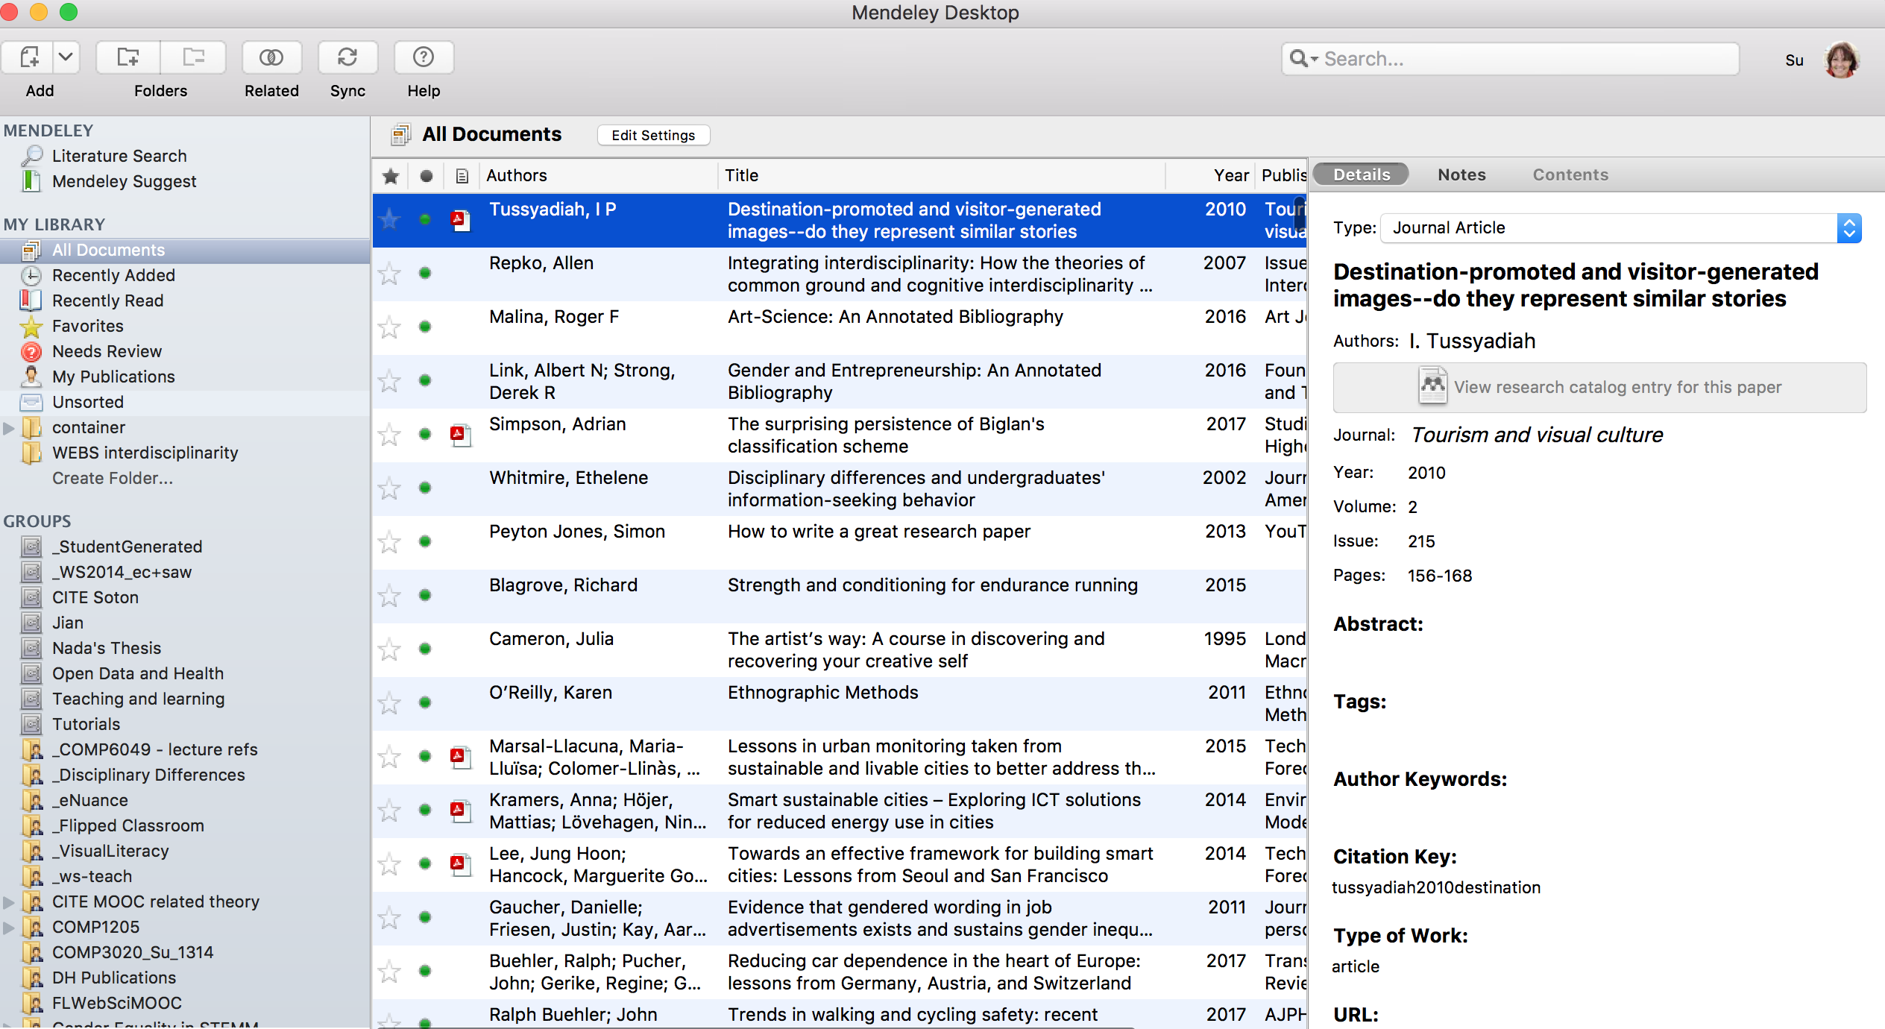
Downloaded the citation and imported it into Mendeley
Tussyadiah, I.P., 2010. Destination-promoted and visitor-generated images--do they represent similar stories. Tourism and visual culture, 2(215), pp.156–168.

Slide 9
Used Google Scholar to look at the more recent articles which cited this paper

Slide 10
Time to decide
Read the whole paper?
Now?
Later?
Find some more papers?
Scan, review and repeat!
Webliography
Google Scholar: http://scholar.google.co.uk
Mendeley
http://www.mendeley.com/

Slide 11
How to read a paper
Keshav, S., 2007. How to read a paper. Sigcomm, 37(3), pp.2–3. Available at: http://www.sigcomm.org/sites/default/files/ccr/papers/2007/July/1273445-1273458.pdf/
Weblinks to that and related works
You may find the final two page overview from the OU the best starting point
Davis, 2007 How to Review a Paper
Dunleavy, 2014 Doing a Quick Literature Review
Keshav, 2007- How to read a paper.pdf
Mitzenmacher n.d. How to read a resesarch paper.pdf
OU, 2007 How to read a paper workflow.graffle - Keshav- How to read a paper workflow.pdf
Notes on Automatic Note Taking http://edshare.soton.ac.uk/17294/

