Slide 1
COMPUTER APPLICATIONS
Yvonne Howard – ymh@ecs.soton.ac.uk
Prof Hugh C. Davis – hcd@soton.ac.uk
Jian Shi – js9g09@ecs.soton.ac.uk

Slide 2
Objectives
Becoming a digitally literate student
To introduce the use of Digital Literacies to support becoming a student in a digital age
The use of digital tools for
Personal effectiveness in support of becoming an engineer.
Communication to share, analyse, and present data.
Collaboration tools for team working.
Skills in programming for engineering solutions.
Python applications
Working in a team to develop a practical engineering software application.

Slide 3
Practicalities: Teaching
Do not be late!
Lectures
Groups 3 & 4 Monday 09:00 building 44, 1041
We will have some of the lectures in the lab (44/1061), starting at 9:00 – we will let you know which ones!
Labs
Groups 3 & 4 Monday directly after lecture until 10:50
Building 44/1061
Register taken at labs.
You are responsible for ensuring that a demonstrator has seen your work and marked it in assessed labs.
Ask for help when you need it.
Self Study

Slide 4
Practicalities: Teaching
Do not be late!
Lectures
Groups 1 & 2 Friday 09:00 building 44, 1041
We will have some of the lectures in the lab (44/1061), starting at 9:00 – we will let you know which ones!
Labs
Groups 1 & 2 Friday directly after lecture until 10:50
Building 44/1061
Register taken at labs.
You are responsible for ensuring that a demonstrator has seen your work and marked it in assessed labs.
Ask for help when you need it.
Self Study

Slide 5
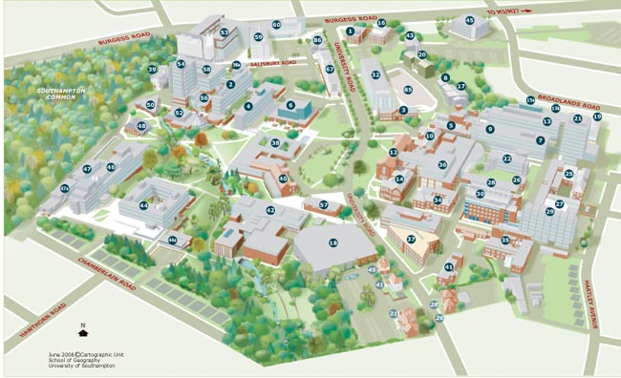

Slide 6
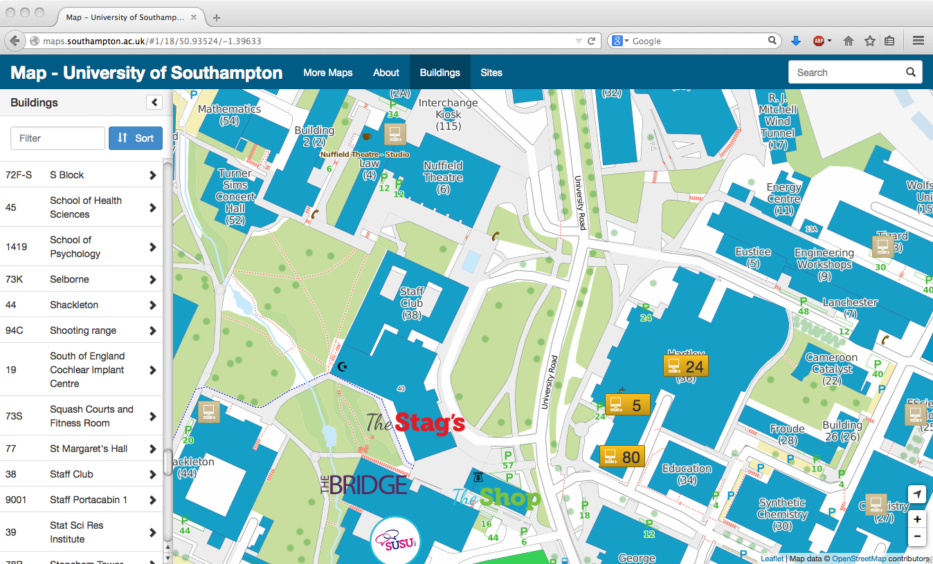
Interactive University map using open data maps.soton.ac.uk

Slide 7
Introductions
Me
You:
Spend 5 minutes talking to the person sitting behind or in front of you.
Find out & make notes:
Their name
Where they’re from
What degree they want to do after FY
What are their interests outside study

Slide 8
Learning
Attending lectures will help you to pass the module.
The lectures will not give you all the answers.
One of the objectives of this course is learning how to learn to use new software.
Labs are practical sessions where you learn how to apply what is taught in the lectures
Help yourself first but ask questions if you are truly lost.
Sign the on-line attendance sheet at each lab.
If you have little or no previous experience of MS Office,
Microsoft have some good online tutorials
Lynda.com, sign on with your UoS user account

Slide 9
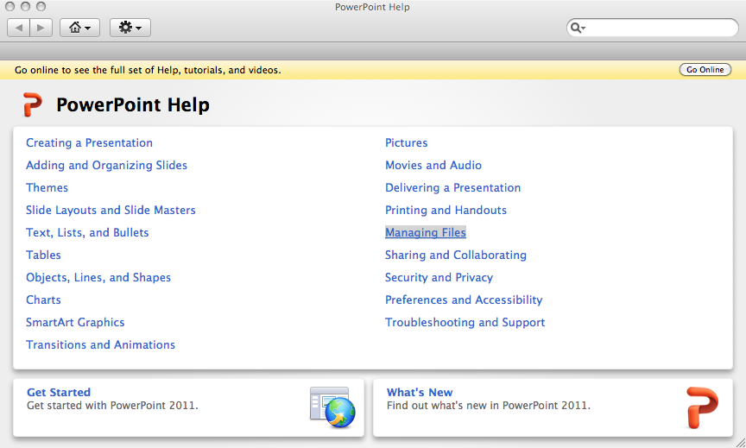
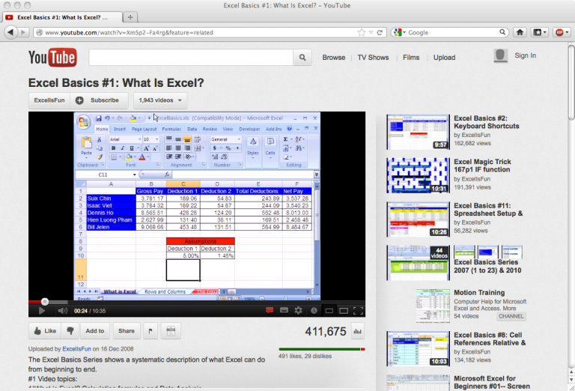
How to do “xxx” in yyy
Help yourself - every application will have some help available- check before asking the post grads
Application-Help menu
Look for resources on the web, the application’s own tutorials are very useful and there are many others e.g on YouTube

Slide 10
Lesson Plan Semester 1 (1)‏
University computing environment and the web as a study tool
Organising Life
Working Together
Online Identity

Slide 11
Lesson Plan Semester 1 (2)‏
Programming concepts
Introduction to Python
Variables and Operators
Decision Structures
Loops
Revision

Slide 12
Assessment
All coursework is handed in online through Blackboard
Coursework pass mark 60%
Assignment 1, worth 20% of course total
Data analysis + presentation
Electronic Hand in November 2017 (date to be confirmed)
Assignment 2, 30%
Simple Python applications
Assessed through labs
Assignment 3, 50% Semester 2
Team programming project, details closer to the time

Slide 13
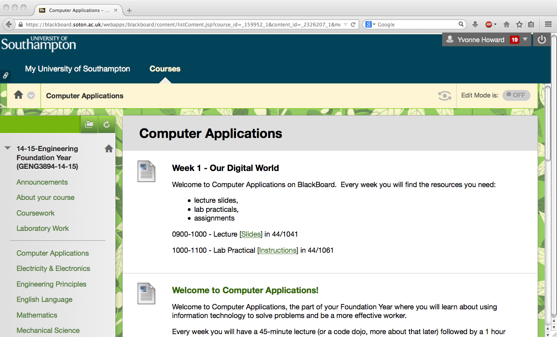
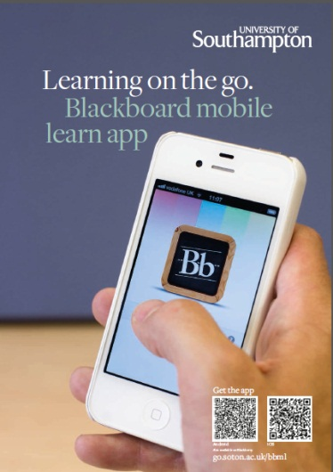
Resources
Available through Blackboard
Foundation Year – Computer Applications
Lecture slides
Possibly extra notes and links to other resources
Practical exercises.
The Web

Slide 14
Appropriate use of University Systems
Read and follow the University regulations
Protect account passwords
Don’t use the university network (including halls) for anything that you can’t justify to:
Hugh, Jian and Yvonne
Dr Barney
the police
your grandmother
Plagiarism and Academic Integrity
www.sell-me-an-essay.com
University Policy on Plagiarism
http://www.calendar.soton.ac.uk/sectionIV/academic-integrity-regs.html
You are cheating yourself, you will be caught
Google doesn’t find everything, you might try the following search engines:
duckduckgo.com
www.yahoo.com
www.bing.com

Slide 15
Literacy, n.
“The quality or state of being literate; knowledge of letters; condition in respect to education, esp. ability to read and write.”
- The Oxford English Dictionary
Discussion (5 min)
In small groups (3-4) what are the types of digital literacy that you can think of (skills concerning the use of ICT and Web 2.0 technology)?

Slide 16
Finding,
evaluating,
processing,
organising,
analysing,
presenting
Using applications and services
Business
Models
Beliefs and
Practices
Digital
Citizenship
Digital
Workpractices
Street Wisdom on the Digital
Highway
Information
Literacy
Digital Academic Practices
ICT
Skills
Identity and Reputation
Communication
Collaboration
Media
Literacy
Social
Networking
Networks
(of People)
Evaluating
Affordances

Slide 17
The learner is given the stuff via the network
The learner finds stuff on the network
The learner finds stuff from the network (of people)
The learner is part of the network and contributes
Stuff
Meaning and Understanding
Business
Models
Beliefs and
Practices
Digital
Citizenship
Digital
Workpractices
Street Wisdom on the Digital
Highway
Information
Literacy
Digital Academic Practices
ICT
Skills
Identity and Reputation
Communication
Collaboration
Media
Literacy
Social
Networking
Networks
(of People)
Evaluating
Affordances

Slide 18
Digital Literacies are the skills needed to live, learn, work, collaborate, influence and lead in the virtual and digital world
Business
Models
Beliefs and
Practices
Digital
Citizenship
Digital
Workpractices
Street Wisdom on the Digital
Highway
Information
Literacy
Digital Academic Practices
ICT
Skills
Identity and Reputation
Communication
Collaboration
Media
Literacy
Social
Networking
Networks
(of People)
Evaluating
Affordances

Slide 19
What is Digital Literacy?
Exploring new technological concepts in a flexible way
Technological
Interacting through ICT in a responsible way
Ethical
Cognitive
Access, selection and critical evaluation of information
Adapted from: Calvani, A., Fini, A., and Ranieri, M. (2009). Assessing Digital Competence in Secondary Education – Issues, Models and Instruments. (M. Leaning, Ed.) Issues in Information and Media Literacy: Education, Practice and Pedagogy , 153-172.

Slide 20
What is Digital Literacy?
Digital Literacy is the awareness, attitude and ability of individuals to appropriately use digital tools and facilities to identify, access, manage, integrate, evaluate, analyse and synthesize digital resources, construct new knowledge, create media expressions, and communicate with others, in the context of specific life situations, in order to enable constructive social action; and to reflect upon this process.
LEVEL 3: Digital Transformation
(innovation/creativity)
LEVEL 2: Digital Usage
(professional/discipline application)
LEVEL 1: Digital Competence
(skills, concepts, approaches, attitudes, etc.)
Adapted from: Martin, A., Grudziecki, J. (2006). DigEuLit: Concepts and Tools for Digital Literacy Development, University of Glasgow, Scotland.

Slide 21
Why is Digital Literacy important
In an increasingly digital world, where the workplace is often virtual, we see it is our responsibility to equip students with ‘digital literacies’ so they develop skills to flourish, influence and lead in that environment.
-Professor Hugh Davis

Slide 22
By the end of the Practical Session
Log in to public workstation, SUSSED, Blackboard
Use digital tools for research
Use a word processing application to record your findings

Slide 23
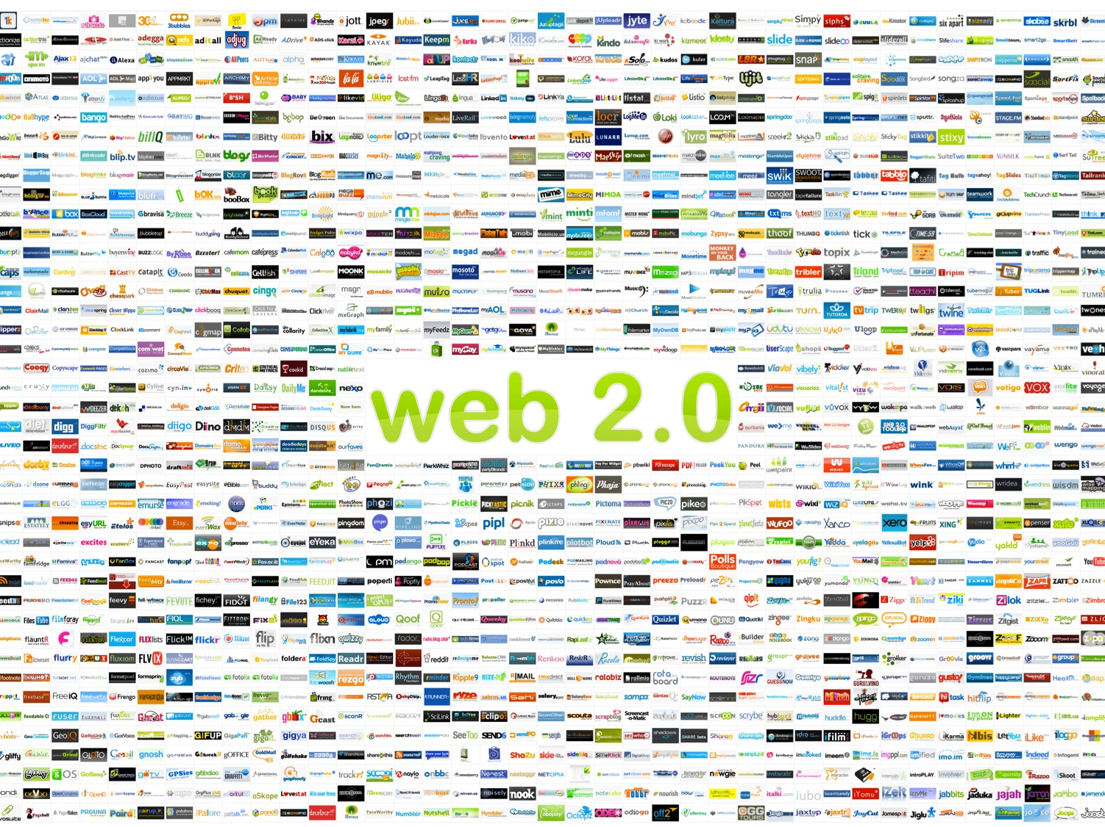
Global
The New Web
All you need is a browser and an internet connection

Slide 24
University Computing Environment

Slide 25
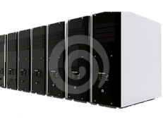
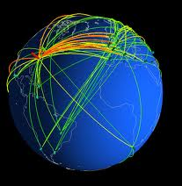
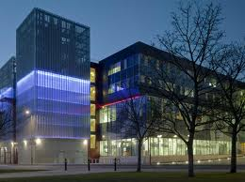
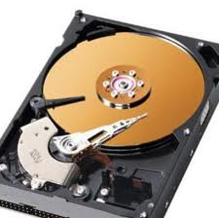
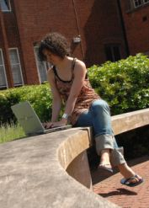
Where’s my stuff?
Global
Internet connected
Tools: Google docs, gmail, Hotmail
Storage: Dropbox
Social Networking: Facebook, Twitter
...
Institutional
Wired/ wireless intranet /
- Institutionally provided software
- Blackboard
- Timetable
- Email
edShare
MSOffice 365
Personal / local
No connection needed
MS Office
Software applications

Slide 26
Personal Software
On your own computer you might have Office 20xx or Open Office (free Open Source equivalent)?
Python for programming, this is available for free download
Links
Open Office http://www.openoffice.org/
Python Programming Language http://www.python.org/
Mac vs Windows vs Linux
I own a Mac and a Windows 7 PC, I regularly use Mac OSX , Windows 7, and Linux
You will be taught using Windows 7/8 and Mac OSX
MS Office is available for Macs, Last year several students used Windows software on Macs by using Parallels Desktop
Other Software
When looking for software it is often a good idea to see if there is a free open source program that suits you before shelling out hard cash
Web Browser, Firefox http://www.mozilla-europe.org/en/firefox/, google chrome, opera
Email, Thunderbird http://www.mozillamessaging.com/en-US/thunderbird/
Graphics, Gimp http://gimp-win.sourceforge.net/
Chat, Pidgin http://www.pidgin.im/
Anti Virus, Clam http://www.clamwin.com/
Media Player, VLC http://www.videolan.org/vlc/

Slide 27
Personal Hardware
You can survive without your own computer (if you are happy using public workstations / the base room)
Laptop vs Desktop vs netbook vs iPAD vs smartphone?
For the same computing power a laptop is more expensive and more fragile.
Having a laptop means that you can always have the computer you use on campus set up how you want it.
Carrying your laptop around all day can get heavy , and will your battery last the day?
Netbooks are great for email and taking notes but don’t have full apps.
Tablets (e.g.iPAD’s) are great for looking up resources on the web and communication but don’t have full apps ( would you like to write a report on your iPAD?)
Backup
Whichever you choose ensure that your computer is backed up regularly
Maybe agree with a friend to hold backups of each other’s files
On line storage (e.g. Dropbox?)
Memory sticks
great for transporting files
very easy to break or lose
do not rely on them as the only place to keep your files

Slide 28
Questions
Software
This course will be taught using Microsoft Office 20xx (Word, Excel, PowerPoint) and Python (2). You will be expected to submit your assignments in formats that can be opened by these programs. All of these are available on the public workstations. Python is available for free download from Python.org.
IT Support
Public workstations have Windows 8, and have Office 365, Python
The public workstations and halls network are provided by ISS. If you have problems with these not working how you think they should, try the ISS support pages http://www.soton.ac.uk/iss/essentials/help/index.html

Slide 29
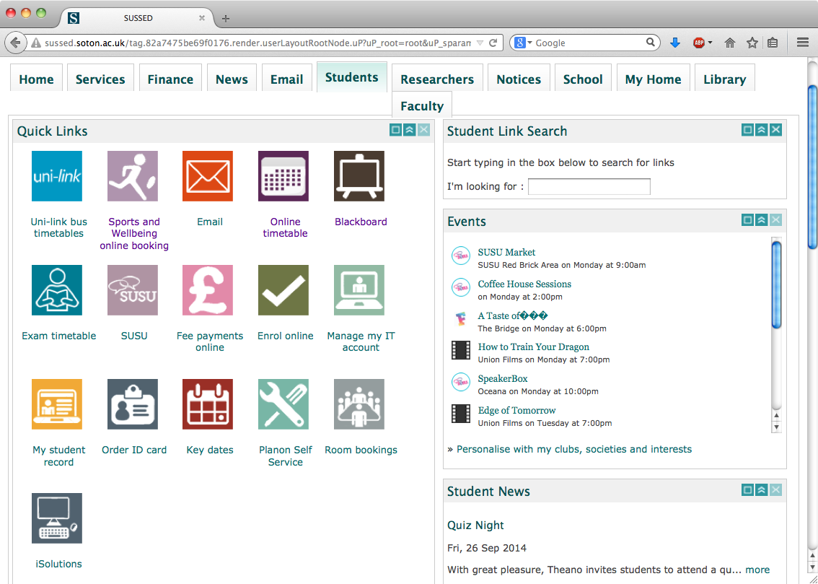
SUSSED
Most student resources can be accessed through the university’s SUSSED portal.
This can be used off campus as well.

Slide 30
SUSSED Email
You can access your university email account. You are expected to check this every day during term time.

Slide 31
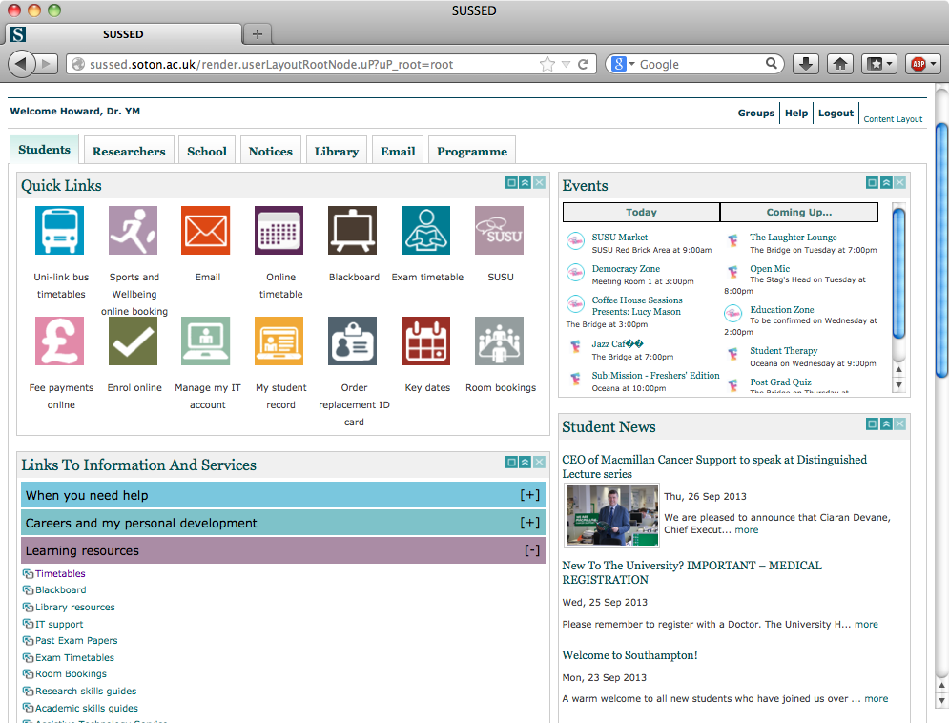
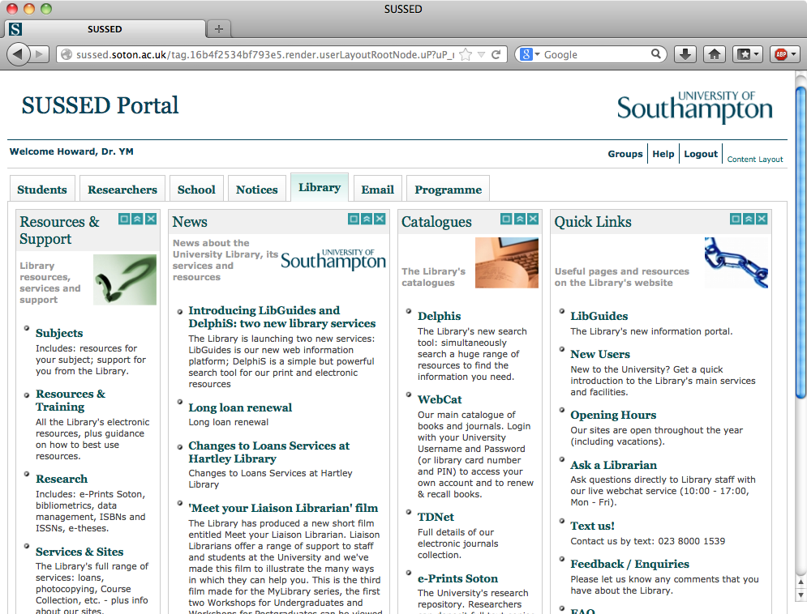
Sussed Library
SUSSED
Library information can be accessed here.

Slide 32
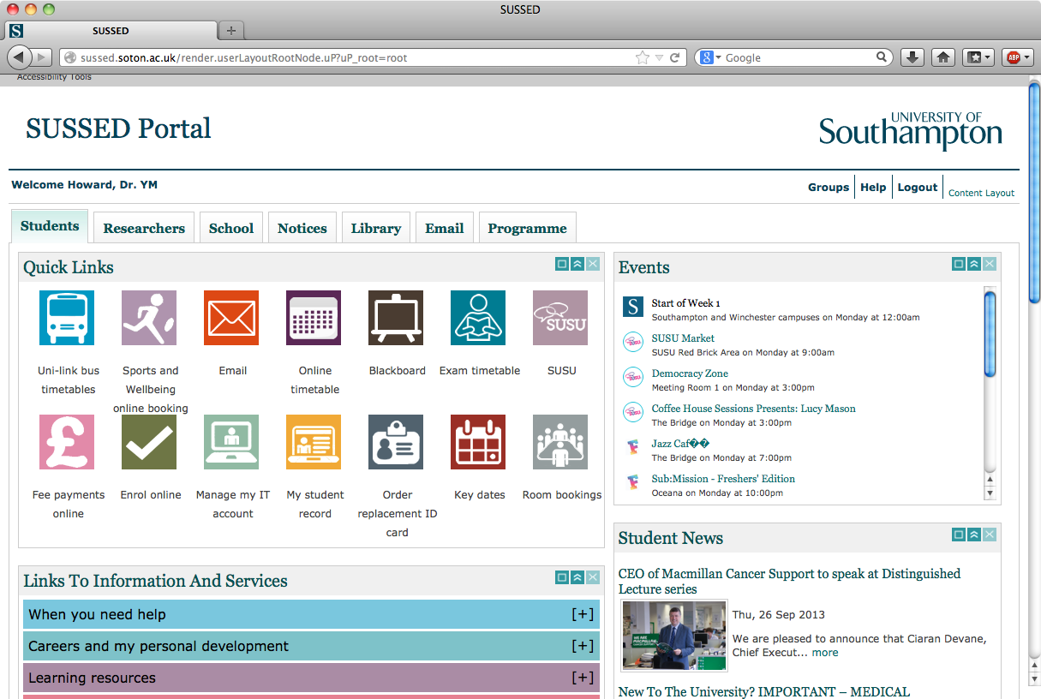
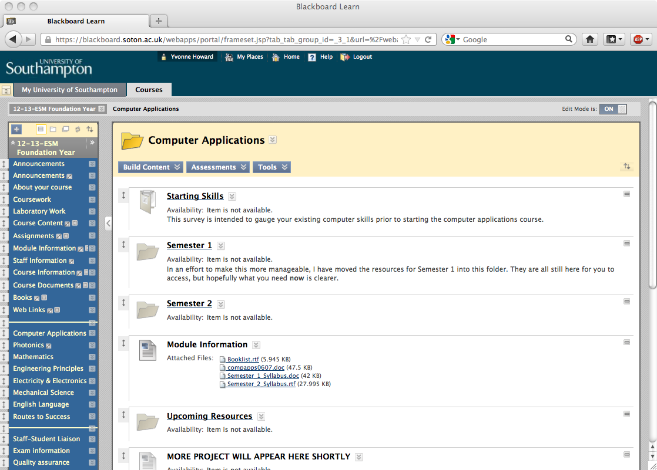
Link to BlackBoard
SUSSED

Slide 33
Mobile apps: Blackboard
free app from:
the Apple store for iphone, ipod and ipad,
Google Play for Android,
Windows store for Windows phone..
http://www.southampton.ac.uk/isolutions/computing/elearn/mobilelearn/

Slide 34
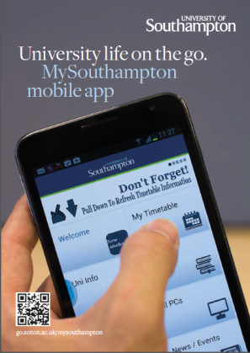
Mobile apps: MySouthampton
Maps, timetable, bus times, staff directory, new student information, ‘Your Library’, Sports Centre times
free app from:
iphone,
Android,
Blackberry
Browser version for for Windows phone and PCs
See http://www.southampton.ac.uk/mysouthampton/

