Slide 1

Infrastructure for Open Educational Resources (OERs)
Just don’t mention the ‘R’ word
Kelly Terrell, EPrints Open Education Lead
EPrints Services, University of Southampton

Slide 2
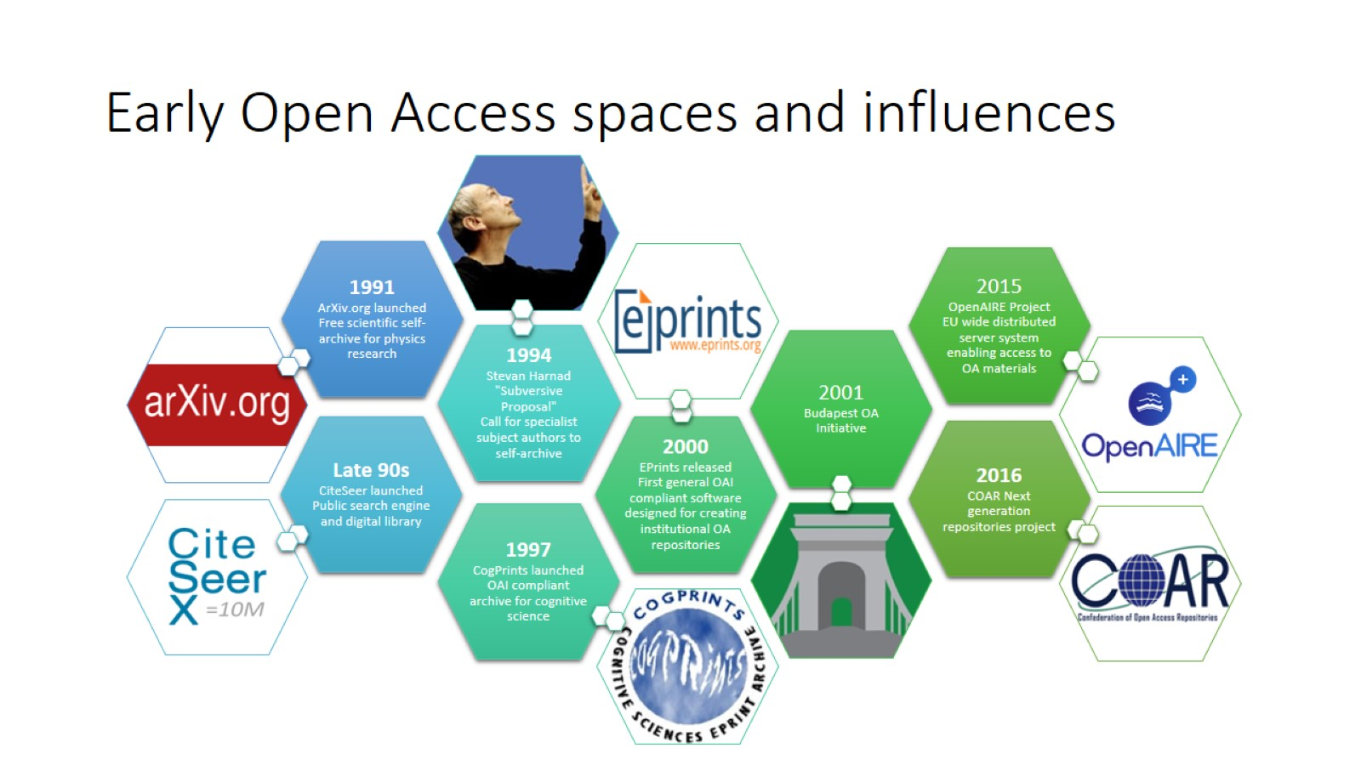
Early Open Access spaces and influences

Slide 3
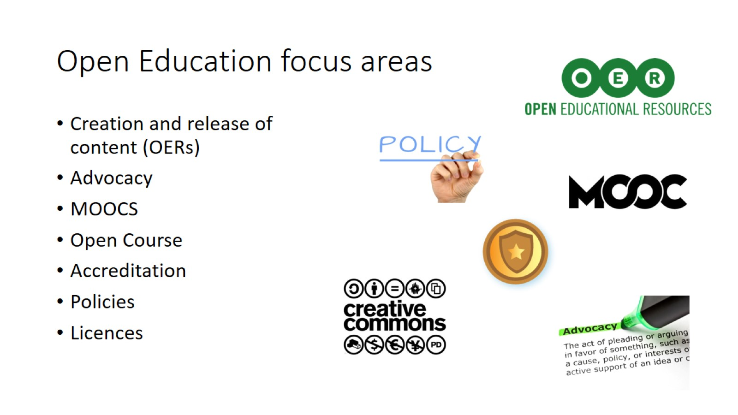
Open Education focus areas

Slide 4
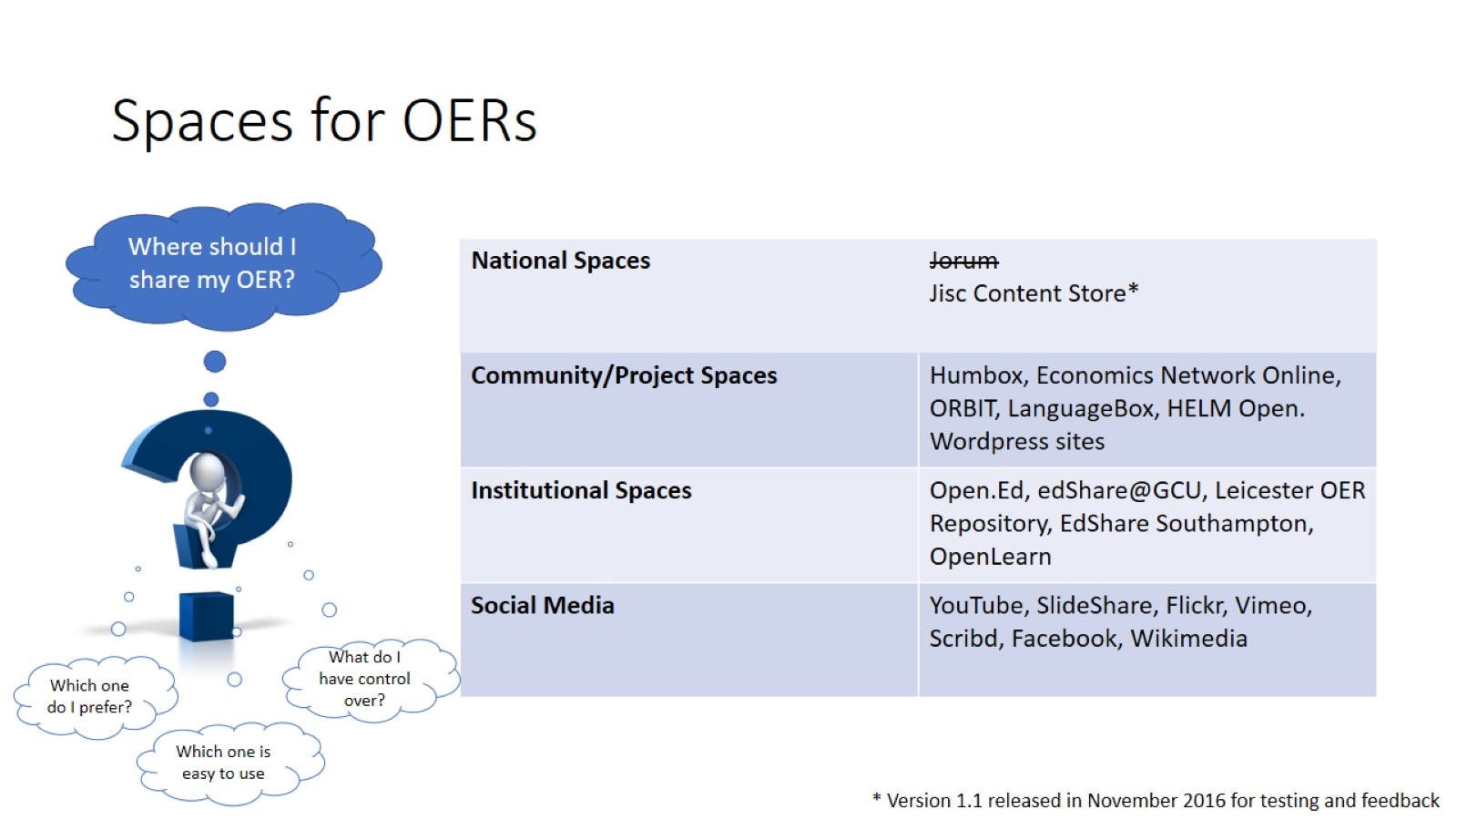
Spaces for OERs

Slide 5
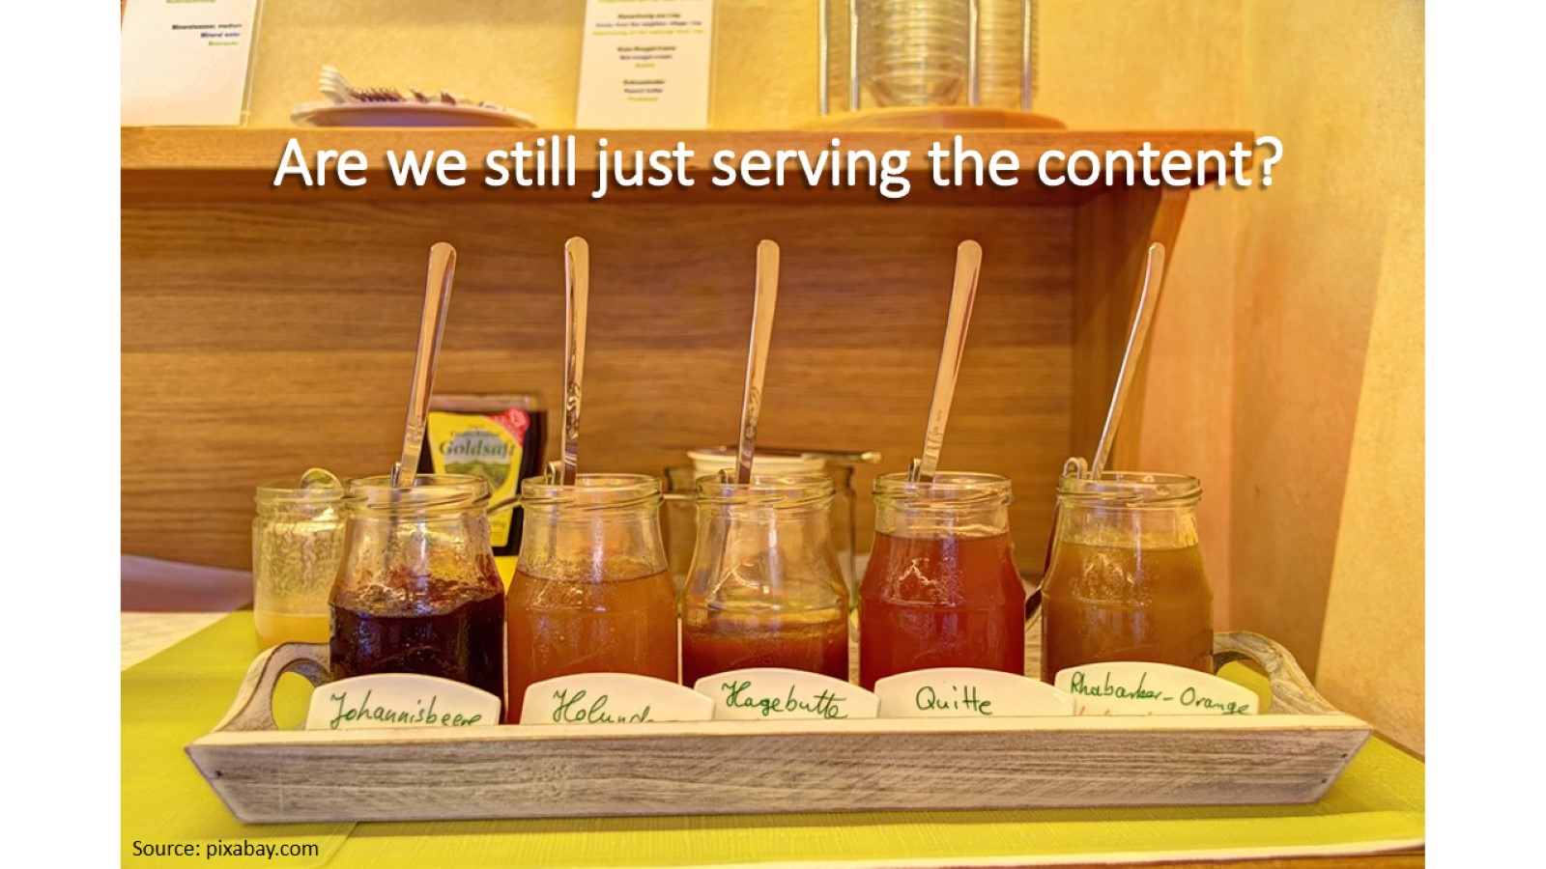
Are we still just serving the content?

Slide 6
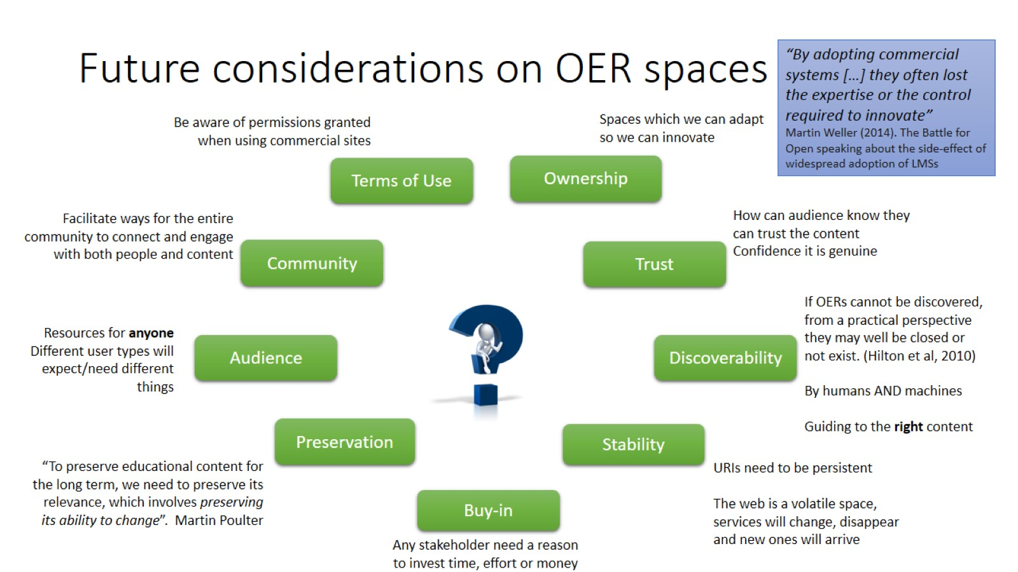
Future considerations on OER spaces

Slide 7
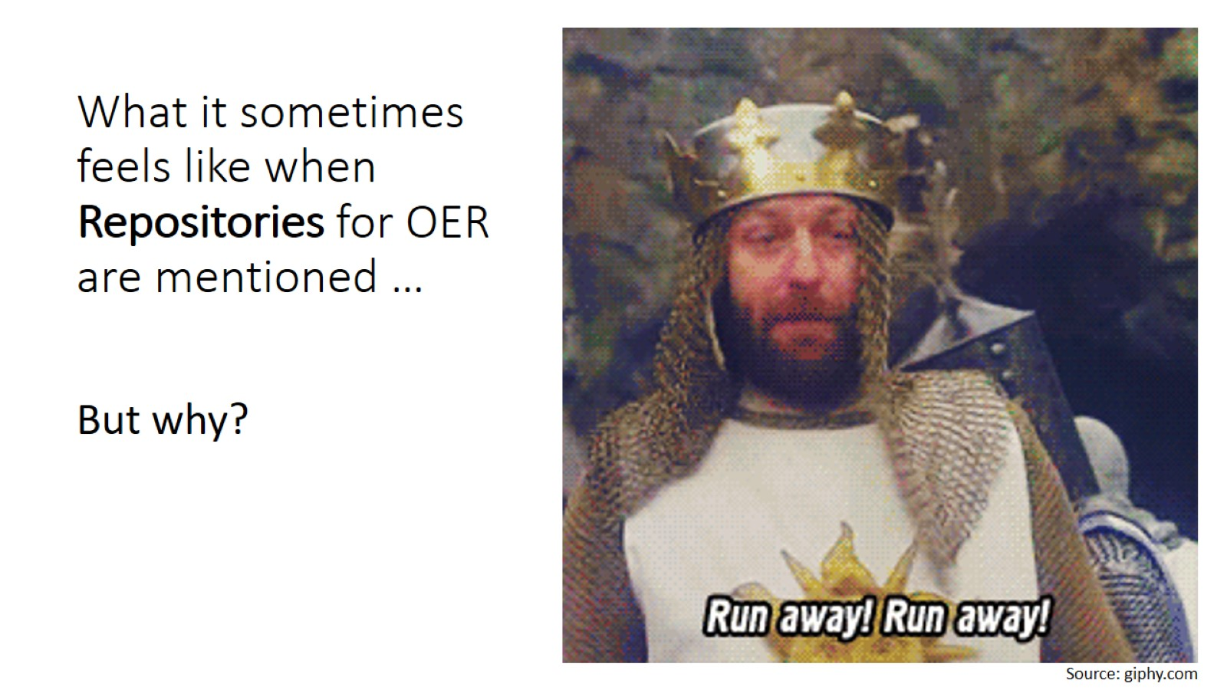
What it sometimes feels like when
Repositories for OER are mentioned …

Slide 8
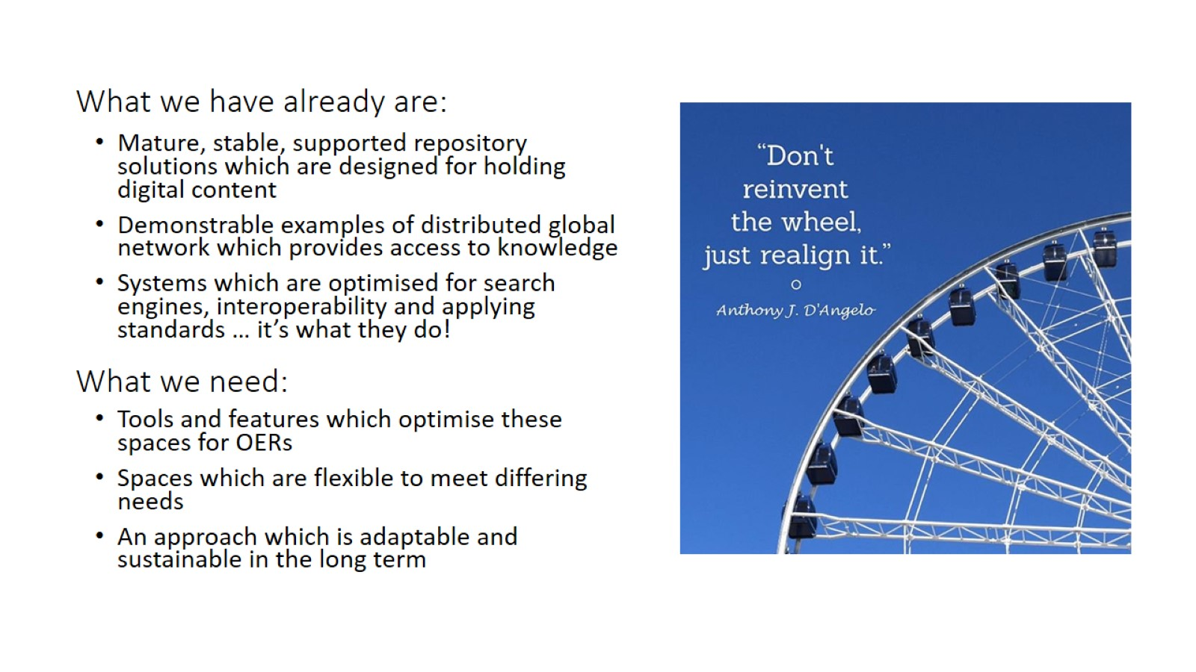
What we have already are:

Slide 9
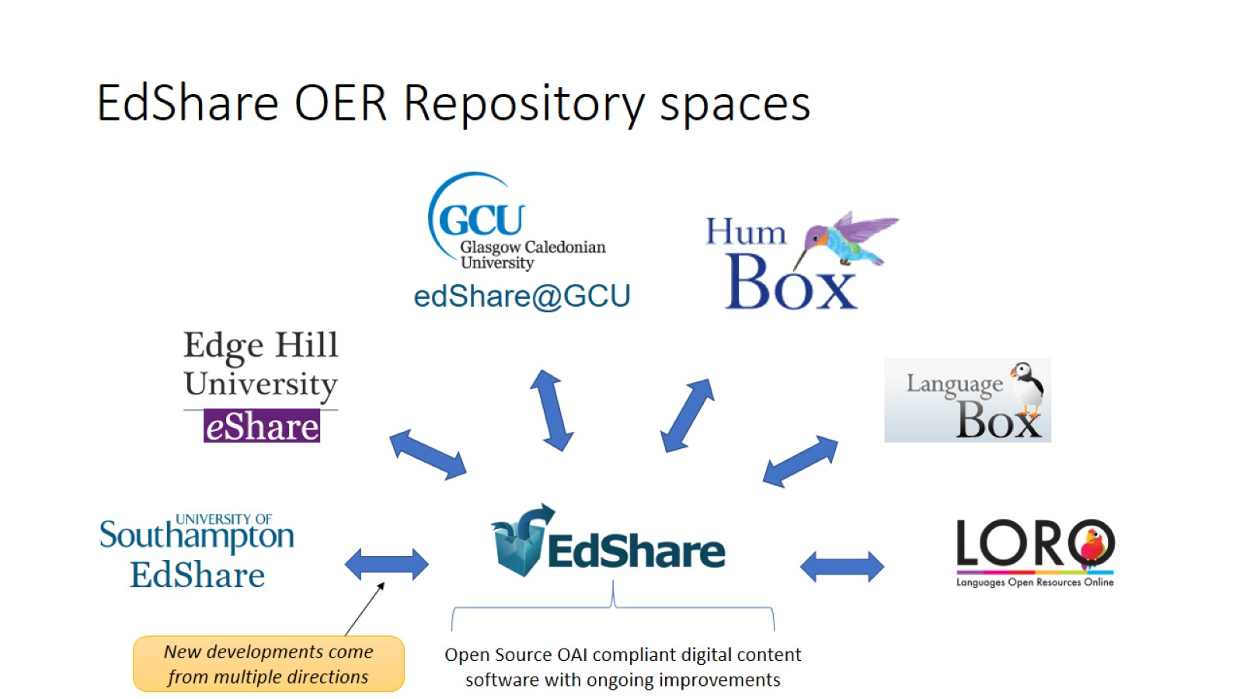
EdShare OER Repository spaces

Slide 10
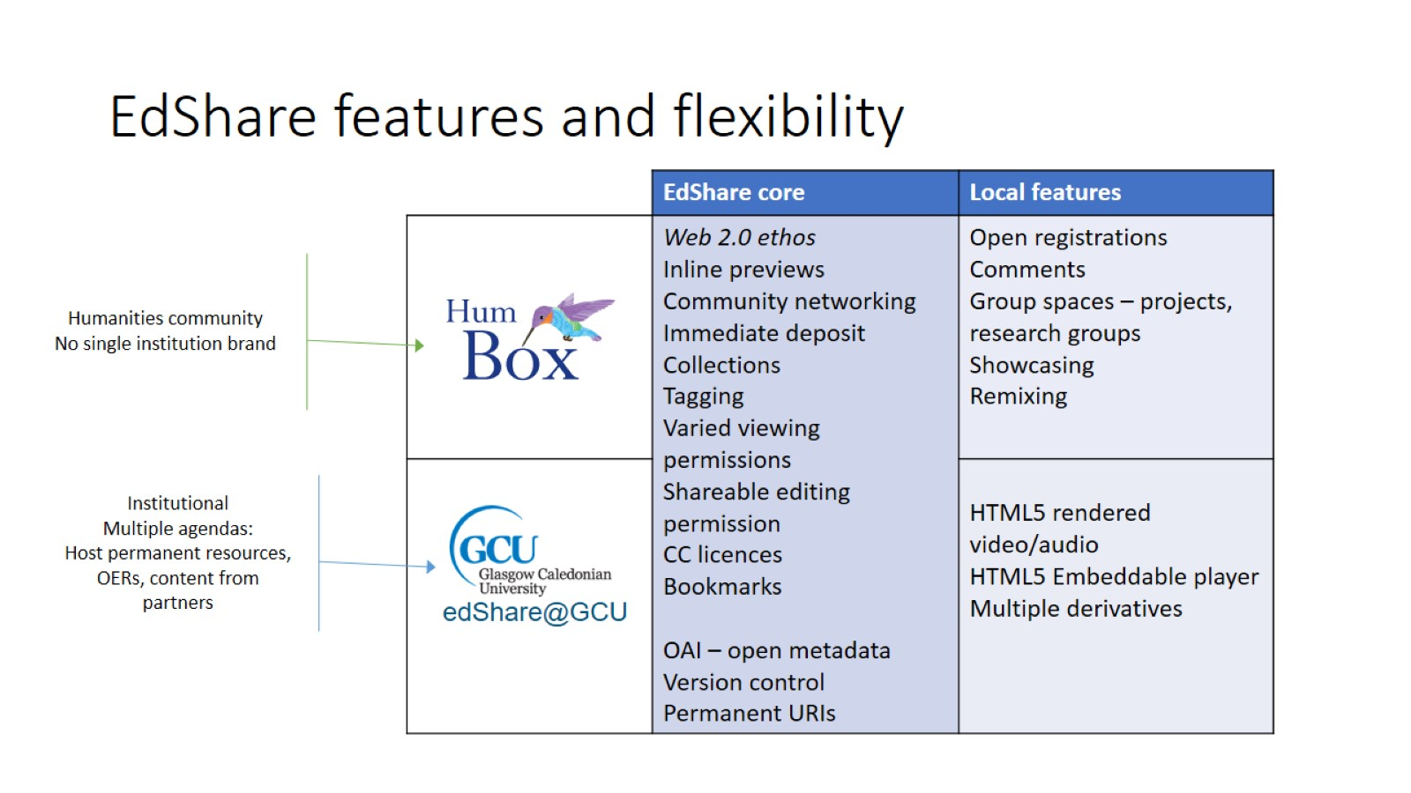
EdShare features and flexibility

Slide 11
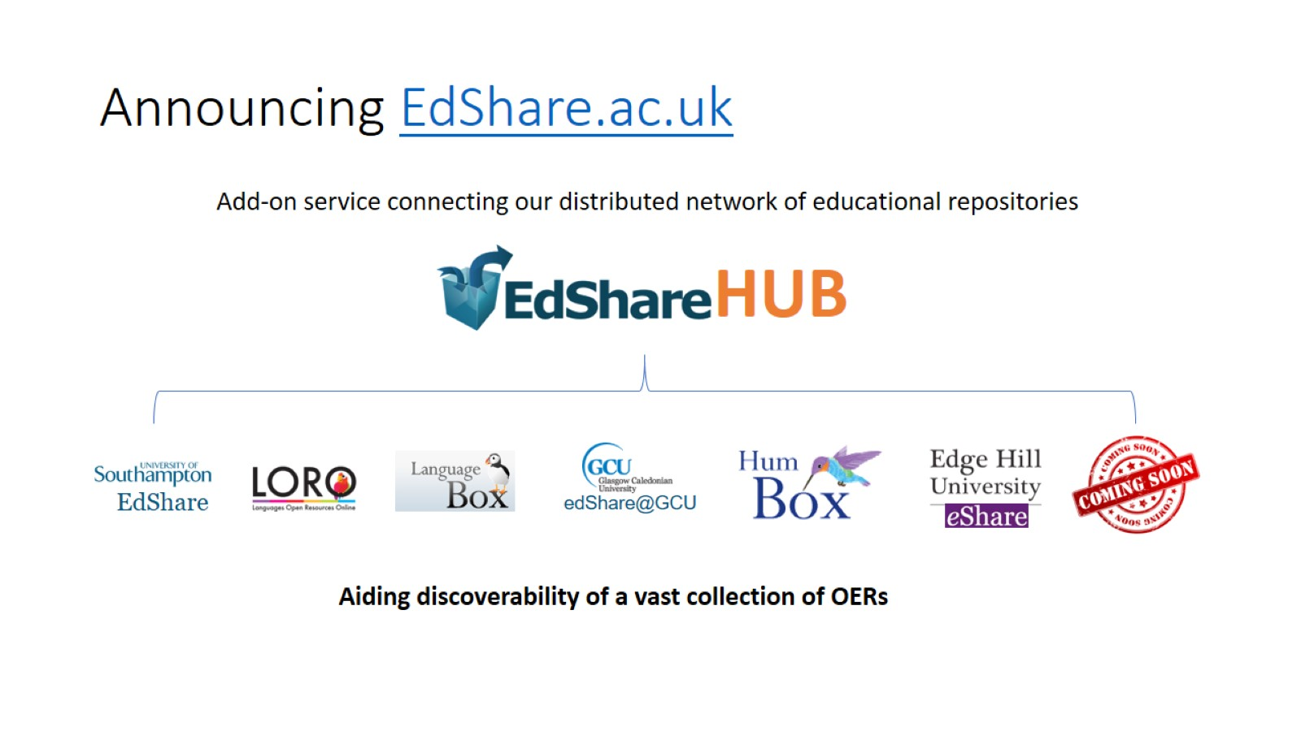
Announcing EdShare.ac.uk

Slide 12

Announcing EdShare.ac.uk

