Slide 1
Digital Inequality
Susan Halford Sociology, Social Policy and Criminology
Susan.Halford@soton.ac.uk,
www.soton.ac.uk/wfrc
Notes:
Please use the dd month yyyy format for the date for example 11 January 2008. The main title can be one or two lines long.

Slide 2
Introduction
The Web as a force for democratization, egalitarianism:
  Access to vast quantities of information
  Ability to navigate this efficiently
  Low barriers to entry, as consumer
  Low barriers to entry, as producer (Web 2.0)
Transcending older, centralised power structures
At the same time concerns about whether this potential is achieved

Slide 3
A Digital Divide?
Inequalities of access
Inequalities in usage
Inequalities in advantages conferred
Inequalities in control of content and data
Aim today: to review these arguments and identify key questions →

Slide 4
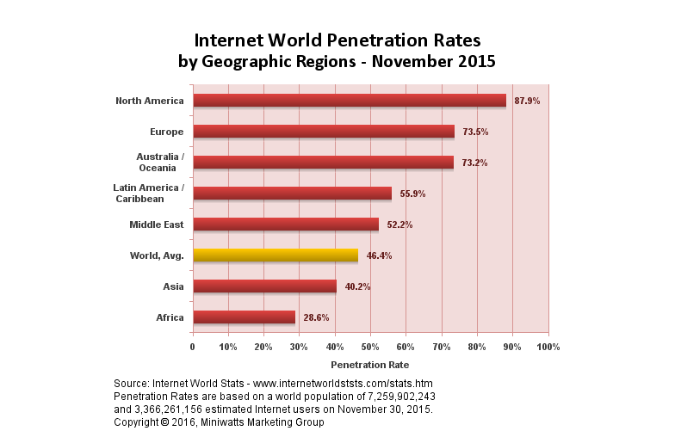
Inequalities of Access
Majority of the world’s population does not have access to the Web
Access heavily weighted to US/ (Western)Europe/Australasia

Slide 5
Global inequalities
Lack of access as a form of social exclusion?
Reproducing/exacerbating inequalities – widening inequality?
Between countries

Slide 6
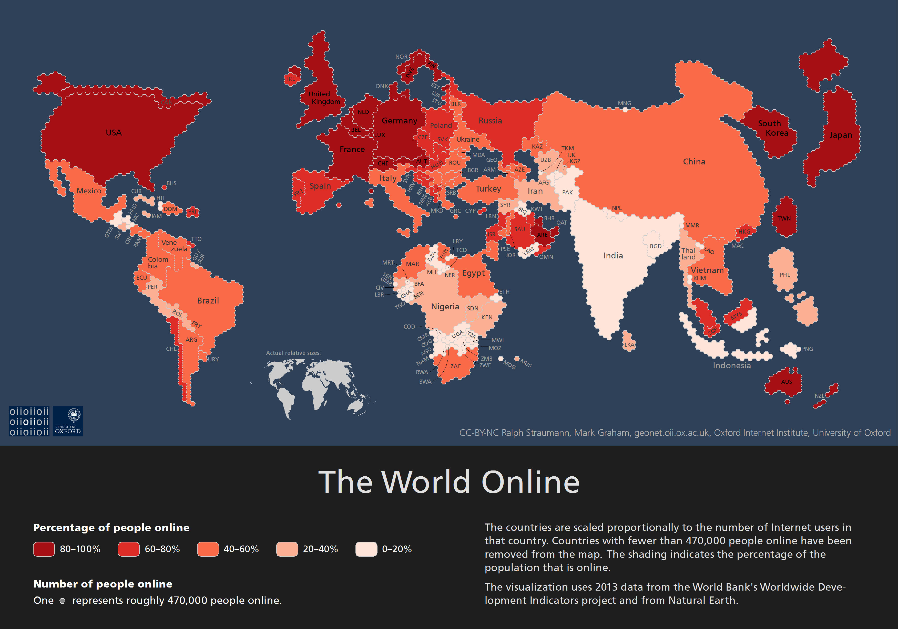
http://geonet.oii.ox.ac.uk/blog/the-world-online/

Slide 7
Global inequalities
Lack of access as a form of social exclusion?
Reproducing/exacerbating inequalities – widening inequality?
Between countries
And within countries

Slide 8
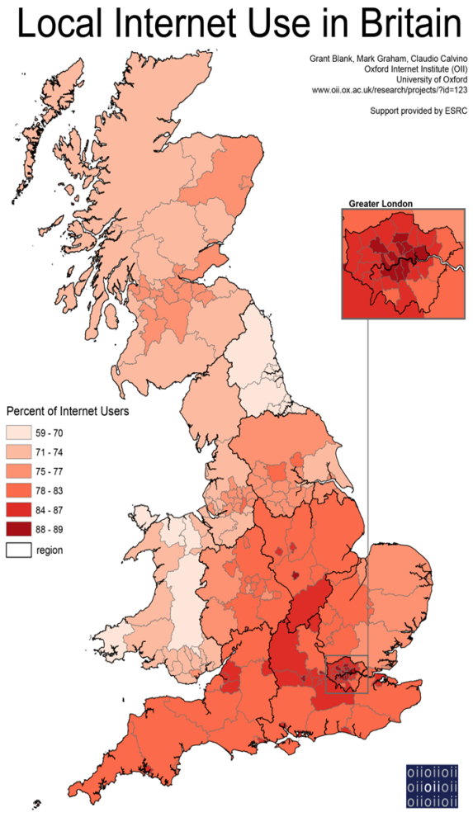
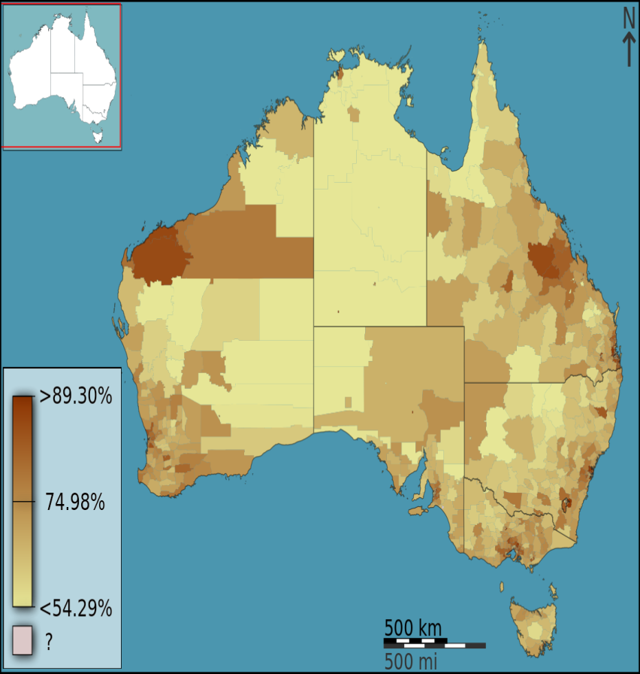
% of Internet users in England, Wales and Scotland 2013 Oxford Internet Survey (OxIS), and the 2011 UK national census. http://geography.oii.ox.ac.uk/?page=internet-use-in-britain
Private dwellings with an internet connection as a fraction of total households, in Australia, Australia, 2011 census results. https://commons.wikimedia.org/wiki/File:Australian_Census_2011_demographic_map_-_Australia_by_SLA_-_BCP_field_5353_Type_of_Internet_connection_Total_Total.svg

Slide 9
Access to Hardware
Initial policy focus from mid-1990s
In international development and in national policy interventions
Inequalities between and within countries
Not an individual matter: internet access disproportionately = wealthier, white, male, urban, higher levels of education.

Slide 10
For example, in the US in 1999 there was:
  A 20 fold lower level of internet access between the richest households ($75K+) and the poorest (under $15k)
  27% whites accessed the internet at home; the figure for blacks and Hispanics was 9%
  18-fold lower computer and internet access among female headed households with dependent children cf. households managed by married families with children
Source: Gilbert and Masucci 2011

Slide 11
interventions:
- library access
- community technology centres
- laptops for schoolchildren
To provide access to the ‘have nots’
But inequalities persist:

Slide 12
In the US (2014) 25% of the population does not use the internet (US Census Bureau 2013)
In the UK (2015) 7m adults have not used the internet in the past three months (ONS 2015)
Not evenly spread: age, socio-economic group and whether or not there are children in the household all make a big difference
Ofcom ‘Accessing the Internet at Home’ (2008)

Slide 13
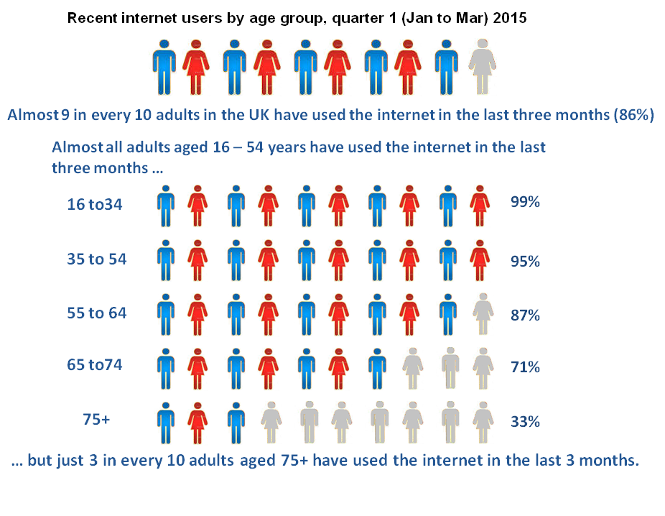
Source: ONS Statistical Bulletin Internet Users 2015
SEC | % with domestic internet access
A, B, C1 | 87%
C2, D, E | 63%
Source: Ofcom (2008) Accessing the Internet at Home

Slide 14
In short:
  Access continues to be a problem, but
  Even given access people don’t necessarily use it
  There is a ‘core-resister’ (Ofcom 2008) group (of which more later)
  Questions of use maybe as important as access

Slide 15
Beyond Hardware?
Access model assumes that internet is a general good, with shared benefits for all
Idea of ‘core resisters’ assumes non-use is perverse
Cf. problematizing the Web, seeing the web from the point of view of individuals in the context of their everyday lives.
Gilbert and Masucci (2011) Strategies for Bridging the Digital Divide Praxis (e)press
Huw Davies (2014)

Slide 16
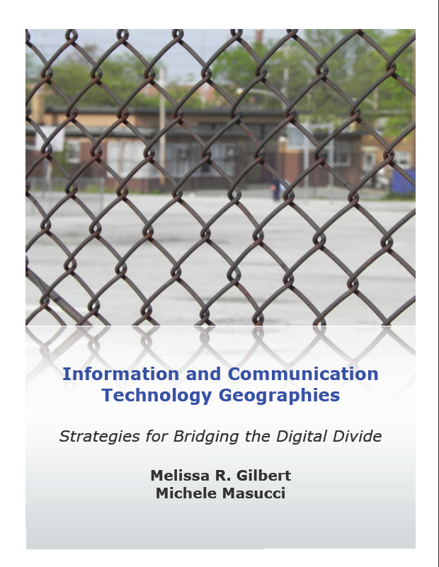
http://www.praxis-epress.org/availablebooks/ictgeographies.html

Slide 17
Access alone is insufficient
Skills required – basic and more advanced
Eszter Hargittai (2008) – ‘some uses are more likely to yield beneficial outcomes than others e.g. might increase access to advantageous resources – enabling users to acquire valuable labour market skills, economic benefits or social networks – others types of use might ‘downright disadvantage the uninformed’.

Slide 18
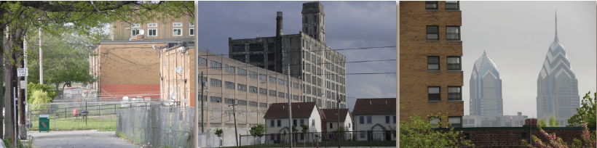
Gilbert and Masucci
  Social action research in North Philadephia
  Exploring the web from the perspective of some of the most marginalised people in the US
  Harrison Plaza – CTC
  KWRU – campaign group
Power and inequality, not access or demographics

Slide 19
Implications beyond North Philadelphia in the late 2000s?
  Reconceptualising core resisters as people making realistic decisions about their lives
  Reconceptualise normative accounts of the web: not a uniform good
  Consider the impact of mobile internet access (but don’t return to hardware driven ‘solutions’)

Slide 20
The Politics of the Web
Content
Ownership
Control – surveillance – corporate power
Big Data

Slide 21
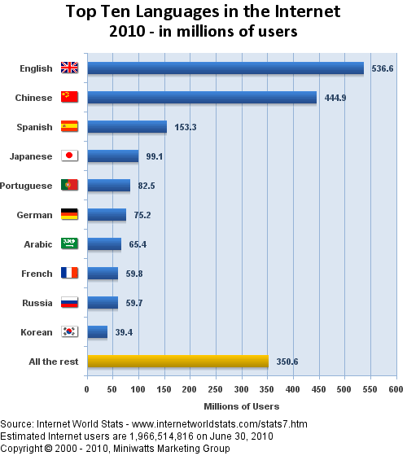

Slide 22
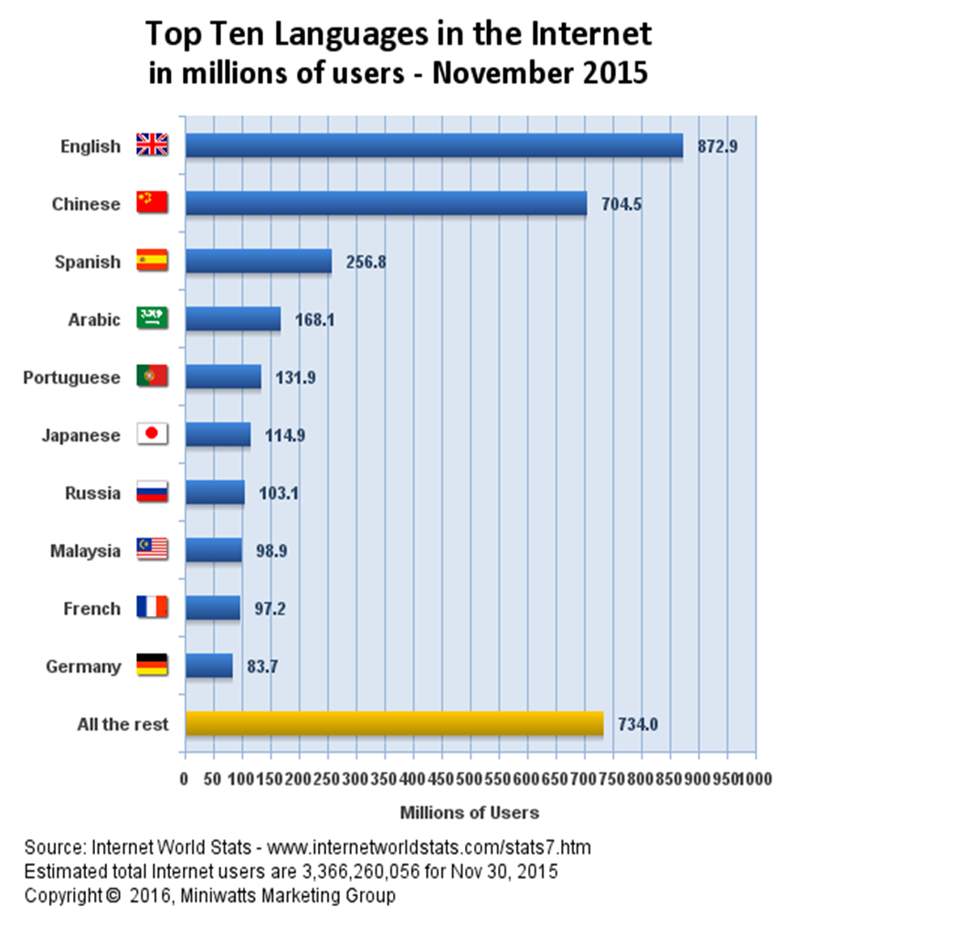

Slide 23


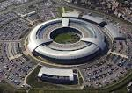
The Politics of the Web
Content e.g. language
Ownership
Control – surveillance
Media giants
http://news.bbc.co.uk/1/hi/technology/8562801.stm
The Filter Bubble – Eli Pariser http://www.ted.com/talks/eli_pariser_beware_online_filter_bubbles.html
Big Data – Frank Pasquale; US Federal Trade Commission 2016

Slide 24
Conclusions
Unpicking and understanding if and how the web is linked to inequality means:
  Recognising that the access divide is not over
  Thinking beyond hardware
  Thinking beyond demographic variables
  Developing a conceptual and theoretical toolkit
    Beyond technological determinism
    Co-constitution
    Intersectionality
    Technical capital
  Building a politics of data, artefacts and infrastructure

Slide 25
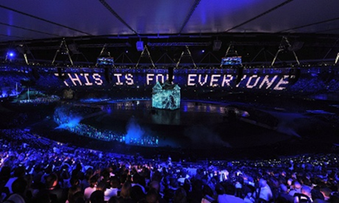
Why does this matter for Web Science?
  Who is the web ‘for’?
  What does the web ‘do’?
  Can the web be pro-human?
  How can we shape the evolution of the Web?

Slide 26
References
Davies, H. (2014) Challenging Orthodoxies in Digital Literacy: young people’s practices online University of Southampton PhD thesis.
Federal Trade Commission (2016) Big Data: a tool for inclusion or exclusion? Washington DC, MD. FTC.
Gilbert, M. and Masucci, M. (2011) Information and Communication Technology Geographies: strategies for bridging the digital divide http://www.praxis-ress.org/availablebooks/ictgeographies.html
Halford, S., and Savage., M (2010) ‘Reconceptualising Digital Social Inequality’ Information, Communication and Society 13, 7 pp. 937 — 955.
Hargittai, E., (2008) ‘The digital reproduction of inequality’, in Social Stratification, ed. D. Grusky, Westview Press, Boulder, pp. 936–944.
Pariser, E., (2012) The Filter Bubble New York, Penguin.
Pasquale, F., (2015) The Black Box Society Cambridge, MA. Harvard University Press.

