Slide 1
Advanced Databases
COMP3211
Dr Nicholas Gibbins - nmg@ecs.soton.ac.uk 2016-2017

Slide 2
Module Aims and Objectives
Gain a better understanding of the nature of data
Understand the issues to be addressed in writing database software
Understand the variety of approaches taken so far
Be able to select an appropriate database for an application
Be aware of the latest developments in the use and application of databases

Slide 3
Learning Outcomes
You will be able to demonstrate knowledge and understanding of:
The internals of a database management system
The issues involved in developing database management software
The variety of available DBMS types and the circumstances in which they're appropriate

Slide 4
Learning Outcomes
You will be able to:
Choose appropriate approaches for data storage and access
Demonstrate how a DBMS processes, optimises and executes a query
Identify issues arising from concurrent or distributed processing and select appropriate approaches to mitigate those issues
Select an appropriate DBMS for an application
Implement components of a DBMS

Slide 5
Prerequisites
COMP1204 or COMP2202
The role of database systems in information management
The concept of data modelling
Entity-Relationship modelling
The Relational model and other models
SQL
Database management issues

Slide 6
COMP3211 vs COMP1204/COMP2202
In COMP1204, you learned how to build databases
In COMP3211, you will learn how to build database management systems

Slide 7
Course Structure
Three lectures per week:
Tuesday 1400 in 58/1007
Thursday 1300 in 6/1083
Friday 0900 in 58/1009

Slide 8
Assessment
75% examination (120 minutes, 3 questions from 5)
25% coursework

Slide 9
Books
Core Text
Garcia-Molina H., Ullman J.D. and Widom J., Database Systems: The Complete Book, 2nd ed., Pearson, 2009.
Parts IV and V are the basis of this module
Background Texts
Elmasri R. and Navathe S.B., Fundamentals of Database Systems, 6th ed., Addison-Wesley, 2010.
Connolly T. and Begg C., Database Systems, 5th ed., Addison-Wesley, 2009.
Date C.J., An Introduction to Database Systems, 8th ed., Pearson, 2004.

Slide 10
Database Management Systems

Slide 11
What is a Database?
Represents some aspect of the real world
A logically coherent collection of data with some inherent meaning
Designed, built and populated with data for a specific purpose
Has an intended group of users and some preconceived applications in which these users are interested

Slide 12
Database System vs. DBMS
Database System
Application programs
DBMS
Software to
process queries
Software to access
stored data
Metadata
Stored Data
Notes:
It is usual to refer to the database and software together as a “database system”

Slide 13
Database Management System
A DBMS is a set of general purpose software, that allows the user to:-
Define the database
Specifying the data types, structures and constraints for the data to be stored
Construct the database
Store the data on some storage medium that is controlled by the DBMS
Manipulate the database
Querying to retrieve specific data, updating to reflect changes in the model of the real world, and generating reports from the data

Slide 14
What should the DBMS do?
Store data (!)
Control or eliminate redundancy
Provide program-data independence
Permit multiple views of the data
Support sharing by multiple users
Support sharing and integration of data between multiple applications
Control concurrent access to data

Slide 15
What should the DBMS do?
Offer various interfaces for data retrieval and manipulation
Be self-describing / contain its own catalogue for metadata
Support data abstraction
Allow complex relationships between objects to be represented
Enforce integrity constraints on the data
Restrict unauthorised access
Facilitate backup and recovery

Slide 16
Topics

Slide 17
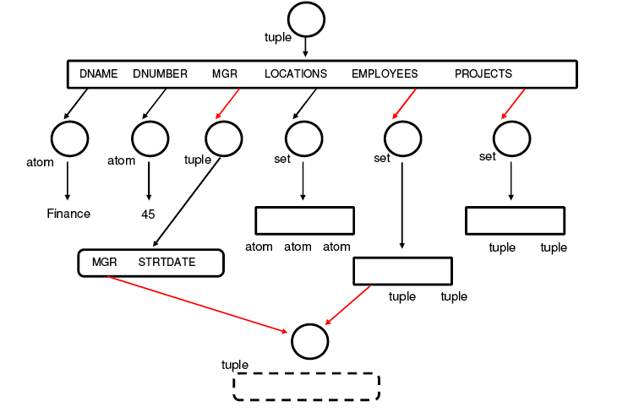
Datatypes
How does the type of data affect what we can do with it?
How do we model:
Temporal data?
Spatial data?
Multimedia data?

Slide 18
DBMS Architecture
What are the functional units within a DBMS?
DDL
Statements
Privileged
Commands
Interactive
Query
Application
Programs
DDL
Compiler
Query
Compiler
Precompiler
Query
Optimiser
DML
Compiler
System
Catalogue
Runtime DB
Processor
Stored Data
Manager
Stored Database

Slide 19
Data Storage
How does a DBMS organise data:
On disc?
In records?
In fields?

Slide 20
Access Structures
How can we improve the speed of access to data in a DBMS?
Indexes, hash tables, B-trees
10
10
20
60
20
40
110
30
10
...
40
...
50
80
70
60
50
70
80
60
90
100
100
90
110
120
120
110
...
30
...
...

Slide 21
Multidimensional Access Structures
How do we improve the speed of access to multidimensional data in a DBMS?

Slide 22
Query Processing and Optimisation
How are queries executed in a DBMS?
How can we modify queries to reduce their execution time?
π_{LNAME}
⨝_{ESSN=SSN}
π_{ESSN}
π_{SSN,LNAME}
⨝_{PNUMBER=PNO}
σ_{BDATE > ‘1957-12-31’}
π_{PNUMBER}
π_{ESSN,PNO}
EMPLOYEE
σ_{PNAME=‘Aquarius’}
WORKS_ON
PROJECT

Slide 23
Transactions and Concurrency
How do we provide users with concurrent access to a DBMS?
What problems can arise?
How can we prevent or mitigate those problems?
READ, WRITE
Active
Partially Committed
Committed
BEGIN TRANSACTION
END TRANSACTION
COMMIT
ABORT
ABORT
Failed
Terminated

Slide 24
Parallel Databases
How can we distribute a DBMS across the machines in a cluster?
How does parallelism affect:
Query processing?
Deadlock detection?
Reliability?
P
P
P
M
M
M

Slide 25
Distributed Databases
How can we distribute a DBMS across a WAN?
How does distribution affect:
Query processing?
Concurrency control?
Reliability?
∪
⨝
⨝
R₃
S
R₅
S

Slide 26
Information Retrieval
How do we support queries over free text data?
How do we evaluate the effectiveness of an IR engine?
query
document collection
query
parsing
indexer
index
retrieval and ranking
answerset

Slide 27
Message Queues
How can we use asynchronous communications for reliable distributed DB applications?
Client
Server
enqueue
dequeue
Client
message queue
Server

Slide 28
Stream Processing
How can we query data when there’s more data than we can store?
input
stream
input
stream
⨝
output
stream

Slide 29
Data Warehousing
How can we best support the analysis of complex, multidimensional data?
OLAP vs OLTP
Region
W
S
N
Juice
10
Cola
50
Product
Milk
20
Cream
12
Toothpaste
15
Soap
10
1 2 3 4 5 6
Month

Slide 30
Non-Relational Databases
What’s out there apart from RDBMS?
Hierarchical, XML
Network, Object
Graph
NoSQL

