Slide 1
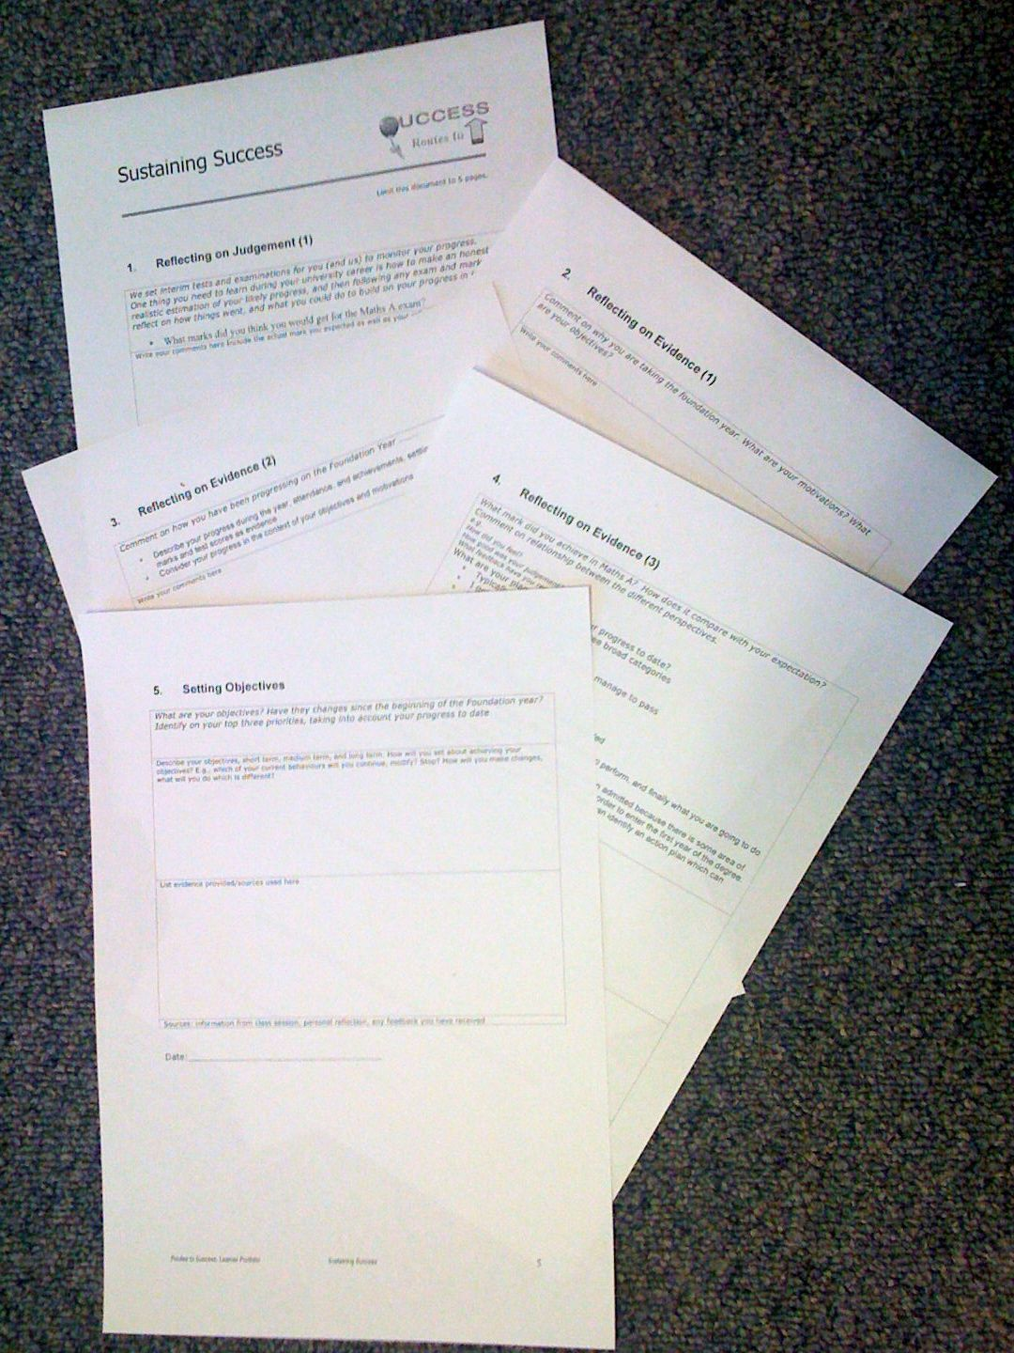
Foundation Year
Routes to Success
Part III - Sustaining Success
Su White, ECS
Su White
Semester 2
overview
Notes
Introduction
Consolidation
Completion
Resource set in Edshare http://www.edshare.soton.ac.uk/15918/
Notes:
Objective to get to know the each other and establish framework for future sessions
Introduce think pair share
Establish expectations for portfolio contribution for this part of the course
Much of the session will be run via discussion and question and answer
The slides will be used according to need, but can form a useful note for review and revision.
They can also be used as reference by students who do not attend the session.

Slide 2
How to use these slides
The slides are the basis for the material we will cover through the module
You can refer to them later on to remind yourself of what we plan to do
Read them in conjunction with other materials provided via blackboard
All the materials are stored in the same EdShare record
Resource set in Edshare http://www.edshare.soton.ac.uk/15918/

Slide 3
Introduction:
Hello and Overview

Slide 4
Intros
You
Me
The team
The module ( and us ☺)
Notes:
Need to establish how the classes will be run
E.g. Q&A
Think share pair
zappers

Slide 5

Its all about you
RTS-3 may seem nothing like
any other of your study on the foundation year so far…
But it covers essentials which you can use for the rest of your life

Slide 6
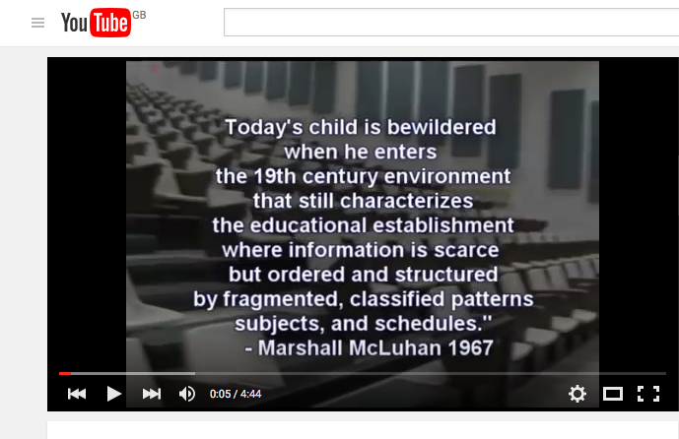
You: A vision of students
https://youtu.be/dGCJ46vyR9o?list=PL77BB94D4838EAD4C

Slide 7
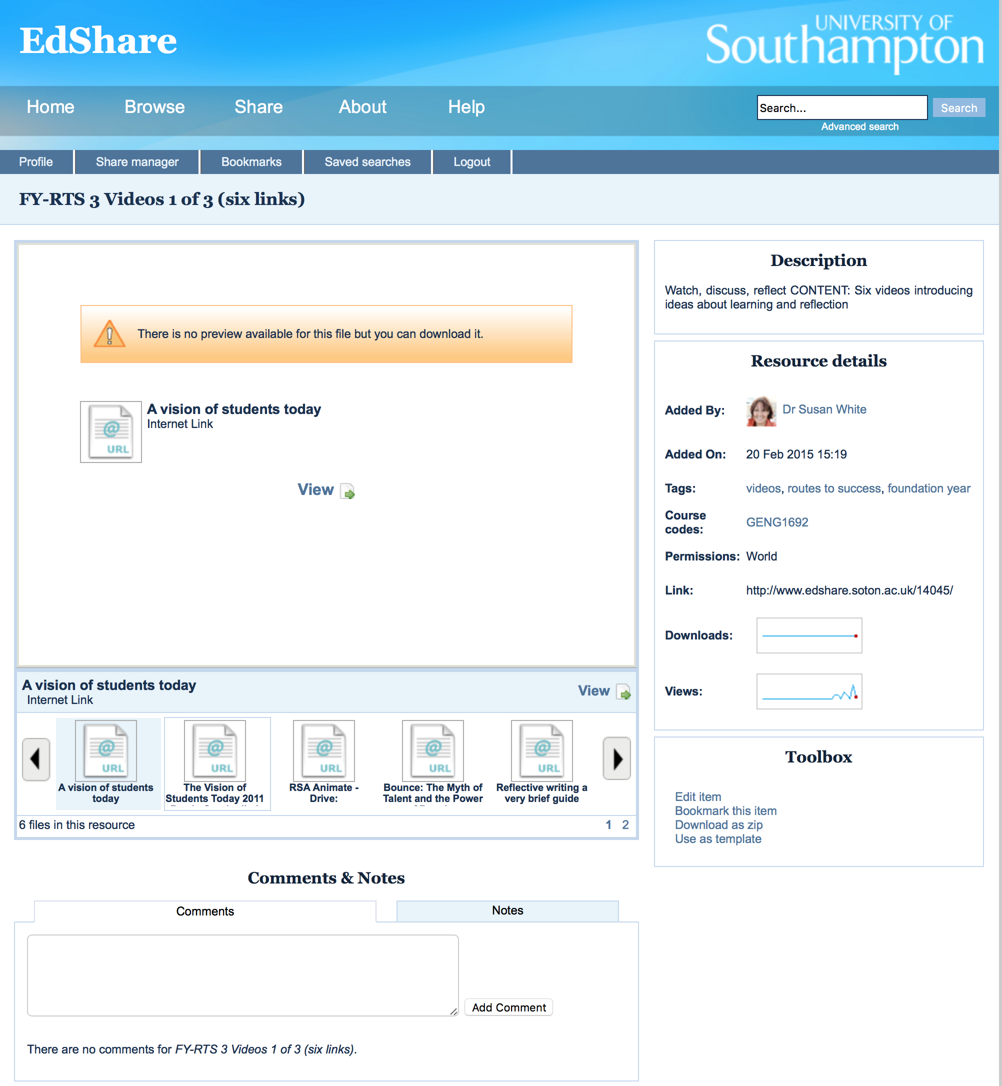
We have collections of videos
The whole collection
Context
Study advice
How to learn anything fast
Flow
First Collection
Mike Wesch, Students Today (2)
Matt Syed, Bounce
RSA Animate, Drive
Reflective Writing
Critical thinking
Watch right now
http://www.edshare.soton.ac.uk/14045/

Slide 8
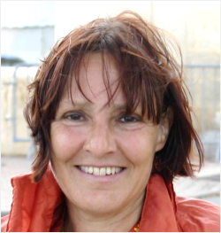
Intros: me, the support team and you?
What about you?
Leader for this section
Dr Su White
Academic in ECS
saw@ecs.soton.ac.uk
Researcher in Web and Internet Science – ECS
Why I am here
Senior tutor on the foundation year
Believe that all students can learn and succeed
Notes:
Objective to get some general feedback from the students – who are you, why are you here? This is also the opening question to the Portfolio interview
Establish the diversity of objectives, but also the commonality
Reminder – from induction….
Extra info - degree profile of students from FY same as that of A level point entry
Students may go on to do degree different to that first selected
Some students take the year a second time
Some students go on to study at another university
You have to pass the course to progress

Slide 9
The team..
This term:
John Mills
Will conduct some of the interviews
( along with me)
you may meet postgrad’s
in lectures
conducting research
  surveys
  group discussions
we are interested in the whole general question
of how you are learning on the foundation year
we are relying on you to participate in all of the various activities

Slide 10
Intros: Why we are here
Each week we will
rehearse part of
the portfolio
Routes to success!
It’s a module
You have coursework
This is the lecture series
I want to make it useful

Slide 11
Introduction:
What you have to do

Slide 12
The portfolio process
Portfolio…
You need to write …
Use the template
Complete each section
cover pages
evidence pages
reflection pages
Hand in on time
Attend the interview
My job
to help you with this task
Your job
do the very best you can
Guidance:
Answer specific questions
Reflect on your answers
Evaluate your motivations

Slide 13
Lecture/Learning Structure:
How the work is paced by the class:

Slide 14
Intros: The big picture themes
learning
reflection
Using feedback
Future planning
self knowledge
Assessment
Interviews
tbc
Hand in
Wed 8th March
Notes:
1) Exam
2) Your motivations
3) Your progress
4) Self knowledge
5) Future Objectives
Explaining how the classes will be used to to fill out the portfolio

Slide 15
I will help you
Supporting tasks
Watch the videos
Complete surveys
Write a draft
before the final version
Videos
  Help you see the bigger picture
Quizzes
  Pace you through the reflection which goes with the course
Drafts
  Help you produce an excellent final version
Student work improved after we introduced the surveys and videos
Complete the tasks: they can help you get better marks!

Slide 16
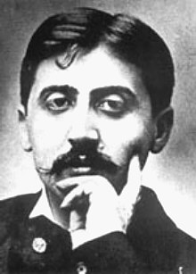
reminder
“We don't receive wisdom;
we must discover it for ourselves
after a journey that no one can take for us …”
Marcel Proust (French novelist 1871 – 1922)

Slide 17

It’s the journey…

Slide 18
Remember
Studying is not simply about transferring
a set of facts from lecturer to students
This module assists you:
  Developing your individual learning
  Recognising how you can be responsible for your own learning
  Learn how to become a resilient learner
  Develop skills so you
    Understand how you best learn
    Reflect on how you can improve
This module needs you to actively engage with this process ☺

Slide 19
If studying alone or revising
Look at the survey questions and complete online
https://www.isurvey.soton.ac.uk/18760

Slide 20
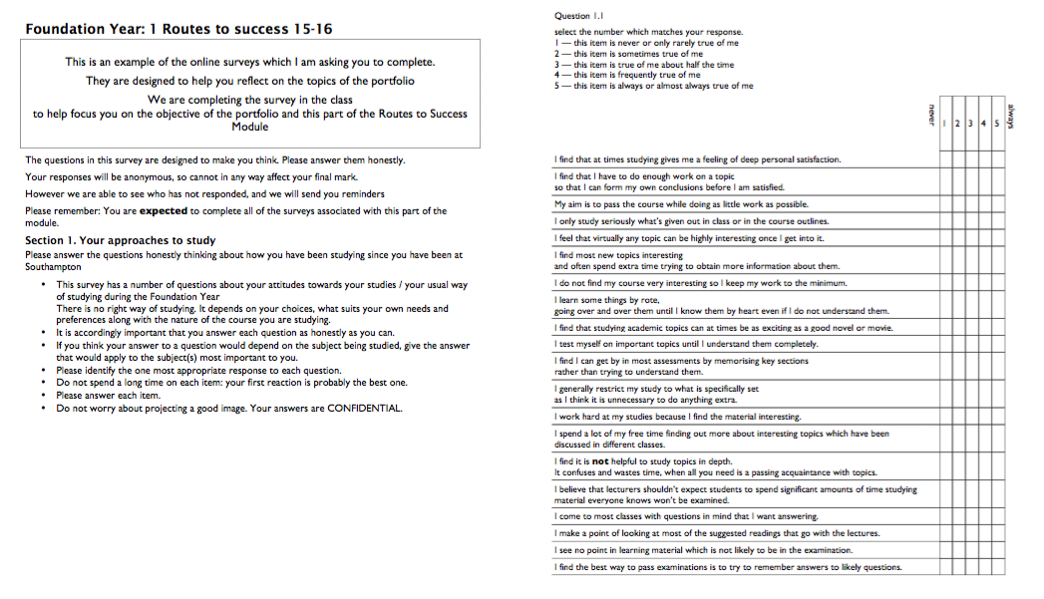
How do you go about learning?
W1 – complete after class
W2 – write main approaches

Slide 21
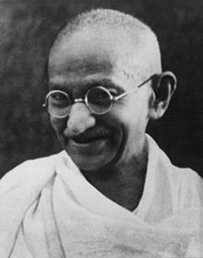
Life and Learning
“Live as if you were to die tomorrow.
Learn as if you were to live forever.”
Mahatma Gandhi, Indian politician and activist 1869 –1948

Slide 22
Reminder: overview of RTS
Engineering
John Mills
Introductory Sessions
Mike Hogg
Thinking about the Problem
Su White
Building on foundations

Slide 23

Your opportunity
“Education is the most powerful weapon which you can use to change the world”
Nelson Mandela (South African politician and activist 1918-2013)

Slide 24

What we expect 1
Work and study independently but also…
Discuss the task with fellow students
  Face-to-face is often better than online
  find time over a coffee or in a social context
Watch the videos together
Proof read work in progress

Slide 25

What we expect 2
Complete surveys if asked
you will get email invitations
… and reminders
Work on your portfolio draft every week
the best students always manage to write excellent portfolios
but you don’t have to be a great author
just write the answers to the questions

Slide 26
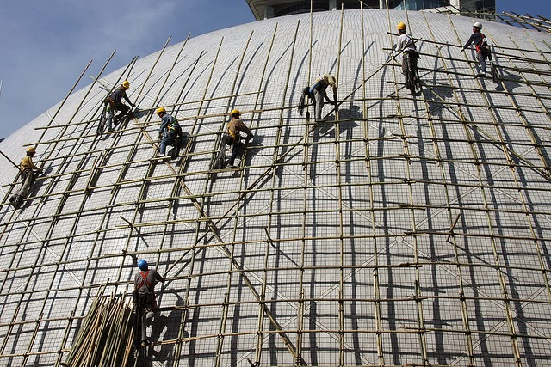
Providing Scaffolding
The videos, readings and tasks are designed to build a scaffolding for you to use
As thinking exercises
When you are doing the coursework
In the immediate future, helping you make good decisions about your study habits
In the longer term during your degree studies
photo by Anne Roberts
Notes:
photo by photo by Anne Roberts

Slide 27
Every student is different
The surveys provide real data about the students
Anonymously
In general terms
The surveys and information from Blackboard provides
A more accurate picture about how much use you are making of the resources
In general how students are interacting with this part of the module
your answers to the quizes help us understand your progress as a class

Slide 28
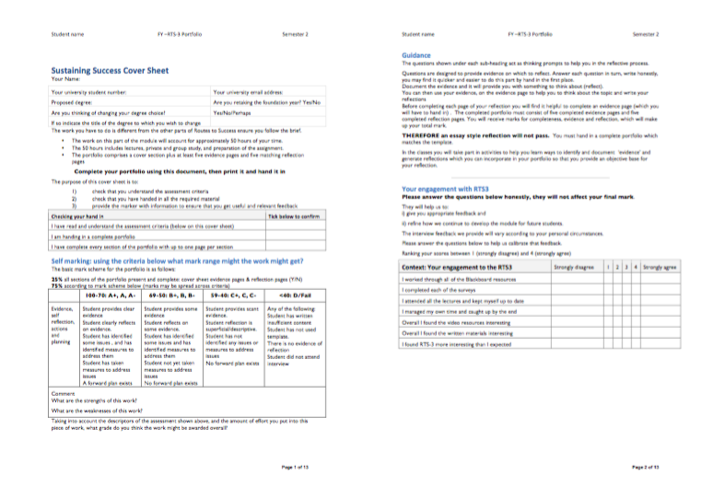
Looking at the portfolio
W1 printout in class

Slide 29
Writing – and how to do it!
Exercise
We are going to spend five minutes free writing
Use the final page of the portfolio
Spend five minutes writing about your approaches to learning, what you do and why you do it the way you do

Slide 30

Rely on your brain….

Slide 31

Start Now
https://youtu.be/hOA-2hl1Vbc

Slide 32
What we know about writing
It can be a thinking tool
You can get rid of fear by writing , freely, for a short while every day
Want to accept a challenge?
http://750words.com/
Sign up – one month free – just right for the portfolio ☺

Slide 33
Now look at the portfolio (1st section)
http://www.edshare.soton.ac.uk/18185/
First section pages 3-4
What are your ambitions?
Do you have goals?
Use paper and index card (in class) *
  think about your goals
  What do you want to achieve over the next few weeks?
  Write quickly – rough ideas
  Select and write down three or more goals that relate to the portfolio
* Studying alone, find a piece of paper and write it down on that
Although a card is best because you can carry it around with you as a reminder afterwards

Slide 34
Use this model for reflection
you can use these set questions to help
think about the evidence
and complete the portfolio
What?
So What?
Now What?

Slide 35
Explaining the model: What?
What?
Use the specific:
“I completed a lab and
received a mark (xxx) for some work (yyy)”
Avoid the general
“I keep missing deadlines and loose marks”
“My marks for this module are OK… Although:”
Explain what actually happens
Try starting with a general, and applying critical thinking, can lead you to the specific
if your first response is to provide a general answer
ask yourself how you can make it much more specific

Slide 36
Explaining the model: So What?
So What?
My work got a: | 1st, 2:1,2:2;3rd, Fail (near pass), Fail
I expected a mark of: | 1st, 2:1,2:2;3rd, Fail (near pass), Fail, no idea
When I handed in I felt: | {your emotion/confidence/state of mind}
When I got the mark | {your emotion/confidence/state of mind}
The reason the for the relationship between my expectations, mark, and feeling was: | A logical analysis of the evidence and observations

Slide 37
Explaining the model: So what?
So What?
An explanation of any logical conclusions which you draw:
examples
I think I was {over optimistic, unrealistic, realistic}
The outcome might have been better if….
The outcome was satisfactory/excellent but….
What you will write will be an objective evaluation of your experience

Slide 38

Explaining the model: Now What
Now What?
A realistic and objective suggestion of changes you will make:
Examples:
How you might
Change your behaviours and do things differently
Look at things differently
NB: it will be different for everyone

Slide 39
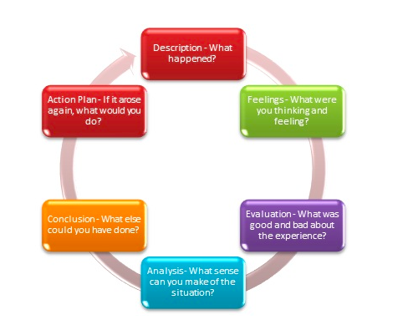
Another way of thinking about it

Slide 40
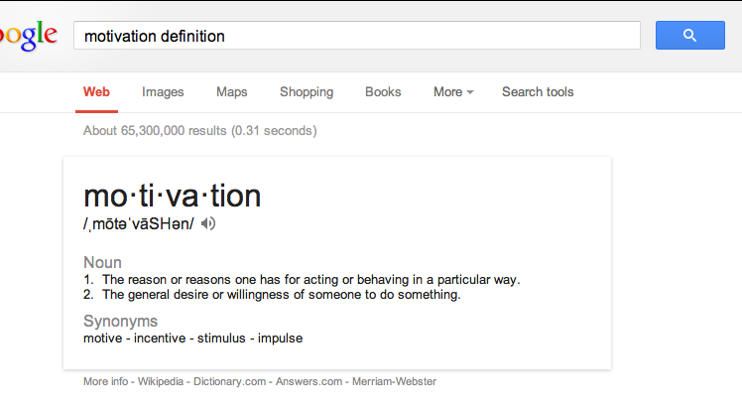
Think about your motivation

Slide 41
Your Task…
About 20 available days from start to the deadline

Slide 42
Self Study: Look at the Portfolio
Notes:
Show the portfolio using the visualiser
Have a one page handout of the sections

Slide 43
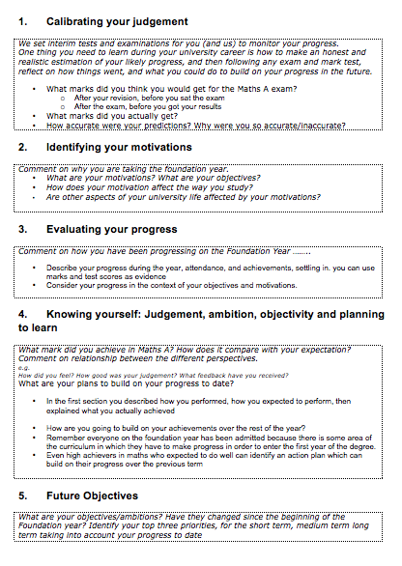
Intro Portfolio
Look at your handout
What would you put in the sections?
Notes:
Each look at the handout individually
Verbal questioning, do you have a problem with section?

Slide 44
Intros: what you have to think about
exam
motivations
progress
Future plans
self knowledge
Notes:
What you have to think about
Exam (performance and progression)
Motivations
Progress
Self Knowledge
Future Plans

Slide 45
Intros:
What we will do
Weeks 1-4
For first three week
  will rehearse thinking
  provide ideas for each section
  Handin your portfolio - 2nd March 2013
  Individual recorded interview
  according to schedule
Remember
no handin
no interview
no mark
Notes:
Explain and discuss the marking process

Slide 46
Intros: each section
Heading
Evidence page
Reeflection Page
Tells you what the section is about
For you to answer questions
For you to reason and discuss your behavours, identify issues, plan change, explain what you have done already

Slide 47
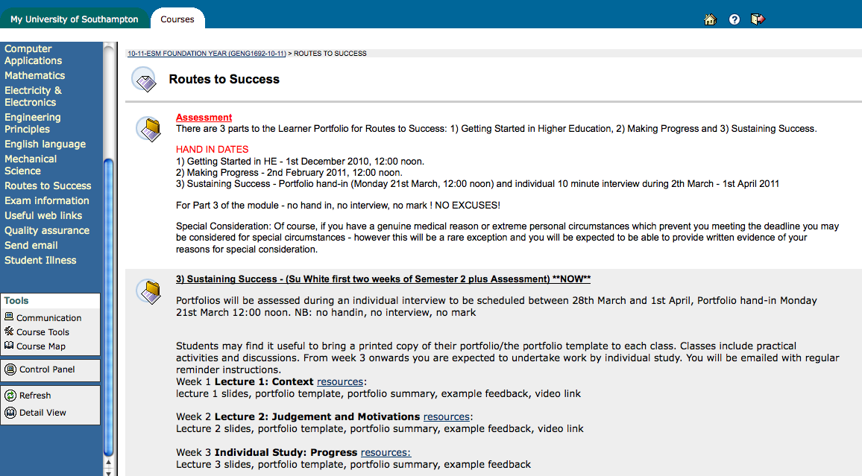
Where to find stuff: Blackboard
Notes:
Use blackboard to check details of the module, and background information which is still relevant

Slide 48
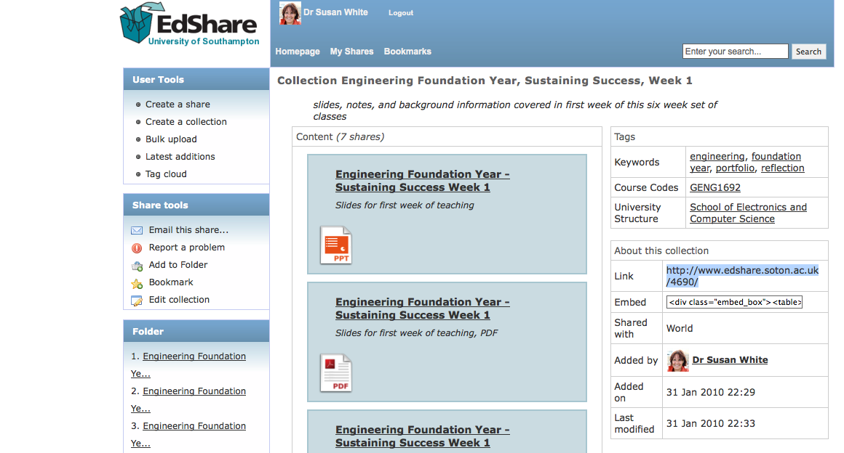
Where to find stuff: Edshare
Notes:
Resources are put into a collection in edshare, go and get them if you want copies

Slide 49
Suggested watching and reading
A vision of students today
How to Get the Most Out of Studying: Part 1 of 5, "Beliefs That Make You Fail... Or Succeed"
How to Learn Anything... Fast - Josh Kaufman
GLADWELL, M. (2008). Outliers, the story of success, Penguin (Audio Book on YouTube)
RSA Animate - Drive: The surprising truth about what motivates us
SYED, M. (2010) Bounce: The Myth of Talent and the Power of Practice, Fourth Estate (video of recent presentation by Matt Syed
The Visions of Students Today 2011 Remix One (trailer)
Plus a few others – the list is constantly renewing – look in edshare

Slide 50
Your formal objectives:
The module - Sustaining Success
Three portfolio components
Getting Started in Higher Education ✔
Making Progress ✔
Sustaining Success: NOW
Notes:
Recap on what has gone, and what is expected
Gauging the level of engagement, and motivation

Slide 51
Bigger Objective
Successfully complete the foundation year
Gain a brilliant degree
Secure the future of you choice/dreams

Slide 52
Objectives (task)
Ambition,
desire, need,
want….
Identify your own objectives
Think for a moment…
What do you want to achieve?
Today
Tomorrow
This semester, year,
During the life of your degree
Should relate to why you are here :-)
Notes:
Relate the whole routes to success class back to the personal

Slide 53
About Feedback
How do we get it?
How? When? So What?

Slide 54
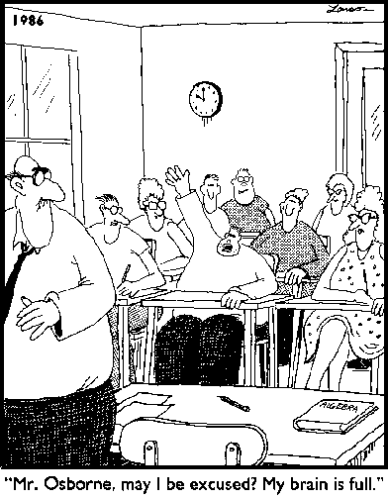
Varieties of Feedback:
Full Brain?
Notes:
Opening for discussion of the range of types of feedback
Learning taking place in three domains
Cognitive
Affective
Psycho-motor

Slide 55
Think about this module (RTS)
What have you done?
What have *you* achieved?
Q How do you rate it so far?
Obviously useful
Surprisingly useful
Still not sure
Don’t think it is helping
Notes:
Interactive discussion, write feedback on board/acetate

Slide 56
Reflection and Feedback 1
True of False?
You can only get feedback on your work from the lecturers or demonstrators
Notes:
Ask the question, get a vote, have some discussion

Slide 57
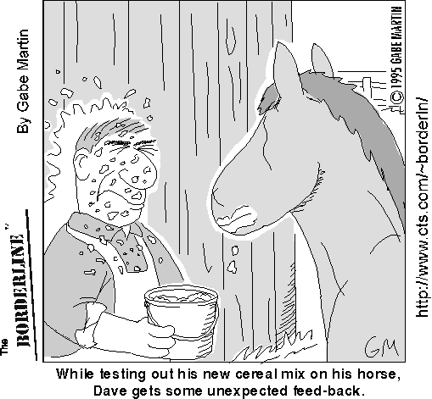
reflection and feedback 2
How can you get feedback from an exam?
Choose any which apply
Listen to the general feedback on how we all did
Think about how I did
Talk to fellow students about
how we did
Read and analyse at my marked
exam script
Attempt the exam a second time
Notes:
Discussion of different types of feedback
Relation between feedback and reflection
Peer learning

Slide 58
exams
Remember
Think back
Before your exam
Make a note now…
TODAY - Think back
Reflecting on your exam performance
As you are thinking about it today…
Make a note

Slide 59
Your Tasks
Some things for you…
And the portfolio ;-)

Slide 60
Consolidation

Slide 61
Three stages
Introduction
Consolidation
Completion

Slide 62
Today
Consolidation

Slide 63
Mental jogging
Complete one of these mental jogging activities. Write down…
Seven issues you might identify in your learning…
Seven ways to solve those issues
Seven questions you have about the portfolio
Seven answers to those questions
Edshare http://www.edshare.soton.ac.uk/16144/

Slide 64
Looking at the portfolio
Make sure you have the correct version
Review the portfolio structure, this week consider the section on exams

Slide 65

Thinking about Flow
Much of the video and writing focuses on happiness
I am interested in how we can access flow to work optimally and achieve our goals
Watch and relate the general context to your own experience
https://youtu.be/8h6IMYRoCZw

Slide 66
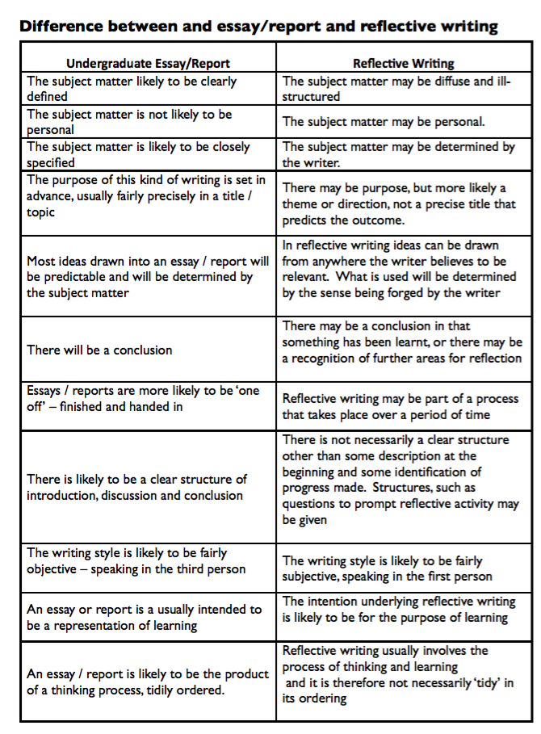
Essays and reports vs reflections
Read/download the hand out
Read each point in turn
How can you relate this to what you write in the portfolio
http://www.edshare.soton.ac.uk/16146/

Slide 67
Where do you get inspiration?
Exercise
Spend five minutes free writing
Use the hand out
Write what inspires you in your chosen topic
  Could be a person, book, idea, objective
  Don’t plan or think about it, just let your unconscious lead you, the only person to read this will be you…(see next slide)
Link to Free writing exercise and background info EdShare http://www.edshare.soton.ac.uk/16145/

Slide 68
five minutes writing
What inspires you in your chosen topic
  Could be a person, book, idea, objective
  Don’t plan or think about it, just let your unconscious lead you, the only person to read this will be you
Don't stop for anything.
Go quickly without rushing.
Never stop to look back, to cross something out, to wonder how to spell something, to wonder what word or thought to use, or to think about what you are doing.
If you can't think of a word or a spelling,
just use a squiggle or else write "I can't think what to say, I can't think what to say" as many times as you want;
or repeat the last word you wrote over and over again; or anything else.
The only requirement is that you never stop.
https://youtu.be/hOA-2hl1Vbc

Slide 69
Start Now
https://youtu.be/hOA-2hl1Vbc

Slide 70
You will have your exam results
Now or very soon
Find some time to think about them…
Wordless recreation to find quiet time
  A walk in the park
  A swim
  A run
  Doodling/colouring
  You could try a free writing exercise
My exams….

Slide 71
exams
What are your reflections on your exam performance?
What are you going to do differently next time?
What could you do before the next exam to make things even better?
Fill in that section of the portfolio as soon as possible

Slide 72
Contents/Resources page 1 of 2
Mental Jogging exercise
Edshare http://www.edshare.soton.ac.uk/16144/

Slide 73
Contents/Resources page 2 of 2
Video of book review explaining Flow YouTube https://youtu.be/8h6IMYRoCZw
Comparing reflection and essays EdShare http://www.edshare.soton.ac.uk/16146/
Free writing exercise EdShare http://www.edshare.soton.ac.uk/16145/
List of videos to watch YouTube
https://www.youtube.com/playlist?list=PLsg_STfjaqqsZi7rN4hzycOAtP8dzmCxJ
EdShare http://www.edshare.soton.ac.uk/14046/
Peer review guidance EdShare http://www.edshare.soton.ac.uk/16143/

Slide 74
1) Progress review
Think about your progress so far this year
What will you continue?
What will you modify?
What will you stop?
By the end of next week
Read each section of the portfolio and sketch in some responses

Slide 75
Next seven days
1) Understand the difference between
  writing a reflection
  and
  writing and essay
2) Watch the video set
3) Make your action plan
  Think about this in the context of
  What you learnt about flow?
  What you need to write in the portfolio?
  What makes you happy?
  What you plan to achieve?
http://www.edshare.soton.ac.uk/14046/
http://www.edshare.soton.ac.uk/16146/

Slide 76
Thank You :-)

Slide 77
Essential Activities..
Think about evidence…
Where will you get evidence?
What sort of evidence can you use?
Watch the videos
  think about *your* education
  Think about *your* learning
Take a look at EdShare - how could you use it to assemble evidence?

Slide 78
Video: A vision of students today
Swap to web browser! Linked from EdShare
Work by Michael Wesch of Kansas State University - Digital Ethnography Project
http://www.edshare.soton.ac.uk/67/
Notes:
This is a five minute video clip which looks at the student experience from the students perspective
Opens up discussion into the tensions between academic and non academic life
Need for work life balance

Slide 79
Introductory resources
These slides
The portfolio template
The first survey
Your free writing
Your goals
The videos (linked from blackboard)
review all the information in these resources
review these slides

