Slide 1
The Science of Social Media: Project Launch
David Millard
dem@ecs.soton.ac.uk
Thanassis Tiropanis
tt2@ecs.soton.ac.uk

Slide 2
COMP6217: Who are You?
Computer Scientists, Web Technologists, Data Scientists, and Web Scientists
Learning
Assessment (%)
COMP6217
(15 credits)
Ten week lecture series
Exam (60%)
Group Project
Personal Summary (8%)
Portfolio (24%)
Dragon’s Den Pitch (8%)

Slide 3
Project: Overview
Your task is to develop an idea for a new social networking tool/website/application
Topic and platform is up to you
Moneymaking, altruistic, experimental, fun
Web-based, Mobile, Desktop
A Developed Idea
Does not have to be a working system
although you may wish to include prototypes or proofs of concept
Instead create an idea portfolio
explores/explains and describes the issues around your idea
explains motivation and requirements
presents design documents and plans
includes evidence that the idea will work

Slide 4
Role of the Mentor
Is a guide to help you develop your idea in a structured way
Will help you pace your activities
And give advice on what activities to undertake
They are our representatives in the group
Will help with any group disputes
Liaise with us if needed
We will allocate mentors to groups next week

Slide 5
Groups 2017
Group 1
Kitromili Sofia - sk1n15
Efimova Yulia - ye1n15
Cheng Kang - kc1u16
Ayling Jacqueline - jaa1g16
Jonak Justyna - jkj1n15
Group 2
Staniforth Jonathan - js30g13
Strouthos Michalis - ms1u16
Gillbard Edward - eg16g15
Suwanicho Ekawut - es1y15
Morgan Cathy - cem1e16
Group 3
Wales Amy - aw2e15
Bobkova Maria - mb3n15
Deng Yongliang - yd1n16
Hamilton Rachel - reth1g16
Group 4
Breeze Susan - smb1n15
Tang Darron - dt6g12
Ralph-Donaldson Travis - tjrd1n16
Cayola Pérez Luis - lcp1u16
Group 5
Thorburn Robert - rht1g16
Roper Bernard - bar1g16
Qu Mojia - mq1e16
Cooper George - gc5g13

Slide 6
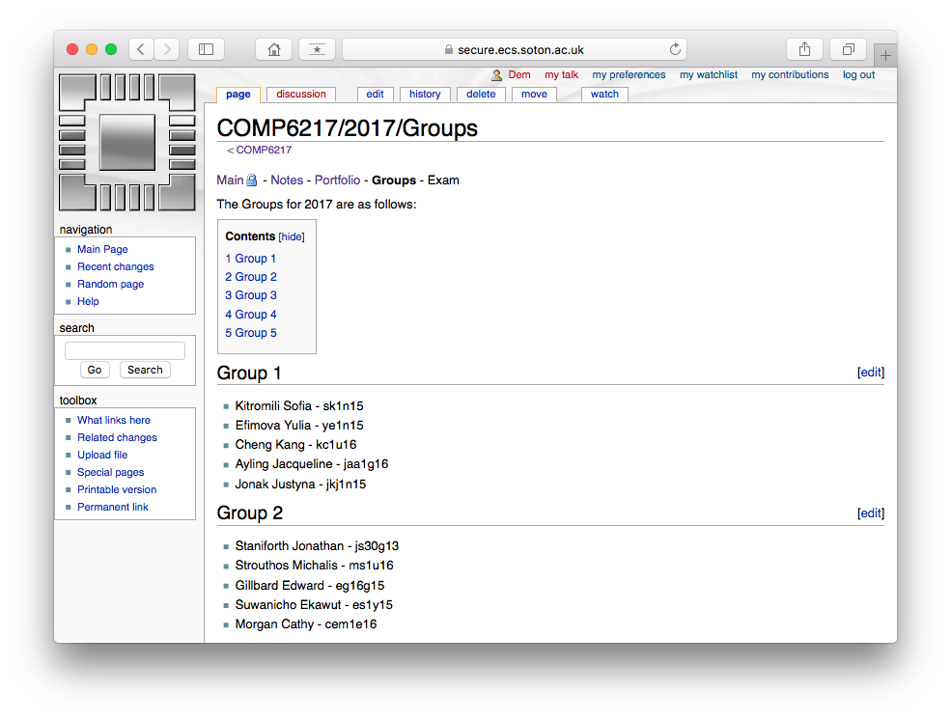
Groups 2017
Group 1
Kitromili Sofia - sk1n15
Efimova Yulia - ye1n15
Cheng Kang - kc1u16
Ayling Jacqueline - jaa1g16
Jonak Justyna - jkj1n15
Group 2
Staniforth Jonathan - js30g13
Strouthos Michalis - ms1u16
Gillbard Edward - eg16g15
Suwanicho Ekawut - es1y15
Morgan Cathy - cem1e16
Group 3
Wales Amy - aw2e15
Bobkova Maria - mb3n15
Deng Yongliang - yd1n16
Hamilton Rachel - reth1g16
Group 4
Breeze Susan - smb1n15
Tang Darron - dt6g12
Ralph-Donaldson Travis - tjrd1n16
Cayola Pérez Luis - lcp1u16
Group 5
Thorburn Robert - rht1g16
Roper Bernard - bar1g16
Qu Mojia - mq1e16
Cooper George - gc5g13
https://secure.ecs.soton.ac.uk/module/COMP6217/

Slide 7
Group Formation and Brainstorm
Each Group needs:
A Name
An initial blog administrator
Some ideas!
Cogs by Ade@Cuckooland

Slide 8
Portfolio
Process and Structure
Potential Content
Create a Blog as you go
You will need a team name
We will use the University blog system (Wordpress)
No fixed set of activities
You need to decide what is best for your project
Use multimedia as well as text
Photos, videos, transcripts
Welcome and project brief
Analysis of existing similar tools
Related academic work
Links to related news items in the tech media
Interviews with potential users
Surveys and focus groups
Mockups and Ideas
Scenarios and Personas
Web maps and Storyboards
Tech demos
UML diagrams
Overview of standards and protocols
Social / Ethical considerations
Economic context
Overview of pitch to dragons den panel

Slide 9
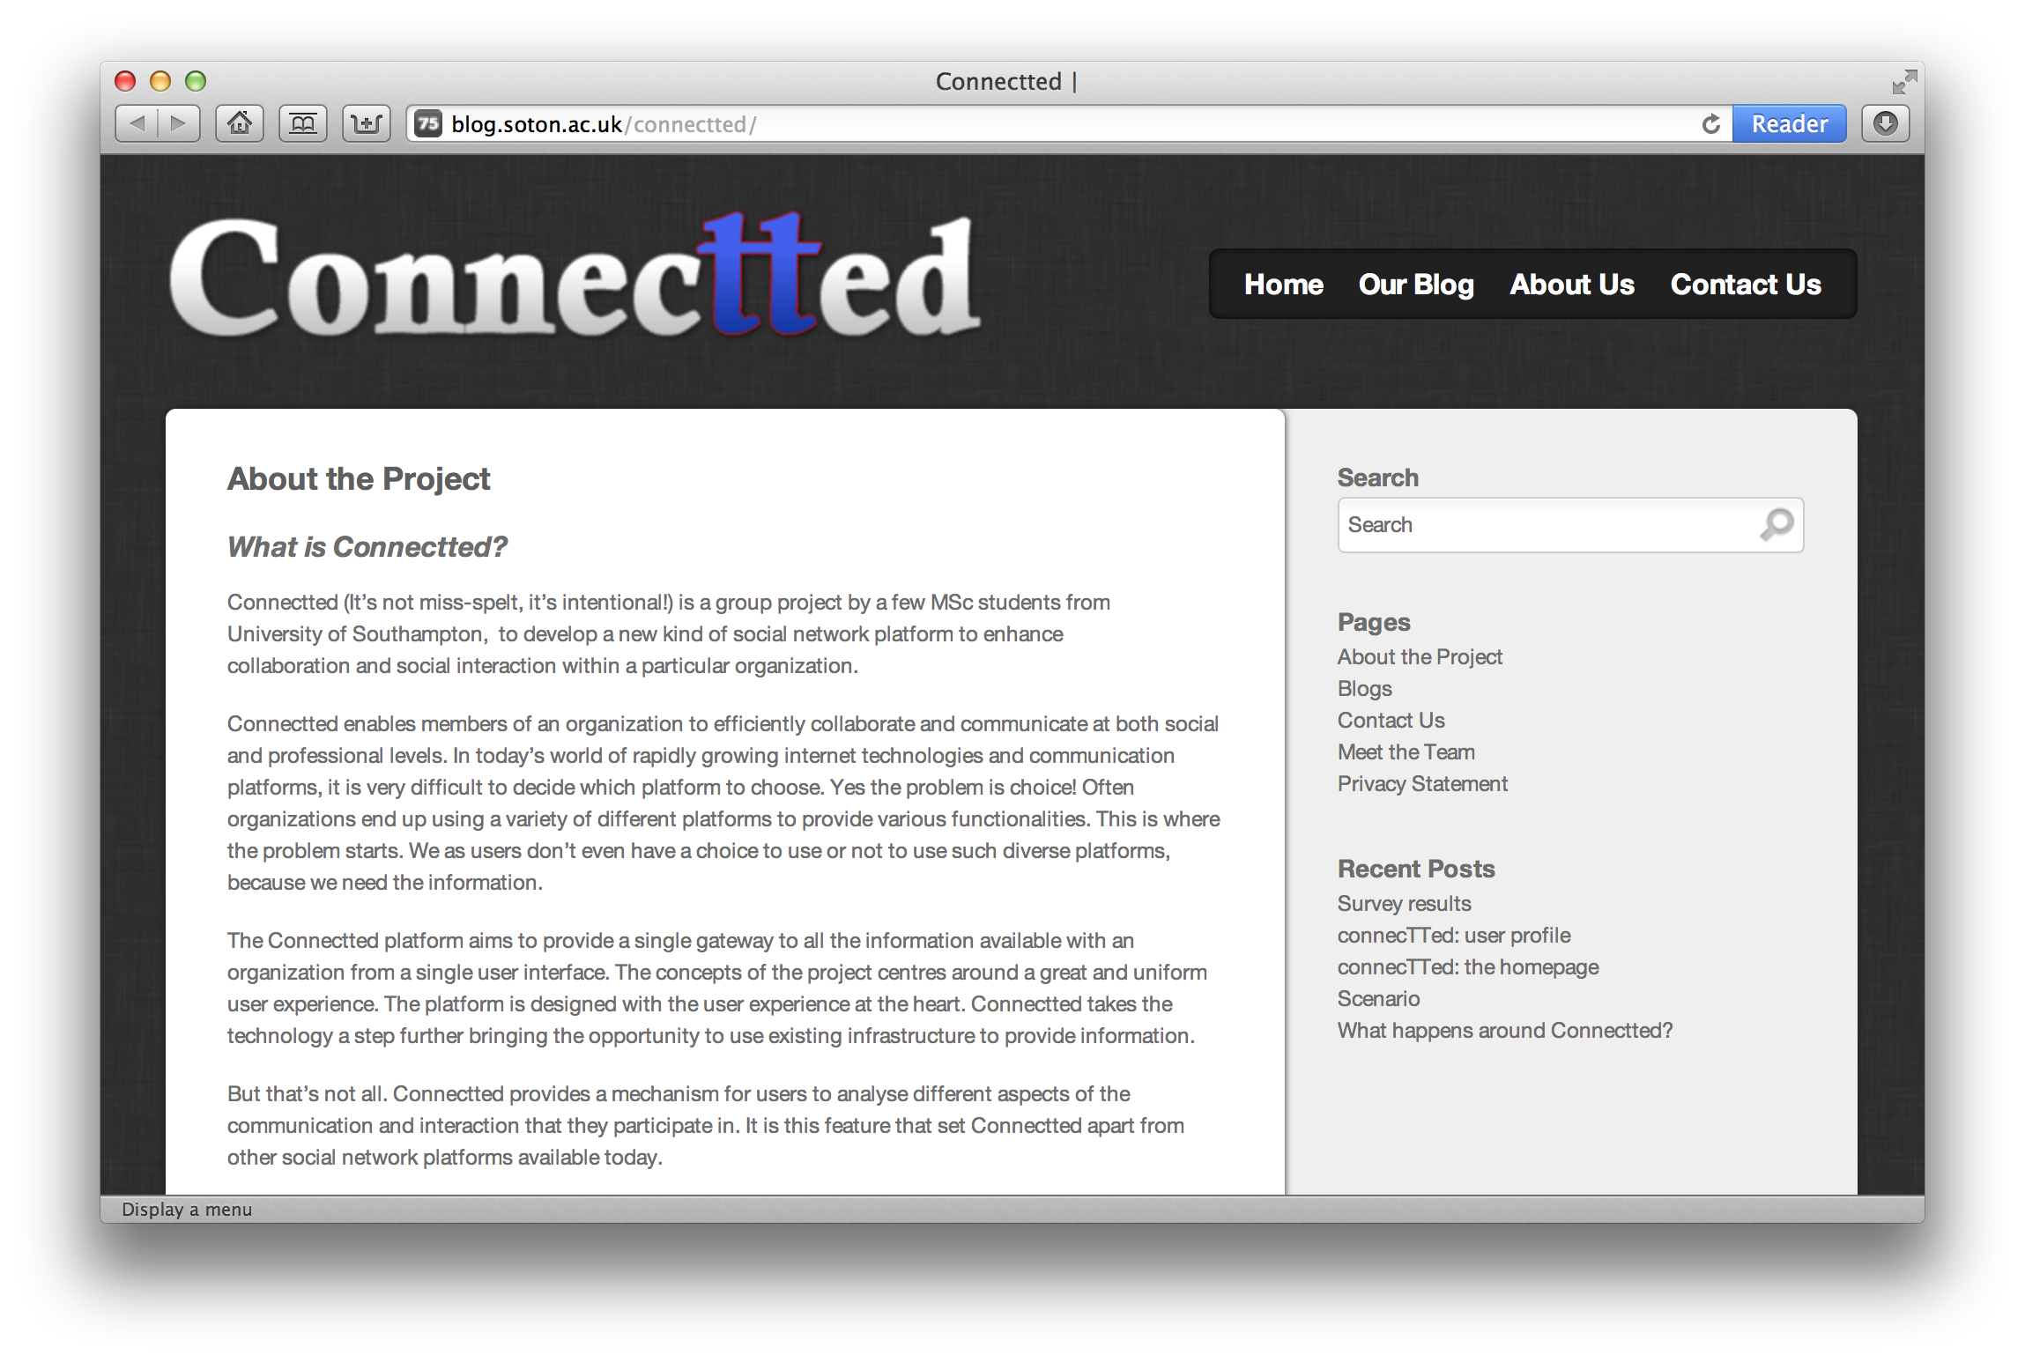
Example Projects: 2012

Slide 10
Example Projects: 2012

Slide 11
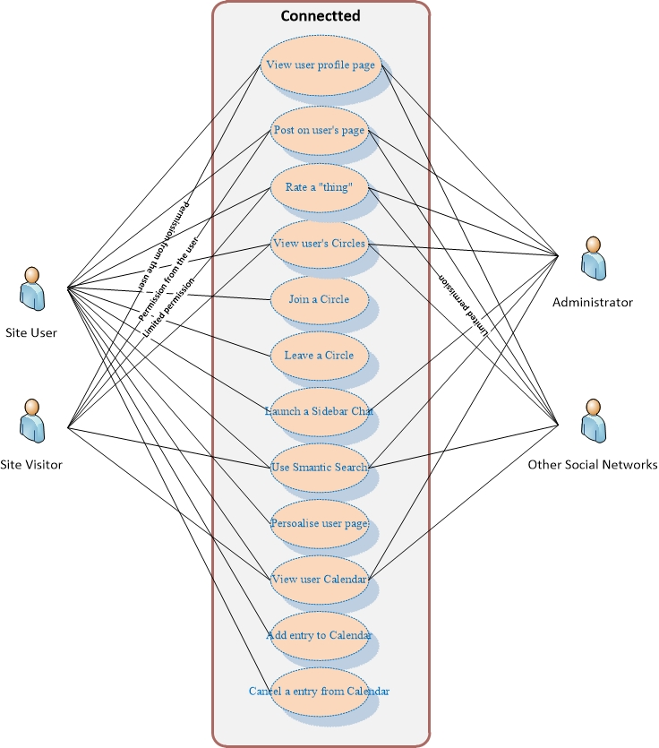
Example Projects: 2012

Slide 12
Example Projects: 2012

Slide 13
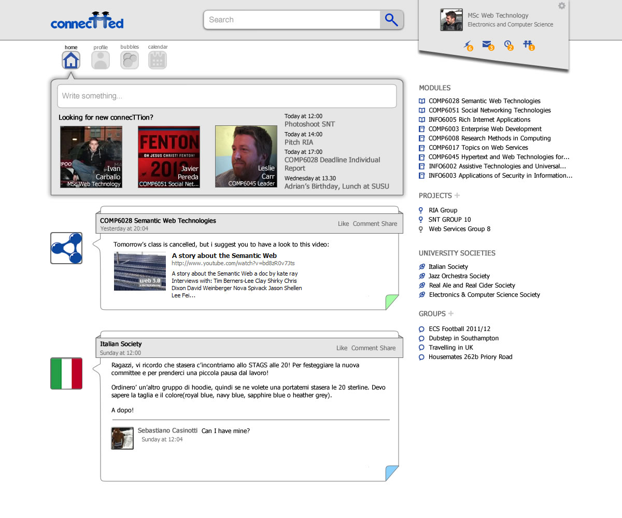
Example Projects: 2012

Slide 14
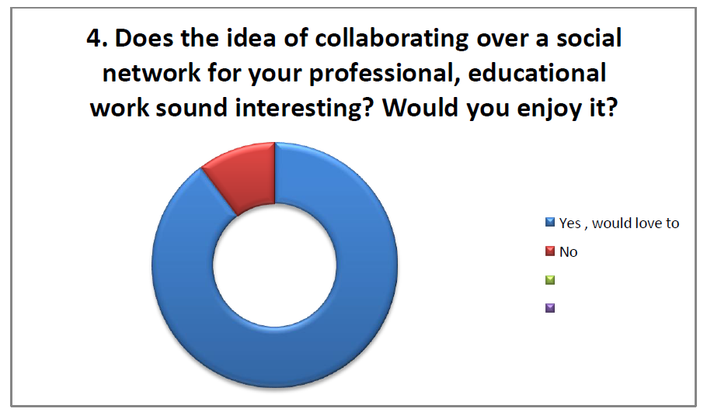
Example Projects: 2012

Slide 15
Assessment: Portfolio
The final portfolio will be marked according to the following marks scheme:
10% - Structure, Story and Use of Media
A strong portfolio would be coherently structured using the entry and tags mechanism of the blog system, and the story of the project and roles of individuals would be clear and told through a variety of media (including video, audio, photos and text) appropriate to the task
50% - Engineering and Design Professionalism
A strong portfolio will show that the team chose appropriate engineering and design steps and solutions for the problem that they were tackling, and that these methods were applied intelligently to produce artifacts of professional quality.
30% - Consideration of contextual factors (social, economic, legal etc.)
A strong portfolio would demonstrate a keen awareness of social factors around their software, and show that the team had undertaken sensible steps to both understand those issues, communicate them through the blog and incorporate them into their design and development work.
10% - Initiative, Innovation and Creativity
A strong portfolio would include ideas and practices that were above and beyond the thinking we would normally expect to see in a standard commercial web development project. This might be in terms of the central idea or in the methods used to explore and develop it.

Slide 16
A Note on Group Marking
Your final mark will be:
As a group: Portfolio (24 marks) + Pitch (8 marks)
As an individual: Exam (60 marks) + Personal Summary (8 marks)
In a normal situation we expect the group mark (portfolio+pitch) to stand for all members of the group
Marks within a group will thus vary according to each person’s personal reflective summary and exam results
In exceptional circumstances (i.e. non-participation, extreme group breakdown, etc.) we will adjust the group mark so that it is not even
This will be transparent (normally involving a group meeting)
May involve special circumstances board
And will be based on mentor feedback

Slide 17
Next steps
By the end of week 4 your group should have:
Requested a blog (http://blog.soton.ac.uk)
Held your first meeting
Brainstormed a topic
Decided on a group name
By the end of week 5 your group should have:
Had an initial meeting with your mentor
Created a welcome blog post that includes a project brief
Approximately 200 words
What is your topic, why is it interesting, what is your rough plan?
After that it is over to you…
Deadline: End of Week 10 (Friday 5th May)

Slide 18
Questions…
?
Dave Millard (dem@ecs.soton.ac.uk)
Thanassis Tiropanis (tt2@ecs.soton.ac.uk)

