Slide 1
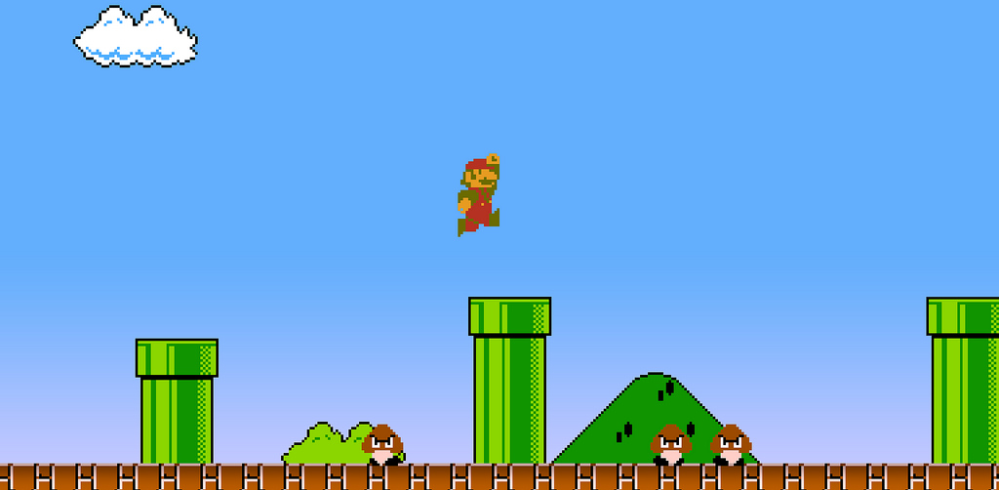
Game Design Basics 1
Structures and Elements

Slide 2
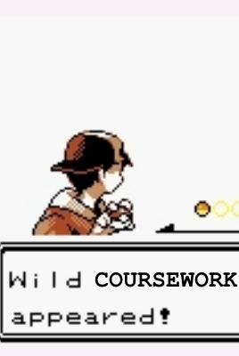
Before we start…
COURSEWORK 1 IS UP
Its time to start putting into action what you’re learning!
Details are on the wiki
Develop a small game prototype in unity in pairs
Prototype must demonstrate a game dynamic, within a level designed to tutorial the dynamic to the player
Game will be assessed at the expo in week 6 and offline

Slide 3
In This Lecture
An exploration of how structure can help us design and understand games
What are the Atomic Components of a games design?
Fullerton’s Formal Game Elements
Hunicke et. al's MDA model
Game Design Exercise

Slide 4
Before we begin …
Game design is a creative subjective process
It is not a solved problem
Rules, theories, and structures do help us to think about the design factors in game creation and how they might affect the result
Rules, theories, and structures do not give us a flawless roadmap to the perfect game
Learn game design theory, demonstrate your learning, understand there is more to game design.
Notes:
Like software design pattern (e.g. MVC), they are a language that helps us talk about the way we build this particular type of software.

Slide 5
The Atoms of a Games Design

Slide 6
Where do we begin in game design?
Lead with theme?
“I want to make a game about the old west!”
Lead with mechanics and dynamics
“I want to make a game about shooting a gun!”
Lead with player avatar
“I want to make a game where you play a cowboy!”
Lead with objectives
“I want to make a game where you rob a bank!”

Slide 7
Where do we begin in game design?
Lead with theme?
“I want to make a game about the old west!”
Lead with mechanics and dynamics
“I want to make a game about shooting a gun!”
Lead with player avatar
“I want to make a game where you play a cowboy!”
Lead with objectives
“I want to make a game where you rob a bank!”
These are all atomic elements of a game design: fundamental building blocks that determine what is fun about a game and how the player gets at that fun

Slide 8
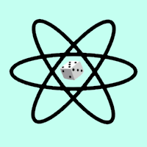
What are the atoms of a games design?
Resources -
Conflict - Boundaries - Outcomes - Aesthetics - Interface - Rewards - Complexity - Difficulty - Characters - Story - Controls -
- Game State - Game Views - The Player - Avatar - Mechanics - Dynamics - Goals - Rules - Theme - Objectives - Procedures
How the content of game design is modelled varies from theory to theory, though most have common patterns.
Notes:
Synthesis of concepts from Challenges for Game Designers and …

Slide 9
State and Views
Game State
The known value of all variables determining the progress, positions, and flow of the game
Game View
How the player perceives the game state
What variables will control what happens in my game?
Position of pieces? Character attributes? Score?
Which of these does the player know, and how do they know?
Health bars? Menus? Game board?

Slide 10
Players, Avatars, Characters
Game personas real, imaginary, or simulated
Players are human beings who interact with the game
Avatars are the manifestation of the player within the game
Characters are personalities written and created within the game
All players have an avatar either explicit (the controlled character in an FPS or RPG) or implicit (the unnamed commander in RTS)
Characters can sometimes be explicit avatars, but also NPCS

Slide 11
Mechanics, Dynamics, Systems, Goals
These are the cogs and belts that drive your game
Broadly speaking:
Mechanics: Individual rules, equations, and algorithms that make the game (e.g. a short sword does 1d6 damage)
Dynamics: Either patterns of play that emerge from mechanics, or how the player experiences a particular mechanic (e.g. ‘A race to the end’ or ‘A sword fight’)
Systems: A collection of mechanics and dynamics
Goals: The motivation to use dynamics

Slide 12
A note on the overloading of “Dynamics”
‘Dynamics’ is a term that means different things to different designers and theorists
To some its how the user experiences a particular mechanic – the animation, the controls, the feeling of engaging with that mechanic
To others it’s a particular pattern of play that emerges from a collection of mechanics – such as a race, a battle, the building of a city.
Most agree that in either form it represents how the player connects to the mechanics.
Notes:
MDA vs Fullerton?

Slide 13
Genre and Theme
Genre: The classification of your systems
Do your systems match the pattern of a collection of other games?
FPS, RTS, RPG, Racing ….
Theme: The classification of your aesthetics, narrative, and content
How is your game ‘skinned’? Does it rely on a particular setting?
Fantasy, Sci Fi, Western, Realistic ….
Consider: What is the relationship between theme and Genre

Slide 14
Fullerton’s Formal Elements

Slide 15
Fullerton’s Formal Elements
Fullerton’s fundamental theory of game design structure
A model of mandatory building blocks that make up the design of a game.
Players, Objectives, Procedures, Rules, Resources, Conflict, Boundaries, Outcomes
“[Formal elements] are those elements that form the structure of a game. Without them, games cease to be games … These are the essence of games, and a strong understanding of their potential interrelationships is the foundation of game design.”

Slide 16
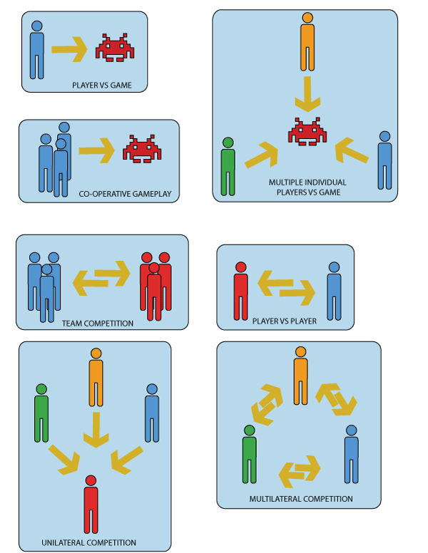
Elements: The Player
Once invited to a game a player is part of “the magic circle” where they adopt the responsibilities and capabilities of their avatar.
What are those responsibilities and capabilities?
How many players does your game need and why?
Can the number be varied?
Are there certain roles that need to be fulfilled?
How do the players interact with each other?

Slide 17
Elements: Objectives I
What motivates your players to engage with your games dynamics?
How does it help the player interaction model? How does it feed from the games narrative?
Classic Objectives:
Capture
Take from the opponent. Hold from the opponent.
Many games from TF2 to Chess
Chase
Outpace the opponent, either to reach or evade
Assassins Creed, Scotland Yard, Tag

Slide 18
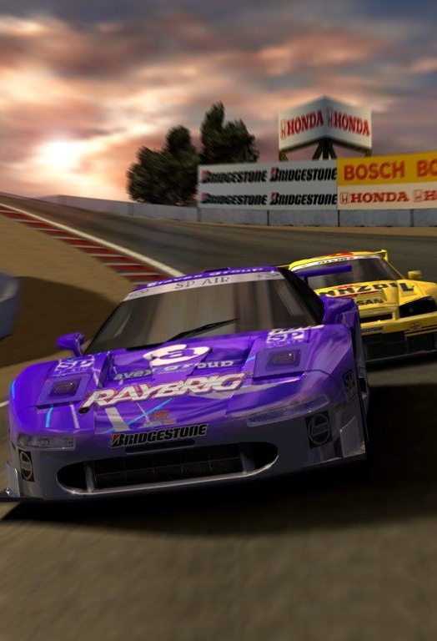
Elements: Objectives II
Race
Outpace an opponent to a shared destination
Gran Turismo, Snakes and Ladders
Alignment
Create design spatial configuration
Tic-Tac-Toe, Bejeweled
Rescue or Escape
Move predefined entities from danger to safety
Mario, Prince of Persia
Forbidden Act
Force your opponent to lose the game
Jenga, Twister

Slide 19
Elements: Objectives III
Construction
Use resources to Build or Maintain Entities
SimCity, Settlers of Catan
Exploration
Observe a game world and find its value
Minecraft, Zelda
Solution
Find solution to given problem under constraint
Tetris, Maze
Outwit
Gain or use knowledge to win
Trivial Pursuit, Diplomacy

Slide 20
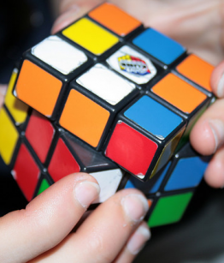
Elements: Procedures
Who does What, When, and How?
How does your player achieve their objectives?
And how does their opponents stop them?
What some game designers would call a games “Dynamics”
How does a player take the rules of the game and exert agency?

Slide 21
Elements: Rules
What transformation and calculations occur in this game?
What some game designers would call “Mechanics”
Definitions, Restrictions, Effects
Rules defining objects and concepts
“The short sword does 1d6 damage, and costs 2 gp”
Rules restricting actions
“Clerics can’t use the short sword”
Rules determining effects
“If the short sword drops you to 0HP you are dead”
Notes:
Constraints that the player agrees to participate within.

Slide 22
Elements: Resources
What might the player transform, using rules, to achieve objectives
Must have both utility and scarcity
Typical resources:
Durational (Control how long the player may act)
Lives, Time, Health
Expendable (Control how the player may act)
Units, Currency, Actions, Inventory
Enhancements (Change how expendables work)
Power ups, Terrain

Slide 23
Elements: Conflict
What must your player contend with to accomplish objectives?
Classic sources of conflict:
Obstacles
Inhibitions to progress
Locked doors, the sack in a sack race
Opponents
Players and NPC with contesting motivations
The other chess player, Bowser
Dilemmas
Difficult choices, complex tactics
Upgrade my property or buy a new one? Bet or don’t bet?

Slide 24
Elements: Boundaries
What are the restrictions in theme, rules, scope, and practicality?
Perceived and explicit?
How can breaking perceived boundaries affect the game? E.g. portal
What is more restricting: systems or theme?
“In reality my pilot could fly anywhere, but theres an invisible wall here”
“I want my character to move between locations quickly, but people can’t fly”

Slide 25
Elements: Outcome
The uncertain conclusion to the game, whether realised or not.
Some games point to an outcome that never happens, such as MMOs.
How is the outcome determined by your other elements?
Does the game have winners and losers
Is this binary (won/lost) or variable (a score)
Is the game zero sum?

Slide 26
Formal Game Elements: Summary
Players, Objectives, Procedures, Rules, Resources, Conflict, Boundaries, Outcome
How do these elements connect to each other?
Can you identify each of these for games you know?
What is the impact of each of these on that game?

Slide 27
MDA

Slide 28
The MDA Framework
A framework by Hunicke et. al. That “bridges the gap between game design and development, game criticism, and technical game research”
Describes three layers
Mechanics: Data and Algorithms of the game
Dynamics: Behaviour of mechanics based on user input
Aesthetics: Desirable emotional response evoked in player

Slide 29
MDA: Mechanics
The statistics, transformations, and algorithms that make up the game
Similar to most existing definitions of “Mechanics” or “Rules”
Mechanics are how you “tune” the game
Adding or removing mechanics affects the entire stack on top of it (both the dynamics and the subsequent aesthetics)
Experimentation at the mechanical level is how we balance a game

Slide 30
MDA: Dynamics
How the mechanics are experienced by the player
The interface between player and mechanic
How is this mechanic controlled
“Press A to jump”
How is this mechanic experienced
“Jumps move at rate x, make a ‘boing’ noise, and move Mario in an arc
How a designer connects Mechanics to desired Aethetics
If I make Jump have no noise instead does that change Mario?

Slide 31
MDA: Aesthetics
The players experience and what makes the game fun.
Taxonomy of aesthetics:
Sensation, Fantasy, Narrative, Challenge, Fellowship, Discovery, Expression, Submission (, Competition)
Games are comprised of a set of desired aesthetics
For example
Quake: Challenge, Sensation, Competition, Fantasy
The Sims: Discovery, Fantasy, Expression, Narrative
Notes:
Sensation - Game as sense-pleasure
Fantasy - Game as make-believe
Narrative - Game as drama
Challenge - Game as obstacle course
Fellowship - Game as social framework
Discovery - Game as uncharted territory
Expression - Game as self-discovery
Submission - Game as pastime
Competition -

Slide 32
Using MDA
MDA can act as a Lens to understand how existing game designs connect the designer to their audience.
MDA can be used as a design tool, where by through iterative passes Aesthetics are added to a design and for each dynamics and mechanics are added to satisfy the aesthetic.
A
A
A
A
A
A
D
D
D
D
D
D
M
M
M
M
M
M
M
M
M

Slide 33
Worked Example: Minecraft?
Sensation
Game as sense-pleasure
Fantasy
Game as make-believe
Narrative
Game as drama
Challenge
Game as obstacle course
Fellowship
Game as social framework
Discovery
Game as uncharted territory
Expression
Game as self-discovery
Submission
Game as pastime

Slide 34
Before we finish…
COURSEWORK 1 IS UP
Its time to start putting into action what you’re learning!
Details are on the wiki
Develop a small game prototype in unity in pairs
Prototype must demonstrate a game dynamic, within a level designed to tutorial the dynamic to the player
Game will be assessed at the expo in week 6 and offline

Slide 35
The Walkover Exercise

Slide 36
The Walkover Exercise
The Walkover Mechanic
When a player walks over a tile they collect the resource depicted
This is a fundamental mechanic in many games
Mario Kart, Monopoly, Sonic, Pacman
You are going to come up with a quick design for which the walkover mechanic is the core mechanic!

Slide 37
Exercise Details
Get into 2s or 3s quickly
You have 20 minutes to come up with a simple original concept that uses the walkover mechanic
You may add other mechanics if you wish.
Consider:
What are the dynamics and aesthetics of the walkover mechanic in your game?
What are the fundamental elements of your design?
Players, Objectives, Procedures, Rules, Resources, Conflict, Boundaries, Outcome
Be prepared to discuss your idea and how the walkover mechanic is used with the class.

Slide 38
What Did I Learn Today?
Games designs are a collection of a wide variety of “atoms” made up of systems, concepts, and design artefacts.
Each atom has a fundamental affect on the resulting game
Fullerton suggests there are 8 fundamental “formal elements” present in every game design
Each of the these elements is connected to the others
The MDA framework describes how mechanical rules experienced as a dynamic can achieve an aesthetic effect.

Slide 39
Reading List
Chapter 2 of Challenges for Game Designers
Chapter 3 of Game Design Workshop
The MDA Framework Paper
“Aesthetics of Play” – Extra Credits

Slide 40
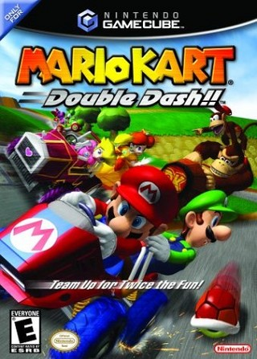
Play List
Play or watch a “Lets Play” video of a “Walkover” Mechanic Game
Suggestion: Mario Kart: Double Dash
Consider:
What are the Mechanics, Dynamics, and Aesthetics of this Game?
What are the Fundamental Elements of this Game?
How does the walk over make the game more fun?
What would be the affect of us removing it?

Slide 41
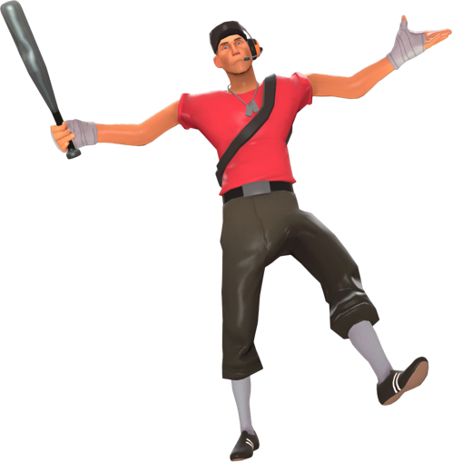
Thank You
COMP3218 Website: https://secure.ecs.soton.ac.uk/module/COMP3218/
David Millard
@hoosfoos | davidmillard.org | dem@soton.ac.uk
Rikki Prince
@rikkiprince | rfp@soton.ac.uk
Tom Blount
@Tom_Blount | tb12g09@ecs.soton.ac.uk

