Slide 1
OPEN DATA for STUDENT EXPERIENCE
Christopher Gutteridge
University of Southampton
& data.ac.uk

Slide 2
Bragsheet
Christopher Gutteridge - @cgutteridge
Previously; Lead Developer of EPrints
(Open access research repository software).
“Linked Open Data Architect” for University of Southampton.
(or whatever we’re currently call doing LOD stuff for an organisation)
Benevolent technical dictator of data.ac.uk
(recently deposed)
Webmaster WWW2006
Assistant Webmaster WWW2007, WWW2009

Slide 3
Open Data

Slide 4
Open Data
FUD

Slide 5
Open Data
Fear. Uncertainty. Doubt.

Slide 6
Open Data Excuse Bingo
Don’t get depressed! Go here for antidotes: http://is.gd/odbingo
Terrorists will use it | We'll get spam | It's too big | It's not very interesting
Thieves will use it | I don't mind, but someone else might | We will get too many enquiries | Lawyers want a custom License
There's no API | Poor Quality | There's already a project to... | We might want to use it in a paper
It's too complicated | Data Protection | People may misinterpret the data | What if we want to sell it later

Slide 7
Menu
Burger ….. £3.50
Chips ….. £1.50
≠

Slide 8
data.southampton.ac.uk

Slide 9
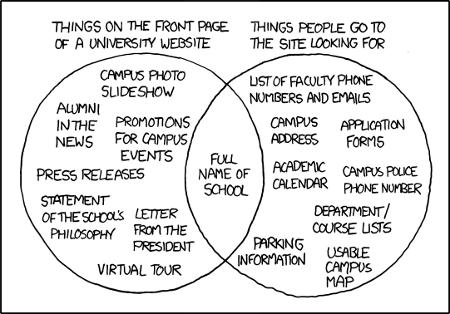

Slide 10
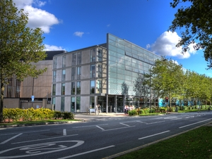

Slide 11
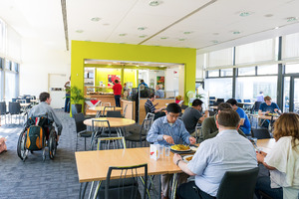

Slide 12
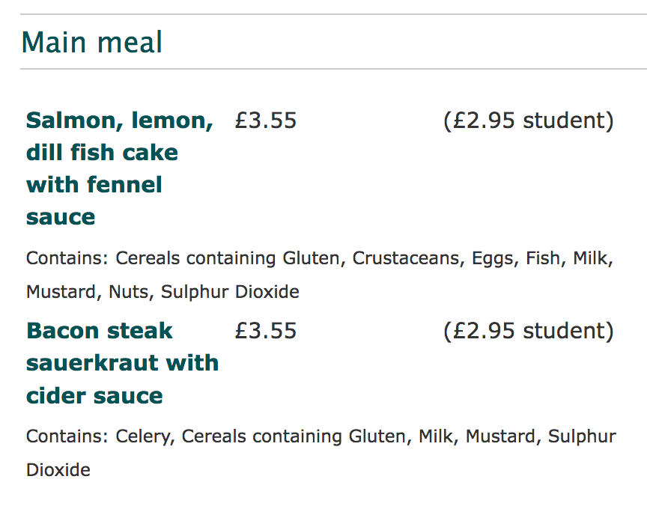
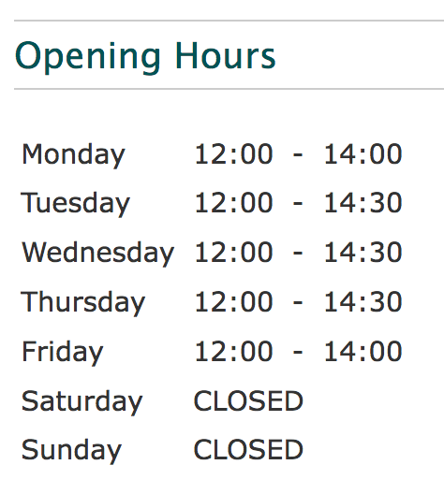

Slide 15
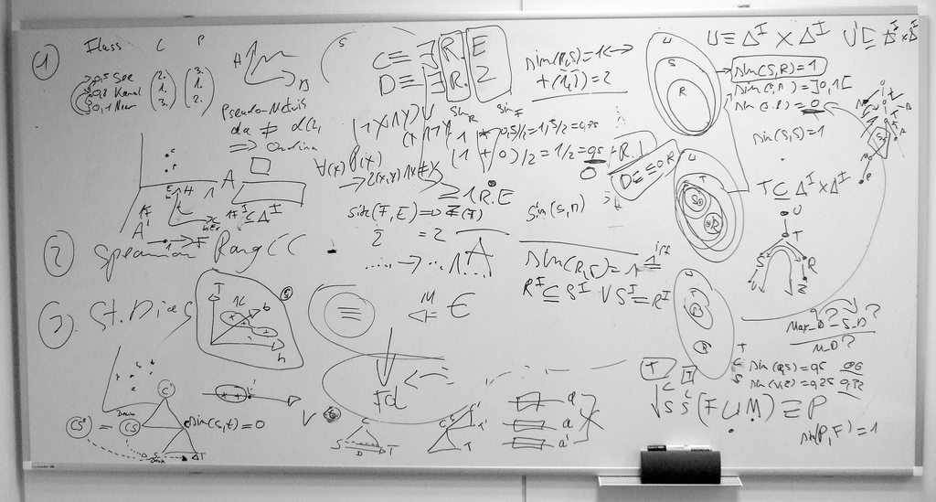

Slide 17
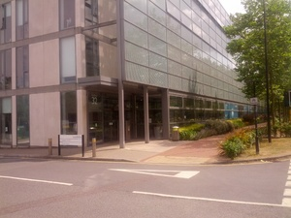
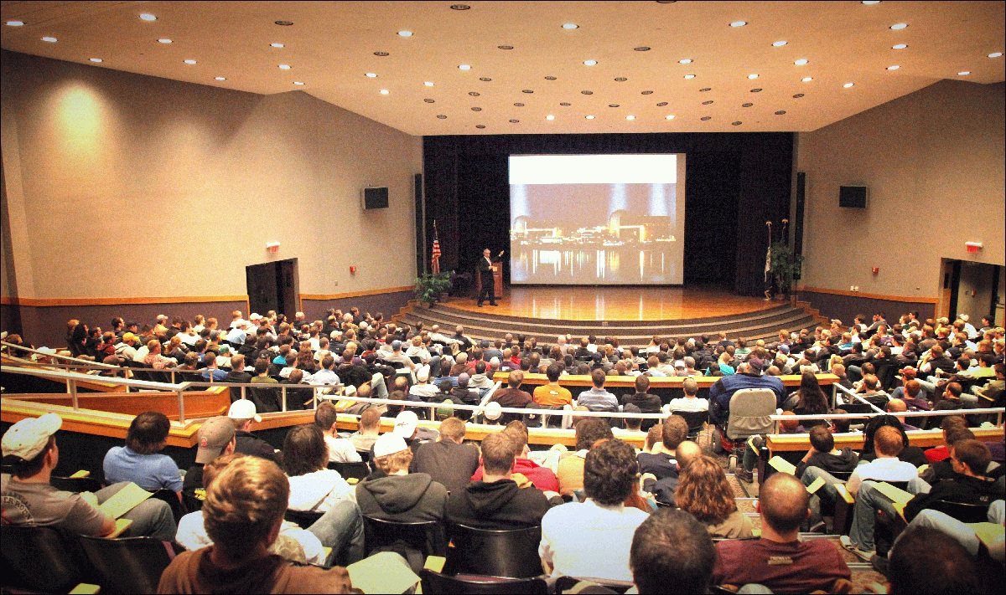

Slide 23
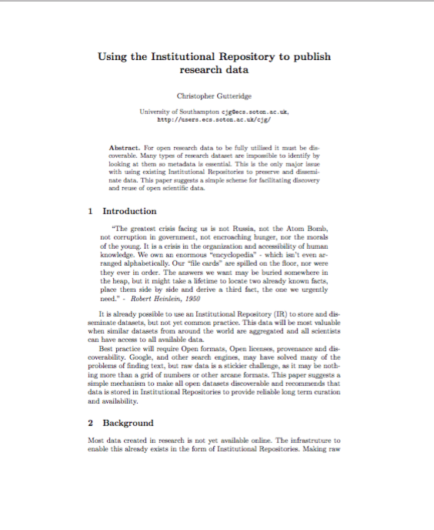
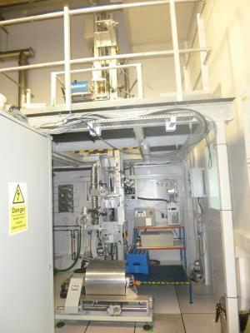

Slide 25
PUBLICATIONS
PROJECTS
PRODUCTS
PEDAGOGY
PARTS
PLACES
PEOPLE

Slide 26
Information core of the university
Parts (of the organisation)
Projects
Products (and services)
Places
People
Pedagogy (courses, modules)
Publications
PUBLICATIONS
PROJECTS
PRODUCTS
PEDAGOGY
PARTS
PLACES
PEOPLE

Slide 27
Interoperable datasets allow results that are greater than the sum of the parts…

Slide 28
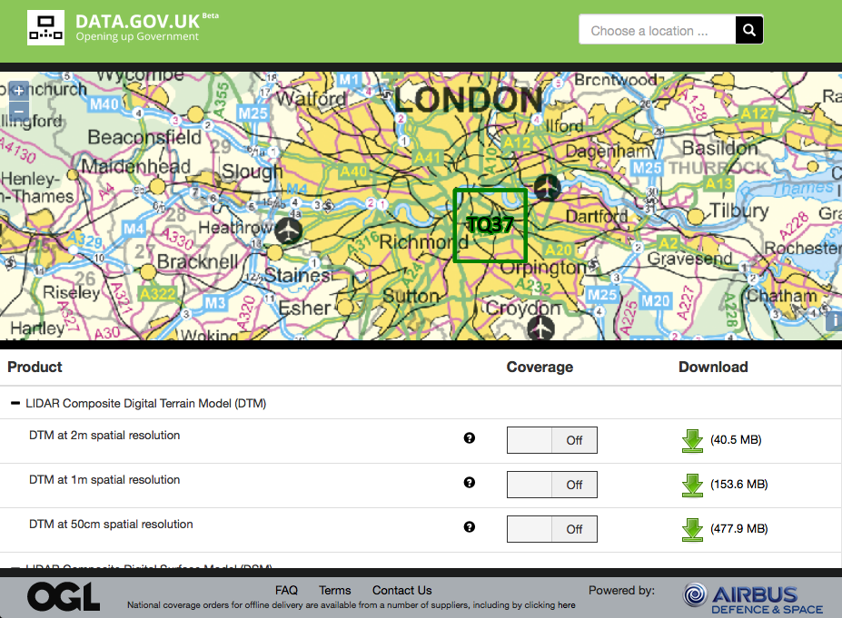

Slide 31
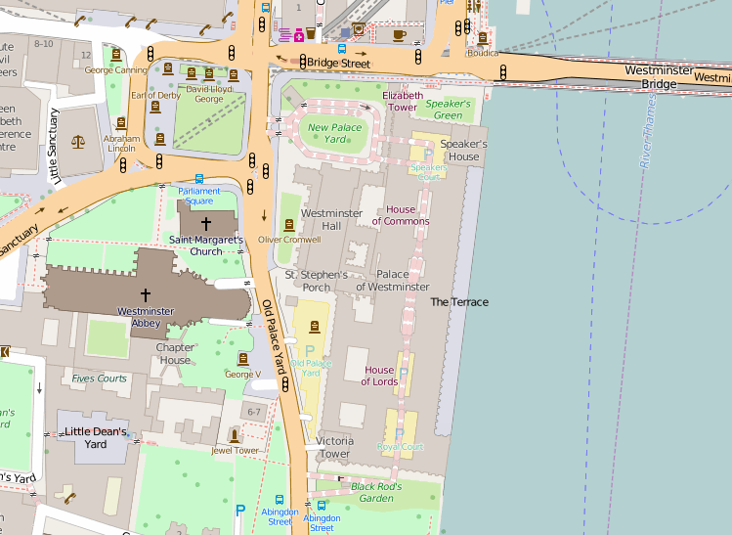

Slide 32
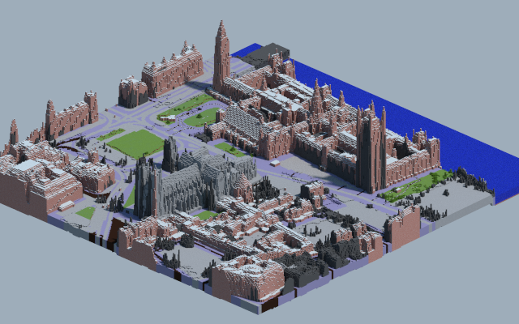

Slide 33
bu
http://bus.southampton.ac.uk/

Slide 34
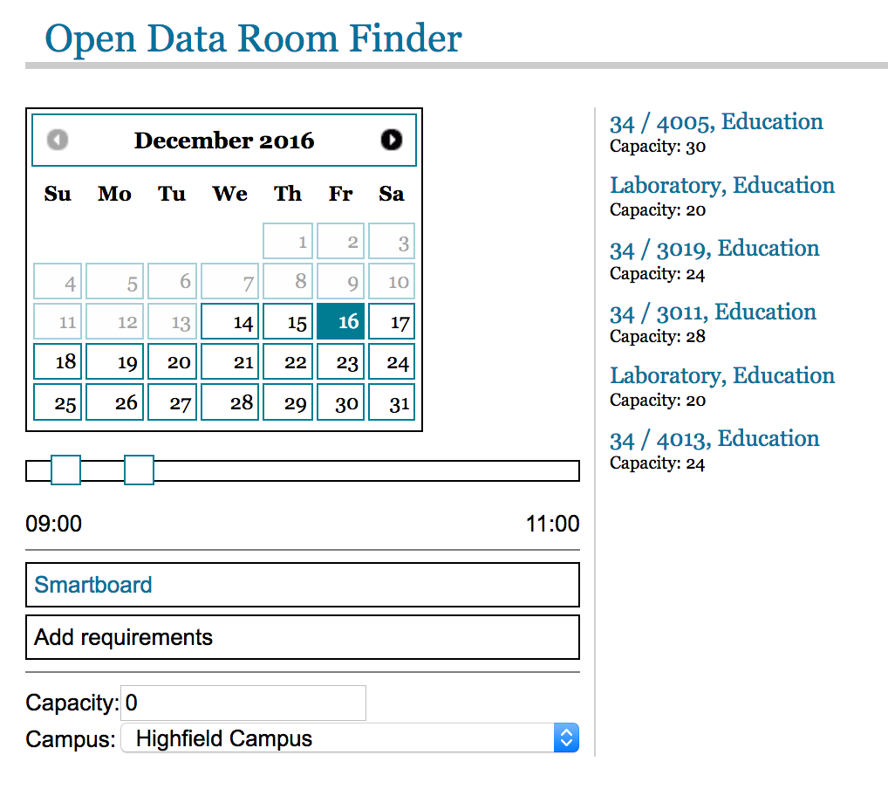

Slide 35
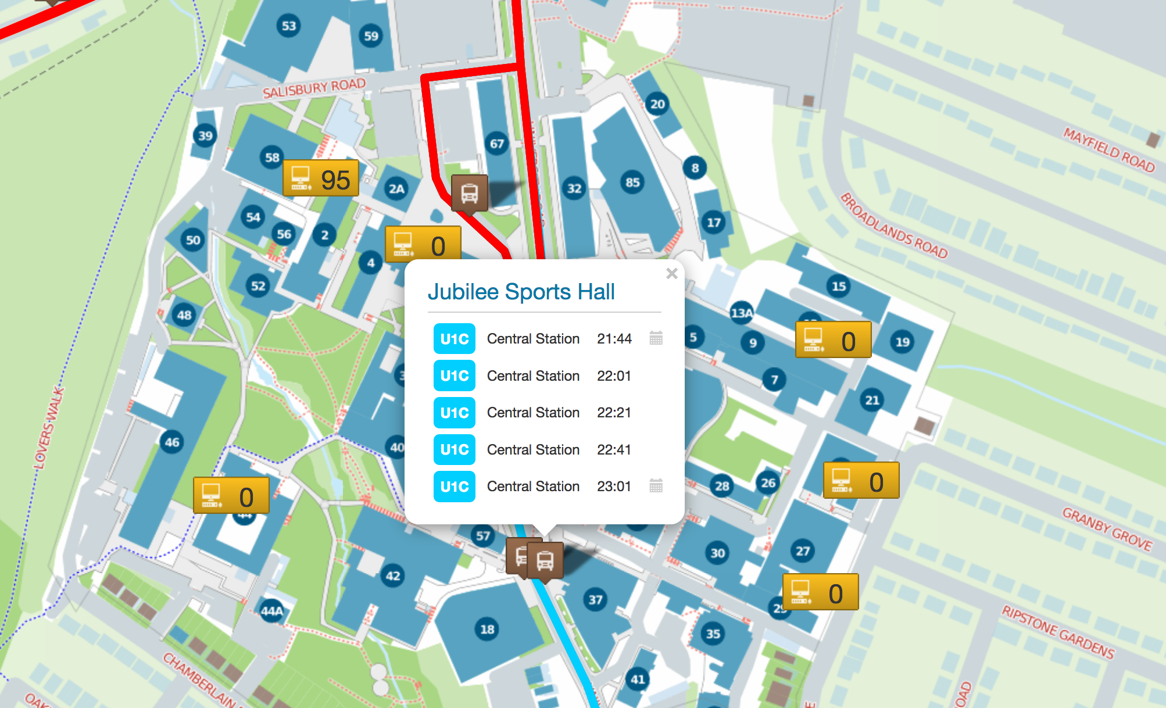

Slide 36
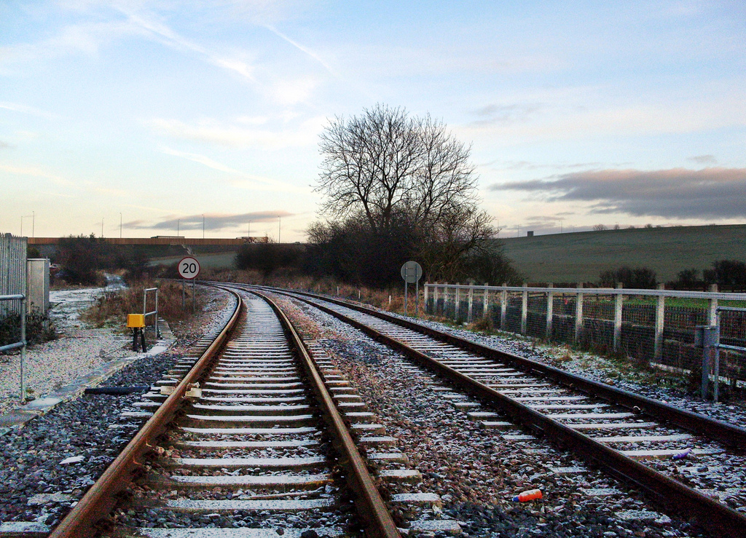
Needless heterogeneity means research doesn’t join up.
Aligning datasets every time
costs too much.
Tools can’t be reused

Slide 37
.ac.uk

Slide 38
Get more value from your data
Make it as open and advertised as possible …to get maximum use.
Link it together …so datasets augment each other.
Harmonise it with other organisations …to create economies of scale.

