Slide 1
MSc Web Sciences Thursday 8th December 2016
Affordances, Expertise, Identity and the World Wide Web
Dr Dan Ashton
Lecturer and MA Pathway Leader: Global Media Management
@danielashton
d.k.ashton@soton.ac.uk

Slide 2
Today’s talk
Key context and concepts: ‘participatory cultures’ and ‘affordances’
Key argument: examining the socio-technological construction of participatory processes and practices in terms of power and expertise.
Two examples from my research
1. Awarding the Self in Wikipedia
2. The Politics of Participatory Practices in Crowdsourced Documentary

Slide 3
Ordinary citizens and community
Howard Rheingold (1994) ‘The technology that makes virtual communities possible has the potential to bring enormous leverage to ordinary citizens at relatively little cost – intellectual leverage, social leverage, commercial leverage, and most important, political leverage... the future of the Net is connected to the future of community, democracy, education, science, and intellectual life—some of the human institutions people hold most dear.’
http://www.rheingold.com/electricminds/html/vcc_vc_intro.html

Slide 4
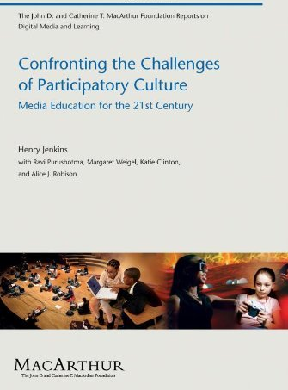
Participatory Cultures
Henry Jenkins et al. (2006: 7): ‘relatively low barriers to artistic expression and civic engagement, strong support for creating and sharing one’s creations, and some type of information mentorship whereby what is known by the most experienced is passed along to novices’
https://mitpress.mit.edu/sites/default/files/titles/free_download/9780262513623_Confronting_the_Challenges.pdf

Slide 5
… is everyone participating?
‘[…] it’s a great leap to presume that the availability of digital networked technologies turns everyone into active participants’ (van Dijck, 2009: 44: http://mcs.sagepub.com/content/31/1/41)
‘“Participation” does not equal “active contribution” to UGC sites’ (van Dijck, 2009: 44) …
How about participating in the same way …

Slide 6
Van Dijck (2009: 44) summarises a survey that categorizes user’s behaviour according to six levels on a participation ladder:
‘Active creators’ – people actually producing and uploading content such as webblogs, videos or photos.
‘Critics’ - provide ratings or evaluations.
‘Collectors’- save URLs on a social bookmarking service which can be shared with other users.
‘Joiners’ – join social networking sites without necessarily contributing content
‘Passive spectators’ - reading blogs or watching peer-generated video, the latter category
‘Inactives’ - do not engage in any of these activities
Can do/be more than one of these. The point is that a more nuanced approach is possible and we can be aware of different forms of UGC behaviour.

Slide 7
Continued questions about the individual in relation to participatory cultures …
What are the different motivations for participation?
What forms of identity formation can be seen within these contexts?
Is participation equal and open to all?
Are there continued power dynamics and hierarchies in evidence?

Slide 8
Key concept: affordances
Technical affordances are the material functionalities of a technology which allow users to perform certain actions’ (Marwick, 2015: 334) http://www.scoopwhoop.com/humor/pic-of-jugaad/ https://www.youtube.com/watch?v=ir3xFKqGv3Q

Slide 9
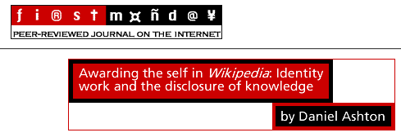
Case study: Wikipedia Service Awards
Why and how do we contribute to Wikipedia?
http://firstmonday.org/article/view/3156/2747

Slide 10
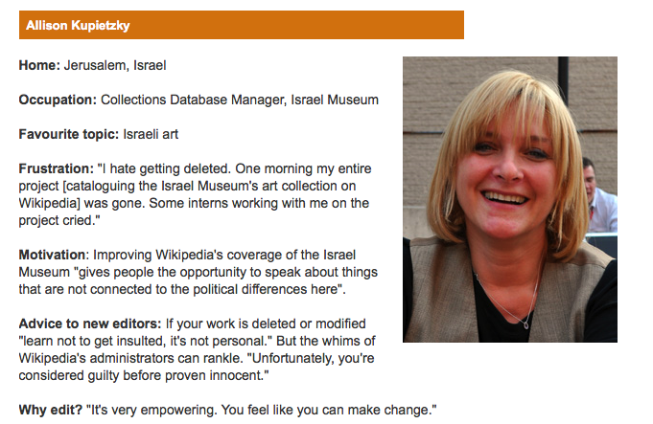
http://www.bbc.co.uk/news/magazine-18833763

Slide 11
‘We do it for love’
Ross McGuiness (12.10.12) ‘The Wikid side of the internet’ in Metro (yes- the free one on the bus)
(Version here: http://www.metro.co.uk/news/newsfocus/914761-edits-on-winehouse-skrillex-and-wile-e-coyote-the-role-of-a-wikipedian)
Insights from Dave Gerard, Wikipedian, on the 17 million resgistered Wikipedia users
‘We do it because it’s our idea of fun but it feels good to be doing something that people actually use.’
‘The volunteer editors really care about they’re doing. We’re amateurs, we do it for love and we care about getting it right.’

Slide 12
Wikipedians
http://www.youtube.com/watch?v=UEkF5o6KPNI

Slide 13
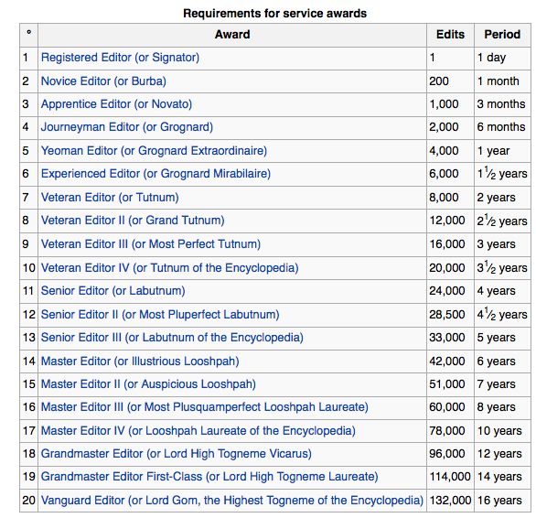
The affordances of Wikipedia: Service awards and constructing a Wiki identity
(http://en.wikipedia.org/wiki/Wikipedia:Service_awards#cite_note-0)
“Service awards are a simple way of acknowledging an editor's level of contribution based on two specific benchmarks: the number of contributions the editor made to Wikipedia and the length of time they have been registered”.

Slide 14
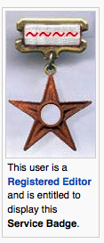
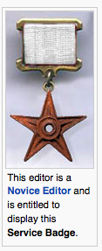
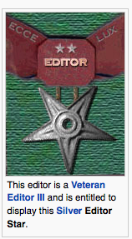
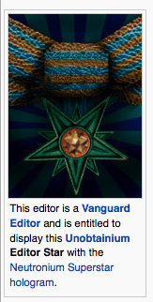
Service awards
‘This is one award that is intended to be given to yourself […] There is no process for receiving these awards; you just determine the award grade to which you are entitled, then display it on your user page’.

Slide 15
Analysis
‘Given that service awards are ‘intended to be given to oneself’ rather than be awarded by others, they point to the investment and work individuals put into their Wikipedia profile and identity’ (Ashton, 2011: online)
It is possible to make the edits - and that is it.
Of interest here is how Wikipedians make edits and then ensure that they gain recognition for doing so.
In this way, they are building and managing their expert Wikipedian identity through the affordances of Wikipedia/the service awards.

Slide 16
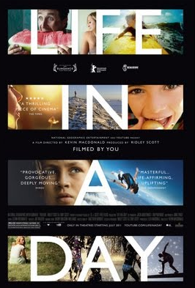
Case study: Life in a Day
How do established forms of power and expertise remain within participatory projects?
In Media International Australia (2015) 154

Slide 17
‘What do you get when you ask the people of the world to chronicle a single day in their lives? You get 80,000 submissions, 4500 hours of footage, from 192 countries. Kevin Macdonald has taken this raw material, all shot on July 24, 2010, and created a 90-minute paean to what it means to be human in the world today.’
https://www.youtube.com/watch?v=bT_UmBHMYzg

Slide 18
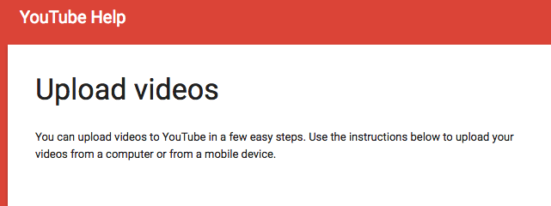
The affordances of YouTube: Crowdsourcing a documentary

Slide 19
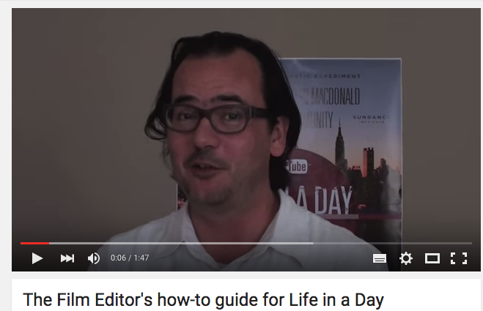
http://www.youtube.com/watch?v=1nIIVH0R0kY
‘Making Your Film for Inclusion in Ours’

Slide 20
‘Responses to ‘Film Editor’s Guide to Life in a Day’

Slide 21
Analysis
Identifies ‘tensions around power and expertise’ and argues ‘potential contributors were cynical of their involvement as “sources” providing content for media professionals to use, and saw the guidance from the production team as attempts to limit their creative agency and the possibilities for self-representation.’
(Ashton, 2015: 109)
The affordances of YouTube can see a crowdsourced documentary be produced, but we must remain mindful of how that process is structured and operationalised.

Slide 22
Summary and thanks
Interest in frameworks and affordances (e.g. Wikipedia and service stars; YouTube and a crowdsourced documentary project)
Examine the implications of these for participating individuals and their sense of who they are and what they can do.
https://www.flickr.com/photos/joealterio/6148881840

Slide 23
REFERENCES
Ashton, D. (2011) "Awarding the self in Wikipedia: Identity work and the disclosure of knowledge", First Monday, 16(1)
Ashton, D. (2015) ‘Producing participatory media: (Crowd)sourcing content in Britain/Life in a Day’, Media International Australia. Special Issue on ‘Making Media Participatory’. 154: 101-111.
Ashton, D. (2017) ‘Digital Stories, Participatory Practices and Life/Britain in a Day: Framing Creativity and Debating Diversity’, in Chapain, C., Comunian, R. and Malik, S. (eds.) Community Filmmaking: Diversity, Innovation, Policy and Practice. London: Routledge.
Jenkins, H. (2006) Confronting the Challenges of Participatory Culture. MacArthur.
Marwick, A.E. (2015) ‘You May Know Me from YouTube - (Micro-) Celebrity in Social Media’, in Marshall, P.D. and Redmond, S. (eds.) A Companion to Celebrity. Wiley-Blackwell, pp. 333-350.
Meikle, G. and Young, S. (2012) Media Convergence. Basingstoke: Palgrave Macmillan.
Van Dijck, J. (2009) ‘Users like you? Theorizing agency in user generated content’, Media, Culture & Society 31(1): 41-58.
FURTHER READINGS
Benkler, Y. (2006) The Wealth of Networks. New Haven: Yale University Press.
Jenkins, H., Ford, S., and Green, J. (2013). Spreadable Media: Creating Value and Meaning in a Networked Culture. NYU Press.
Schäfer, M. (2011) Bastard Culture! how user participation transforms cultural production. Chicago: University of Chicago Press.

