Slide 1
Scientific Research
A “Social Machine” of experienced researchers an technology
Jeremy Frey

Slide 2
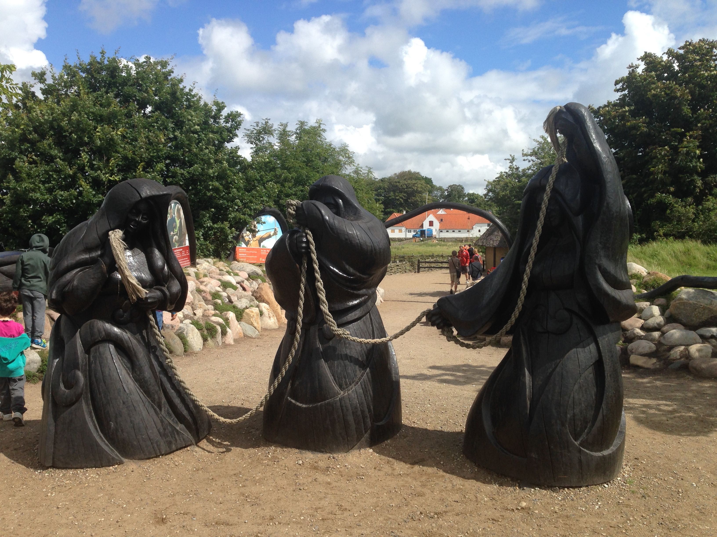
Past, Present and Future
The three Norns (Fates)

Slide 3
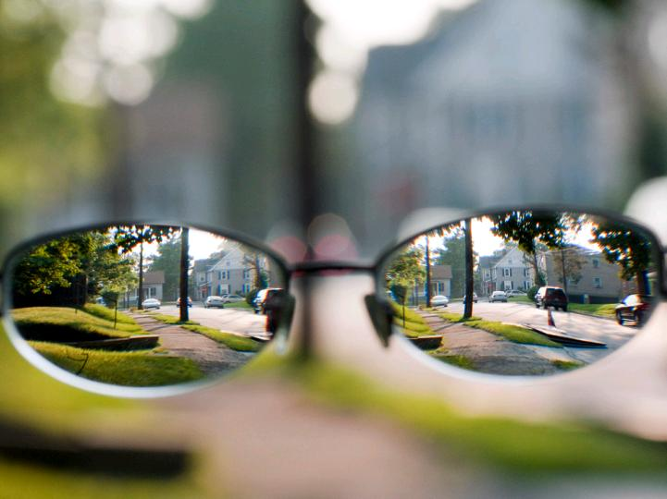
Vision
Chemistry
Digital
Chemistry
“What we live in and on ..”
Digital Technoscape
“The way we live …”
cc: haglundc - https://www.flickr.com/photos/86676407@N00
Notes:
New ways for the digital community to work with the environmental science & engineering communities in supporting the way we adapt to living with environmental change.

Slide 4
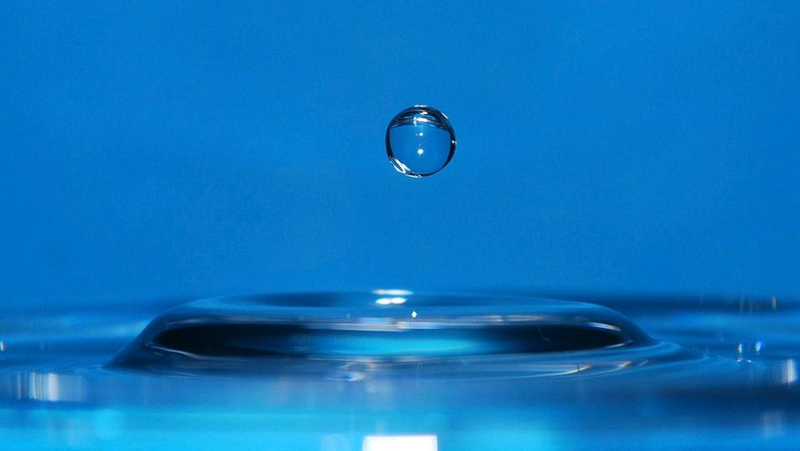
PURE
cc: larces - https://www.flickr.com/photos/23629727@N02

Slide 5
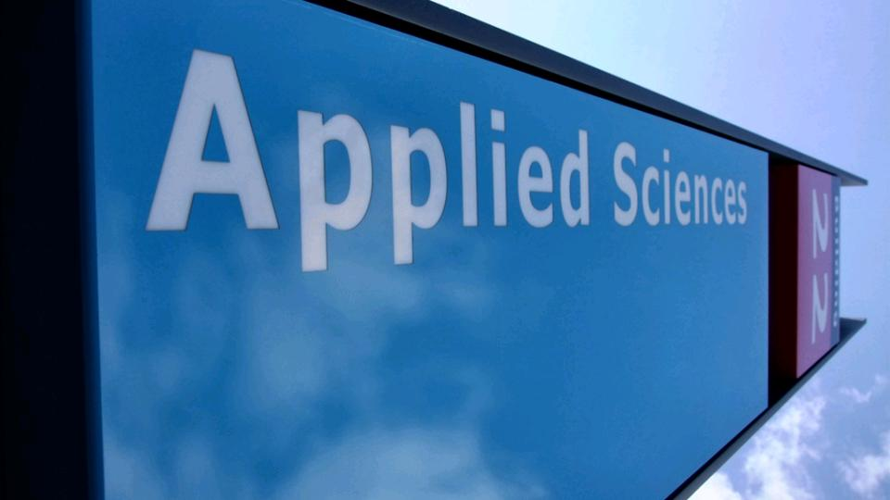
APPLIED
cc: Gerard Stolk (vers le Carême) - https://www.flickr.com/photos/20762304@N00

Slide 6
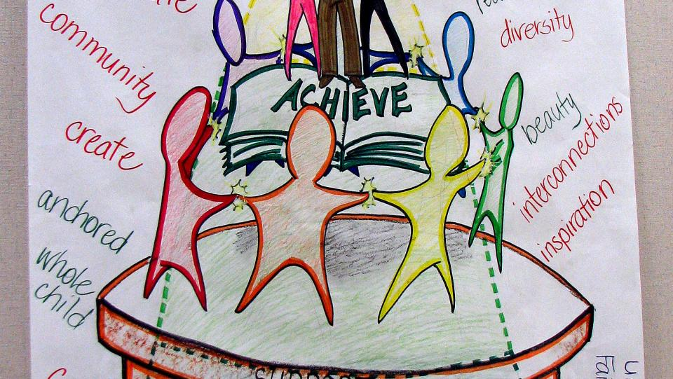
RELATIONSHIPS
cc: tuchodi - https://www.flickr.com/photos/35034360491@N01

Slide 7
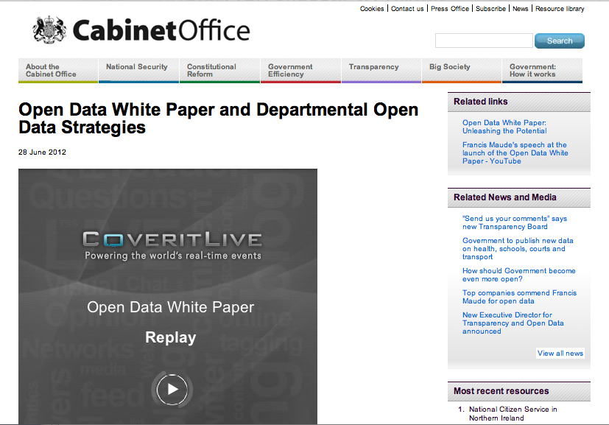
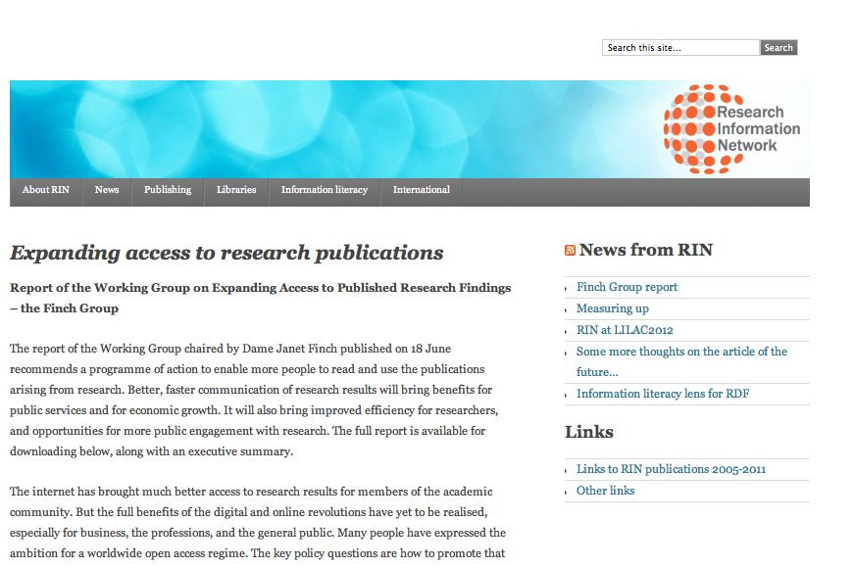
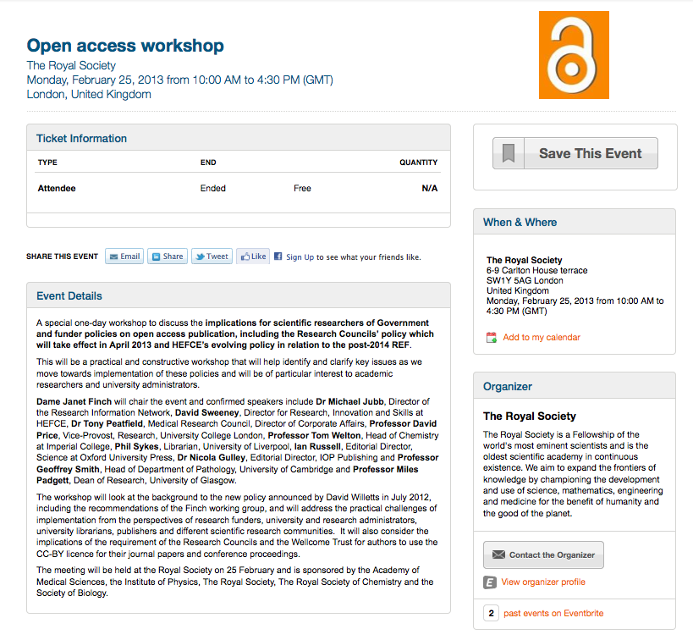
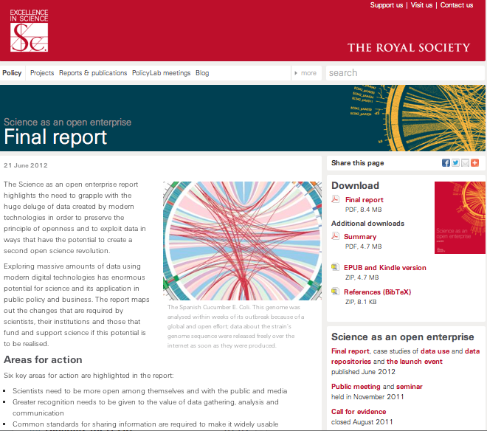
Intelligent Open Access to Data

Slide 8
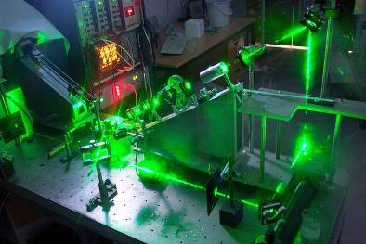
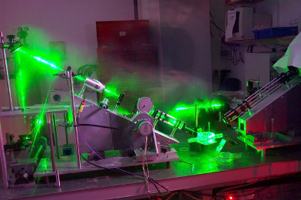
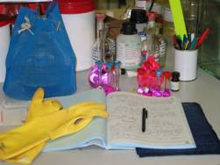
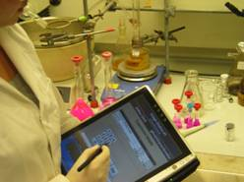
“The Laboratory”
A laboratory is an Integration of people and equipment
A complex socio-technical system
Disrupted or integrated by digital infrastructure?
How to support (a) people to do what they are best at doing and (b) computers to undertake what they can do best and (c) ensure that they can work together.

Slide 9
Contexts
Digital context for human action
Human context for computational processes
To support provenance and trust of the laboratory process
Ensure discovery, integration and validation of data and information

Slide 10
Reproducibility
How to ensure reproducibly?
How to preserve provenance?
How to acquire trust?
How to retract incorrect information
Open Notebook Science
Citizen science vs Expert Science

Slide 11
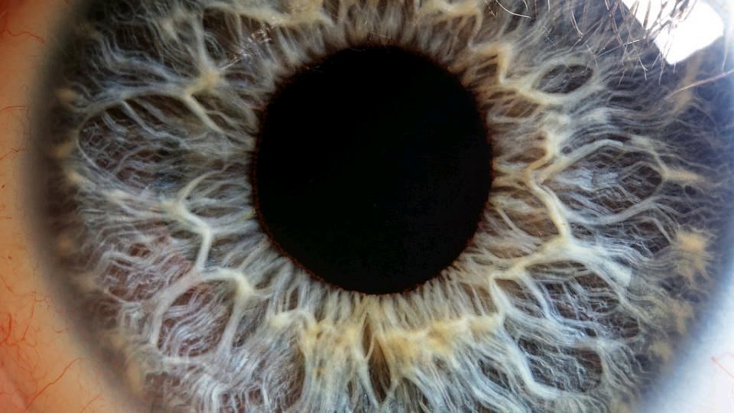
HUMAN
cc: Macroscopic Solutions - https://www.flickr.com/photos/107963674@N07

Slide 12
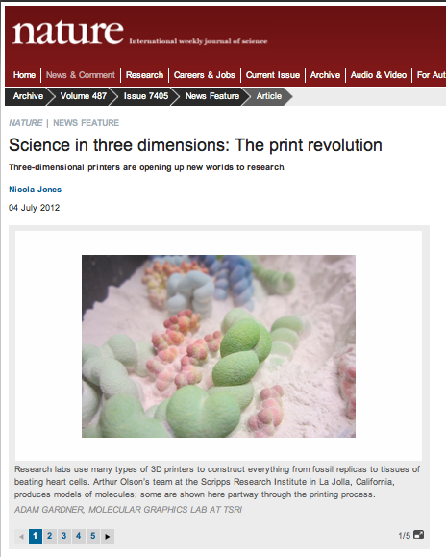
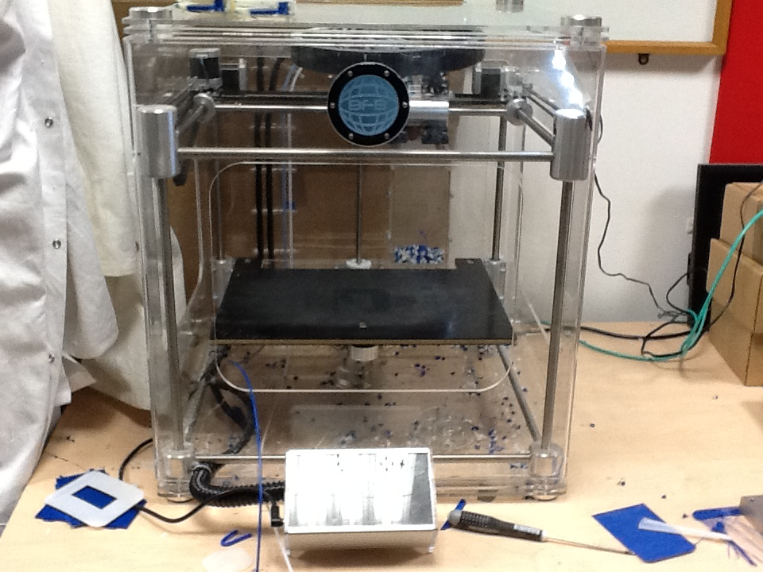
Change in the whole way we design and build
3D Printers: A radical change to the
experimental section of a paper!

Slide 13
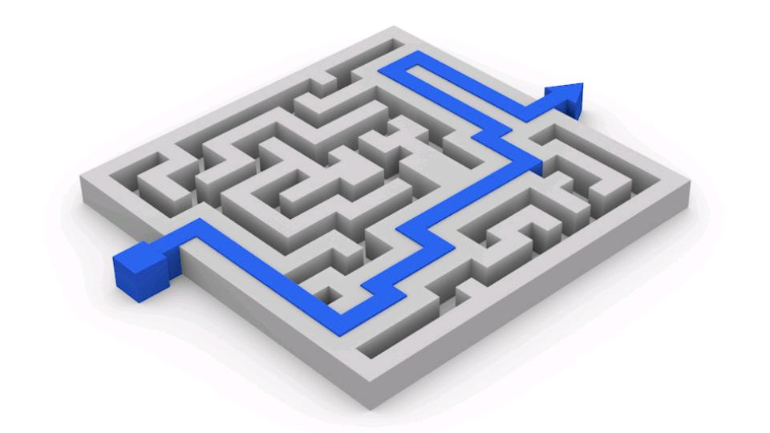
DATA DRIVEN
cc: FutUndBeidl - https://www.flickr.com/photos/61423903@N06

Slide 14
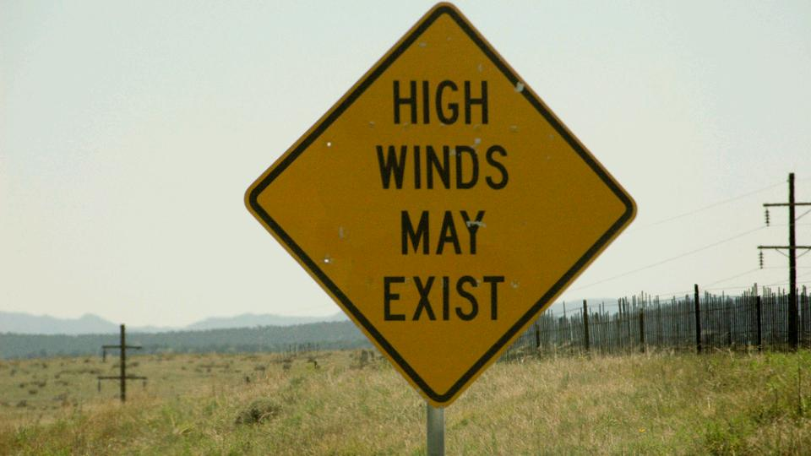
Ontology
cc: Rich Anderson - https://www.flickr.com/photos/99105016@N00

Slide 15
Collaborations
Impact of collaborative challenges
Maths “Project Polymath”
Games “Foldit”
Analytics “Kaggle”
How does this influence value and trust?

Slide 16
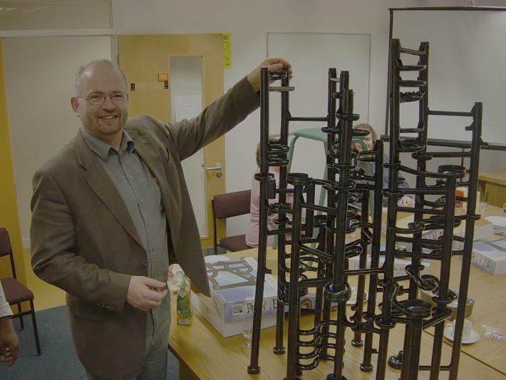
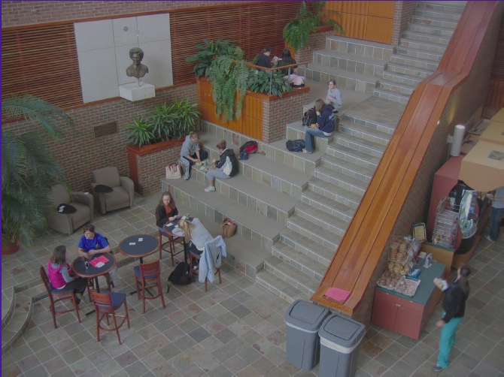
How do we communicate?
If you can't describe what you are doing as a process, you don't know what you're doing.
W. Edwards Deming
Surprisingly difficult to explain what a process involves
Much of the detail is assumed to be understood and not explicitly discussed
This is where the miss-understandings usually arise.
Growing need for the global (virtual) equivalent of the
“Tea Room”

Slide 17
Semiotic Web
We have the document Web
We have to some extent the Web of Data
We have to a little extent the Semantic Web of relationships
We all interact with the Semiotic Web via the signs and symbols used in the human – Web interface
But social, cultural, language, background influences on the interpretation is poorly understood

Slide 18
OPEN Notebook Science

Slide 19
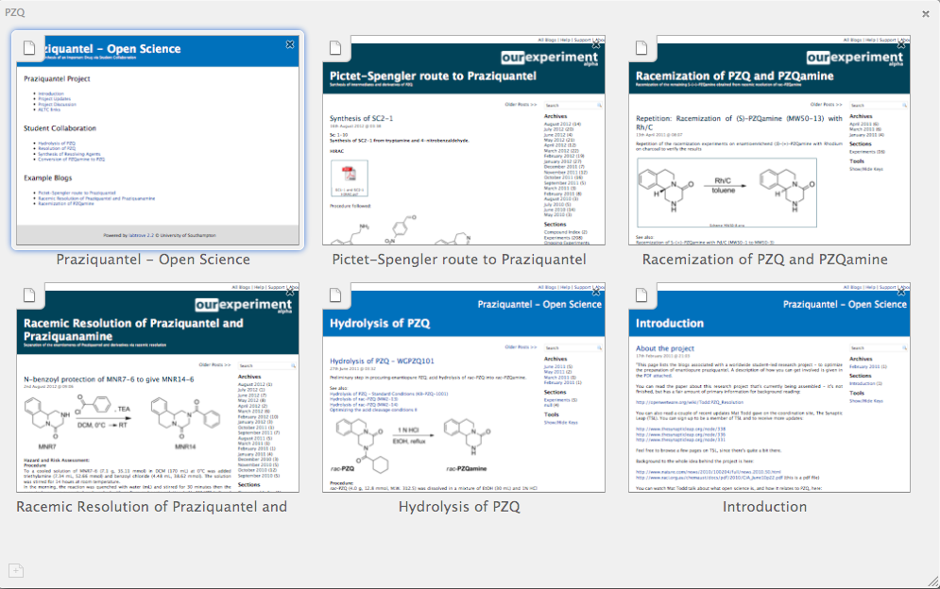
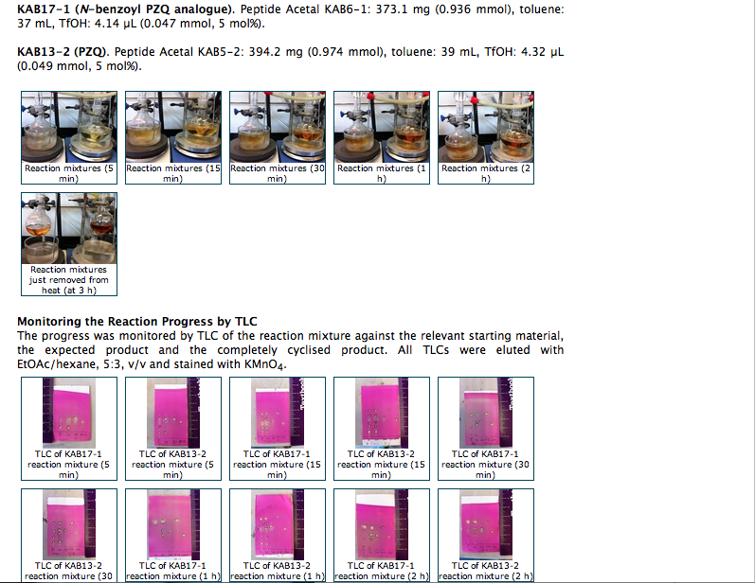
LabTrove Open Notebooks Mat Todd’s PZQ Project

Slide 20
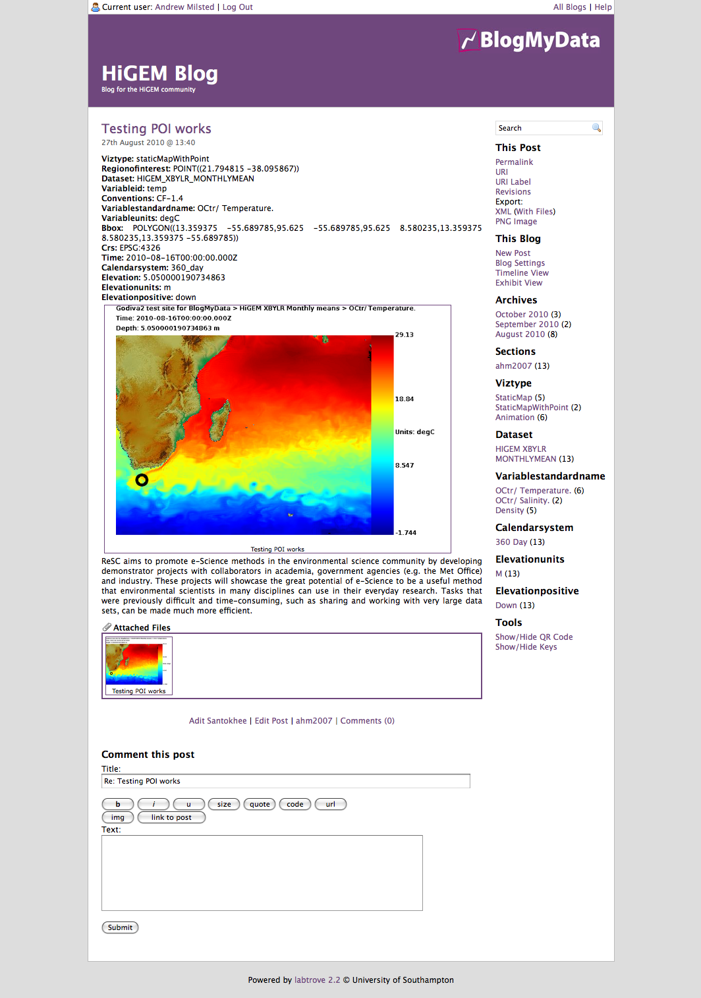
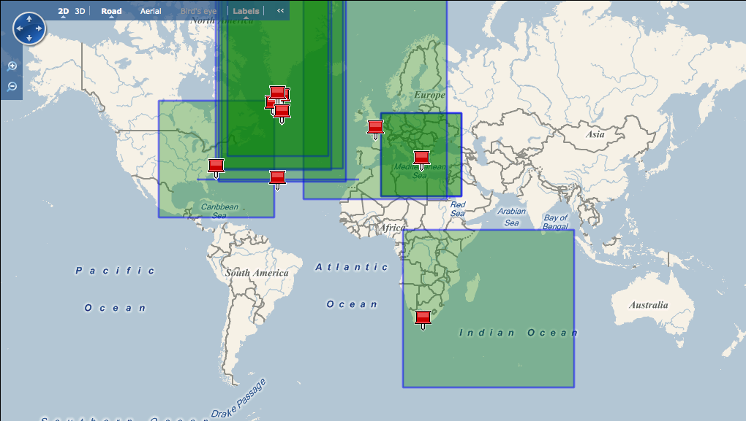
BlogMyData Project - Godiva

Slide 21
Laboratories of the Future

Slide 22
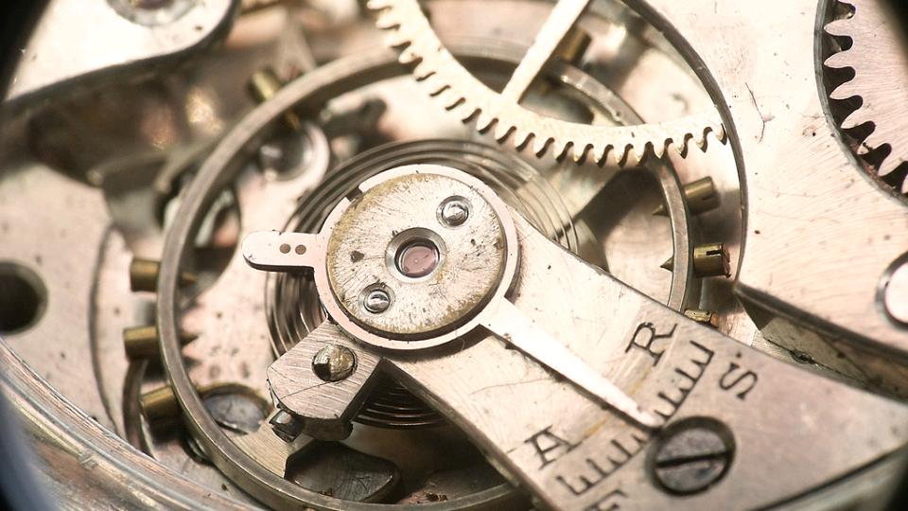
MACHINE
cc: Pierre J. - https://www.flickr.com/photos/7969902@N07

Slide 23
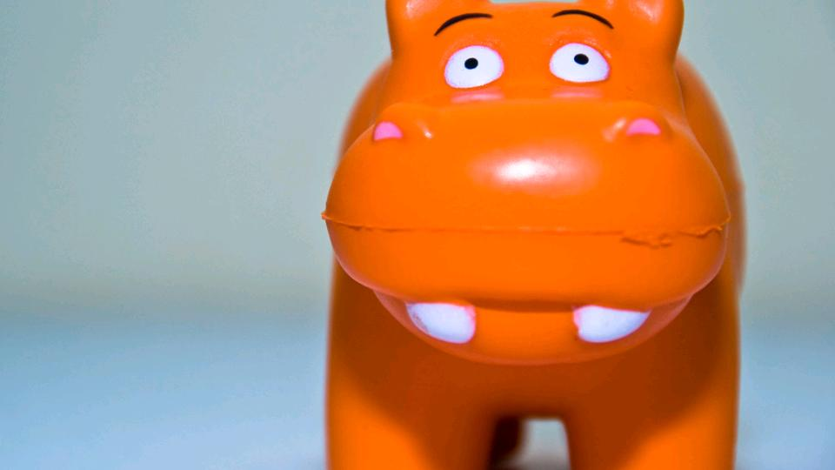
INTELEGENT
cc: --Filippo-- - https://www.flickr.com/photos/71882589@N00

Slide 24
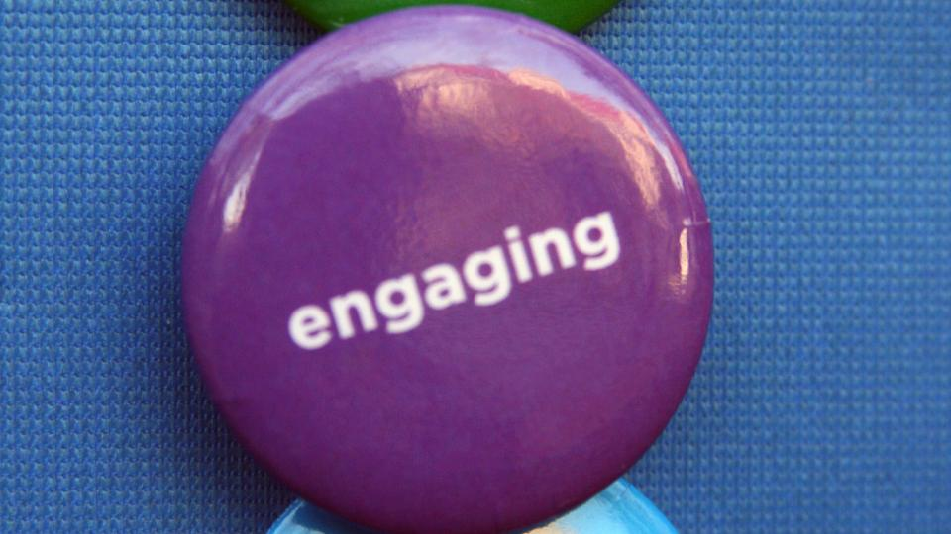
COMMUNITY
cc: quinn.anya - https://www.flickr.com/photos/53326337@N00
Notes:
For IUPAC to re-engage with its roots in industry given the importance of open “intelligent access” for innovation

Slide 25
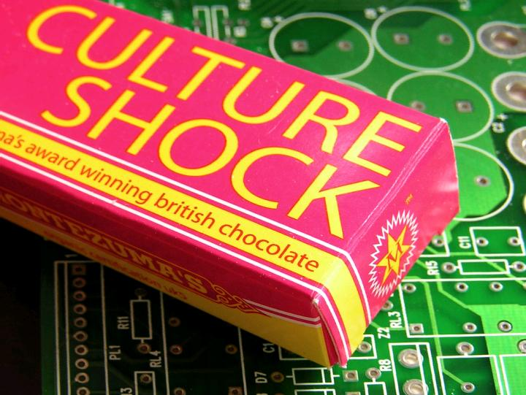
Culture
cc: jovike - https://www.flickr.com/photos/49503078599@N01

Slide 26
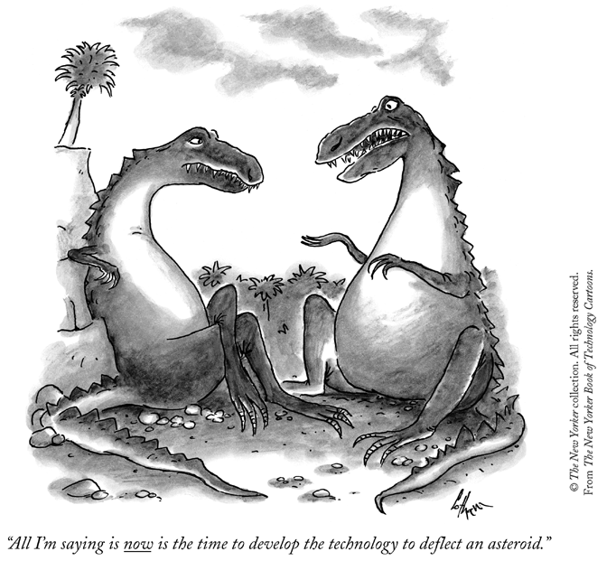
We must speed up the knowledge discovery process
All I am saying is that now is the time to develop the technology to deflect an asteroid

