Slide 1
TOPICS in SOCIO-technical systems: examples from citizen science
Elena Simperl e.simperl@soton.ac.uk @esimperl
November 21th, 2016

Slide 2
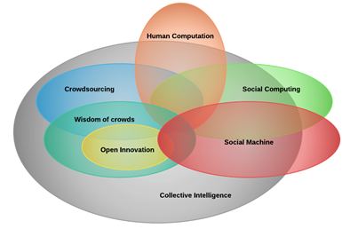
Social machines
Systems bringing together human/social and machine capabilities, empowered by the Web

Slide 3
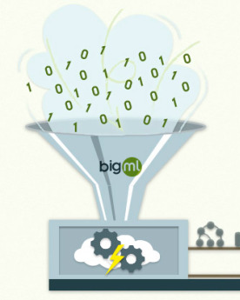
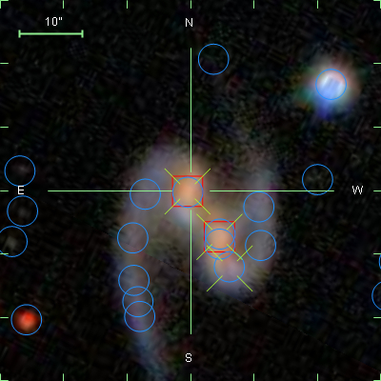
Citizen science as a social machine

Slide 4
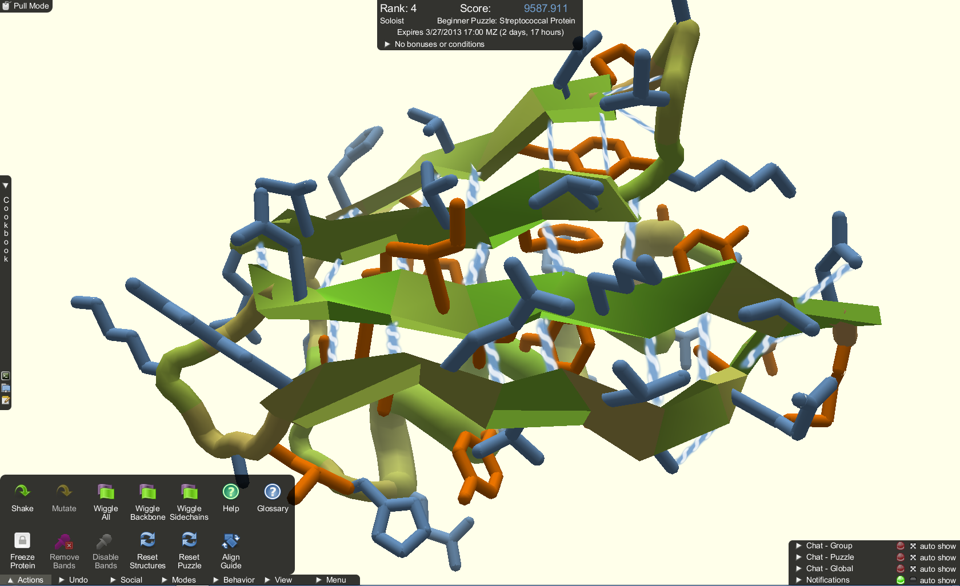
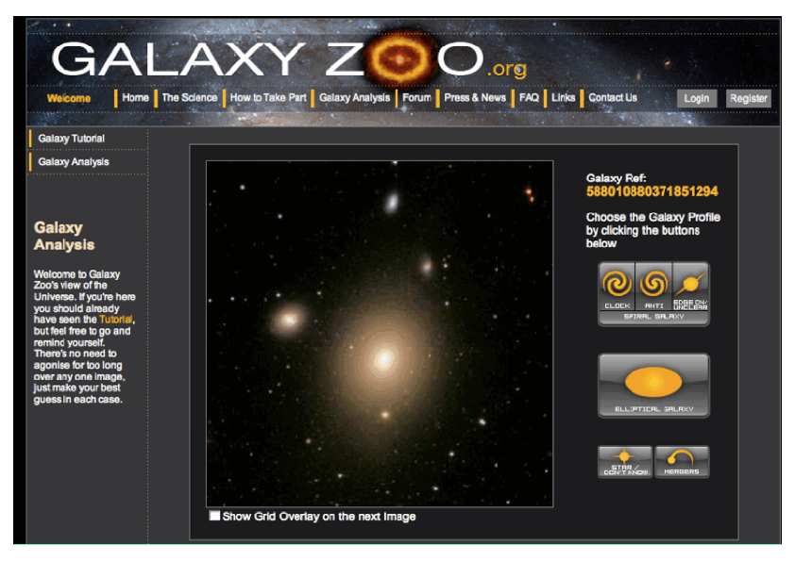
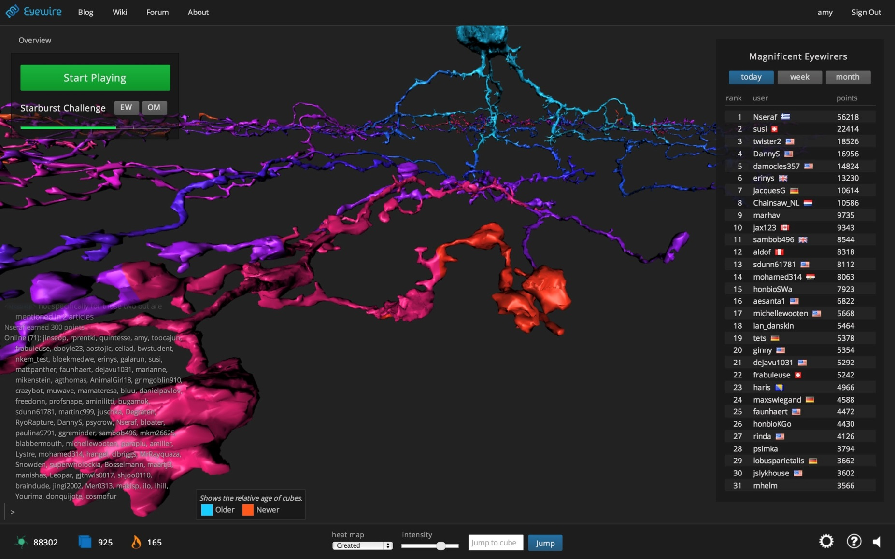
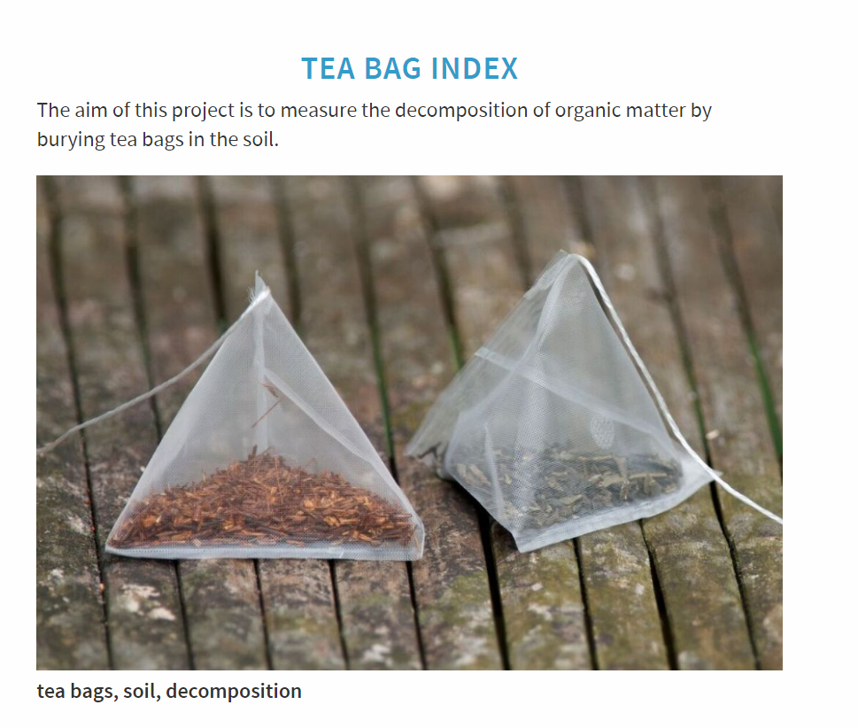
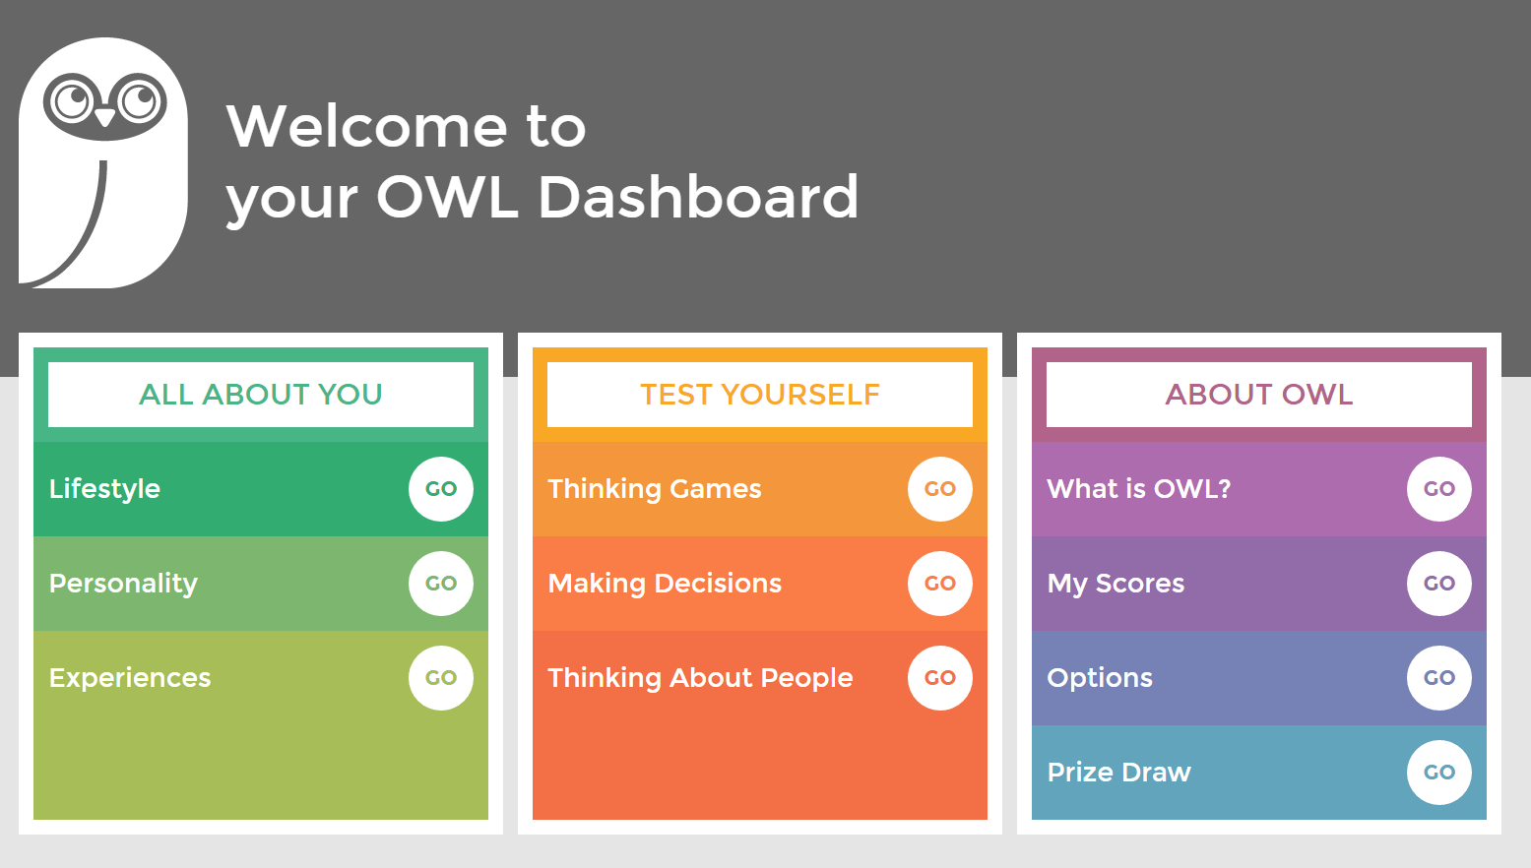
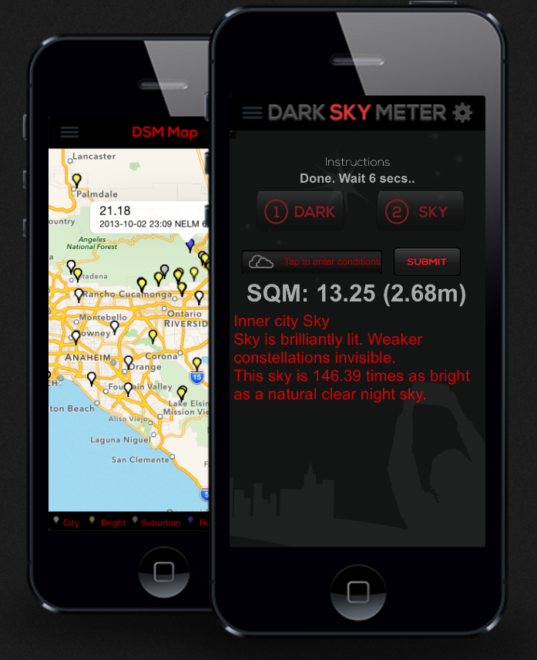
Citizen science projects

Slide 5
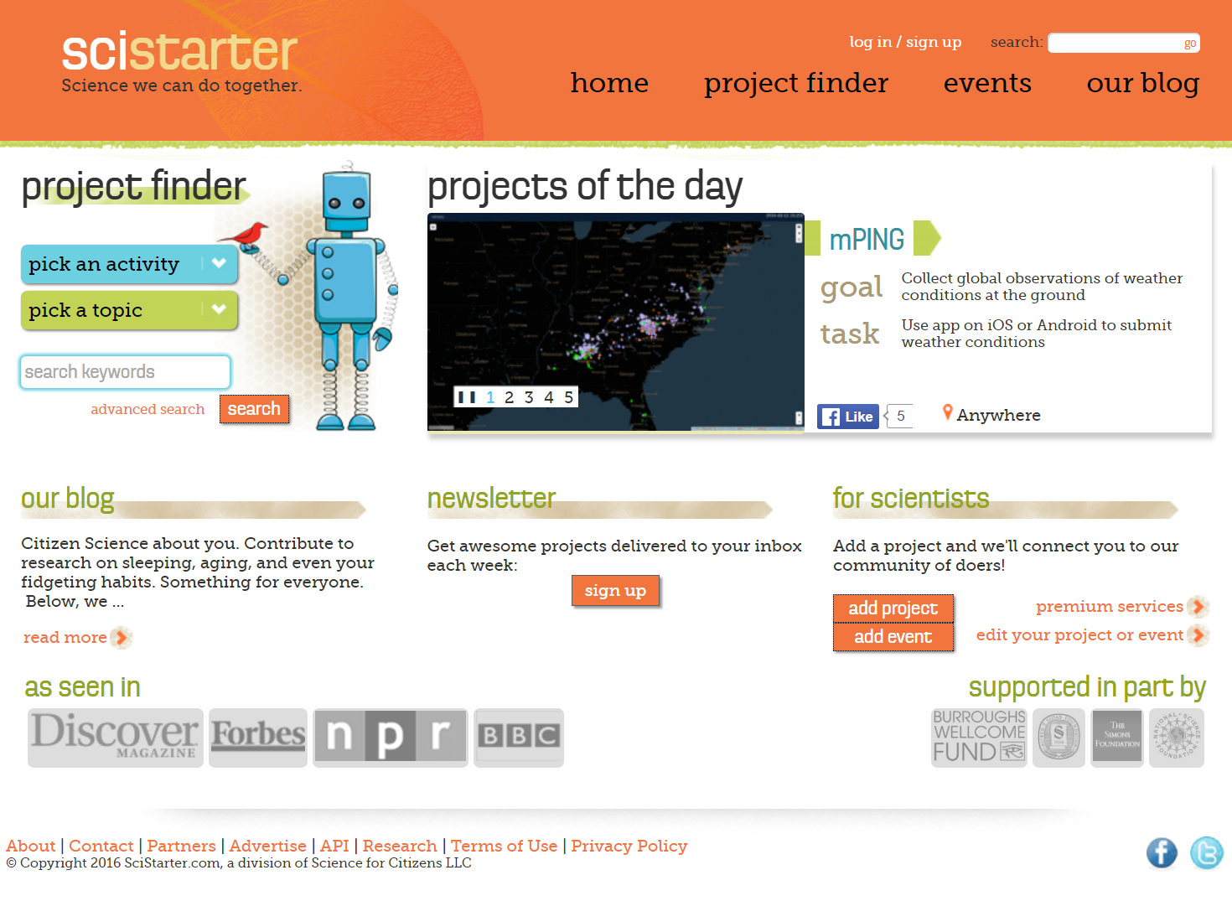
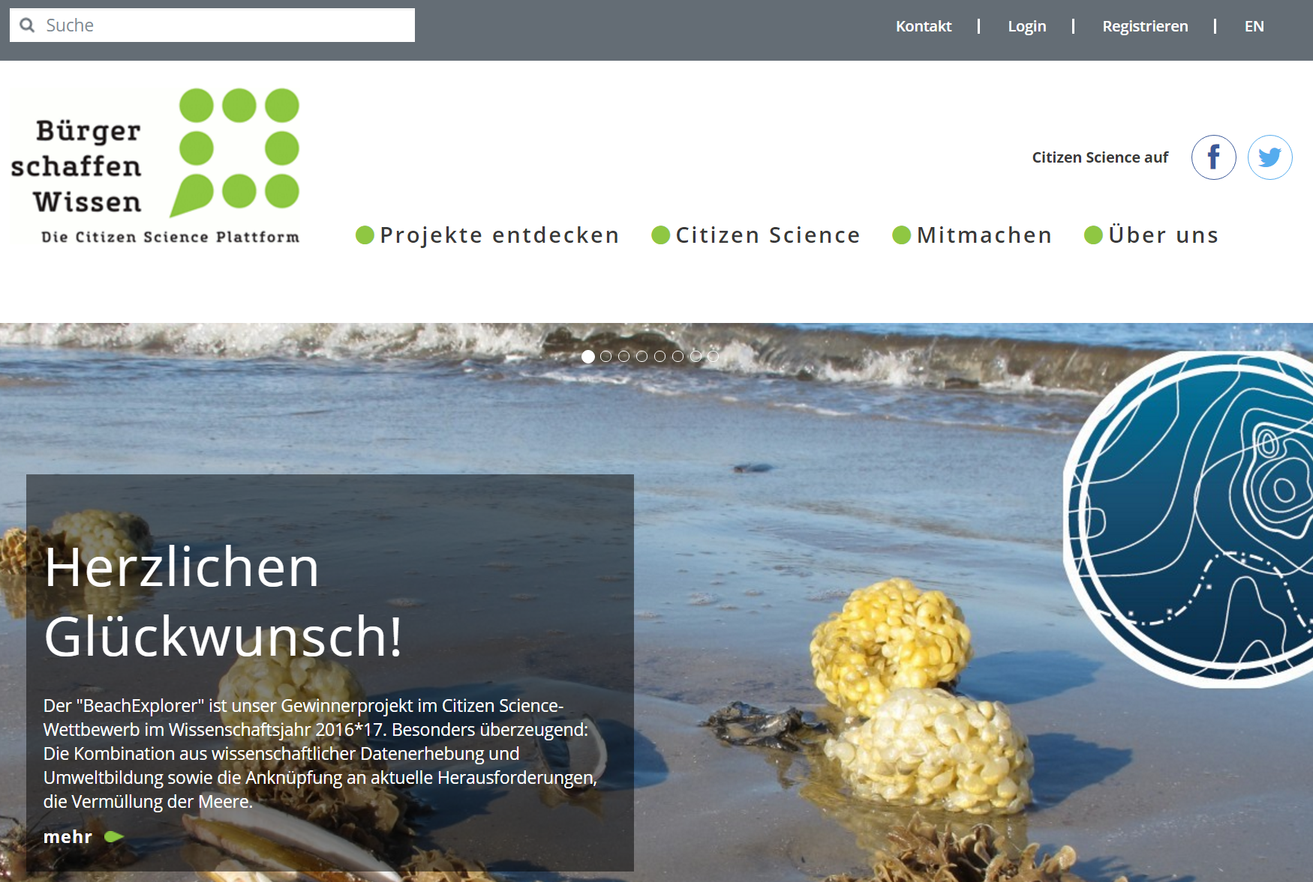
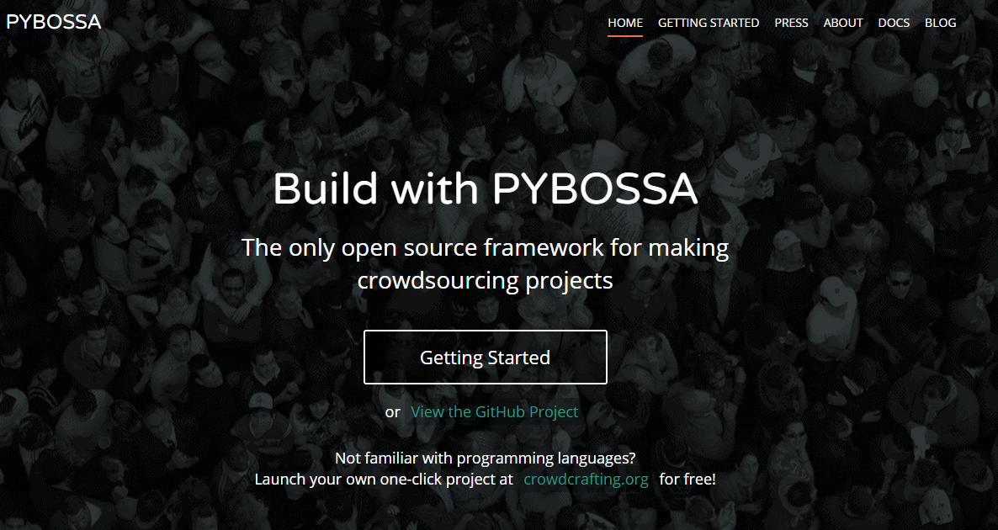
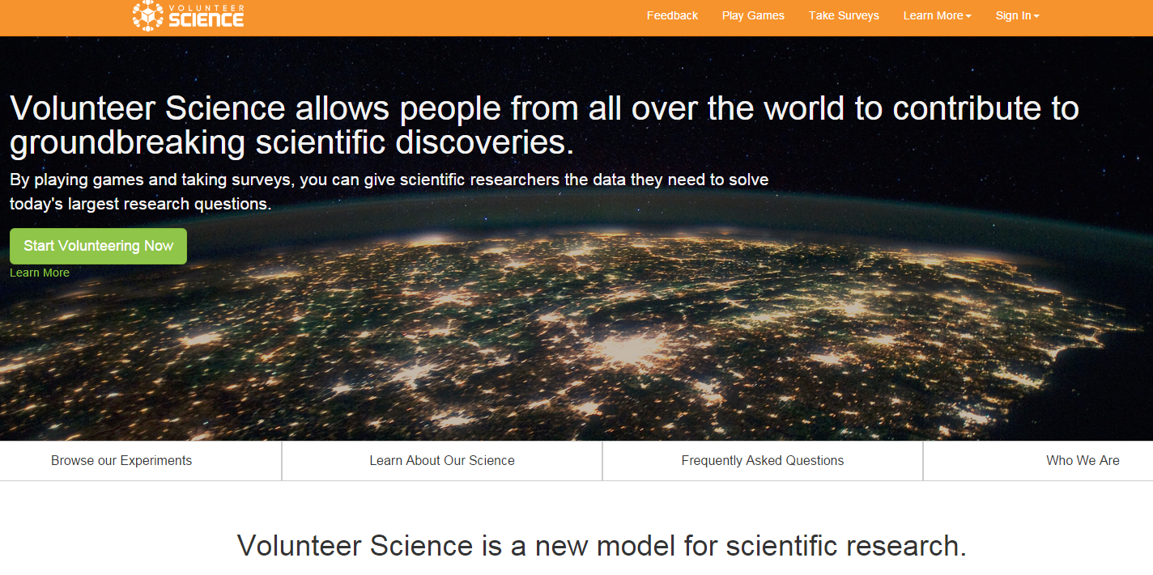
Citizen science platforms

Slide 6
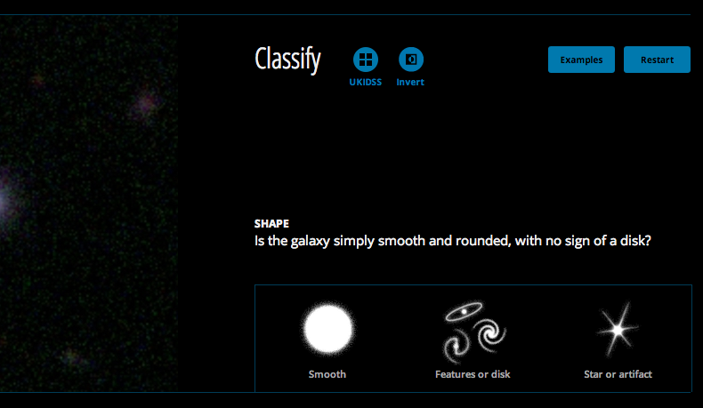
Studying citizen science: human computation & CrowdSOurcing
Task design
Task assignment
Answer validation and aggregation
Contributors’ performance
Motivation and incentives

Slide 7
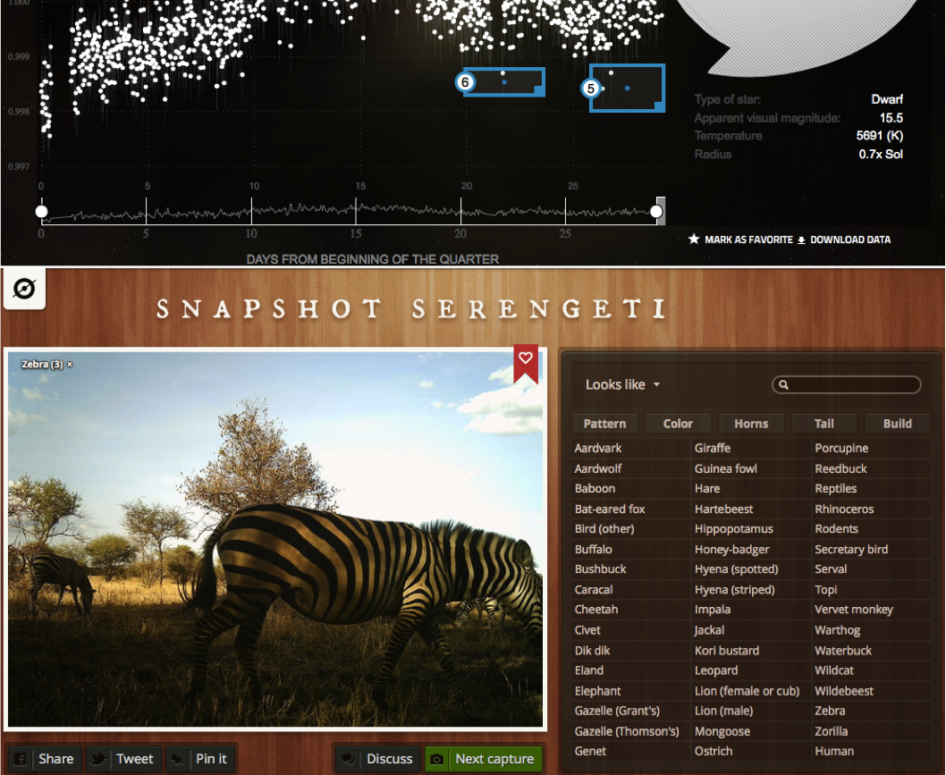
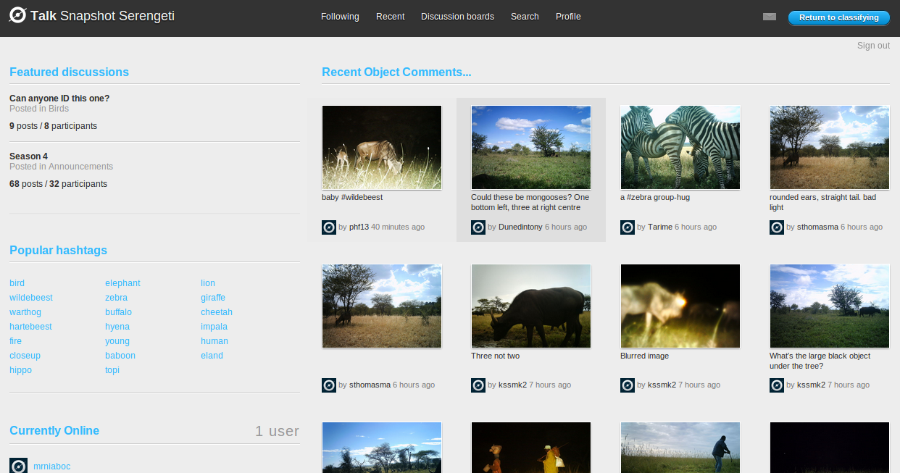
Studying citizen science: online community
Roles and activities
Patterns of participation
Community health
Motivation and incentives

Slide 8
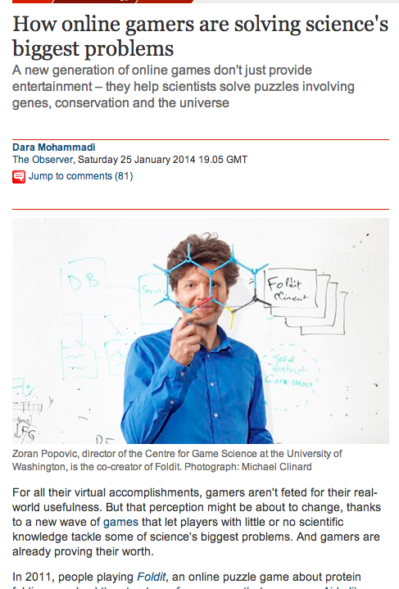
Studying citizen science: open Science
Scientific workflows
Scientific practice
Publishing, citation, and peer-review models

Slide 9
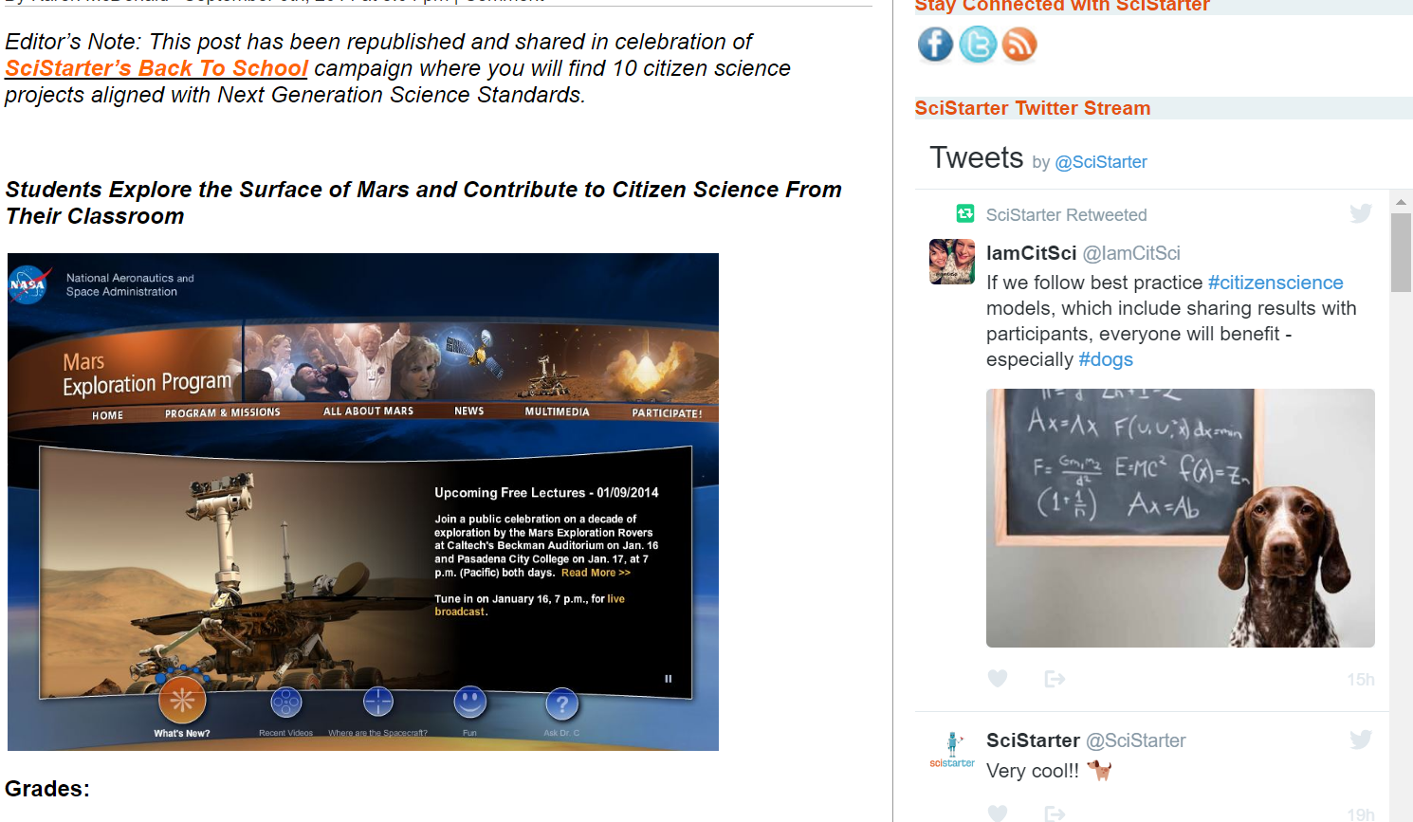
Studying citizen science: education and sciComm
Teaching methods and assessment
Tutorial design
Learning analytics
Engagement strategy

Slide 10
When makes citizen science successful
tasks
people
time
quality
science
community
learning
social media
…

Slide 11
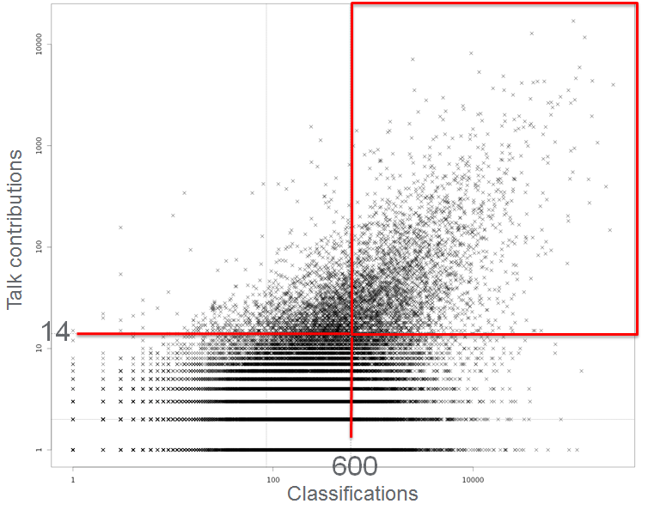
Levels of engagement
~1% of participants contribute 72% of Talk & 29% of Task
[Luczak-Roesch et al., 2014]

Slide 12
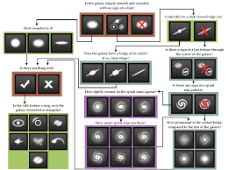
Data quality
Existing quality inference algorithms are limited to binary classification
Conceptualise the problem for realistic workflows
Develop efficient implementations of algorithms and compare them

Slide 13
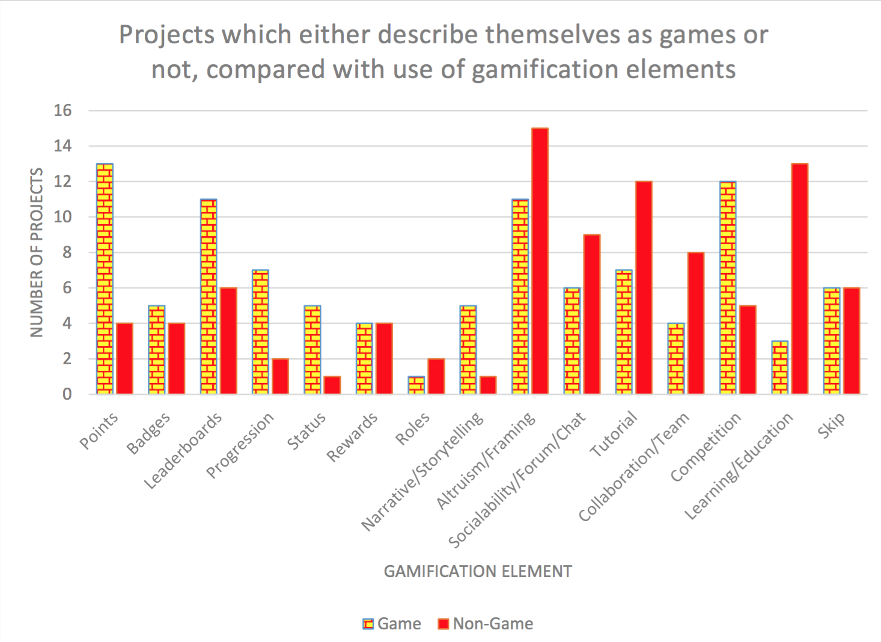
Gamification
Survey of 27 papers &
31 VCS projects

Slide 14
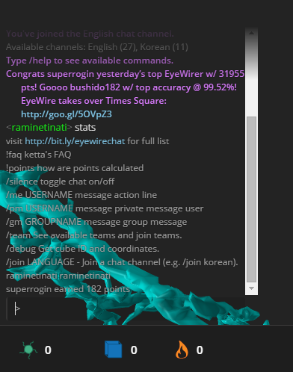
Sociality
Discussions and engagement with volunteers are integral part of the experience
Leads to serendipitous scientific discoveries
Encourages autonomy and helps with community building

Slide 15
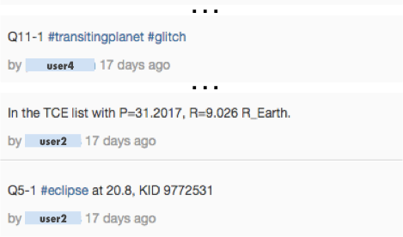
Chat and instant messaging
10
Microposts
91%
8
6
4
2
0
PH
SG
SW
NN
GZ
CC
PF
SF
AP
WS
[Luczak-Roesch et al., 2014; Tinati et al., 2015, WebSci]

Slide 16
Discussion profiles
Highly active thread starters and answerers across a wide range of topics
1
2.8%
First to respond and question answerers
Highly active thread starters and first to reply back
4
1%
2
14.6%
Long active volunteers (the core group), posting sporadically
Thread followers and PM (one-to-one) talkers
Watcher and starter of many threads, but not first to reply
8
0.4%
3
6.5%
6
69.0%
Content producers, posting across many boards and threads
Infrequent volunteers, single thread posts, no personal messages
7
0.1%
5
5.5%
Deeply engaged volunteers, few threads but multiple posts within them
9
0.1%
[Tinati et al., 2015, WebSci]

Slide 17
From projects to ecosystems
Project A
Participant X
Project B
Part. Y
Project C
[Luczak-Roesch et al., 2014]

Slide 18
What’s next?
Human computation & crowdsourcing
Task assignment: what tasks are interesting/relevant for whom?
Data quality: scalable and in real-time
Peer review, collaborative approaches
The role of gamification: is science a game?
Online community
Making discussions more effective
Science
Citizen science platforms that everyone can use
New forms of publishing, citation, reproducibility, and replication
Education
Tutorial design
Learning analytics

Slide 19
e.simperl@SOTON.AC.UK @esimperl www.sociam.org www.stars4all.eu
All publications available at http://dblp.uni-trier.de/pers/hd/s/Simperl:Elena_Paslaru_Bontas

