Slide 1
Introduction to
Kelly Terrell, EPrints Open Education Lead University of Southampton
@KellyATerrell K.Terrell@soton.ac.uk
#EdShare

Slide 2
EPrints HQ in the Web Science research labs at University of Southampton
Notes:
Brief introduction
Working in an enterprise group within the research labs in ECS –EPServices
We manage the core EPrints software which is open source and free
We provide a number of bespoke solutions and paid for services to support this work
We are not for profit, so this model ensures the continued support and development of the core software
POLL: Who in the room has heard of Eprints
POLL: Who in the room has heard of EdShare
Nearly 10 years ago, and a number of key people in these labs came together to start up a project called EdSpace

Slide 3
@KellyATerrell
www.edspace.ecs.soton.ac.uk
Notes:
Early 2007 - Uni. Of Soton project, some funding from Jisc as part of the Institutional Exemplars programme
Need for single system to hold all manner of teaching and learning resources and encourage sharing and collaboration across the university
Although the primary purpose was needs of the institution, choices made by the team quickly resulted in an offering well suited to sharing content openly:
OER activity was acknowledged and of interest to the group but was not the primary purpose
Eprints was selected due to it’s open source design and it’s support for all content types

Slide 4
@KellyATerrell
www.edspace.ecs.soton.ac.uk
Notes:
Early 2007 - Uni. Of Soton project, some funding from Jisc as part of the Institutional Exemplars programme
Need for single system to hold all manner of teaching and learning resources and encourage sharing and collaboration across the university
Although the primary purpose was needs of the institution, choices made by the team quickly resulted in an offering well suited to sharing content openly:
OER activity was acknowledged and of interest to the group but was not the primary purpose
Eprints was selected due to it’s open source design and it’s support for all content types

Slide 5
@KellyATerrell
www.edspace.ecs.soton.ac.uk
…and more coming soon
Notes:
Early 2007 - Uni. Of Soton project, some funding from Jisc as part of the Institutional Exemplars programme
Need for single system to hold all manner of teaching and learning resources and encourage sharing and collaboration across the university
Although the primary purpose was needs of the institution, choices made by the team quickly resulted in an offering well suited to sharing content openly:
OER activity was acknowledged and of interest to the group but was not the primary purpose
Eprints was selected due to it’s open source design and it’s support for all content types

Slide 6
@KellyATerrell
edShare@GCU
EdShare
…and more coming soon
Notes:
Early 2007 - Uni. Of Soton project, some funding from Jisc as part of the Institutional Exemplars programme
Need for single system to hold all manner of teaching and learning resources and encourage sharing and collaboration across the university
Although the primary purpose was needs of the institution, choices made by the team quickly resulted in an offering well suited to sharing content openly:
OER activity was acknowledged and of interest to the group but was not the primary purpose
Eprints was selected due to it’s open source design and it’s support for all content types

Slide 7
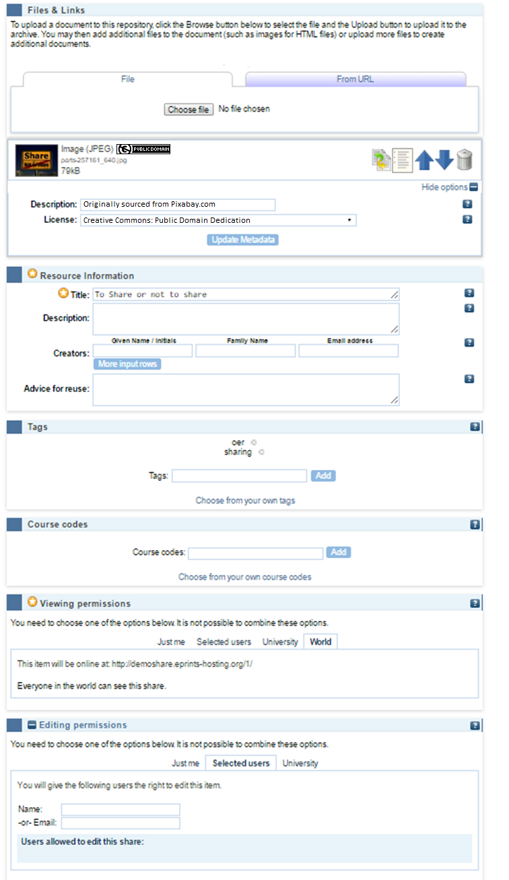
Lightweight workflow
Simple upload
CC licences
Minimal mandatory req
Tags
Viewing permissions
Editing permissions

Slide 8
Lightweight workflow
Simple upload
CC licences
Minimal mandatory req
Tags
Viewing permissions
Editing permissions

Slide 9
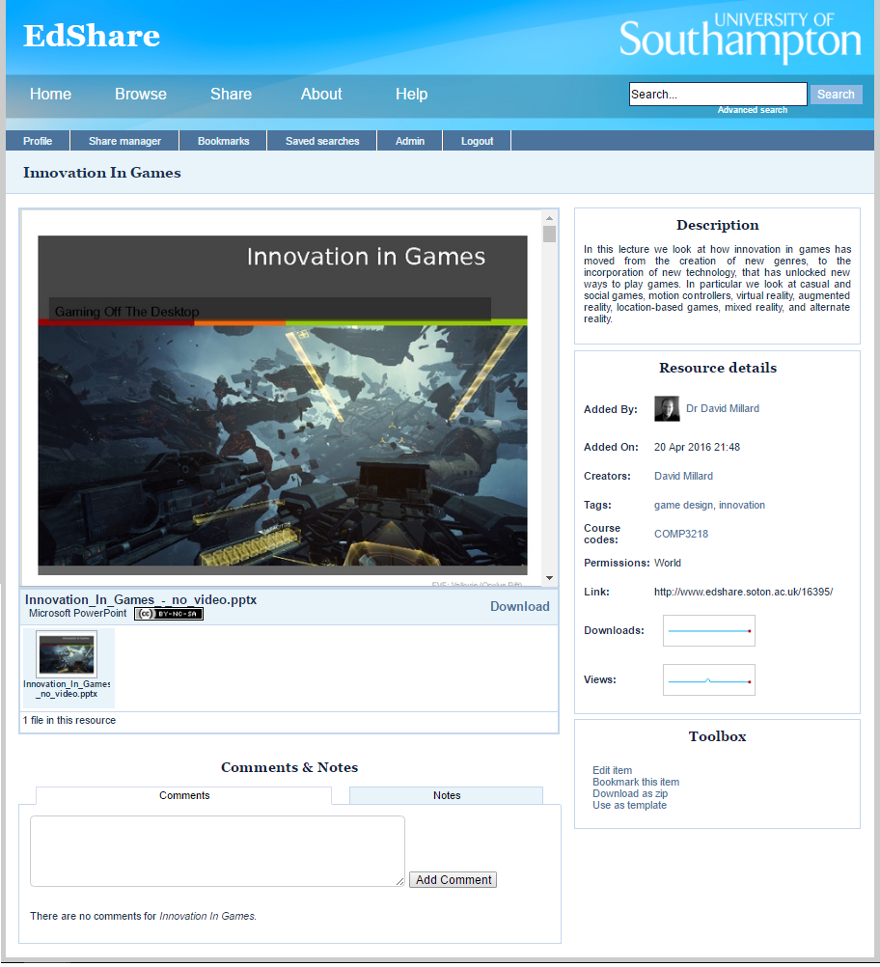
Inline Previews & HTML5 Player
Preview support for a variety of formats
Multiple derivatives (video & audio)
Greater device support
Multiple download options
Embeddable player

Slide 10
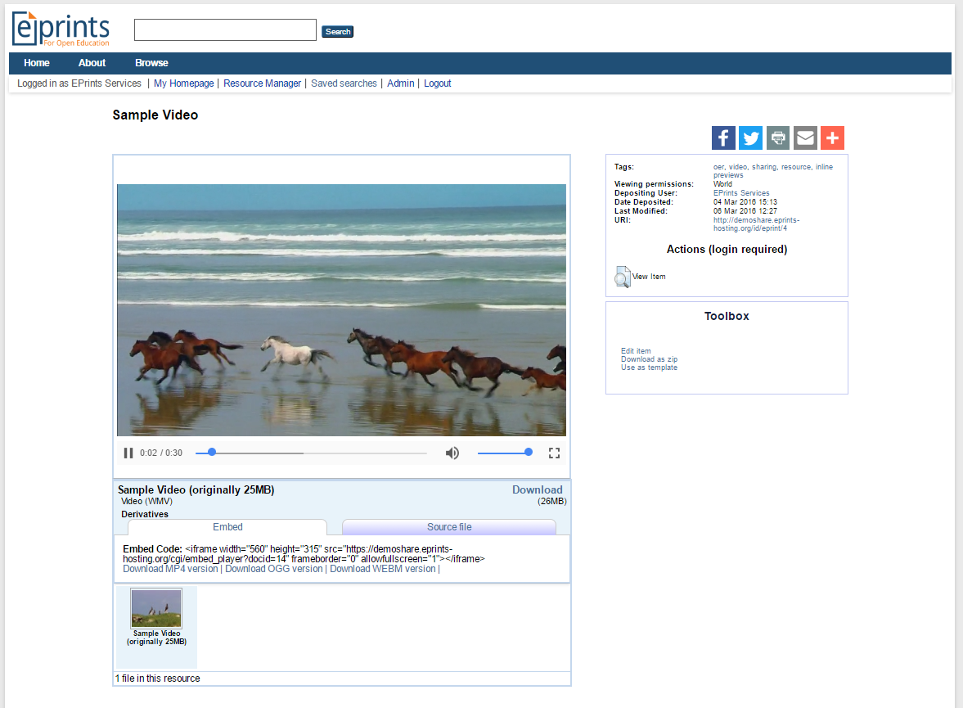
Inline Previews & HTML5 Player
Preview support for a variety of formats
Multiple derivatives (video & audio)
Greater device support
Multiple download options
Embeddable player

Slide 11
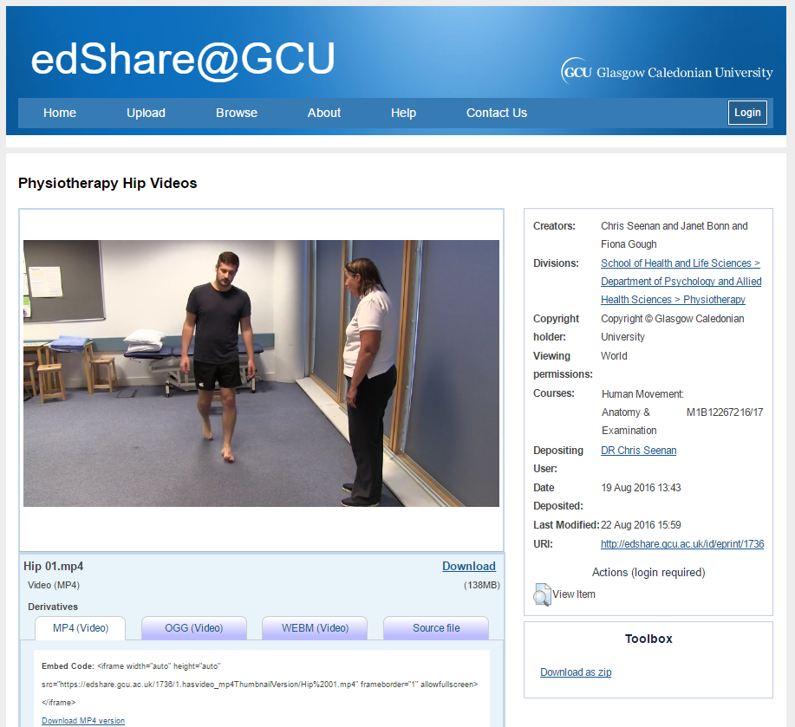
Inline Previews & HTML5 Player
Preview support for a variety of formats
Multiple derivatives (video & audio)
Greater device support
Multiple download options
Embeddable player

Slide 12
Inline Previews & HTML5 Player
Preview support for a variety of formats
Multiple derivatives (video & audio)
Greater device support
Multiple download options
Embeddable player

Slide 13
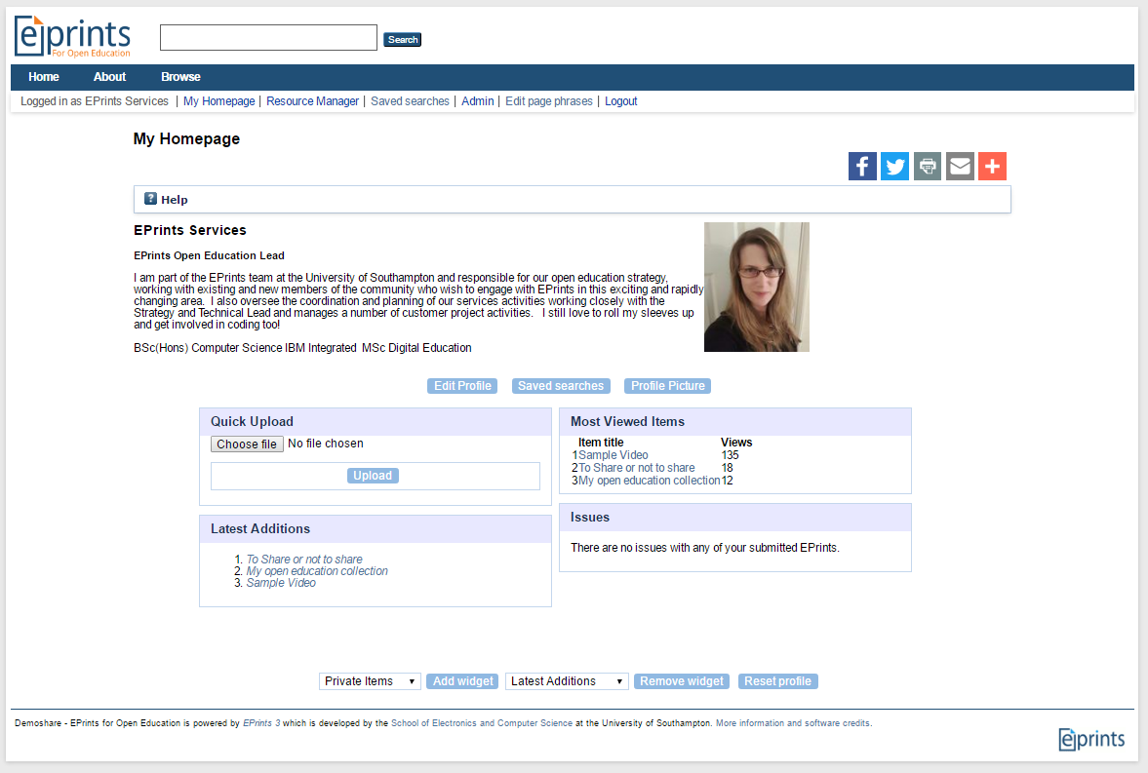
Community
Personalised homepage
Public profile page
Add private notes to resources
Public comments

Slide 14
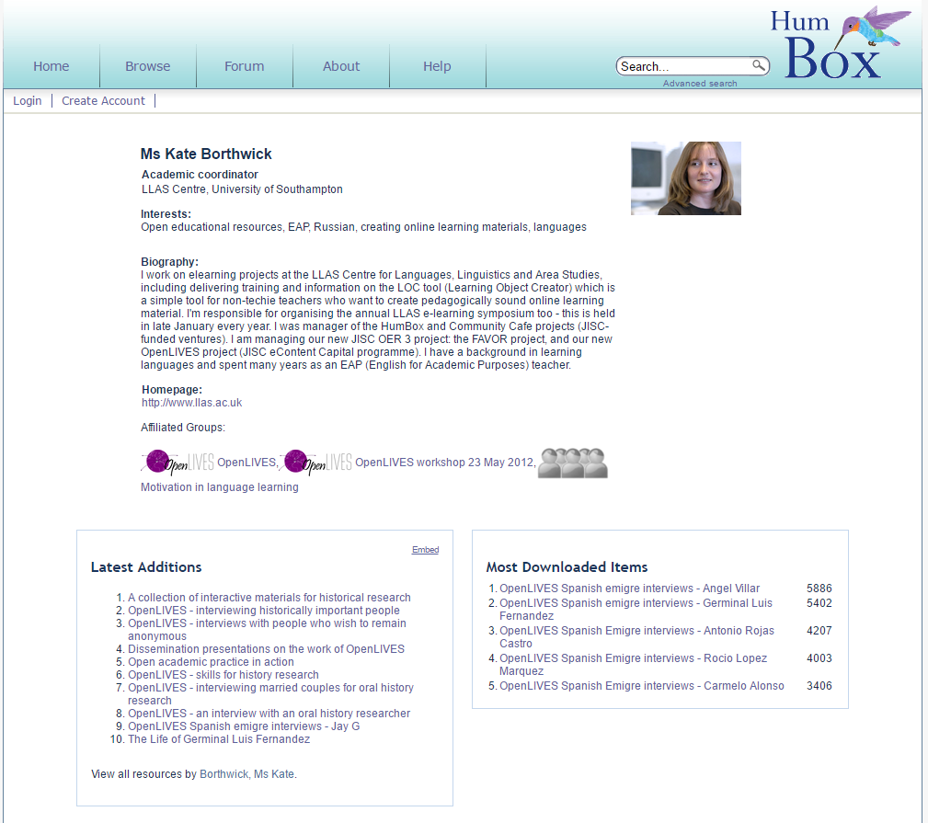
Community
Personalised homepage
Public profile page
Add private notes to resources
Public comments

Slide 15
Community
Personalised homepage
Public profile page
Add private notes to resources
Public comments

Slide 16
Feature summary
Lightweight workflow
Immediate deposit
Edit live items
Share editing permission
Inline previews
Latest CC4 licences
Embeddable HTML5 player
Public profile pages
Private notes
Public comments
Fully customisable metadata

Slide 17
What lies ahead for EdShare
Community developments!
Social sharing plugin (comment, like, share, notes)
Absorbing lots of generic enhancements as a result of OA work
Responsive public front-end, faceted search
Statistics package improvements
Discoverability focused improvements – channels, playlists, showcasing resources
More than just a management environment …
Source: Pixabay

Slide 18
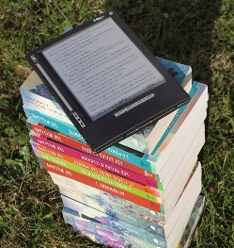
Future directions for EdShare: Stepping outside the comfort zone
Showcasing Resources:
Quality indicator for OER repositories recommended by Atenas & Havemann (2014)
Method of promotion to help expose materials
Manually created (hmm), or dynamically generated based on user interactions:
Most popular, Most viewed, Most liked
Channels:
Associated content in one place with ability for users to subscribe/follow
Atenas, J. and Havemann, L. (2014). Questions of quality in repositories of open educational resources: a literature review. Research in Learning Technology, 22.

Slide 19
Future directions for EdShare: Stepping outside the comfort zone
Community:
Allow any user to register
Permit direct editing of records, such as providing links to new versions which exist elsewhere
(Crowdsourcing metadata another quality indicator from Atenas & Havemann (2014))
Collaborate with users on the creation of resources

Slide 20
Future directions for EdShare: Stepping outside the comfort zone
Social Media Sharing:
Another quality indicator recommended by Atenas & Havemann (2014)
Social networks particularly for learners and academics professional is a trusted route for information discovery

Slide 21
Future directions for EdShare: Stepping outside the comfort zone
Open Courses:
Allow anyone in the institution freedom to structure and run an open course
Could be of any scale, but ideal for those who wish to run small scale experiments engaging with a global community of users
Benefit of permitting users to see resources in their context of use

Slide 22
Future directions for EdShare: Stepping outside the comfort zone
Playlists:
User generated ‘playlist’ to identify a sequence of resources or non-sequential that they have collated for a purpose
Sharing of a personal learning path vs a prescribed one
Recommendations:
Based upon usage data collected from other users
Based upon linked data between records

Slide 23
Future directions for EdShare: Stepping outside the comfort zone
Evaluation Tools:
Quality indicator of OER repository recommended by Atenas & Havemann (2014)
Demonstrate trust in the community by allowing them to engage and provide feedback.
Ratings can provided associated metadata to feed views such as ‘Most Viewed’, ‘Most Popular’
A default offering of many social media sites where OERs are already being shared

Slide 24
www.eprints.org/edshare
demoshare.eprints-hosting.org
EdShare User Group
K.Terrell@soton.ac.uk
Twitter: @KellyATerrell and @EPrints
Source: Pixabay

