Slide 1
Web Science and the Mind
Stevan Harnad
U Southampton, UQÀM, McGill

Slide 2
Symbol Grounding Problem
Dictionary + Dictionary Game
Category learning game online
Deep learning nets
Open Access - Scientometrics - ROAR/ROARMAP

Slide 3
Symbol Grounding Problem

Slide 4
What is the Symbol Grounding Problem?

Slide 5
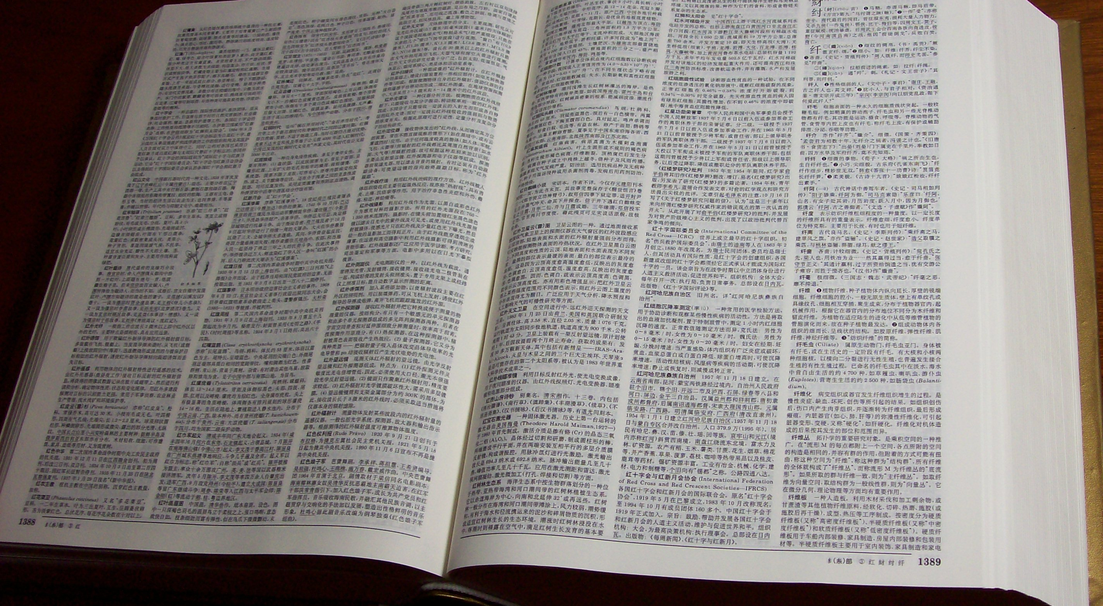
Chinese-Chinese
Dictionary-Go-Round

Slide 6
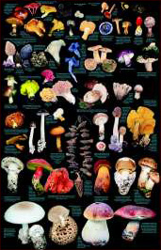
What is Categorization?
Doing the right thing with the right KIND of thing

Slide 7
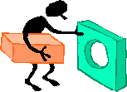
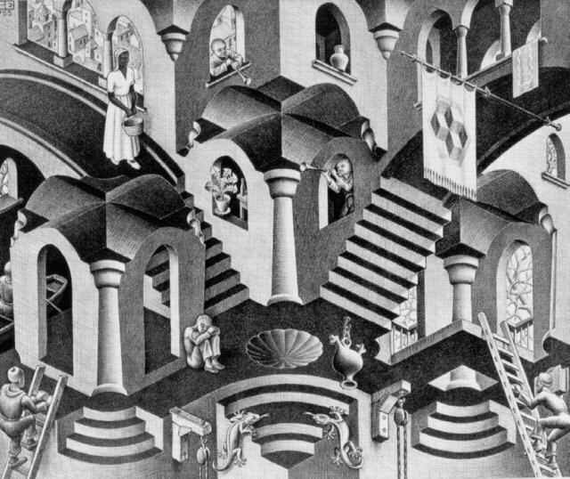
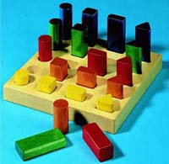
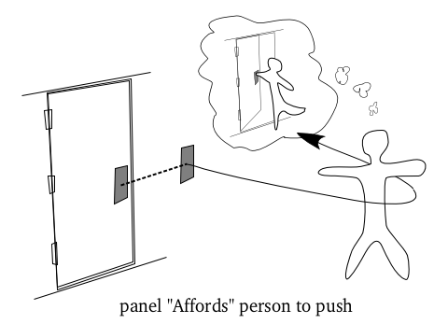
Gibsonian Affordances

Slide 8
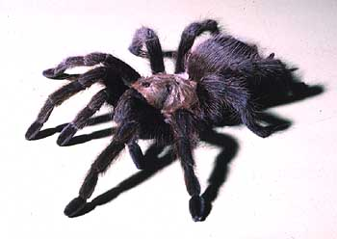
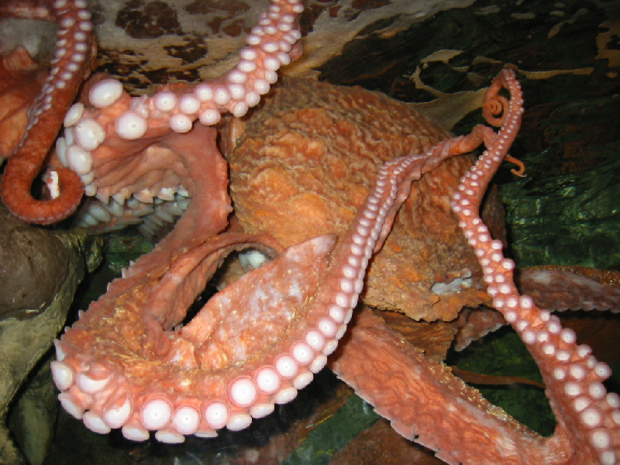
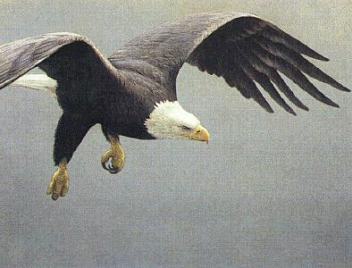
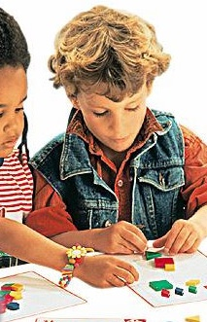
Nonhuman species categorize too

Slide 9
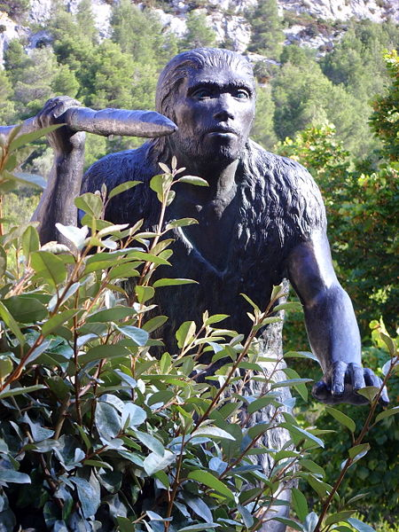
Nonhuman animals have categories but they don’t speak
(why not??)
The Advent of Language 300,000 years ago
Notes:
Language evolved as reciprocal barter: no charge for words, hence open access…

Slide 10
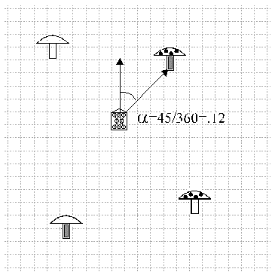
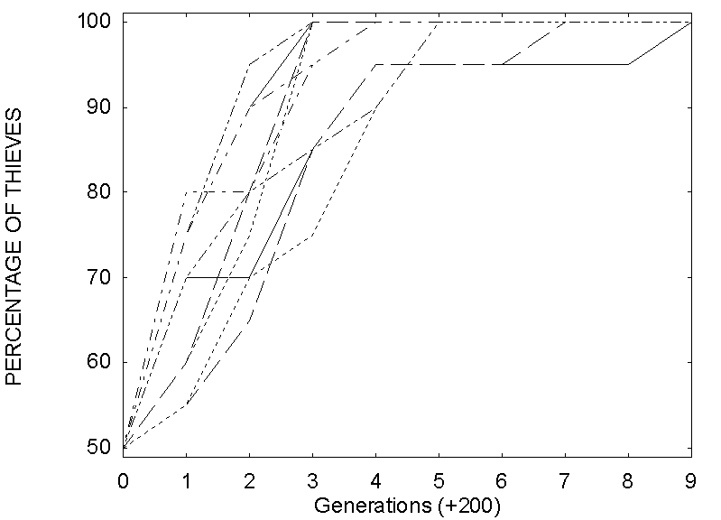
Artificial Life Simulation of Language Evolution

Slide 11
Symbol Grounding Problem
Dictionary + Dictionary Game

Slide 12
Dictionaries (and Encylopedias and Textbooks) are Category Repositories

Slide 13
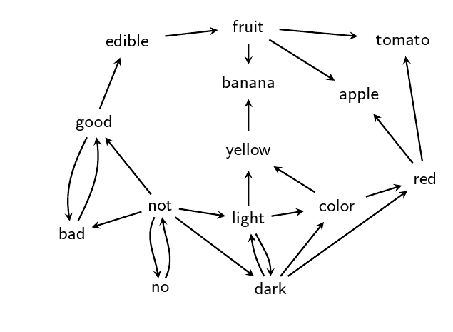
Toy dictionary represented as graph

Slide 14
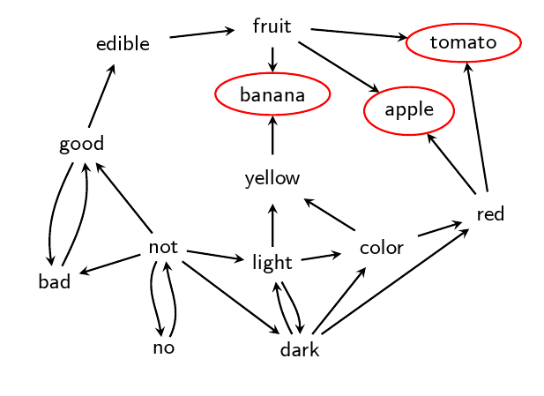
Some words are not used in any deﬁnition.

Slide 15
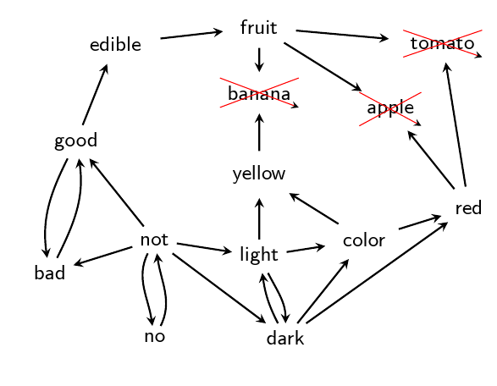
They can be removed

Slide 16
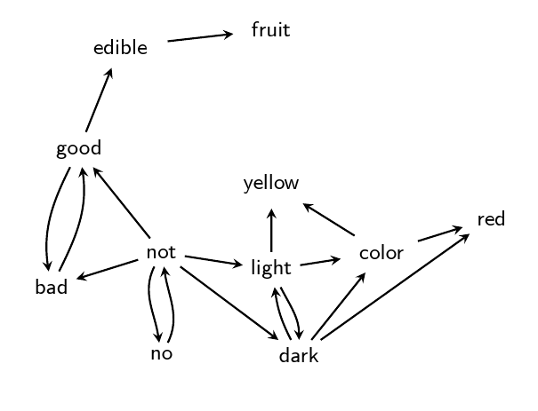

Slide 17
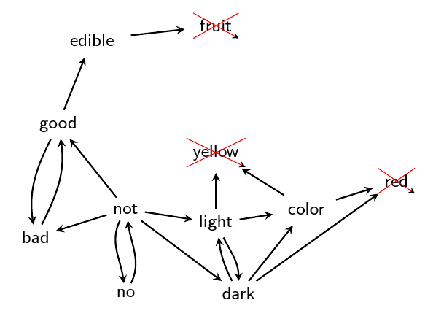
This process is recursive.

Slide 18
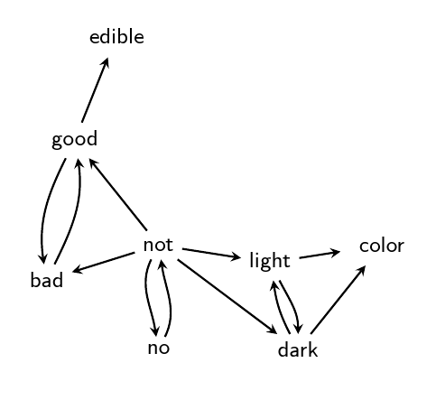

Slide 19
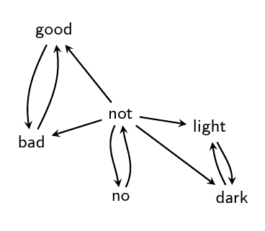
Till no other word can be removed

Slide 20
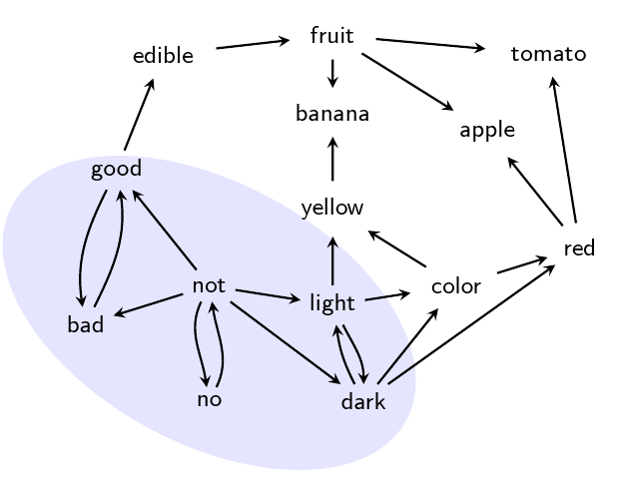
Resulting subgraph is
“Grounding Kernel” (GK) of dictionary

Slide 21
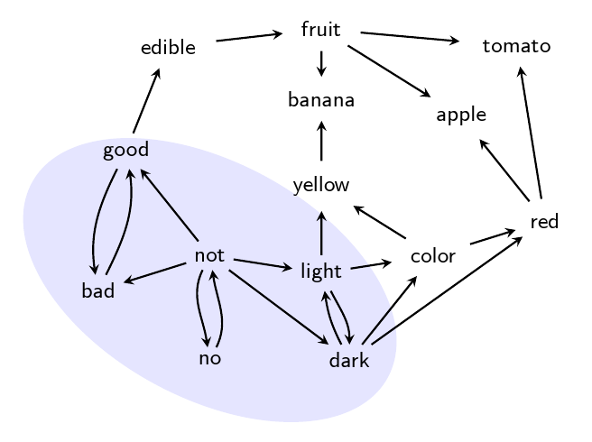
GK can be decomposed further
into “Strongly Connected Components” (SCCs)

Slide 22
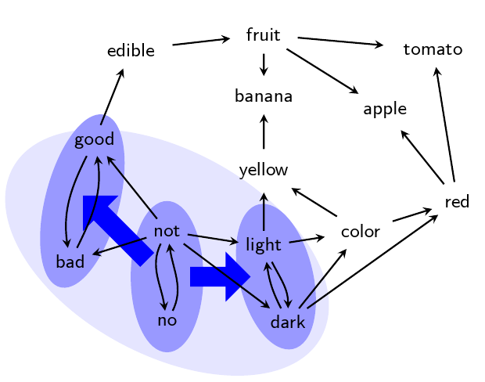

Slide 23
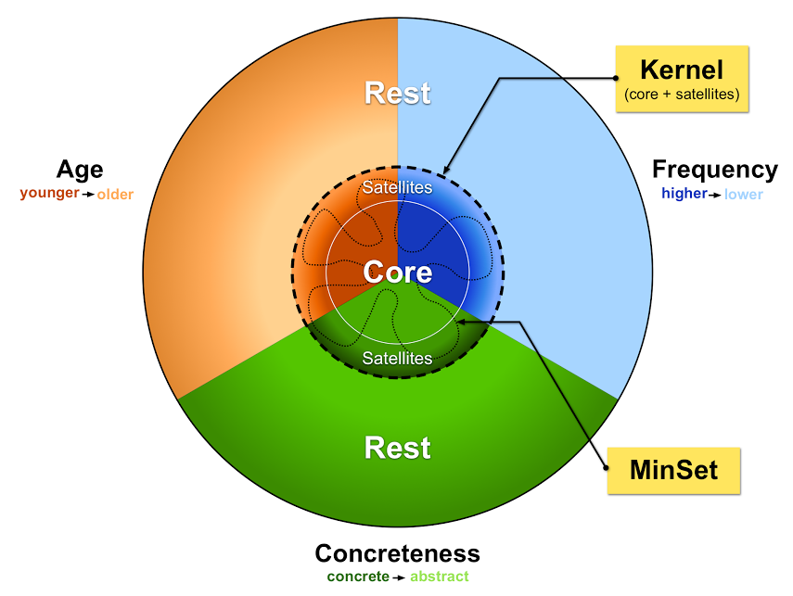
Dictionary Hidden Structure

Slide 24
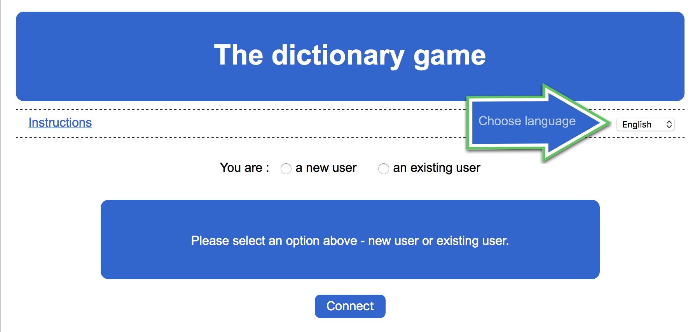
http://lexis.uqam.ca:8080/dictGame

Slide 25
Symbol Grounding Problem
Dictionary + Dictionary Game
Category learning game online

Slide 26

The Whorf Hypothesis

Slide 27
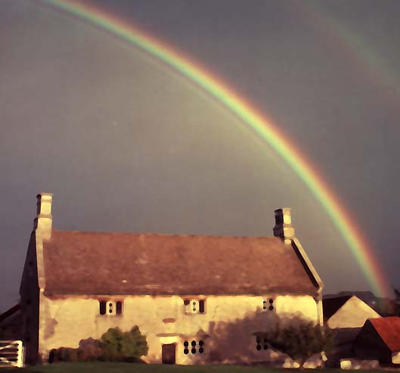
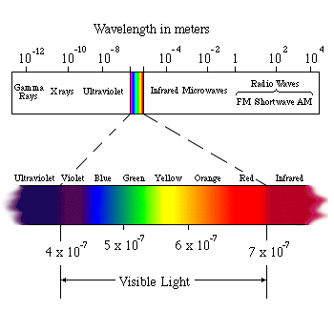
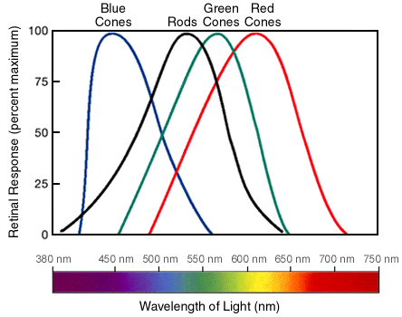
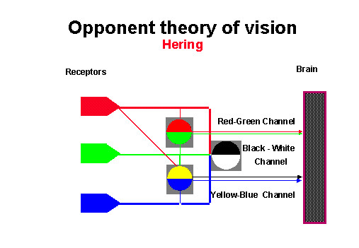
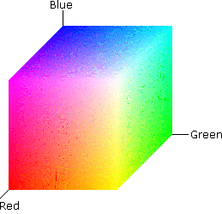
Categorical Perception (CP)
“Warping" of similarity space

Slide 28
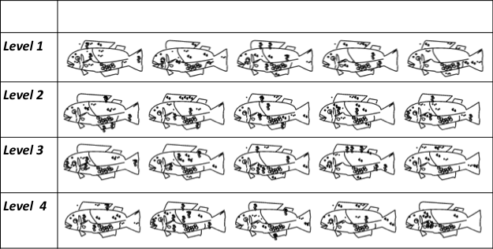

Ailfish and Limfish
Xi-Wei Kang U Southampton

Slide 29
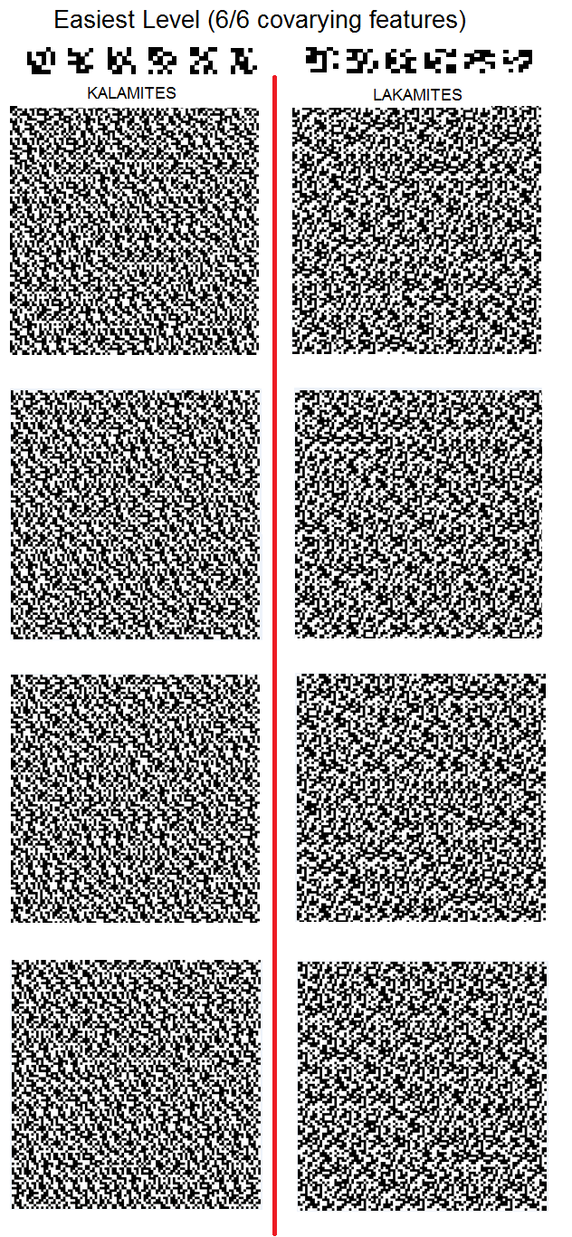
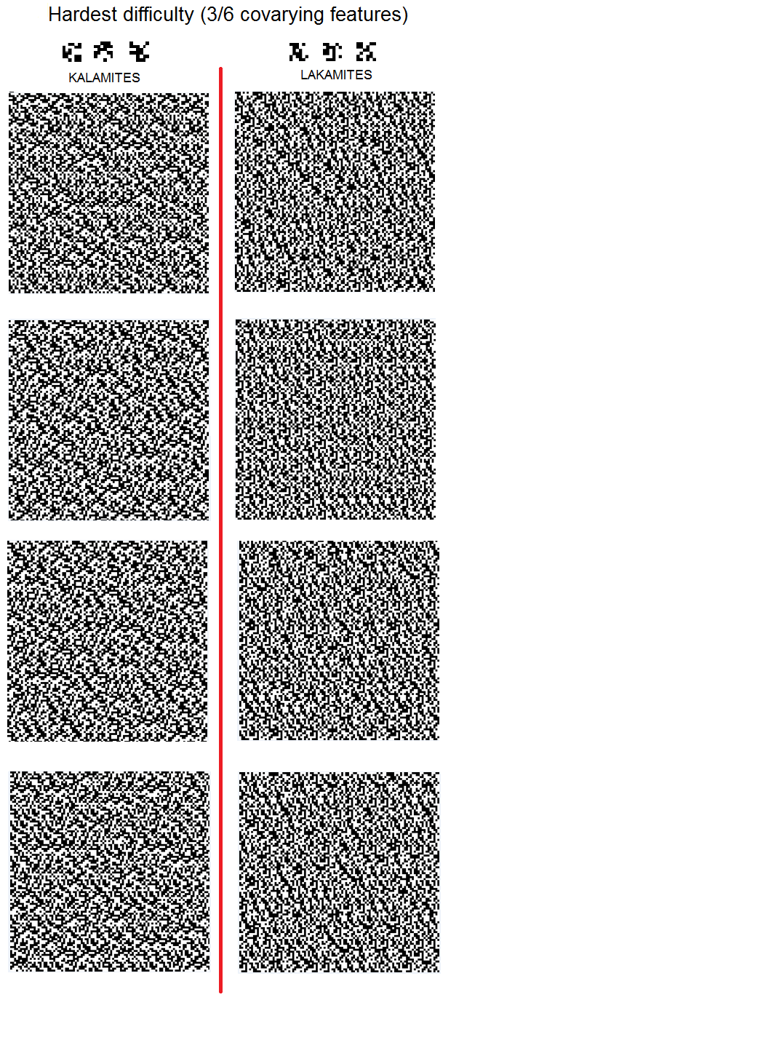
“Kalamite” and “Lakamite” textures

Slide 30
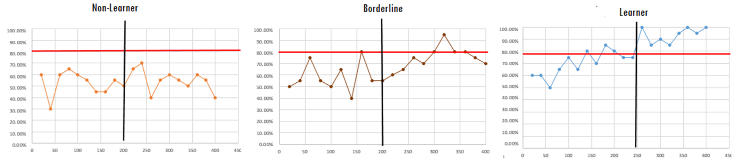
Learners, borderlines and nonlearners

Slide 31
% covariant features and task difficulty

Slide 32
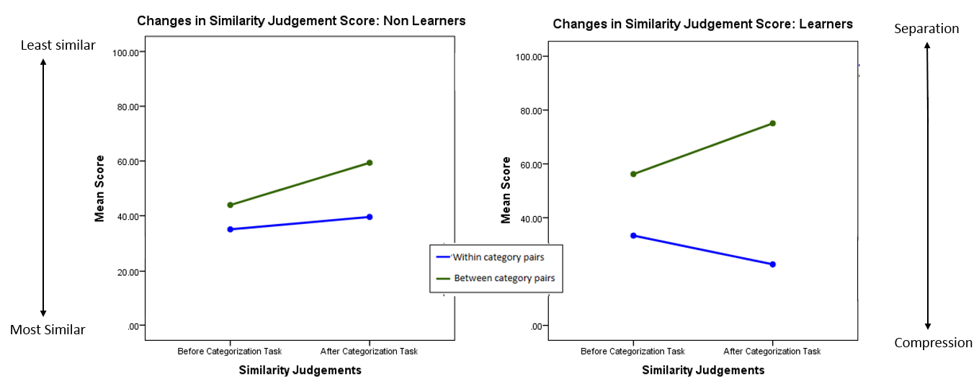
Compression and Separation

Slide 33
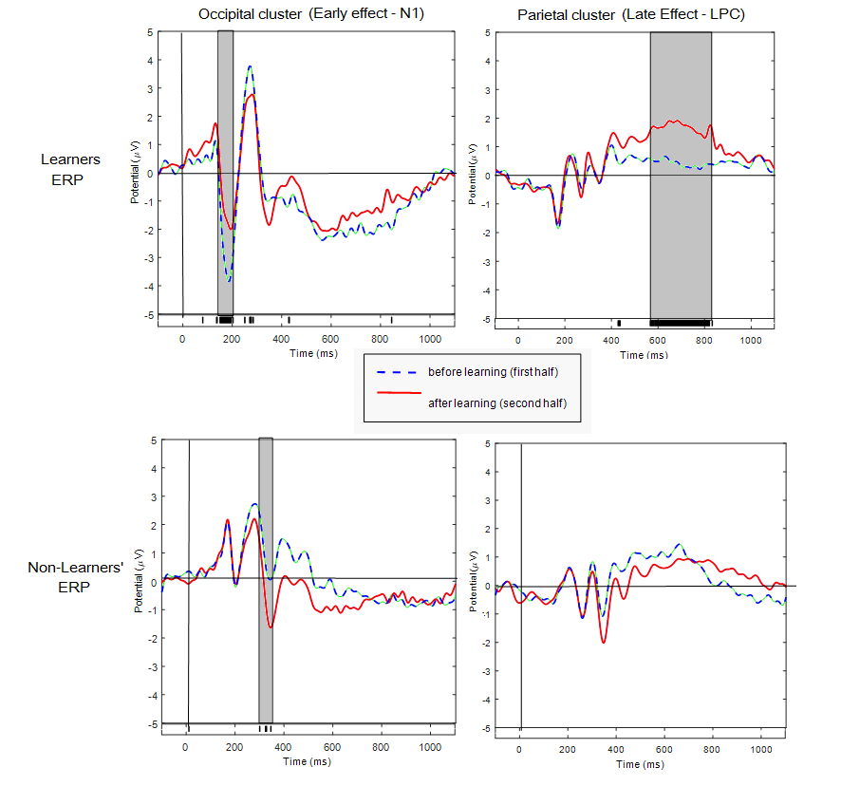
Early N1 (sensory) and late Pc (cognitive) effects

Slide 34
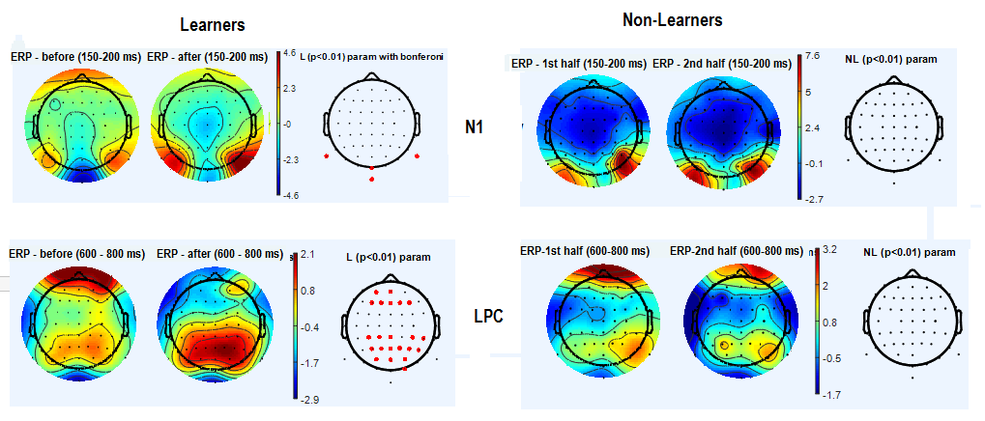
Scalp Distribution of Changes

Slide 35
Symbol Grounding Problem
Dictionary + Dictionary Game
Category learning game online
Deep learning nets

Slide 36
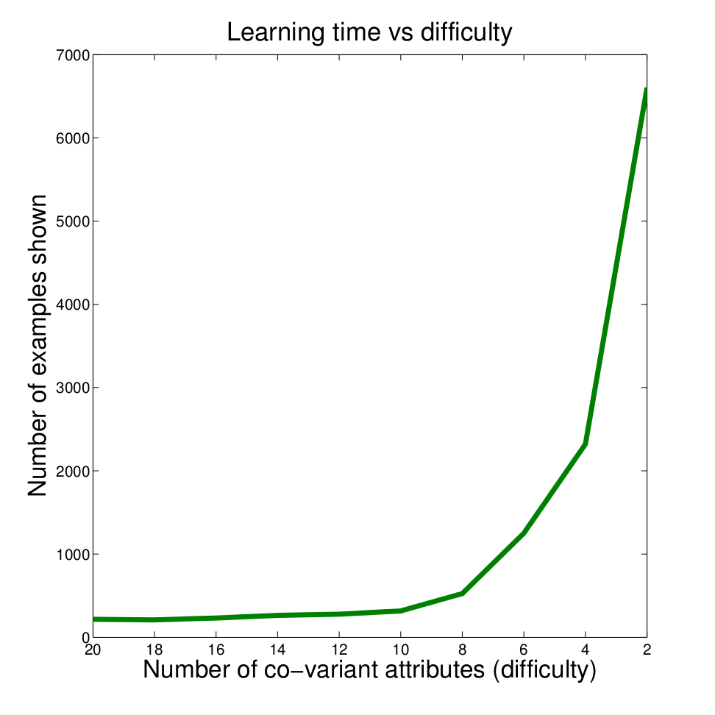
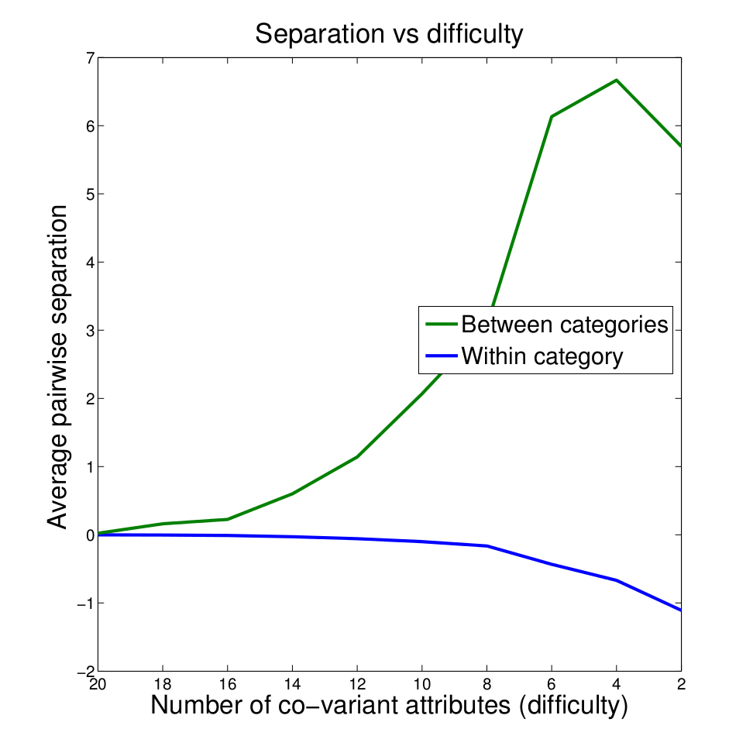
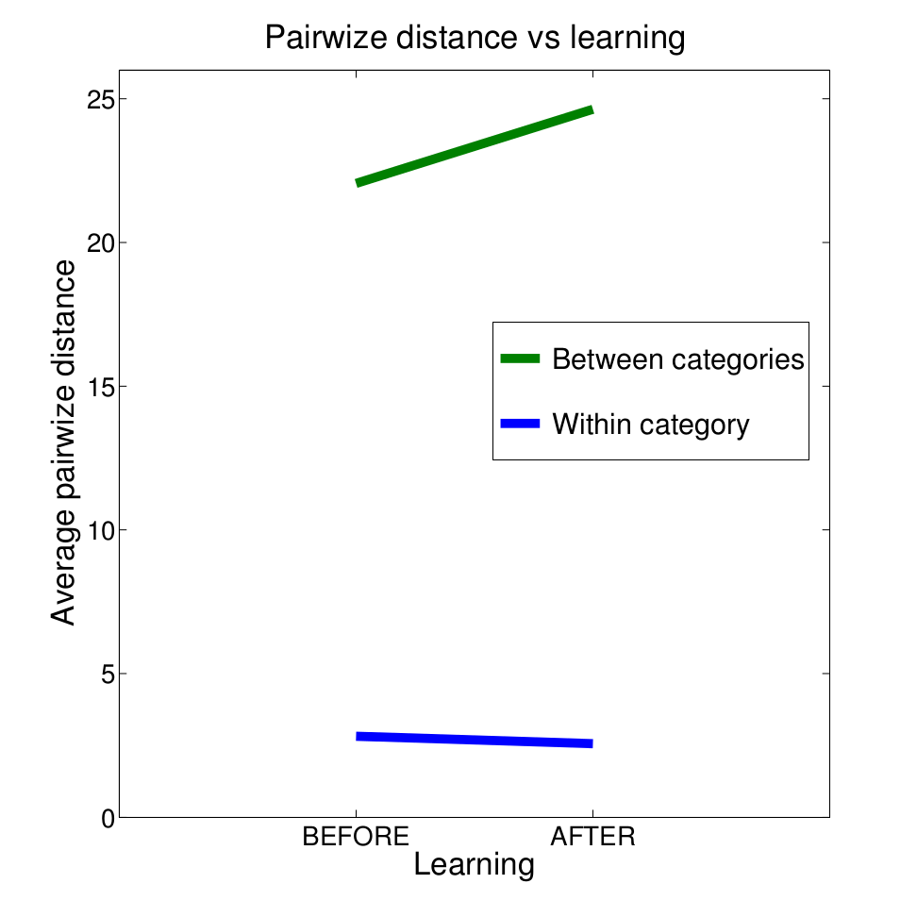
Deep Learning Net Model

Slide 37
Symbol Grounding Problem
Dictionary + Dictionary Game
Category learning game online
Deep learning nets
Open Access - Scientometrics - ROAR/ROARMAP

Slide 38
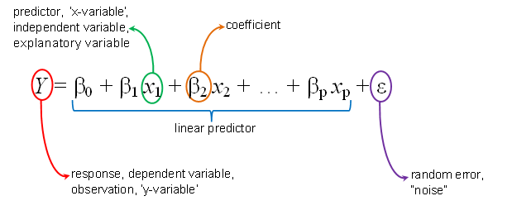
ROAR & ROARMAP
http://roar.eprints.org
http://roarmap.eprints.org

Slide 39
How is this relevant to the web?
The web (taking over from our dictionaries, encyclopedias, textbooks and treatises as category repositories) is now our global category commmons.
The “semantic web” is not a semantic web at all; it is a syntactic web (squiggles and squoggles) based only on shape, not on meaning, and that includes all metadata tags (which are as useless as a chinese definition to someone who does not understand chinese).
So to understand web use (“web cognition”), just as when we want to understand dictionary use, we can graph it to extract its kernel, core and satellites: citations as well as links can be analyzed like definitional links
Apart from the grounding, I hope I gave a taste of ways in which the web can be used to understand cognition (the online dictionary game and the online category-learning task).
I did not get to the ROAR/ROARMAP part, but there I would have pleaded for datamining ROAR and ROARMAP’s rich database in order to monitor and guide open access and open-access policy as well as in order to validate research performance metrics.

Slide 40
Thank you
Xi-Wei Kang U Southampton

