Slide 1
www.socrative.com
Student login: WHITE689
Student login: WHITE689

Slide 2
How to write abstracts
COMP1205 - Professional Development
Steve White (S.T.White@soton.ac.uk)
Week 3, Thurs 20th Oct, 2016
Notes:
Steve White, 3rd year Web Science PhD student, but I also work here at the Avenue teaching academic skills, particularly academic writing. Today we’re going to look at writing abstracts, which is a great skills to develop in terms of your written communicaton skills, and of course will be important for your group presentation and individual technical report writing. But, summarising, and abstract writing in particular can be challenging, so we’ll look at some key points of abstracts today. By the end of this 45 minute session today (and I will finish on time) you should I …[slide]

Slide 3
Session aim
purpose
content
structure
To introduce the writing of abstracts in terms of:
Notes:
Outline session aims and relate to assignments – As I mentioned summarising in writing is an important professional skill, so this course also assesses these skills – in your group presentation needs a tentative/draft abstract; and for the individual technical report. (they’re doing their CV task at the moment)
This will be useful for your technical report and the abstract for your presentations

Slide 4
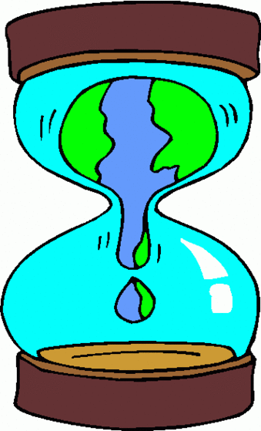
The ‘shape’ of academic communication
Image: Clipartbro.com
Notes:
(What do you think is generally the ‘shape’ of academic communications such as conference papers, or presentations, journal articles, book chapters etc?
Often referred to as an ‘hourglass’ - does anyone know why? General to specific, then specific to general.

Slide 5
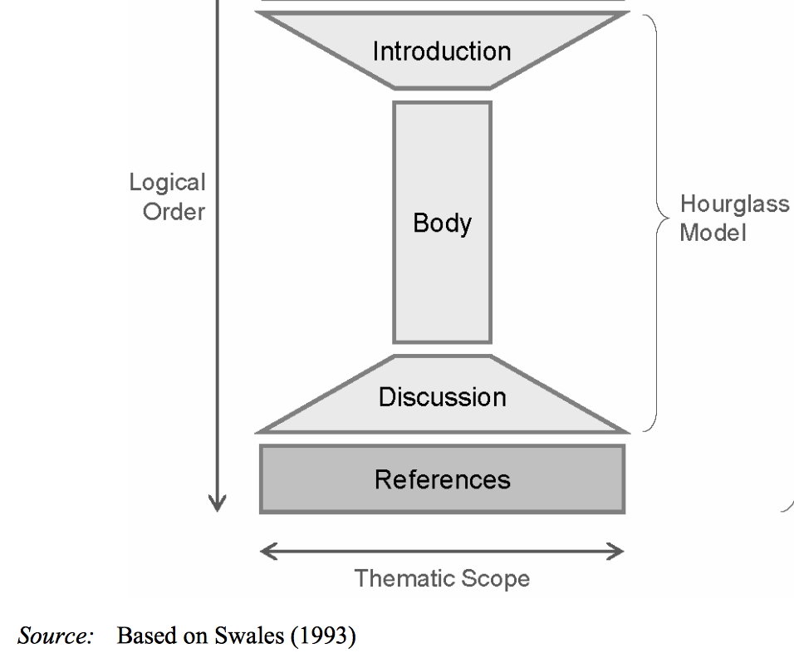
The ‘Hourglass’ model
Notes:
Traditional structure of academic communication (journal, essays, reports, presentations). From general to specific …BUT there is something missing …

Slide 6
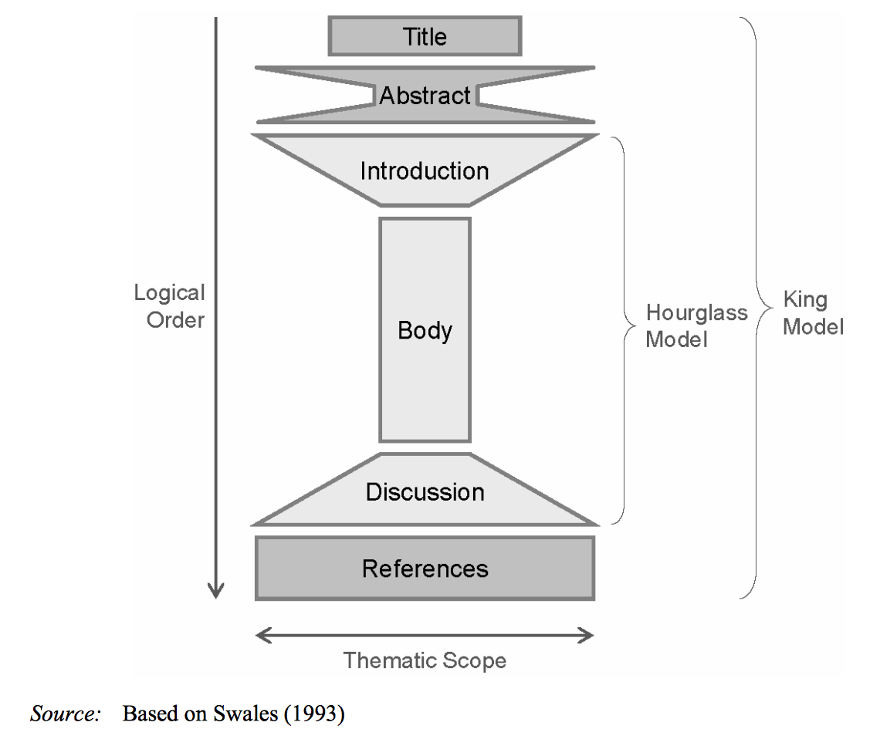
The ‘King’ model
Notes:
So, this reflects the wider content of an academic communication - including important extra elements of the title and the abstract. So this is the place of the abstract in academic writing, but what is the function of abstracts in your writing and why are they important?

Slide 7
www.socrative.com
Student login: WHITE689
Student login: WHITE689

Slide 8
What is the function of an abstract?
To cite other studies related to your work
To explain the methodology of your work in detail
To concisely inform the world of your sheer genius
To summarise the overall aim or content of your work
Notes:
Refer to Socrative questions

Slide 9
Why are abstracts important?
A reader might only look at your abstract in deciding whether or not to read your work
Research databases use abstracts as the primary means of finding research reports on particular subjects
Abstracts are the main opportunity to grab the attention of the reader, and to show why your work is important or useful
They are an anagram of ‘crab stats’, and everyone loves crab statistics.
Notes:
Refer to Socrative questions

Slide 10
The ‘King’ model
Notes:
What do you notice about the shape of the abstract in relation to the shape of the overall body of the communication? It’s the same shape, but reduced, so

Slide 11
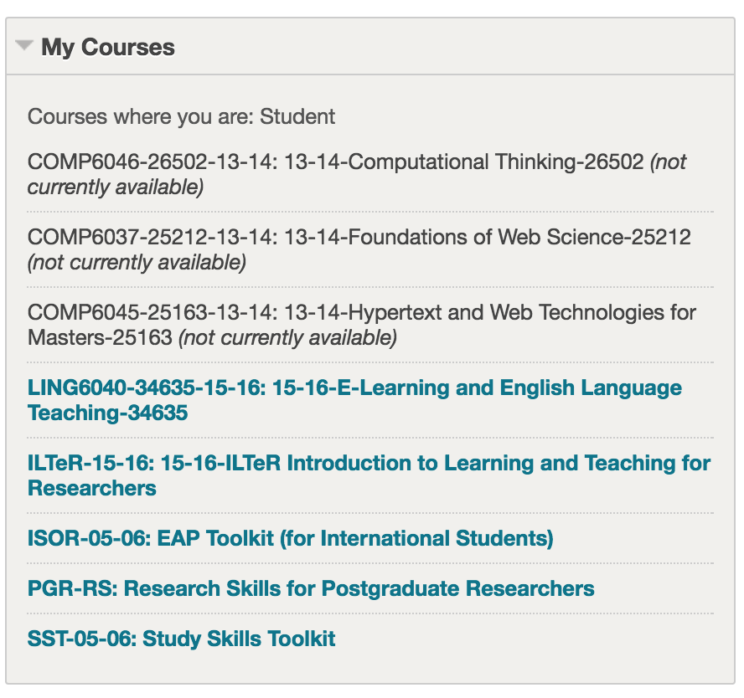
Support resources for your academic skills

Slide 12
Southampton University LibGuides:
Academic Skills: http://library.soton.ac.uk/sash/home
ECS MyLibrary: http://library.soton.ac.uk/ecs
Including your subject librarian Fiona Nichols

Slide 13
An “abstract is a miniature version of the whole. It is, if you like, a mini-me.”
Thomson (2016)
Notes:
Yes - an abstract is a summary of the entire paper, article or conference presentation. Broadly, they follow the same ‘moves’ as a report/article/presentation, and these focus on around 5 main rhetorical ‘moves’. Seems simply, right? Well - they’re not so easy to write.
From Patter PhD blog:
Thomson, 3/10/2016 ( https://patthomson.net/2016/10/03/finishing-the-phd-write-a-tiny-text/ )

Slide 14
So, what are the functional parts of an abstract?
Broader context
Problem
Solution and approach
Results
Contribution / So what?
See Koopman (1997) for a quick (1 page) guide to writing abstracts
Notes:
‘Broader context’ might include some motivation about why we might care about the subject at hand and the results.

Slide 15
‘Basics of research paper writing and editing’ (Derntl, 2014)
Publishing research results is an integral part of a researcher’s professional life. However, writing is not every researcher’s favourite activity, and getting a paper published can be a very tedious and time-consuming process. Fortunately, many of the obstacles along the writing and publishing path can be avoided by following some simple guidelines and practices. This paper presents a synthesis of guidelines found in literature about structuring and writing scientific papers. The paper outlines the process of publishing research papers in journals and conference proceedings, aiming to provide early-stage researchers with a handy introduction to essential issues. The paper takes an interdisciplinary stance by giving examples from technology-enhanced learning research and borrowing from literature in social, natural and computing sciences.
Broader context
Problem
Solution and approach
Results
Contribution / So what?
Notes:
So, you can see that this is a typical abstract – you don’t need to read it now, but you can see that in this case there are 6 sentences – a short abstract might only be 5 or 6 sentences in length (longer for a longer piece of work like a dissertation or thesis). Let’s take a look at each part (or ‘move’ in turn).

Slide 16
[Title of paper: Basics of research paper writing]
Broader context
The first sentence addresses the broad context. This locates the study in a policy, practice or research field.
Publishing research results is an integral part of a researcher’s professional life.
Advice in bold from Patter blog, 3/10/2016

Slide 17
[Title of paper: Basics of research paper writing]
Problem
The second sentence establishes a problem related to the broad
context you have set out. It often starts with But, Yet or However…
However, writing is not every researcher’s favourite activity, and getting
a paper published can be a very challenging and time-consuming
process.

Slide 18
[Title of paper: Basics of research paper writing]
Solution and approach
The third sentence says what specific research has been done.
This sentence often starts with ‘This research…’ or ‘I report…’
Fortunately, many of the obstacles along the writing and publishing path
can be avoided by following some simple guidelines and practices.
This paper presents a synthesis of guidelines found in literature about
structuring and writing scientific papers.
Notes:
Some journals / editors don’t like the use of ‘I’ - check with whoever is marking your work (avoid to be safe)

Slide 19
[Title of paper: Basics of research paper writing]
Results
The fourth sentence reports the results. Don’t try to be too tricky here, just start with something like.. ‘This study shows…’, or ‘Analysis of the data suggests that…’
The paper outlines the process of publishing research papers in journals
and conference proceedings, aiming to provide early-stage researchers
with a handy introduction to essential issues.

Slide 20
[Title of paper: Basics of research paper writing]
Contribution / So what?
The fifth and final sentence addresses the ‘So What?’ question,
and makes clear the claim to contribution.
The paper takes an interdisciplinary stance by giving examples from
technology-enhanced learning research and borrowing from literature in
social, natural and computing sciences.

Slide 21
‘Basics of research paper writing and editing’ (Derntl, 2014)
Publishing research results is an integral part of a researcher’s professional life. However, writing is not every researcher’s favourite activity, and getting a paper published can be a very tedious and time-consuming process. Fortunately, many of the obstacles along the writing and publishing path can be avoided by following some simple guidelines and practices. This paper presents a synthesis of guidelines found in literature about structuring and writing scientific papers. The paper outlines the process of publishing research papers in journals and conference proceedings, aiming to provide early-stage researchers with a handy introduction to essential issues. The paper takes an interdisciplinary stance by giving examples from technology-enhanced learning research and borrowing from literature in social, natural and computing sciences.
Broader context
Problem
Solution and approach
Results
Contribution / So what?

Slide 22
‘Basics of research paper writing and editing’ (Derntl, 2014)
Publishing research results is an integral part of a researcher’s professional life. However, writing is not every researcher’s favourite activity, and getting a paper published can be a very tedious and time-consuming process. Fortunately, many of the obstacles along the writing and publishing path can be avoided by following some simple guidelines and practices. This paper presents a synthesis of guidelines found in literature about structuring and writing scientific papers. The paper outlines the process of publishing research papers in journals and conference proceedings, aiming to provide early-stage researchers with a handy introduction to essential issues. The paper takes an interdisciplinary stance by giving examples from technology-enhanced learning research and borrowing from literature in social, natural and computing sciences.
Broader context
Problem
Solution and approach
Results
Contribution / So what?

Slide 23
Propose a problem …
Broader context
Problem
Solution and approach
Results
Contribution / So what?

Slide 24
[Title of paper: ]
Broader context
The first sentence addresses the broad context. This locates the study in a
policy, practice or research field.

Slide 25
[Title of paper:]
Problem
The second sentence establishes a problem related to the broad context you
have set out. It often starts with But, Yet or However…

Slide 26
[Title of paper:]
Solution and approach
The third sentence says what specific research has been done.
This sentence often starts with This research… or I report…

Slide 27
[Title of paper:]
Results
The fourth sentence reports the results.
Don’t try to be too tricky here, just start with something like..
‘This study shows…’, or 'Analysis of the data suggests that…'

Slide 28
[Title of paper:]
Contribution / So what?
The fifth and final sentence addresses the ‘So What?’ question,
and makes clear the claim to contribution.

Slide 29
Review
Reflect on whether you understand the writing
of abstracts in terms of:
purpose
content
structure
Notes:
Outline session aims and relate to assignments -
This will be useful for your technical report and the abstract for your presentations

Slide 30
Why do we use abstracts in academic and professional communication?
To briefly outline the purpose, content and outcome of your work
To concisely list reports or articles which are similar to your work
To explore in depth the methodology of your work
Notes:
Refer to Socrative questions

Slide 31
References
Derntl, M., 2014. Basics of research paper writing and publishing. International Journal of Technology Enhanced. Available at: http://www.inderscienceonline.com/doi/abs/10.1504/IJTEL.2014.066856 [Accessed October 8, 2016].
Koopman, P. (1997) How to write an abstract. Carnegie Mellon University. Available at: https://users.ece.cmu.edu/~koopman/essays/abstract.html [Accessed October 15, 2016]
Proctor, M. (2002) The Abstract. University of Toronto. Available at: http://www.writing.utoronto.ca/advice/specific-types-of-writing/abstract [Accessed Octorber 15, 2006]
[Swales, J., 1990. Genre Analysis: English in academic and research settings, Cambridge: Cambridge University Press.]
Thomson, P., 2016. Finishing the PhD - write a tiny text. Patter. Available at: https://patthomson.net/2016/10/03/finishing-the-phd-write-a-tiny-text/ [Accessed October 3, 2016].

