Slide 1
Poster Exercise
Planning your topics

Slide 2
Group exercise:
Individually
Look at the posters
(via slideshow)
Identify the (possible) contributory disciplines
In Pairs
Discuss your analysis
Expand the list of contributory views
Share
In a round
Tell the class what you learnt
Comment on the titles
  are they useful?
  did you understand them?
think
share
pair
Notes:
There is a handout, make notes during the feedback

Slide 3

Quick preview
While you are looking at the posters
Think about the topics
What disciplines?
What variations on a theme
Posters are follow at the end of this slide set.
Or you can look at them on the web site pdf downloads available
http://dtc.webscience.ecs.soton.ac.uk/people-and-partners/list-of-students/student-research-interests/web-science-posters/
Notes:
Then swap over to the posters slideset in common core

Slide 4
Scan through papers from previous Web science conferences
Available from web science trust
http://journal.webscience.org/
Available from the ACM digital library
Links from DL are dynamic so….
Search for web science and year (2011 – 2016)
2011 was the 4th conferenece

Slide 5
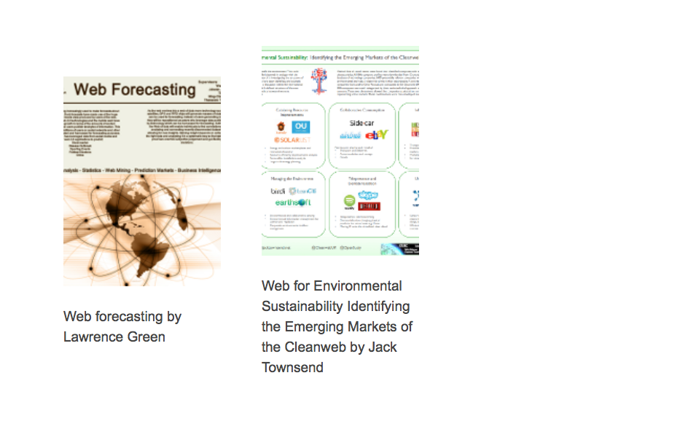

Slide 6
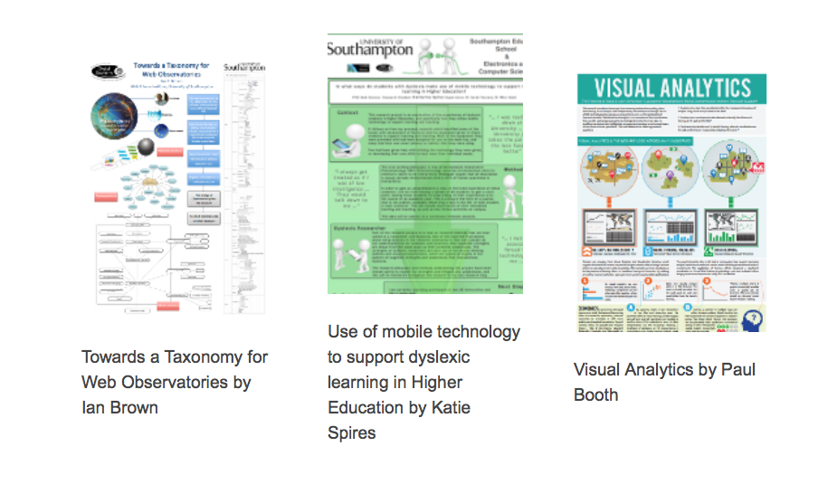

Slide 7
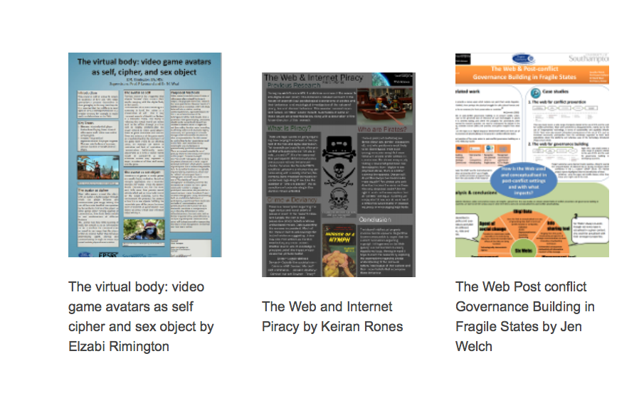

Slide 8
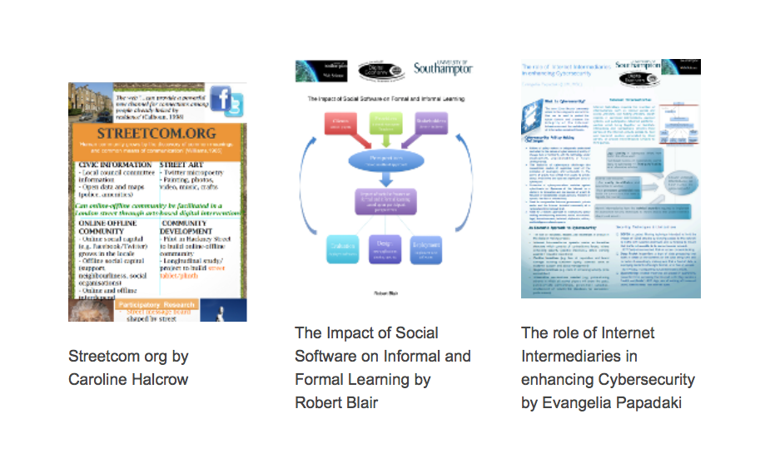

Slide 9


Slide 10


Slide 11


Slide 12


Slide 13
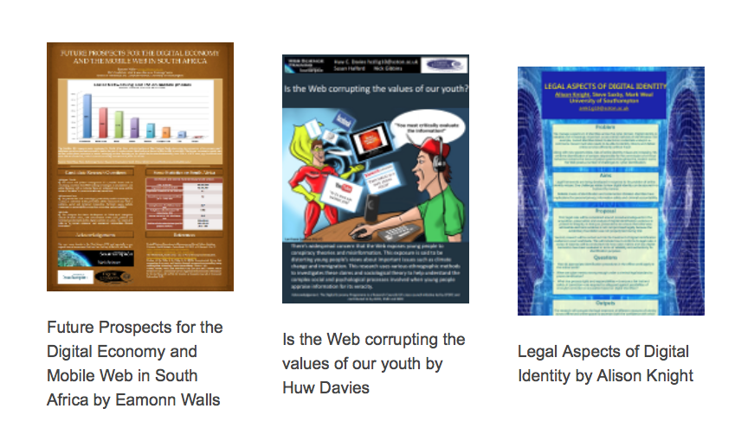

Slide 14


Slide 15


Slide 16
Possible activities
Posters

Slide 17
Quick preview: group projects
While you are looking at the posters go by
Use them to help you think your own groups’ ideas
Reflect on them
Posters are available in a slide set http://www.edshare.soton.ac.uk/13359/
Or you can look at them on the web site pdf downloads available
http://dtc.webscience.ecs.soton.ac.uk/people-and-partners/list-of-students/student-research-interests/web-science-posters/

Slide 18
Quick preview: individual reports
While you are looking at the posters go by
Use them to help you think your own ideas
Reflect on them
Posters are available in a slide set http://www.edshare.soton.ac.uk/13359/
Or you can look at them on the web site pdf downloads available
http://dtc.webscience.ecs.soton.ac.uk/people-and-partners/list-of-students/student-research-interests/web-science-posters/

Slide 19
Quick preview: poster preparation
While you are looking at the posters go by
Which ones are most visually appealing?
Which ones can you actually read?
How useful are the titles?
Posters are available in a slide set http://www.edshare.soton.ac.uk/13359/
Or you can look at them on the web site pdf downloads available
http://dtc.webscience.ecs.soton.ac.uk/people-and-partners/list-of-students/student-research-interests/web-science-posters/

Slide 20
Class exercise: thinking about interdisciplinarity
Individually
Look at the posters
Identify the (possible) contributory disciplines
In Pairs
Discuss your analysis
Expand the list of contributory views
Share
In a round
Tell the class what you learnt
How useful are the titles?
think
share
pair
Notes:
There is a handout, make notes during the feedback

