Slide 1
WEBS2002
Interdisciplinary Project
Introduction Exploring Interdisciplinarity

Slide 2
First point of reference
https://secure.ecs.soton.ac.uk/module/1617/WEBS2002/31055/

Slide 3
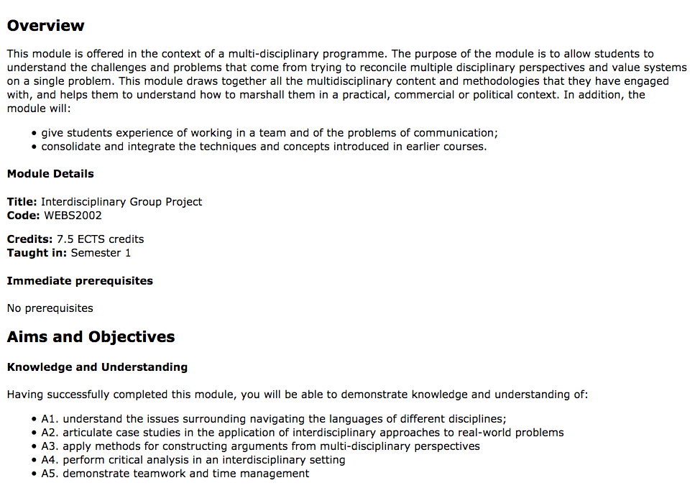
What/how do we want you to learn?
Always go back to the syllabus

Slide 4
Objectives
give students experience of working in a team and of the problems of communication;
consolidate and integrate the techniques and concepts introduced in earlier courses.

Slide 5
Knowledge and Understanding
Having successfully completed the module, you will be able to demonstrate knowledge and understanding of:
A1. the issues surrounding navigating the languages of different disciplines; A2. case studies in the application of interdisciplinary approaches to real-world problems; A3. methods for constructing arguments from multi-disciplinary perspectives; A4. critical analysis in an interdisciplinary setting; A5. teamwork and time management.

Slide 6
Intellectual Skills
Having successfully completed the module, you will be able to:
B1. prepare an argument from a multi-disciplinary perspective for a given problem; B2. critically evaluate arguments and weigh their merits; B3. work effectively in a group to deliver a targeted report; B4. appreciate the interdependence and conflict inherent in a group project.

Slide 7
Subject Specific Skills
Having successfully completed the module, you will be able to:
C1. synthesise disciplinary perspectives to inform a public understanding of the web.
Employability/Transferable/Key Skills
Having successfully completed the module, you will be able to:
D1. handle some of the conflict inherent in a group project; D2. make critical judgements of your own and other peoples work; D3. take responsibility for scheduling and running group meetings.

Slide 8
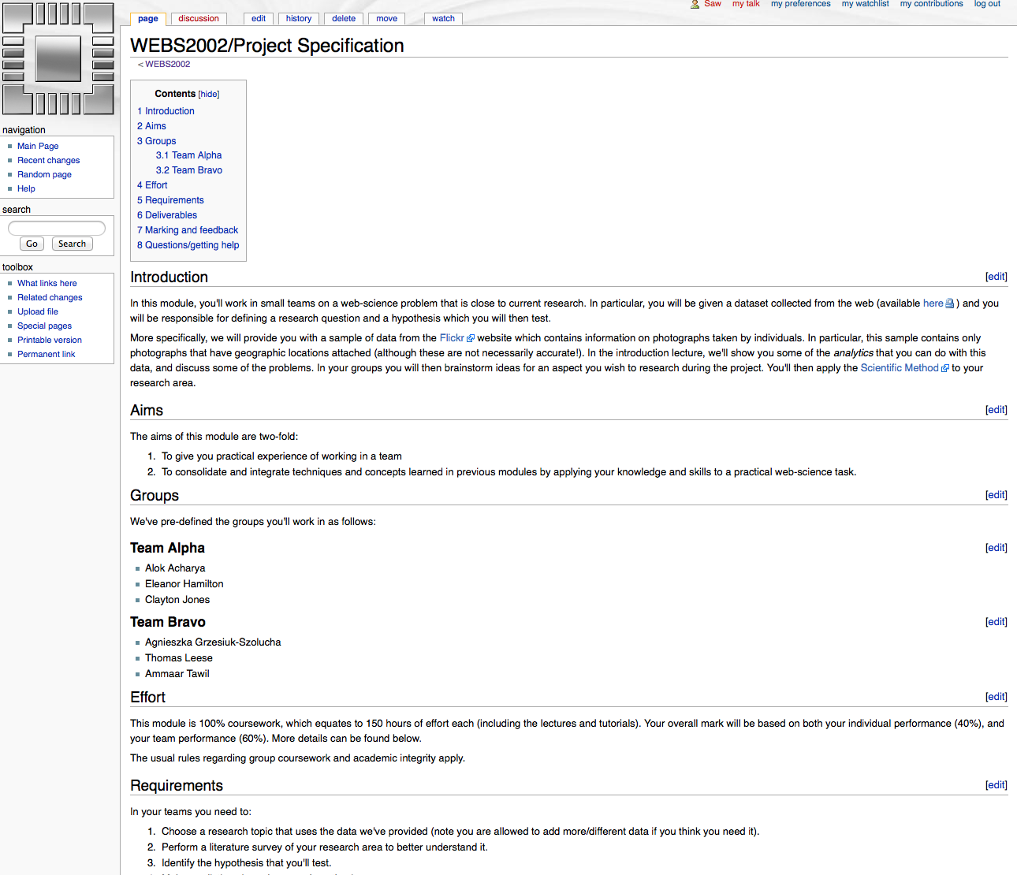
The task is a vehicle
But always check back to the syllabus
… and the assessment criteria
Go to the handin
Check and plan
PS remember it’s a group project!!
https://secure.ecs.soton.ac.uk/noteswiki/w/WEBS2002/Project_Specification

Slide 9
What we expect you to do
1. DEFINE problems, issues, topics or questions that warrant interdisciplinary examination
2. PRESENT a clear rationale for taking interdisciplinary approach including the advantages to be gained
3. IDENTIFY relevant disciplines
4. CONDUCT a literature review (what is known on the topic from each of the disciplines)
5. DEVELOP a command of each relevant discipline set out the analytical structure central to each discipline, identify key underlying assumptions, and methods of evaluation.
6. STUDY the problem and generate insights including predictions from each of the relevant disciplines - in isolation!!
7. IDENTIFY conflicts between and/or areas of complementary between the insights offered from each discipline
8. CREATE common ground by developing a cohesive framework of analysis that incorporates insights from the relevant disciplines in a systematic manner
9. COMBINE disciplinary insights to construct new more integrated understanding of the problem
Repko & Welch 2005

Slide 10
The flow of activites
problem
Disciplinary insights
Integration
Understanding

Slide 11
Class exercise:
Individually
Look at the posters
Identify the (possible) contributory disciplines
In Pairs
Discuss your analysis
Expand the list of contributory views
Share
In a round
Tell the class what you learnt
Comment on the titles
  are they useful?
  did you understand them?
think
share
pair
Notes:
There is a handout, make notes during the feedback

Slide 12

Quick preview
Why you are looking at the posters go by
Use them to help you think your own groups’ ideas
Reflect on them
Posters are available in a slide set http://www.edshare.soton.ac.uk/13359/
Or you can look at them on the web site pdf downloads available
http://dtc.webscience.ecs.soton.ac.uk/people-and-partners/list-of-students/student-research-interests/web-science-posters/
Notes:
Then swap over to the posters slideset in common core

Slide 13
Prepare yourself
Watch and read
Be ready for
You will get an email from me as a reminder
Watch the YouTube videos
Read one of the papers in the Mendeley group
Discussions of
  Interdisciplinarity
  research practice

