Slide 1
Repositories for open education
@KellyATerrell
+ improving discoverability of OERS
A reflection and look forwards for EPrints
Kelly Terrell, EPrints Services, University of Southampton
Notes:
In this presentation I will share information about the repository for OERs that was created in 2007 by the University of Southampton
Additionally I will be talking about one of the challenges around OER – Discoverability. This is a topic I studied as part of my MSc in Digital Education and I will be sharing some of the key finds with you.

Slide 2
EPrints HQ in the Web Science research labs at University of Southampton
Notes:
Brief introduction
I am part of an enterprise group called EPrints Services and we are part of the web sciences research labs in ECS – Electronics & Computer Sciences
We manage the core EPrints software which is open source and free
We provide a number of bespoke solutions and paid for services to support this work
We are not for profit, so this model ensures the continued support and development of the core software
POLL: Who in the room has heard of EPrints
POLL: Who in the room has heard of EdShare
Nearly 10 years ago, and a number of key people in these labs came together to start up a project called EdSpace

Slide 3
@KellyATerrell
edShare@GCU
EdShare
www.edspace.ecs.soton.ac.uk
…and more coming soon
Notes:
- In Early 2007 - Uni. Of Soton project, some funding from Jisc as part of the Institutional Exemplars programme
- Need for single system to hold all manner of teaching and learning resources and encourage sharing and collaboration across the university
- This was nearly 10 years ago. OER activity at the time was acknowledged and of interest to the group but was not the primary purpose
- Although the primary purpose was needs of the institution, choices made by the team quickly resulted in an offering well suited to sharing content openly:
Eprints was selected due to it’s open source design and it’s support for all content types
EdShare was influenced by model and design of social media sites
Following slides outline some (not all) of the features implemented in the original project as well as developments over the past 12-18mths
Since the end of the research project in 2009, EdShare has become a supported and developed solution by EPrints Services

Slide 4
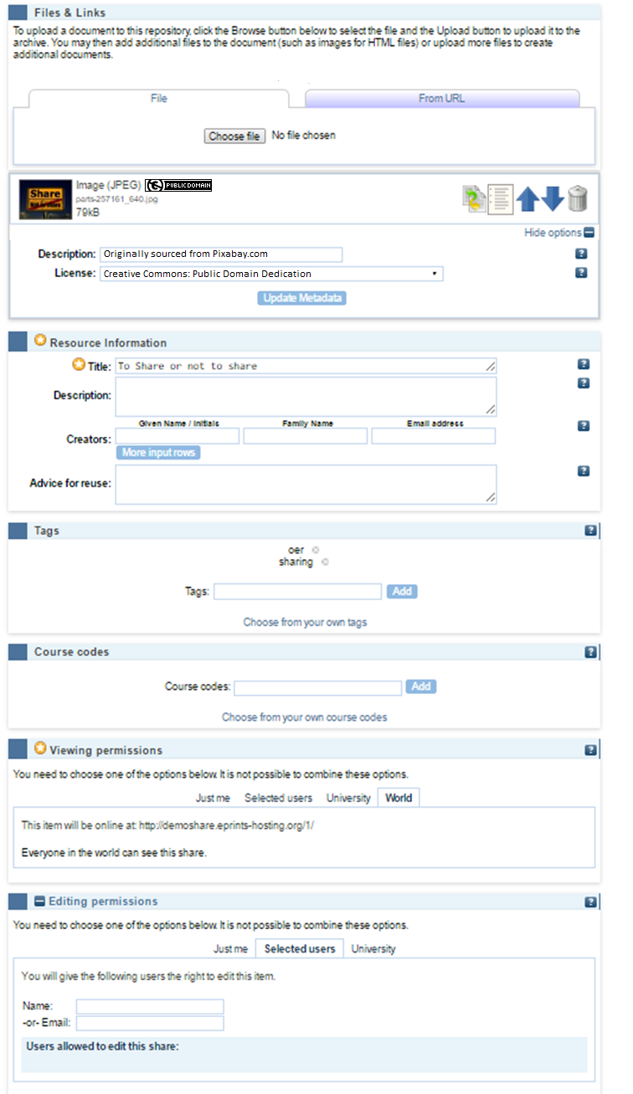
Lightweight workflow
Simple upload
CC licences
Minimal mandatory req
Tags
Viewing permissions
Editing permissions

Slide 5
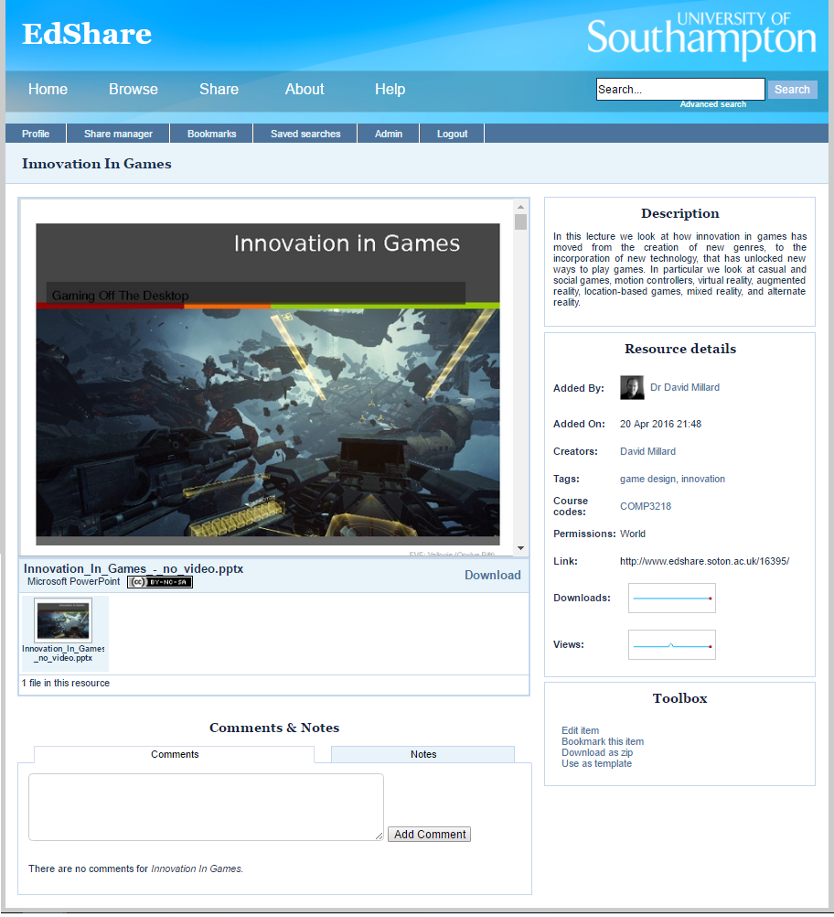
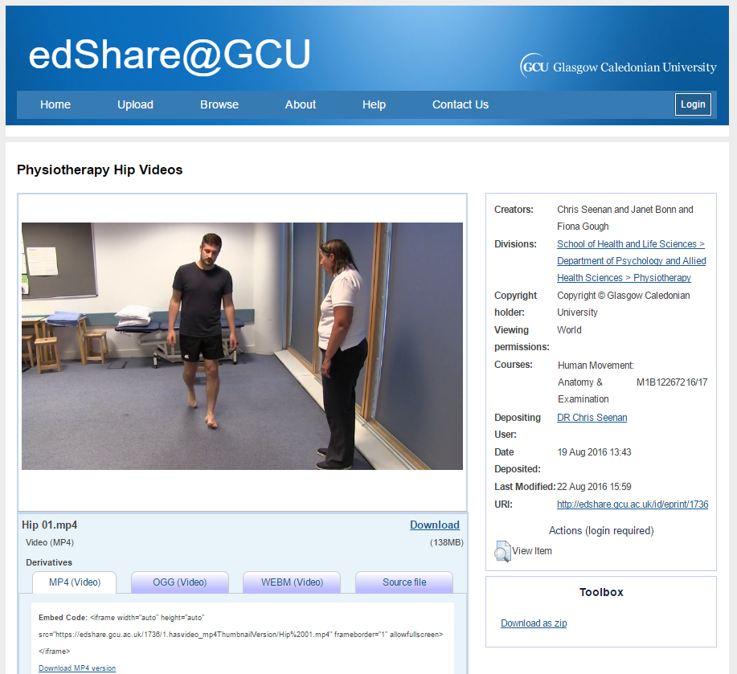
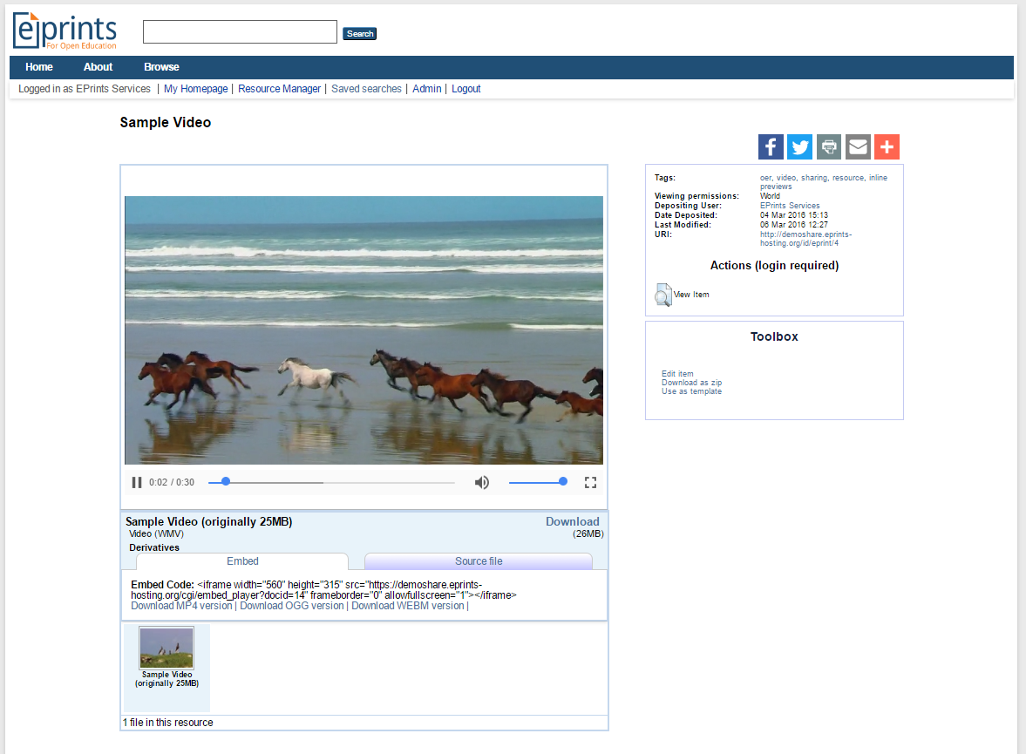
Inline Previews & HTML5 Player
Preview support for a variety of formats
Multiple derivatives (video & audio)
Greater device support
Multiple download options
Embeddable player

Slide 6
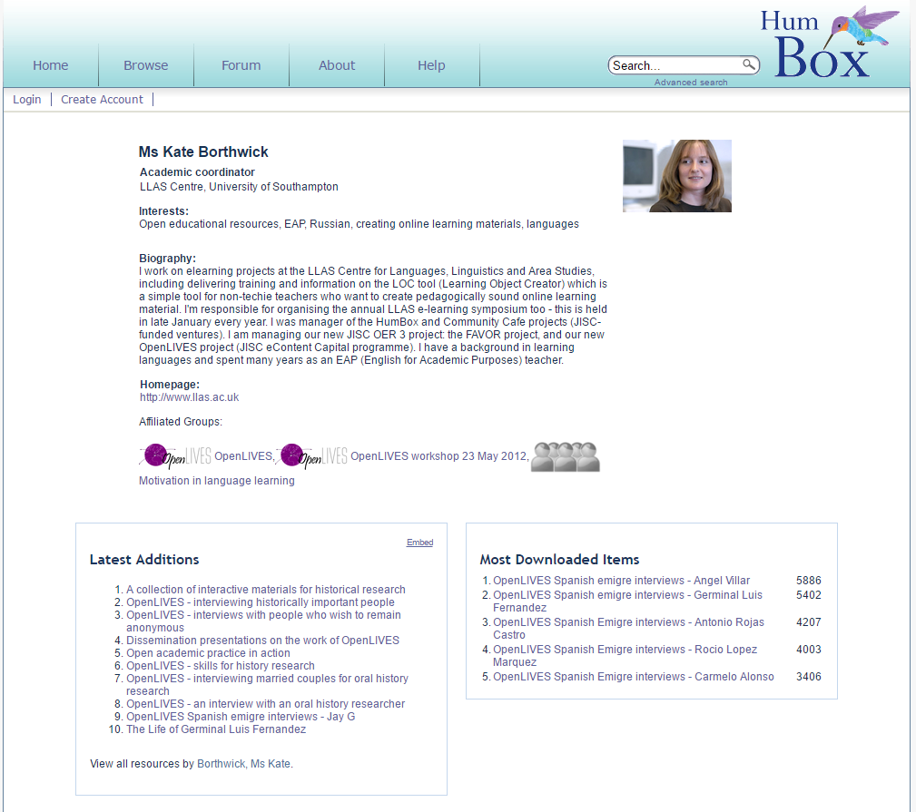
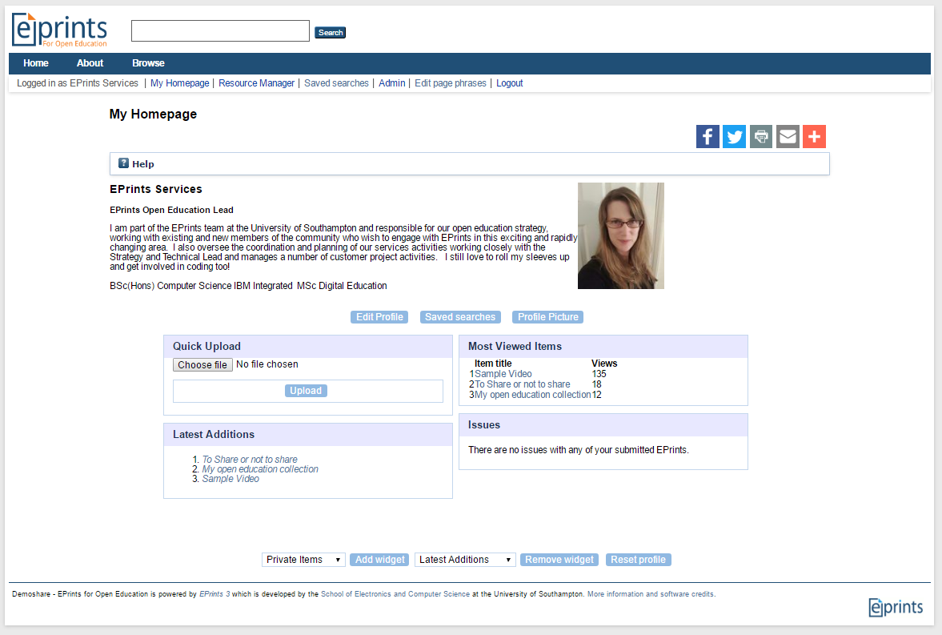
Community
Personalised homepage
Public profile page
Add private notes to resources
Public comments

Slide 7
What repository features should be available to users of OERs?
@KellyATerrell
Notes:
Take a couple of minutes to chat to the person next to you – you can also tweet me your thoughts
----------------------------
Repositories are great for managing a large diverse collection of content, making things as simple as possible for you to share your resource for consumption.
We are still currently in a relative comfort zone when it comes to being open – we remain as the sole providers of content presented in the repository and control how it appears.
Is that as open as we are going to be – could we be doing more, should we be doing more

Slide 8
OE & OERs: Remembering why
Removal of barriers and re-balancing the dominance of elite education institutions to provide fairer and greater access to publicly funded educational content
Anyone around the world wishing to access high quality education content may do so freely leading to greater social and economic progression (Downes 2011, Lane 2008, Hylen 2006, UNESCO 2002) Downes, S. (2011). Five Key Questions. Retrieved 24 July 2014. http://www.downes.ca/post/55055. Lane, A. (2008). Widening participation in education through open educational resources. In Opening Up Education: The Collective Advancement of Education through Open Technology, Open Content, and Open Knowledge. T. Iiyoshi and M. S. V. Kumar (Eds.). (Cambridge, MA: MIT Press): pp. 149-163.. Hylen, J. (2006). Open Educational Resources: Opportunities and Challenges, Proceedings of Open Education, 49-63. UNESCO. (2002). Forum on the impact of open courseware for higher education in developing countries: Final report. UNESCO.
Notes:
All about removing barriers - is adding content to the repository enough?
We place a lot of emphasis on providing the content, posting it online with a licence.
One of the most significant challenges to emerge around OERs has been their discoverability – by all types of users, be they academic, students or self-learners.

Slide 9
What do mean when we talk about Discoverability
“to show the presence of something hidden or otherwise difficult to see and to make it known” http://www.merriam-webster.com/dictionary/discoverable
“If OERs cannot be discovered, from a practical perspective they may as well be closed or not exist” (Hilton et al 2010. The Four R’s of Openness and ALMS Analysis: Frameworks for Open Educational Resources )
Can you find me?
Image Source: Pixabay
Notes:
First what do we mean by ‘discoverability’
This may seem like it has an obvious clear answer, but just as openness has many levels (it is not a case of open vs closed), so does the discoverability of OERs – it’s not a simple as ensuring Google shows it in its results page.
For OERs we are talking about a diverse population of users with different expectations of how they want to interact with the resources, apply search strategies for finding and trusting them. They will also have different levels of ability to make decisions on whether they have found something that meets their needs.

Slide 10
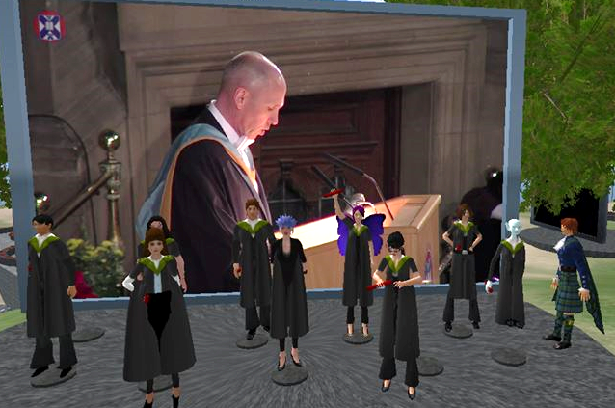
MSc in Digital Education research project (University of Edinburgh)
Discoverability Strategies of Open Educational Resources: A Scoping Study. My full report is available from kellyaterrell.wordpress.com
Determine strategies used within the UK higher education community to release OERs to address the challenge of discoverability by education users
Sample = 35 Jisc funded UKOER projects
Limitations – grand plans vs reality
Notes:
During 2014 I tackled this topic in a small piece of research as part of a Master in Digital Education I was doing with the University of Edinburgh.
This included a literature review to get greater understanding of what we really mean by OERs as well as the technical and non-technical understanding of the topic of discoverability – of which there was a surprisingly small amount. Much of which was based around search engine optimisation.
Specifically my study focused on identifying strategies used by UK HEIs to address the challenge of discoverability and I would like to share with you some of the key findings from this.
Limitations had be imposed on the study as it was a masters – the UKOER projects were selected as a case study, of which 35 met my criteria for inclusion – i.e. being about OER release and still existing

Slide 11
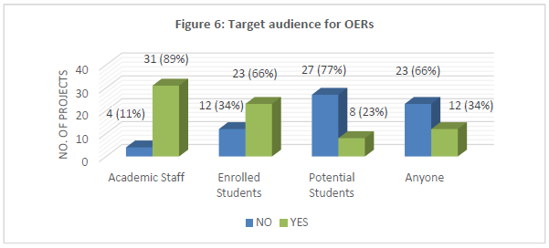
Declared target audiences for OERs
Full report available at http://kellyaterrell.wordpress.com
Notes:
In the data collection process it clearly became apparent that projects had consciously targeted their OER for specific audiences.
Surprisingly only 34% has explicitly declared they were be released for a global audience / anyone.
66% declared they were for enrolled students (either at their own or another institution doing a specific course)
89% declared they were for academic students
Fine in itself – but could this type of conscious bias affect how much effort we put in to the resources discoverability factors?

Slide 12
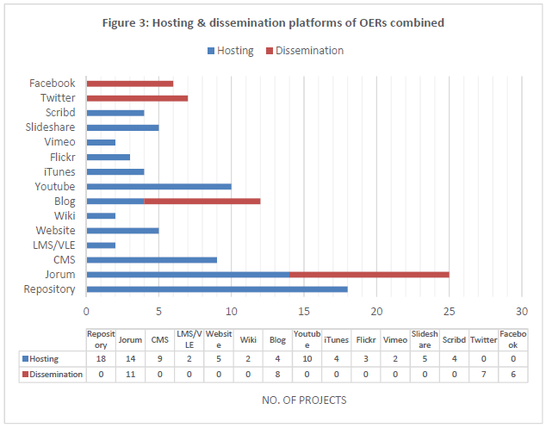
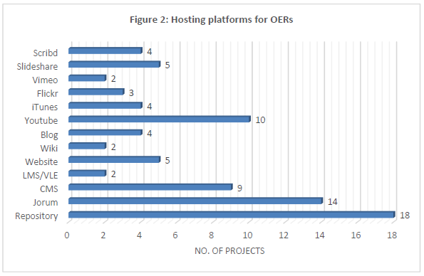
OER Hosting & Dissemination Platforms
51% using a repository to host their OERs
Further 26% using a CMS
Facebook, Twitter and Blogs used as dissemination platforms
In one case of Twitter, tweets could only be seen with approval ☹
Full report available at http://kellyaterrell.wordpress.com
Notes:
Overwhelming preference for management environments

Slide 13
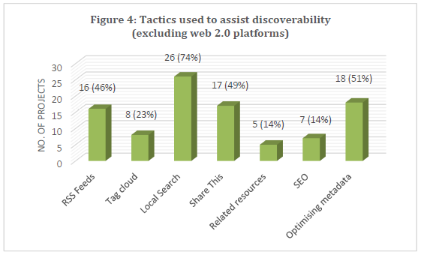
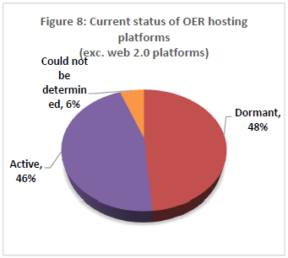
Tactics provided/used to aid discoverability
Only half were using ‘Share This’ widget to encourage social network sharing
Less than a quarter guided users to related resources
Content must be looked after carefully to adapt to technology changes and prevent content from sliding in to oblivion (JISC Spotlight)
Full report available at http://kellyaterrell.wordpress.com
Notes:
Thinking about our users, I look across the sites used by the projects to identify what they offered to aid discoverability by our range of users.
Over half talk about metadata optimisation – helped expose data to search engines
Surprising that only half offered a share this widget, a simple method of increasing visibility of a record through personal networks
Related resources which can be driven a number of different way – again a simple mechanism to offering alternatives to a user that may not have found exactly what they need.
The biggest concern (though perhaps not a surprise) was the next piece of data – that 48% of the projects analysed were no longer active!
The big problem with this was reflected in a report by the Jisc Spotlight project – technology is constantly changes, services will disappear, new ones will arrive, search algorithms are constantly evolved. Content no matter how good will disappear if it is not looked after.
With this is mind that I think we have to reconsider how the user community interacts with our repositories

Slide 14
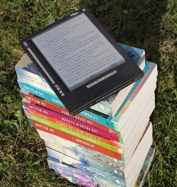
Future directions for EdShare: Stepping outside the comfort zone
Showcasing Resources:
Quality indicator for OER repositories recommended by Atenas & Havemann (2014)
Method of promotion to help expose materials
Manually created (hmm), or dynamically generated based on user interactions:
Most popular, Most viewed, Most liked
Channels:
Associated content in one place with ability for users to subscribe/follow
Atenas, J. and Havemann, L. (2014). Questions of quality in repositories of open educational resources: a literature review. Research in Learning Technology, 22.

Slide 15
Future directions for EdShare: Stepping outside the comfort zone
Community:
Allow any user to register
Permit direct editing of records, such as providing links to new versions which exist elsewhere
(Crowdsourcing metadata another quality indicator from Atenas & Havemann (2014))
Collaborate with users on the creation of resources

Slide 16
Future directions for EdShare: Stepping outside the comfort zone
Social Media Sharing:
Another quality indicator recommended by Atenas & Havemann (2014)
Social networks particularly for learners and academics professional is a trusted route for information discovery

Slide 17
Future directions for EdShare: Stepping outside the comfort zone
Open Courses:
Allow anyone in the institution freedom to structure and run an open course
Could be of any scale, but ideal for those who wish to run small scale experiments engaging with a global community of users
Benefit of permitting users to see resources in their context of use

Slide 18
Future directions for EdShare: Stepping outside the comfort zone
Playlists:
User generated ‘playlist’ to identify a sequence of resources or non-sequential that they have collated for a purpose
Sharing of a personal learning path vs a prescribed one
Recommendations:
Based upon usage data collected from other users
Based upon linked data between records

Slide 19
Future directions for EdShare: Stepping outside the comfort zone
Evaluation Tools:
Quality indicator of OER repository recommended by Atenas & Havemann (2014)
Demonstrate trust in the community by allowing them to engage and provide feedback.
Ratings can provided associated metadata to feed views such as ‘Most Viewed’, ‘Most Popular’
A default offering of many social media sites where OERs are already being shared

Slide 20
Thank you
www.eprints.org/edshare
demoshare.eprints-hosting.org
K.Terrell@soton.ac.uk
Twitter: @KellyATerrell and @EPrints

