Slide 1
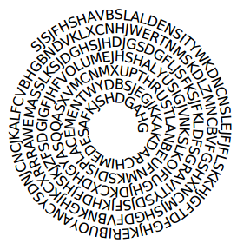
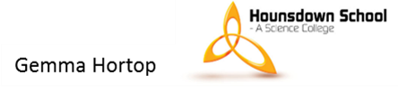
Floating and Sinking
Learning Objective: Explain why things float and sink
Find 5 keywords from the spiral.
Below are the first letters of 3 of them:
B__________
U__________
A __________- (Scientist in ancient Rome who shouted ‘Eureka!’)

Slide 2
Floating and Sinking
Keywords:
Density
Buoyancy
Mass
Volume
Upthrust
Archimedes

Slide 3
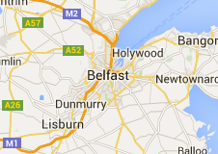

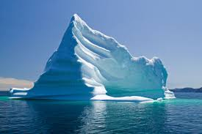
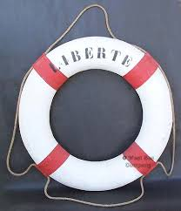
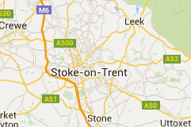
What connects all of
these images?

Slide 4
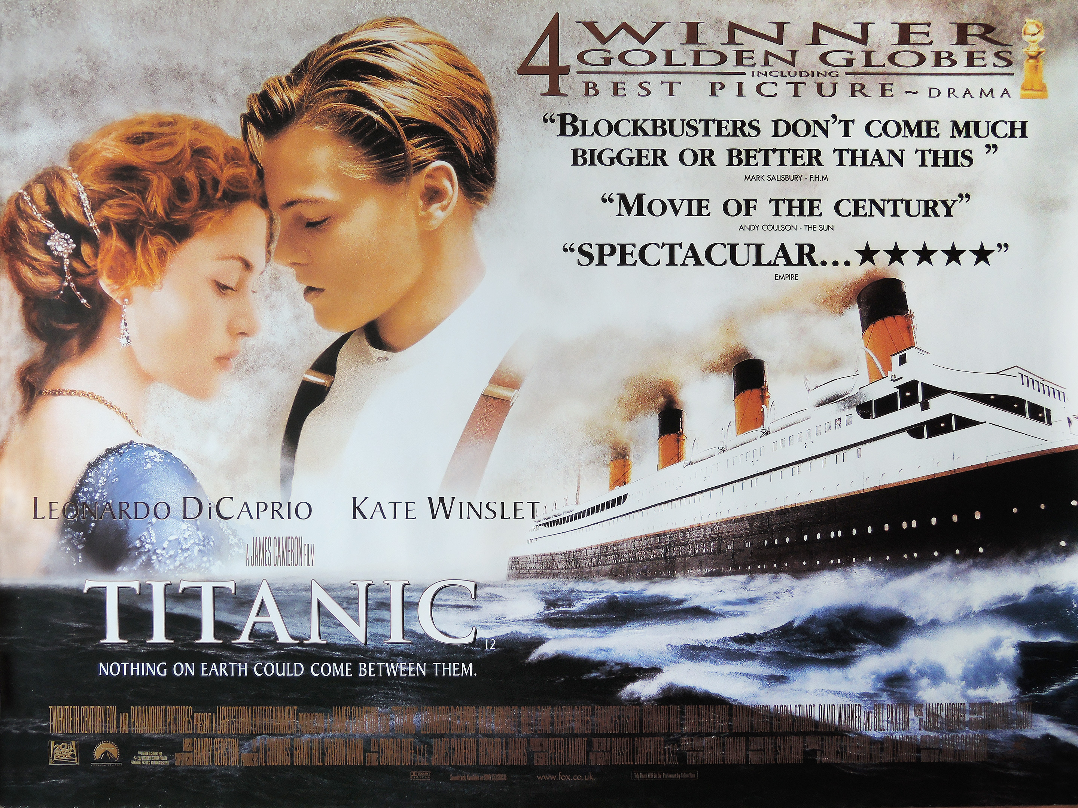
The Titanic
Notes:
Trailer video hyperlinked to image (2minutes)

Slide 5
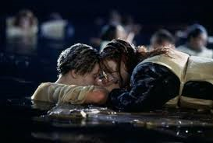
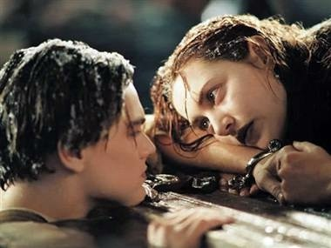
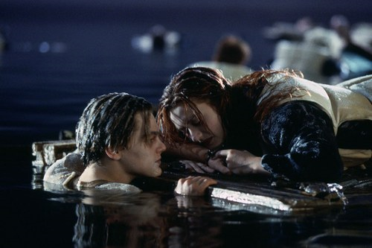
Final Objective: To be able to scientifically answer the question:
“Would Jack and Rose both have fitted on the door?”
Literacy Objectives:
Discussion and using correct terminology to write an explanation
Numeracy Objectives:
To be able to calculate density

Slide 6
Learning Objectives
All: Describe the 2 forces acting on objects on water to explain if it will float or sink
Most: Will be able to work out the volume of an irregular sized object using Archimedes’ principle.
Some: Calculate density using mass and volume and use this to predict if an object will sink or float

Slide 7
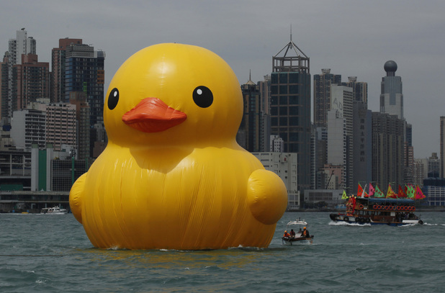
Why is this rubber duck floating?

Slide 8
What are the independent and dependent variables?
Tie an elastic band around the
object.
Hook it up to a Newton meter
and weigh it in air.
See whether it floats or sinks.
Hook it up to the Newton meter and weigh it either in the water or on the water.
Repeat for two objects that float and two objects that sink.
Draw an appropriate results table
LO: to say whether Jack and Rose could both have fitted on the door.

Slide 9
Why is this rubber duck floating?
Notes:
Improve their answer

Slide 10

The object needs to exert less force down on to the water than the water exerts up on to it.
This duck is floating because the 2 forces are equal.
What would happen if the weight of the duck increased?

Slide 11
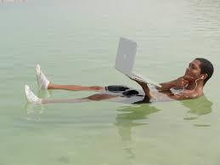
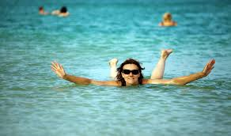
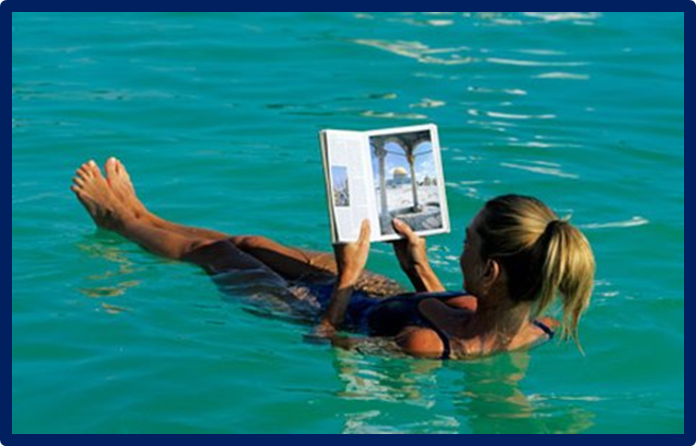
Floating in the Dead Sea- how is this possible?
The dead sea has a very high concentration of salt. Why does this make it possible for people to float?

Slide 12
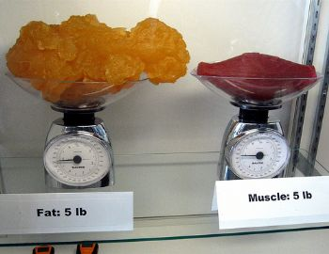

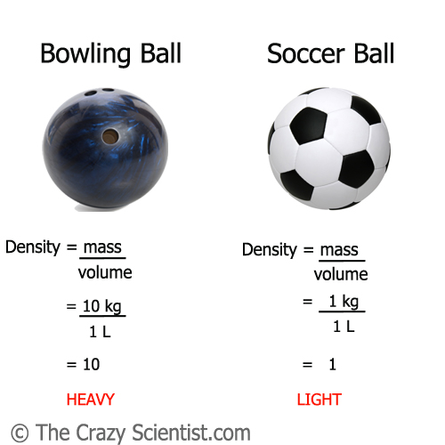
The water in the dead sea is denser but what does that mean?

Slide 13
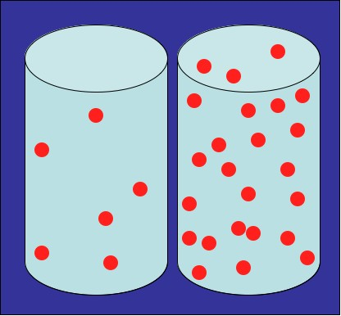
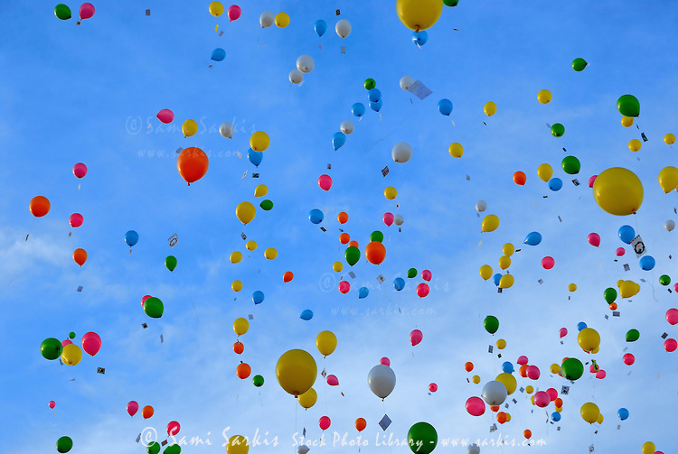
Density is the amount of “stuff” (mass) in a fixed space (volume)
Notes:
Write it in their glossary

Slide 14
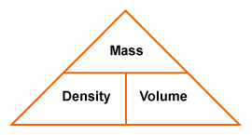
Calculating Density
Density = Mass ÷ Volume
How could you use this triangle to find the mass of an object?

Slide 15
Keeping things afloat
For an object to float it needs to be less dense than the liquid it is in.
LO: to say whether Jack and Rose could both have fitted on the door.

Slide 16
Learning Objectives
All: Describe the 2 forces acting on objects on water to explain if it will float or sink √
Most: Will be able to work out the volume of an irregular sized object using Archimedes’ principle.
Some: Calculate density using mass and volume and use this to predict if an object will sink or float

Slide 17
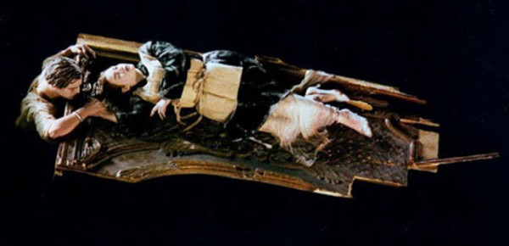
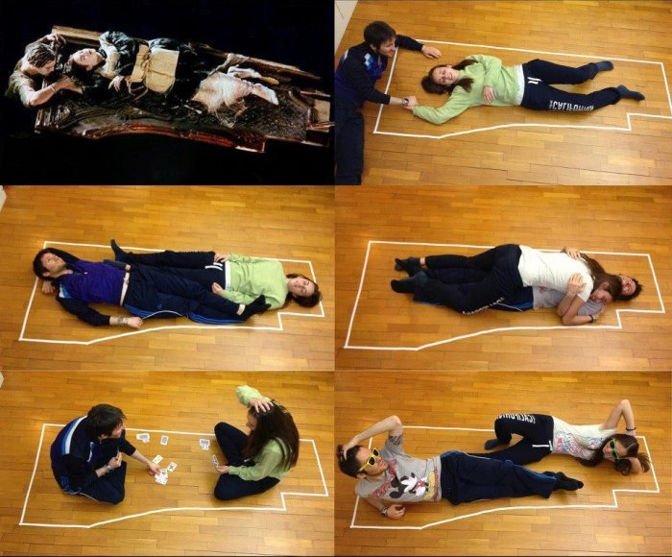
Could Jack have got on the door with Rose?
If the issue wasn’t space, why did Jack not join Rose on the door?
What do we need to know to work out the total density of Jack, Rose and the door in the water?
LO: to say whether Jack and Rose could both have fitted on the door.

Slide 18
Why is calculating density so difficult?
They are funny shaped so how do we work out their volume?
Notes:
Humans are a funny shape so it is hard to work out our volume.

Slide 19
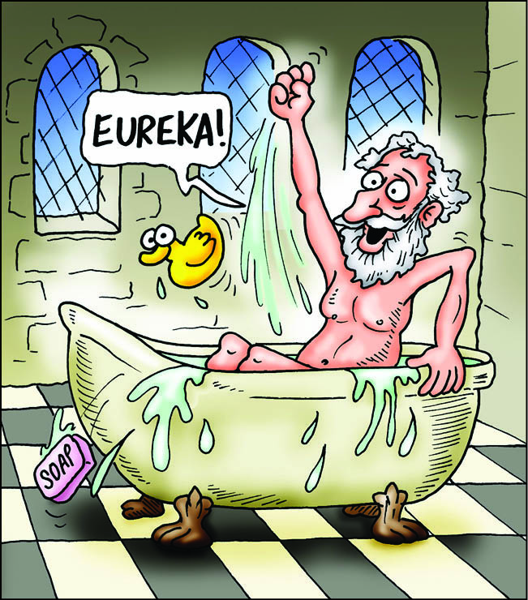
Archimedes’ Principle
I think I can help you with that!

Slide 20
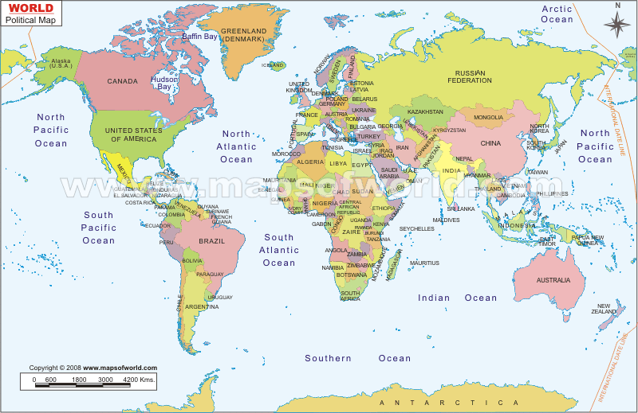
http://maps.google.co.uk/maps?hl=en&resnum=0&q=Syracuse+sicily+map&um=1&ie=UTF-8&hq=&hnear=Syracuse+SR,+Italy&gl=uk&ei=ni1LS5zOBNeM4garucj_Ag&sa=X&oi=geocode_result&ct=image&resnum=1&ved=0CA0Q8gEwAA
Archimedes was born in Syracuse on the eastern coast of Sicily and educated in Alexandria in Egypt. He then returned to Syracuse, where he spent most of the rest of his life, devoting his time to research and experimentation in many fields.

Slide 21


Your task
You are going to watch a video which explains an important observation that Archimedes made which will help us work out the density of Jack, Rose and the door.
In pairs you will have some key words connected to the video clip. You need to provide as much detail as you can about why the word has been included.

Slide 22


Slide 23
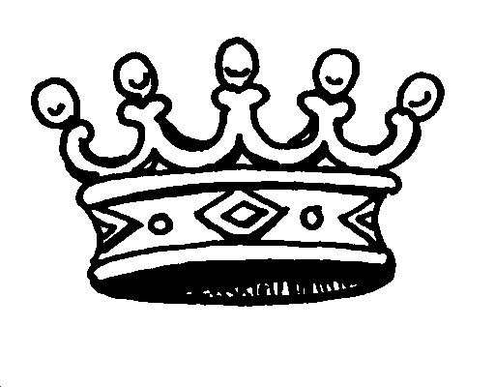
Names:_____________________________________
The King
Volume
Gold
Silver
Density
Bath
Eureka
Displacement

Slide 24
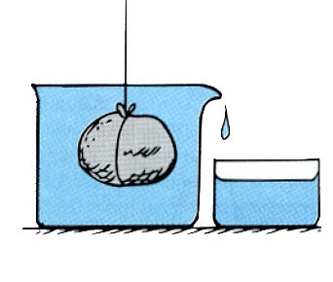
Archimedes’ Principle
He found that the volume of water displaced is equal to the volume of the object

Slide 25
Practical Investigation
You have been given a measuring cylinder, a eureka
can with a spout, a balance and some different
materials of which we do not know the density. We
are going to weigh the material to find its mass and
submerge the material in liquid to find its volume
then calculate density.
Write an aim for the investigation.
The aim for this investigation is to find out how different __________ are/have/affect___________
Draw a table to collect your results

Slide 26
Calculations – show your working out!
The mass of an object is 10g, it has a volume of 300cm³. Find it’s density in g/cm³.
The mass of a coin A is 2.56g, it has a volume of 11.13cm³. The volume of coin B is 9.13cm³ and it has a mass of 4.11g. Which coin is more dense?
The density of an object is 11.3 g/cm³. It has a volume of 3cm³. What is it’s mass?
Notes:
For students that have finished.

Slide 27
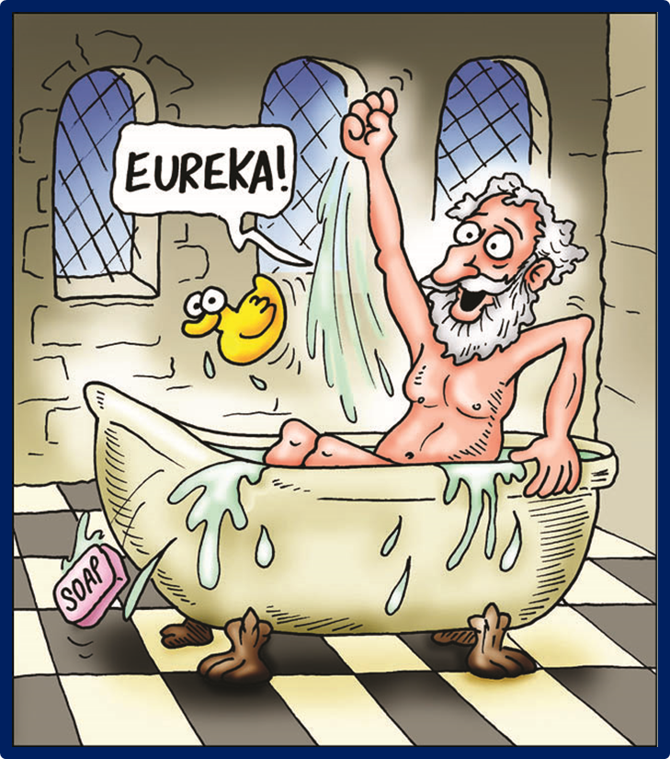
How well did you do?
Density (g/cm³):
Aluminium- 2.7
Lead – 11.34
Wax – around 0.5
Marble – 2.76
Slate – 2.75
Steel – 7.60

Slide 28
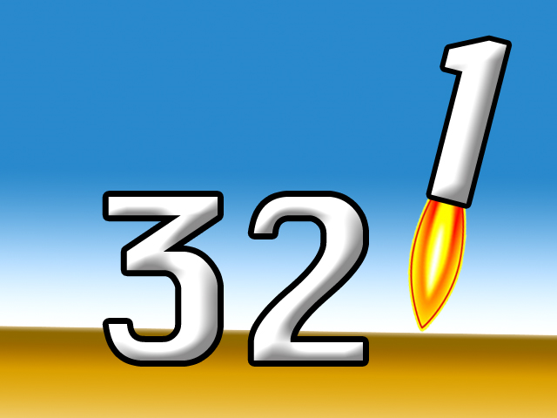
Write 3 sentences that sum up what you have learnt today.
Write 2 key words
Write down one letter that you link to the lesson and be ready to justify your choice.

Slide 29
Learning Objectives
All: Describe the 2 forces acting on objects on water.
Most: Calculate density using mass and volume and use this to predict if an object will sink or float
Some: Can use Archimedes’ principle of water displacement to explain why an object sinks or floats.

Slide 30
Names:_____________________________________
The King
(A király)
Volume
(kötet)
Gold
(Arany)
Silver
(Ezüst)
Density
(Sűrűség)
Bath
(Fürdőkád)
Eureka
Displacement
(Elmozdulás)

Slide 31
Final Objective: To be able to scientifically answer the question:
“Would Jack and Rose both have fitted on the door?”
Mass of door = 196kg
Mass of Rose = 55kg
Mass of Jack = 73kg
Volume of door in the water = 0.254m³
Density of water = 1000kg/m³

