Slide 1
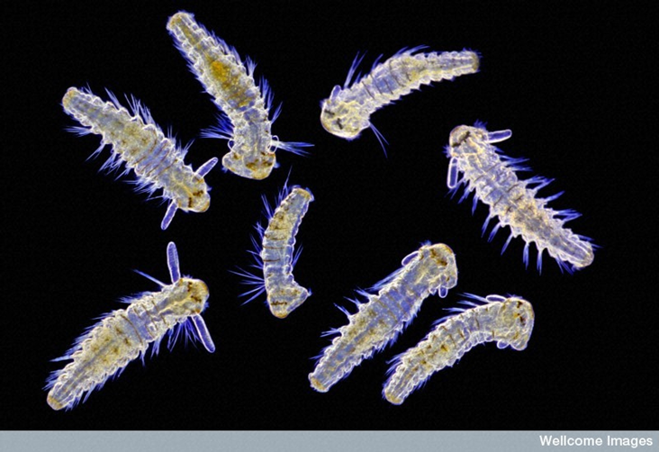
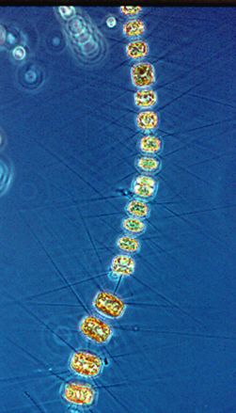
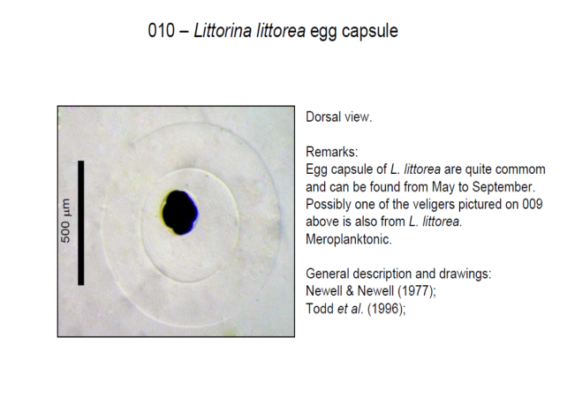
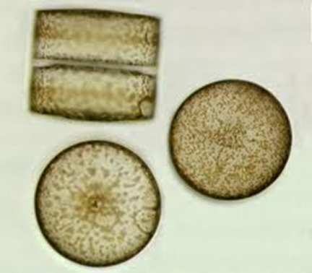
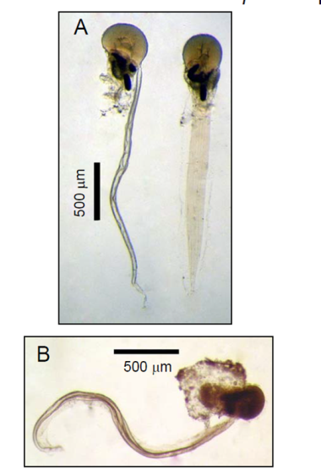
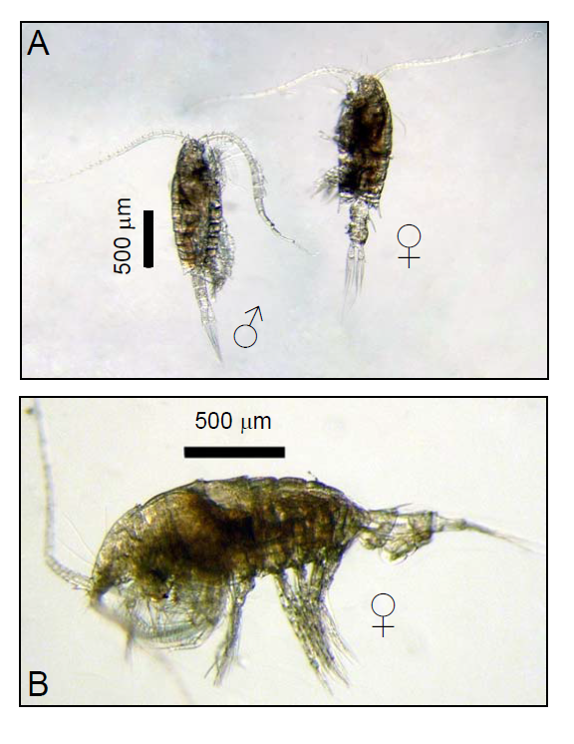
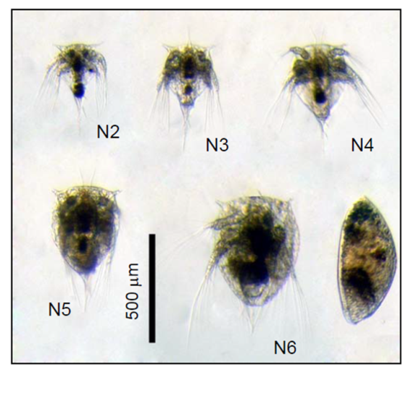
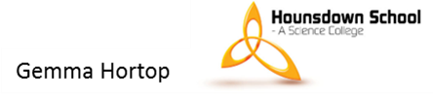
Polychaete larvae
look like Worms
Diatoms
Egg capsule
Copepods – biggest animal
you will see
Sea squirt
Barnacle larvae look like fleas.

Slide 2
Diatoms
Copepods – biggest animal
you will see
Barnacle larvae look like fleas.
Sea squirt

