Slide 1
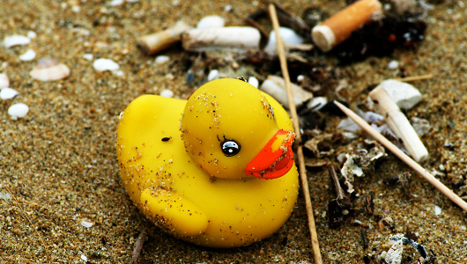
Remember me. What is the impact of all that plastic in the ocean?

Slide 2
Today’s lesson
ALL – Understand the causes and some of the effects of pollution on our oceans.
MOST – will understand the effect of adding too much fertiliser to farmland and how this causes algae blooms.
SOME – will understand the term “dead zone” and the role of eutrophication.

Slide 3
Key Terms…
Algae bloom
Eutrophication
Dead Zone
Fertilisers
Nutrients

Slide 4
Watch the video and write down reasons why the Ocean’s are so important.

Slide 5
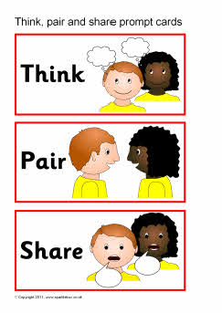
Think, pair, share
Where do you think all the pollution comes from? Make a list in your book.

Slide 6
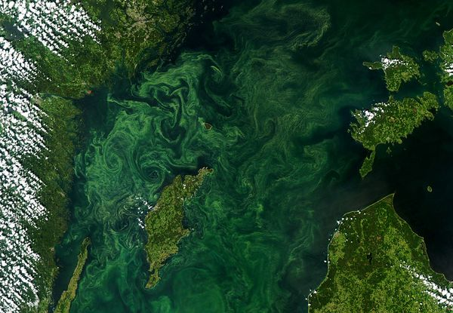
Any ideas?
Notes:
Algae bloom in Baltic Sea 2005 – now the world’s largest ocean dead zone

Slide 7
This is an algal bloom.
Plants like fertilisers as it helps them grow.
This bloom is caused by fertiliser running into rivers off the land.

Slide 8
Your task….
Control
(clean water)
Water with algae
Water with algae
and fertiliser
Record the Oxygen levels

Slide 9
Questions
Why do we need a jar with no algae in it?
What do we need to do to make sure it is a fair test?
Why are we going to record the oxygen levels every few days?
Draw a results table in your book

Slide 10
Why are algae blooms a problem?
They create dead zones where nothing can survive.

Slide 11
It’s called eutrophication…..

Slide 12
Your task….
Produce a poster which explains how dead zones form
Use the following key terms..
Fertilisers
Run off
Algae Bloom
Bacteria
Decomposition
Hypoxia

Slide 13
In 7-10 days time
1
2
3
Control
(clean water)
Water with algae
Water with algae
and fertiliser
Put the algae in Jar 3 in a dark cupboard
What do you predict will happen?
Notes:
The algae will die due to lack of light and the oxygen levels will drop as bacteria decompose them.

Slide 14
Plenary
Draw the pyramid in your book!
Write one question that you have about today’s lesson
Write two keywords from the lesson
Write three things that you learnt in today’s lesson

