Slide 1
Mysteries of the deep

Slide 2
Learning Outcomes….
All- will be able to describe what happens to water pressure as the depth increases.
Most – will be able to explain why humans cannot dive down very far.
Some – will be able to explain what “the bends” are.

Slide 3
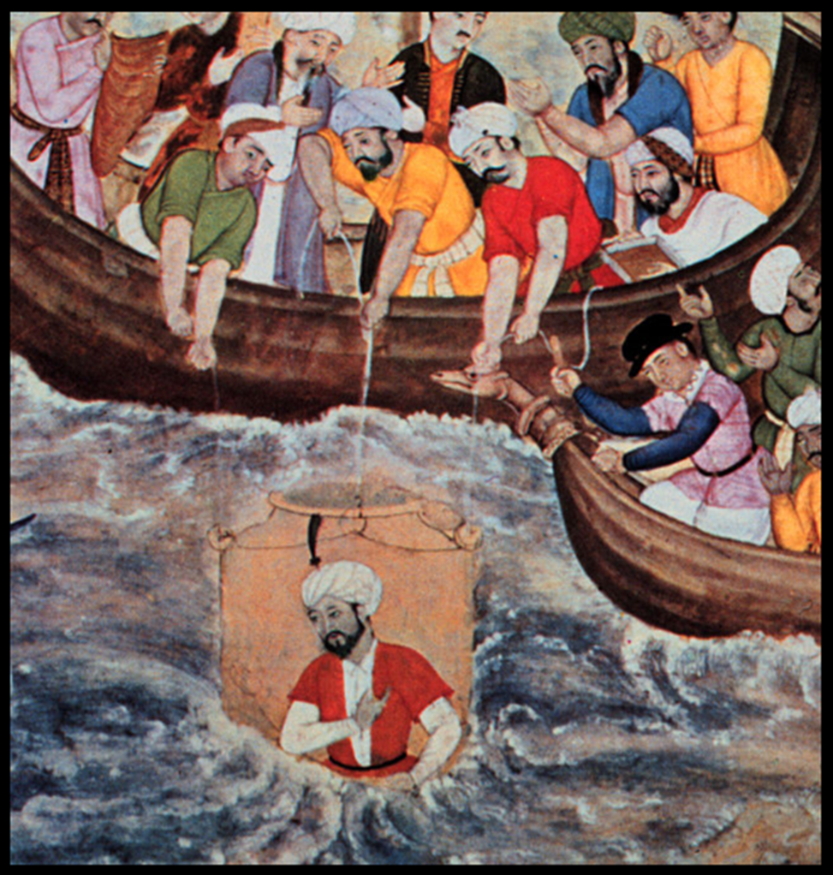
Deep Sea Diving
When do you think humans first started exploring the deep?
Notes:
The picture is believed to be Alexander the Great using a Diving Bell and he lived from 356- 323 BC.

Slide 4
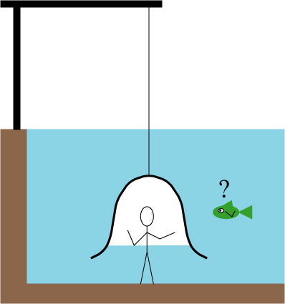
The Diving Bell.
Your teacher will perform a demonstration of the diving bell. Explain how you think it works?
Notes:
Scrunch up a ball of tissue into the bottom of a glass. Slowly push it down (upside down) into a tank of water and then pull it back out slowly. Show the class that the tissue is still dry.

Slide 5
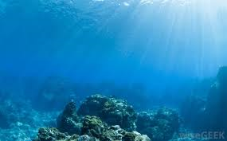
Discuss what some of the dangers of travelling down into the deep ocean might be?

Slide 6
Pressure in liquids
Pressure in liquids increases as the depth of the liquid increases
This can be seen by how far water squirts out of a tall container with holes at different depths

Slide 7
As you go deeper in the ocean pressure increases.
This is because the weight of all the water above you is pushing down.
WEIGHT

Slide 8
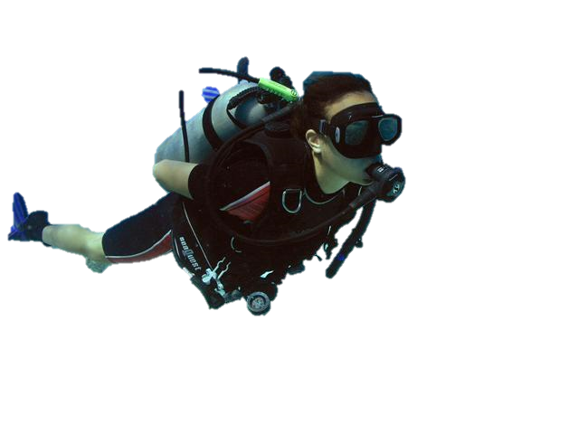
Can you explain why I can only dive down to around 50m?

Slide 9
The Diver Bends!!!
A diver will start having breathing problems if they dive too far down.
They can suffer from something called “The Bends”.
When you dive down the pressure of the water on our body means the air in our lungs gets squashed.
This is the same for the air coming out of the air tanks a diver breathes from. It is under high pressure.

Slide 10
Pressurised Gas
Gases under high pressure will dissolve in liquids.
For example Fizzy drinks have pressurised carbon dioxide dissolved in them
The same thing happens when the high pressure gas in the diver’s air tanks dissolves into their blood stream.
When you open the bottle you release pressure which causes the drink to fizz (bubbles)
If a diver returns to the surface too quickly the nitrogen dissolved in the bloodstream does the same thing.

Slide 11
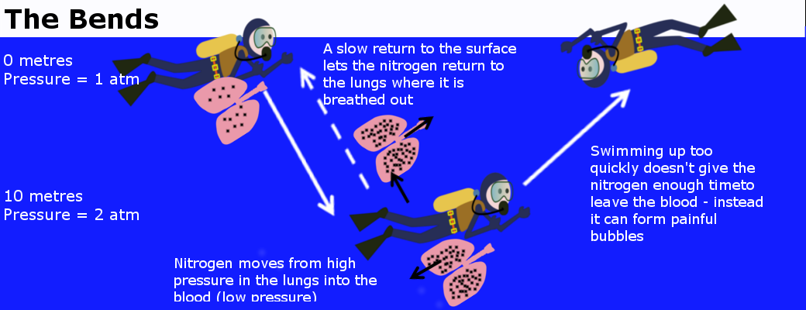
If the diver were to swim quickly to the surface, it is just like uncorking a bottle of soda -- the gas is released. This can cause a very painful condition, and it is sometimes fatal.

Slide 12
What if you could dive down that far?

Slide 13
Learning Outcomes….
All- will be able to describe what happens to water pressure as the depth increases.
Most – will be able to explain why humans cannot dive down very far.
Some – will be able to explain what “the bends” are.

Slide 14
The Diving Bell.
Do you need to change your explanation of how you think it works?
Notes:
Scrunch up a ball of tissue into the bottom of a glass. Slowly push it down (upside down) into a tank of water and then pull it back out slowly. Show the class that the tissue is still dry.

