Slide 1
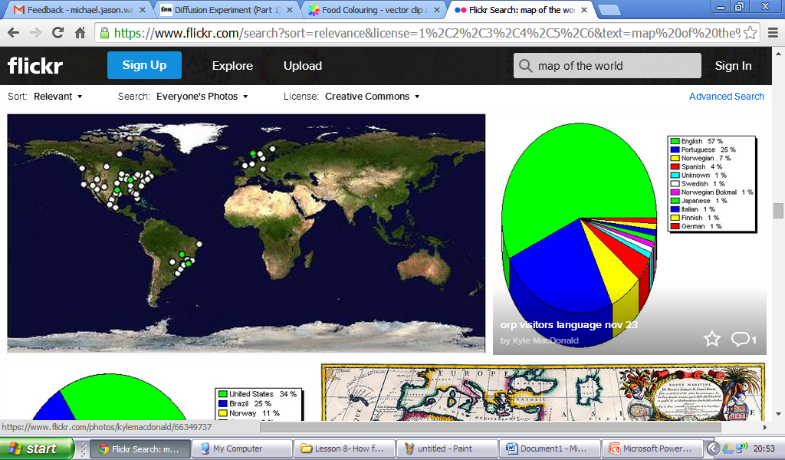
Surfing in warm water is more dangerous compared to cold water
 | Attempt 1 | Attempt 2 | Attempt 3 | Mean Average
Independent Variable
.................................................................................................................................
Dependent variable:
................................................................................................................................
What needs to be kept the same?
……………………………………………………………………………………………………………………….
Why is three attempts useful?
Conclusion of evidence
-State your findings
-Quote and discuss the evidence you have for those findings
-Using scientific ideas, discuss what could have caused these findings (use your scientific keywords)
………………………………………………………………………………………………………………………………………………………………………………………………………………………………………………………………………………………………………………………………………………………………………………………………………………………………………………………………………………………………………………………………………………………………………………………………………………………………………………………………………………………………………………………………………………………………………………………………………………………………………………………………………………………………………………………………………………………………………………………………………………………………………………………………………………………………………………………………………………………………………………………………………………………………………………………………………………………………………………………………………………………………………………………………………………………………………………………………………………………………………………………………………………………………………………………………………………………………………………………………………………………………………………………………………………………………………………………………………………………………………………………………………………………………………………………………………………………
Which area on the map would you most like to surf at and why? ………………………………………………………………………………………………………

