Slide 1
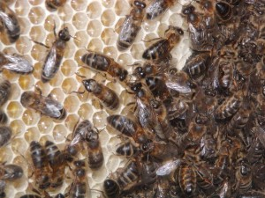
Imagine a long rectangular box with a wall in the middle separating the two sides. Crammed in one side is a huge swarm of bumble bees all travelling in random directions; the other side is empty. Now, if we remove the wall, what will happen?

Slide 2
The bees will spread out into the whole box so they have more space.
This is an example of diffusion
They move from high concentration to low concentration.

Slide 3
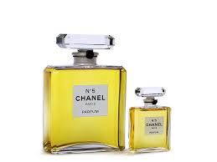
What will happen if you take the top of a perfume bottle and come back an hour later? Why?

Slide 4
The perfume can be smelt from across the room.
Perfume is made of alcohol which has a low boiling point.
The perfume evaporates and the gas particles spread through the air particles in the room.
The perfume is at a high concentration in the bottle so spreads out to a lower concentration.
This is diffusion.

Slide 5
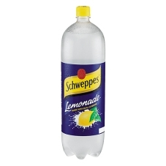
What will happen to a bottle of fizzy drink if the cap is left off but the drink is untouched?

Slide 6
A fizzy drink is fizzy because it contains Carbon Dioxide.
If the cap is left off it the carbon dioxide can escape.
The gas will diffuse out into the air so the drink will eventually go flat.
The carbon dioxide moves from a high concentration to a low concentration.

