Slide 1
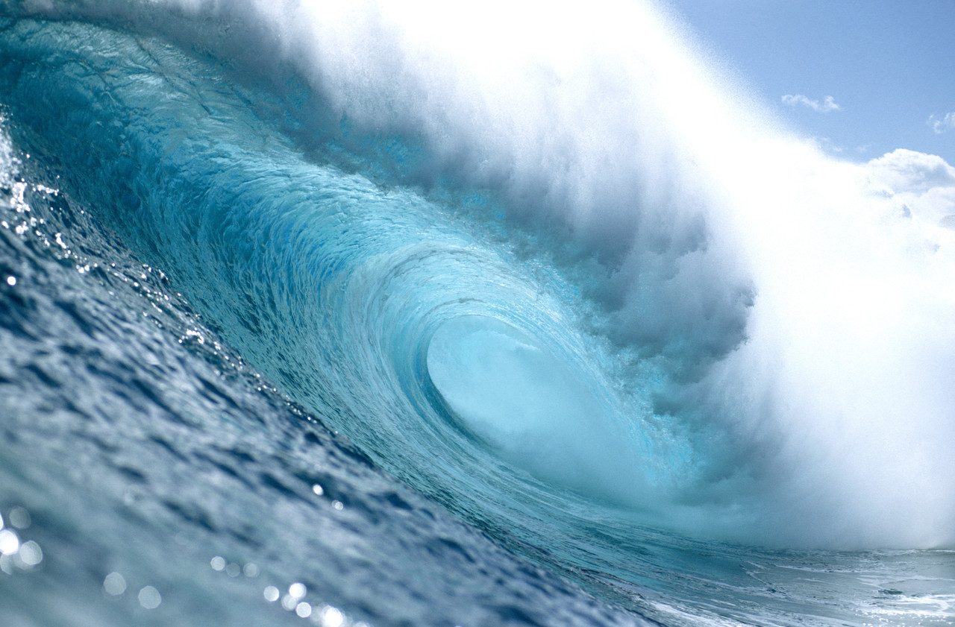


Ocean’s Deep

Slide 2
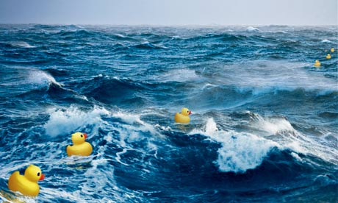
What can a rubber duck teach us about our oceans?
Aims:
To map the largest oceans and seas in the world
To explain what rubber ducks teach us about the ocean

Slide 3
Below are the world’s top 10 largest oceans and seas by area.
1. Rank them in order from largest to smallest
Pacific Ocean | Bering Sea
Arctic Ocean | Caribbean Sea
Mediterranean Sea | South China Sea
Arabian Sea | Southern Ocean
Indian Ocean | Atlantic Ocean
2. Mark the locations of these oceans and seas on your map – check your spellings! 3. Colour code – seas/oceans
Notes:
Extra challenges – 1. Create a colour code to show which are oceans/seas 2. Write a hypothesis – what do you think the rubber ducks might teach us?

Slide 4
Below are the world’s top 10 largest oceans and seas by area.
1. Rank them in order from largest to smallest
Pacific Ocean 64,196,000sq miles | Arabian Sea 1,491,000sq miles
Atlantic Ocean 33,400,00sq miles | South China Sea 1,148,000sq miles
Indian Ocean 28,400,000sq miles | Caribbean Sea 971,000sq miles
Southern Ocean 20,327,000sq miles | Mediterranean Sea 969,000sq miles
Artic Ocean 5,100,000sq miles | Bering Sea 873,000sq miles
Notes:
Extra challenges – 1. Create a colour code to show which are oceans/seas 2. Write a hypothesis – what do you think the rubber ducks might teach us?

Slide 5

1. Where are the oceans and seas?
Aims:
To map the largest oceans and seas in the world
To explain what rubber ducks teach us about the ocean

Slide 6
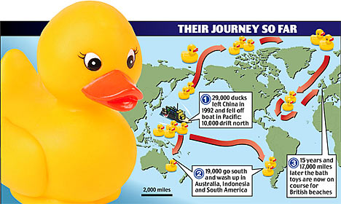
1. Add to your map the journey of the ducks
2. Watch the video to find out what the ducks can teach us...

Slide 7
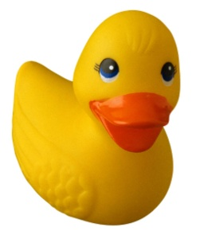
What do rubber ducks teach us about oceans?
In your books write a sentence which answers the question above! The words and phrases below might help...
SURFACE CURRENTS
CONNECT OCEANS NUTRIENTS CARRY HEAT AROUND THE WORLD

Slide 8
2. What do rubber ducks teach us about oceans?
Aims:
To map the largest oceans and seas in the world
To explain what rubber ducks teach us about the ocean

Slide 9
ALL – explain what an ocean current is.
MOST –explain why ocean currents are so important
SOME –Explain the term thermohaline
Currents are wide bands of water that flow around the oceans in huge circles. They are swept along by global winds which drag the water with them. The Earth’s spin makes currents swing to the side.
Some currents are warm (up to a sizzling 30°C), others are cold (down to a chilly -2°C). They take warm water from near the Equator and cold water from near the poles, and carry it around the world.

Slide 10
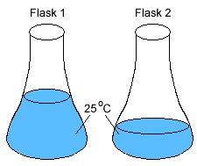
Thermohaline currents
Which beaker will taste more salty and why (they both contain 100g of salt)?

Slide 11

Thermohaline currents
The smaller beaker will taste more salty as it is dissolved in less water particles.
Look at the data on water depth and salinity obtained from the R.V. Callista.
What is the relationship and why might that be?

Slide 12
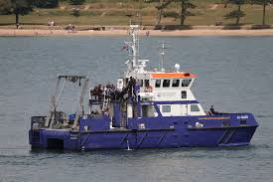
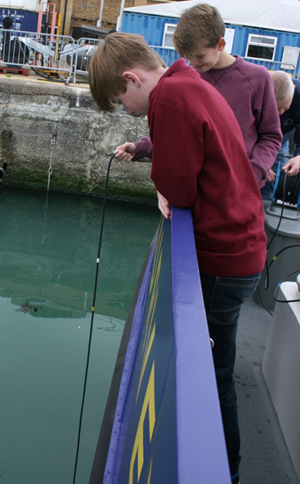
Year 8 data collected from R.V. Callista on 15th May 2015
Water Depth(m) | Salinity (PSU Practical salinity unit)
0 | 29.9
1 | 30.4
2 | 30.7
3 | 33.1
4 | 31.5
5 | 31.5
6 | 31.5
7 | 31.8
8 | 31.9

Slide 13
Thermohaline currents
The saltier the water the greater its density.
This means it sinks.
Teacher demo
Notes:
Large tank of water. Pour a large beaker of coloured salty water down the side of a glass rod into one side of the tank. It should sink.

Slide 14
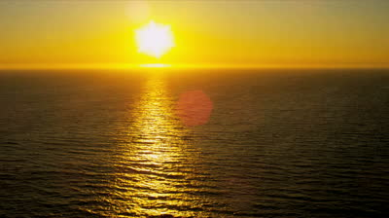
Thermohaline currents
The sun heats the ocean surface water so it evaporates, leaving the salt. More salt in less water = higher density, so it sinks.
This is one part of a thermohaline current.

Slide 15
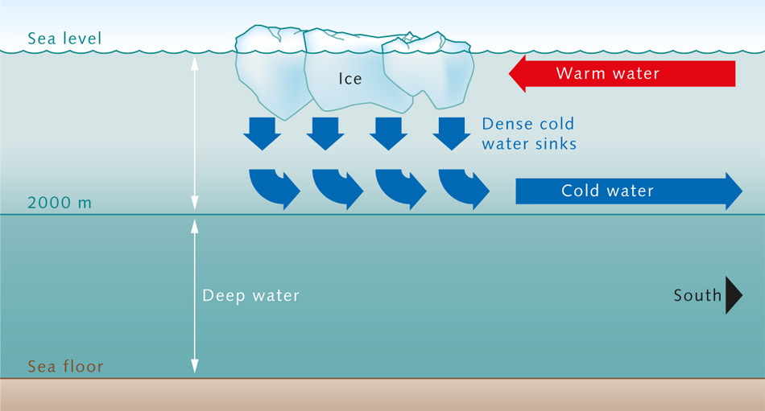
The Thermo part of thermohaline.
The ocean currents are also important for moving heat around the planet.
What was the relationship between the temperature and depth of water on R.V. Callista?

Slide 16
Year 8 data collected from R.V. Callista on 14th May 2015
Water Depth(m) | Temperature (°C)
0 | 13.3
1 | 13.5
2 | 13.5
3 | 13.5
4 | 13.5
5 | 13.3
6 | 13.1
7 | 13.0
8 | 13.0
Notes:
Note: It was a very cold and wet day so unusually the surface was actually cooler that below as heat had been transferred from the surface to the surrounding air which was around 11.8°C

Slide 17
Thermohaline currents
The colder the water the greater its density.
This means it sinks.
Teacher demo
Notes:
Use room temperature water. Float an ice cubed dyed blue on one side of the tank and as it melts the water should sink. On the other side drop a small bottle of hot red water and the water should spread out along the surface.

Slide 18
ALL – explain what an ocean current is.
MOST –explain why ocean currents are so important
SOME –Explain the term thermohaline
Watch the following video and then explain the importance of the Thermohaline currents.
Oceanography
Climate
Thermohaline

Slide 19


Slide 20
In your books write down...
Aims:
To map the largest oceans and seas in the world
To explain what rubber ducks teach us about the ocean
1 thing rubber ducks teach us about oceans
2 things that move ocean currents
3 importance of ocean currents

