Slide 1
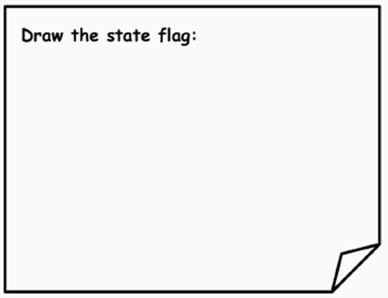
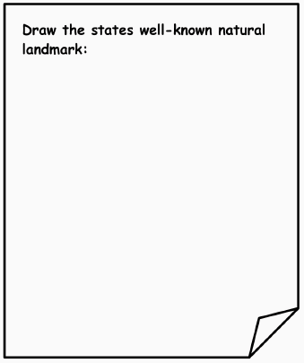
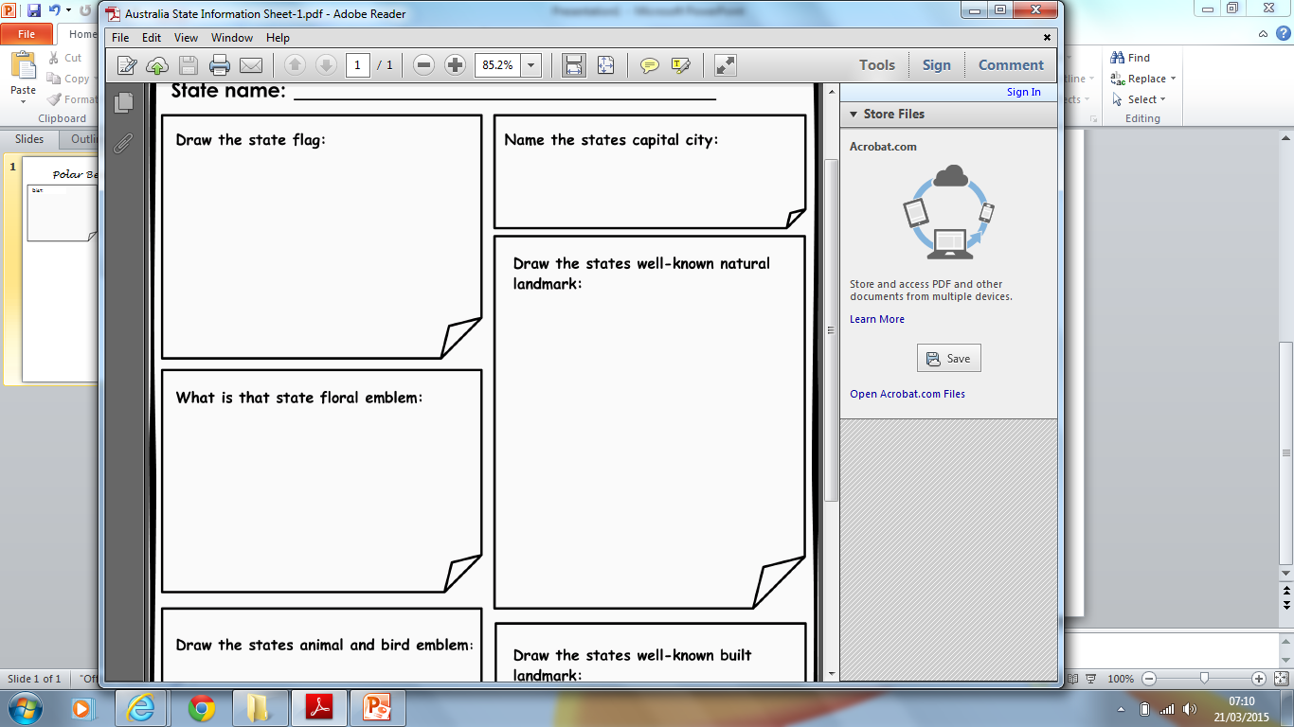

Polar Bear Fact file
Diet:
Behaviour in the wild
Where are they distributed
in the World?
Photograph
Description of their habitat

