Slide 1
Open Data
Christopher Gutteridge

Slide 2
Christopher Gutteridge
@cgutteridge
chris@data.ac.uk
data.southampton.ac.uk
data.ac.uk
data.totl.net

Slide 3
“The opposite of ‘open’ isn’t ‘closed’.
The opposite of ‘open’ is ‘broken’.”
- John Wilbanks
… do you agree?

Slide 4
Some data should be private.
Open Data & Privacy go hand in hand.

Slide 5
Open Data?
Remove barriers to use and reuse.

Slide 6
Open Data?
Remove barriers to use and reuse.
Social
Legal
Awareness / Discoverability
Compatability
Technical
Trust
Convenience
Documentation
...

Slide 7
Types of Data

Slide 8
Types of Data

Slide 9
Types of Data

Slide 10
Types of Data

Slide 11
Reasons to Openly Publish
Improve your reputation
Because somebody makes you
Get some sucker to write your apps for free

Slide 12
(equipment demo)

Slide 13
Reasons to Openly Publish
Improve your reputation
Because somebody makes you
Get some sucker to write your apps for free

Slide 14
Reasons to Openly Publish
Improve your reputation
  all the cool kids are doing it
Because somebody makes you
  the ‘stick’ method
Get some sucker to write your apps for free
  only works if it’s in the public good
  otherwise it’s hacksploitation!
Because it actually achieves your personal (or business) goals
  the ‘carrot’ method

Slide 15
Useful aggregations for Equipment & Facilities data
UK Academia
South-coast public sector
Universities in N.Ireland + R. of Ireland
Hampshire Businesses

Slide 16
Other Useful “standard” Datasets
(for a university to share)
Staff Expertise
Vacancies
Organisational Structure
Buildings & Campuses
Publications
… research data (a can of worms!)

Slide 17
Publishing models & formats

Slide 18
Publishing Organisation Datasets
Well known formats available for:
Events
Publications
News headlines
Nothing in common use for:
Staff Expertise
Programmes of Events
Vacancies
Organisational Structure
Buildings, Rooms
Points of service
Products
  Food Menus

Slide 19


Slide 20
RDF or XML Vocabularies don’t solve the problem by themselves.
You need:
Examples to copy.
Tools which consume and produce the format.
Online checking tools.

Slide 21
A dataset should at least solve one usecase.
Over modelling is fun.
Stop it.

Slide 22
Autodiscovery

Slide 23
/.well-known/openorg
http://www.soton.ac.uk/.well-known/openorg
or
<link rel=“openorg” href=“http://id.southampton.ac.uk/dataset/profile/latest”>

Slide 24
Linked Data Augmentation
Linked datasets augment each other
Key datasets for augmenting other data at the uni.
  People
  Products
  Services
  Places
  Courses
  Parts of the organisation
  External authorities

Slide 25
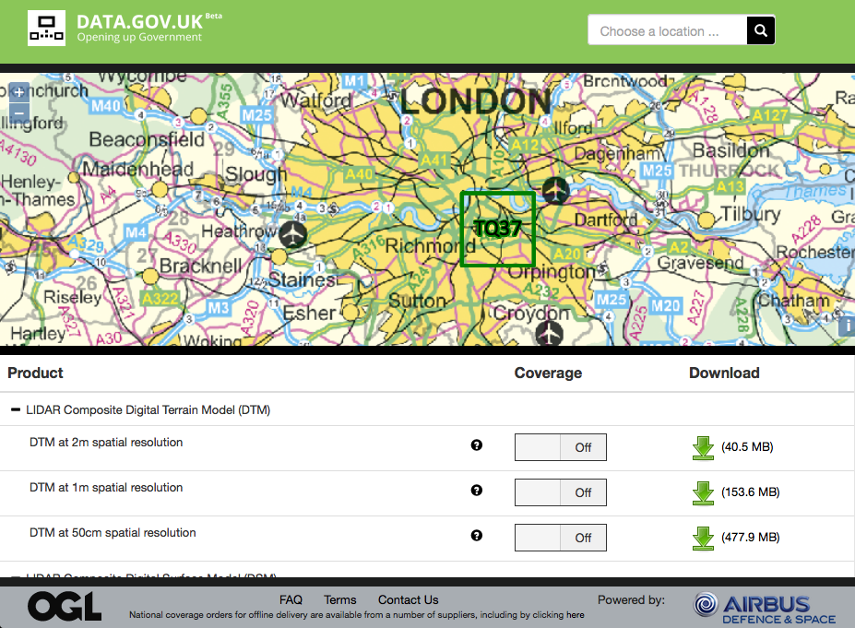

Slide 26
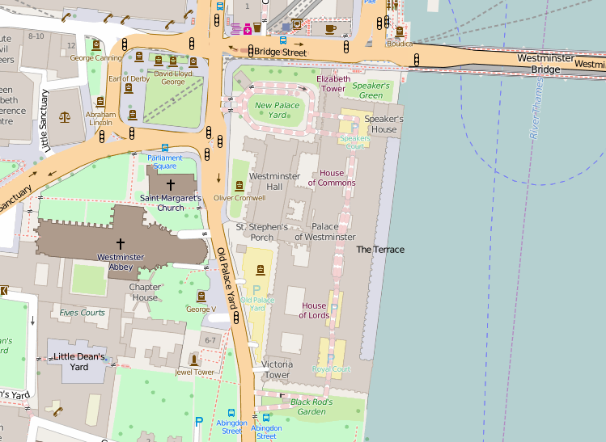

Slide 27


Slide 28


Slide 29
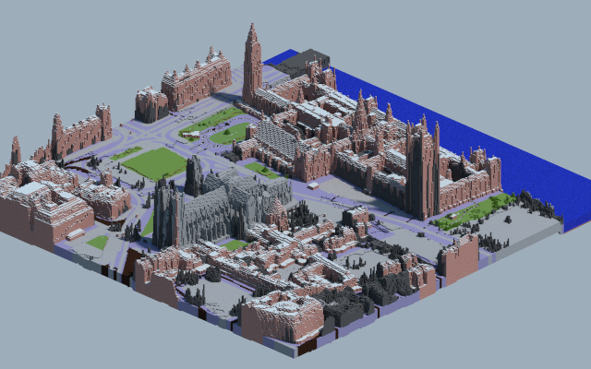

Slide 30
$ ./generate-world Demo
--postcode PO381NL
--size 250

Slide 31
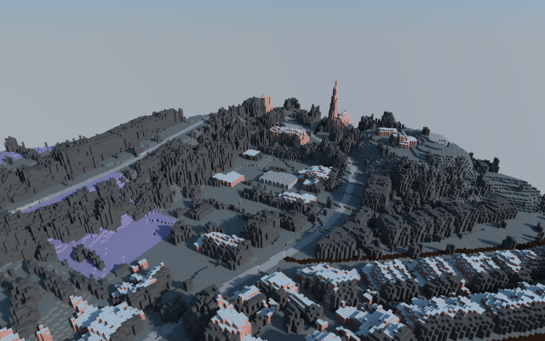
$ ./generate-world Demo
--postcode PO381NL
--size 250

Slide 32
Publishing Open Data

Slide 33
Tabular Data For the Humans
Understanding “Graph” data is a big cognitive load, compared with SQL/Excel.
Don’t expect any small company to be able to generate good RDF.
RDF is neat for aggregation, but make easy ways for people to get started.
Provide tabular-data routes in & out where possible!

Slide 34
JSON for Developers
SPARQL & RDF is too high a learning curve
JSON works really well in Javascript
Gives more structure than CSV

Slide 35
Open Data Publishing
Dataset
Repository
Data
Document
+ metadata

Slide 36
Open Data Publishing
Dataset
Repository
Data
Document
+ metadata
Conversion
Tools
RDF

Slide 37
Open Data Publishing
JSON
Dataset
Repository
Data
Document
+ metadata
Conversion
Tools
CSV
RDF
SPARQL
Store

Slide 38
Open Data Publishing
JSON
Dataset
Repository
Data
Document
+ metadata
Conversion
Tools
CSV
RDF
SPARQL
Store

Slide 39
Open Data Publishing
JSON
Dataset
Repository
Data
Document
+ metadata
Conversion
Tools
CSV
RDF
SPARQL
Store
Per-Item Pages
HTML, JSON, RDF
List of Items
Pages
Tools & Apps

Slide 40
Open Data Publishing
JSON
Dataset
Repository
Data
Document
+ metadata
Conversion
Tools
CSV
RDF
SPARQL
Store
URI Resolver
Per-Item Pages
HTML, JSON, RDF
List of Items
Pages
Tools & Apps

Slide 41
Open Data Publishing
JSON
Dataset
Repository
Data
Document
+ metadata
Conversion
Tools
CSV
RDF
SPARQL
Store
Map Tile Server
URI Resolver
Per-Item Pages
HTML, JSON, RDF
List of Items
Pages
Tools & Apps
Maps

Slide 42
Why aren’t they using our data?

Slide 43
“If you build it, they will come.”

Slide 44
“If you build it, they will come.”
Nothing but beautiful lies!

Slide 45
Probability of open dataset reuse =
Value of dataset to audience
X
Potential audience size
X
Ease of discovery
X
Ease of grasping the value of the dataset
X
Ease of exploiting dataset

Slide 46
Find yourself some open data
data.gov.uk
  UK Government open data
www.hampshirehub.net
  Hampshire council open data
data.southampton.ac.uk
  Our open data
datahub.io
  Open data catalogue
http://sotoncitydata.org/
  List of open data about Southampton (Needs work!)

