Slide 1
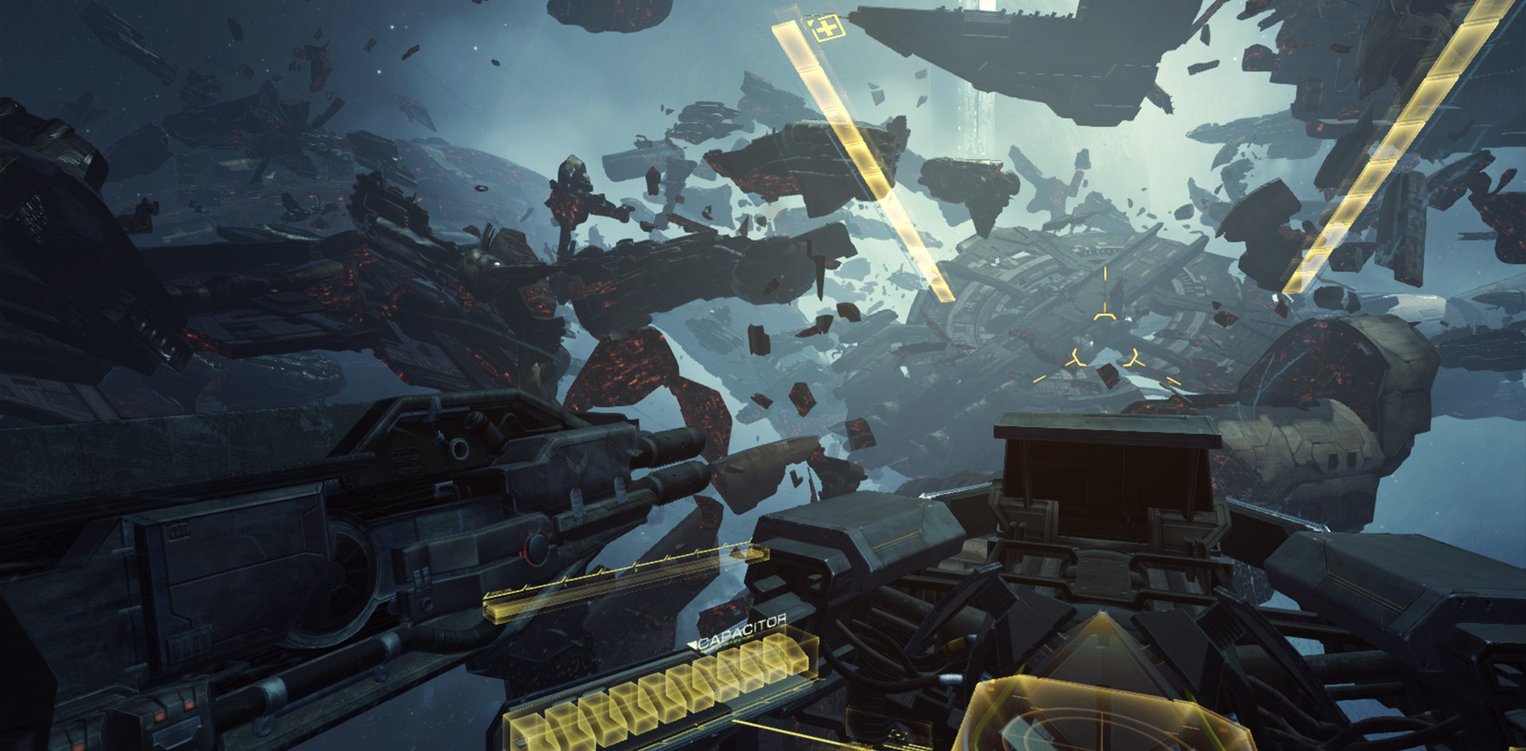
Innovation in Games
Gaming Off The Desktop
EVE: Valkyrie (Oculus Rift)

Slide 2
Summary
What do we mean by Innovation in Games?
New Mindsets
Social Gaming
Casual Gaming
New Technology
Motion Controllers
Virtual Reality
New Realities
Augmented Reality
Location-based Gaming
Mixed Reality
Alternate Reality
Dragon’s Lair

Slide 3
Innovation
Genre | Sub-Genre | Key Example | Date
Action | Platformer | Donkey Kong | 1981
 | First Person Shooter (FPS) | Wolfenstein 3D | 1992
 | Shoot ’em-up | Space Invaders | 1978
 | Beat ‘em-up | Double Dragon | 1987
Adventure | Text adventure | Zork | 1980
 | Graphic adventure | Kings Quest | 1983
 | Interactive Movie | Dragon’s Lair | 1983
Action-Adventure | Stealth | Metal Gear | 1987
 | Survival Horror | Resident Evil | 1996
 | Metroidvania | Metroid | 1986
Role-playing | Action RPG | Dragon Slayer | 1984
 | MMORPG | Ultima Online | 1997
 | Open World (Sandbox) | Ultima | 1981
 | JRPG | Dragon Quest | 1986
Simulation | Construction/Management | SimCity | 1989
 | Life | Little Computer People | 1985
 | Vehicle | F-15 Strike Eagle | 1985
Strategy | 4X (eXplore, eXpand, eXploit and eXterminate) | Civilization | 1991
 | Real-Time Strategy (RTS) | Herzog Zwei | 1989
Sports | Racing | Pole Position | 1982
 | Sports Sim | Pong | 1972
Genre Innovations

Slide 4
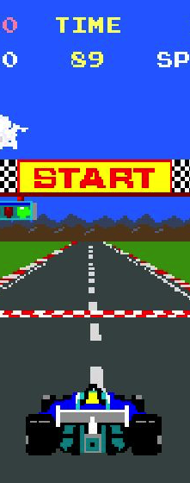
Innovation
Genre Innovations (1970s, 1980s, 1990s)…
…to more recent innovations in hardware and software (1990s, 2000s, 2010s). e.g.
networking
multiplayer in the 1990s (LAN)
MMO in the 2000s (WAN)
devices (e.g. handhelds, smartphones)
input controllers (wiimotes, MS Kinect)
displays (3D Accelerators, HD, VR)
Pole Position

Slide 5
New Mindsets
And new audiences
Peggle

Slide 6
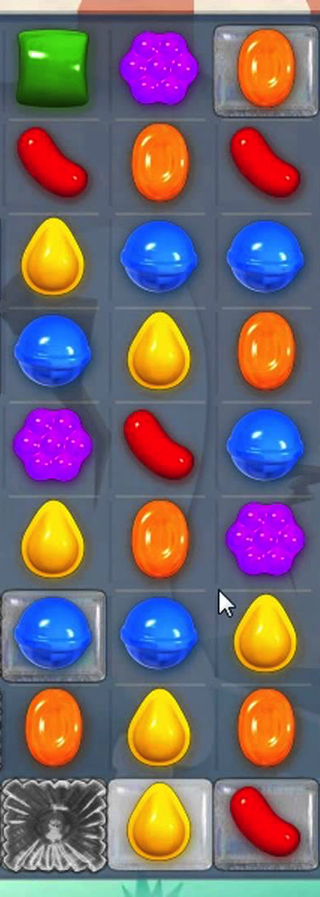
Casual Games
2010 Games Industry worth $50B
2015 Games Industry worth $90B
Why? 185 Million Active US Gamers aged 13+, 50% women
61 Million PC Players
72 Million Console Players
154 Million Mobile Players
Candy Crush
$1 million per day (WoW roughly $2.7 million, LoL $4 million)
Mechanics are linked to monetization
Gameplay modes show clearly how near you are to success
Randomization creates a frisson around each play
Creates one-more-play ethos that is directly linked to the purchase of extra moves (no. 1 in-app purchase for the game)
Understanding Engagement in the Rapidly Expanding Gaming Universe, Patrick Walker, EEDAR
Keynote at GDC16, http://www.eedar.com/blog/eedar-insights-gdc16
Candy Crush Saga

Slide 7
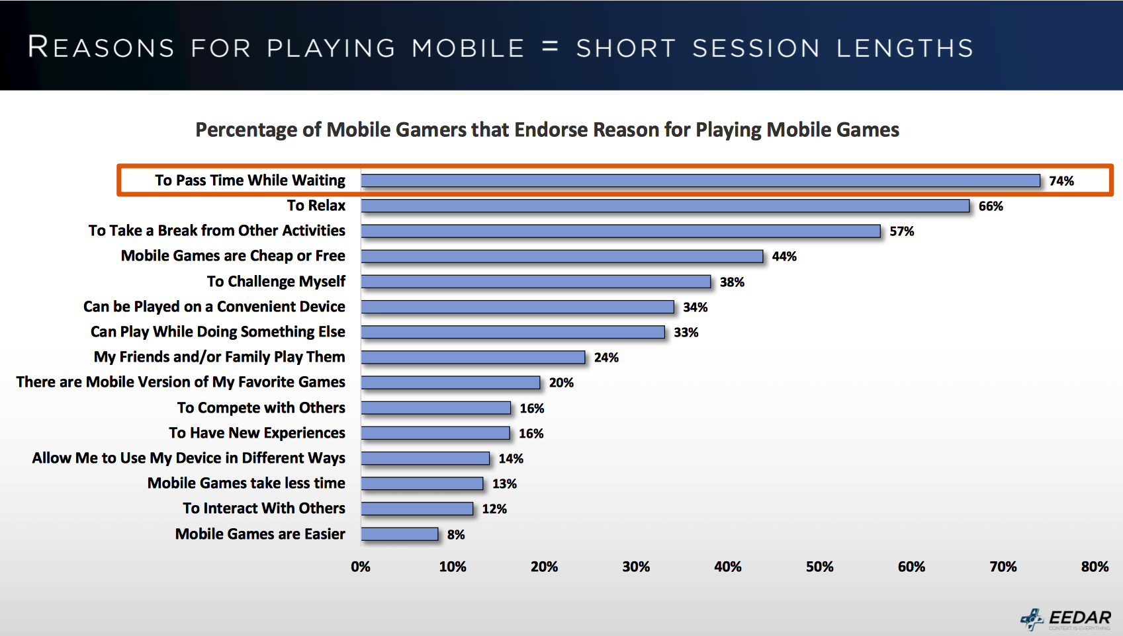
Casual Games
Understanding Engagement in the Rapidly Expanding Gaming Universe, Patrick Walker, EEDAR
Keynote at GDC16, http://www.eedar.com/blog/eedar-insights-gdc16

Slide 8
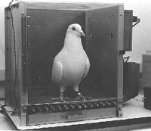
Skinner Boxes (Operant conditioning)
Psychologist Burrhus Frederic Skinner (1904-1990)
Testing behavioral conditioning
(in pigeons, but this works on people too!)
A pigeon in a box, with a button to release food
Skinner discovered that rewarding the pigeon only some of the time (interval reinforcement) was more effective than consistent rewards
Takehome: You can use sophisticated operant schedules of reinforcement to reward (and encourage) repetitive actions. This is an tactic often used in casual games.

Slide 9
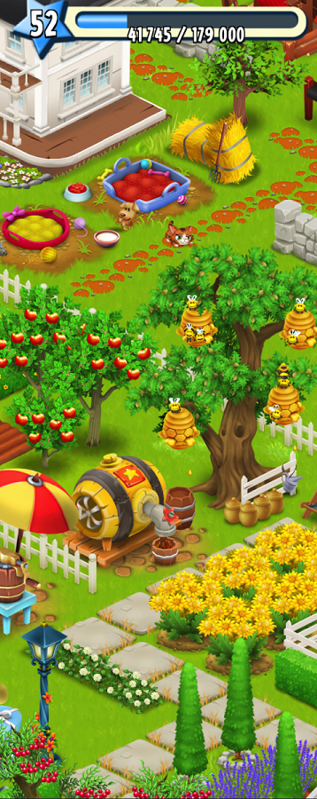
Skinner Boxes in Games
Look out for:
A reward system that slows down over time and/or has a variable schedule
Level systems where each level is harder than the previous one
Random loot drops
An end goal that is eventually replaced with another end goal, ad infinitum.
Daily goals (Weekly community derby in Hay Day)
Generative dungeons (Diablo)
The use of real-time events to establish a game into daily life patterns
A reason to be addictive.
Monetization! Linking length of play to money spent.
Repetitive gameplay to the point that it's not fun anymore.
A game so addicting that you won't care.
Skinner's Box and Video Games: How To Create Addictive Games.
http://hubpages.com/games-hobbies/Skinners-Box-and-Video-Games
Hay Day

Slide 10
Skinner Boxes in Games
Look out for:
A reward system that slows down over time and/or has a variable schedule
Level systems where each level is harder than the previous one
Random loot drops
An end goal that is eventually replaced with another end goal, ad infinitum.
Daily goals (Weekly community derby in Hay Day)
Generative dungeons (Diablo)
The use of real-time events to establish a game into daily life patterns
A reason to be addictive.
Monetization! Linking length of play to money spent.
Repetitive gameplay to the point that it's not fun anymore.
A game so addicting that you won't care.
Dave says NO!
This is immoral and lazy
Addiction is a poor substitute for genuine engagement
Skinner's Box and Video Games: How To Create Addictive Games.
http://hubpages.com/games-hobbies/Skinners-Box-and-Video-Games
Hay Day

Slide 11
Social Games
Social Games principally use social networks (or community) to provide gameplay.
Public Player Statistics
Persistent Game Worlds
Tick-based Games
Events timed to real world
Encouraged Return Visits
Grinding
Drop-in/Drop-out
Private Game Spaces
Massively Single-Player Online Games
Construction
Pottering
Visits (to other player’s private game spaces)
Altruistic Actions
Invites
Collaborative Actions
Delayed Reciprocity
Purchasable Game Advantage
Björk, S. (2010). Principles and patterns of social games: Where’s the difference compared to other games?. GCO Games Convention Online 2010. Leipzig.

Slide 12
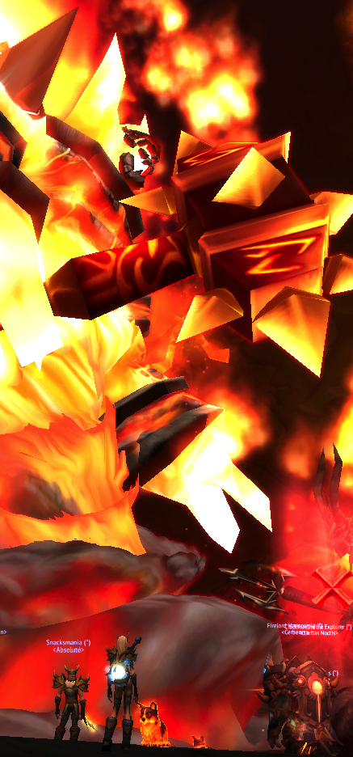
Social Games
Other games with a social element
Social Difficulty Curve (like pacing). E.g. MMORPG
Solo questing
Auction house
Ad-hoc adventuring parties
Friends lists
Regular adventuring groups
Guilds – multiparty RAIDS
Manage your own guild
World of Warcraft (Firelands RAID)

Slide 13
Social Games
Other games with a social element
Social Difficulty Curve (like pacing). E.g. MMORPG
Solo questing
Auction house
Ad-hoc adventuring parties
Friends lists
Regular adventuring groups
Guilds – multiparty RAIDS
Manage your own guild
Safe Space: Learning the mechanics
World of Warcraft (Firelands RAID)

Slide 14
Social Games
Other games with a social element
Social Difficulty Curve (like pacing). E.g. MMORPG
Solo questing
Auction house
Ad-hoc adventuring parties
Friends lists
Regular adventuring groups
Guilds – multiparty RAIDS
Manage your own guild
Safe Space: Learning the mechanics
Impersonal Interactions:
Co-operation Rewards
(low social risk, high in-game rewards)
World of Warcraft (Firelands RAID)

Slide 15
Social Games
Other games with a social element
Social Difficulty Curve (like pacing). E.g. MMORPG
Solo questing
Auction house
Ad-hoc adventuring parties
Friends lists
Regular adventuring groups
Guilds – multiparty RAIDS
Manage your own guild
Safe Space: Learning the mechanics
Impersonal Interactions:
Co-operation Rewards
(low social risk, high in-game rewards)
Personal Interactions: Enjoying Social Victories
(less handholding,
independent social challenges)
World of Warcraft (Firelands RAID)

Slide 16
Social Games
Other games with a social element
Social Difficulty Curve (like pacing). E.g. MMORPG
Solo questing
Auction house
Ad-hoc adventuring parties
Friends lists
Regular adventuring groups
Guilds – multiparty RAIDS
Manage your own guild
Safe Space: Learning the mechanics
Impersonal Interactions:
Co-operation Rewards
(low social risk, high in-game rewards)
Personal Interactions: Enjoying Social Victories
(less handholding,
independent social challenges)
Social Play:
Social Difficulty outweighs mechanical difficulty,
social rewards become signfiicant
World of Warcraft (Firelands RAID)

Slide 17
Local Multiplayer Games
Games designed to be played by a group of players in the same physical space
Not just a LAN-party
Designed to take advantage of the affordances of all being together
including non-digital participants
E.g. role-based team games like Artemis
Where someone is the captain
Artemis

Slide 18
Local Multiplayer Games
https://www.youtube.com/watch?v=V9Q2X32hZN

Slide 19
New Technologies
And new possibilities
Wii Sports

Slide 20
Inputs (Controllers)
Motion Control
Accelerometers (Wiimotes, Smart Devices)
Vision Systems (Kinect, Move)
Seen as gateway systems
Casual Games and Party Games
Less intimidating than a full blown controller
More naturalistic control
Peripherals or core systems?
What is the added value?
What is the lowest risk for developers?
A way of extending the lifetime of an existing console?
No More Heroes

Slide 21
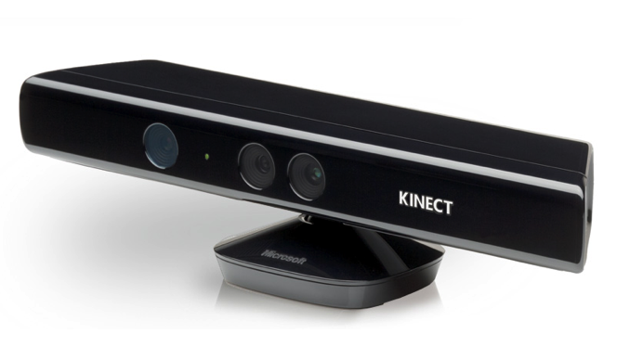
The Uncanny Valley of Control
Tools as an extension of ourselves
Car driving
Writing with a pen
The Controller disappears
Kinect is so close to our everyday experience of action that it hits an uncanny value
Means that natural action is better
A control-first design
What is it fun to physically do?
Extra Credits: Kinect Disconnect
https://www.youtube.com/watch?v=ijcezUy3ZzY
No More Heroes

Slide 22
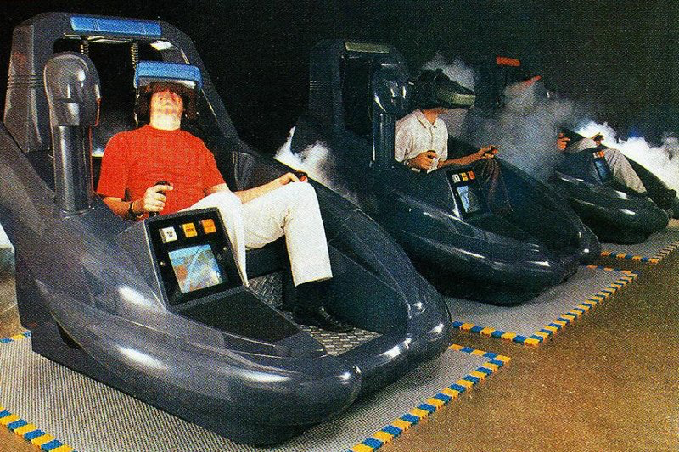
VR
Virtual Reality
Stereoscopic Glasses (Sega Master System 3D Glasses, 1987)
Stereoscopic 3D goggles (Virtuality, 1991, shown above)
Motion tracking with Stereoscopic 3D goggles (Google Cardboard, Samsung Gear VR)
Head tracking with Stereoscopic 3D goggles (Occulus Rift, PS VR)
Room tracking with Stereoscopic 3D goggles (HTC Vive)

Slide 23
VR
Virtual Reality
Stereoscopic Glasses (Sega Master System 3D Glasses, 1987)
Stereoscopic 3D goggles (Virtuality, 1991, shown above)
Motion tracking with Stereoscopic 3D goggles (Google Cardboard, Samsung Gear VR)
Head tracking with Stereoscopic 3D goggles (Occulus Rift, PS VR)
Room tracking with Stereoscopic 3D goggles (HTC Vive)
Positional
Controllers

Slide 24
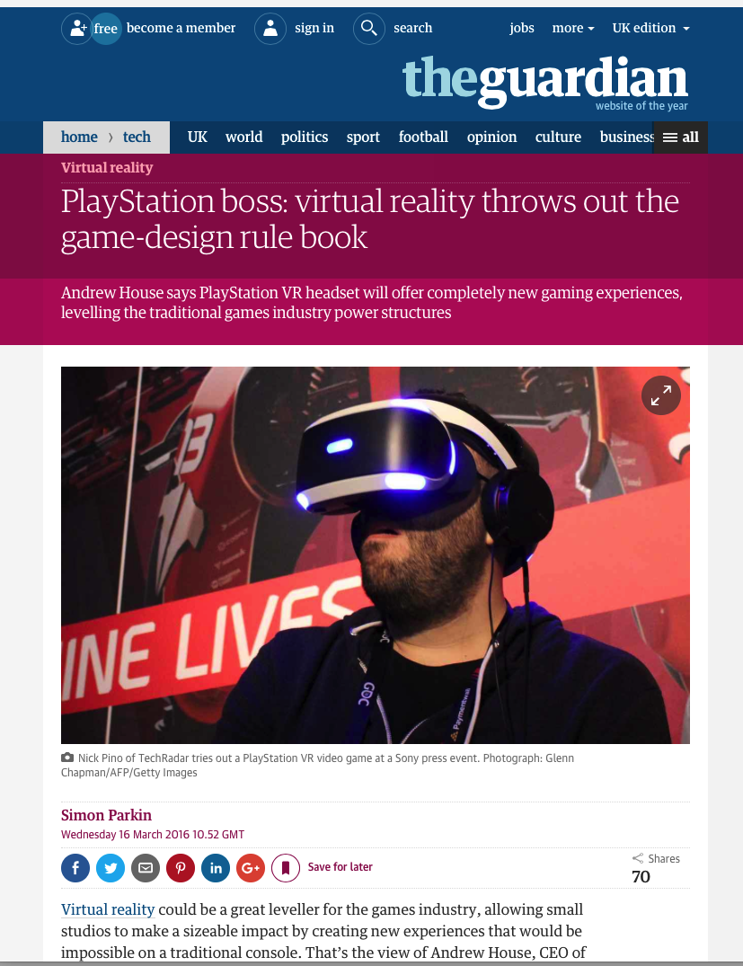
VR
VR is a new medium and will require new design principles
These are still emerging
But they are being discussed by industry experts

Slide 25
VR
Which Way is North
how do you make your player face the right direction?
how will compasses and reticles work?
Don’t Make Me Move
how to move the body through space?
does everything have to be on rails?
Never Seize the Camera
does just remove player agency
makes them vomit
Pincer Controls
positional controls are limited, need to design around them
Depth Perception
In VR there are optimal distances, don’t get to close!
Design Tips for VT Games, Tadhg Kelly, Techcrunch, Jun 2015,
http://techcrunch.com/2015/06/21/design-tips-for-vr-games/
Tilt Brush (HTC Vive)

Slide 26
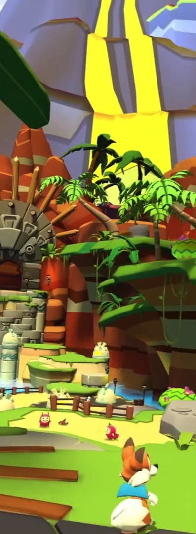
VR
Immersion – cognitive
All games strive for immersion (flow)
Presence – perceptional
In VR presence is equally important
Breaks in presence are to be avoided!
E.g. Never take control of the players head
Sudden cuts are disorientating
Beware the uncanny valley
Comfort is a priority, what do we do about
Vertigo
Claustrophobia
Agoraphobia
Lucky’s Tale (Oculus Rift)
Rebooting Game Design for Virtual Reality, Jed Ashford, Sony Entertainment Europe, GDC 2014
http://www.gdcvault.com/play/1020914/Rebooting-Game-Design-for-Virtual

Slide 27
New Realities
Now Things Get Weird
Can You See Me Now (Blast Theory)

Slide 28
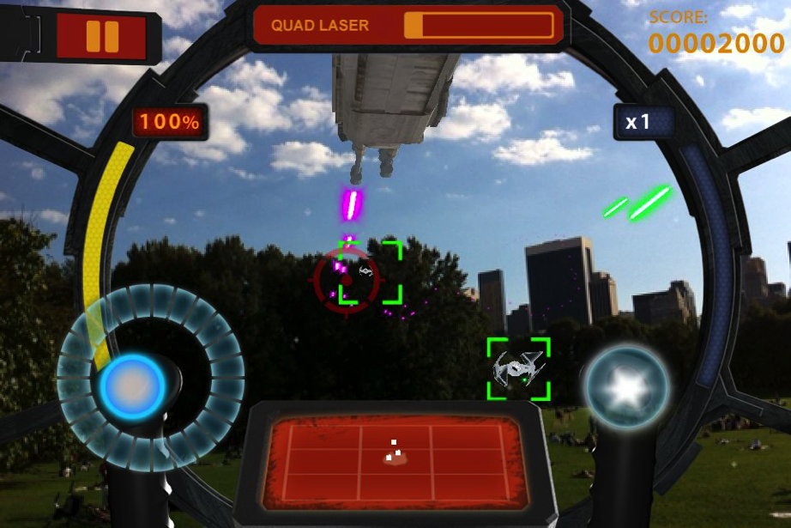
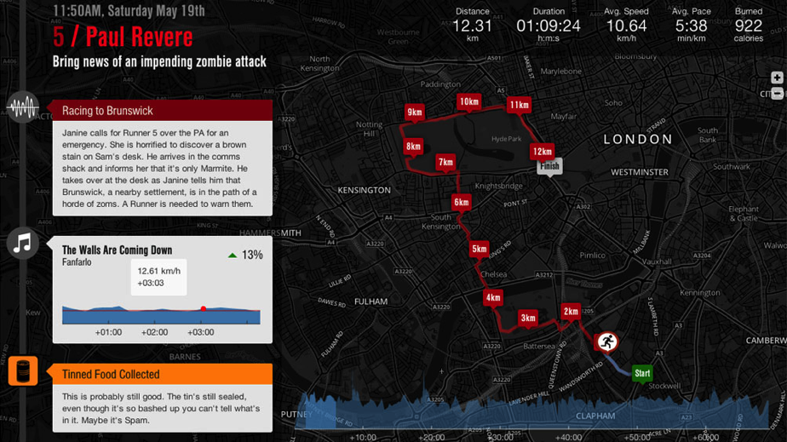
Augmented Reality Games
Digital Reality overlaid on the real world
Graphically (E.g. Star Wars Arcade: Falcon Gunner)
Goggles / Display (Smart Phones)
Overlay (Google Glass)
Audibly (E.g. Zombies. Run!)
based on location
Top - Star Wars Arcade: Flacon Gunner
Bottom – Zombies. Run!

Slide 29
Location-based Games
Location is an input device
Location-based games use changes in location as player control
Feedback (and additional interaction) provided on a smart device
Can be tailored to single locations (i.e. events are anchored on specific places)
Or generalised to types of places
E.g. Wanderlust (uses Foursquare db of venues)
Story events are triggered by bars, cafes, museums, etc.
Viking Ghost Hunt

Slide 30
Location Based Patterns
Canyons
A linear narrative represented as a sequence of nodes accessed in a predefined order.
Deltas
A start node that repeatedly branches to multiple other optional nodes accessed based on user choices.
Plains
A collection of nodes that are all accessible and can be accessed in any order
Millard, David, Hargood, Charlie, Jewell, Michael O. and Weal, Mark J. (2013)
Canyons, deltas and plains: towards a unified sculptural model of location-based hypertext. In, ACM Hypertext 2013, 01 - 02 May 2013. , 1-10.

Slide 31
CHAPTER 2
KEY
SINGLE CHAPTER
CHAPTER 1
CHAPTER 3
CHAPTER 4
Pinned
Node
NAME
PLAIN
CANYON
Chapter
CHAPTER 1
CHAPTER 2
CHAPTER 3
CHAPTER 4
CHAPTER 1
CHAPTER 2
CHAPTER 3
Transition
Stack
Time Trigger
DELTA
HYBRID

Slide 32
CHAPTER 2
KEY
SINGLE CHAPTER
CHAPTER 1
CHAPTER 3
CHAPTER 4
Pinned
Node
NAME
PLAIN
CANYON
Chapter
CHAPTER 1
CHAPTER 2
CHAPTER 3
CHAPTER 4
CHAPTER 1
CHAPTER 2
CHAPTER 3
Transition
Stack
Time Trigger
DELTA
HYBRID

Slide 33
CHAPTER 2
KEY
SINGLE CHAPTER
CHAPTER 1
CHAPTER 3
CHAPTER 4
Pinned
Node
NAME
PLAIN
CANYON
Chapter
CHAPTER 1
CHAPTER 2
CHAPTER 3
CHAPTER 4
CHAPTER 1
CHAPTER 2
CHAPTER 3
Transition
Stack
Time Trigger
DELTA
HYBRID

Slide 34
CHAPTER 2
KEY
SINGLE CHAPTER
CHAPTER 1
CHAPTER 3
CHAPTER 4
Pinned
Node
NAME
PLAIN
CANYON
Chapter
CHAPTER 1
CHAPTER 2
CHAPTER 3
CHAPTER 4
CHAPTER 1
CHAPTER 2
CHAPTER 3
Transition
Stack
Time Trigger
DELTA
HYBRID

Slide 35
Examples
Riot! - Guide of square in Bristol using interactive play based on a historical riot that divides area up into zones
HopStory - Brewery guide for collection of narrative fragments from locations to build up story
SEQUENCE OF PLAINS
TIMED SEQUENCE OF PLAINS

Slide 36
Examples
Riot! - Guide of square in Bristol using interactive play based on a historical riot that divides area up into zones
HopStory - Brewery guide for collection of narrative fragments from locations to build up story
SEQUENCE OF PLAINS
TIMED SEQUENCE OF PLAINS
San Servalo - Location aware fiction set on an island with conditional unveiling of content.
Viking Ghost Hunt - Branching adventure game with contextual awareness of player
DELTA OF PLAINS
PLAIN TO DELTAS

Slide 37
Mixed Reality
Combines players in real world (AR) spaces, with players in fully digital (VR) spaces
E.g. Can You See Me Now?
Won the Golden Nica for Interactive Art at the Ars Electronica, Linz, Austria in 2003
Blast Theory
http://www.blasttheory.co.uk

Slide 38
Alternate Reality Games
Games that use the real world as a canvas
Weaving fictional elements seamlessly into our ‘real’ media landscape:
Websites
News stories
Social Media Profiles
User-generated Content
Players discover a way in, a rabbit hole, and piece together a serious of clues in these fictional elements to uncover (and/or participate in) a story.
E.g. The Beast, Posters for the film A.I listed Jeanine Salla as Sentient Machine Therapist
The Beast (Poster for A.I, 2001)

Slide 39
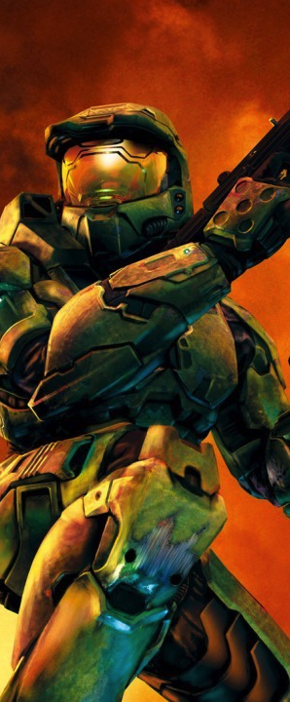
Alternate Reality Games
Often ARGs take the Matrix approach
That reality is more than it seems, and that the players are ones who have taken the red pill
There is a real thrill in taking the red pill!
Players stumble into an ARG through being part of online communities, or just being observant
Because they are played collaboratively en masse they can get away with being very obtuse and difficult to solve
Often ARGs are promotional (typically for games and movies) in the spirit of viral marketing
I Love Bees (Halo 2, 2004)

Slide 40
I love bees (HALO 2)
‪The I love Bees Phenomenon‬
‬
https://www.youtube.com/watch?v=SNhurUnOWKQ
I Love Bees (Halo 2, 2004)

Slide 41
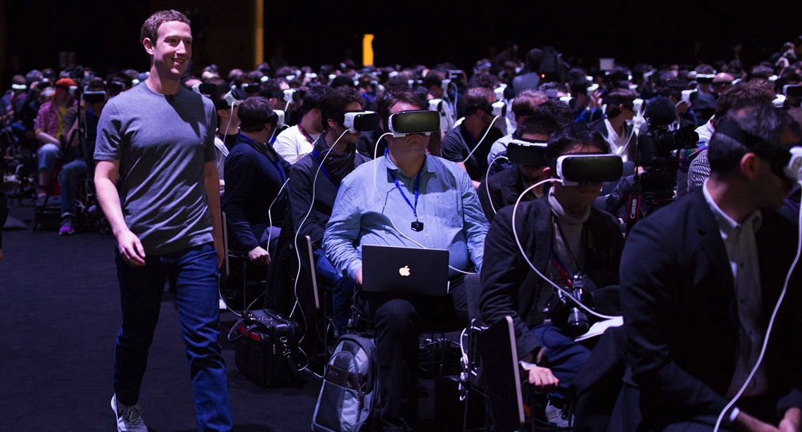
Designing Games off the Desktop
Activity
Terrifying Dystopian Future

Slide 42
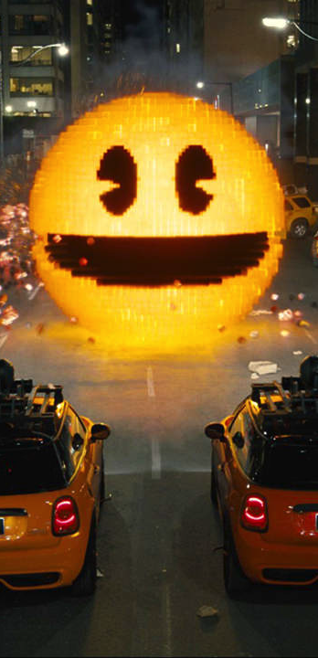
Activity
Sort yourself into pairs
Each pair will get dealt two cards
1. A classic video game
2. A innovative game technology/approach
Spend 15 minutes considering how you might reimagine the classic game using the innovation
What are the mechanics of your game?
How is the innovation used within the game?
How does the innovation add to the experience or gameplay (and avoid being a gimmick!)
It is okay to reimagine the game – as long as it is recognizably inspired by the original!
Pixels (film, 2015, 17% Rotten Tomatoes)

Slide 43
Activity
Spend ten minutes considering how you might reimagine the classic game using the innovation
What are the mechanics of your game?
How is the innovation used within the game?
How does the innovation add to the experience or gameplay (and avoid being a gimmick!)
Pairs who felt that their game and innovation worked together
Pairs who felt that their game and innovation were difficult to reconcile
Pixels (film, 2015, 17% Rotten Tomatoes)

Slide 44
Thank You
COMP3218 Website: https://secure.ecs.soton.ac.uk/module/COMP3218/
David Millard
@hoosfoos | davidmillard.org | dem@soton.ac.uk

