Slide 1
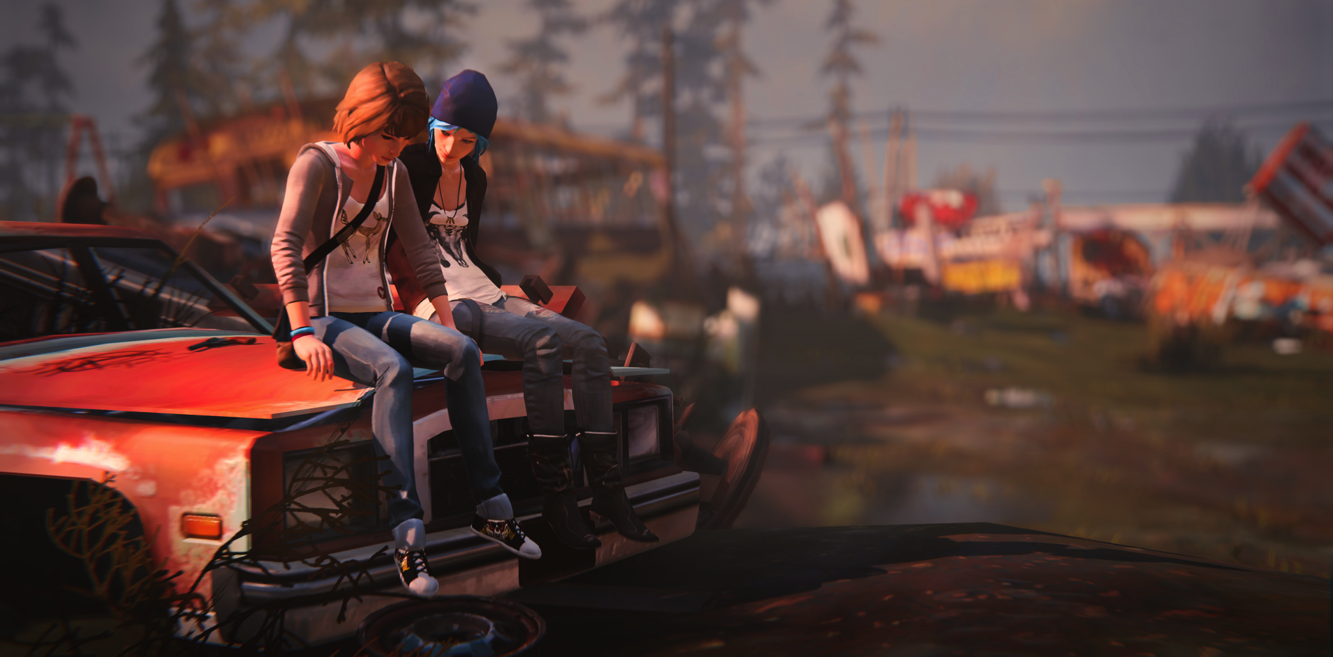
The Poetics of Game Narratives
Ludology, Narratology, and No Man Righteous
Life is Strange

Slide 2
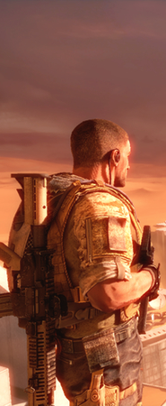
Overview
Ludology vs. Narratology
Types of Immersion
Poetics
Approach 1: Emphasise the Fabula
Environmental Storytelling
Narrative Architecture
Approach 2: Fusion
Thematic Cohesion
Mechanics as Metaphor
Diegetic Choices
A Critical Playing of Spec Ops: The Line
Spec Ops: The Line

Slide 3
Ludology vs. Narratology
"Interactivity is almost the opposite of narrative; narrative flows under the direction of the author, while interactivity depends on the player for motive power" - Ernest Adams
"There is a direct, immediate conflict between the demands of a story and the demands of a game. Divergence from a story's path is likely to make for a less satisfying story; restricting a player's freedom of action is likely to make for a less satisfying game." - Greg Costikyan
"Outside academic theory people are usually excellent at making distinctions between narrative, drama and games. If I throw a ball at you I don't expect you to drop it and wait until it starts telling stories." - Markku Eskelinen
FIFA 15

Slide 4
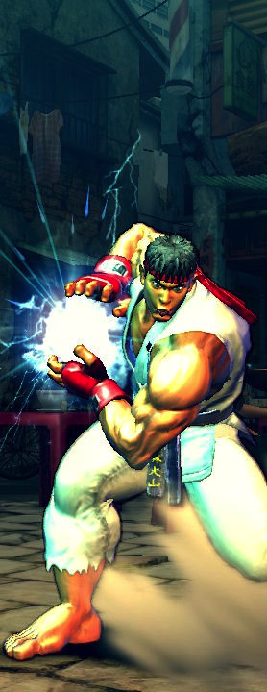
Games are not Narratives
“Computer games and narratives are very different phenomena. Two phenomena that fight each other. Two phenomena that you basically cannot have at the same time. Any interactive narrative or attempt at interactive storytelling is a zigzag between these two columns.”
Narratives | Games
Fixed Sequence | Flexible Sequence
Variable Speed | Fixed Speed
Story/Fabula | Program/Material (Mechanics/Assets)
Past | Present
Requires anthropomorphic actors | Can be abstract
Narrative desire | Desire for understanding/performance
Consume once | Play many times
Jesper Juul: "A Clash between Game and Narrative". Paper presented at the Digital Arts and Culture conference, Bergen, Norway, November 1998. https://www.jesperjuul.net/text/clash_between_game_and_narrative.html
Streetfighter 4

Slide 5
Immersion
Sensory
Challenge-Based
(Flow)
Imaginative
(Suspension of Disbelief)
Ermi, L. and Mayra, F. (2005) "Fundamental Components of the Gameplay Experience: Analysing Immersion" In print proceedings, Changing Views: Worlds in Play, Digital Games Research Association Conference Proceedings

Slide 6
Immersion
Civilization 3
Sensory
Challenge
Imaginative
Ermi, L. and Mayra, F. (2005) "Fundamental Components of the Gameplay Experience: Analysing Immersion" In print proceedings, Changing Views: Worlds in Play, Digital Games Research Association Conference Proceedings

Slide 7
Immersion
Civilization 3
Pro-Evolution Soccer 4
Sensory
Sensory
Challenge
Imaginative
Challenge
Imaginative
Ermi, L. and Mayra, F. (2005) "Fundamental Components of the Gameplay Experience: Analysing Immersion" In print proceedings, Changing Views: Worlds in Play, Digital Games Research Association Conference Proceedings

Slide 8
Immersion
Civilization 3
Pro-Evolution Soccer 4
KOTOR
Sensory
Sensory
Sensory
Challenge
Imaginative
Challenge
Imaginative
Challenge
Imaginative
Ermi, L. and Mayra, F. (2005) "Fundamental Components of the Gameplay Experience: Analysing Immersion" In print proceedings, Changing Views: Worlds in Play, Digital Games Research Association Conference Proceedings

Slide 9
Immersion
Civilization 3
Pro-Evolution Soccer 4
KOTOR
Sensory
Sensory
Sensory
Challenge
Imaginative
Challenge
Imaginative
Challenge
Imaginative
Tell Tale’s The Walking Dead?
Ermi, L. and Mayra, F. (2005) "Fundamental Components of the Gameplay Experience: Analysing Immersion" In print proceedings, Changing Views: Worlds in Play, Digital Games Research Association Conference Proceedings

Slide 10
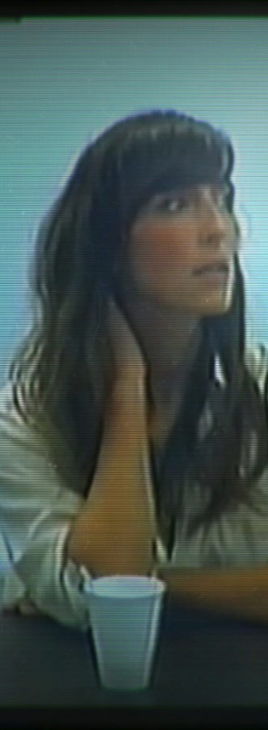
Some Baselines
Not all games tell stories
Many games do have narrative aspirations
Narrative analysis need not be prescriptive. There is not one future of games
The experience of playing games can never be simply reduced to the experience of a story
If some games tell stories, they are unlikely to tell them in the same ways that other media tell stories
Jenkins, Henry. “Game Design as Narrative Architecture.” First Person: New Media as Story, Performance, and Game. Cambridge: The MIT Press, 2004. 118-130 http://interactive.usc.edu/blog-old/wp-content/uploads/2011/01/Jenkins_Narrative_Architecture.pdf
Her Story

Slide 11
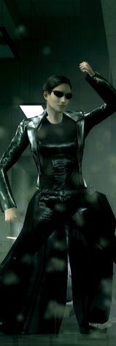
Transmedia Storytelling
Games should be seen as part of a larger Transmedia storytelling environment
Definition: Transmedia storytelling represents a process where integral elements of a fiction get dispersed systematically across multiple delivery channels for the purpose of creating a unified and coordinated entertainment experience.
Example: In The Matrix franchise, key bits of information are conveyed through three live action films, a series of animated shorts, two collections of comic book stories, and several video games.
The Matrix Path of Neo
Jenkins, H. Transmedia Storytelling 101 (March 22, 2007)
http://henryjenkins.org/2007/03/transmedia_storytelling_101.html

Slide 12
How do we reconcile
Narrative and Play?

Slide 13
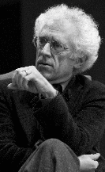
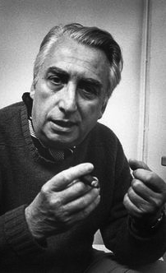
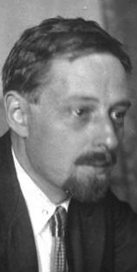
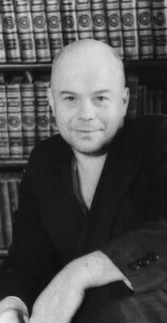
Remember Narratology 101
Narrative Text
“a text in which a narrative agent tells a story”
Game Text
Narratologists
Mieke Bal
Narratology, 1985
Story
“these elements are organized in a certain way into a story. Their
arrangement in relation to one another is such that they can produce the
effect desired, be this convincing, moving, disgusting, or aesthetic.”
Dramatic
Arc
French Structuralists
Tzvetan Todorov
Roland
Barthes
Fabula
“a series of logically and chronologically related events that are caused
or experienced by actors… Events, actors, time, and location
Ingether constitute the material of a fabula.”
Premise
Characters
World-Building
Russian Formalists
Vladimir
Propp
Viktor Shklovsky

Slide 14
Remember Narratology 101
Narrative Text
“a text in which a narrative agent tells a story”
Game Text
Narratologists
Mieke Bal
Narratology, 1985
Story
“these elements are organized in a certain way into a story. Their
arrangement in relation to one another is such that they can produce the
effect desired, be this convincing, moving, disgusting, or aesthetic.”
Dramatic
Arc
Fabula First
Text First
French Structuralists
Tzvetan Todorov
Roland
Barthes
Fabula
“a series of logically and chronologically related events that are caused
or experienced by actors… Events, actors, time, and location
Ingether constitute the material of a fabula.”
Premise
Characters
World-Building
Russian Formalists
Vladimir
Propp
Viktor Shklovsky

Slide 15
Remember Narratology 101
Narrative Text
“a text in which a narrative agent tells a story”
Game Text
Narratologists
Mieke Bal
Narratology, 1985
Story
“these elements are organized in a certain way into a story. Their
arrangement in relation to one another is such that they can produce the
effect desired, be this convincing, moving, disgusting, or aesthetic.”
Dramatic
Arc
Fabula First
Text First
French Structuralists
Tzvetan Todorov
Roland
Barthes
Fabula
“a series of logically and chronologically related events that are caused
or experienced by actors… Events, actors, time, and location
Ingether constitute the material of a fabula.”
Premise
Characters
World-Building
Russian Formalists
Vladimir
Propp
Viktor Shklovsky
How does a game Text, drive your experience of the Story and Fabula?

Slide 16
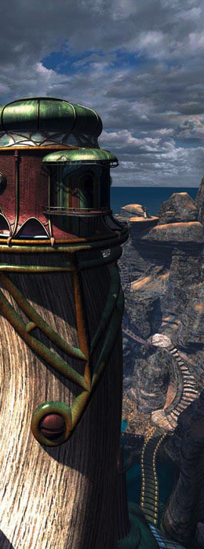
Poetics
Poetics is the theory of literary forms
Term derives from the Greek poietikos, things pertaining to creation, production and making
Can be interpreted broadly, covering a wide range of forms (not just poetry!)
It’s not Aesthetics
The philosophy of art (theory of beauty and taste)
And it’s not Hermeneutics
The interpretation of text (and methods)
And don’t get me started on Exegesis!
Myst

Slide 17
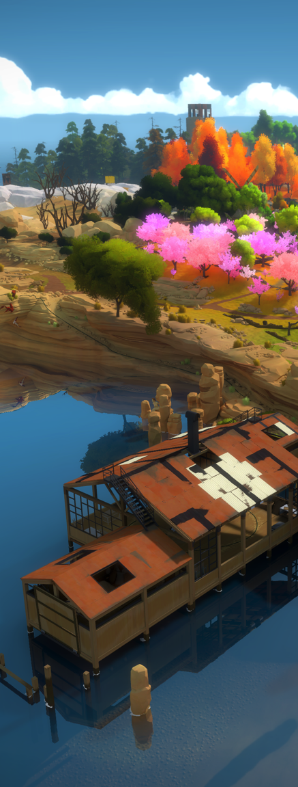
Why is Poetics Relevant?
So rather than being about what a text means, or why that meaning has value
Poetics is about how a text functions, how its elements come together to produce an effect in the reader
Or for games:
Poetics is about how a game functions, how its elements come together to produce an effect in the player
The Witness

Slide 18
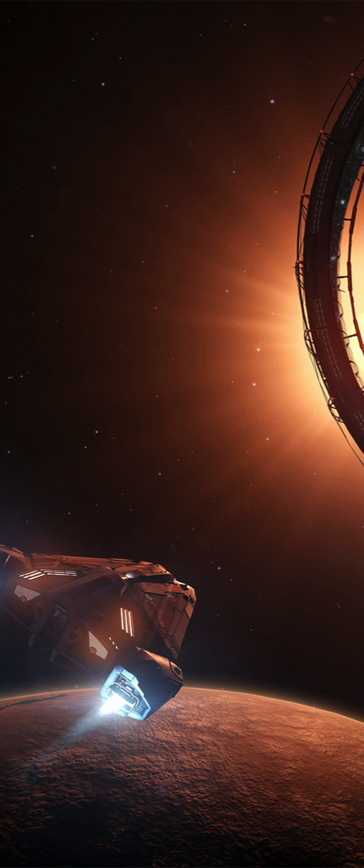
Games as a Poetic Form
So it’s not that games shouldn’t tell stories, but that games should tell stories differently to novels/TV/film
The argument has evolved: What is the best way to tell stories in games?
Elite Dangerous

Slide 19
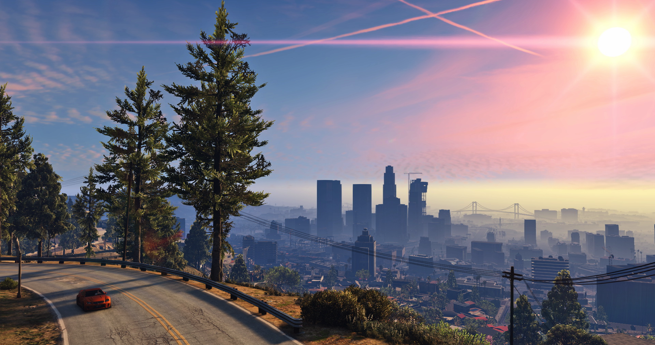
Approach 1: Emphasise the Fabula
GTA V

Slide 20
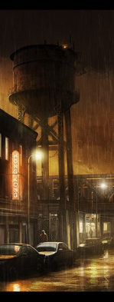
Reject the Grand Narrative Arc
The Setup introduces the characters and the storyworld they inhabit
The Complication introduces a challenge to be overcome
The Development is the long phase that dominates the bulk of the storytelling, as the protagonist works towards her goal
The Resolution or climax is the culmination of the struggles of the development phase, often resulting in some form of victory or defeat
The Denouement or falling action ties up the story’s loose ends, and allows the narrative experience to gracefully end
Bizzocchi J. "Games and Narrative: An Analytical Framework", published in Loading - the Journal of the Canadian Games Studies Association, Vol. 1, No 1 (2007)
Heavy Rain

Slide 21
Embrace a More Modest Framework
Storyworld - what is the environment within which the game unfolds
Character - who are the beings that populate this game world
Emotion - both the emotions shown by the games characters and those elicited in the player
Narrative Interface - how are narrative sensibilities instantiated in the appearance and the functionality of the interface design
Micro-Narratives - smaller moments of narrative flow and coherence that occur within a broader context of game play
GTA V
Bizzocchi J. "Games and Narrative: An Analytical Framework", published in Loading - the Journal of the Canadian Games Studies Association, Vol. 1, No 1 (2007)

Slide 22
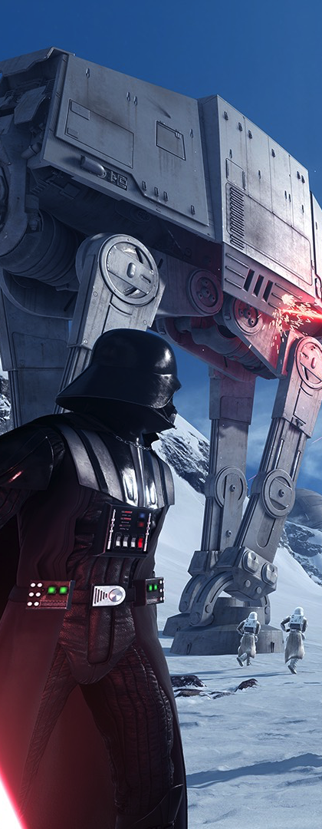
Space and Environment to Invoke Story
Evocative Spaces
Games that draw upon and enhance our existing narrative experiences
“… to give concrete shape to our memories and imaginings of the storyworld”
(Transmedia Storytelling)
Enacting Stories
Environmental or Spatial Storytelling
Progress through space and place
(Adam’s Story as Journey)
Jenkins, Henry. “Game Design as Narrative Architecture.”
First Person: New Media as Story, Performance, and Game. Cambridge: The MIT Press, 2004. 118-130
http://interactive.usc.edu/blog-old/wp-content/uploads/2011/01/Jenkins_Narrative_Architecture.pdf
Star Wars Battlefront

Slide 23
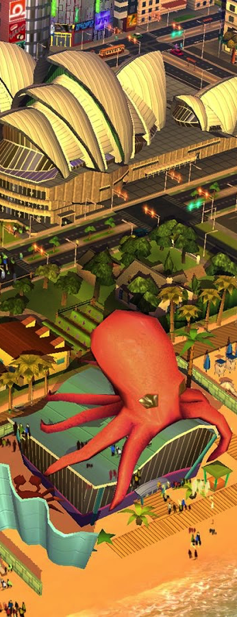
Space and Environment to Invoke Story
Emergent Narratives
Stories that arise from rich game worlds, taking shape through gameplay
(narrative sensemaking and anthropomorphism)
Embedded Narratives
See Story as a means of communicating information about the Fabula
Games can do the same by distributing information through its experience (spaces, mechanics, feedback)
Jenkins, Henry. “Game Design as Narrative Architecture.”
First Person: New Media as Story, Performance, and Game. Cambridge: The MIT Press, 2004. 118-130
http://interactive.usc.edu/blog-old/wp-content/uploads/2011/01/Jenkins_Narrative_Architecture.pdf
SimCity BuildIt

Slide 24
Emphasise the Fabula
Fabula
“a series of logically and chronologically related events that are caused
or experienced by actors… Events, actors, time, and location
Ingether constitute the material of a fabula.”
Premise
Characters
World-Building
Choices about the design and organization of game spaces have narratological consequences
game designers as narrative architects (rather than storytellers)

Slide 25
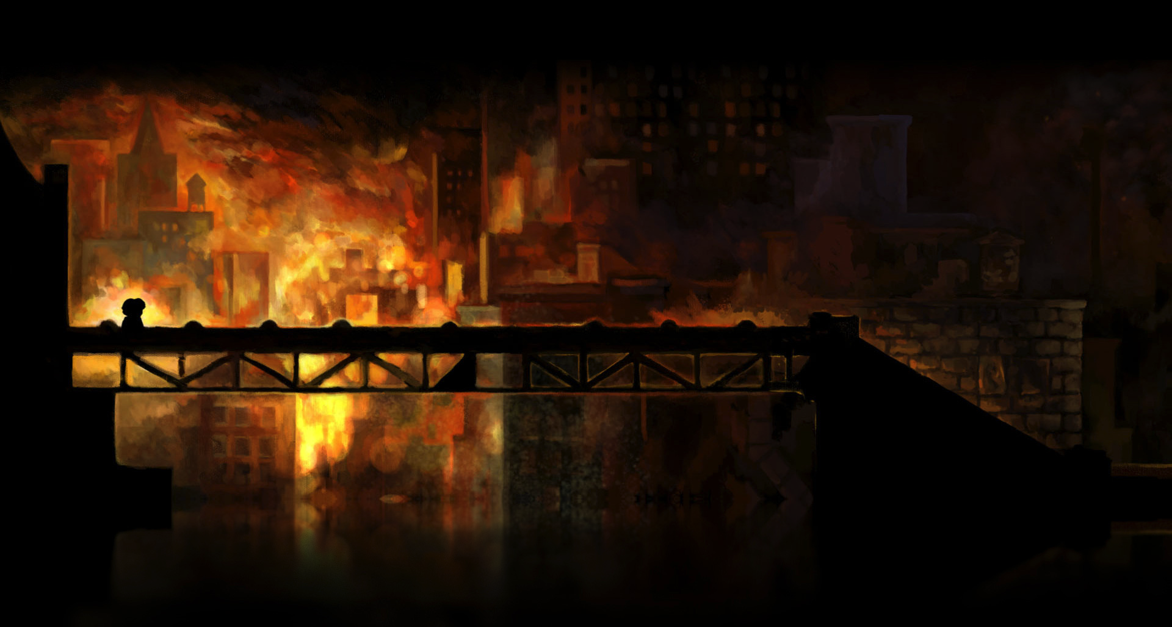
Approach 2: Fusion
Braid

Slide 26
Games as a Poetic Form
So it’s not that games shouldn’t tell stories, but that games should tell stories differently to novels/TV/film
The Embedded Narrative taken to the extreme: What is the best way to tell stories in games?
Remember that the form of a medium has a symbiotic relationship with how it’s message is perceived*
So what are the properties/elements of a game that could reinforce a narrative, or make it more powerful?
And what are the ways in which a narrative can enhance the way in which we experience a game?
Thomas Was Alone

Slide 27
Games as a Poetic Form
So it’s not that games shouldn’t tell stories, but that games should tell stories differently to novels/TV/film
The Embedded Narrative taken to the extreme: What is the best way to tell stories in games?
Remember that the form of a medium has a symbiotic relationship with how it’s message is perceived*
So what are the properties/elements of a game that could reinforce a narrative, or make it more powerful?
And what are the ways in which a narrative can enhance the way in which we experience a game?
Thomas Was Alone
* from Marshall McLuhan. Understanding Media: The Extensions of Man (1964). Mentor New York

Slide 28
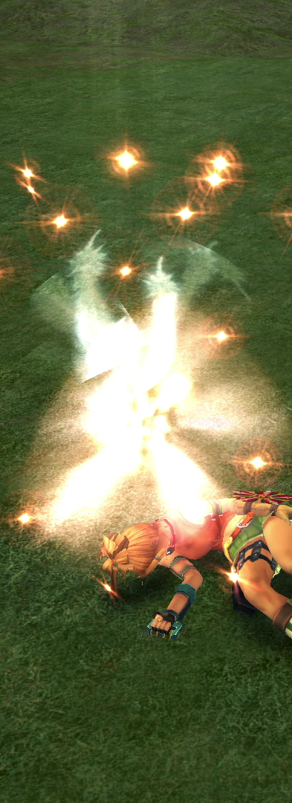
Thematic Coherence
Are the themes coherent across
Art
Audio Effects
Music
Writing
Mechanics!
Are the rules of the playable world consistent with those of the unplayable world
Pheonix Down doesn’t work in cutscenes :-(
Final Fantasy X

Slide 29
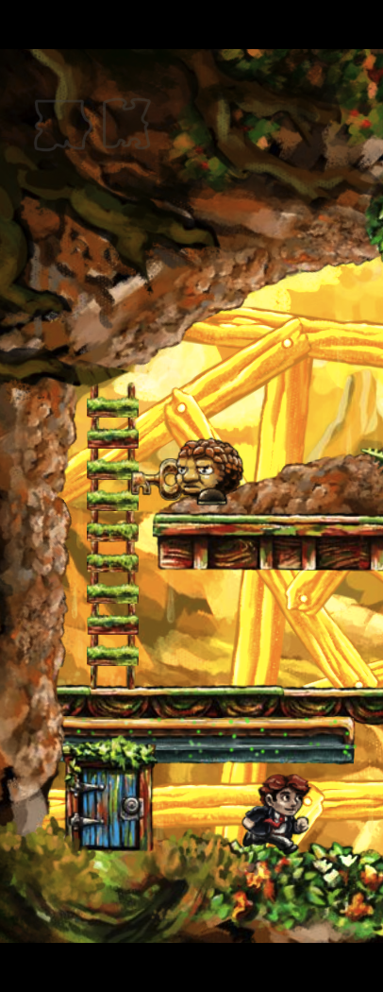
Mechanics as Metaphor
Mechanics are a key part of the game experience (the Game Text)
Do they resonate with the Story that you are trying to tell? Are they part of the message?
Braid

Slide 30
thatgamecompany: Flower
(0:00 – 3:32)
http://thatgamecompany.com/games/flower/
http://thatgamecompany.com/games/flower/

Slide 31
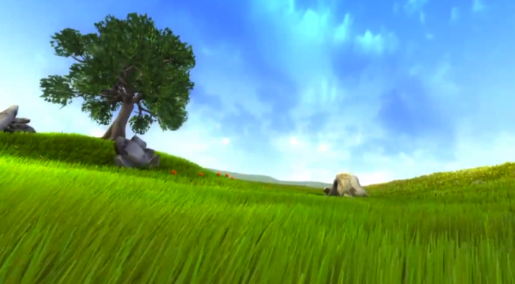
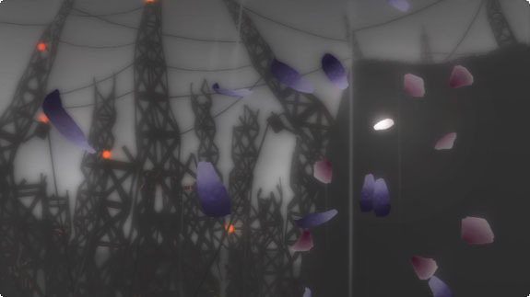
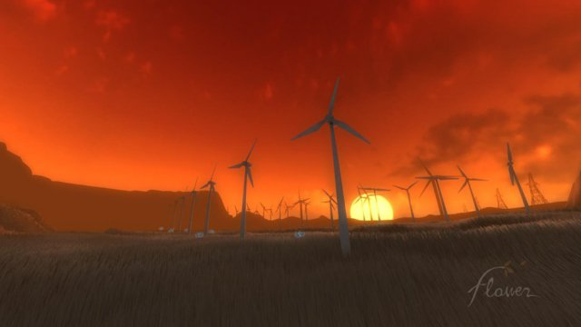
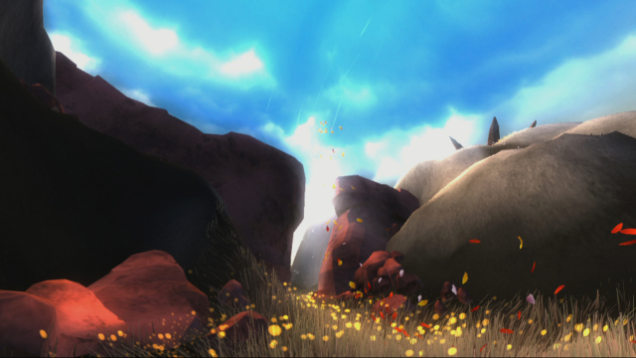
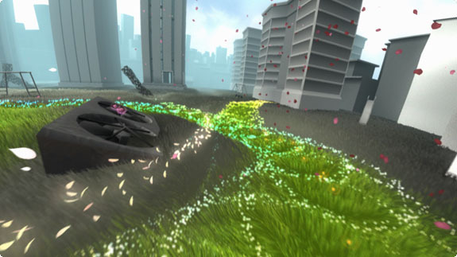
thatgamecompany: Flower
Levels 1 & 2
Levels 4 & 5
Levels 3 & 6
The absence of a relationship between humans and nature; no signs of human activity
Dysfunctional relationship between humans and nature; images of darkness, ruins and chaos
Peaceful and Harmonious relationship between humans and nature; co-existence (windmills) to symbiosis (your restorative powers extend to the whole environment)
Isaac Yuen, Interactive Storytelling: Thatgamecompany’s Flower (2012), Ekostories http://ekostories.com/2012/03/30/flower-thatgamecompany-nature/

Slide 32
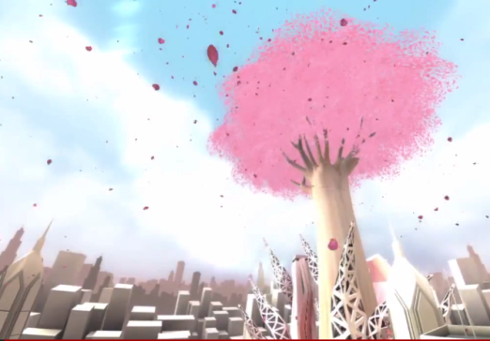
Excitement, renewal, catharsis, transcendence
I also found the narrative of Flower to be centered on the key idea of empowerment. A petal, the most insignificant object imaginable, has the power to shape the world. At first, its power is subtle – small patches of grass, changing rock formations, making the wind blow – but by the end of the game, it becomes an irresistible agent of change, sweeping over the old decaying ruins of the city as an agent of renewal. For me, experiencing the last level conveyed the message that even the most powerless of us has the ability to transform the world we live in.
Isaac Yuen, Interactive Storytelling: Thatgamecompany’s Flower (2012), Ekostories http://ekostories.com/2012/03/30/flower-thatgamecompany-nature/

Slide 33
Excitement, renewal, catharsis, transcendence
I also found the narrative of Flower to be centered on the key idea of empowerment. A petal, the most insignificant object imaginable, has the power to shape the world. At first, its power is subtle – small patches of grass, changing rock formations, making the wind blow – but by the end of the game, it becomes an irresistible agent of change, sweeping over the old decaying ruins of the city as an agent of renewal. For me, experiencing the last level conveyed the message that even the most powerless of us has the ability to transform the world we live in.
Mechanic: Single petal that grows with each interaction
Mechanics as metaphor: transformations grow in size, but are stunted by human presence
Information design as part of the landscape: length of trail and transformations
Aesthetic journey: peace to discord to harmony
Isaac Yuen, Interactive Storytelling: Thatgamecompany’s Flower (2012), Ekostories http://ekostories.com/2012/03/30/flower-thatgamecompany-nature/

Slide 34
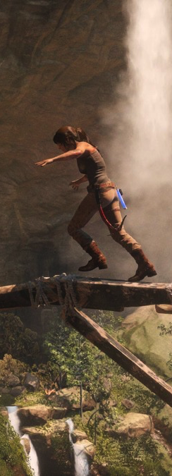
Diegetic Choices
Mechanical choices are embedded in play, so why not Narrative choices?
Diegetic Choices happen within the story world, using the standard mechanics of the game
Extra-Diegetic Choices happen outside the story world using mechanics especially designed for them
Stacey Mason. 2013. On Games and Links: Extending the Vocabulary of Agency and Immersion in Interactive Narratives.
In Proceedings of the 6th International Conference on Interactive Storytelling - Volume 8230 (ICIDS 2013)
Rise of the Tomb Raider

Slide 35
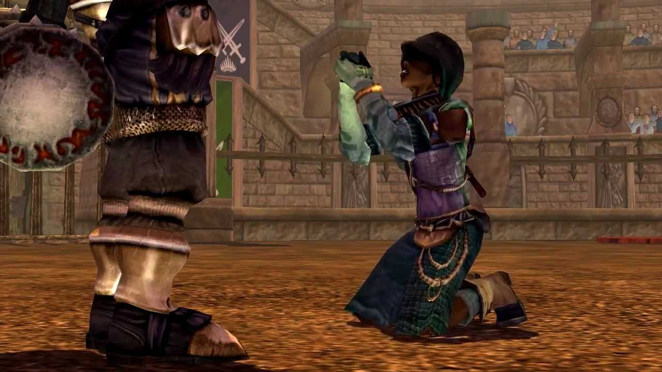
Diegetic or Non-Diegetic?
Fable – After fighting your childhood rival Whisper in the arena, she begs
for her life. Do you continue to attack her, or run from the arena?

Slide 36
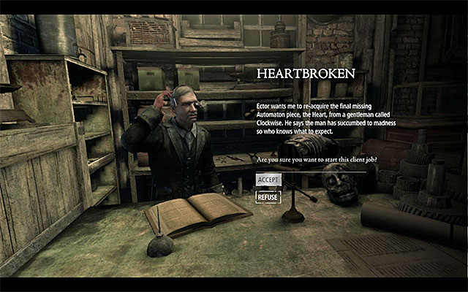
Diegetic or Non-Diegetic?
Thief – Ector is an inventor who dreams of building an automaton, he wants you to steal the last piece, the heart, for him – do you?

Slide 37
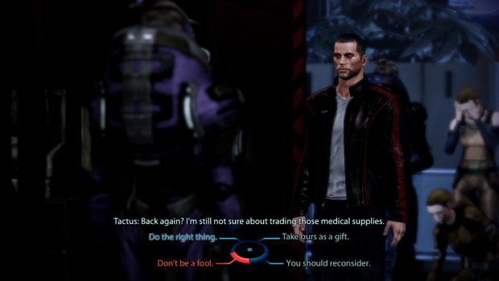
Diegetic or Non-Diegetic?
Mass Effect 3 – The refugee leader Tactus has military supplies that you need,
you can trade medical supplies in return, but he is not convinced – do you threaten him?

Slide 38
Summary
Ludology vs. Narratology
Types of Immersion
Poetics
Approach 1: Emphasise the Fabula
Environmental Storytelling
Narrative Architecture
Approach 2: Fusion
Thematic Cohesion
Mechanics as Metaphor
Diegetic Choices
A Critical Playing of Spec Ops: The Line
Spec Ops: The Line

