Slide 1
Linked Data
Publishing on the Semantic Web
Dr Nicholas Gibbins - nmg@ecs.soton.ac.uk
2015-2016

Slide 2
Linked Data
Semantic Web is the Web for machines
  Take existing data and republish it to the Web
  Rely on hypertextual nature of the Web to facilitate linking between data
How do we publish this data?
What identifiers do we use?

Slide 3
Semantic Web Principles
Anyone can make assertions about anything
Entities are referred to using Uniform Resource Identifiers
Based on XML technologies
Formal semantics

Slide 4
Resources and Identifiers

Slide 5
Uniform Resource Identifiers
What does a URI on the Semantic Web refer to?
  A real world object?
  A web page?
  Both?
What does a URI identify in general?
What is a resource?
What are the implicit semantics in a URI?

Slide 6
What is a resource?
From RFC2616 (HTTP/1.1):
“A network data object or service that can be identified by a URI […] Resources may be available in multiple representations (e.g. multiple languages, data formats, size, and resolutions) or vary in other ways.”

Slide 7
What is a resource?
From RFC2396 (URIs):
“A resource can be anything that has identity. Familiar examples include an electronic document, an image, a service (e.g., "today's weather report for Los Angeles"), and a collection of other resources. Not all resources are network "retrievable"; e.g., human beings, corporations, and bound books in a library can also be considered resources.
The resource is the conceptual mapping to an entity or set of entities, not necessarily the entity which corresponds to that mapping at any particular instance in time. Thus, a resource can remain constant even when its content - the entities to which it currently corresponds - changes over time, provided that the conceptual mapping is not changed in the process.”

Slide 8
httpRange-14
W3C Technical Architecture Group issue
  “What is the range of the HTTP range dereference operation?”
  Raised in March 2002
  Closed in June 2005
TBL’s original stance: HTTP URIs (without "#") should be understood as referring to documents, not cars

Slide 9
All resources are equal…
…but some are more equal than others
The things identified by URIs are resources
Some resources can be retrieved by dereferencing their URIs
  Or rather, representations of some resources can be retrieved
Some resources cannot be retrieved
  People, cats, cars

Slide 10
Information Resources
“Information resources are resources, identified by URIs and whose essential characteristics can be conveyed in a message”
  An (abstract) document (with a URI) can be dereferenced to get an ‘obvious’ representation of that document
  The majority of current Web resources are information resources

Slide 11
What makes an information resource?
Consider the case of resources identified by HTTP URIs:
If dereferencing the URI results in a 200 OK response code, the resource is an information resource
  From the HTTP RFC: “an entity corresponding to the requested resource is sent in the response”
If it results in a 303 See Other response, the resource could be any resource
  “the response to the request can be found under a different URI and SHOULD be retrieved using a GET method on that resource”
If it results in a 4xx (client error) or 5xx (server error) response, we can’t say either way

Slide 12
The Linked
Data Principles

Slide 13
Linked Data Principles
Set of publishing practices for SW data:
1. Use URIs as names for things
2. Use HTTP URIs so that people can look up those names
3. When someone looks up a URI, provide useful information
4. Include links to other URIs. so that they can discover more things
Effectively, putting the hypertext back into the Semantic Web
Simplifies integration between datasets while maintaining loose coupling

Slide 14
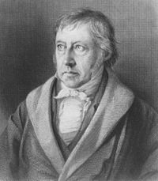

1. Use URIs as names for things
Use a unique identifier to denote things
URIs are defined in RFC 2396
Hegel, Georg Wilhelm Friedrich
  http://dbpedia.org/resource/Georg_Wilhelm_Friedrich_Hegel
  http://viaf.org/viaf/89774942
  …
Hegel, Georg Wilhelm Friedrich: Gesammelte Werke / Vorlesungen über die Logik
  urn:isbn:978-3-7873-1964-0

Slide 15
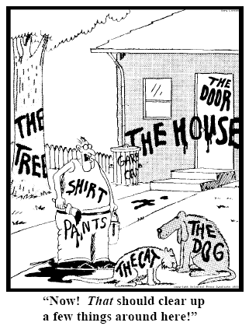
Names for things

Slide 16
2. Use HTTP URIs
Enables “lookup” of URIs via Hypertext Transfer Protocol
Piggy-backs on hierarchical Domain Name System to guarantee uniqueness of identifiers
Uses established infrastructure
Connects logical level (thing) with physical level (source)
Important distinction between name/“thing URI” and location/“source URI”
  Also called “other resource“/“non-information resource“ vs. “information resource“
  See also httpRange 14

Slide 17
3. Provide useful information
When somebody looks up a URI, return data using the standards (RDF*, SPARQL)

Slide 18
4. Link to other URIs
Enable people (and machines) to jump from server to server
External links vs. internal links (for any predicate)
Using external vocabularies enables linking
Vocabularies might be interlinked, too
Special owl:sameAs links to denote equivalence of identifiers (useful for data merging)
Other types of links are possible as well

Slide 19
Example
graph describing ‘sw’
graph describing ‘tbl’
2001-05
tbl
Tim Berners-Lee
The Semantic Web
date
name
tbl
title
creator
graph describing ‘jh’
sw
jh
publishedIn
creator
jh
James Hendler
sci
am
ora
name
creator
graph describing ‘ora’
ora
Ora Lassila
graph describing ‘sciam’
name
sci
am
title
Scientific American

Slide 20
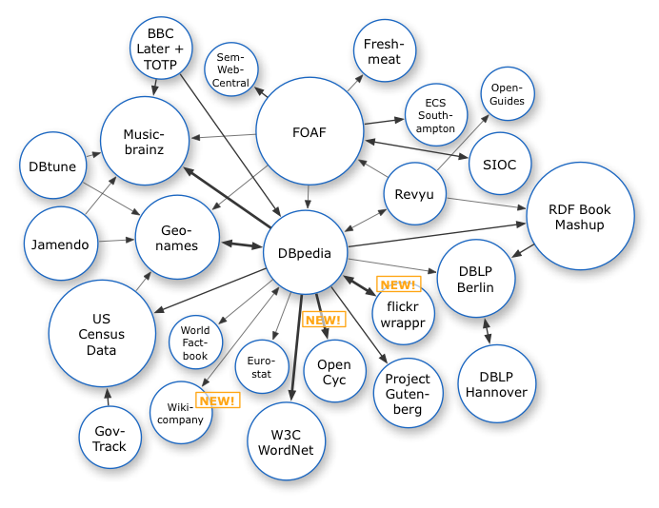
Linked Data on the Web: 2007

Slide 21
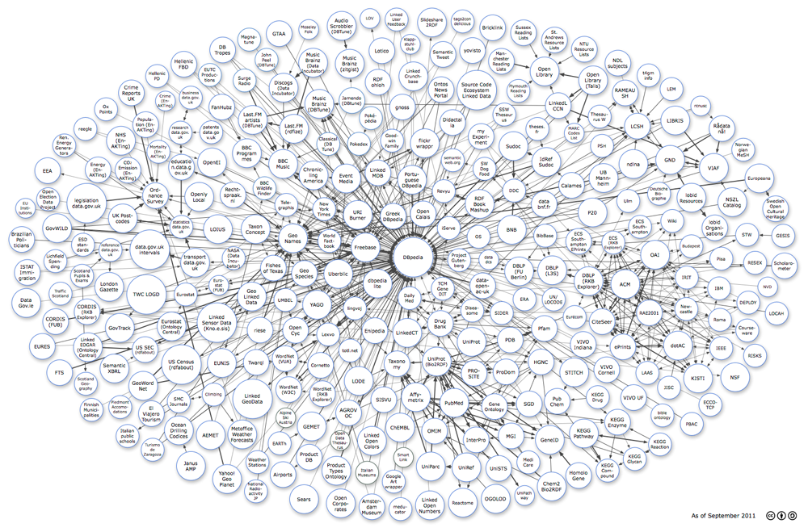
Linked Data on the Web: 2011

Slide 22
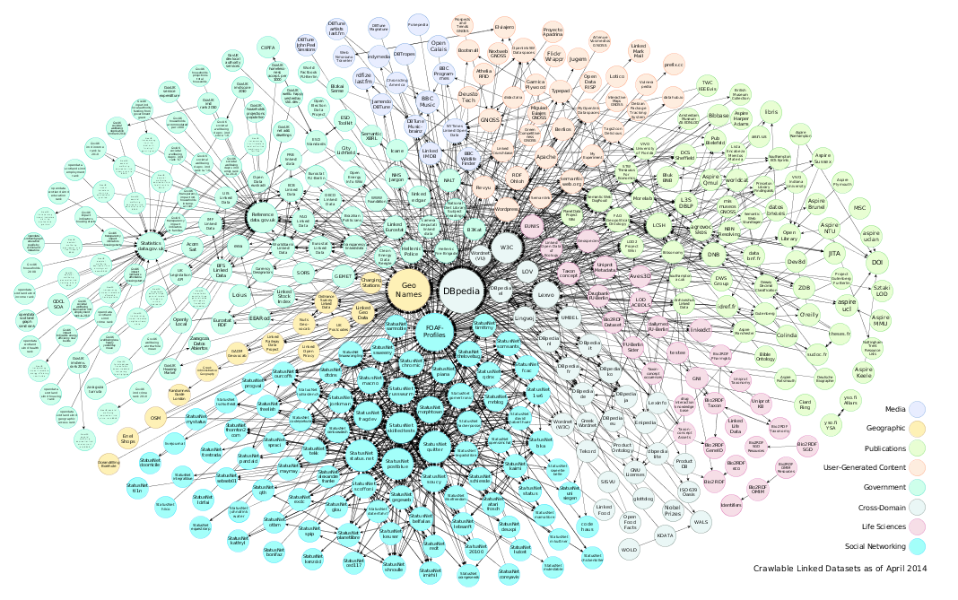
Linked Data on the Web: 2014

Slide 23
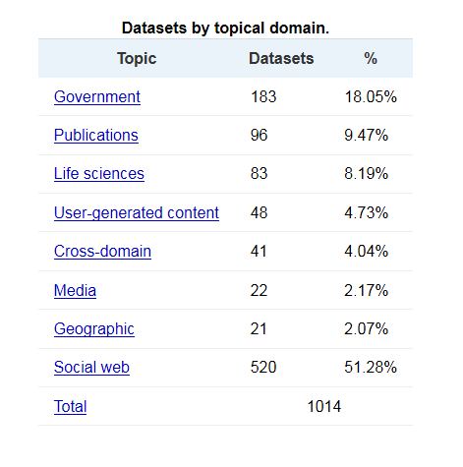
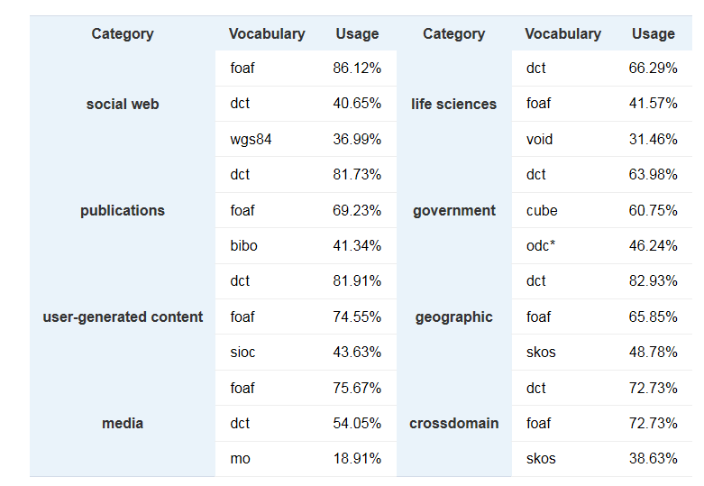
Analysis of the LOD Cloud: 2014
http://linkeddatacatalog.dws.informatik.uni-mannheim.de/state/

Slide 24
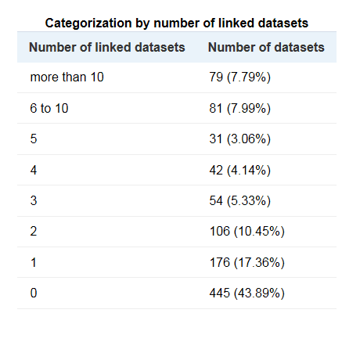
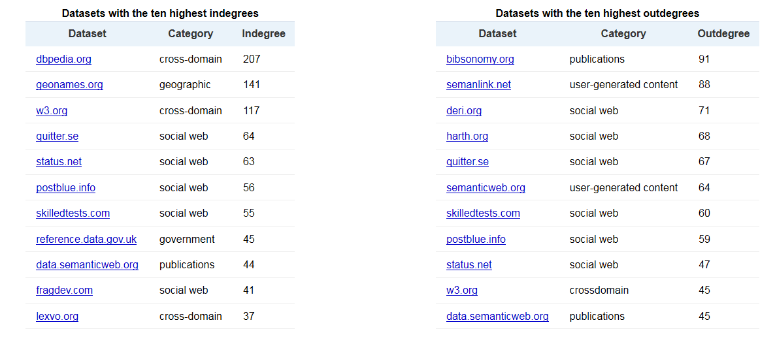
Interlinking in the LOD Cloud 2014
http://linkeddatacatalog.dws.informatik.uni-mannheim.de/state/

Slide 25

Publishing Semantic Web Data
http://www.flickr.com/photos/cibergaita/97220057/lightbox/

Slide 26
Creating Semantic Web resources
In http://example.org/data.rdf :
@prefix foaf: <http://xmlns.com/foaf/0.1/>
<#fred> <foaf:name> “Fred Smith”.
We have a new resource: http://example.org/data.rdf#fred

Slide 27
Defining RDF Vocabularies
SW Best Practice Recipes for Publishing RDF Vocabularies
Distinguishes between ‘hash’ and ‘slash’ namespaces
  http://example.org/ontology#foo
  http://example.org/ontology/foo
Uses content negotiation (HTTP Accept: header) to serve different representations of resources
  Machine-readable RDF vs human-readable HTML

Slide 28
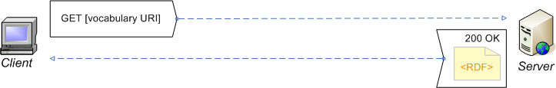
Minimal Hash Namespace

Slide 29
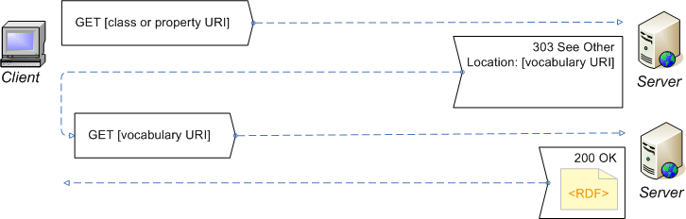
Minimal Slash Namespace

Slide 30
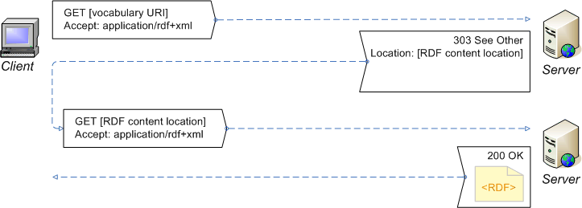
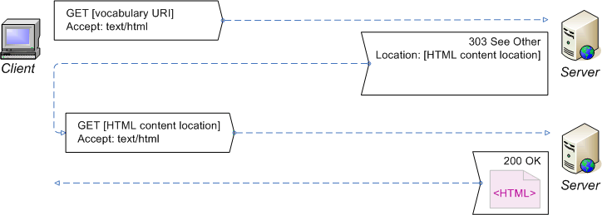
Extended Hash Namespace

Slide 31

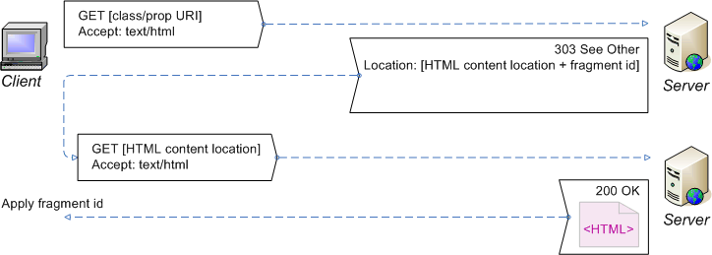
Extended Slash Namespace

Slide 32
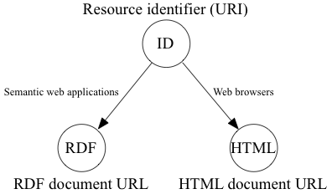
Cool URIs

Slide 33
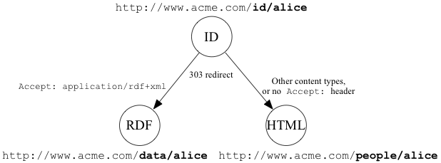
Cool URIs – 303 Pattern

Slide 34
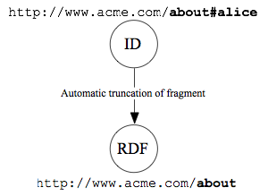
Cool URIs – Hash Pattern

Slide 35
Cool URIs
ID
303
redirect
303
redirect
uses
mentions
RDF
meta
HTML
homepage

Slide 36
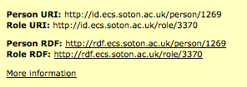
Cool URIs in ECS
ID URI: http://id.ecs.soton.ac.uk/person/1269
RDF URI: http://rdf.ecs.soton.ac.uk/person/1269
HTML URI: http://www.ecs.soton.ac.uk/people/nmg

Slide 37
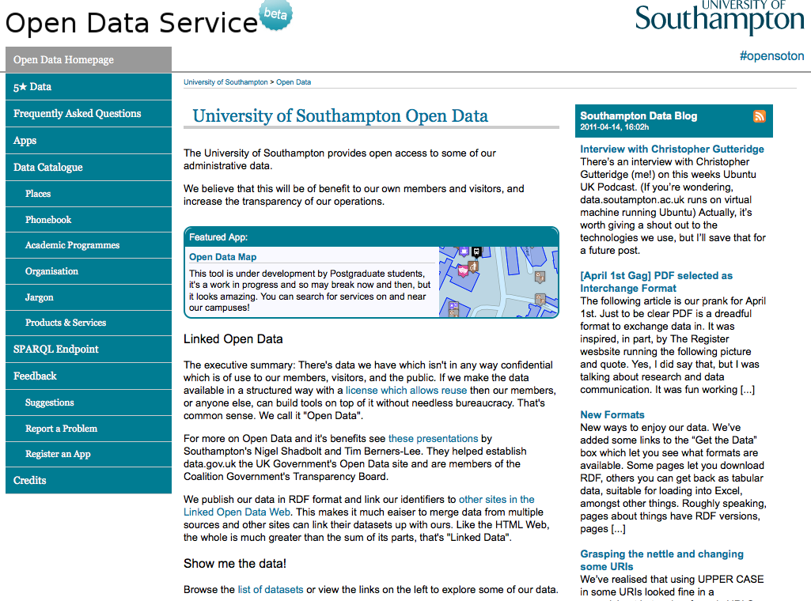

Slide 38
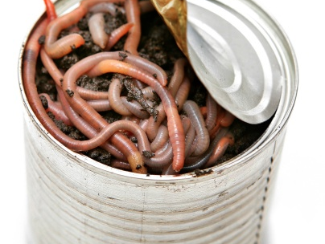
It’s not quite that simple...

Slide 39
rdfURIMeaning-39
W3C Technical Architecture Group issue
  Raised in July 2003
  Currently open
Is a given inference engine expected to take into account a given document under given circumstances?
How does one avoid having to commit to things one does not trust?

Slide 40
HttpRedirections-57
W3C Technical Architecture Group issue
  “Mechanisms for obtaining information about the meaning of a given URI”
  Raised in July 2007
  Currently open
Further consideration of the use of:
  303 HTTP status codes (and interaction with caching)
  Other possible mechanisms for obtaining a description of a (non-information) resource (HTTP Link: header – see RFC2068)

Slide 41
UniformAccessToMetadata-62
W3C Technical Architecture Group issue
  “Given the URI of an HTTP-accessible information resource R, how can an agent learn the URIs of metadata documents about R authorized by the owner of the original URI”
  Raised in March 2009
  Currently open

Slide 42
Further Reading
Architecture of the World Wide Web
http://www.w3.org/TR/webarch/
R.T. Fielding and R.N. Taylor, Principled Design of the Modern Web Architecture, ACM Transactions on Internet Technology 2 (2): 115–150
http://www.ics.uci.edu/~taylor/documents/2002-REST-TOIT.pdf
Uniform Resource Identifiers (URI): Generic Syntax
IETF RFC2396
http://www.ietf.org/rfc/rfc2396.txt
Hypertext Transfer Protocol - HTTP/1.1
IETF RFC2616
http://www.ietf.org/rfc/rfc2616

Slide 43
Further Reading
What do HTTP URIs identify?
http://www.w3.org/DesignIssues/HTTP-URI
W3C TAG issue httpRange-14
http://www.w3.org/2001/tag/group/track/issues/14
W3C TAG Issue rdfUriMeaning-39
http://www.w3.org/2001/tag/group/track/issues/39
W3C TAG issue httpRedirections-57
http://www.w3.org/2001/tag/group/track/issues/57
W3C TAG issue UniformAccessToMetadata-62
http://www.w3.org/2001/tag/group/track/issues/62
Dereferencing HTTP URIs
http://www.w3.org/2001/tag/doc/httpRange-14/2007-05-31/HttpRange-14

Slide 44
Further Reading
Cool URIs for the Semantic Web
http://www.w3.org/TR/2007/WD-cooluris-20071217/
Best Practice Recipes for Publishing RDF Vocabularies
http://www.w3.org/TR/swbp-vocab-pub/

