Slide 1
SOCIAL MEDIA ANALYTICS
David Millard
dem@soton.ac.uk
@hoosfoos
davidmillard.org

Slide 2
PART I Analytics

Slide 3
Surveillance – What technologies are used?

Slide 4
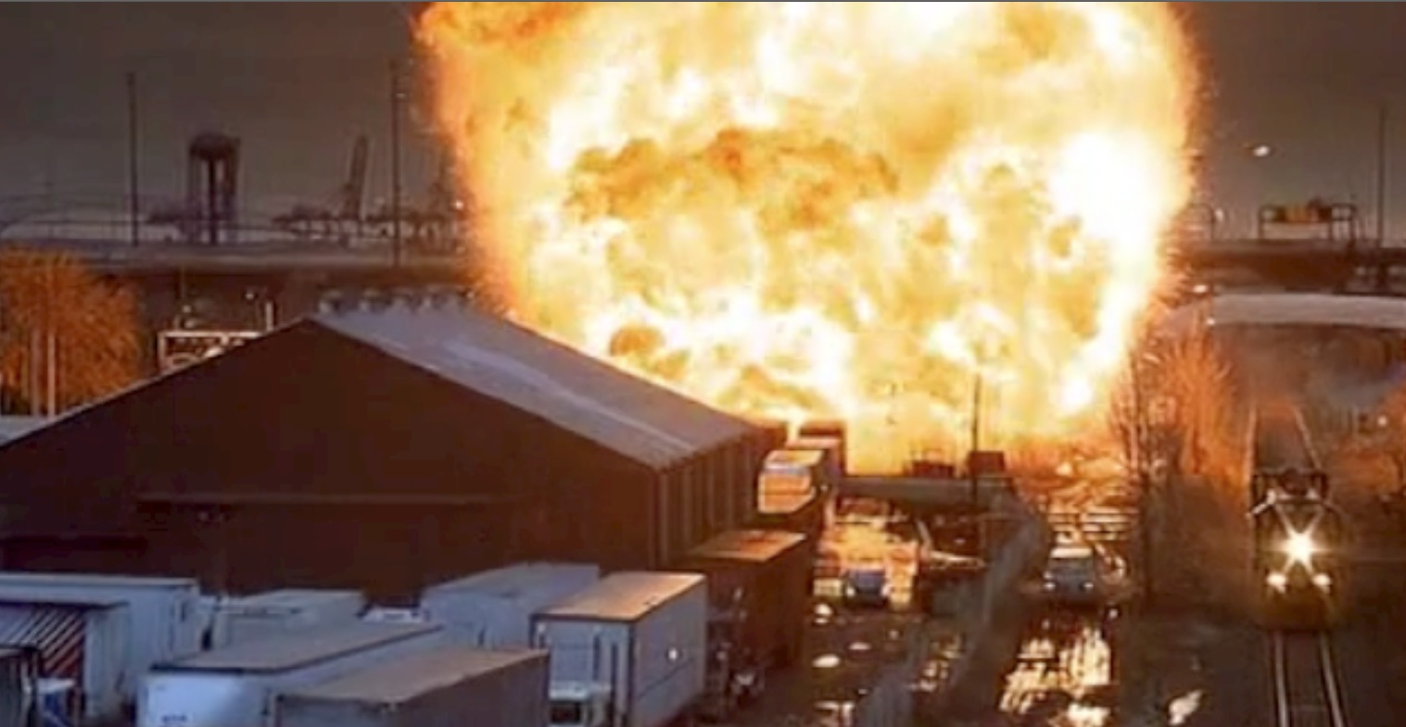
Surveillance – What technologies are used?
Was this realistic in 1998?

Slide 5
Surveillance – What technologies are used?
Was this realistic in 1998?
Is it realistic in 2016?

Slide 6
“Analytics is the discovery and communication of meaningful patterns in data. [It] relies on the simultaneous application of statistics, computer programming and operations research to quantify performance. Analytics often favors data visualization to communicate insight.”
Wikipedia.org
“the systematic computational analysis of data or statistics”
Oxford English Dictionary
“Studying the past data to predict trends, evaluate performance, and manage effects”
- Black’s Law Dictionary

Slide 7
“Analytics is the discovery and communication of meaningful patterns in data. [It] relies on the simultaneous application of statistics, computer programming and operations research to quantify performance. Analytics often favors data visualization to communicate insight.”
Wikipedia.org
“the systematic computational analysis of data or statistics”
Oxford English Dictionary
“Studying the past data to predict trends, evaluate performance, and manage effects”
- Black’s Law Dictionary

Slide 8
“Analytics is the discovery and communication of meaningful patterns in data. [It] relies on the simultaneous application of statistics, computer programming and operations research to quantify performance. Analytics often favors data visualization to communicate insight.”
Wikipedia.org
“the systematic computational analysis of data or statistics”
Oxford English Dictionary
“Studying the past data to predict trends, evaluate performance, and manage effects”
- Black’s Law Dictionary

Slide 9
“Analytics is the discovery and communication of meaningful patterns in data. [It] relies on the simultaneous application of statistics, computer programming and operations research to quantify performance. Analytics often favors data visualization to communicate insight.”
Wikipedia.org
“the systematic computational analysis of data or statistics”
Oxford English Dictionary
“Studying the past data to predict trends, evaluate performance, and manage effects”
- Black’s Law Dictionary

Slide 10
Think About Your Own Social Network

Slide 11
Think About Your Own Social Network
What Online Social Networks do you use?

Slide 12
Think About Your Own Social Network
What could I find out about you?

Slide 13
Think About Your Own Social Network
What could I find out about your friends
from your network?

Slide 14
Think About Your Own Social Network
What could I find out about you from the
combined networks of your friends?

Slide 15
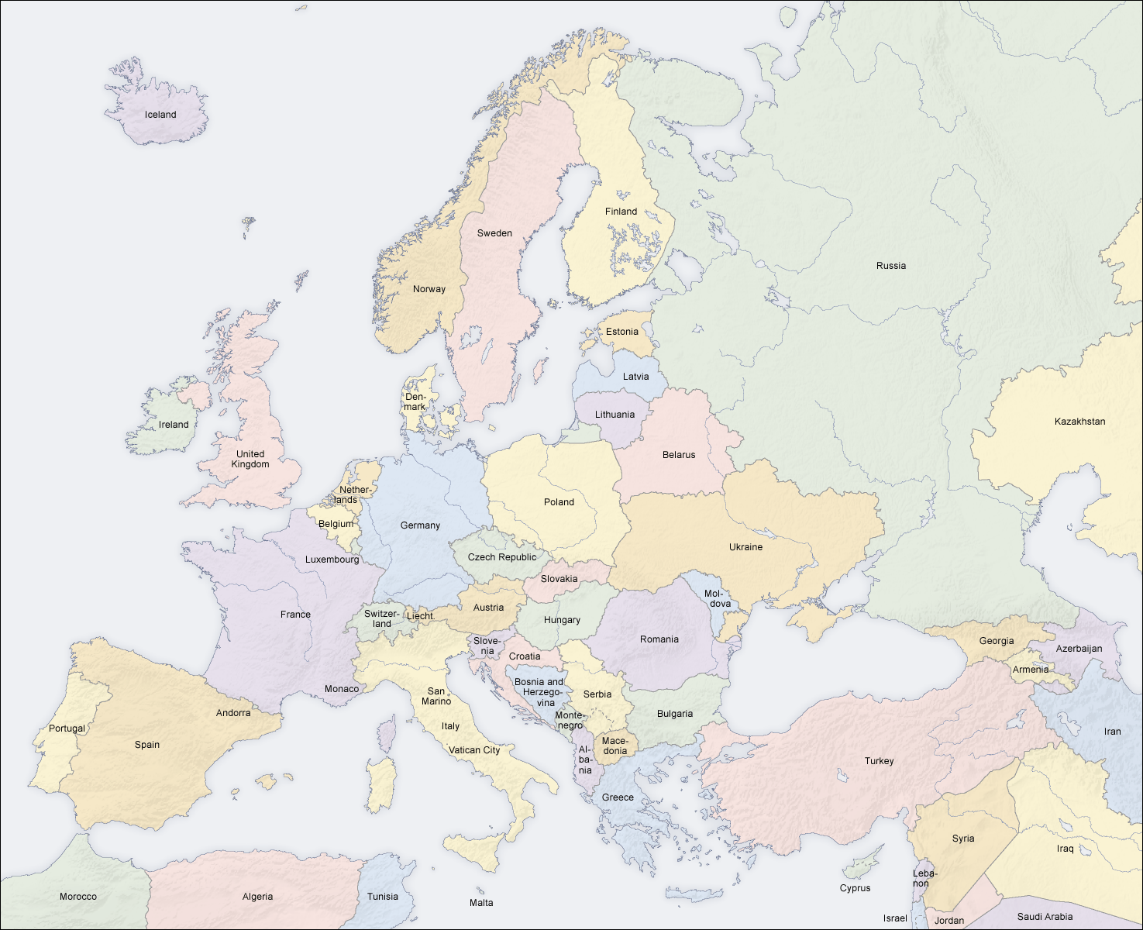
You are not alone
So what might the whole network tell you about the whole world?

Slide 16
Example Methods
Network analysis – look at the structures
Example: Who are the connectors – people who bridge two or more networks?
Example: Who are the core – people with high centrality?
Content Analysis
Sentiment analysis – look at whether content is positive or negative
Example: What was the public reaction to the Prime Ministers speech?
Content Tracking – trace where information flows from and to
Example: How did this news story spread?
Clustering
Peak finding – look at how things cluster in time
Example: When were the interesting moments in the football game?
Location clustering – look at how things cluster in space
Example: What are the interesting places that people photograph in London?

Slide 17
Example Methods
Network analysis – look at the structures
Example: Who are the connectors – people who bridge two or more networks?
Example: Who are the core – people with high centrality?
Content Analysis
Sentiment analysis – look at whether content is positive or negative
Example: What was the public reaction to the Prime Ministers speech?
Content Tracking – trace where information flows from and to
Example: How did this news story spread?
Clustering
Peak finding – look at how things cluster in time
Example: When were the interesting moments in the football game?
Location clustering – look at how things cluster in space
Example: What are the interesting places that people photograph in London?

Slide 18
Example Methods
Network analysis – look at the structures
Example: Who are the connectors – people who bridge two or more networks?
Example: Who are the core – people with high centrality?
Content Analysis
Sentiment analysis – look at whether content is positive or negative
Example: What was the public reaction to the Prime Ministers speech?
Content Tracking – trace where information flows from and to
Example: How did this news story spread?
Clustering
Peak finding – look at how things cluster in time
Example: When were the interesting moments in the football game?
Location clustering – look at how things cluster in space
Example: What are the interesting places that people photograph in London?
loved
idiot
rubbish
great
rubbish
nonsense
welcome
opportunity
foolish
good
dangerous
ill-conceived

Slide 19
Example Methods
Network analysis – look at the structures
Example: Who are the connectors – people who bridge two or more networks?
Example: Who are the core – people with high centrality?
Content Analysis
Sentiment analysis – look at whether content is positive or negative
Example: What was the public reaction to the Prime Ministers speech?
Content Tracking – trace where information flows from and to
Example: How did this news story spread?
Clustering
Peak finding – look at how things cluster in time
Example: When were the interesting moments in the football game?
Location clustering – look at how things cluster in space
Example: What are the interesting places that people photograph in London?
loved
idiot
rubbish
great
rubbish
nonsense
welcome
opportunity
foolish
good
dangerous
ill-conceived

Slide 20
Example Methods
Network analysis – look at the structures
Example: Who are the connectors – people who bridge two or more networks?
Example: Who are the core – people with high centrality?
Content Analysis
Sentiment analysis – look at whether content is positive or negative
Example: What was the public reaction to the Prime Ministers speech?
Content Tracking – trace where information flows from and to
Example: How did this news story spread?
Clustering
Peak finding – look at how things cluster in time
Example: When were the interesting moments in the football game?
Location clustering – look at how things cluster in space
Example: What are the interesting places that people photograph in London?
loved
idiot
great
rubbish
welcome
rubbish
opportunity
nonsense
good
dangerous
foolish
ill-conceived
5
7

Slide 21
Example Methods
Network analysis – look at the structures
Example: Who are the connectors – people who bridge two or more networks?
Example: Who are the core – people with high centrality?
Content Analysis
Sentiment analysis – look at whether content is positive or negative
Example: What was the public reaction to the Prime Ministers speech?
Content Tracking – trace where information flows from and to
Example: How did this news story spread?
Clustering
Peak finding – look at how things cluster in time
Example: When were the interesting moments in the football game?
Location clustering – look at how things cluster in space
Example: What are the interesting places that people photograph in London?
loved
idiot
great
rubbish
welcome
rubbish
opportunity
nonsense
good
dangerous
foolish
ill-conceived
58%

Slide 22
Example Methods
1500: Jack Jones (@jonesey) – And once again #saintsfc rumble into action
1501: Jamie Jameson (@northernlad) – #MUFC gonna kick some #saintsfc butt!
Network analysis – look at the structures
Example: Who are the connectors – people who bridge two or more networks?
Example: Who are the core – people with high centrality?
Content Analysis
Sentiment analysis – look at whether content is positive or negative
Example: What was the public reaction to the Prime Ministers speech?
Content Tracking – trace where information flows from and to
Example: How did this news story spread?
Clustering
Peak finding – look at how things cluster in time
Example: When were the interesting moments in the football game?
Location clustering – look at how things cluster in space
Example: What are the interesting places that people photograph in London?
1501: HarryRednapp (@knowwhatImeanharry) – #saintsfc I miss you guys!
1515: Alice Bored (@reluctantWAG) – OH watching the horrible #MUFC again :-(
1538: Katie Fan (@MUTotalFan) – OH NO! Surely that was in! #MUFC
1538: Sammie South (@playitagain) – god that was a close one :-( #saintsfc
1539: Katie Fan (@MUTotalFan) – the ref is from Scumpton, I know it! #MUFC
1552: George Daws (@bigbaby) – I so need a beer after that #MUFC
1600: Sammie South (@playitagain) – here we go again #saintsfc
1631: John Smith (@smithy) – GOAALLL!!!! #saintsfc
1631: Don Nutbeam (@vcsoton) – More proof Southampton is best! #saintsfc
1631: Jamie Jameson (@northernlad) – Jesus we let one in from these turkeys? #MUFC
1632: John Smith (@smithy) – Is it me or was that a contender for goal of the year? #saintsfc
1644: : Katie Fan (@MUTotalFan) – damn timewasting #mufc
1647: John Smith (@smithy) – omg, they only went and did it #saintsfc

Slide 23
Example Methods
1500: Jack Jones (@jonesey) – And once again #saintsfc rumble into action
1501: Jamie Jameson (@northernlad) – #MUFC gonna kick some #saintsfc butt!
1500
1501: HarryRednapp (@knowwhatImeanharry) – #saintsfc I miss you guys!
Network analysis – look at the structures
Example: Who are the connectors – people who bridge two or more networks?
Example: Who are the core – people with high centrality?
Content Analysis
Sentiment analysis – look at whether content is positive or negative
Example: What was the public reaction to the Prime Ministers speech?
Content Tracking – trace where information flows from and to
Example: How did this news story spread?
Clustering
Peak finding – look at how things cluster in time
Example: When were the interesting moments in the football game?
Location clustering – look at how things cluster in space
Example: What are the interesting places that people photograph in London?
1515: Alice Bored (@reluctantWAG) – OH watching the horrible #MUFC again :-(
1530
1538: Katie Fan (@MUTotalFan) – OH NO! Surely that was in! #MUFC
1538: Sammie South (@playitagain) – god that was a close one :-( #saintsfc
1539: Katie Fan (@MUTotalFan) – the ref is from Scumpton, I know it! #MUFC
1552: George Daws (@bigbaby) – I so need a beer after that #MUFC
1600
1600: Sammie South (@playitagain) – here we go again #saintsfc
1630
1631: John Smith (@smithy) – GOAALLL!!!! #saintsfc
1631: Don Nutbeam (@vcsoton) – More proof Southampton is best! #saintsfc
1631: Jamie Jameson (@northernlad) – Jesus we let one in from these turkeys? #MUFC
1645
1632: John Smith (@smithy) – Is it me or was that a contender for goal of the year? #saintsfc
1644: : Katie Fan (@MUTotalFan) – damn timewasting #mufc
1647: John Smith (@smithy) – omg, they only went and did it #saintsfc

Slide 24
Example Methods
1500: Jack Jones (@jonesey) – And once again #saintsfc rumble into action
1501: Jamie Jameson (@northernlad) – #MUFC gonna kick some #saintsfc butt!
1500
1501: HarryRednapp (@knowwhatImeanharry) – #saintsfc I miss you guys!
Network analysis – look at the structures
Example: Who are the connectors – people who bridge two or more networks?
Example: Who are the core – people with high centrality?
Content Analysis
Sentiment analysis – look at whether content is positive or negative
Example: What was the public reaction to the Prime Ministers speech?
Content Tracking – trace where information flows from and to
Example: How did this news story spread?
Clustering
Peak finding – look at how things cluster in time
Example: When were the interesting moments in the football game?
Location clustering – look at how things cluster in space
Example: What are the interesting places that people photograph in London?
1515: Alice Bored (@reluctantWAG) – OH watching the horrible #MUFC again :-(
1530
1538: Katie Fan (@MUTotalFan) – OH NO! Surely that was in! #MUFC
1538: Sammie South (@playitagain) – god that was a close one :-( #saintsfc
1539: Katie Fan (@MUTotalFan) – the ref is from Scumpton, I know it! #MUFC
1552: George Daws (@bigbaby) – I so need a beer after that #MUFC
1600
1600: Sammie South (@playitagain) – here we go again #saintsfc
1630
1631: John Smith (@smithy) – GOAALLL!!!! #saintsfc
1631: Don Nutbeam (@vcsoton) – More proof Southampton is best! #saintsfc
1631: Jamie Jameson (@northernlad) – Jesus we let one in from these turkeys? #MUFC
1645
1632: John Smith (@smithy) – Is it me or was that a contender for goal of the year? #saintsfc
1644: : Katie Fan (@MUTotalFan) – damn timewasting #mufc
1647: John Smith (@smithy) – omg, they only went and did it #saintsfc

Slide 25
Example Methods
1500: Jack Jones (@jonesey) – And once again #saintsfc rumble into action
1501: Jamie Jameson (@northernlad) – #MUFC gonna kick some #saintsfc butt!
1500
1501: HarryRednapp (@knowwhatImeanharry) – #saintsfc I miss you guys!
KICK-OFF
Network analysis – look at the structures
Example: Who are the connectors – people who bridge two or more networks?
Example: Who are the core – people with high centrality?
Content Analysis
Sentiment analysis – look at whether content is positive or negative
Example: What was the public reaction to the Prime Ministers speech?
Content Tracking – trace where information flows from and to
Example: How did this news story spread?
Clustering
Peak finding – look at how things cluster in time
Example: When were the interesting moments in the football game?
Location clustering – look at how things cluster in space
Example: What are the interesting places that people photograph in London?
1515: Alice Bored (@reluctantWAG) – OH watching the horrible #MUFC again :-(
1530
1538: Katie Fan (@MUTotalFan) – OH NO! Surely that was in! #MUFC
SHOT AT GOAL
1538: Sammie South (@playitagain) – god that was a close one :-( #saintsfc
1539: Katie Fan (@MUTotalFan) – the ref is from Scumpton, I know it! #MUFC
1552: George Daws (@bigbaby) – I so need a beer after that #MUFC
1600
1600: Sammie South (@playitagain) – here we go again #saintsfc
1630
1631: John Smith (@smithy) – GOAALLL!!!! #saintsfc
GOAL SCORED
1631: Don Nutbeam (@vcsoton) – More proof Southampton is best! #saintsfc
1631: Jamie Jameson (@northernlad) – Jesus we let one in from these turkeys? #MUFC
1645
1632: John Smith (@smithy) – Is it me or was that a contender for goal of the year? #saintsfc
1644: : Katie Fan (@MUTotalFan) – damn timewasting #mufc
FINAL WHISTLE
1647: John Smith (@smithy) – omg, they only went and did it #saintsfc

Slide 26
Using Patterns for Predictions…
In 2013 researchers in Cambridge looked at the predictive power of Facebook likes…
Michal Kosinski, David Stillwell, and Thore Graepel. Private traits and attributes are predictable from digital records of human behavior. Proceedings of the National Academy of Sciences. 2013 110 (15) 5802-5805;

Slide 27
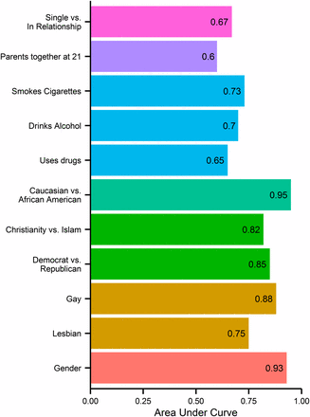
Using Patterns for Predictions…
In 2013 researchers in Cambridge looked at the predictive power of Facebook likes…
Michal Kosinski, David Stillwell, and Thore Graepel. Private traits and attributes are predictable from digital records of human behavior. Proceedings of the National Academy of Sciences. 2013 110 (15) 5802-5805;

Slide 28
Riot – Big Brother is friending you

Slide 29
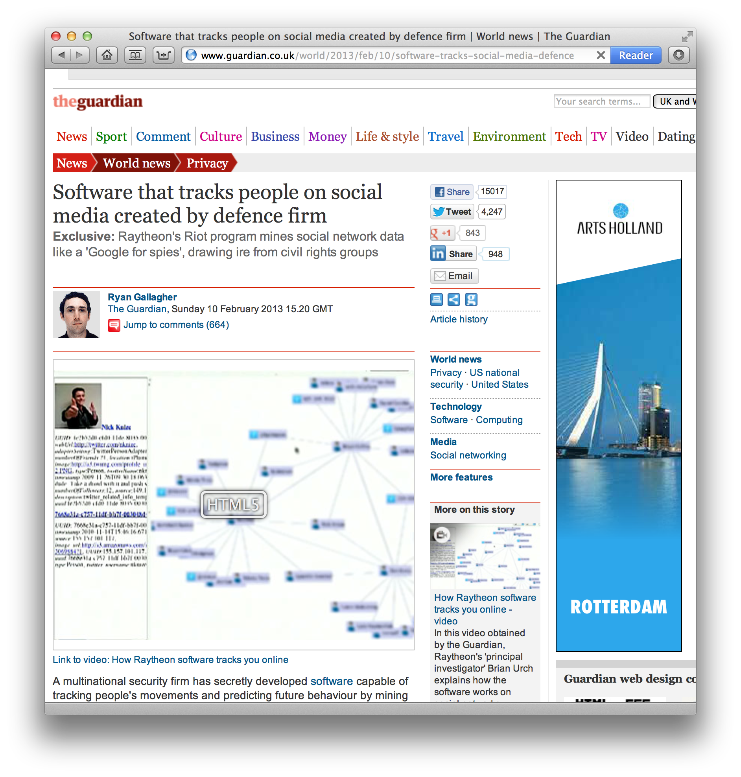
Riot – Big Brother is friending you

Slide 30
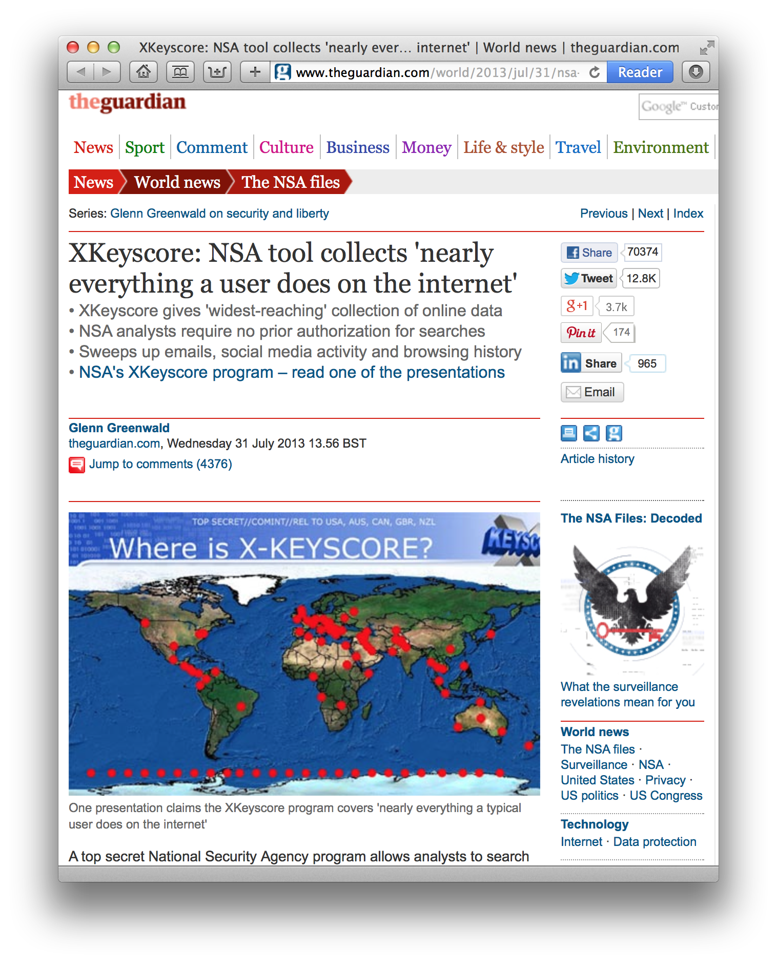
Riot – Big Brother is friending you

Slide 31
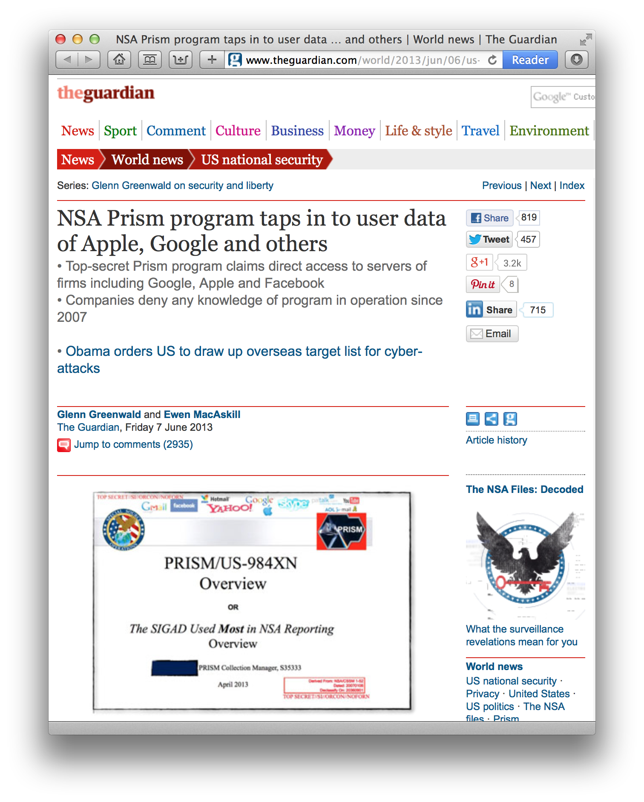
Riot – Big Brother is friending you

Slide 32
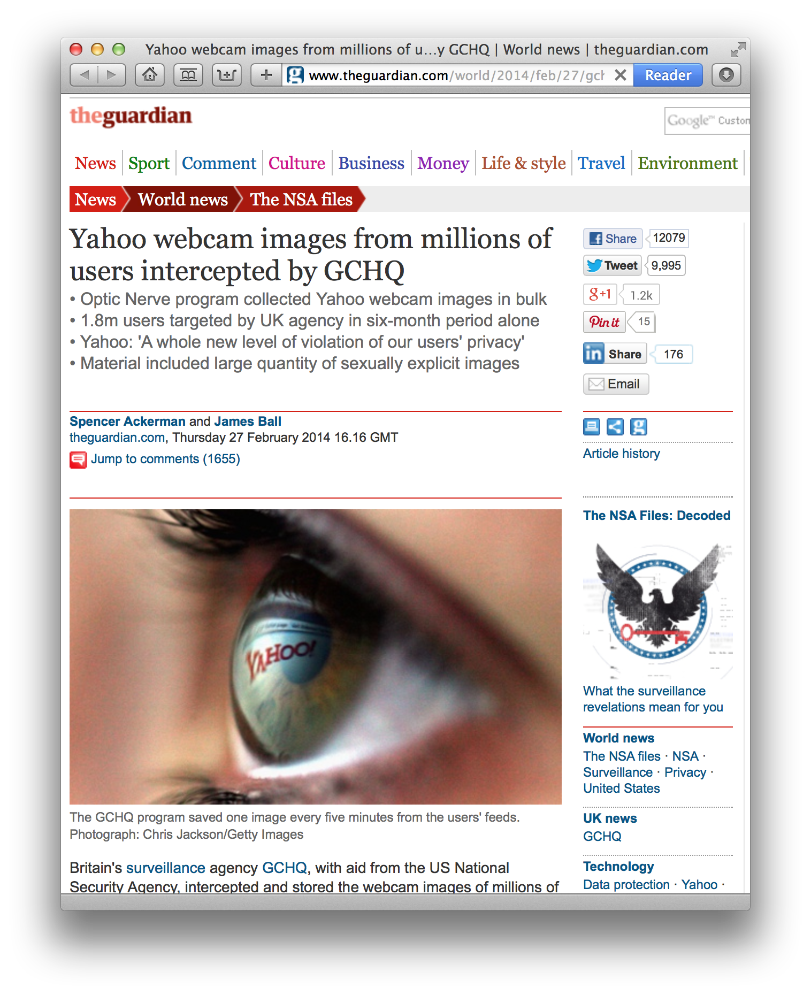
Riot – Big Brother is friending you

Slide 33
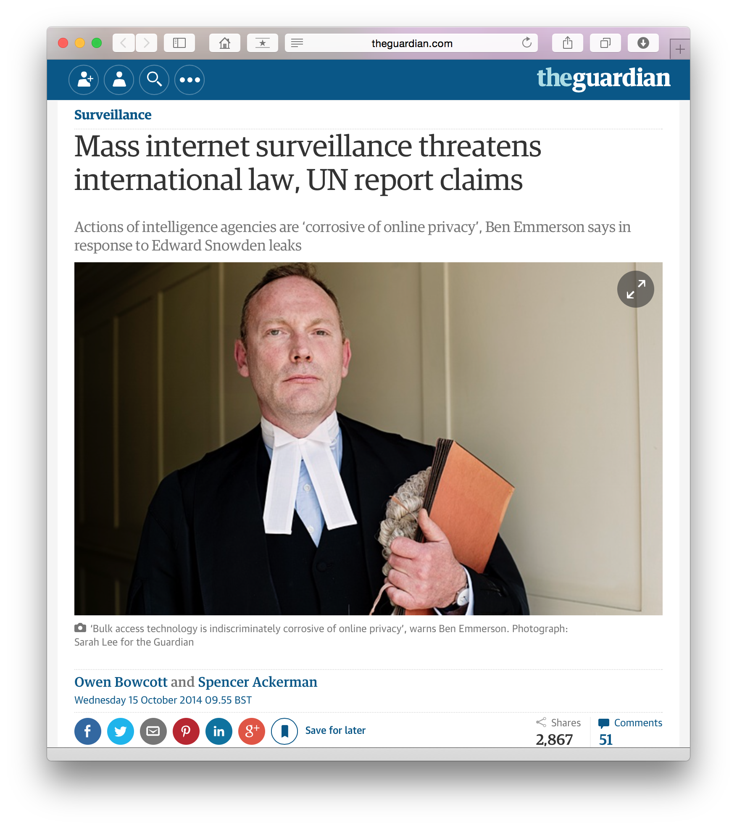
Riot – Big Brother is friending you

Slide 34
Summary
Our data trails are subject to analytics
The automatic discovery of patterns in trends that reveal information about ourselves
We lay down our own digital footprints (data)
But others also lay down information about us
Mass analytics can reveal more about you than you believe you have revealed (e.g. network/sentiment/event analysis)
Next we look at two examples of analytics:
To calculate trust in a social network
To identify powerful individuals in a social network

Slide 35
Questions…
?
Dave Millard (dem@soton.ac.uk)

Slide 36
PART II Trust

Slide 37
This country has a dark future unless we can attract better people into politics

Slide 38
Most people would be horrified if they knew how much news the public hears and sees is distorted

Slide 39
It is safe to believe that in spite of what people say most people are primarily interested in their own welfare

Slide 40
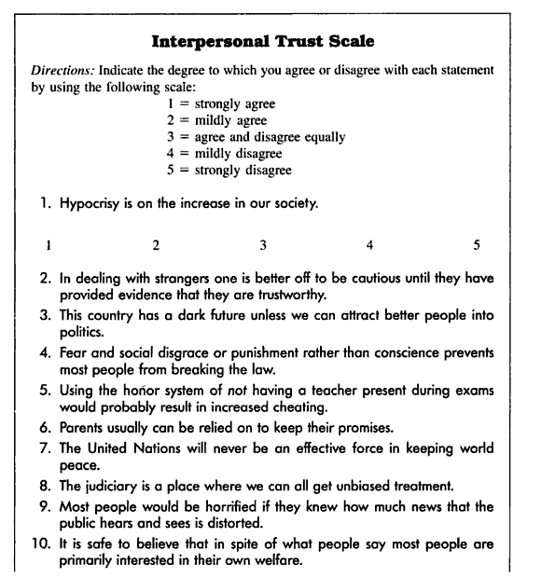
Generalized Trust
Rotter’s Interpersonal Trust Scale (ITS)
The ITS measures an individual’s general tendency to trust different groups of people
E.g. teachers, parents, politicians, physicians, classmates, and friends
The survey measures the individual’s “general optimism regarding the society”
Rotter, J. B. 1967. A new scale for the measurement of inter- personal trust. Journal of Personality. 35; 615-665

Slide 41
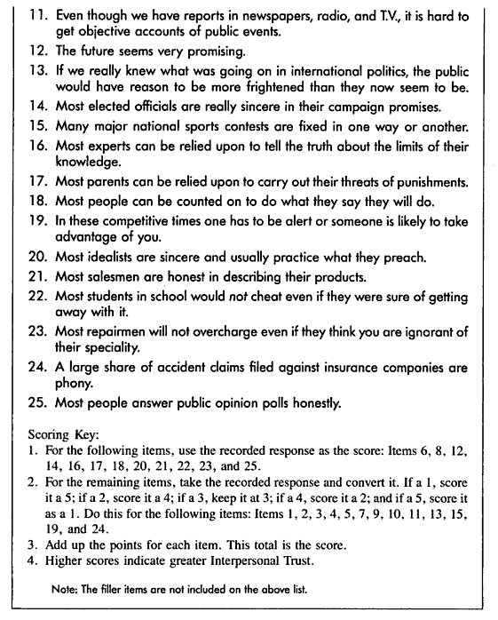
Generalized Trust
Rotter summarised his 13 years of findings in 1980
Subjects that are high in interpersonal trust tend to be:
more trustworthy
better liked
happier
Subjects low in interpersonal trust tend to exhibit untrustworthy behavior (self-reported cheating and lying)
Rotter, J. B. (1980). Interpersonal trust, trustworthiness, and gullibility. American Psychologist, 35(1), 1-7

Slide 42
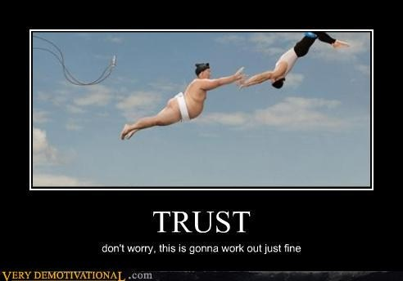
Rotter is talking about Trust as a general disposition But what about Dyadic trust (between two people)

Slide 43
Think About Your Own Social Network
How might I use your network to identify
the most trusted person?

Slide 44
How Might we Calculate Trust?

Slide 45
How Might we Calculate Trust?
Dan
Bob
Clare
Alice
Artz and Gil. A survey of trust in computer science and the semantic web. Web Semantics: Science, Services and Agents on the World Wide Web (2007) vol. 5 (2) pp. 58-71

Slide 46
How Might we Calculate Trust?
Bob is selling Clare a car that used to belong to Alice
Dan has bought stuff from Bob before
Can Clare trust the info he gives her about the car?
Dan
Bob
Registration Info
…………
…………
Clare
Alice
Artz and Gil. A survey of trust in computer science and the semantic web. Web Semantics: Science, Services and Agents on the World Wide Web (2007) vol. 5 (2) pp. 58-71

Slide 47
How Might we Calculate Trust?
Policy-Based Trust
Provenance-Based Trust
Reputation-Based Trust
Global Trust
Local Trust

Slide 48
Policy-Based Trust
Commute responsibility to a trusted 3rd party
Use security protocols to verify credentials
Registration Info
…………
…………
Dan
Bob
Registration Info
…………
…………
Clare
Alice
Artz and Gil. A survey of trust in computer science and the semantic web. Web Semantics: Science, Services and Agents on the World Wide Web (2007) vol. 5 (2) pp. 58-71

Slide 49
Policy-Based Trust
Commute responsibility to a trusted 3rd party
Use security protocols to verify credentials
Registration Info
…………
…………
Dan
Token
Bob
Registration Info
…………
…………
Clare
Alice
Artz and Gil. A survey of trust in computer science and the semantic web. Web Semantics: Science, Services and Agents on the World Wide Web (2007) vol. 5 (2) pp. 58-71

Slide 50
Policy-Based Trust
Commute responsibility to a trusted 3rd party
Use security protocols to verify credentials
Registration Info
…………
…………
Dan
Token
Bob
Registration Info
…………
…………
Clare
Alice
Artz and Gil. A survey of trust in computer science and the semantic web. Web Semantics: Science, Services and Agents on the World Wide Web (2007) vol. 5 (2) pp. 58-71

Slide 51
Policy-Based Trust
Commute responsibility to a trusted 3rd party
Use security protocols to verify credentials
Registration Info
…………
…………
Dan
Token
?
Bob
Registration Info
…………
…………
Clare
Alice
Artz and Gil. A survey of trust in computer science and the semantic web. Web Semantics: Science, Services and Agents on the World Wide Web (2007) vol. 5 (2) pp. 58-71

Slide 52
How Might we Calculate Trust?
Policy-Based Trust
Provenance-Based Trust
Reputation-Based Trust
Global Trust
Local Trust

Slide 53
Provenance-Based Trust
The provenance of a piece of data is the process that led to that piece of data.
Dan
Bob
Registration Info
…………
…………
Clare
Alice
Moreau. The foundations for provenance on the web. Foundations and Trends in Web Science (2009)

Slide 54
Provenance-Based Trust
The provenance of a piece of data is the process that led to that piece of data.
Dan
Bob
Registration Info
…………
…………
Clare
Sold to Bob
2010
…………
………
Alice
Moreau. The foundations for provenance on the web. Foundations and Trends in Web Science (2009)

Slide 55
Provenance-Based Trust
The provenance of a piece of data is the process that led to that piece of data.
Sold to Alice
2008
…………
………
Dan
Bob
Registration Info
…………
…………
Clare
Sold to Bob
2010
…………
………
Alice
Moreau. The foundations for provenance on the web. Foundations and Trends in Web Science (2009)

Slide 56
Provenance-Based Trust
The provenance of a piece of data is the process that led to that piece of data.
Sold to Alice
2008
…………
………
Imported and Registered
2007
Dan
Bob
Registration Info
…………
…………
Clare
Sold to Bob
2010
…………
………
Alice
Moreau. The foundations for provenance on the web. Foundations and Trends in Web Science (2009)

Slide 57
Provenance-Based Trust
The provenance of a piece of data is the process that led to that piece of data.
Because provenance data is transparent, Clare is free to check with anyone named in the process.
Dan
Imported and Registered
2007
Sold to Alice
2008
…………
………
Sold to Bob
2010
…………
………
Bob
Registration Info
…………
…………
Clare
Alice
Moreau. The foundations for provenance on the web. Foundations and Trends in Web Science (2009)

Slide 58
How Might we Calculate Trust?
Policy-Based Trust
Provenance-Based Trust
Reputation-Based Trust
Global Trust
Local Trust

Slide 59
Reputation-Based Trust
Trust based on personal experience or the experiences of others
Dan
Bob
Registration Info
…………
…………
Clare
Alice
Moreau. The foundations for provenance on the web. Foundations and Trends in Web Science (2009)

Slide 60
Reputation-Based Trust
Trust based on personal experience or the experiences of others
Bob is 100% trustworthy
Dan
Bob is 90% trustworthy
Bob is 50% trustworthy
Bob
Registration Info
…………
…………
Clare
Alice
Moreau. The foundations for provenance on the web. Foundations and Trends in Web Science (2009)

Slide 61
Reputation-Based Trust
Trust based on personal experience or the experiences of others
Bob is 100% trustworthy
Dan
Bob is 90% trustworthy
Weight = 5
Bob is 50% trustworthy
Bob
Registration Info
…………
…………
Weight = 10
Clare
Alice
Weight = 2
Moreau. The foundations for provenance on the web. Foundations and Trends in Web Science (2009)

Slide 62
Reputation-Based Trust
Trust based on personal experience or the experiences of others
Alice is 80% trustworthy
Bob is 100% trustworthy
Dan is 60% trustworthy
Dan
Bob is 90% trustworthy
Weight = 5
Bob is 50% trustworthy
Bob
Registration Info
…………
…………
Weight = 10
Clare
Alice
Weight = 2
Moreau. The foundations for provenance on the web. Foundations and Trends in Web Science (2009)

Slide 63
Reputation-Based Trust
Trust based on personal experience or the experiences of others
Alice is 80% trustworthy
Bob is 100% trustworthy
This is the favoured approach in social networks, so how do we combine these in a meaningful way?!
Dan is 60% trustworthy
Dan
Bob is 90% trustworthy
Weight = 5
Bob is 50% trustworthy
Bob
Registration Info
…………
…………
Weight = 10
Clare
Alice
Weight = 2
Moreau. The foundations for provenance on the web. Foundations and Trends in Web Science (2009)

Slide 64
How Might we Calculate Trust?
Policy-Based Trust
Provenance-Based Trust
Reputation-Based Trust
Global Trust
Local Trust

Slide 65
Global Trust: The Ebay Example
B
C
A
D
F
E
Resnick et al. The value of reputation on eBay: A controlled experiment. Experimental Economics (2006) vol. 9 (2) pp. 79-101

Slide 66
Global Trust: The Ebay Example
B
- 1
C
+3
A
+2
+3
+6
-1
D
F
- 2
E
Resnick et al. The value of reputation on eBay: A controlled experiment. Experimental Economics (2006) vol. 9 (2) pp. 79-101

Slide 67
Global Trust: The Ebay Example
Global means the whole network is used to calculate a single trust value for each node
Resnick et al. show buyers will pay a STRONG-reputation seller 8.1% more on average than a NEW seller
A Pretty Poor system that is easy to exploit - Example of Yhprum’s Law?
+8, -2 = 80%
B
- 1
C
+3
A
+2
+3
+6
-1
D
F
- 2
E
+6, -2 = 75%
Resnick et al. The value of reputation on eBay: A controlled experiment. Experimental Economics (2006) vol. 9 (2) pp. 79-101

Slide 68
How Might we Calculate Trust?
Policy-Based Trust
Provenance-Based Trust
Reputation-Based Trust
Global Trust
Local Trust

Slide 69
Local Trust: The Filmtrust Example
Imagine a Network of People and Films where people trust people and people rate films
Q: How much should Alice like Jaws?
B
4*
9
Jaws
A
2*
3
C
Golbeck. Filmtrust: movie recommendations from semantic web-based social networks. Consumer Communications and Networking Conference (2006) pp. 282-268

Slide 70
Local Trust: The Filmtrust Example
Imagine a Network of People and Films where people trust people and people rate films
Q: How much should Alice like Jaws?
B
4*
9
Jaws
A
2*
t(A->B) * r(B->Jaws) + t(A->C) * r(C->Jaws)
3
t(A->B) + t(A->C)
C
9 * 4 + 3 *2
9 + 3
3.5*
Golbeck. Filmtrust: movie recommendations from semantic web-based social networks. Consumer Communications and Networking Conference (2006) pp. 282-268

Slide 71
Local Trust: The Filmtrust Example
Alice’s view is 3.5* but what about Dan?
B
4*
9
5*
Jaws
E
A
2*
3
C
4
7
D
Golbeck. Filmtrust: movie recommendations from semantic web-based social networks. Consumer Communications and Networking Conference (2006) pp. 282-268

Slide 72
Local Trust: The Filmtrust Example
Alice’s view is 3.5* but what about Dan?
B
4*
t(D->C) * r(C->Jaws) + t(D->E) * r(E->Jaws)
t(D->C) + t(D->E)
9
5*
Jaws
7 * 2 + 4 *5
7 + 4
E
A
2*
3.1*
3
C
4
7
D
Golbeck. Filmtrust: movie recommendations from semantic web-based social networks. Consumer Communications and Networking Conference (2006) pp. 282-268

Slide 73
Local Trust: The Filmtrust Example
Local Trust is therefore…
Based on trust paths, from one node in the network to another
Each node has its own trust values for every other node in the network
B
4*
9
5*
Jaws
E
A
2*
3
C
4
7
D
Golbeck. Filmtrust: movie recommendations from semantic web-based social networks. Consumer Communications and Networking Conference (2006) pp. 282-268

Slide 74
Summary
Trust is can be thought of as a general view/value
But in computing we typically are talking about dyadic trust (between two people)
In our software we typically take one of three views on how to manage trust:
Through policy (requires a secure 3rd party)
Through provenance (requires records and transparency)
Through reputation (where reputation is a proxy for trust)
In Social Media Analytics we tend to use reputation
Global Trust
uses all the values in the network
assigns one trust value to each node (person in the network)
Local Trust
when we are members of the network
uses trust paths (routes from us to them)
thus each node can have multiple trust values for every other node

Slide 75
Questions…
?
Dave Millard (dem@soton.ac.uk)

Slide 76
PART III Power

Slide 77
Who has What Power?

Slide 78
Types of Power
Power
French, J.R.P., & Raven, B. (1959). 'The bases of social power,' in D. Cartwright (ed.) Studies in Social Power. Ann Arbor, MI: University of Michigan Press.

Slide 79
Types of Power
Power
Reward
Positive: The granting of a good
Negative: The removal of a bad
French, J.R.P., & Raven, B. (1959). 'The bases of social power,' in D. Cartwright (ed.) Studies in Social Power. Ann Arbor, MI: University of Michigan Press.

Slide 80
Types of Power
Power
Reward
Coercive
The threat of something negative
Is the withdrawal of punishment a reward?
French, J.R.P., & Raven, B. (1959). 'The bases of social power,' in D. Cartwright (ed.) Studies in Social Power. Ann Arbor, MI: University of Michigan Press.

Slide 81
Types of Power
Power
Reward
Coercive
Legitimate
Power from position in culture/society/group.
Stems from authority but also norms and values
French, J.R.P., & Raven, B. (1959). 'The bases of social power,' in D. Cartwright (ed.) Studies in Social Power. Ann Arbor, MI: University of Michigan Press.

Slide 82
Types of Power
Power
Reward
Coercive
Legitimate
Referent
Power from charisma, attraction and a sense of ‘oneness’
Referent Power is not mediated by the powerful
French, J.R.P., & Raven, B. (1959). 'The bases of social power,' in D. Cartwright (ed.) Studies in Social Power. Ann Arbor, MI: University of Michigan Press.

Slide 83
Types of Power
Power
Reward
Coercive
Legitimate
Referent
Expert
Power based on the perception of knowledge.
Credibility vs. Self-evident facts
French, J.R.P., & Raven, B. (1959). 'The bases of social power,' in D. Cartwright (ed.) Studies in Social Power. Ann Arbor, MI: University of Michigan Press.

Slide 84
Think About Your Own Social Network
How might I discover the most powerful person
in your network?

Slide 85
Working Definitions of Power
In Political Philosophy:
Power is “the production of intended effects”
Russell, B., 1948. Power - A New Social Analysis Sixth., London: Unwin Brothers
Power as Action

Slide 86
Working Definitions of Power
In Communication Theory:
Power is "relational capacity that enables a social actor to influence asymmetrically the decisions of other social actor(s) in ways that favor the empowered actor's will, interests, and values.”
Castells, M., 2009. Communication Power, OUP Oxford
Critical people: Connectors, Mavens and Salesmen
Gladwell, M. 2002. The Tipping Point: How Little Things Can Make a Big Difference. Back Bay Books.
Power as Action
Power as Influence

Slide 87
Analysing Power
Split into three groups
As a group consider the following network
It represents people working in a small company
Consider each person in the network, who is the most powerful?
You will be given some written guidance to help you decide

Slide 88
Alice
Is connected to both Ned and Bob
Henry
Is connected to Kelly, Gemma and Jake
Bob
Is connected to both Alice and Dan
Iris
Is connected to Gemma
Clare
Is connected to Dan
Jake
Is connected to Henry
Dan
Is connected to Bob, Clare, Fred, Gemma, Kelly and Mavis
Kelly
Is connected to Mavis, Dan and Henry
Ellie
Is connected Fred
Larry
Is connected to Mavis
Fred
Is connected to Dan, Ellie and Gemma
Mavis
Is connected to Larry, Kelly and Dan
Gemma
Is connected to Dan, Fred, Henry and Iris
Ned
Is connected to Alice

Slide 89
0900: Dan – Back to work… again
1011: Mavis – @Dan @Kelly they ran out of storylines long ago!
1245: Henry – I think I just wet myself: http://peoplefallingontheirface.com
0910: Alice – Is it too early for a coffee?
1050: Bob – found this last night – horrible animal abuse! http://www.LOLcats.com
1310: Gemma– RT @Henry: I think I just wet myself: http://peoplefallingontheirface.com
0911: Henry– Morning all! This should cheer you up! http://www.LOLcats.com
1055: Alice– RT @Bob - http://www.LOLcats.com <- eek, poor cats!
1310: Henry – @Gemma: back so soon!
0912: Fred– Do we have that accounts meeting this morning?
1055: Iris – Damn – printer is out of paper again!
1313: Jake – @Henry: you are a sick man
0913: Kelly – RT @Henry: This should cheer you up! http://www.LOLcats.com
1107: Alice – Erm… just back from loo, where is everyone?
1320: Jake – have you seen this one: http://extremeiironing.com
0910: Dan – @Fred Yes, its at 1100
1107: Bob – @Alice We’re in the accounts meeting you duffer!
1310: Henry – RT @Jake have you seen this one: http://extremeiironing.com
0917: Mavis – RT @Henry: This should cheer you up! http://www.LOLcats.com
1203: Fred– God – that was the dullest meeting of all time!
1312: Gemma - RT @Jake have you seen this one: http://extremeiironing.com
0925: Bob – @Alice it’s never to early for a coffee!
1203: Gemma @Fred – you’re right, time for lunch?
1320: Dan – @Kelly any chance you could get Henry to focus on his work?
0925: Gemma– RT @Henry: http://www.LOLcats.com <- Brilliant!
1205: Bob – Fred and Gemma off to lunch again – get a room!
1320: Kelly – @Henry Erm.. Dan is not impressed with your browsing habits!
0945: Ellie: @Fred Sorry, missed your message – its at 11am!
1205: Dan – @Bob Oh to be young again :-)
1320: Henry – @Kelly Oops :-( Thanks for the heads up!
1010: Kelly – anyone see Eastenders Street last night?
1230: Kelly – Anyone fancy lunch from the breakfast van – I could murder a burger
1350: Clare – @Dan I’m back from the sales pitch, when can I update you?
1010: Kelly – Steve and Larry had a big fight – they broke the bust of Queen Liz!
1231: Mavis– @Kelly you are on
1350: Larry – Oh bugger it – how does this social network thing work again?
1010: Mavis– @Kelly that was really fake, you could see the punches missing!
1231: Mavis– @Larry you fancy some lunch with @Kelly and me?
1010: Dan – @Kelly That bust has been in the show from day one #jumptheshark !
1231: Henry– @Kelly sorry, got some research to do here

Slide 90
Analysing Power – Go! You have 10 min
Split into three groups
As a group consider the following network
It represents people working in a small company
Consider each person in the network, who is the most powerful?
You will be given some written guidance to help you decide

Slide 91
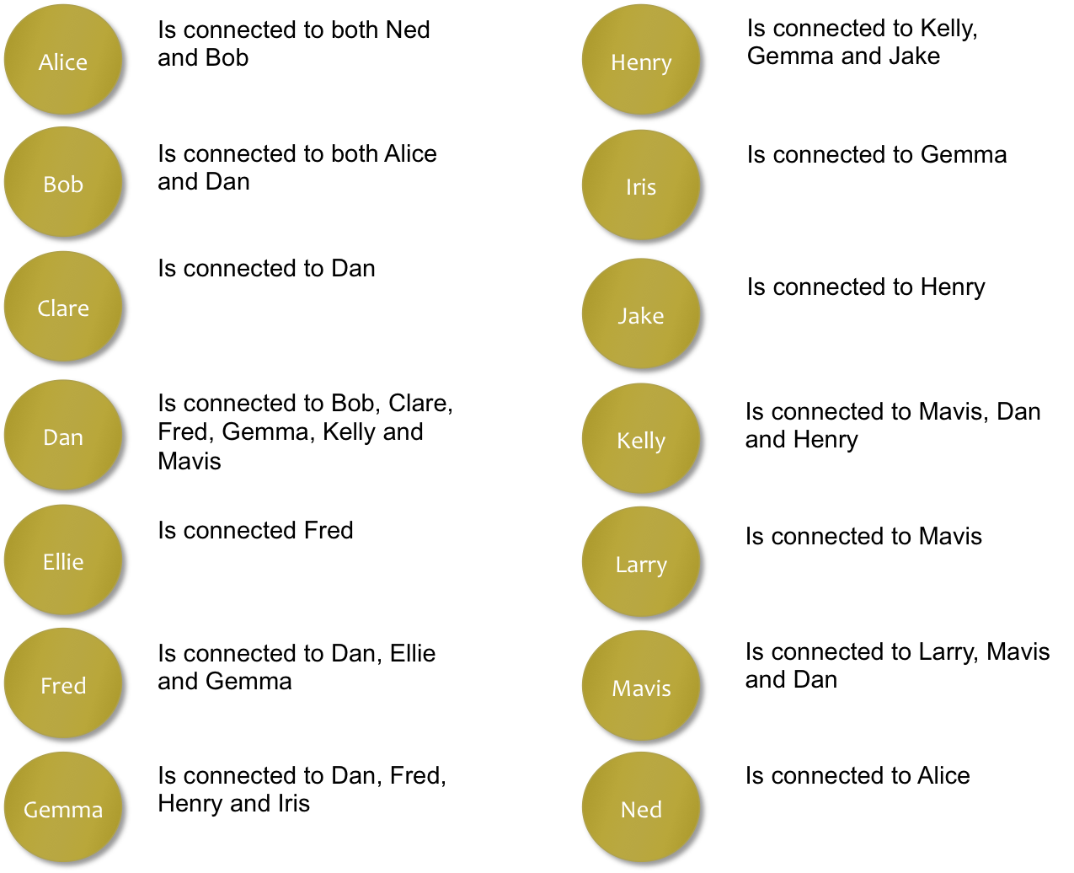
Group 1: Feedback

Slide 92
2
1
Ellie
Bob
1
2
Clare
Alice
3
Fred
1
6
Ned
Dan
4
Gemma
3
Mavis
3
3
Henry
Kelly
1
Iris
1
Larry
1
Jake

Slide 93
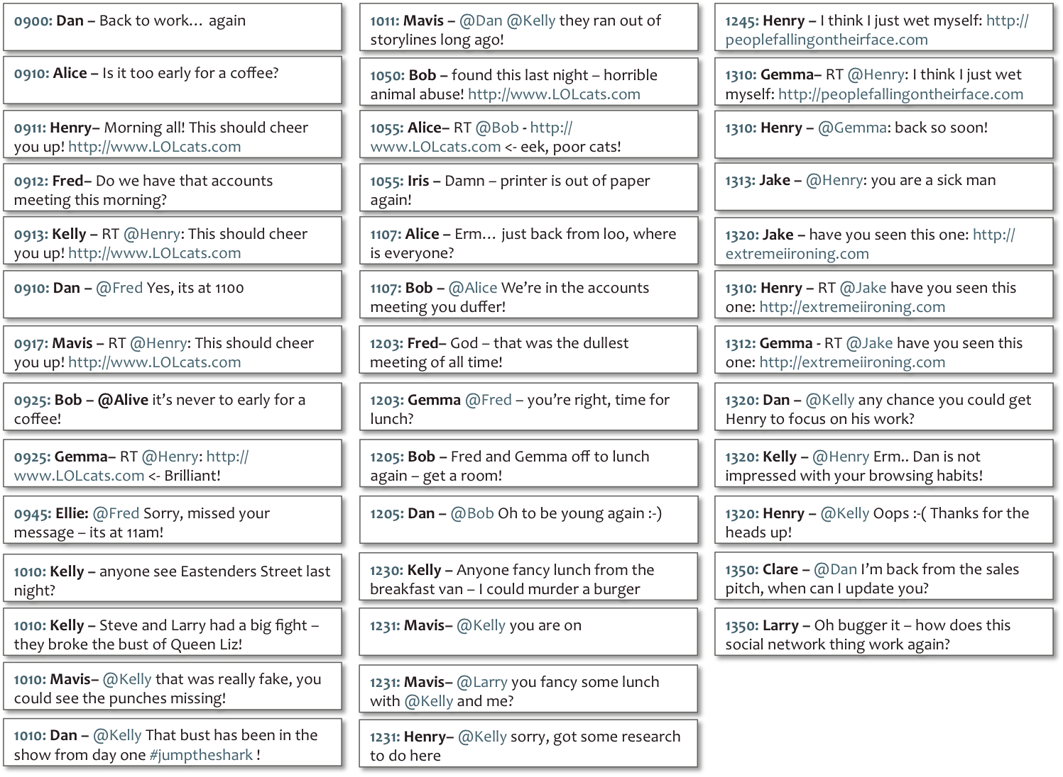
Group 2: Feedback

Slide 94
0900: Dan – Back to work… again
1011: Mavis – @Dan @Kelly they ran out of storylines long ago!
1245: Henry – I think I just wet myself: http://peoplefallingontheirface.com
0910: Alice – Is it too early for a coffee?
1050: Bob – found this last night – horrible animal abuse! http://www.LOLcats.com
1310: Gemma– RT @Henry: I think I just wet myself: http://peoplefallingontheirface.com
0911: Henry– Morning all! This should cheer you up! http://www.LOLcats.com
1055: Alice– RT @Bob - http://www.LOLcats.com <- eek, poor cats!
1310: Henry – @Gemma: back so soon!
0912: Fred– Do we have that accounts meeting this morning?
1055: Iris – Damn – printer is out of paper again!
1313: Jake – @Henry: you are a sick man
0913: Kelly – RT @Henry: This should cheer you up! http://www.LOLcats.com
1107: Alice – Erm… just back from loo, where is everyone?
1320: Jake – have you seen this one: http://extremeiironing.com
0910: Dan – @Fred Yes, its at 1100
1107: Bob – @Alice We’re in the accounts meeting you duffer!
1310: Henry – RT @Jake have you seen this one: http://extremeiironing.com
0917: Mavis – RT @Henry: This should cheer you up! http://www.LOLcats.com
1203: Fred– God – that was the dullest meeting of all time!
1312: Gemma - RT @Jake have you seen this one: http://extremeiironing.com
0925: Bob – @Alice it’s never to early for a coffee!
1203: Gemma @Fred – you’re right, time for lunch?
1320: Dan – @Kelly any chance you could get Henry to focus on his work?
0925: Gemma– RT @Henry: http://www.LOLcats.com <- Brilliant!
1205: Bob – Fred and Gemma off to lunch again – get a room!
1320: Kelly – @Henry Erm.. Dan is not impressed with your browsing habits!
0945: Ellie: @Fred Sorry, missed your message – its at 11am!
1205: Dan – @Bob Oh to be young again :-)
1320: Henry – @Kelly Oops :-( Thanks for the heads up!
1010: Kelly – anyone see Eastenders Street last night?
1230: Kelly – Anyone fancy lunch from the breakfast van – I could murder a burger
1350: Clare – @Dan I’m back from the sales pitch, when can I update you?
1010: Kelly – Steve and Larry had a big fight – they broke the bust of Queen Liz!
1231: Mavis– @Kelly you are on
1350: Larry – Oh bugger it – how does this social network thing work again?
1010: Mavis– @Kelly that was really fake, you could see the punches missing!
1231: Mavis– @Larry you fancy some lunch with @Kelly and me?
RT
Retweets – propagation
1010: Dan – @Kelly That bust has been in the show from day one #jumptheshark !
1231: Henry– @Kelly sorry, got some research to do here

Slide 95
0900: Dan – Back to work… again
1011: Mavis – @Dan @Kelly they ran out of storylines long ago!
1245: Henry – I think I just wet myself: http://peoplefallingontheirface.com
0910: Alice – Is it too early for a coffee?
1050: Bob – found this last night – horrible animal abuse! http://www.LOLcats.com
1310: Gemma– RT @Henry: I think I just wet myself: http://peoplefallingontheirface.com
0911: Henry– Morning all! This should cheer you up! http://www.LOLcats.com
1055: Alice– RT @Bob - http://www.LOLcats.com <- eek, poor cats!
1310: Henry – @Gemma: back so soon!
0912: Fred– Do we have that accounts meeting this morning?
1055: Iris – Damn – printer is out of paper again!
1313: Jake – @Henry: you are a sick man
0913: Kelly – RT @Henry: This should cheer you up! http://www.LOLcats.com
1107: Alice – Erm… just back from loo, where is everyone?
1320: Jake – have you seen this one: http://extremeiironing.com
0910: Dan – @Fred Yes, its at 1100
1107: Bob – @Alice We’re in the accounts meeting you duffer!
1310: Henry – RT @Jake have you seen this one: http://extremeiironing.com
0917: Mavis – RT @Henry: This should cheer you up! http://www.LOLcats.com
1203: Fred– God – that was the dullest meeting of all time!
1312: Gemma - RT @Jake have you seen this one: http://extremeiironing.com
0925: Bob – @Alice it’s never to early for a coffee!
1203: Gemma @Fred – you’re right, time for lunch?
1320: Dan – @Kelly any chance you could get Henry to focus on his work?
0925: Gemma– RT @Henry: http://www.LOLcats.com <- Brilliant!
1205: Bob – Fred and Gemma off to lunch again – get a room!
1320: Kelly – @Henry Erm.. Dan is not impressed with your browsing habits!
0945: Ellie: @Fred Sorry, missed your message – its at 11am!
1205: Dan – @Bob Oh to be young again :-)
1320: Henry – @Kelly Oops :-( Thanks for the heads up!
1010: Kelly – anyone see Eastenders Street last night?
1230: Kelly – Anyone fancy lunch from the breakfast van – I could murder a burger
1350: Clare – @Dan I’m back from the sales pitch, when can I update you?
1010: Kelly – Steve and Larry had a big fight – they broke the bust of Queen Liz!
1231: Mavis– @Kelly you are on
1350: Larry – Oh bugger it – how does this social network thing work again?
1010: Mavis– @Kelly that was really fake, you could see the punches missing!
1231: Mavis– @Larry you fancy some lunch with @Kelly and me?
RT
Retweets – propagation
1010: Dan – @Kelly That bust has been in the show from day one #jumptheshark !
1231: Henry– @Kelly sorry, got some research to do here

Slide 96
2
1
1
Ellie
Bob
1
2
Clare
Alice
3
Fred
1
6
Ned
Dan
4
Gemma
3
Mavis
3
4
3
Henry
Kelly
1
Iris
1
1
2
Larry
Jake

Slide 97
Group 3: Feedback

Slide 98
0900: Dan – Back to work… again
1011: Mavis – @Dan @Kelly they ran out of storylines long ago!
1245: Henry – I think I just wet myself: http://peoplefallingontheirface.com
0910: Alice – Is it too early for a coffee?
1050: Bob – found this last night – horrible animal abuse! http://www.LOLcats.com
1310: Gemma– RT @Henry: I think I just wet myself: http://peoplefallingontheirface.com
0911: Henry– Morning all! This should cheer you up! http://www.LOLcats.com
1055: Alice– RT @Bob - http://www.LOLcats.com <- eek, poor cats!
1310: Henry – @Gemma: back so soon!
0912: Fred– Do we have that accounts meeting this morning?
1055: Iris – Damn – printer is out of paper again!
1313: Jake – @Henry: you are a sick man
0913: Kelly – RT @Henry: This should cheer you up! http://www.LOLcats.com
1107: Alice – Erm… just back from loo, where is everyone?
1320: Jake – have you seen this one: http://extremeiironing.com
0910: Dan – @Fred Yes, its at 1100
1107: Bob – @Alice We’re in the accounts meeting you duffer!
1310: Henry – RT @Jake have you seen this one: http://extremeiironing.com
0917: Mavis – RT @Henry: This should cheer you up! http://www.LOLcats.com
1203: Fred– God – that was the dullest meeting of all time!
1312: Gemma - RT @Jake have you seen this one: http://extremeiironing.com
0925: Bob – @Alive it’s never to early for a coffee!
1203: Gemma @Fred – you’re right, time for lunch?
1320: Dan – @Kelly any chance you could get Henry to focus on his work?
0925: Gemma– RT @Henry: http://www.LOLcats.com <- Brilliant!
1205: Bob – Fred and Gemma off to lunch again – get a room!
1320: Kelly – @Henry Erm.. Dan is not impressed with your browsing habits!
0945: Ellie: @Fred Sorry, missed your message – its at 11am!
1205: Dan – @Bob Oh to be young again :-)
1320: Henry – @Kelly Oops :-( Thanks for the heads up!
1010: Kelly – anyone see Eastenders Street last night?
1230: Kelly – Anyone fancy lunch from the breakfast van – I could murder a burger
1350: Clare – @Dan I’m back from the sales pitch, when can I update you?
1010: Kelly – Steve and Larry had a big fight – they broke the bust of Queen Liz!
1231: Mavis– @Kelly you are on
1350: Larry – Oh bugger it – how does this social network thing work again?
1010: Mavis– @Kelly that was really fake, you could see the punches missing!
1231: Mavis– @Larry you fancy some lunch with @Kelly and me?
RT
Retweets – propagation
1010: Dan – @Kelly That bust has been in the show from day one #jumptheshark !
1231: Henry– @Kelly sorry, got some research to do here

Slide 99
0900: Dan – Back to work… again
1011: Mavis – @Dan @Kelly they ran out of storylines long ago!
1245: Henry – I think I just wet myself: http://peoplefallingontheirface.com
0910: Alice – Is it too early for a coffee?
1050: Bob – found this last night – horrible animal abuse! http://www.LOLcats.com
1310: Gemma– RT @Henry: I think I just wet myself: http://peoplefallingontheirface.com
0911: Henry– Morning all! This should cheer you up! http://www.LOLcats.com
1055: Alice– RT @Bob - http://www.LOLcats.com <- eek, poor cats!
1310: Henry – @Gemma: back so soon!
0912: Fred– Do we have that accounts meeting this morning?
1055: Iris – Damn – printer is out of paper again!
1313: Jake – @Henry: you are a sick man
0913: Kelly – RT @Henry: This should cheer you up! http://www.LOLcats.com
1107: Alice – Erm… just back from loo, where is everyone?
1320: Jake – have you seen this one: http://extremeiironing.com
0910: Dan – @Fred Yes, its at 1100
1107: Bob – @Alice We’re in the accounts meeting you duffer!
1310: Henry – RT @Jake have you seen this one: http://extremeiironing.com
0917: Mavis – RT @Henry: This should cheer you up! http://www.LOLcats.com
1203: Fred– God – that was the dullest meeting of all time!
1312: Gemma - RT @Jake have you seen this one: http://extremeiironing.com
0925: Bob – @Alice it’s never to early for a coffee!
1203: Gemma @Fred – you’re right, time for lunch?
1320: Dan – @Kelly any chance you could get Henry to focus on his work?
0925: Gemma– RT @Henry: http://www.LOLcats.com <- Brilliant!
1205: Bob – Fred and Gemma off to lunch again – get a room!
1320: Kelly – @Henry Erm.. Dan is not impressed with your browsing habits!
0945: Ellie: @Fred Sorry, missed your message – its at 11am!
1205: Dan – @Bob Oh to be young again :-)
1320: Henry – @Kelly Oops :-( Thanks for the heads up!
1010: Kelly – anyone see Eastenders Street last night?
1230: Kelly – Anyone fancy lunch from the breakfast van – I could murder a burger
1350: Clare – @Dan I’m back from the sales pitch, when can I update you?
1010: Kelly – Steve and Larry had a big fight – they broke the bust of Queen Liz!
1231: Mavis– @Kelly you are on
1350: Ned – Oh bugger it – how does this social network thing work again?
1010: Mavis– @Kelly that was really fake, you could see the punches missing!
1231: Mavis– @Larry you fancy some lunch with @Kelly and me?
RT
Retweets – propagation
1010: Dan – @Kelly That bust has been in the show from day one #jumptheshark !
1231: Henry– @Kelly sorry, got some research to do here
@name
Replies – conversation

Slide 100
2
1
1
Ellie
1
2
Bob
1
2
Clare
Alice
3
3
Fred
1
2
Ned
6
Dan
4
1
Gemma
3
Mavis
3
4
2
3
8
Henry
Kelly
1
Iris
1
1
1
2
Larry
Jake

Slide 101
2
1
1
Ellie
1
2
Bob
1
2
Clare
Alice
3
3
Fred
1
2
Ned
6
Dan
The Boss
4
1
Gemma
3
Mavis
3
4
2
3
8
Henry
Kelly
The Joker
The Socialite
1
Iris
1
1
1
2
Larry
Jake

Slide 102
Working Definitions of Power
In Social Networks we might interpret power as connection
We can use network characteristics like Betweenness, Centrality and Hops to analyse a persons ability or potential to influence
Power as Action
Power as Influence
Power as Connection
6
Dan

Slide 103
Working Definitions of Power
Or we might interpret power as propagation
Propagation of Content (URIs) – we can trace a URI through Social Media and identify sources (originating posts)
Propagation of Content (Concepts) – we can trace concepts (terms) through Social Media and identify key sources whose concepts survive and are passed on the most
Retweets are a good way to automatically trace either
Power as Action
Power as Influence
Power as Connection
Power as Propagation
4
6
Henry
Dan

Slide 104
Working Definitions of Power
In Social Networks we might interpret power as interaction
we can look at audience reaction and can discover who engages most with others
replies, messages, sharing, joint activities, etc…
Power as Action
Power as Influence
Power as Connection
Power as Propagation
Power as Interaction
4
8
6
Henry
Kelly
Dan

Slide 105
A Warning from Sociology…
…these views of power may be a little naïve

Slide 106
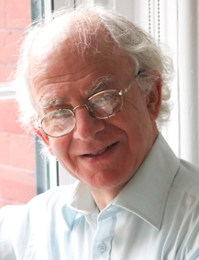
Deeper Dimensions of Power
Prof. Steven Lukes
New York University
The Radical View of Power.
Lukes, S., 2005. Power: A Radical View 2nd ed., Palgrave Macmillan

Slide 107
Deeper Dimensions of Power
1st Dimension:
Overt and Observable
Prof. Steven Lukes
New York University
The Radical View of Power.
Lukes, S., 2005. Power: A Radical View 2nd ed., Palgrave Macmillan

Slide 108
Deeper Dimensions of Power
1st Dimension:
Overt and Observable
Prof. Steven Lukes
New York University
The Radical View of Power.
2nd Dimension:
Covert, Controlling Agendas
Lukes, S., 2005. Power: A Radical View 2nd ed., Palgrave Macmillan

Slide 109
Deeper Dimensions of Power
1st Dimension:
Overt and Observable
Prof. Steven Lukes
New York University
The Radical View of Power.
2nd Dimension:
Covert, Controlling Agendas
3rd Dimension:
Shape Desires and Beliefs
Lukes, S., 2005. Power: A Radical View 2nd ed., Palgrave Macmillan

Slide 110
Summary
There are different types of power
(reward, coercive, legitimate, etc)
And different views of what power means
Power as Action vs. Power as Influence
In Social Media Analytics we typically take one of three views on how to measure power:
By our connections to others (e.g. followers, friends)
By the propagation of our views through the network (e.g. retweets)
By our ability to inspire interaction (e.g. messages, replies)
But!
This is still a simplification
And power is not always direct (Luke’s dimensions of power)

Slide 111
Questions…
?
Dave Millard (dem@soton.ac.uk)

Slide 112
Thank You
!
Dave Millard (dem@soton.ac.uk)

