Slide 1
Foundations in Web Science
How has the Web impacted on Sociology?

Slide 2
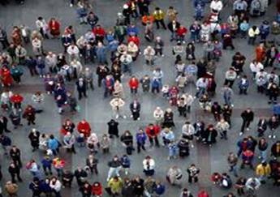
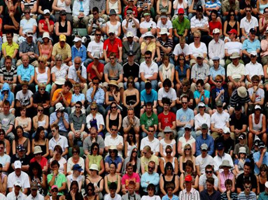
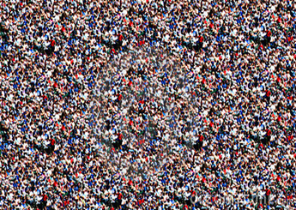
Sociology
Understanding society
The study of people & the world we make
How we live together … and sometimes, don’t
The relationships we have: as families, communities, workers & citizens
The institutions we build – police, education, mass- media, religions, governments, economies
Cultures, values, meanings and practices
How we live as individuals in this wider social context
And how this changes over time and between places

Slide 3
How has the Web Changed the Social World?
Communities
Identities
Work
Healthcare Nettleton, S., (2006) The Emergence of E-Scaped Medicine?
Globalisation Castells, M. (1997) The Rise of Network Society
Inequality Halford, S., and Savage, M. (2010) Retheorising digital Social Inequality
Notes:
how technology and social change has impacted on collective groupings of people – from place based community to cities – gemeinschaft and gesellschaft – commuinities of interest – solidarities/alienation? Meaning of community – real friends?
end of the body – in cyberspace no-one knows you’re a dog – who we can be – questions about stability and coherence; multiplicity and authenticity – debates in sociology about identity what it is – not self-evident
De=spatialisation of work – working at home; working in remote teams; new forms of work in the digital economy – occupations, skills, practices, expectations; digital labour – mechanical turk; working for free – crowdsourcing or github to learn skills promote self
Healthcare – sarah – changing professional practice – no longer the doctor who knows from experience – access to a world of information point increasingly ins to be able to access this information; escaped knowledge and information
Globalisation – pre web – changed the pace of globalisation? Cultural globalisation – consumption of films/tv – homogenisation? Or opportunities to spread diversity?
How are life experiences and life chances shaped by the Web? Access to use

Slide 4
How has the Social World Changed the Web?
Facebook
Pornography
Cybercrime
Consumerism
Diaspora
‘the world’?
Notes:
You know all about this … from technological determinism – whereby tech proceeds along a neat and predefined path of scientific discovery -> contingent sociotechnical outcomes as the social and the technical shape each other. The sociological argument pre-dates the Web by many years, centuries even if we claim Marx for Sociology; but the evolution of the Web gave sociology a lot more to think about --- how social processes shaped the direction of the web – some claim to map the spread of the web in china by the growth of porn sites; secure payment attributed to porn; alternatively or as well – facebook has driven the growth of the web – we all know its origins, hasn’t stayed the same over time --- constant battles over if and how the web is being changed by cybercrime and anti-terrorism measures - Cameron’s attempts to ban encryption;

Slide 5
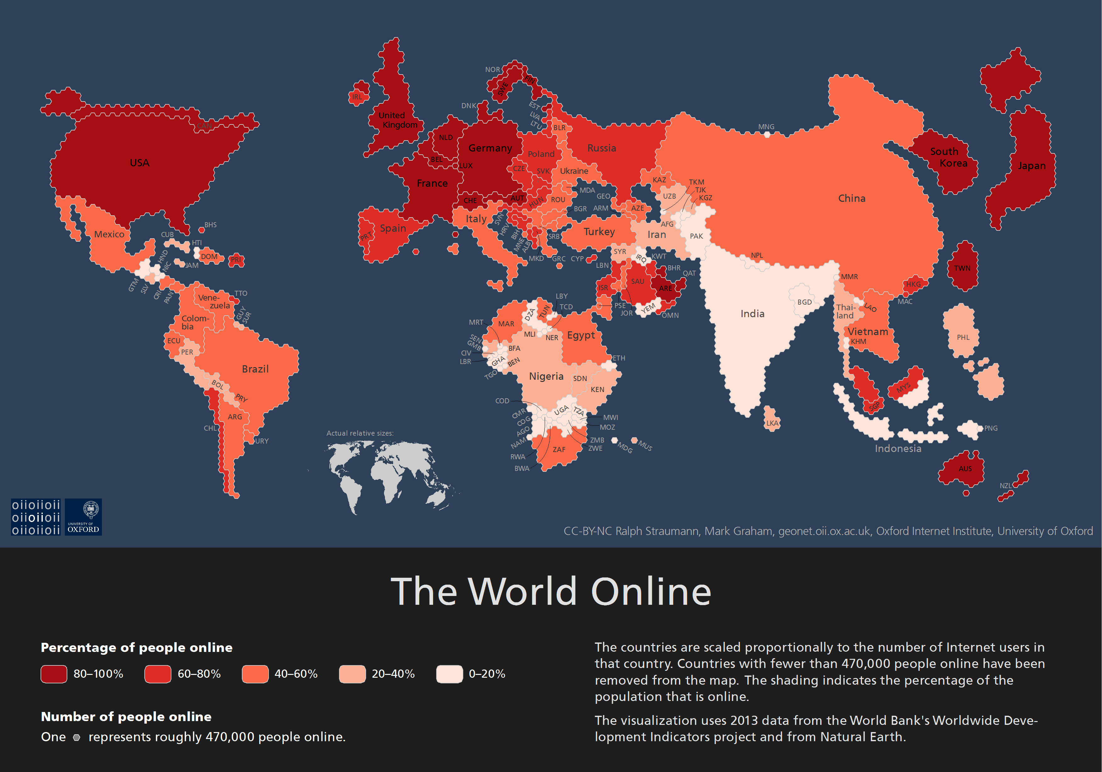
http://geonet.oii.ox.ac.uk/blog/the-world-online/
Notes:
Uneven across the world
And also within countries 12m in UK
In whose image has the web been shaped? Increasing concern about the centralisation of the Web in the hands of a few powerful organizations
Facebook, Google, the big media corporations for instance: in terms of content, driving technologies and – increasingly – data ownership
Questions of power, discourse

Slide 6
How has the Web Changed Sociology
Changed the questions that we ask
Supported new theoretical approaches e.g. mobilities paradigm; re-assembling the social; performative sociological perspectives
Savage, M., and Burrows, R., (2007) ‘The coming crisis of empirical sociology’ Sociology, 41(5) pp.885-899
The e-scaped social
Disciplinary disputes and occupational closure
Sociology of data and artefacts
Towards Big Data sociology? https://www.youtube.com/watch?v=9urYbd_rVoc
Public Sociology
Notes:
The history of discplines – emergence of sociology esp post ww2 in UK – primary claim was access to ‘the social’ - In 2007, Savage and Burrows opened up what turned out to be a highly controversial debate about digital data and the future of empirical Sociology. The focus of their concern was a growing awareness of the scale and scope of social data being routinely generated outside the academy, for example by large retail corporations, administrative organizations, market research companies and the mass media using digital technologies to record routine transactions and circulate data. They compare, for instance, an ESRC funded research project on social networks – the ‘most detailed study [of social ties] ever carried out in the UK’ (Savage and Burrows 2009; 886) – which generated questionnaire data from a sample of 320 individuals and interview data from 30 participants, with the 7bn records of every single telephone call made over several years, held by a large telecommunications company. Similarly, they question the significance of the sociological interview – which aims to elicit life-stories, values and meanings – in a context where such narratives now saturate the mass media via confessional interviews, reality TV and Web 2.0 applications such as You Tube and Facebook.
In his history of the discipline, Savage (2010) describes how social changes following World War II prompted new concerns with the everyday lives of ‘ordinary’ people. Distinct from historical concern with the past, the zeitgeist of the early 1960s emphasised social change in the present, change that could only be accessed and understood by a specialist discipline – not history, philosophy or economics but sociology – with the ‘right’ methodological tools. In the 1960s these tools were understood to be, primarily, the sample survey and the in-depth interview. Through ownership of these tools, sociologists (and the emergent social sciences more broadly) could claim privileged access to ongoing realities. Thus, the politics of method provided the foundation for claims to disciplinary expertise and status, opening up a new space in the historical disciplinary settlement between the natural sciences and the humanities, a home for the social sciences and for sociology in particular.
But Savage’s (2010) point is this: the strategies of occupational closure that led to the formation of post-war British sociology have been weakened. Neither sociology – nor social science more generally – can convincingly continue to claim privileged access to reality through particular methodological expertise and the generation of empirical data. To the contrary, Savage and Burrows (2009) argue ‘…we, as sociologists, are losing whatever jurisdiction we once had over the study of the social as the generation, mobilization and analysis of social data become ubiquitous’ (Savage and Burrows 2009; 763)
Provoked all kinds of controversies – deliberately so – what was the future of sociology – (i) disciplinary disputes & occ closure (ii) a sociological response

Slide 7
Potential Sources
Deborah Lupton's book Digital Sociology (2014)
Orton-Johnson and Prior's 2013 book of the same title

