Slide 1
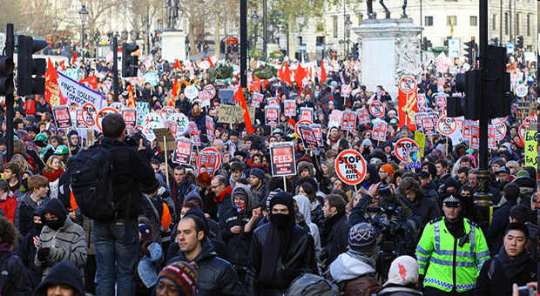
Dr Silke Roth
@SilkeRoth sroth@soton.ac.uk
Department of Sociology, Social Policy and Criminology
Collective Action and Social Change Guest Lecture 17/11/14

Slide 2
Overview
Part 1 – Social Movements and Protest
Part 2 – Digital Humanitarianism

Slide 3
Part 1: Social Movement
“A social movement is a conscious, collective, organized attempt to bring about or resist large-scale change in the social order by non-institutionalized means.”
Cohen and Kennedy (2007)
Global Sociology, p. 437

Slide 4
Some Causes of Social Movements
(Perception of) Social Inequality and Change
Political Opportunity
  Regime Crises, Decline in Repression
Prior Organisation and Collective Identity
Cross-cutting solidarities
Leadership Availability
Communication Networks
Belief in Necessity and Effectiveness
Frame Alignment and Alignment Skill
Lofland (1996) Social Movement Organizations.
Guide to Research on Insurgent Realities

Slide 5
Outcomes of Social Movements
Political and Policy Outcomes
Mobilization
Cultural Outcomes

Slide 6
Tarrow (1994)
Power in Movement
Repertoires in Contention (Conventional, Disruptive, Violent)
  Protests, Strikes, Sit-Ins, Blocking Traffic
  Boycotts, withholding rents or tax
  Petitions, Lobbying
  Education (Leaflets, Teach-Ins, Ads)
Repertoires of Organisational Form:
  Small grassroots organisation
  Large mass membership organisation
  Coalitions and networks

Slide 7
Electronic Repertoires of Contention
Conventional Electronic Contention
  Representation, information distribution, research, artistic production, fundraising, lobbying, mobilization
Disruptive Electronic Contention
  Email floods, form floods, fax bombs, viruses, worms, trojan horses, data theft or destruction, site alteration or redirection, denial of service, virtual sit-ins
Violent Electronic Contention (‘cyberterrorism’)
  Property destruction, human injury or death through gaining control over networked computer control systems (air traffic control, electrical power grids etc.)
  Sasha Costanza-Chock (2003) in: Representing Resistance: Media, Civil Disobedience and the Global Justice Movement,
  ed. by Opel and Pompper

Slide 8
Van Laer & Van Aelst (2010)
Internet and Social Action Repertoires

Slide 9
Bennett & Segerberg (2012)
The Logic of Connective Action
Collective action – organisational resources, collective identity, collective endeavour
Connective action – personalised content shared across media networks, individualised, weak tie networks
Mix of online media & offline activities
  example Occupy (Roth, Saunders, Olcese 2014)

Slide 10
Some Literature on
Collective & Connective Action
Snow, David A., Soule, Sarah A, & Kriesi, Hans Peter (eds). (2007) The Blackwell Companion to Social Movements. HM 131 SNO
Mercea, D (2012) Digital prefigurative participation: The entwinement of online communication and offline participation in protest events. New Media & Society Vol. 14, No. 1, p. 153-169.
Van Laer, J & Van Aelst, P (2010) Internet and Social Movement Repertoires. Information, Communication & Society,13:8
Bennett, W L & Segerberg, A (2012) The Logic of Connective Action. Information, Communication & Society 15:5,739-768.
Castells, M (2013) Networks of Outrage and Hope. Social Movements in the Internet Age. Cambridge: Polity.
Diani, M (2000) Social Movement Networks Virtual and Real. Information, Communication & Society 3:3, 386-401.
Garrett, R K (2006) Protest in an Information Society (lit review) Information, Communication & Society 9:2, p. 202-224.
Harlow, S & Harp, D (2012) Collective Action on the Web Information, Communication & Society 15:2,
Farrell, H. (2012). "The Consequences of the Internet for Politics." Annual Review of Political Science 15(1): 35-52.
L Illia (2003). ‘Passage to cyberactivism: how dynamics of activism change.’ Journal of Public Affairs 3(4): 326-337.
Arab Spring
Wolfsfeld, G., E. Segev, et al. (2013). "Social Media and the Arab Spring: Politics Comes First." The International Journal of Press/Politics 18(2): 115-137.
Soengas, X. (2013). "The Role of the Internet and Social Networks in the Arab Uprisings - An Alternative to Official Press Censorship." Comunicar(41): 147-155.
Kerton, S. (2012). "Tahrir, Here? The Influence of the Arab Uprisings on the Emergence of Occupy." Social Movement Studies 11(3-4): 302-308.
Occupy
Journal of Critical Globalisation Studies (2012) issue 5, special issue on Occupy
Social Movement Studies (2012) Special Issue on Occupy
Roth, S, Saunders, C & Olcese, C (2014) “Occupy as a Free Space – Mobilization Processes and Outcomes” Sociological Review Online 19 (1), February 2014

Slide 11
Part 2: Digital Humanitarianism
ICT in Development, Disaster prevention, Disaster response
Crisis-Mapping and Crowd-Sourcing
E-health

Slide 12
Some literature on digital humanitarianism
Burns, R. (2014). "Moments of closure in the knowledge politics of digital humanitarianism." Geoforum 53(0): 51-62.
Burns, R. (2014). "Rethinking big data in digital humanitarianism: practices, epistemologies, and social relations." GeoJournal: 1-14.
Burns, R. and J. Thatcher (2014). "Guest Editorial: What’s so big about Big Data? Finding the spaces and perils of Big Data." GeoJournal: 1-4.
Meier, P. (2011). "New information technologies and their impact on the humanitarian sector." International Review of the Red Cross 93(884): 1239-1263.
Meier, P. (2012). "Crisis Mapping in Action: How Open Source Software and Global Volunteer Networks Are Changing the World, One Map at a Time." Journal of Map & Geography Libraries 8(2): 89-100.
Sandvik, K. B. (2015). "The humanitarian cyberspace: shrinking space or an expanding frontier?" Third World Quarterly: 1-16.
E-health
Odine, M. (2015) "South Africa's mobiles deliver healthcare services." Journal of Emerging Trends in Educational Research and Policy Studies 6, 182-188.
Vijaykumar, S., R. J. Wray, T. Buskirk, H. Piplani, J. Banerjee, M. Furdyk and R. Pattni (2014). "Youth, New Media, and HIV/AIDS: Determinants of Participation in an Online Health Social Movement." Cyberpsychology, Behavior, and Social Networking 17(7): 488-495.

