Slide 1
Web Science + Health Science
Dr Richard Giordano
Senior Lecturer
Faculty of Health Sciences
University of Southampton

Slide 2
Science
Web science
Interdisciplinary research that seeks to understand and explain the Web
Health science
An applied science that address the use of science, engineering, biology, mathematics, etc. to the delivery of health care

Slide 3
People make, use, share and interpret information, knowledge, and artifacts
For example
How is <information> made?
Who uses information?
Why do they use it?
When?
How do people work with it?
Who controls it?

Slide 4
Interdisciplinary research
The application of both technological and social perspectives to the study of the web
How digital information or knowledge networks affect both people and social systems (such as organizations or communities)
..and vice versa

Slide 5
But where is this located?
Derived from Nova Southeastern University School of Medicine

Slide 6
An explanatory tour: We live in societies

Slide 7
And societies are made up of people and their relations, beliefs…

Slide 8
We like to have fun

Slide 9
People share information & knowledge

Slide 10
But we also share symbols and meanings

Slide 11
And we interpret the world around us

Slide 12
And we have knowledge and skills

Slide 13
We know how to do things that others can’t do

Slide 14
And we develop professional identities

Slide 15
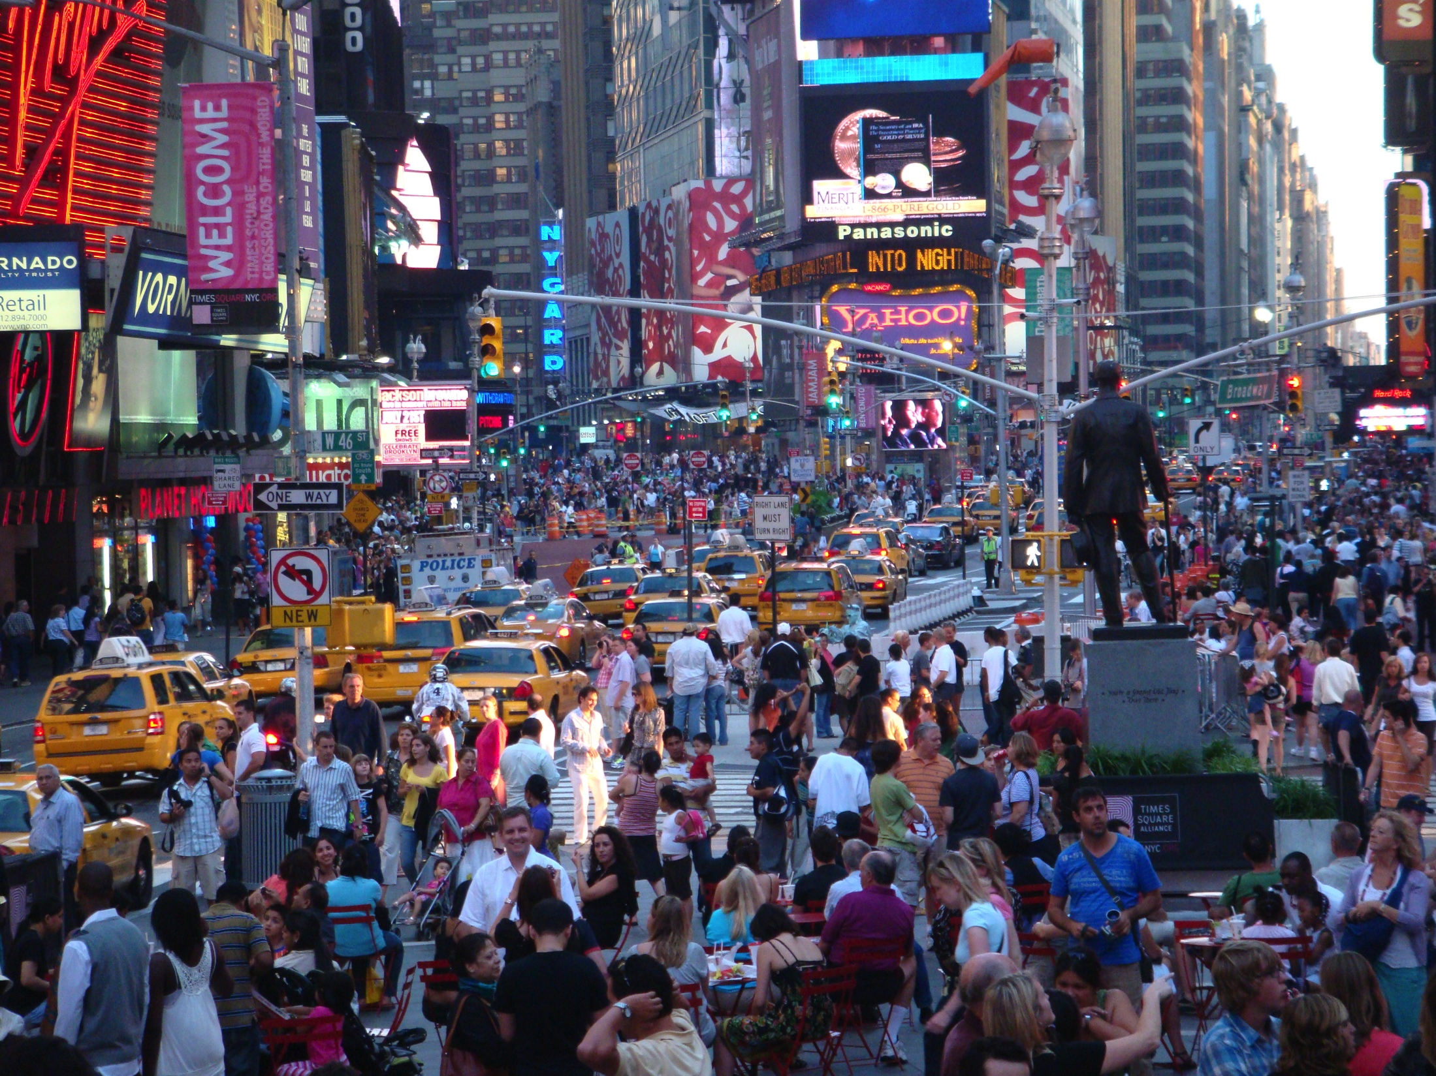
Web science exists in social, cultural, and engineering spaces
Web science

Slide 16
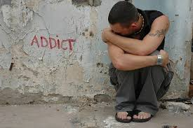
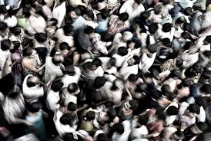
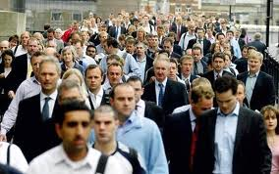
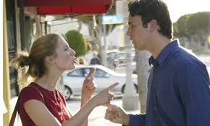
Our work needs to deal with this

Slide 17
Some projects
Quantified Self in the Doctor’s Office
Collaborative healing
The replication of ‘truth’
The hived mind and clinical cognitive flow
Socially-generated alternative therapies

Slide 18
Your projects
Be creative
Only a loose connection with health, per se

