Slide 1
Innovation Management: Impact of the Web
Dr David Baxter
23rd November 2015

Slide 2
Outline
What is Innovation?
And does it matter?
New web-based products and services
New web-based business models
Managing innovation: changes
Distributed and collaborative work
Customer insight and engagement

Slide 3
About me
Dr David Baxter, Associate Professor of Innovation
Industrial Management first degree
Cranfield PhD 2003-2007
Industry supported PhD project in Knowledge Management for Engineering Design
Cranfield School of Management 2009-2014
Centre for Innovative Products and Services
Current research on Agile methods in innovation projects, tacit knowledge, customer insight

Slide 4
Does innovation matter?
Notes:
Use divider pages to break up your presentation into logical sections and to provide a visual break for the viewer. The title can be one or two lines long.

Slide 5
Innovation
“The development and implementation of new ideas” (Van de Ven 1986)
“The successful exploitation of new ideas” (Cox, 2005)

Slide 6
The Innovation Imperative
A market level view
The Growth Imperative
The Survival Imperative
The Moral Imperative

Slide 7
The Growth Imperative
If you don’t grow, your future is highly uncertain (and bankruptcy quite likely)
Innovation is necessary for growth
“uncertainty about the profit rate under a no‐growth policy makes the firm's prospects highly unattractive… and bankruptcy practically certain”
Myron J. Gordon and Jeffrey S. Rosenthal (2003), Cambridge Journal of Economics 27(1): 25-48.

Slide 8
The Survival Imperative
Innovation is necessary to develop and maintain some competitive advantage
Sustainable Competitive Advantage?
‘Sustained Advantage’ is extremely rare: whilst some firms exhibit superior economic performance, only a very small minority, and very rarely for a long time (Wiggins & Ruefli 2002)

Slide 9
The Moral Imperative
Do you want the future to be better or worse?
How will it become better? You have to be able to pay for that.
Profit allows us to provide for the future
Profit, then, is a moral imperative (Peter Drucker)

Slide 10
The State of Innovation
The best companies do it: The top 20% of UK companies see innovation as a mainstream activity that must be sponsored by senior management and run in a structured way
http://www.pwc.com/gx/en/innovationsurvey/index.jhtml
Most companies don’t do it: In a survey of 14,000 UK companies, 45% are innovation active, 18% are product innovators, 10% are process innovators
https://www.gov.uk/government/uploads/system/uploads/attachment_data/file/301385/14-p107a-first-findings-from-the-ukis-2013.pdf

Slide 11
Managing Innovation
Innovation is critical to the economic health of a nation
Innovation is a wide-ranging topic that refers to implementing something new
Moving from the idea / research to commercial value is difficult!
How to identify economic value? And how to capture it?
How to manage the process from idea to launch?

Slide 12
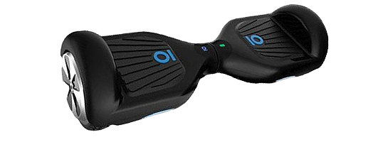
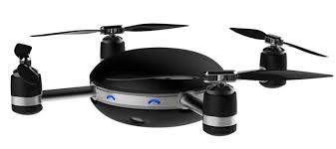
New Products

Slide 13
New Services

Slide 14
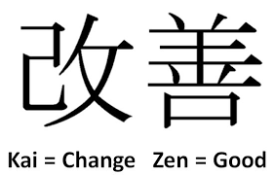
New Processes

Slide 15
New Business Models

Slide 16
The Innovation Pentathlon
Innovation Strategy
Ideas
Prioritization
Implementation
(NPD, etc)
People and Organization
Source: Goffin and Mitchell, 2010

Slide 17
Innovation Strategy
Targets
Calls for ideas
Research
Partnerships
Portfolio strategy
Roadmaps
Risk-reward
Resources
Partnerships
Acquisitions
Ideas
Prioritization
Implementation
Training
Recruitment
Processes
People and Organization
Source: Goffin and Mitchell, 2010

Slide 18
An evolving Innovation Strategy
Crowdsourced
Open platforms
Social media
Changed portfolio
Customer input
Crowd funding
Global partnerships
Dynamic networks
Rapid change
Ideas
Prioritization
Implementation
Distributed teams
Informed and connected
Collaboration platforms
People and Organization
Source: Goffin and Mitchell, 2010

Slide 19
Innovation and Technology Transfer
Notes:
Use divider pages to break up your presentation into logical sections and to provide a visual break for the viewer. The title can be one or two lines long.

Slide 20
Innovation and technology transfer
The ‘linear model’ of innovation in which:
Research centres develop new technology
Companies apply it for commercial gain
How is this impacted by the Web?
‘Democratizing’ innovation

Slide 22
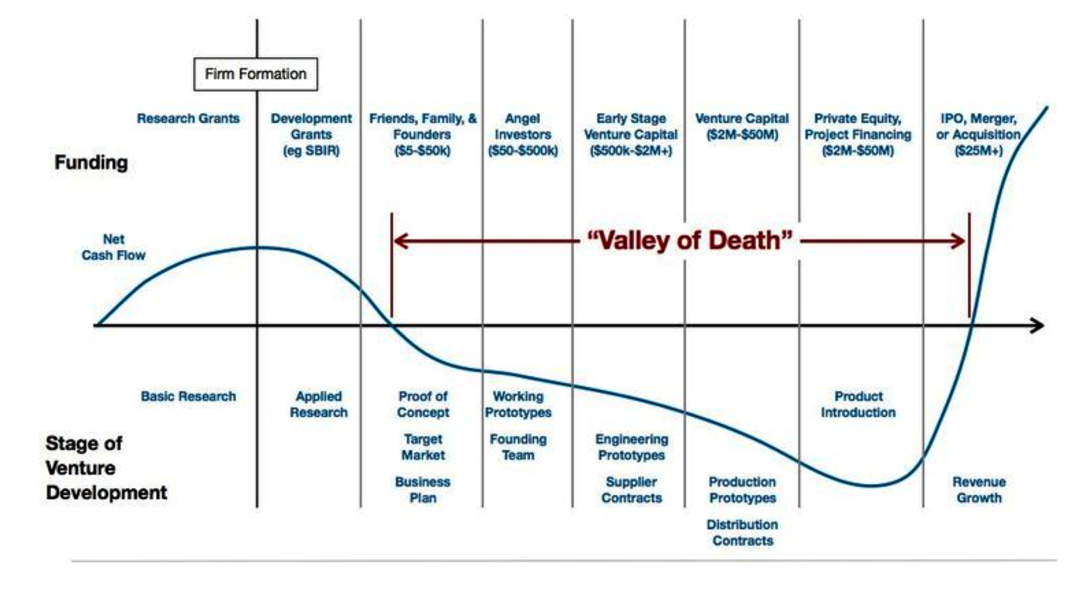
The Valley of Death

Slide 23
An example of Web-based innovation
Notes:
Use divider pages to break up your presentation into logical sections and to provide a visual break for the viewer. The title can be one or two lines long.

Slide 24
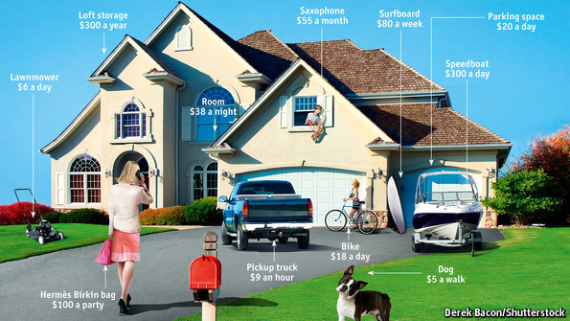
The Sharing Economy
http://www.economist.com/news/leaders/21573104-internet-everything-hire-rise-sharing-economy

Slide 25
The Sharing (or Collaborative) Economy

Slide 26
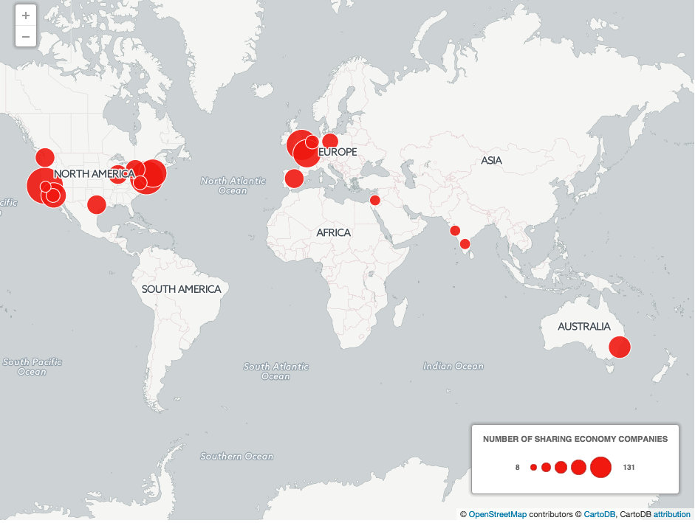
The UK is a key player in the sharing economy
http://www.telegraph.co.uk/finance/newsbysector/mediatechnologyandtelecoms/11882122/Mapped-how-the-sharing-economy-is-sweeping-the-world.html

Slide 27
Sharing Economy Growth
“The global sharing economy is worth $15bn per year, according to PwC, and is projected to soar to $335bn in 10 years”
“The UK sector is set to grow from £500m to £9bn over the next decade”
Davidson, L. (2015) Mapped: How the sharing economy is sweeping the world. Available at: http://www.telegraph.co.uk/finance/newsbysector/mediatechnologyandtelecoms/11882122/Mapped-how-the-sharing-economy-is-sweeping-the-world.html (Accessed: 23 November 2015).

Slide 28
Sharing economy questions
With more open access to ideas (crowdsourcing), finance (crowdfunding), skills (online platforms):
What is the impact on innovation?
How to manage innovation in this environment?
How do large firms engage with the peer-to-peer model?
Do we need new models of innovation?
What about product-service systems?
What about the regulatory environment?
How do regulators deal with this?
Does this represent unfair competition?
What about monopolies / single platforms (Uber, Airbnb)?

