Slide 1
From Universal Green Open Access to Open Science
Stevan Harnad
Web Science, U Southampton

Slide 2
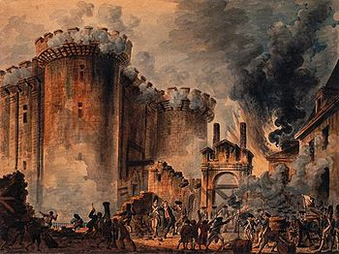
Four Cognitive Revolutions: Speaking (fast turnaround time) Handwriting (slow turnaround time) Print (slow turnaround time) Skywriting (fast turnaround time)

Slide 3
Revolution #1: 300,000 Years ago: The Advent of Language (words were free)
Notes:
Language evolved as reciprocal barter: no charge for words, hence open access…

Slide 4
Revolution #2: 6000 years ago The Advent of Handwriting

Slide 5
Revolution #3: 600 years ago: Print Spoken interactions are online cognition; written interactions are offline cognition.

Slide 6
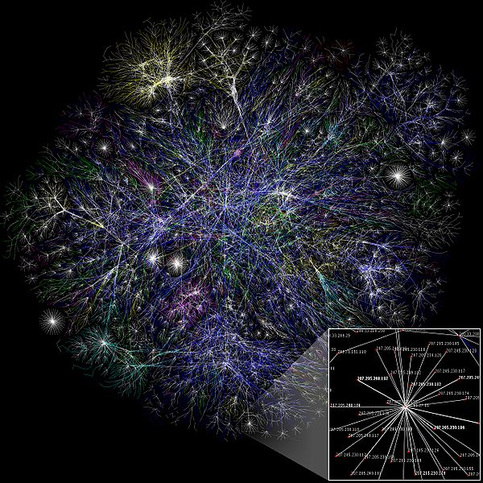
Revolution #4: 50 yrs ago: Internet

Slide 7
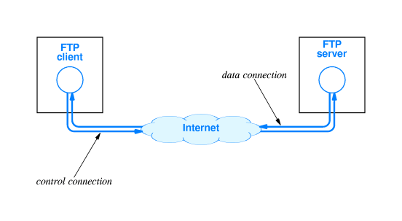
FTP: 1960’s (Computer scientists began sharing papers by depositing them in anonymous FTP archives:

Slide 8
1989 – 2002 Psycoloquy (one of earliest Gold OA journals)

Slide 9
25 years ago: the Web

Slide 10
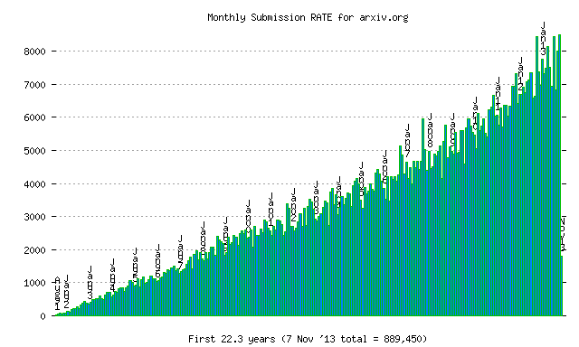
Arxiv 1991 (physicists have been depositing – no questions asked – for nearly a quarter century now)

Slide 11
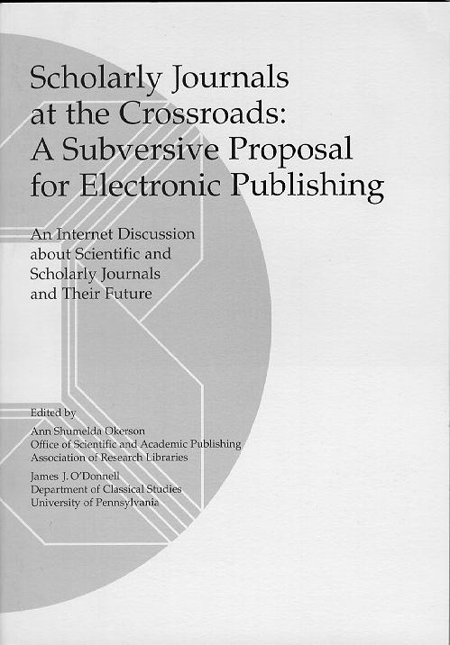
Jun 1994 – Subversive Proposal (authors should self-archive the final, refereed, accepted drafts of their journal articles, free for all online)

Slide 12
Jan 1996 – JISC ELiB Cogprints Project (Matt Hemus)

Slide 13
Sep 1998 – American Scientist Open Access Forum (Amsci) (now the Global Open Access Forum (GOAL)

Slide 14
Oct 1999 – EPrints announced (Rob Tansley, later Chris Gutteridge)

Slide 15
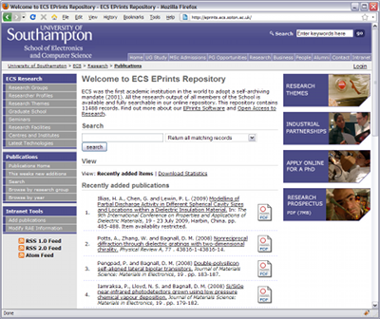
Jan 2000 – First EPrints repository goes live (eprints.ecs.soton.ac.uk)

Slide 16
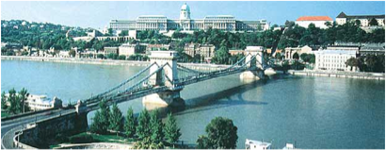
Dec 2001 – Budapest Open Access Initiative (BOAI) BOAI 1 (Green) + BOAI 2 (Gold)

Slide 17
Feb 2002 – International Meeting on National Policies on Open Access
(Tom Cochrane (QUT) was in attendance)

Slide 18
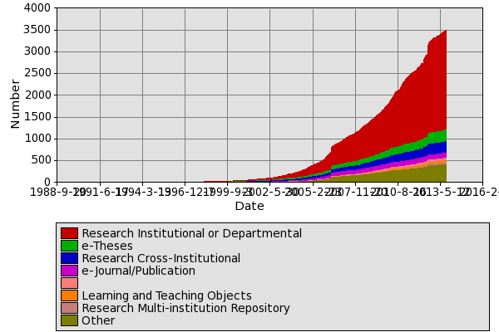
2003 -- ROAR Registry of Open Access Repositories (Tim Brody)

Slide 19
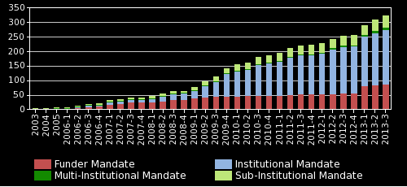
2003 – ROARMAP Registry of Open Access Repository Mandates and Policies

Slide 20
Jan 2003 – ECS Open Access mandate (world’s first OA mandate) (Wendy Hall)

Slide 21
25 Feb 2004 QUT World’s First Institution-Wide OA Mandate (Tom Cochrane)

Slide 22
May 2004 Elsevier endorses immediate, unembargoed Green OA Self-archiving

Slide 23
Aug 2004 – Joint Southampton OA Recommendation to Parliamentary Select Committee Les Carr, Dave DeRoure, Stevan Harnad, Jessie Hey, Tony Hey, Steve Hitchcock (Southampton) Charles Oppenheim (Loughborough)

Slide 24
Sep 2004 – OA Advantage Bibliography (Steve Hitchcock)

Slide 25
2004 NIH OA Policy “Recommendation” (Upgraded to Mandate 2007)

Slide 26
Dec 21 2004 U Minho First University-Wide OA Mandate in Europe (Eloy Rodrigues)

Slide 27
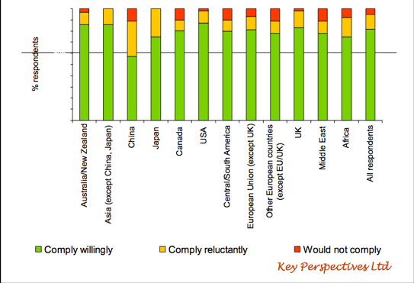
Swan & Brown 2005 Survey “would authors comply with Green OA mandates?”

Slide 28
Mar 2005 – Berlin 3 Open Access workshop, Southampton

Slide 29
Jun 2006 – Southampton Institutional Deposit Mandate for RAE items (Les Carr)

Slide 30
2007 U Liège Optimal Immediate-Deposit Mandate (Bernard Rentier)

Slide 31
Jan 2008 – Southampton upgrades to full institutional mandate (but a very weak one)

Slide 32
Feb 2008 – Harvard A&S Mandate

Slide 33
Mandated (Minho, CERN, QUT, Soton ECS) vs Unmandated OA (2002-2006)

Slide 34
% UK OA Green (Immediate&Delayed), Gold (Immediate)) & Gold (Delayed) ISI indexed UK articles published 2007-2012 (tested 2013)

Slide 35
% UK OA Green (Immediate&Delayed), Gold (I) & Gold (D) ISI-indexed UK Articles published in 2012 (tested in 2013)
Biomedical
Research
Earth Space
Biology
Social Sc
Professional Fields
Chemistry
Math.
Psycho.
Humanities
Health
Arts
Green OA I&D: 21.1%
Gold OA I : 6%
Gold OA D : 10.7%
Total : 37.7%

Slide 36
Comparing Liege, Minho, QUT, Surrey, Lancaster, UK-mandated average & UK-unmandated average Liege immediate-deposit mandate is strongest and most effective mandate (Minho & QUT are now both upgrading to the Liege immediate-deposit mandate)

Slide 37
UK Unmandated UK Mandated U. Liège (24,686) (11,995) (1,452)
% Deposit of ISI-indexed published in 2012
UK vs U. Liège
(2013)

Slide 38
Deposit Timing: Liège (vertical line is date of publication)

Slide 39
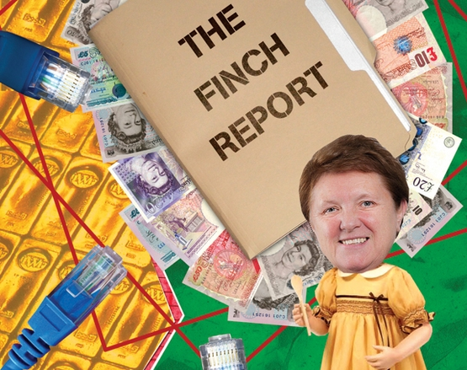
2012 The Finch Fiasco The UK’s U-Turn from Cost-Free Green to Fool’s Gold

Slide 40
2012: BOAI-10 OA Policy Recommendations
1. On policy
1.1. Every institution of higher education should have a policy assuring that peer-reviewed versions of all future scholarly articles by faculty members are deposited in the institution’s designated repository...
Deposits should be made as early as possible, ideally at the time of acceptance, and no later than the date of formal publication.
University policies should respect faculty freedom to submit new work to the journals of their choice. [emphasis added]
University policies should encourage but not require publication in OA journals [emphasis added] ...
1.3. Every research funding agency, public or private, should have a policy assuring that peer-reviewed versions of all future scholarly articles reporting funded research are deposited in a suitable repository and made OA as soon as practicable.
Deposits should be made as early as possible, ideally at the time of acceptance, and no later than the date of formal publication...

Slide 41
Feb 2013: OSTP Directive & FASTR & PAPS Bills

Slide 42
May 2013 -- FRS/FNRS Belgium Harmonized Funder+Institution Mandate (Liège Immediate-Deposit Model)

Slide 43
Dec 2013 EU Horizon 2020 OA Mandate

Slide 44
March 2014: HEFCE Mandate Immediate-Deposit for REF2020 (Liège/FNRS Model)

Slide 45
Open Access: How?
Universities and Funders adopt the ID/OA mandate:
Immediate Deposit
+
Optional Access
+
Button
(Sole mechanism for submitting for performance review or research funding)

Slide 46
Pre-Green Fool’s Gold vs Post-Green Fair Gold
Journals unaffordable but must-have journals uncancellable
Pre-Green (Fool’s) Gold is arbitrarily and enormously over-priced
Pre-Green (Fool’s) Gold is double-paid (must-have subscriptions fees, incoming, (Fool’s) Gold publication fees, outgoing
Pre-Green (Fool’s) hybrid Gold is either double-dipped, or each individual institution’s outgoing publications subsidize all other institutions’ incoming subscription fees

Slide 47
Pre-Green Fool’s Gold vs Post-Green Fair Gold
Universal Green makes journals cancellable and subscriptions unsustainable
Post-Green cancellations force journal cost-cutting and down-sizing to the Post-Green essentials
Print edition, online edition, access-provision, archiving, and their expenses are all obsolete Post-Green, offloaded instead onto the worlwide network of Green OA repositories.
The sole remaining function and cost of peer-reviewed journal publishing Post-Green will be peer review, paid for out of a fraction of institutional subscription savings as affordable, sustainable Post-Green Fair Gold

Slide 48
Universal Green OA: and then what?
All articles OA in institutional repositories immediately upon acceptance
Journals can be cancelled
Sole remaining cost of peer reviewed journal publishing post-green is peer review, paid for out of a fraction of the annual journal cancellation savings

Slide 49
(1994) A Subversive Proposal
(2001) The Self-Archiving Initiative
(2002) The Budapest Open Access Initiative
(2004) Memorandum to UK To UK Government Science and Technology Select Committee Select Committee on Science and Technology Written Evidence
(2004) For Whom the Gate Tolls? Select Committee on Science and Technology Written Evidence
(2007). No Need for Canadian PubMed Central: CIHR Should Mandate IR Deposit.
(2011) What Is To Be Done About U.S. Public Access to Peer-Reviewed Scholarly Publications Resulting From U.S. Federally Funded Research?
(2011) Comments on Open Access FAQ of German Alliance of Scientific Organisations
(2012) Digital Research: How and Why the RCUK Open Access Policy Needs to Be Revised
(2013). Response to HEFCE REF OA Policy Consultation.
(2013). Comments on HEFCE/REF Open Access Mandate Proposal.
(2013) Evidence to House of Lords Science and Technology Select Committee on Open Access
(2013) Evidence to BIS Select Committee Inquiry on Open Access.
(2013). Follow-Up Comments for BIS Select Committee on Open Access
(2013) Recommandation au ministre québécois de l'enseignement supérieur.
(2013) Comments on Canada’s NSERC/SSHRC/CIHR Draft Tri-Agency Open Access Policy
Multiple Comments on CIHR Open Access Policy
Multiple Comments on SSHRC Open Access Policy
Multiple Comments on OA Progress in Canada
Multiple Comments on NIH Public Access Policy
Multiple Comments on Harvard Open Access Policy
Multiple Comments on France/HAL Open Access Policy
Multiple Comments on Australian Open Access Policy
Comments on H. Varmus's 1999 E-biomed Proposal [1] [2]
Harnad, S. (2007) The Green Road to Open Access: A Leveraged Transition. In: Anna Gacs. The Culture of Periodicals from the Perspective of the Electronic Age. L'Harmattan. 99-106.
Harnad, S. (2010) No-Fault Peer Review Charges: The Price of Selectivity Need Not Be Access Denied or Delayed. D-Lib Magazine 16 (7/8)

