Slide 1
Learned Whorfian Effects and Dimensional Reduction
Stevan Harnad
UQÀM, U Southampton, McGill
Based on the ongoing work of;
Xi-Wei Kang U Southampton
Phlippe Vincent-Lamarre UQÀM, U Ottawa
Fernanda Perez Gay McGill, UQÀM
Daniel Rivas McGill, UQÀM

Slide 2
The Turing test

Slide 3
Summary
“Categorical Perception” (CP) (within-category compression and between-category separation in discriminability or similarity) can be induced by category learning
Learned CP increases with task difficulty
Task difficulty increases as the proportion of features co-varying with category membership decreases (“dimensional reduction”)
Only successful learners show learned CP
Category-learning and CP ground the meaning of words
Word meaning can be learned (“grounded”) directly by trial-and-error sensorimotor induction or indirectly by verbal instruction (definition, description)
Every dictionary has “minimal grounding sets” (MinSets) out of which all the rest of the words can be reached via verbal definitions using only the MinSet words
The MinSet words are more frequent than the rest of the dictionary, more concrete, and learned earlier
Learned CP is a weak Whorfian Effect (language influences perception)

Slide 4
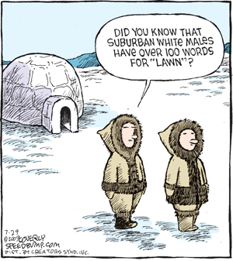
The Whorf-Sapir Hypothesis

Slide 5
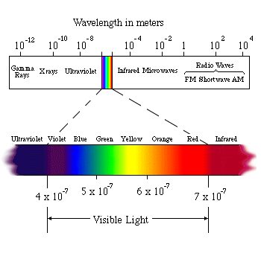
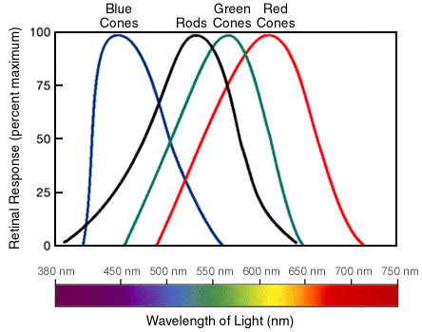
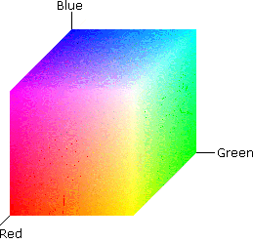
Categorical Perception (CP)
“Warping" of similarity space

Slide 6
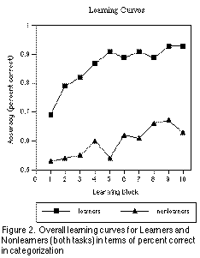
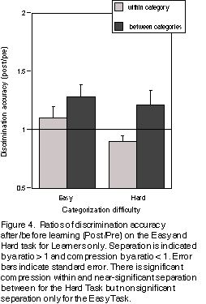
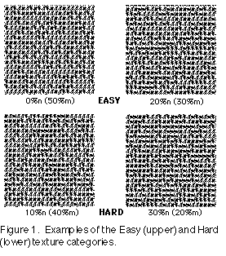
Learned Categorical Perception (CP)
Pevtzow, R. & Harnad, S. (1997)

Slide 7
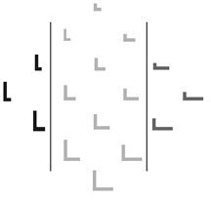
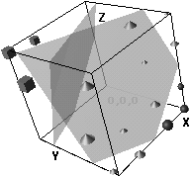
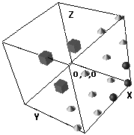
Prior neural net models of category learning
Tijsseling & Harnad 1997

Slide 8
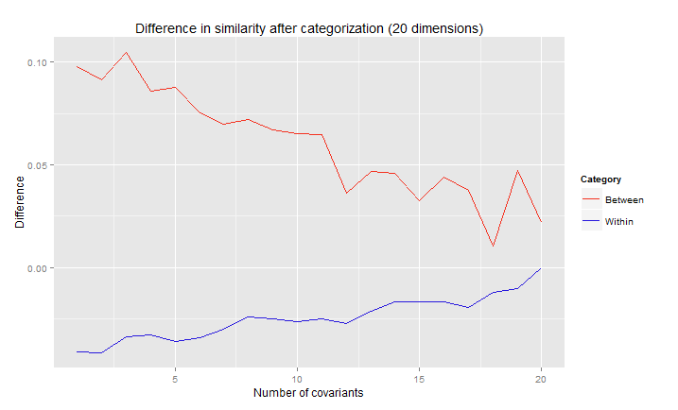
[0,#,#,1,#,1,#] -> category 1
[1,#,#,0,#,0,#] -> category 2
[0,0.3,0.6,1,0.1,1,0.2] -> Exemplar category 1
[0,0.2,0.9,1,0.3,1,0.1] -> Exemplar category 1
[1,0.2,0.7,0,0.8,0,0.2] -> Exemplar category 2
[1,0.8,0.9,0,0.2,0,0.3] -> Exemplar category 2
Results of
Philippe Vincent-Lamarre
UQÀM/U Ottawa

Slide 9
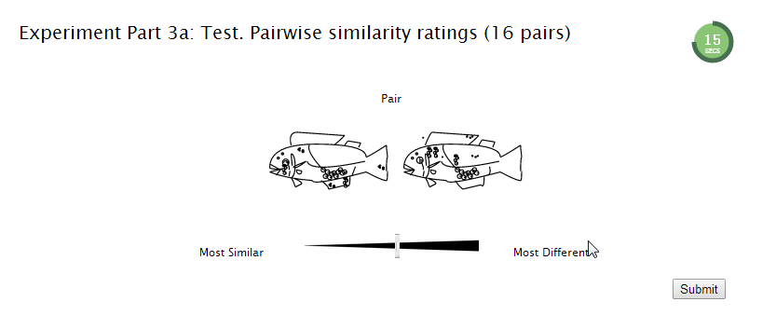
Learning to Categorize AILFISH and LIMFISH
Pattern Demonstration
Similarity Judgments Tests
Category Learning Tests
Similarity Judgments Tests
Xi-Wei Kang U Southampton

Slide 10
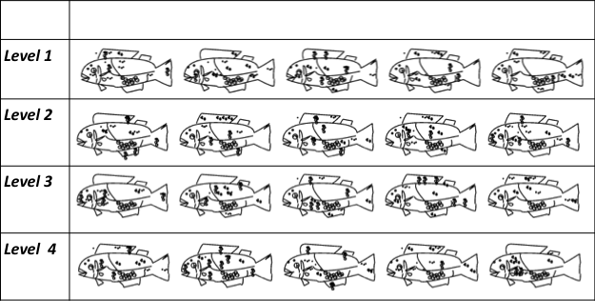
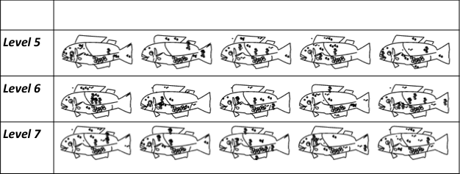
Stimuli adapted from Sigala, N., & Logothetis, N. K. (2002). Visual categorization shapes feature selectivity in the primate temporal cortex. Nature, 415(6869), 318-320. http://www.cnbc.cmu.edu/~samondjm/papers/SigalaandLogothetis2002.pdf

Slide 11
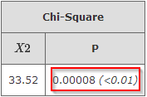
Proportion of Successful Learners

Slide 12
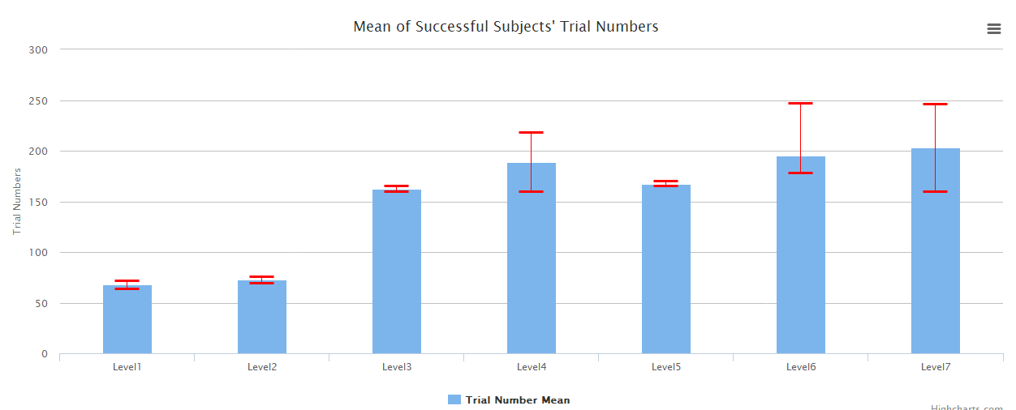
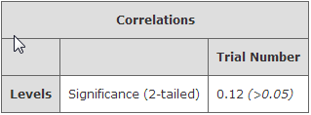
Number of trials till criterion

Slide 13
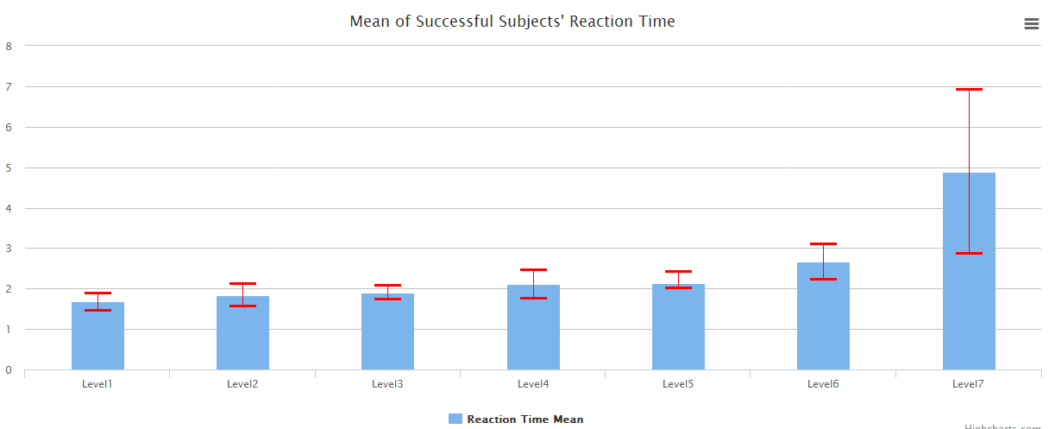
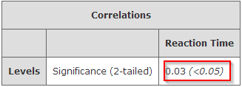
Reaction Times

Slide 14
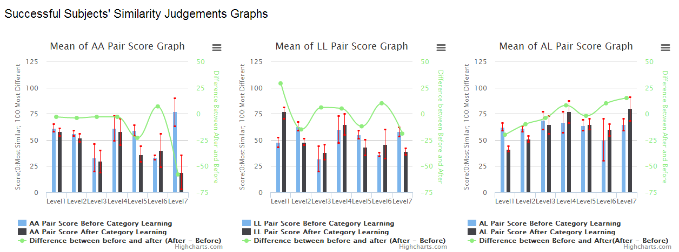
Within-Category (AA, LL) and Between-Category (AL) Similarity Ratings Successful Subjects

Slide 15
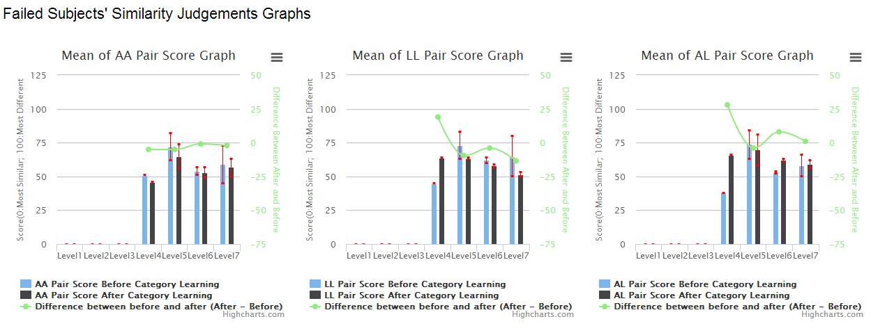
Within-Category (AA, LL) and Between-Category (AL) Similarity Ratings Unsuccessful Subjects

Slide 16
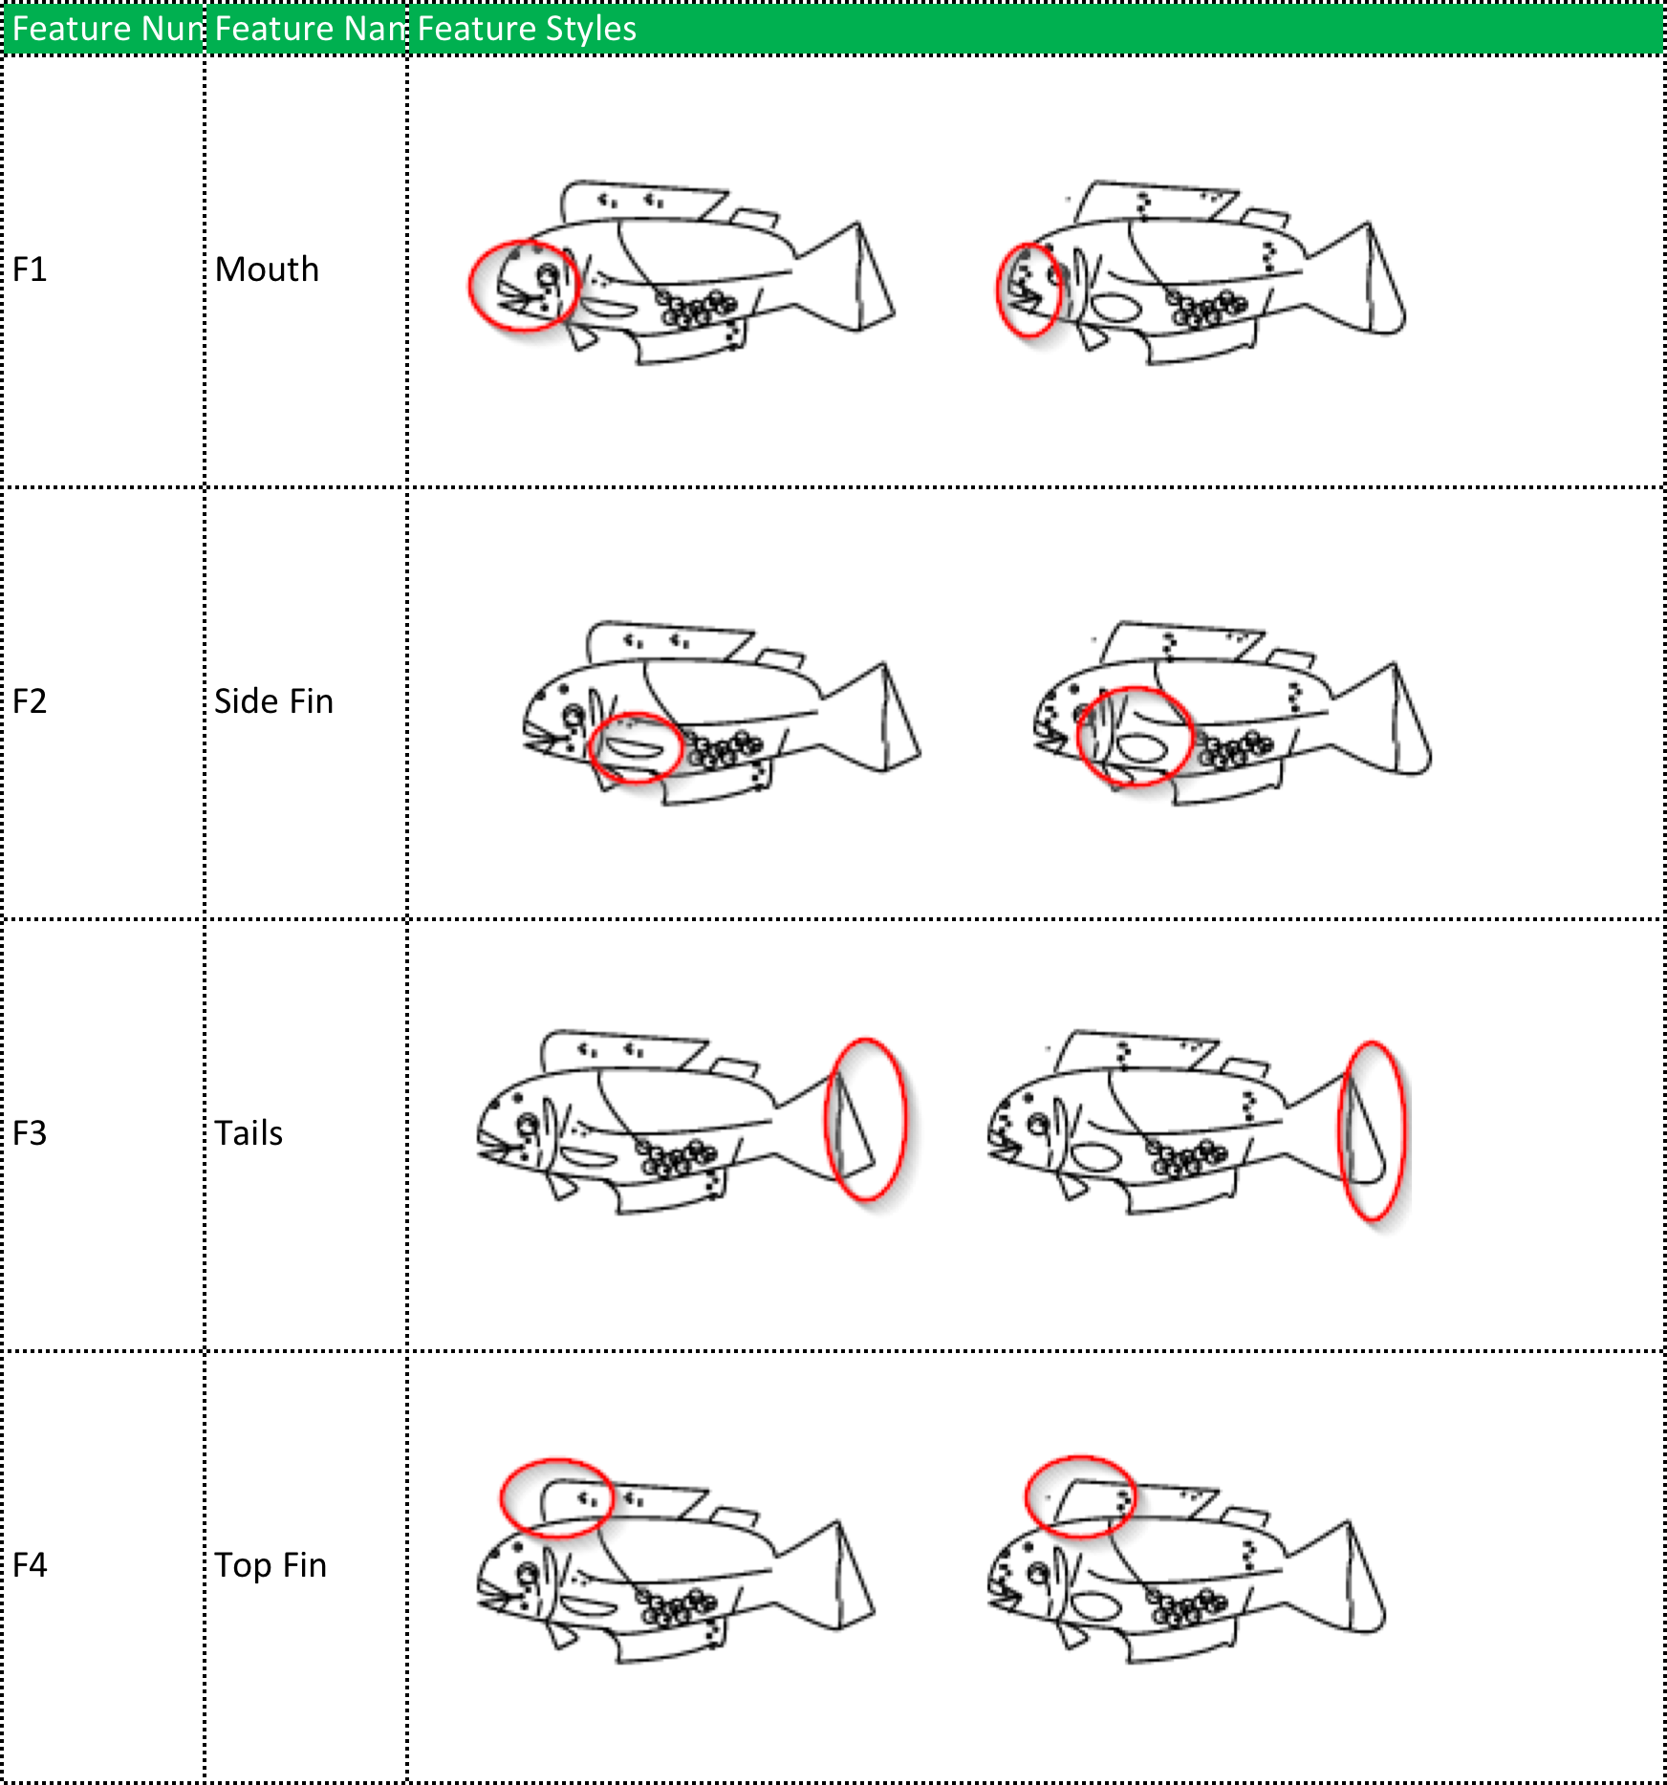
4 relevant features
64 pre-learning
pairwise similarity ratings
160 category learning trials
With corrective feedback
Success criterion:
20 error-free trials
64 post-learning
pairwise similarity ratings
160 unique stimuli

Slide 17
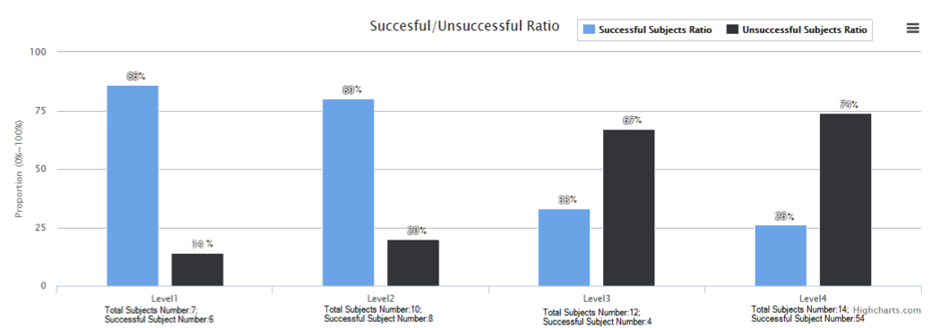
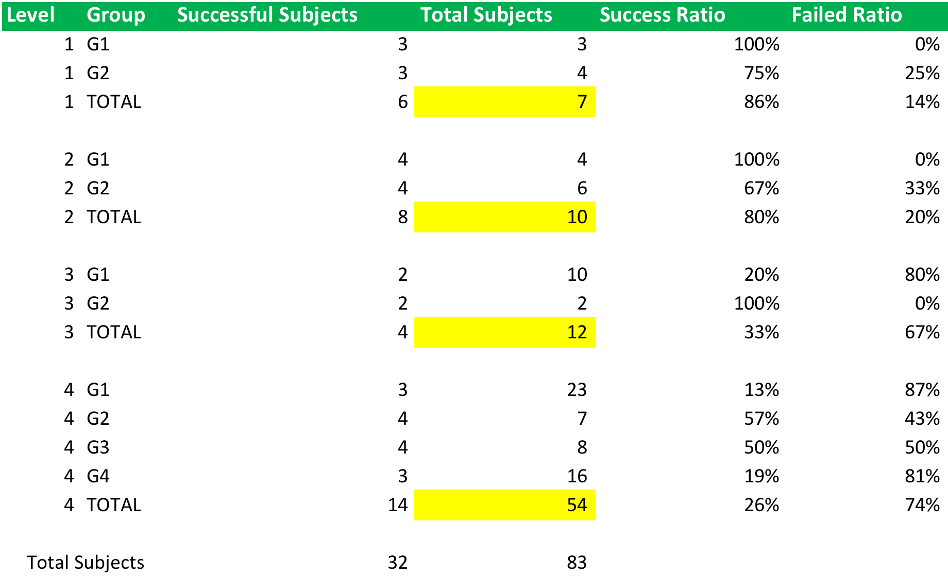
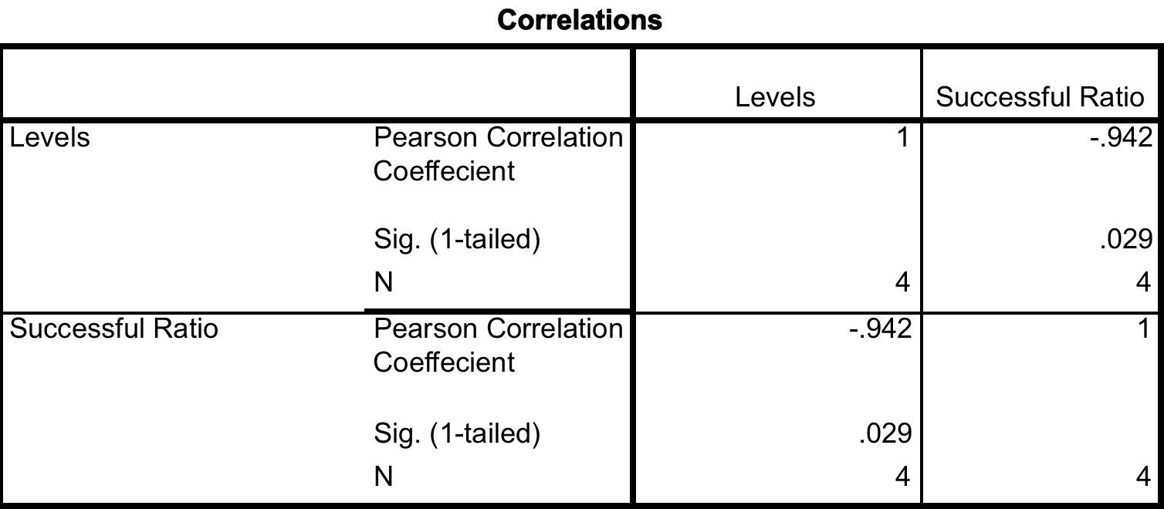

Slide 18
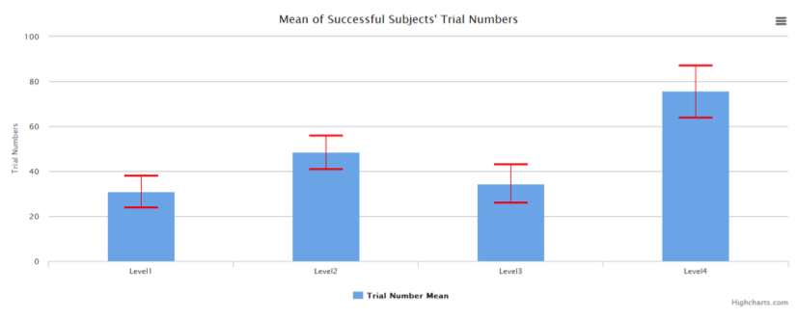
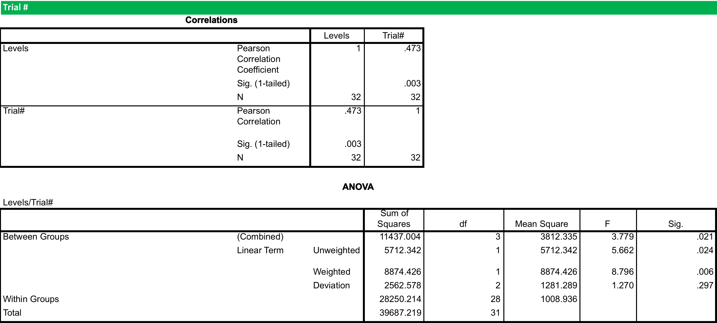

Slide 19
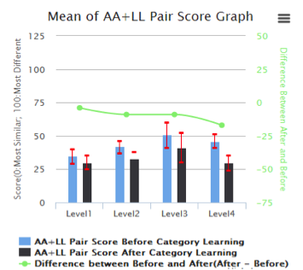
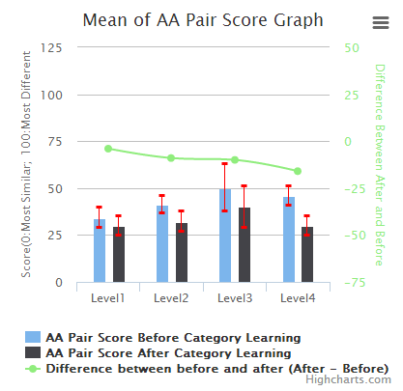
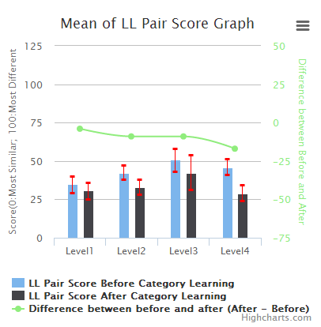
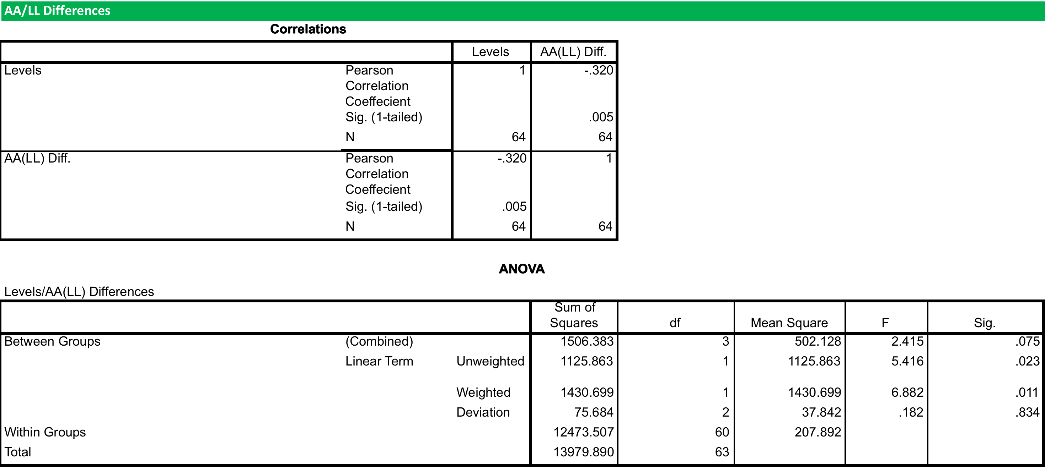
Within-category compression

Slide 20
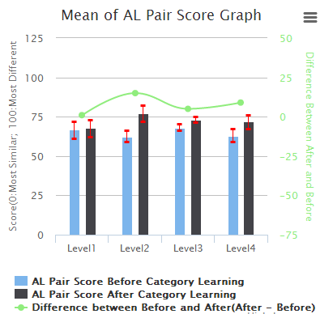
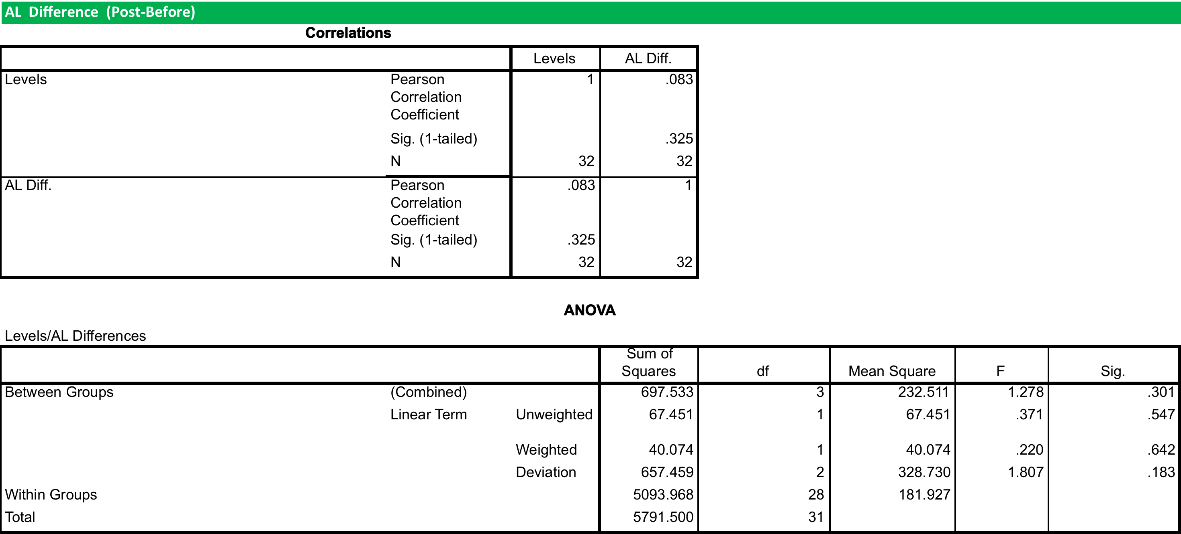
Between-category
separation

Slide 22
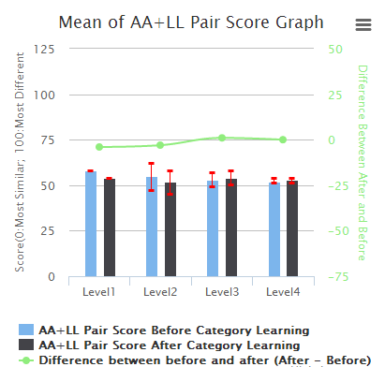
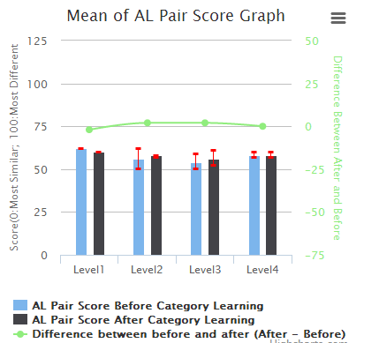
Successful
Learners
WITHIN
Failed
Learners
WITHIN
BETWEEN
BETWEEN

Slide 23
CP as a side-effect of Dimensional Reduction

Slide 24
[0,#,#,1,#,1,#] -> category 1
[1,#,#,0,#,0,#] -> category 2
[0,0.3,0.6,1,0.1,1,0.2] -> Exemplar category 1
[0,0.2,0.9,1,0.3,1,0.1] -> Exemplar category 1
[1,0.2,0.7,0,0.8,0,0.2] -> Exemplar category 2
[1,0.8,0.9,0,0.2,0,0.3] -> Exemplar category 2
Results of
Philippe Vincent-Lamarre
UQÀM/U Ottawa

Slide 25
What is the Symbol Grounding Problem?

Slide 26
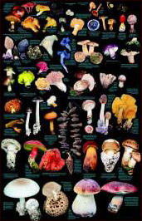
What is Categorization?
Doing the right thing with the right KIND of thing

Slide 27
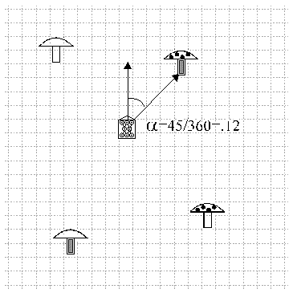
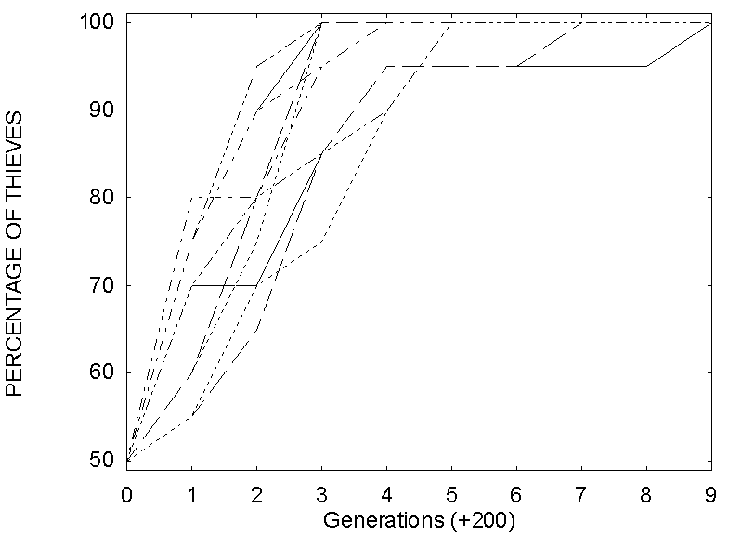
Hearsay: A New Way To Acquire Categories
Cangelosi & Harnad 2002

Slide 28
Dictionaries (and Encylopedias and Textbooks) are Category Repositories

Slide 29
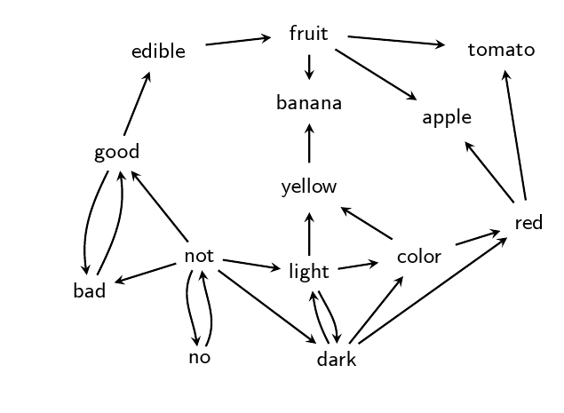
Toy dictionary represented as graph

Slide 30
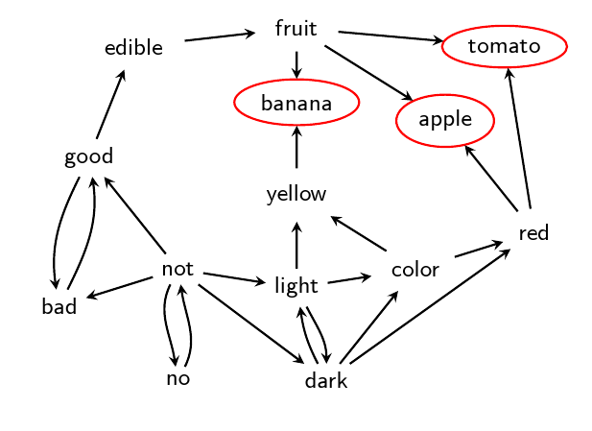
Some words are not used in any deﬁnition.

Slide 31
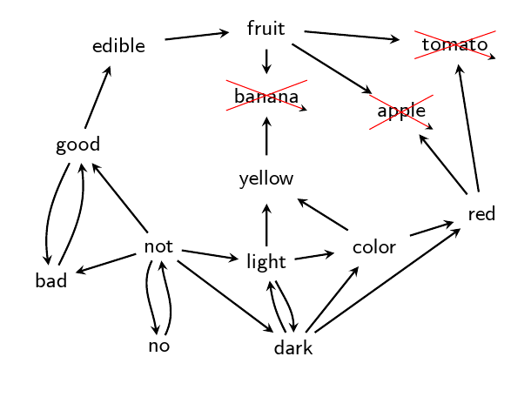
They can be removed

Slide 32
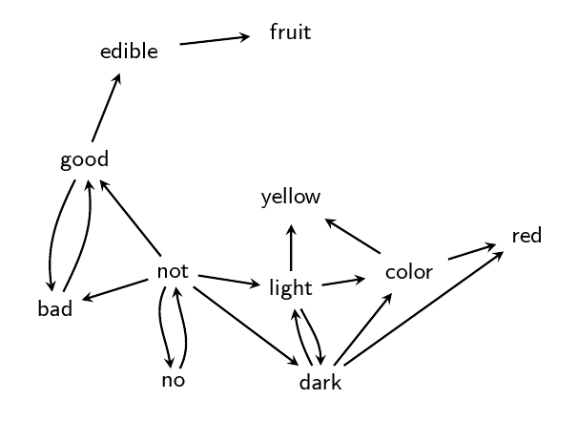

Slide 33
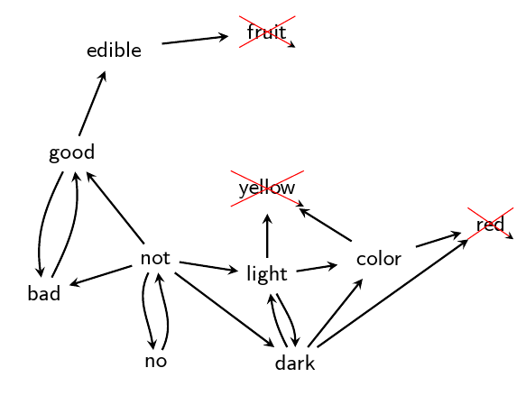
This process is recursive.

Slide 34
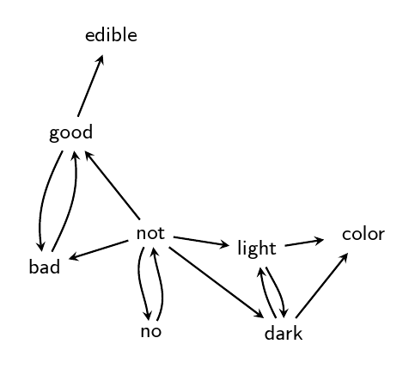

Slide 35
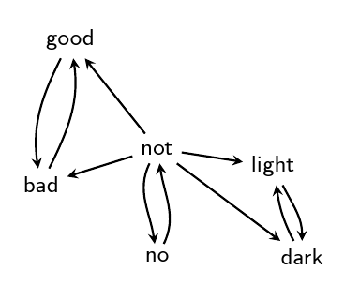
Till no other word can be removed

Slide 36
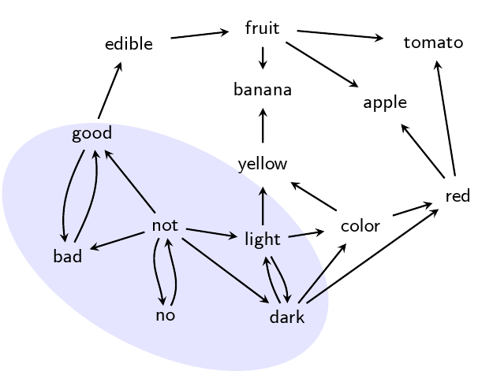
Resulting subgraph is
“Grounding Kernel” (GK) of dictionary

Slide 37
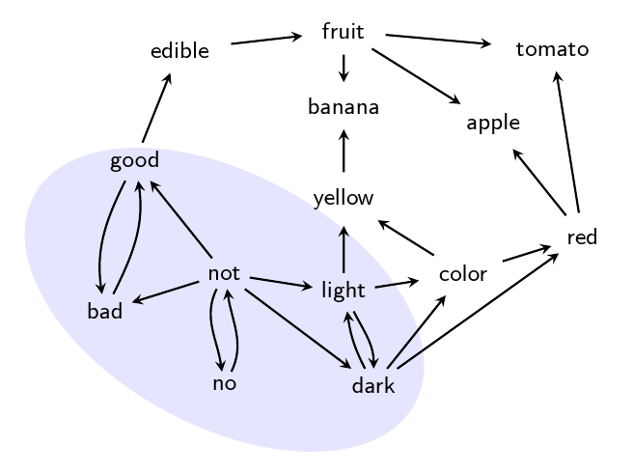
GK can be decomposed further
into “Strongly Connected Components” (SCCs)

Slide 38
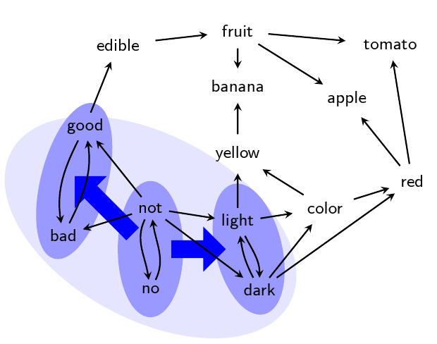

Slide 39
Dictionary Hidden Structure

Slide 40
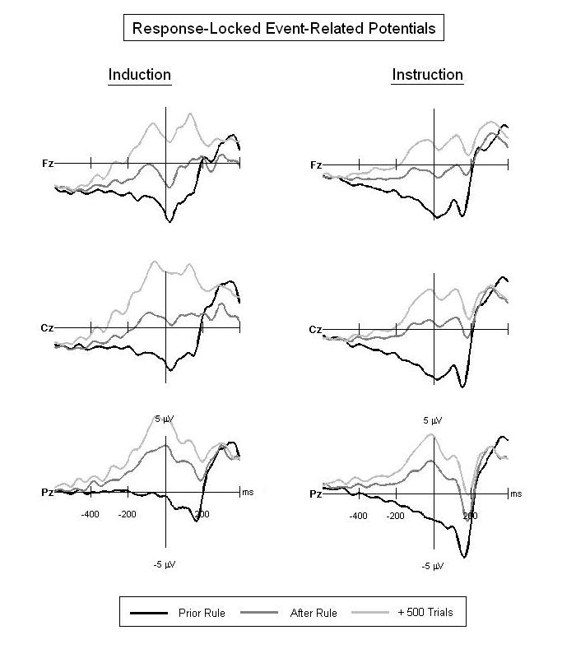
Ongoing work:
ERP Correlates of Category Learning By Sensorimotor Induction Versus Verbal Instruction

Slide 41
Summary
“Categorical Perception” (CP) (within-category compression and between-category separation in discriminability or similarity) can be induced by category learning
Learned CP increases with task difficulty
Task difficulty increases as the proportion of features co-varying with category membership decreases (“dimensional reduction”)
Only successful learners show learned CP
Category-learning and CP ground the meaning of words
Word meaning can be learned (“grounded”) directly by trial-and-error sensorimotor induction or indirectly by verbal instruction (definition, description)
Every dictionary has “minimal grounding sets” (MinSets) out of which all the rest of the words can be reached via verbal definitions using only the MinSet words
The MinSet words are more frequent than the rest of the dictionary, more concrete, and learned earlier
Learned CP is a weak Whorfian Effect (language influences perception)

Slide 42
Thank you
Xi-Wei Kang U Southampton
Phlippe Vincent-Lamarre UQÀM, U Ottawa
Fernanda Perez Gay McGill, UQÀM
Daniel Rivas McGill, UQÀM

