Slide 1
Linked Data and the Semantic Web
COMP6218 Web Architecture
Dr Nicholas Gibbins – nmg@ecs.soton.ac.uk
2015-2016

Slide 2
From an (Early) History of the Web
“... a goal of the Web was that, if the interaction between person and hypertext could be so intuitive that the machine-readable information space gave an accurate representation of the state of people's thoughts, interactions, and work patterns, then machine analysis could become a very powerful management tool, seeing patterns in our work and facilitating our working together through the typical problems which beset the management of large organizations.”
T. Berners-Lee, The World Wide Web: Past, Present and Future, 1996
Notes:
TBL’s original vision of the Web was much more ambitious than the reality of the existing (syntactic) Web
TBL (and others) have since been working towards realising this vision, which has become known as the Semantic Web

Slide 3
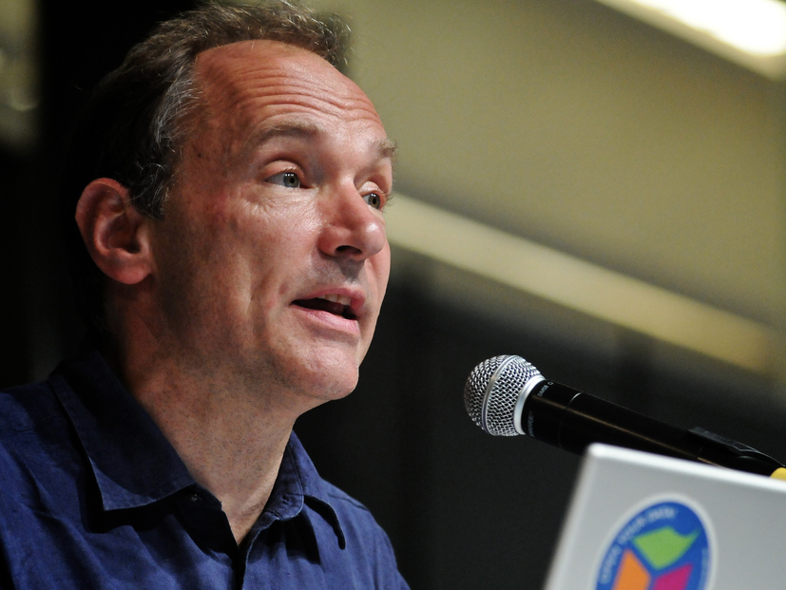
I have a dream for the Web [in which computers] become capable of analyzing all the data on the Web – the content, links, and transactions between people and computers. A ‘Semantic Web’, which should make this possible, has yet to emerge, but when it does, the day-to-day mechanisms of trade, bureaucracy and our daily lives will be handled by machines talking to machines. The ‘intelligent agents’ people have touted for ages will finally materialize.
Notes:
Tim Berners-Lee, WWW Keynote, 1999

Slide 4
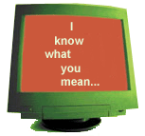
What is the Semantic Web?
The Semantic Web is an extension of the current Web in which information is given a well-defined meaning, better enabling computers and people to work in cooperation.
It is the idea of having data on the Web defined and linked in a way that it can be used for more effective discovery, automation, integration and reuse across various applications.
The Web can reach its full potential if it becomes a place where data can be processed by automated tools as well as people.
W3C Activity Statement

Slide 5
Making the Web Semantic…

Slide 6
…in a way that machines can deal with….
This is a type of object event and this is its title
This is the URL of the web page for the event
This is a type of object photograph and the photograph is of Tim Berners-Lee
Tim Berners-Lee is an invited speaker at the event

Slide 7
…via meta content
<owl:Class rdf:ID="Conference">
<rdfs:subClassOf rdf:resource="#Meeting-Taking-Place"/>
<rdfs:subClassOf rdf:resource="#Publication-Type-Event"/>
-<rdfs:subClassOf>
-<owl:Restriction>
<owl:onProperty rdf:resource="#published-proceedings"/>
<owl:allValuesFrom rdf:resource="#Conference-Proceedings-Reference"/>
</owl:Restriction>
This is a type of object event and this is its title
This is the URL of the web page for the event
This is a type of object photograph and the photograph is of Tim Berners-Lee
Tim Berners-Lee is an invited speaker at the event

Slide 8
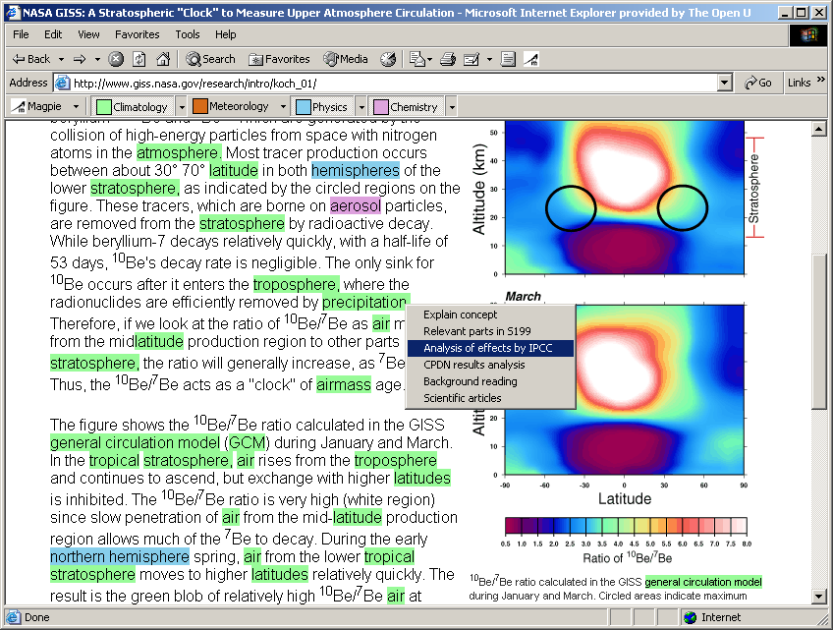
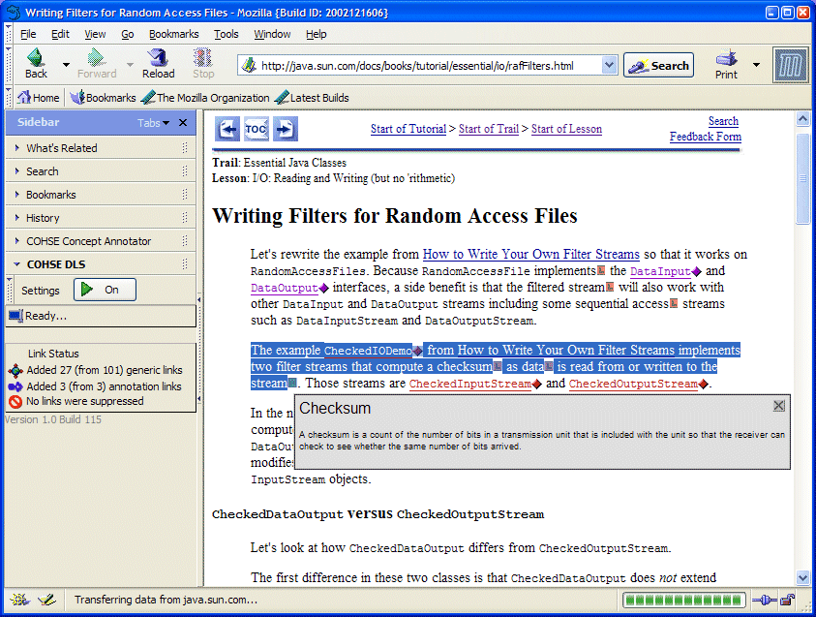
Which Semantic Web?
The Annotated Web
Enrich existing web pages with annotations
Classify web pages
Use natural language techniques to extract information from web pages
Annotations enable enhanced browsing and searching

Slide 9
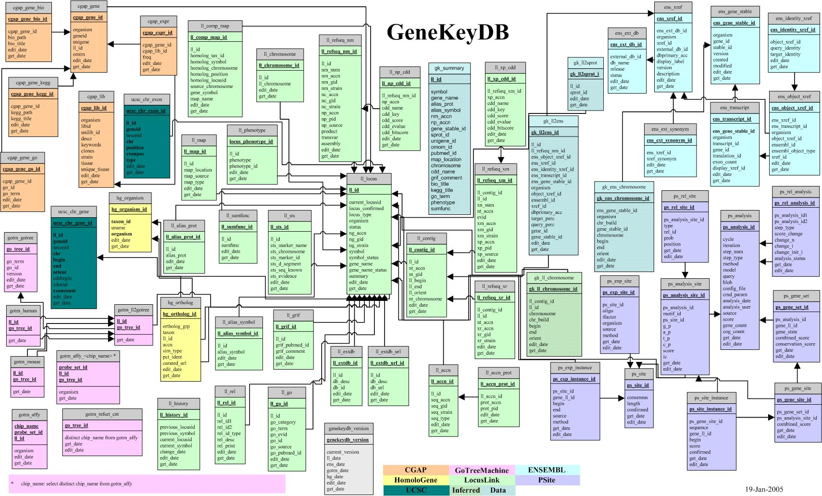
Which Semantic Web?
The Web of Data
Expose existing databases in a common format
Express database schemas in a machine-understandable form
Common format allows the integration of data in unexpected ways
Machine-understandable schemas allow reasoning about data
Make the most of the structure you already have

Slide 10
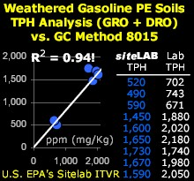
Can Annotate/Expose Anything
Databases
Scientific structures
Workflows
Publications
People
Product Descriptions
Geographical Information
Financial Data

Slide 11
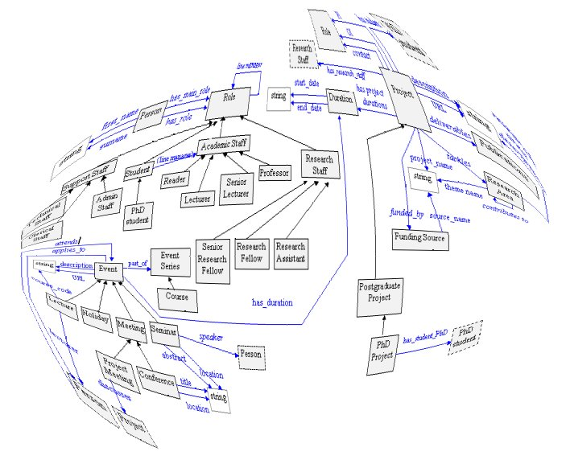
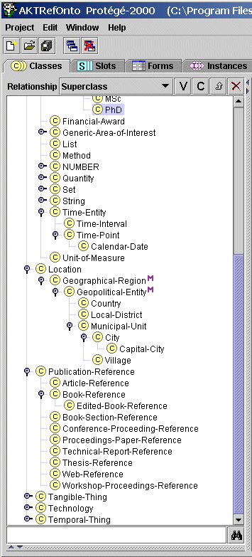
Building Shared Meaning
We need shared vocabularies to describe objects in these domain of interest:
ontologies

Slide 12
The Cynic’s View
The Semantic Web is just old-fashioned artificial intelligence
Artificial intelligence hasn’t delivered on its previous promises, so why should it now?

Slide 13
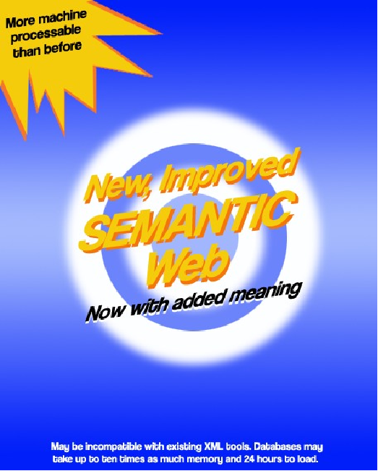
The Semantic Web Hype Cycle
Visibility
Semantic Web c. 2002
Semantic Web c. 2010
Technology Trigger
Peak of Inflated Expectation
Trough of Disillusionment
Slope of Enlightenment
Plateau of Productivity
Maturity

Slide 14
Rocket Science (not)
Is this rocket science? Well, not really. The Semantic Web, like the World Wide Web, is just taking well established ideas, and making them work interoperably over the Internet. This is done with standards, which is what the World Wide Web Consortium is all about. We are not inventing relational models for data, or query systems or rule-based systems. We are just webizing them. We are just allowing them to work together in a decentralized system - without a human having to custom handcraft every connection.
Tim Berners-Lee, Business Case for the Semantic Web, http://www.w3.org/DesignIssues/Business

Slide 15
The Cynic’s View, part 2
Don’t we already have a machine-readable interchange format, namely XML?

Slide 16
On the World Wide Web…
The World Wide Web is the Web for people
Information is predominantly textual
Technologies include URI, HTTP, XML, HTML
Information needs humans to give it meaning
XML is a machine-readable format
It can be parsed to give an unambiguous document structure
but
It has no formal meaning
Meanings of XML interchange formats must be explicitly agreed

Slide 17
On the Semantic Web…
The Semantic Web is the Web for machines
Information is structured
Technologies include RDF, RDFS, OWL (in addition to those for the Web)
Information can be interpreted by machines
Humans need not interact directly with Semantic Web information
RDF is a machine-understandable format
The structures generated by an RDF parser have a formal meaning
RDF is a framework for interchange formats that provides a base level of common understanding

Slide 18
Machine readable: XML
<foo bar=“2003386947”> <baz qux=“19J”>502-224</baz> <quux>2</quux> <quuux>3998SB</quuux> </foo>
foo
bar=2003386947
baz
quux
quuux
quz=19J
502-224
2
3998SB

Slide 19
Machine readable: XML
<order ref=“2003386947”> <part catalogue=“19J”>502-224</part> <quantity>2</quantity> <customer>3998SB</customer> </order>
order
ref=2003386947
part
quantity
customer
catalogue=19J
502-224
2
3998SB

Slide 20
Semantic Web Data Interchange
RDF data may be freely composed with other RDF data
Assertions can be mixed with assertions about weather, physics, business processes, weblogs and syndication, genealogy, politics, and so on, without the need for prior coordination between the designers of vocabularies for these domains
The RDF position is that it is too difficult to agree on interchange formats
Instead, we should use ontologies to facilitate mapping between formats

Slide 21
The triple
Underlying model of triples used to describe the relations between entities in the Semantic Web
(subject, predicate, object)
e.g. “RDF Semantics”, “edited by”, “Pat Hayes”
edited by
RDF Semantics
Pat Hayes
subject
predicate
object
Notes:
Network knowledge representation
Labelled, directed graph
Entities as nodes, relations as edges

Slide 22
Example
Take a citation:
Tim Berners-Lee, James Hendler and Ora Lassila. The Semantic Web. Scientific American, May 2001
We can identify a number of distinct statements in this citation:
There is an article titled “The Semantic Web”
One of its authors is a person named “Tim Berners-Lee” (etc)
It appeared in a publication titled “Scientific American”
It was published in May 2001

Slide 23
Example
We can represent these statements graphically:
2001-05
The Semantic Web
date
title
name
Tim Berners-Lee
creator
publishedIn
creator
name
James Hendler
creator
name
Ora Lassila
title
Scientific American

Slide 24
Example
There are two types of node in this graph:
Literals, which have a value but no identity (a string, a number, a date)
Resources, which represent objects with identity (a web page, a person, a journal)
Scientific American

Slide 25
Example
Resources are identified by URIs
Property labels are also identified by URIs, and are drawn from a vocabulary or ontology
http://purl.org/dc/elements/1.1/title
http://www.sciam.com/
Scientific American
subject
predicate
object

Slide 26
Knowledge as links
2001-05
The Semantic Web
date
title
name
Tim Berners-Lee
creator
publishedIn
creator
name
James Hendler
creator
name
Ora Lassila
title
Scientific American

Slide 27
Mixing Vocabularies
The triple-based graph model makes it possible to mix terms from different vocabularies in the same graph
2001-05
The Semantic Web
date
title
name
Tim Berners-Lee
creator
publishedIn
creator
name
James Hendler
creator
name
Ora Lassila
foaf
title
dc
Scientific American
bibo

Slide 28
Linked Data Principles
Set of publishing practices for SW data:
Use URIs as names for things
Use HTTP URIs so that people can look up those names
When someone looks up a URI, provide useful information
Include links to other URIs. so that they can discover more things
Effectively, putting the hypertext back into the Semantic Web
Simplifies integration between datasets while maintaining loose coupling

Slide 29
Example
graph describing ‘sw’
graph describing ‘tbl’
2001-05
tbl
Tim Berners-Lee
The Semantic Web
date
name
tbl
title
creator
graph describing ‘jh’
sw
jh
publishedIn
creator
jh
James Hendler
sci am
ora
name
creator
graph describing ‘ora’
ora
Ora Lassila
graph describing ‘sciam’
name
sci am
title
Scientific American

Slide 30
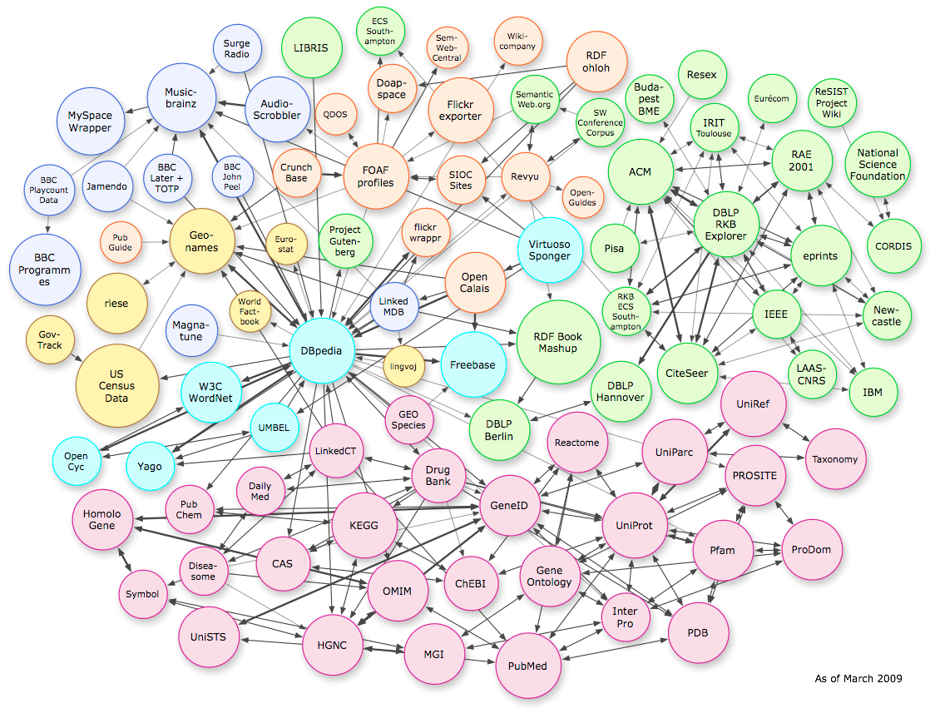

Slide 31
