Slide 1
Innovating for City Sustainability
Dr Pelin Demirel (p.demirel@soton.ac.uk)
16 November 2015

Slide 2
My work and contact details
Innovation economics (focusing on firms’ innovation behaviour)
Sustainability (in the context of firm behaviour, government policies and city sustainability)
CONTACT DETAILS:
Email: p.demirel@soton.ac.uk
Office: Building 28 Room 2019

Slide 3
Today
City sustainability context:
What is going on in cities?
What is the role of innovation for city sustainability?
What is the role of entrepreneurship for a more sustainable city?
Implications for web science research

Slide 4
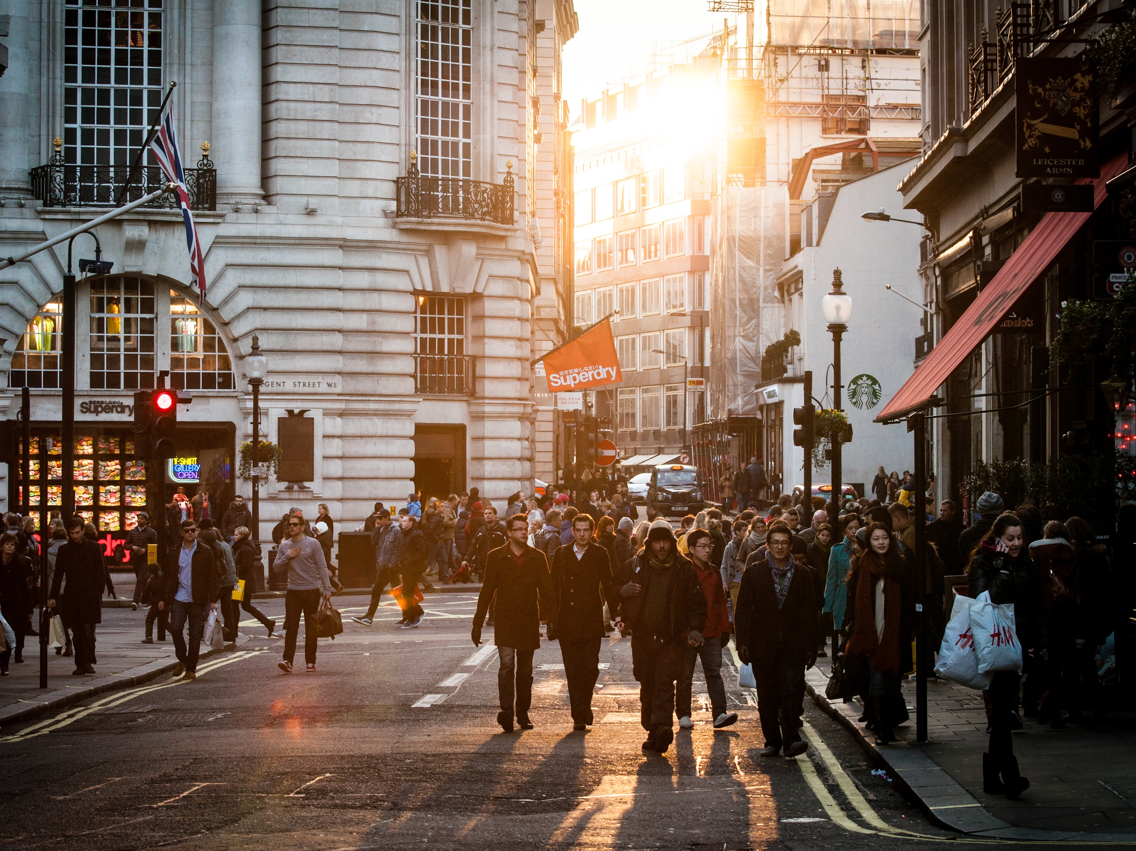
Understanding Cities

Slide 5
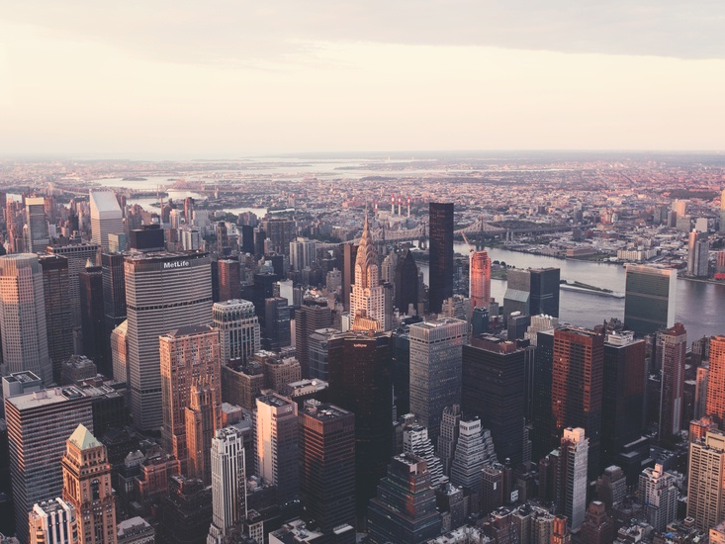
<2% of the world’s surface
>50% of the world’s population
80% of the GDP
>75% of the resource use
>85% of the CO2 emissions

Slide 6
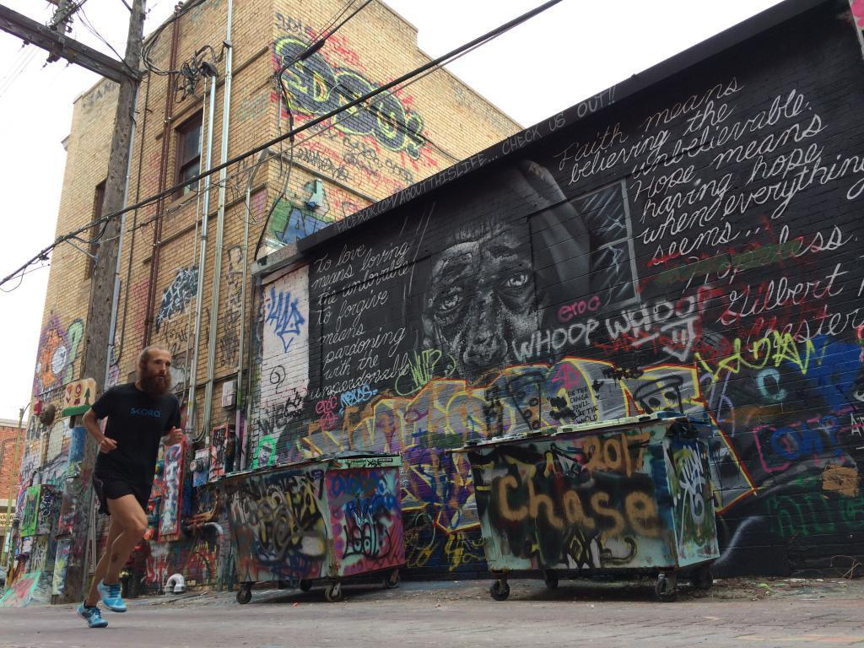
Poverty, inequality, culture, jobs, creativity, growth,
and perhaps one day sustainability…
Notes:
Deep increase in concentrated poverty in cities
since 1970s.
Poverty is persistent and rebounds of poverty
are rare. Poverty in neighbourhoods is correlated with
lower economic opportunity.
1 in 3 urbanites live in housing settlements (UN Habitat, 2003)
Cities in the developed part of the world wrestle with the aging infrastructure
Cities in the developing part of the world have to cope with fast urbanization

Slide 7
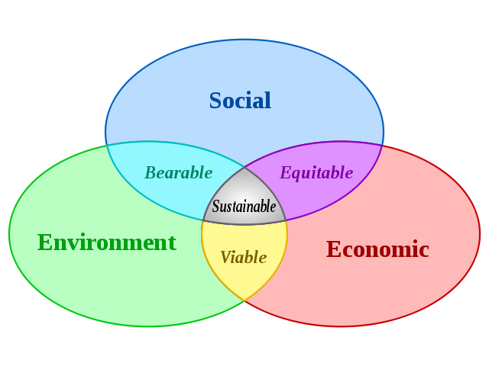
Sustainability
Three ‘pillars’ of sustainability: reconciliation of environmental, social equity and economic demands.
Issues of value judgement. Always a pragmatic compromise

Slide 8
The city jargon
https://futurecities.catapult.org.uk

Slide 9
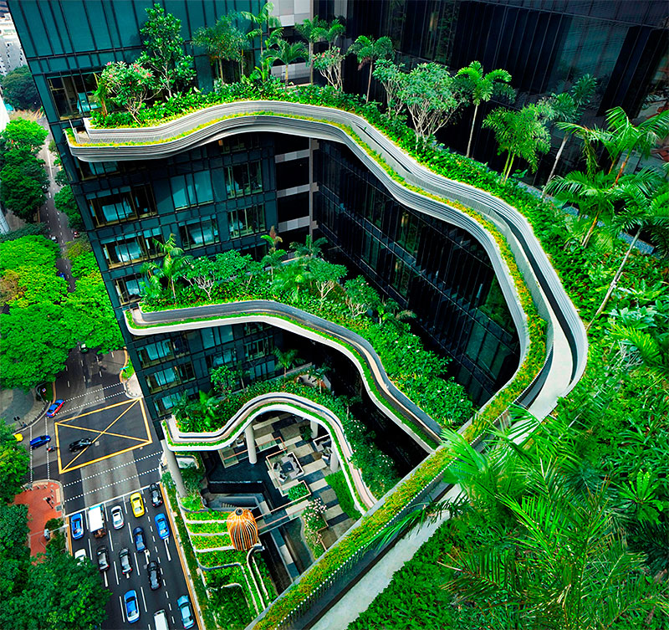
Innovation and the city

Slide 10
Back to Schumpeter…
Innovation can happen through:
New goods
New ways of producing goods
The opening of a new market
The conquest of a new source of supply of raw materials or half-manufactured goods
The carrying out of the new organization of any industry
Joseph Alois Schumpeter
1883-1950

Slide 11
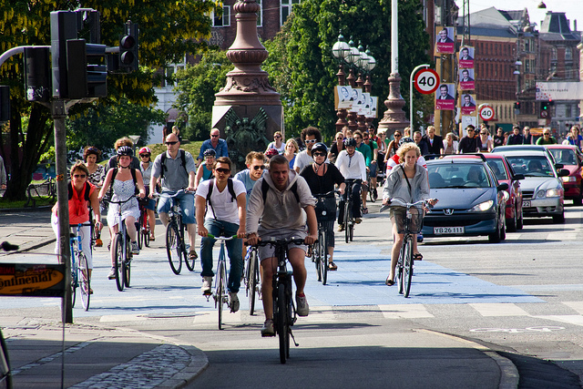
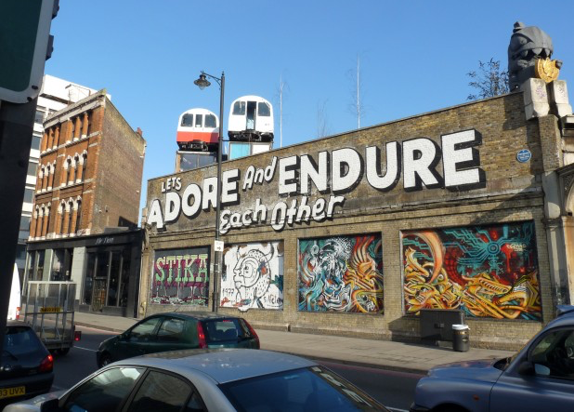
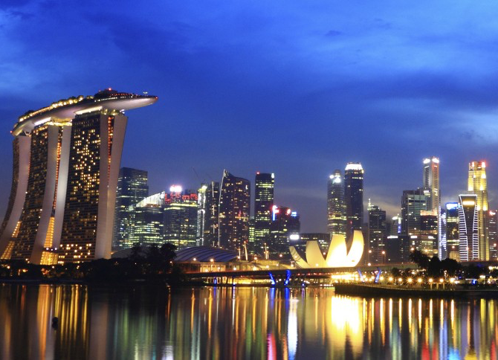
Notes:
new types of urban place or space (e.g. science parks, urban regeneration)
new methods of space or place production to create location specifi􏰜c advantages for producing goods/services or other urban activities (e.g. cluster formation)
opening new markets—whether by place marketing speci􏰜fic cities in new areas and/or modifying the spatial division of consumption through enhancing the quality of life for residents, commuters or visitors (e.g. boosting tourism)
Finding new sources of supply to enhance competitiveness (e.g. immigration)
Realigning the positioning of the city (e.g. global city)

Slide 12
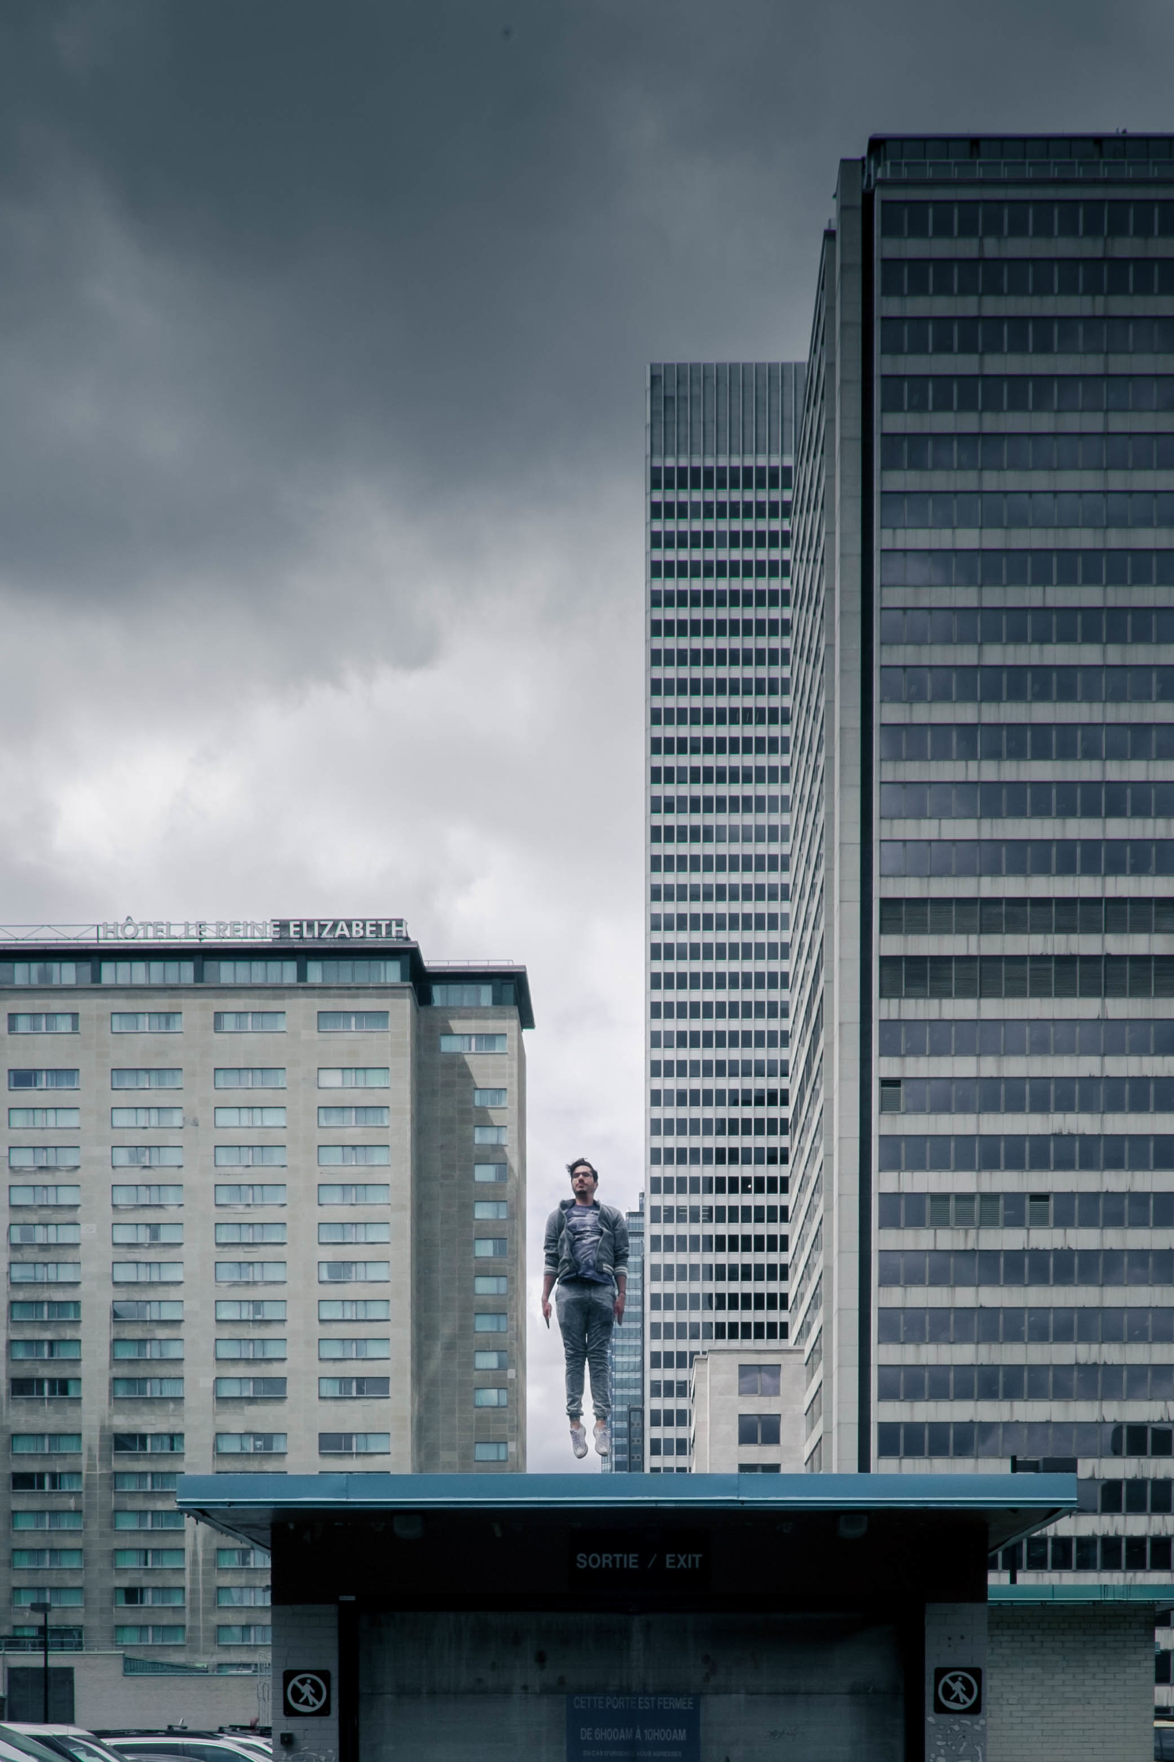
The entrepreneur and the city
Notes:
City politicians as entrepreneurs: vision, leadership and identification of opportunities to mobilize resources for sustainability.

Slide 13
The role of the entrepreneur for city sustainability: (the innovator and the risk taker)
New technologies such as mobile devices, data analytics and powerful web applications help to improve administration and communication in cities.
Issues such as poverty, health problems and environmental disasters can be alleviated with the help of technologies for advanced communication and warning systems.
Can entrepreneurs help to make cities more sustainable, and resilient?

Slide 14
The literature sees sustainable entrepreneurs as…
a ‘solution’ rather than ‘cause’ of environmental degradation (York and Ventakamaran, 2010, JBV), a panacea for many social and environmental concerns (Hall et al., 2010, JBV)
“discovering, evaluating, and exploiting economic opportunities that are present in environmentally relevant market failures” (Dean and McMullen, 2007, JBV)
The role of the (local) government and its policies
play a crucial role in the emergence and success of
sustainable entrepreneurs (Mazzucato, 2013).

Slide 15
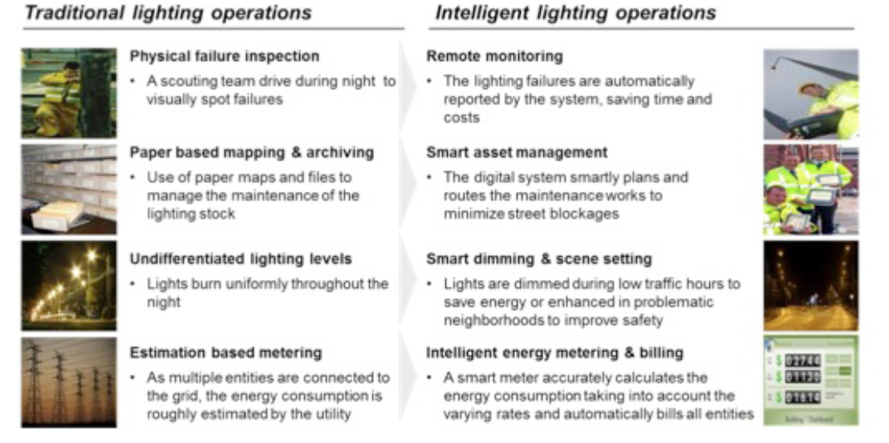
An example from Amsterdam…
￼
Cisco, 2013

Slide 16
An app to reduce food waste…

Slide 17
Beat pollution with wearable technology…

Slide 18
The web as a transformer of city sustainability landscape
Social, economic and technological ‘connections’ and ‘networks’ are still an underutilized in our efforts to be more sustainable.
What can the web entrepreneurs do to minimize resource use, maximize social wellbeing and reduce the costs of doing so in our cities? Is there a role for them given that large companies have more resources?
Research on ‘smart cities’ offer many ideas for using technology and data analytics to make cities more sustainable. What are the implications of using these for social sustainability (ethics, privacy etc.)

Slide 19
ANY QUESTIONS? Thank you for your ATTENTION. Dr Pelin Demirel p.demirel@soton.ac.uk

