Slide 1
EndNote X7 - basic graduate session
Notes:
This guide introduces the main features of EndNote.

Slide 2
What is EndNote for?
Build a personal reference library
Search databases and export references
Customise EndNote
Insert citations and build bibliography
Synchronise the library online
Notes:
EndNote is bibliographic management software that allows you to collect all the references from a range of resource types in a single location.
The results of a database search can be automatically exported to EndNote, and other notes, files and graphics can be added to individual records, allowing all information to be stored in a single location.
EndNote works alongside Word, inserts short citations within the text and generates full bibliographic references at the end of the current document. The appearance and management of citations and references is controlled through the EndNote Library.
Using EndNote, a document created with references in one referencing style can be automatically converted to a different referencing style if required.
The EndNote library can also be synchronised online, giving access to your references, wherever you are
All features of EndNote can be edited to suit personal preferences.

Slide 3
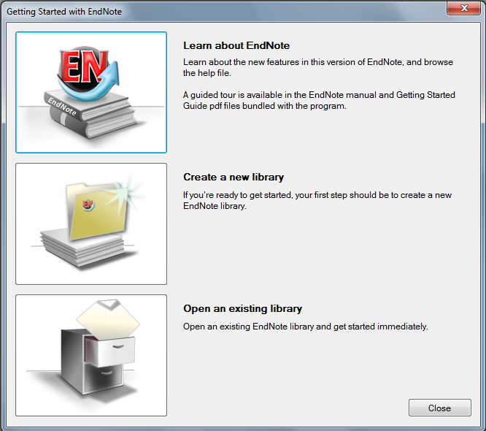
Create or open a library
Go to:
Start  All Programs  Bibliographic Software  EndNote X7
Notes:
On public workstations, go to Start, All Programs, Bibliographic Software, EndNote X7.
When you first load EndNote the welcome screen invites you to create a new library or open an existing library.
To create a new library, click on the picture.

Slide 4
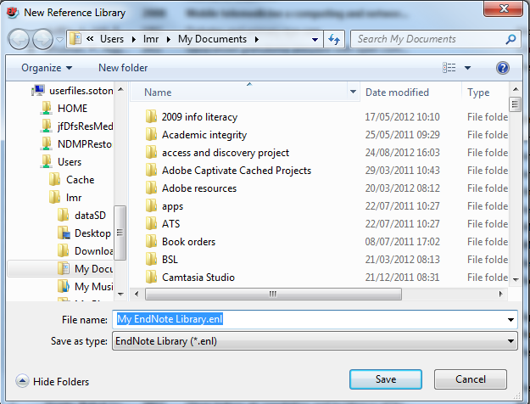
It is best to save all libraries in a folder called 'EndNote' or 'EndNote X7'
Notes:
The system will ask you where to save the new library: it is best to create a new folder called EndNote or EndNote X7 and save the library within that.

Slide 5
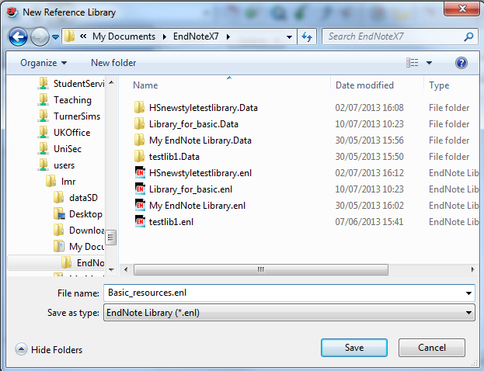
⬆
⬆
Give the new library a name, and click 'Save'
An EndNote library always has two parts - the library 'shape' and the data collected
Notes:
On future occasions, the library will appear in this window in two parts, the EndNote part with the EndNote icon which holds the information about the format of the library, and a data folder which contains the individual record information. Both parts are needed if you wish to transfer the library elsewhere.

Slide 6
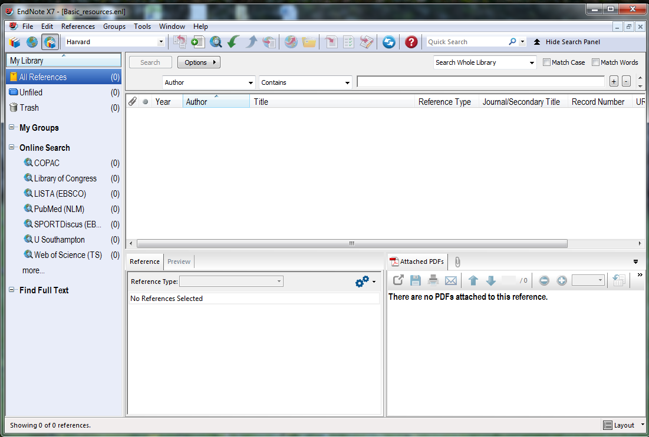
It is usually best to keep all references in one main library
Smaller libraries for particular topics can be created using the 'Groups' option
Notes:
It is best to keep all references in a single library: smaller libraries for particular purposes can be created using the Groups option, which is described later.

Slide 7
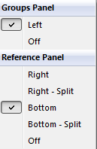
Use the layout menu to customise the library view
Notes:
It is best to keep all references in a single library: smaller libraries for particular purposes can be created using the Groups option, which is described later.
Use the layout dropdown menu to show or hide the Groups panel, and to hide or move the Reference panel.

Slide 8
Add a new reference

Slide 9

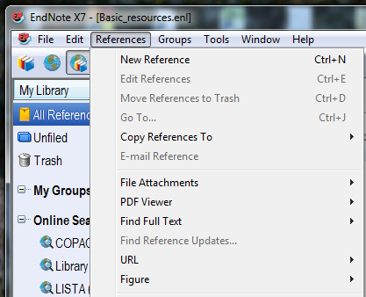
Add a new reference
Click on the 'New Reference' icon…
… or go to 'New Reference' on the dropdown menu
Notes:
To add a new reference, click on the New Reference icon on the toolbar, or go to New References on the References dropdown menu.

Slide 10
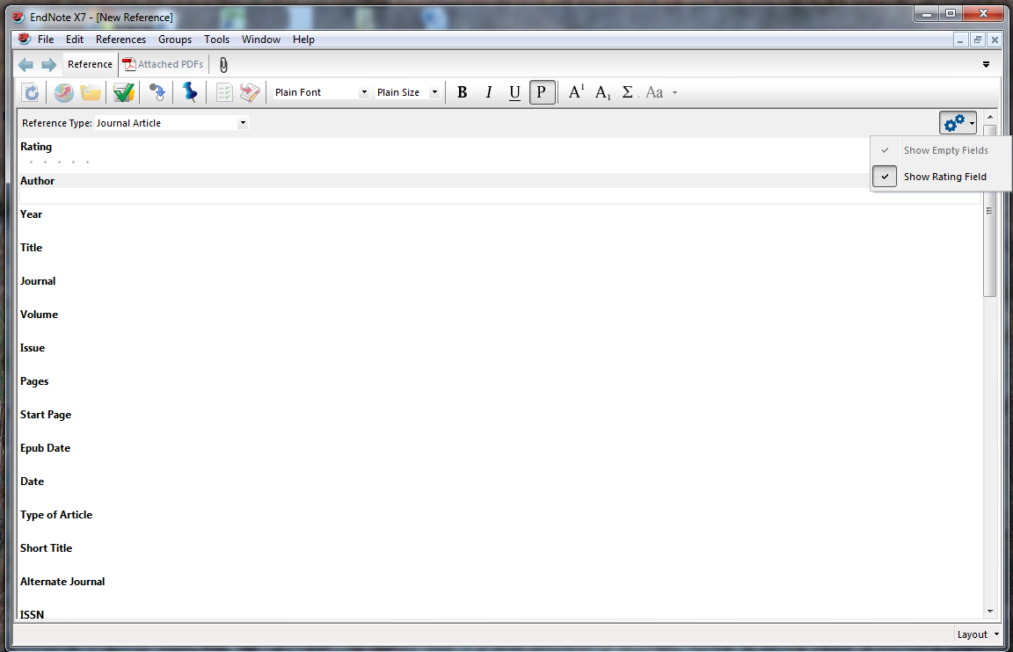
Scroll down to see more fields
Notes:
EndNote records are constructed from many fields - scroll down to see more of these.
Selection and order of fields is determined by the reference type.
Check the appearance of the bibliographic record.
If you do not wish to see the Rating field within the record it can be hidden by clicking the cogwheel icon.
Choose whether to include the rating field in the library view - see the library layout section below.
Changes can be made at any time.
To edit an existing record, double click on the EndNote library entry.

Slide 11
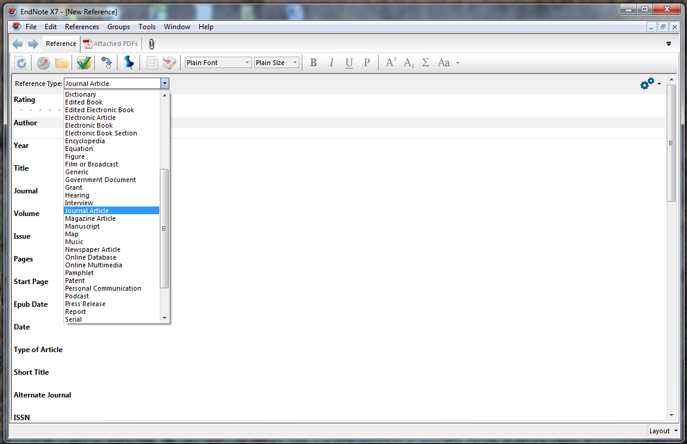
Click the record's 'close' icon to save the completed or edited record automatically
Choose the reference type from the dropdown menu
The reference type can be changed at any time
Notes:
Use the dropdown menu to change the reference type. You can change the reference type at any time.
Choose the 'best fit' for the medium and complete all useful fields.
Reference type definitions in EndNote may not always fit with UK practice, for example in Law.
Custom types are available to create unusual reference types.
When all details are completed, click the record's Close icon (the grey cross in full screen mode).
This will save the record details automatically.

Slide 12
More about record fields

Slide 13
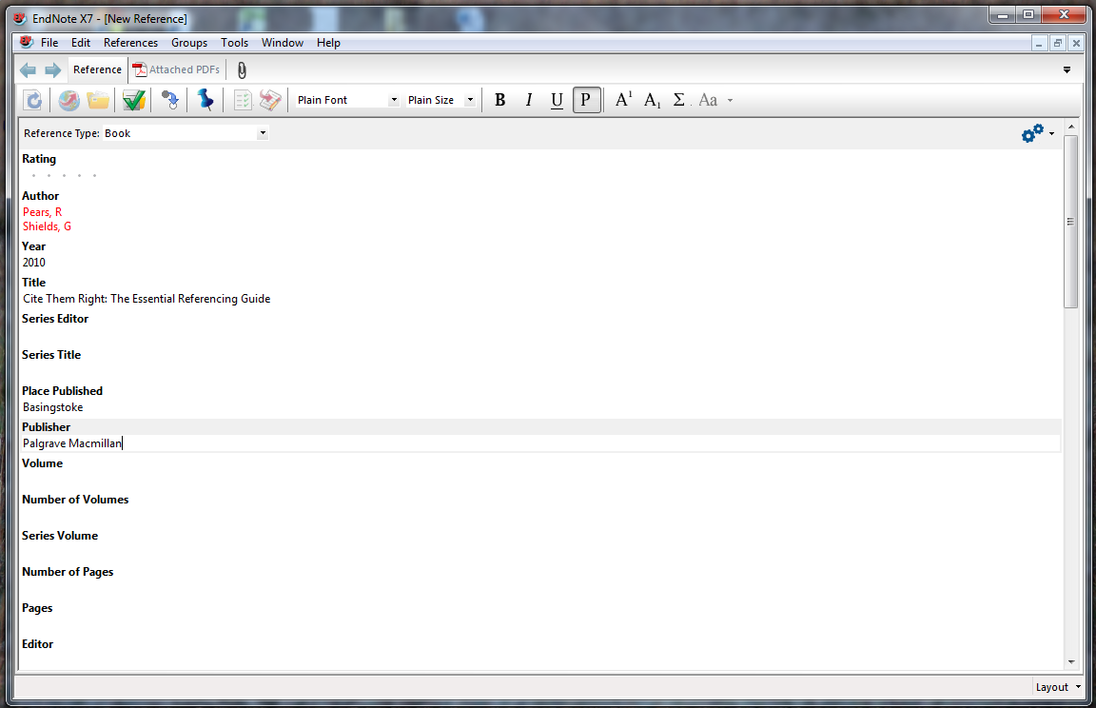
When all chosen fields have been completed, click the record close icon
Enter one author per line, surname first, followed by a comma
Author, Journal and Keyword fields are indexed
Notes:
Note some important points about the various record fields:
Use one author or editor per line, as EndNote counts the number of lines in order to establish the number of authors.
Enter the surname, followed by a comma, which is an important character, then first names or initials - EndNote will format this field according to the instructions given. Corporate authors must always be terminated by a comma.
The author, journal title and keywords fields are indexed and displayed in red.
Use only the record fields required: the bibliographic templates can be modified to include additional fields if required.
The URL field provides an automatic hyperlink.
Some fields, such as Notes and Research Notes, are free format and can be used for text or graphics. Files in other formats can also be attached to the records.
It is best to use Research Notes for your own comments
When using the keywords field, terms can be created in advance, to ensure consistency. New terms can be added at any time.
When all chosen fields have been completed, Click the RECORD Close icon - the grey cross.

Slide 14
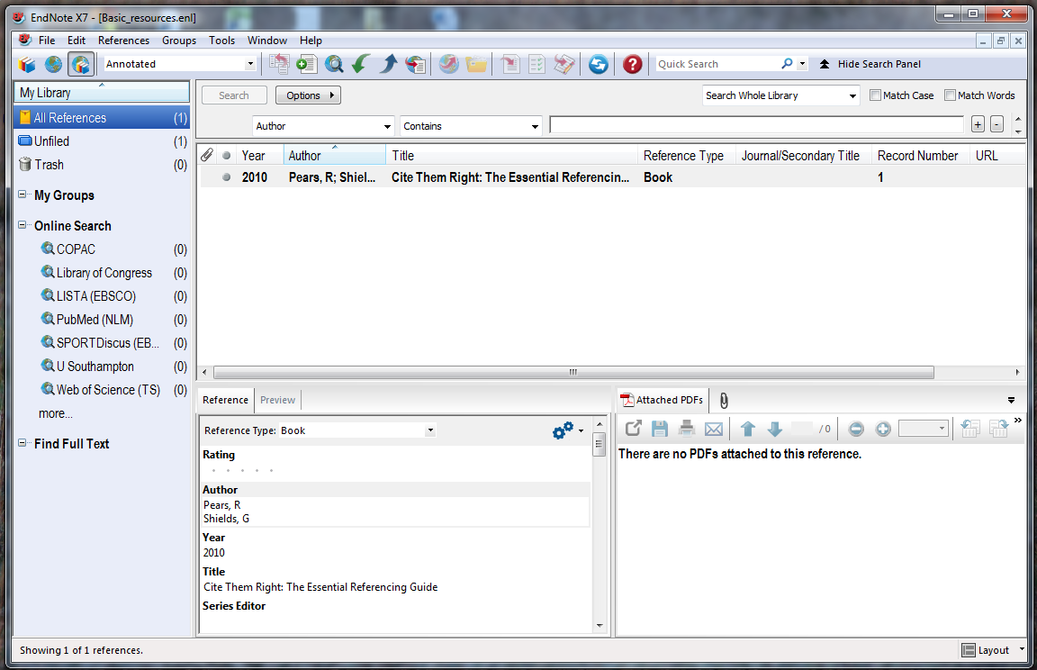
The record is added to the library
Notes:
The record is then added to the library.

Slide 15
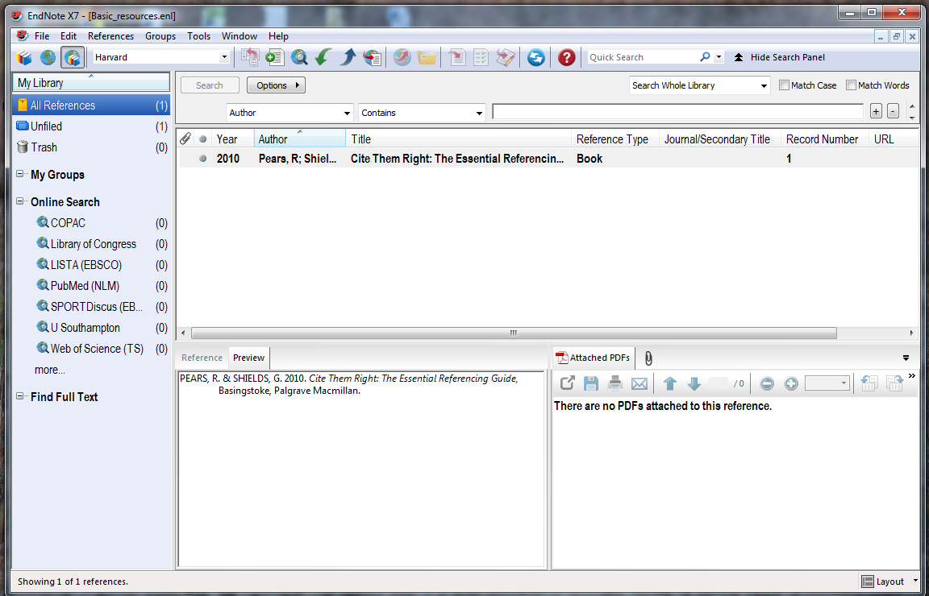
The Preview pane shows the full bibliographic reference in the chosen reference style
Notes:
The bibliographic record is displayed in the Preview pane, in accordance with the chosen reference style.

Slide 16
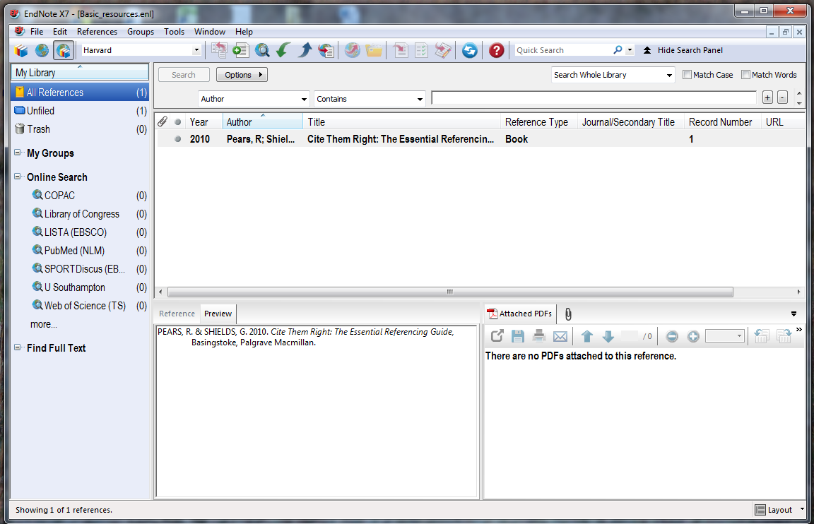
Read and unread records are indicated here
Notes:
The second column has an unread/read button - the parameters for this can be changed in EndNote preferences.

Slide 17
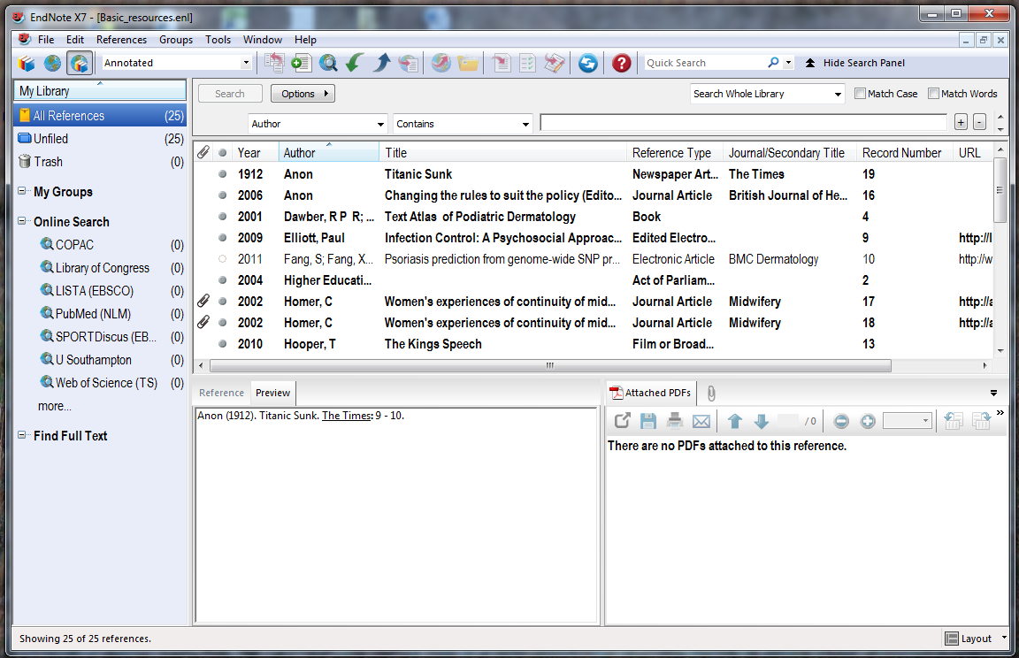
Left-click on a column heading to organise
Notes:
Left click on a column heading to organise references by this heading.

Slide 18
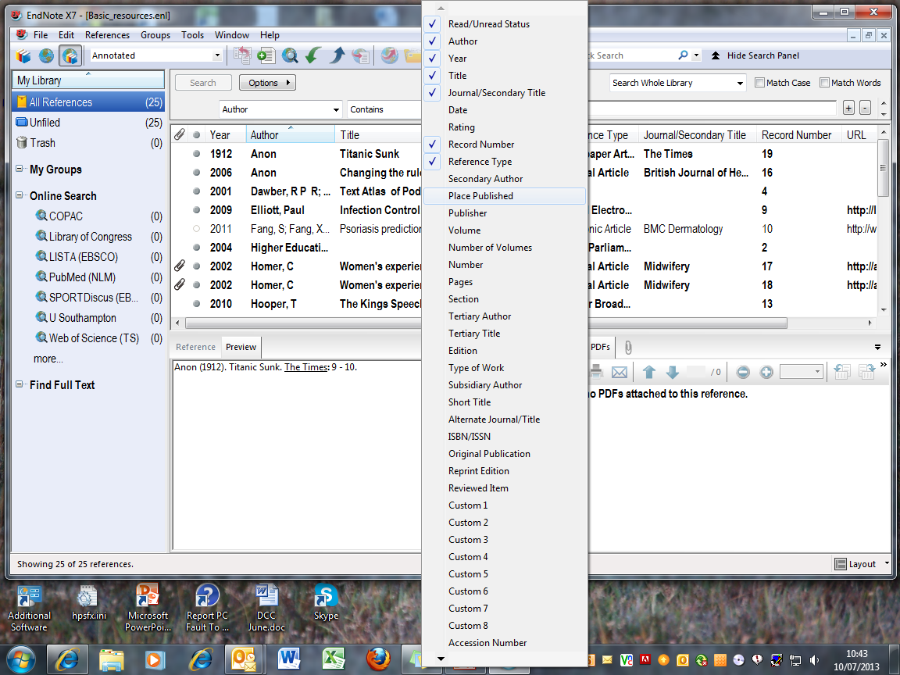
Right click in the headings bar and select fields for display
Notes:
Right-click in the headings bar to select fields to be displayed in the library. Up to 10 fields can be displayed.

Slide 19
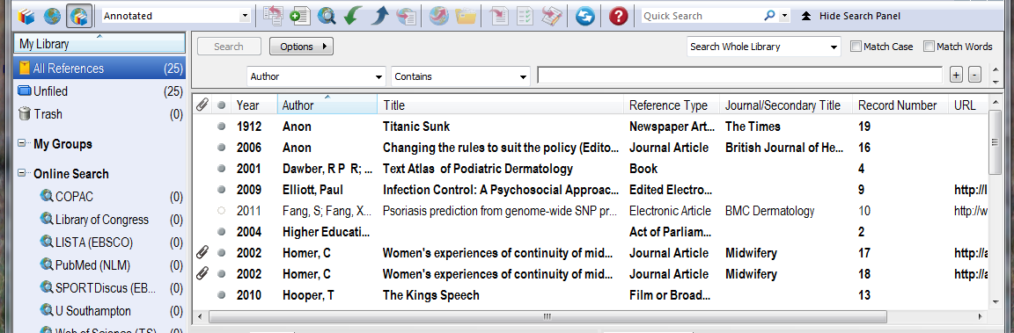
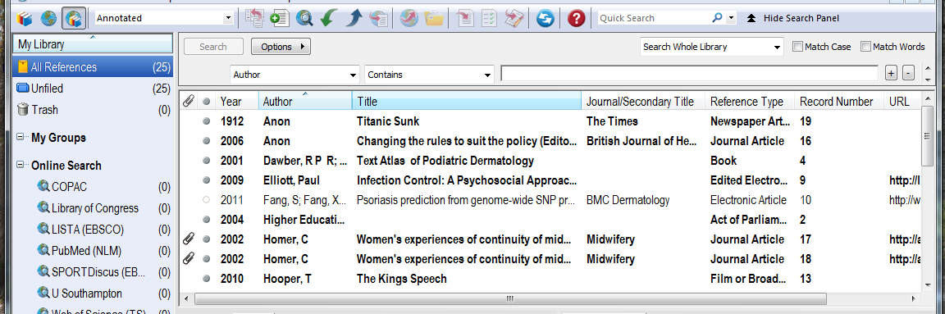
Select and drag columns to change layout
Notes:
To change the overall layout of the library, select and drag column headings to desired location

Slide 20
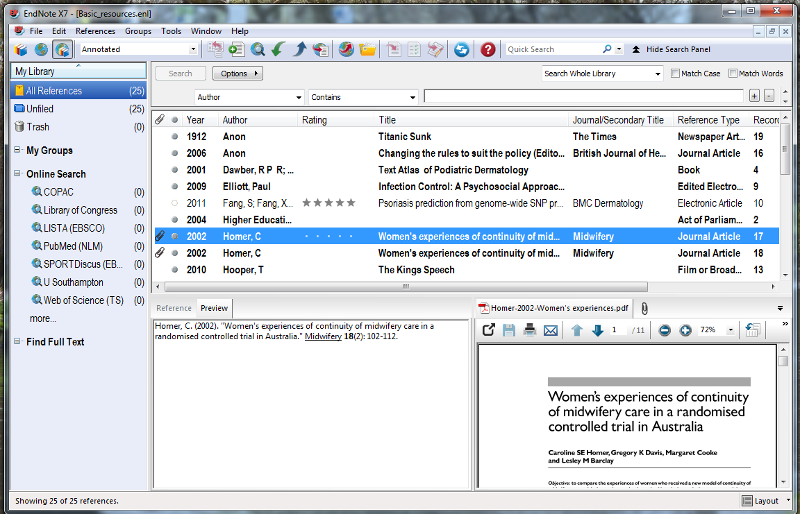
Click to add a rating
Notes:
Use the Rating column to identify particularly useful resources: click in the record, then on the dot corresponding to the number of stars (left-to-right)

Slide 21
Change the reference style

Slide 22
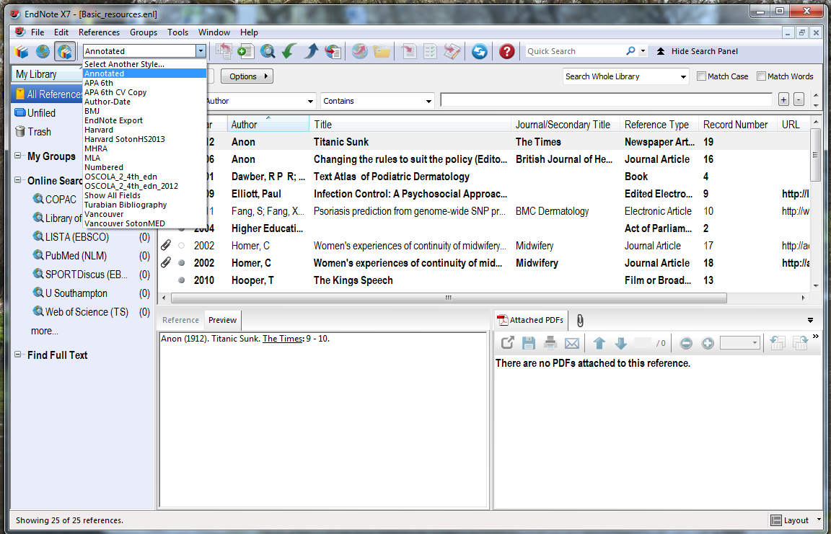
The default style is 'Annotated'
Go to the dropdown menu and choose 'Select Another Style'
Notes:
The default reference style is 'Annotated'
Use this process to select another style - changes can be made at any time.
Go to the dropdown menu, and choose Select Another Style..

Slide 23
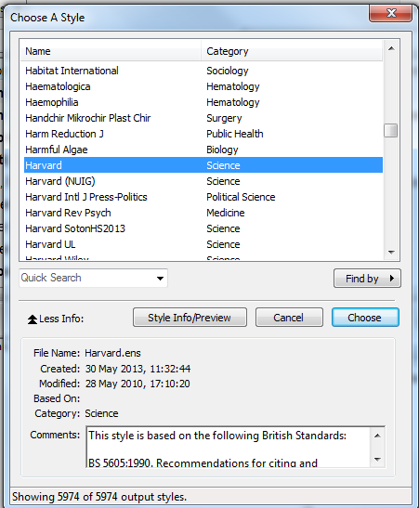
EndNote has nearly 6000 reference styles
Scroll down to select the required reference style and click 'Choose'
Notes:
The Choose a Style window opens.
There are nearly 6000 choices, including general reference styles, journal house styles and academic libraries.
Select a new style, in this case 'Harvard', and click Choose.

Slide 24
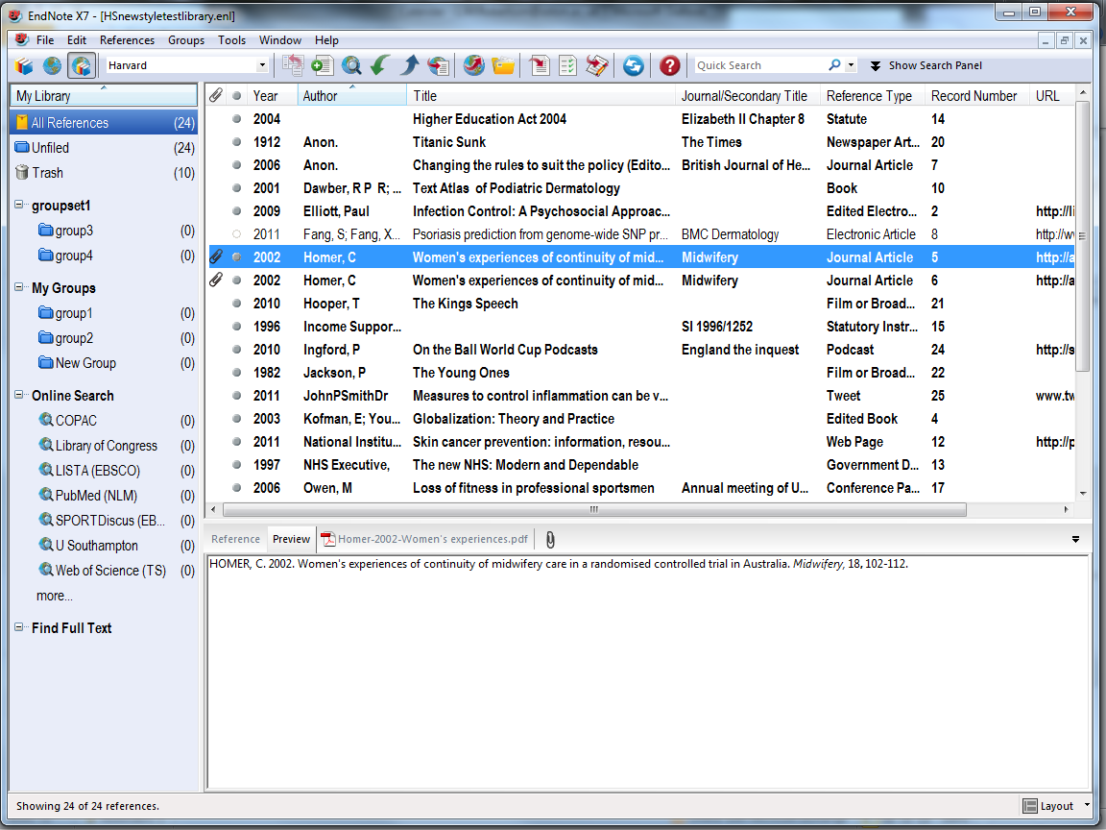
The library is now formatted in the selected Reference Style
Notes:
The EndNote Library is displayed in the new reference style.
The reference style can also be modified - changes will be saved to an EndNote folder in 'My Documents' so that they are automatically accessed next time the EndNote library is opened.

Slide 25
Find and use UoS styles

Slide 26
Some faculties in the university have specific reference style requirements
EndNote styles are available for Medicine, Health Sciences and Management.
Find these on the EndNote Library guide or on individual subject guides

Slide 27
EndNote styles are available on all UoS public workstations, and on EndNote online
If your department uses Harvard, but does not have specific requirements, then use the style
Harvard_SotonUNI2013

Slide 28
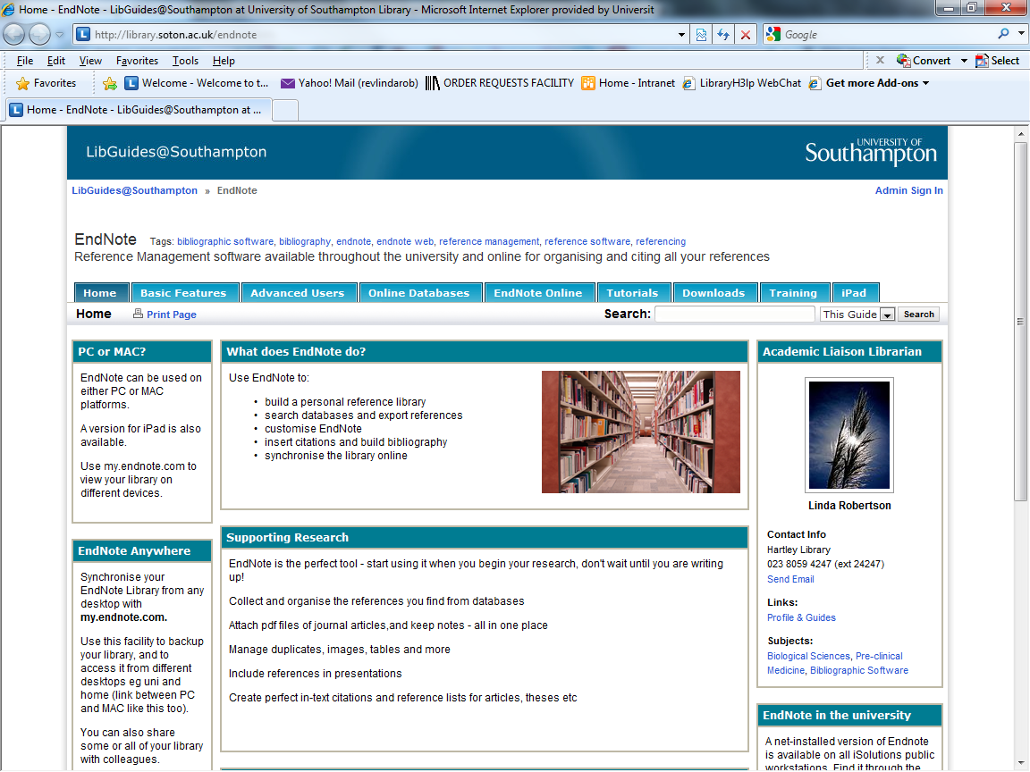
Go to the Downloads tab
Notes:
To download individual style files to your own computer, go to the Downloads tab on the EndNote library guide.

Slide 29
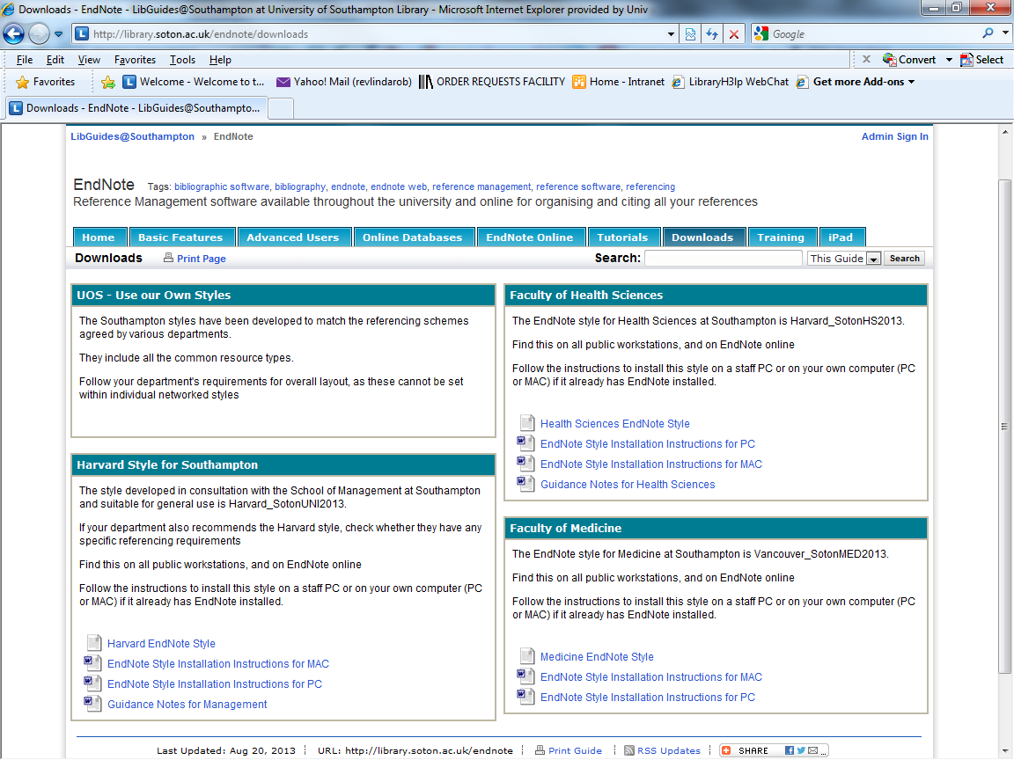
UoS style for Health Sciences
UoS style for Medicine
Notes:
This page has style files and instructions for saving the file to your own computer. Follow the same procedure for staff MDE computers

Slide 30
UoS general Harvard style
Additional notes for Management
Notes:
Find the UoS general Harvard style on this page, with additional notes for the School of Management.

Slide 31
The style file should be saved within the EndNote program:
Find this at:
My Computer  OS disk (C:)  Program Files (x86)  EndNote X7  Styles
Notes:
EndNote Styles must be saved in the correct location. They will then be displayed with other available styles.

Slide 32
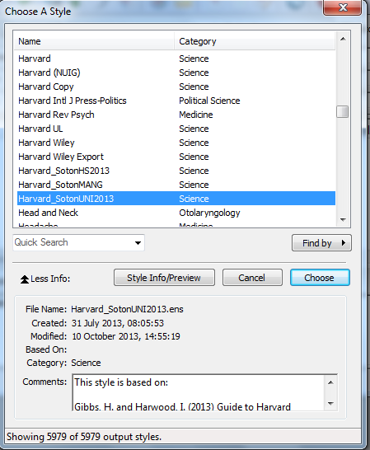
Select the required style
Notes:
In the EndNote program, go to Choose another style to see the specific styles displayed.

Slide 33
Edit the reference style

Slide 34
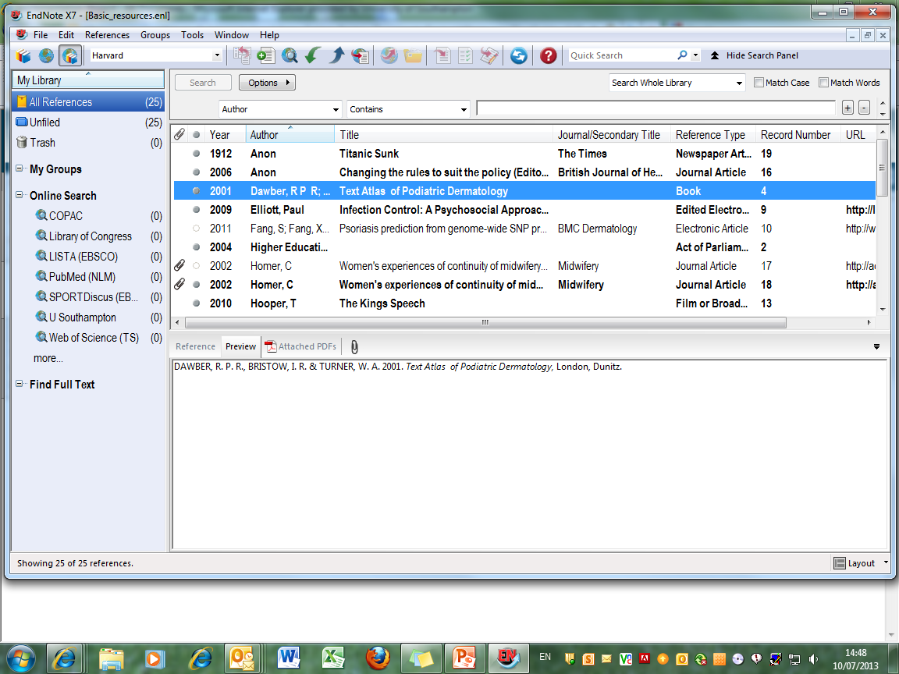
It may be necessary to edit the existing reference style
Notes:
Some faculties require variations to standard referencing styles. Harvard in particular is used in a number of slightly differing formats. The Faculty of Health Sciences has its own EndNote style: Harvard_SotonHS2013. A more general university style, also adopted by the Management School, is Harvard_SotonUNI2013.

Slide 35
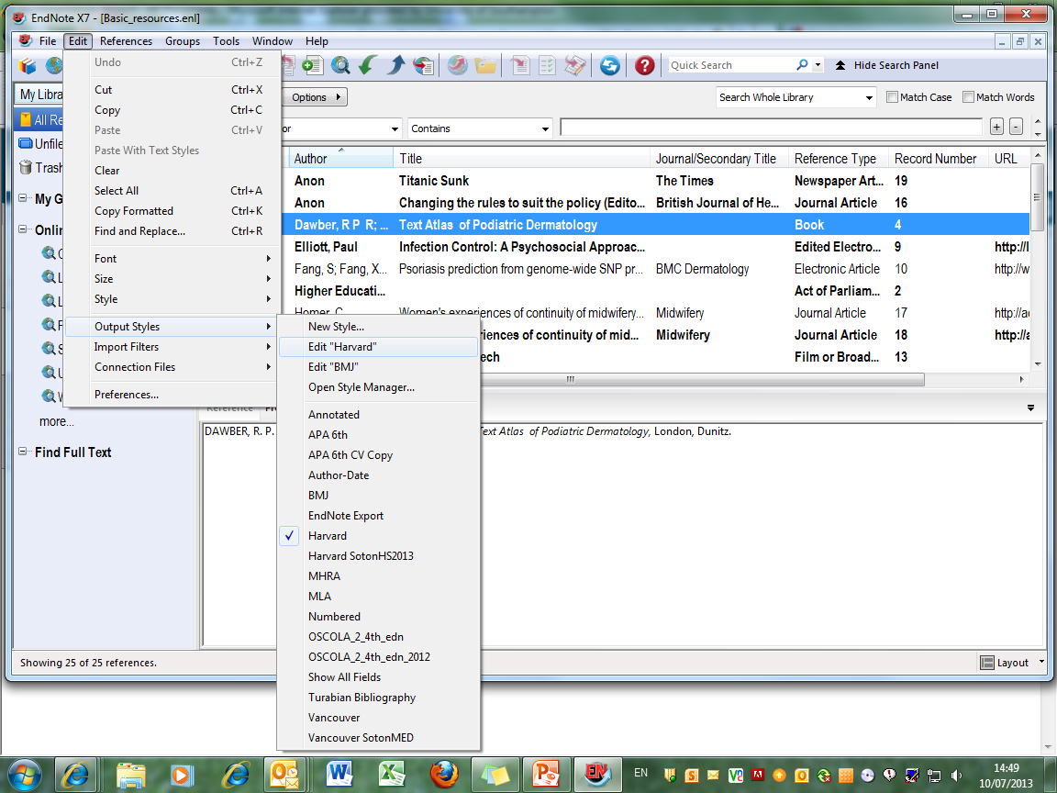
Go to 'Edit ➔ Output Styles ➔ Edit "Style"
Notes:
To Edit the current style, go to Edit, Output Styles, Edit "Current Style", in this case Harvard.

Slide 36
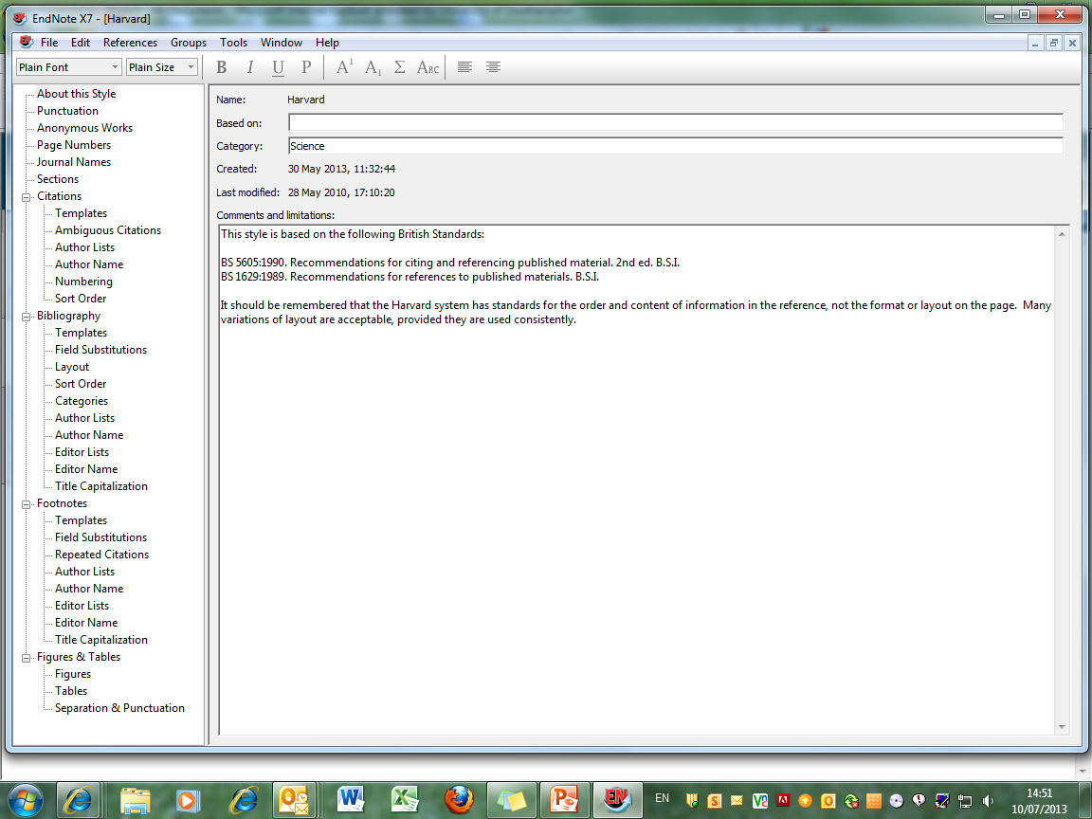
This window controls all aspects of the referencing style
Notes:
This window controls all aspects of the referencing style: there are sections for in-text citation, full bibliographic references, and also for footnotes, which are used by some referencing styles.

Slide 37
Edit the reference style - citations

Slide 38
Go to Edit  Output Styles  Edit 'Harvard'
Notes:
To edit the referencing style, go to Edit, Output styles, Edit "Reference Style", in this case, Harvard.

Slide 39
Any element of the citation, bibliographic record or footnote can be edited using this page
Notes:
This window allows you to edit all aspects of the Endnote bibliographic record. The main groups are Citations which are the short references within the written text, Bibliography which is the list of full references at the end of the document, and Footnotes, which are used at the bottom of individual pages in some referencing systems.

Slide 40
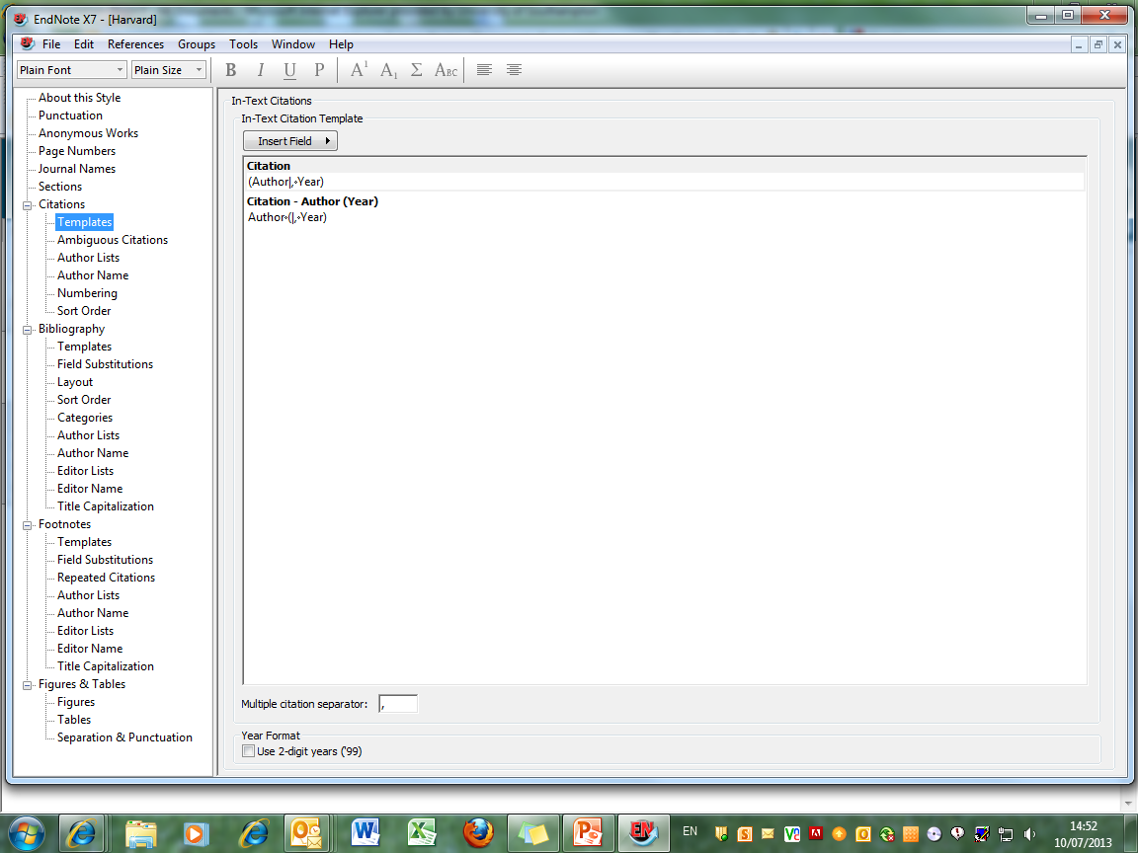
When all changes have been made, click the record 'close' icon
Notes:
Click Citations then Templates to see how this tool works. The operation of other fields is similar to those described in the Format Bibliography section.
In this example, EndNote picks up the contents of the 'Author' field from the record, adds a comma, then the contents of the 'Year' field and encloses everything in brackets.
The vertical line links the following punctuation to the next field, so that if the field is empty, you do not get stray punctuation in the record.
Make any changes you require, and then click the close record icon.

Slide 41
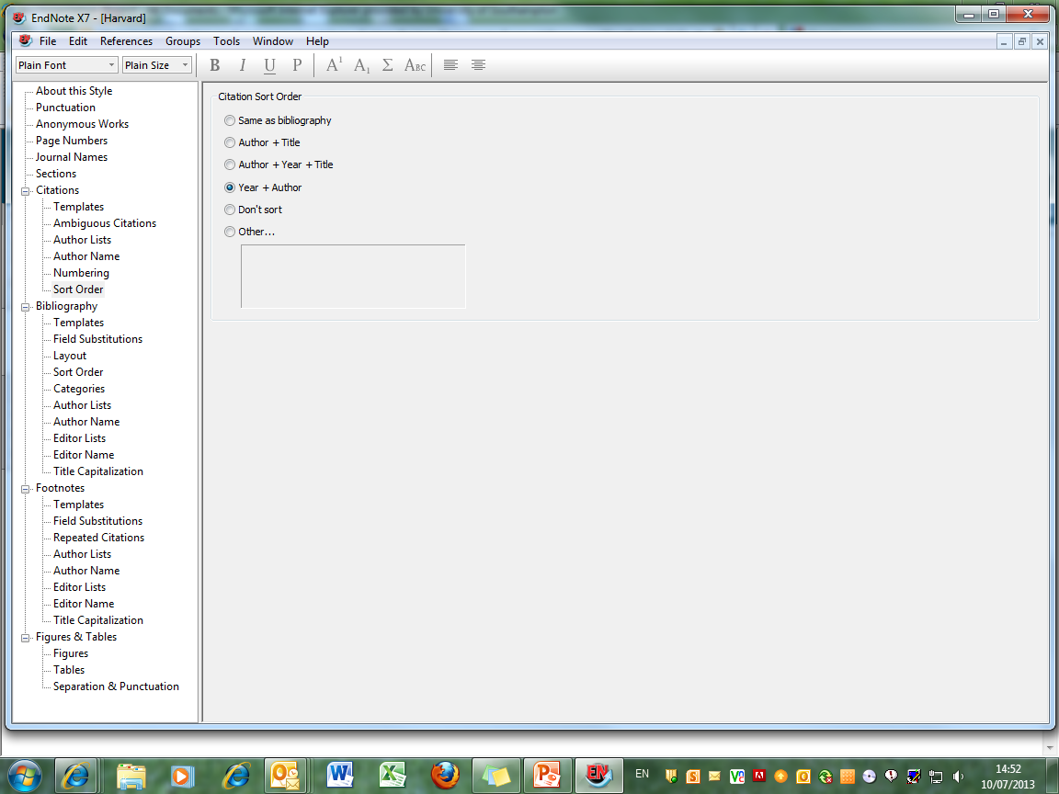
Choose preferred citation sort order here
Notes:
Use this option to edit the in-text citation sort order.
The default order is 'Don't sort'
If you have multiple citations at single points in the text, you may wish to arrange these either alphabetically or chronologically. Choose the relevant option from the list.

Slide 42
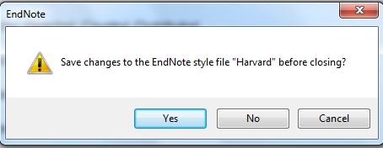
Click 'Yes' to save changes
Notes:
Click Yes to save the changes.

Slide 43
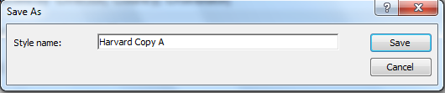
Save with the default Style name or use your own
Notes:
You will be prompted to save the edited style with a new name.
This edited style will then appear in EndNote's reference style list and can be applied to any EndNote library. This style is stored in your university profile, so can be accessed at any time from any public workstation.

Slide 44
Edit the reference style - bibliography

Slide 45
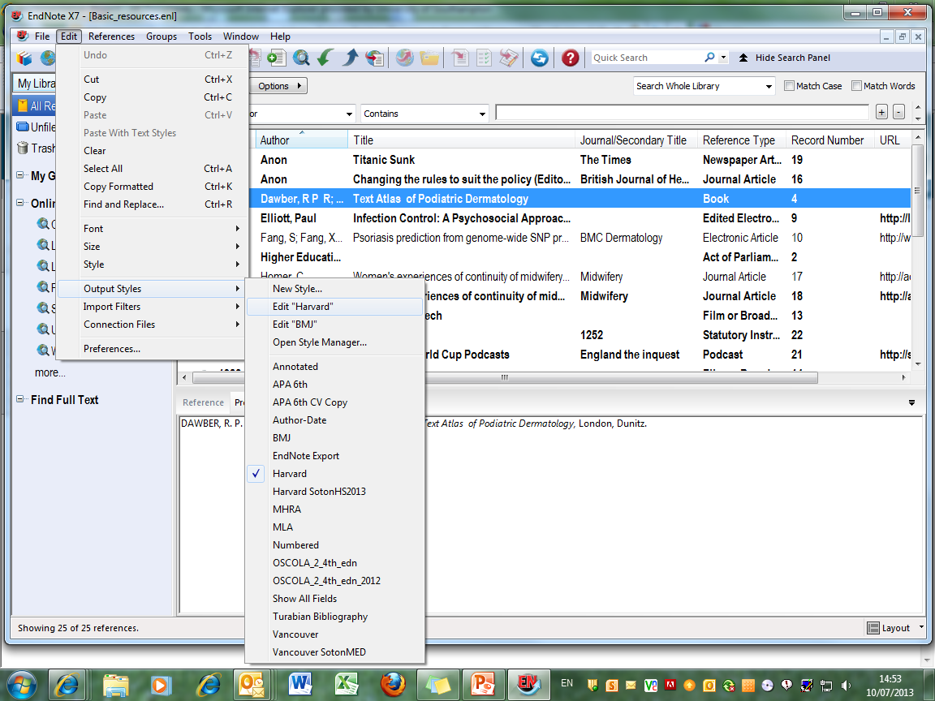
To format the bibliography, go to 'Edit  Output Styles  Edit 'Harvard''
Notes:
To make changes to the way the bibliography is displayed, go to Edit, Output styles, Edit "Reference Style", in this case, Harvard.

Slide 46
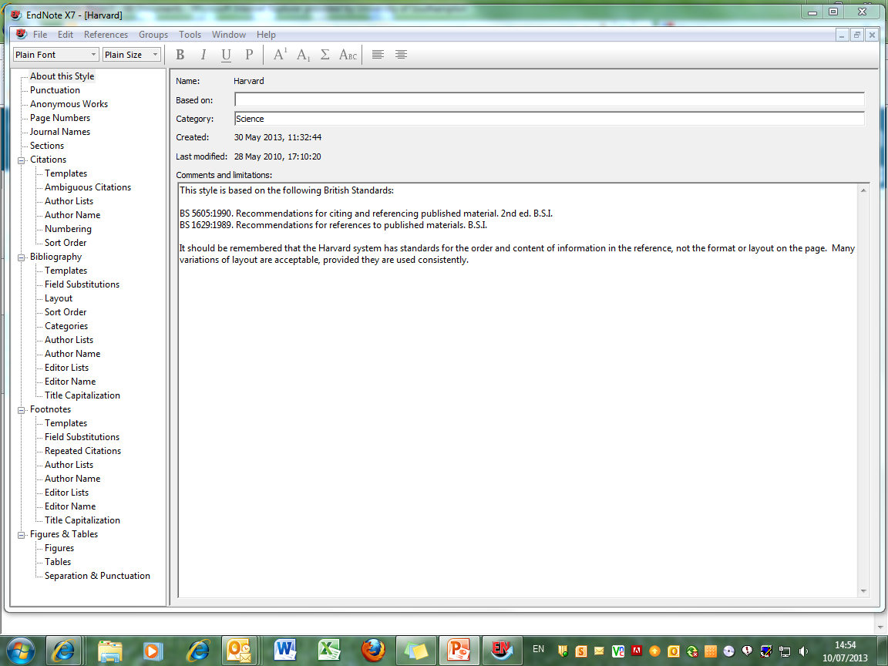
This section allows you to change different elements of the bibliographic record
Notes:
The bibliography section allows you to control the appearance of the various elements in the bibliographic record.

Slide 47
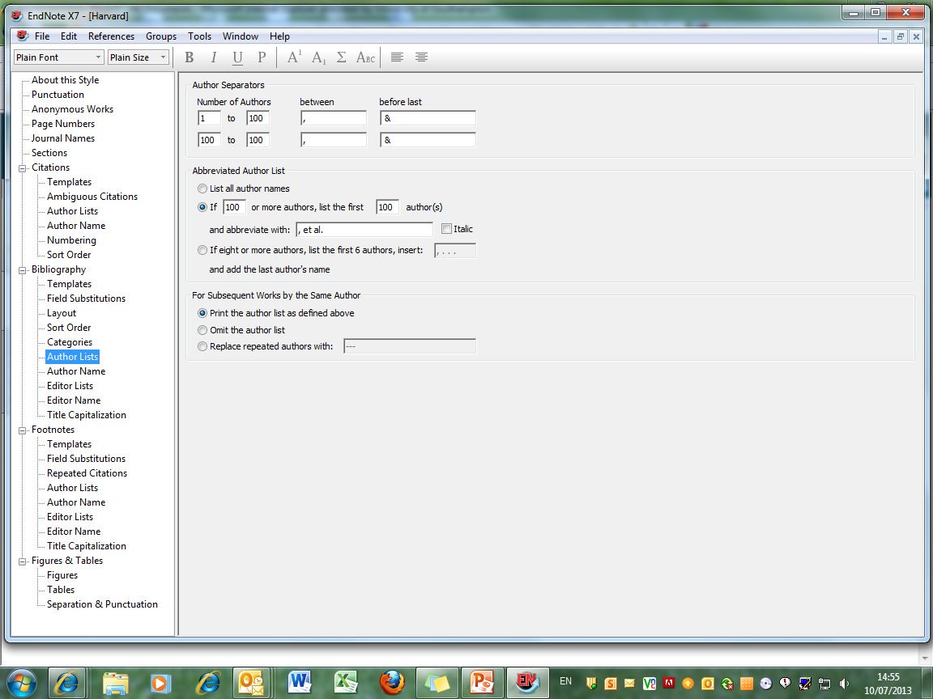
'Author Lists' lets you control how many authors are displayed
Notes:
The Author Lists section allows you to control how many authors are displayed, and the separating punctuation.
Any changes to Author Lists must be replicated in Editor Lists.

Slide 48
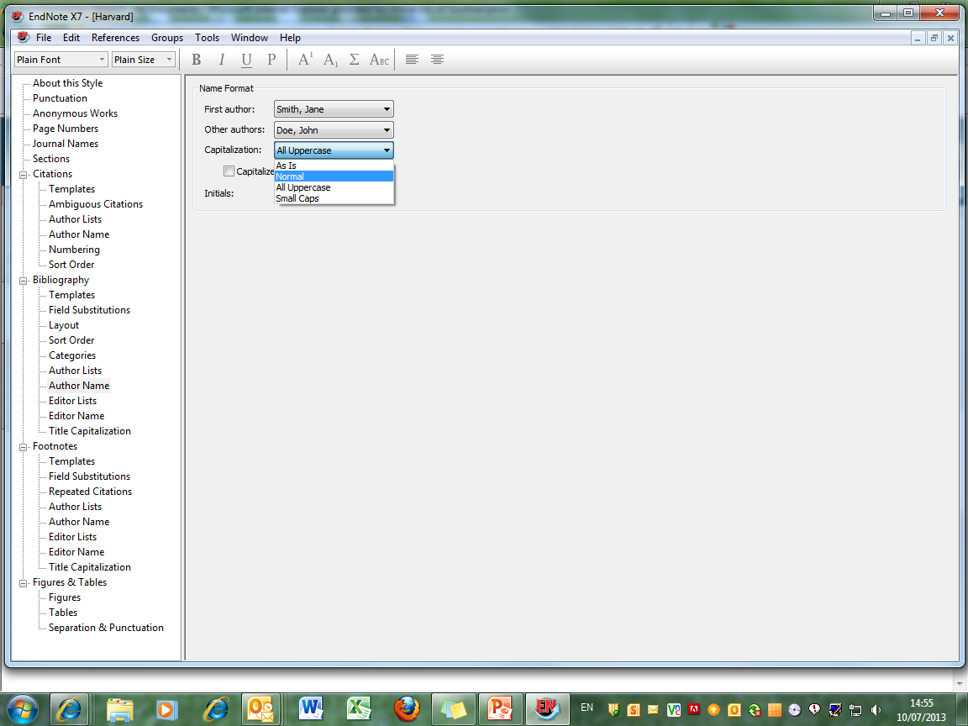
'Author Name' allows choices about capitalisation - choose 'Normal' for names in lower case but with initial capital letters
Notes:
Changes to Author Name must be replicated in Editor Name.
These windows allow you to make choices about capitalisation - the default is All Uppercase. Choose Normal for names in lower case but with initial capital letters.

Slide 49
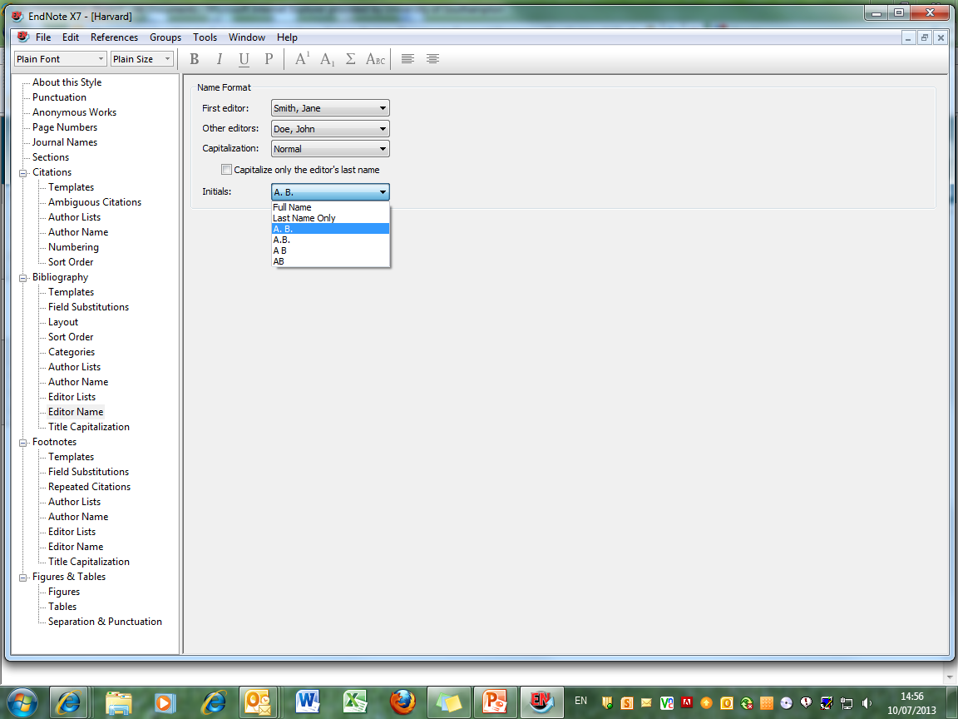
Make choices about the punctuation of initials
Notes:
Choices can also be made about the display of initials: with or without full-stops, with or without spaces between.

Slide 50
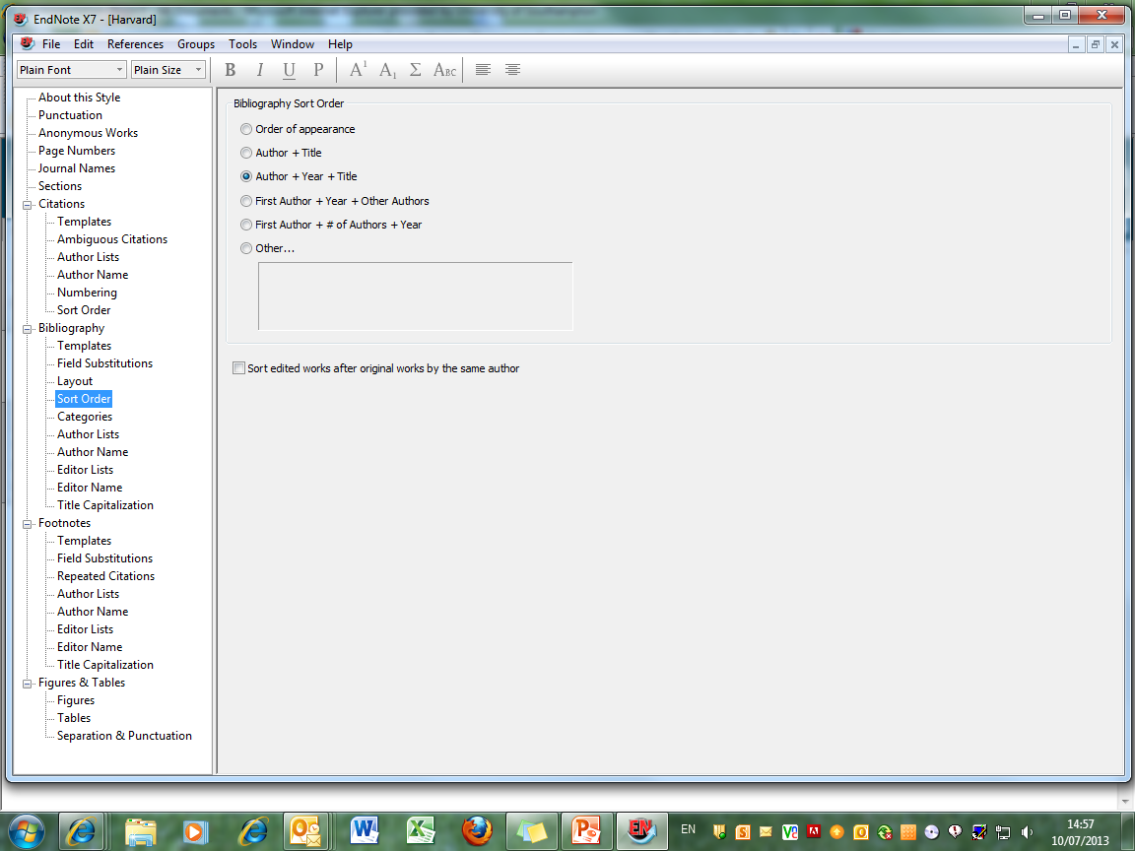
Choose the order in which bibliographic records are displayed…
Notes:
Control the order in which bibliographic records are displayed -this is normally by author, year, title, but it is possible to sort according to any field in the EndNote record. To do this, click Other.

Slide 51
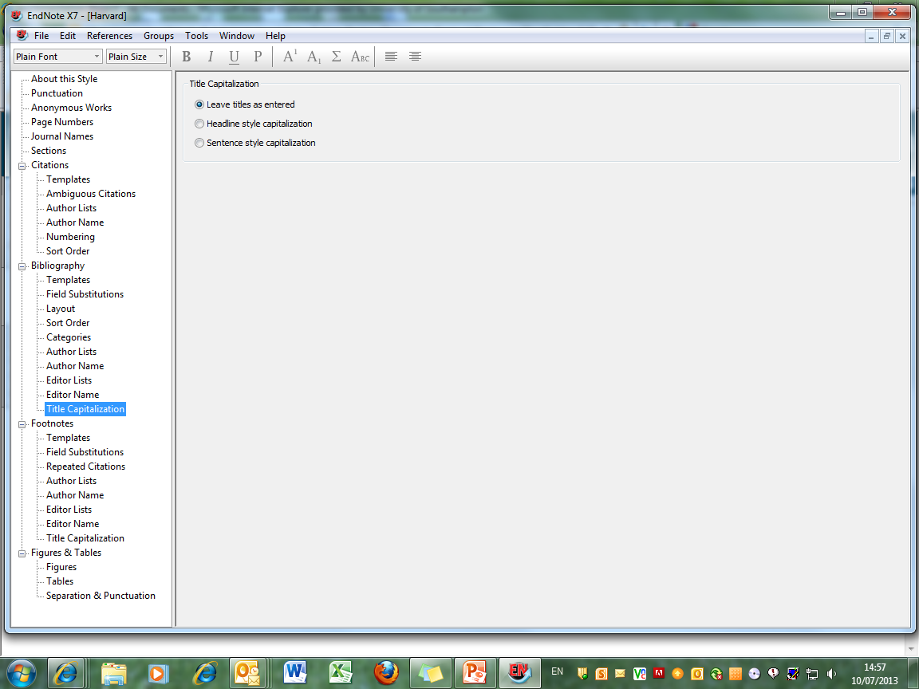
The Title Capitalization control applies to all primary titles in the EndNote Library
Choose 'Headline Style' to capitalize major words, 'Sentence Style' for initial words only, or leave titles as they were typed in.
Notes:
Choose the style for primary title capitalisation - Headline style will capitalise all major words, Sentence style will capitalise the initial word only.
Note that the same style will be applied to all records in the library: if the conventions for book titles and journal article titles differ, you may wish to leave titles as entered.

Slide 52
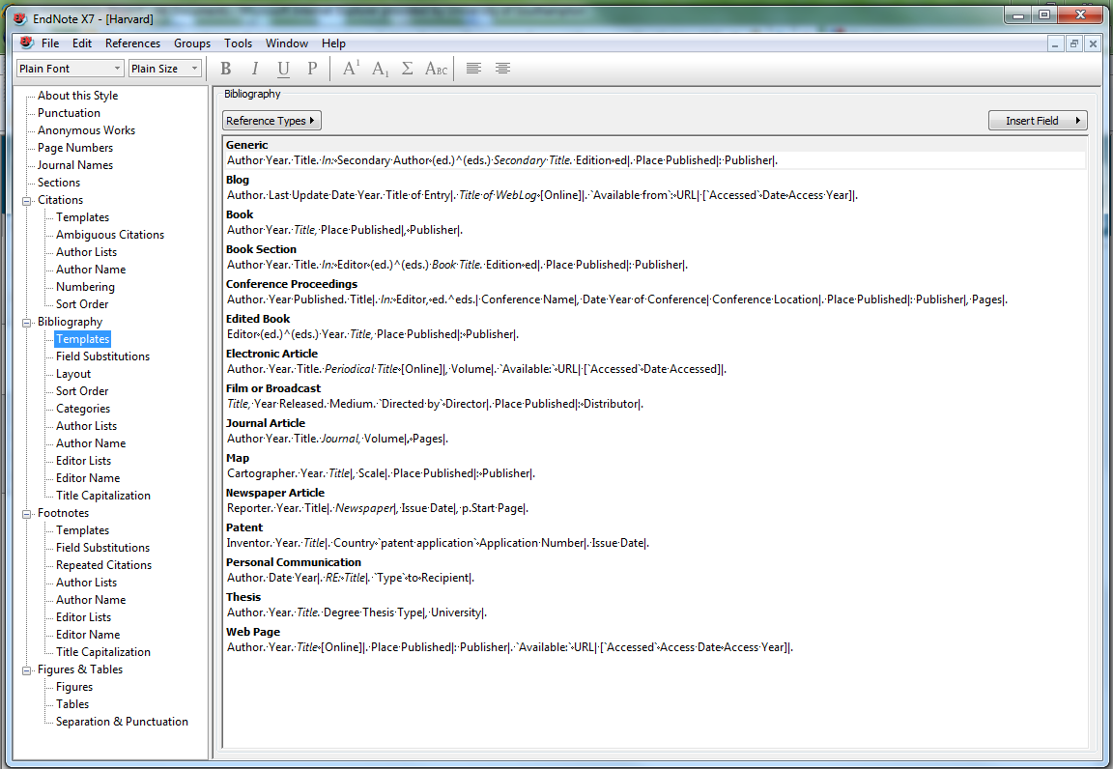
'Generic' is used for any Reference Type without a specific template
Further Reference Type templates can be created, or existing templates edited
The templates show which fields will be used from the EndNote record, and how they will be displayed, for a range of Reference Types
Notes:
The Templates window shows how the bibliographic record will be displayed for a wide range of reference types. More can be added, by clicking the Reference Types button and creating a template on the principles of existing types.
Generic is used for any reference type which does not have a specific template.
In the templates, where the name of an EndNote record field appears, this will be replaced by the contents of that field, according to the format in the template (bold, italic etc) Other characters are displayed as typed. Field Names are case-sensitive.
The vertical bar links punctuation to the next field, so that if there is no data in a given record field, stray punctuation is eliminated. The ^ means that Endnote will choose whether to display the singular or plural option according to the number of authors/editors.

Slide 53
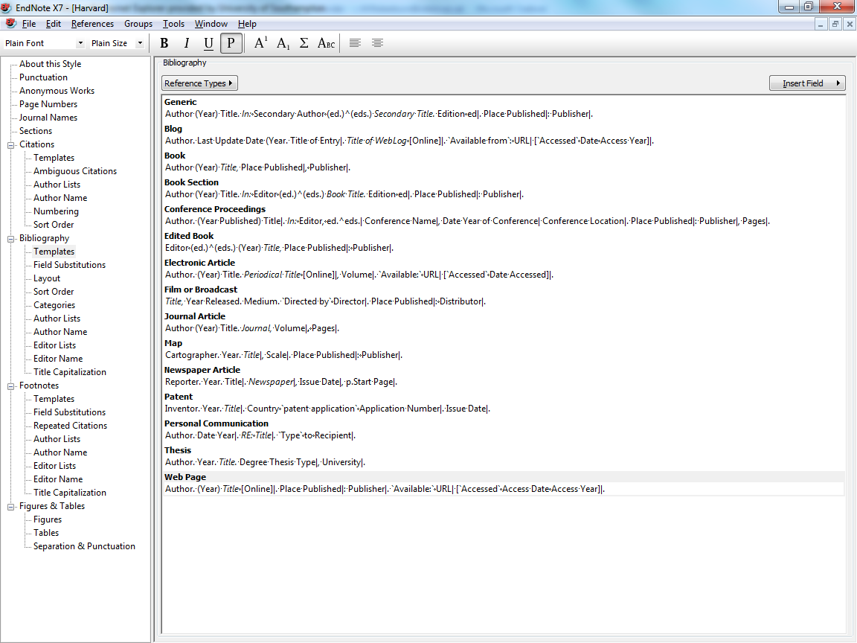
Click the record's 'close' icon (the grey cross) to save the changes automatically
Here the Year field has been edited to include brackets for all Reference Types, including Generic, likely to be used
Notes:
Existing reference type templates can be edited, for example, displaying the year in brackets or inserting the issue number in the journal article template.
It is not necessary to edit Reference Types that will not be used, but Generic must always be included.
In this case the Year field has been edited for some Reference types.
When all changes have been made, click the record Close icon.

Slide 54
Click 'Yes' to save changes
Notes:
You will be prompted to save the edited style with a new name.

Slide 55
Save with the default Style name or use your own
Notes:
The original reference style remains unchanged, but a variation is created.
This edited style will then appear in EndNote's reference style list and can be applied to any EndNote library. This style is stored in My Documents, so can be accessed at any time from any public workstation.

Slide 56
Apply an edited reference style

Slide 57
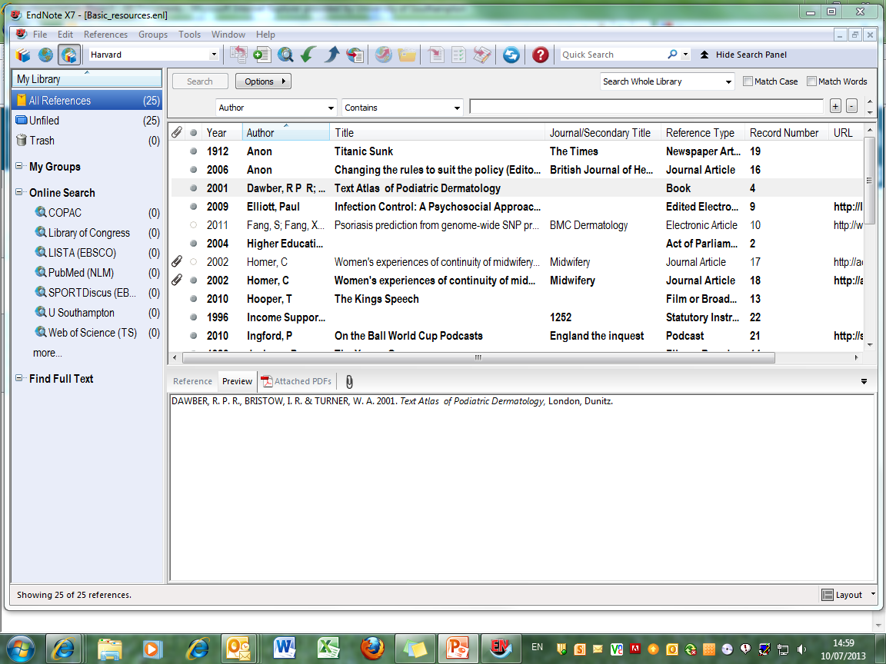
Changes to a Reference Style are not automatically applied:
Notes:
Changes to the Referencing Style are not automatically applied to the EndNote Library. To apply changes, go to the Reference Style dropdown menu and choose Select another style.

Slide 58
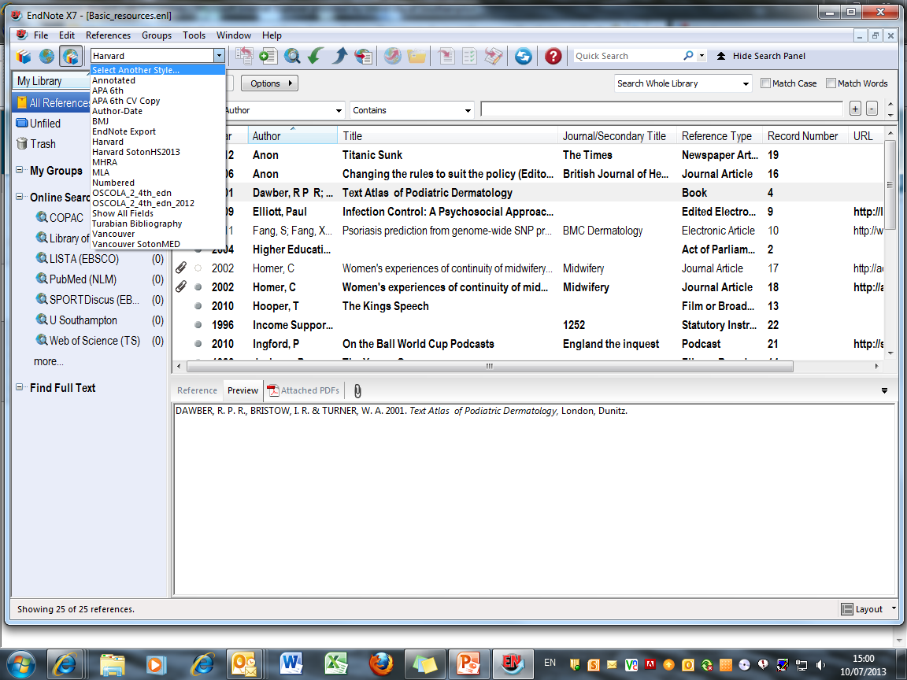
Go to the Reference Style dropdown menu and choose 'Select Another Style'

Slide 59
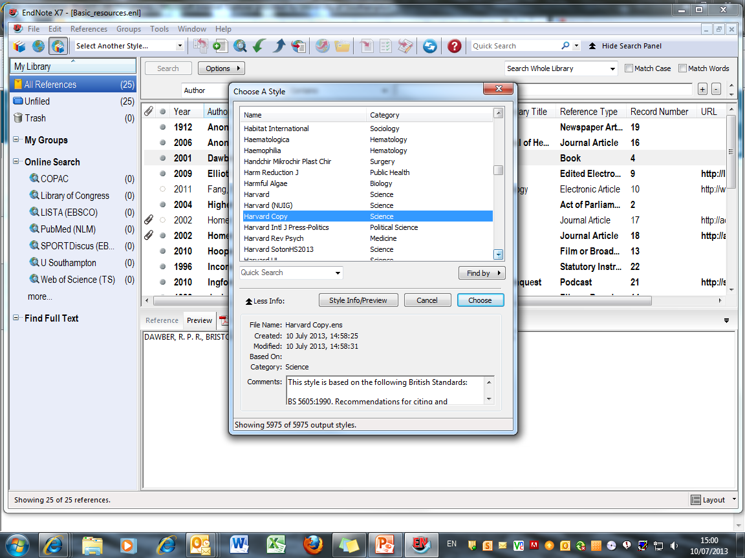
Select the style and click 'Choose'
The edited reference style now appears in the Style list
Notes:
The edited style is now one of the choices - select and click Choose.

Slide 60
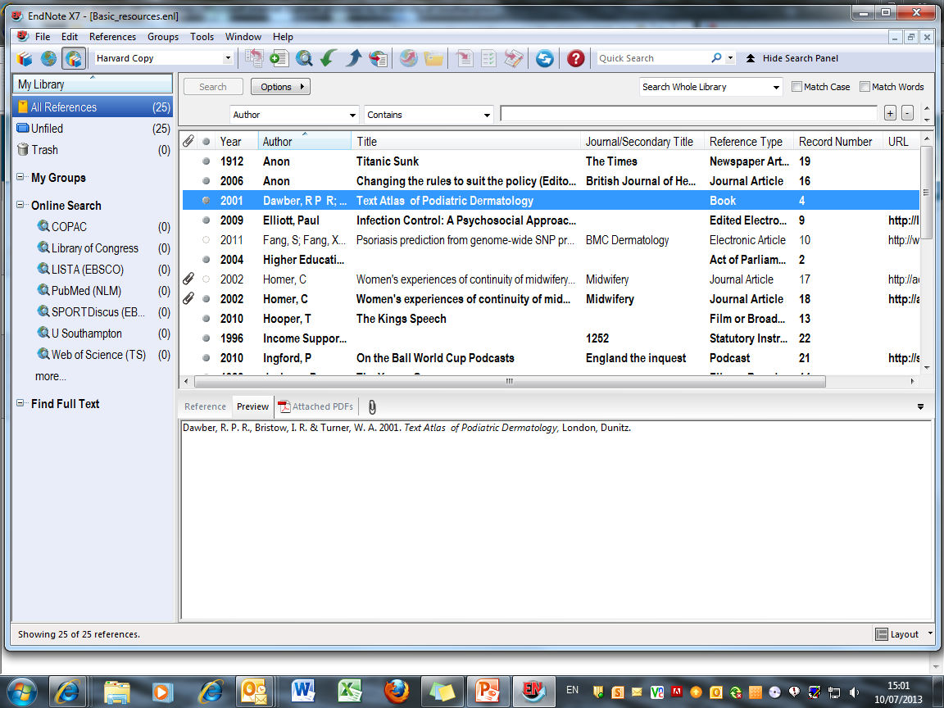
Changes to the Referencing Style are applied
Further edits to the style can be made at any time
Notes:
The edits are now applied to the EndNote Library.
Further changes can be made at any time, and the same copy style updated and then applied again to the library concerned. If references from the Library have already been used in a document, new changes can only be applied by using the Format Bibliography option in Word.

Slide 61
Set some EndNote preferences

Slide 62
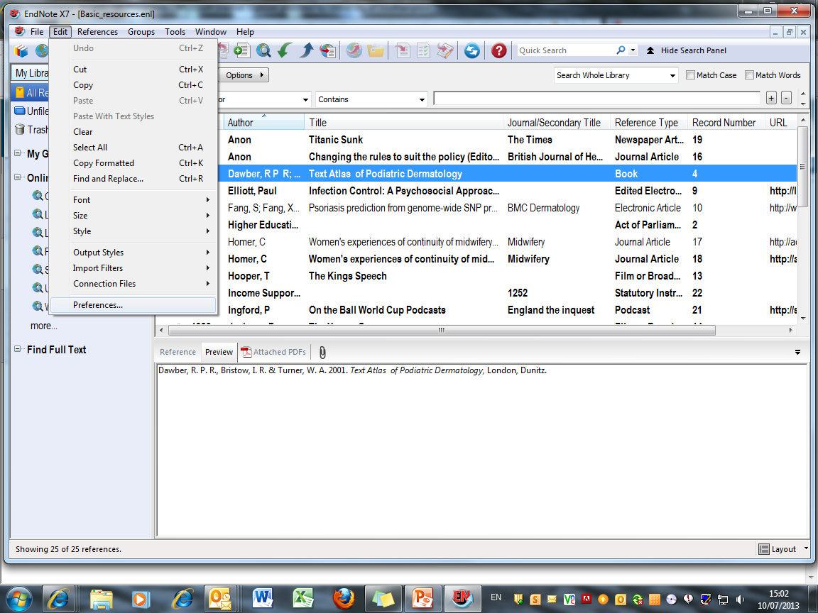
To manage the appearance of the EndNote Library, go to Edit  Preferences…
Notes:
Preferences control how the EndNote Library itself appears, rather than the individual records. To see the options, go to Edit, Preferences.

Slide 63
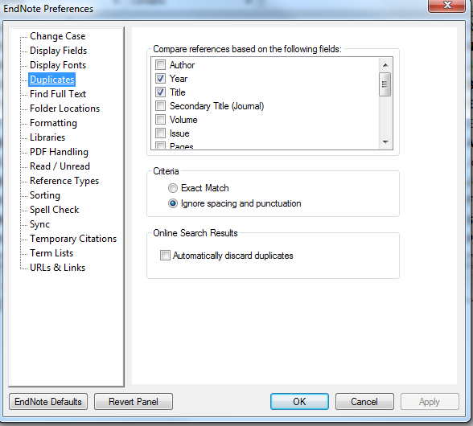
Use the 'Duplicates' option to set criteria for comparing records
Notes:
Use the Duplicates option to set criteria for comparing possible duplicates. The default comparisons are Author, Year,Title and Reference Type. Because databases list author names differently for the same publication, it is best to uncheck the Author option.

Slide 64
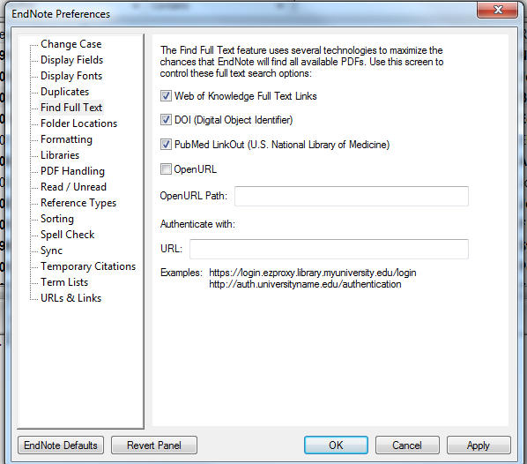
Use the 'Find Full Text' option to optimise full text retrieval: ensure these three options are checked
Notes:
The Find Full Text option searches for the full text of articles already in the EndNote Library. To maximise the number of records retrieved, ensure that Web of Knowledge, DOI and PubMed options are all checked.

Slide 65
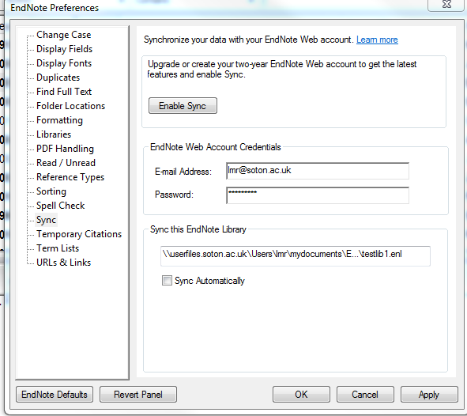
Use your Web of Knowledge login to synchronise the library between desktop and web

Slide 66
Sort references into groups

Slide 67
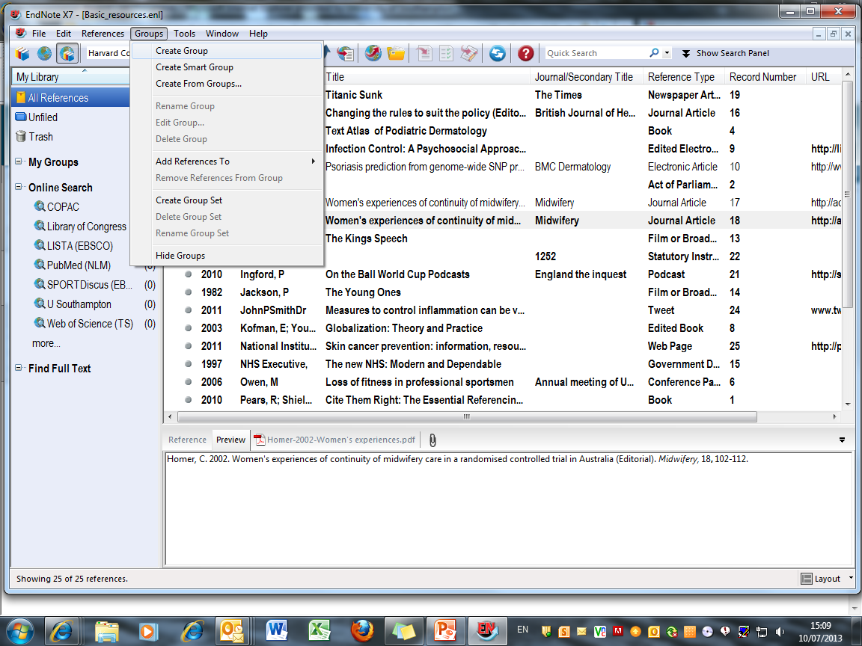
Click to Create a Custom Group
Notes:
The best way of managing a large EndNote Library is to create sub-libraries, or groups. Up to 5000 groups can be attached to a single library.
Groups can be custom groups or Smart groups.
Any item in the main library may be included in a custom group.
Smart groups are given set criteria - any item fulfilling these criteria is automatically added to the group. The criteria can be modified at any time. The criteria for a new Smart group will be applied to the existing EndNote Library, and to any items that are added subsequently.
All entries are included in the main EndNote library: they may be copied into more than one group, or be entries in more than one Smart group.
Deleting a record from a main library removes it from all groups: deleting a record from a custom group does not remove it from the main library or from other groups. It is not possible to delete an item from a Smart group.
To create a Custom group, go to Groups, Create Group.

Slide 68
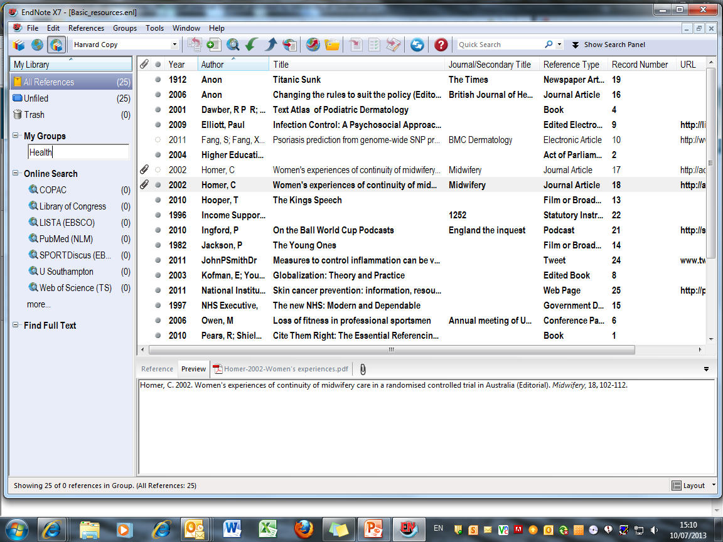
The group can be named, and managed by rightclicking
Notes:
Name the group. The new group is displayed in the My Groups panel. Options to manage the group are available on right-click.

Slide 69
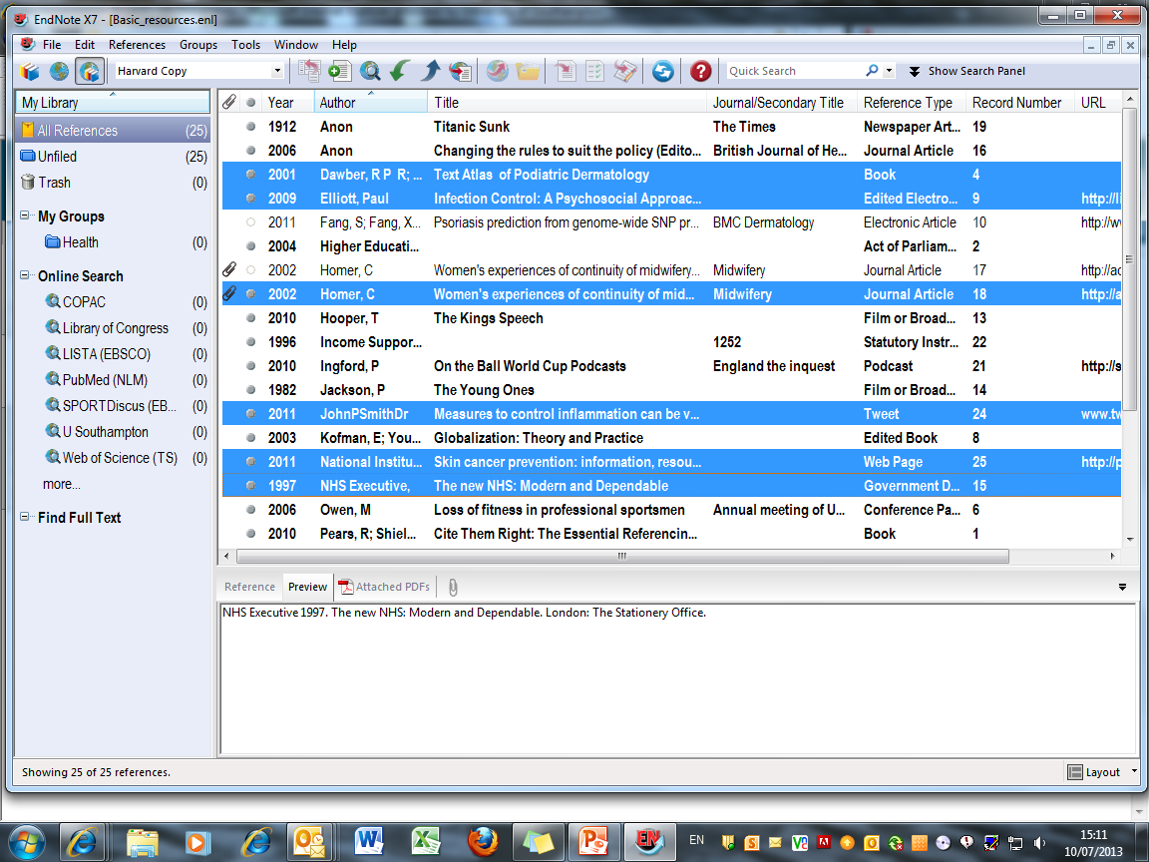
Drag selected records on to the group name to add the records to the group
Notes:
Select the records to be added to the group, and drag on to the group name.

Slide 70

Add or remove records in Custom Groups at any time
Notes:
Custom groups can be populated manually at any time. Records deleted from groups are not deleted from the main library

Slide 71
Working with Smart Groups

Slide 72

Go to Groups ➔ Create Smart Group
Notes:
Smart groups are created by setting criteria which apply to every item in the group. Go to Groups, Create Smart Group.

Slide 73

Set criteria for any Endnote field
Notes:
Criteria can be set for any field in the EndNote record, including pdf text and sticky notes.

Slide 74

Use Boolean operators to combine search terms
Notes:
Use Boolean operators And/Or/Not to combine search terms. Additional lines for further search terms can be added if required.

Slide 75

Notes:
Whenever a Smart Group is created, the entire EndNote library and any subsequent entries will be copied automatically into the Smart group. If an individual item is deleted from a Smart group, it will also be deleted from All References. If an entire Smart Group is deleted, the references remain in the EndNote Library.

Slide 76
Back up the EndNote Library

Slide 77

Go to File ➔ Compressed Library (enlx)…
Notes:
It is best to back up the EndNote library for security and/or before synchronising with EndNote Web. This backup should not be used in parallel with the original library. Go to File, Compressed Library (enlx)….

Slide 78

Choose the references to back up and click 'Next'
Notes:
Choose to save with or without attached files. It is also possible to save references in a particular Group/Group Set. Make choices and click Next.

Slide 79

Select a location for the file and click 'Save'
Notes:
You will be prompted to save the compressed file. This will be saved with a .enlx extension, and zips together the Data folder and the .enl file for the library

Slide 80
Export database information to EndNote
Export references to a new or existing library or group
Connection files and import filters are used
Most databases (including DelphiS) export directly to EndNote
A number of databases export URL links as part of the record
The export process is common to all databases on a given platform
There is a separate process for searching any library catalogue
Notes:
Information can be exported directly from many databases into a new or existing library or group. The information from the database will populate the relevant fields in the EndNote record. This can include the abstract, and in many cases a URL link to the original database entry.
The EndNote export process uses connection files and import filters: all these are installed on public workstations. If you have purchased a copy of EndNote then additional files and filters can be downloaded from the supplier's website.
Some databases will provide automatic hyperlinks back to the original database record.
Every database operates on a 'platform' - all databases on a given platform export records in the same way.
Export directly from DelphiS or download from classic library catalogues including WebCat using a slightly different process -see the separate section.

Slide 81
Export from Web of Science

Slide 82

This is the Web of Science home page
Enter a search term - in this case 'diabetes' and click 'Search'
Notes:
This procedure applies to any database on the Web of Science platform.
It is best, but not essential, to open the EndNote library before starting the search.
Use the library website to access the Web of Science platform. In this case a search of the core collection has been chosen.
The instructions here are for exporting required articles to EndNote rather than conducting an effective search strategy.
Enter a search term, in this case 'diabetes' and click Search.

Slide 83

On the Results pages, click required items, then click 'Add to Marked List'
Notes:
When the search process is complete, click on the number of results to display the records. Check the boxes for any required records and save to Marked List.

Slide 84

Create a list of all required records from the search, then export the marked list
Notes:
Check the boxes for required records on each page and then click the Marked List icon to export to EndNote.

Slide 85

Save directly to EndNote from the Results page
Notes:
Choose to save directly to EndNote from any results page: choose the Send to EndNote desktop option from the dropdown menu.

Slide 86

There is no 'Selected Records' option here
Include the abstract or choose the full record
Notes:
Choosing the Send to EndNote option from the results page does not give an option to export selected records: be sure to choose the Author, Title, Source, Abstract or Full Record option. Note that choosing' Full Record and Cited References does not create separate records for the cited references, but merely exports the details to the Notes field.

Slide 87

It is helpful to include the abstract in exported records
Select fields to be included in output, then choose 'EndNote desktop'
Notes:
Select the fields to be included in the output (check the 'abstract' box as well) and then click EndNote.
Note 'Save to EndNote online' goes to the web version, which has more limited functionality.

Slide 88

Click on any imported reference to view details of the record
A temporary group 'Imported References' is created. The references have already been added to the main library
Selected references are imported to the open EndNote Library
Notes:
The records will import directly into the EndNote library. These become a temporary group of Imported References, but are already added to the main library of All References. The temporary group will be overwritten at the next import activity, or when the library is closed.
Double click on any of the imported references to view.

Slide 89

Scroll down the page
Notes:
Scroll down the page to see the full record.

Slide 90

Click the URL link to view the source record
Notes:
The URL field contains a hyperlink to the original database record.

Slide 91

The Web of Science database record is displayed
Notes:
Download the full text automatically (see next section) or go to the Full Text link: click the TDNet button to check for full text access, and download the PDF to attach to the EndNote library later.

Slide 92
Find full text of articles

Slide 93

For the best search, go to 'Edit ➔ Preferences'
Notes:
The Find Full Text option currently works between EndNote and Web of Science/PubMed to automatically download PDF files and attach these to the EndNote record for any papers which are either publicly available, or supplied free of charge through the database platform. This does not currently include papers from journals for which the university pays a subscription.
Ensure that all available search options are selected. Go to Edit, Preferences…

Slide 94

Choose 'Find Full Text' and check the WOK, DOI and PubMed options
Notes:
Choose the Find Full Text option and ensure that the Web of Knowledge, DOI and PubMed options are selected. It is not yet possible to use the OpenURL option to search subscription journals as well.

Slide 95

To search the whole library for free full text, select a single item, then go to 'Edit  Select All'
Notes:
To search all records in the EndNote Library, select one entry, then go to Edit, Select All.

Slide 96

Select 'Find Full Text  Find Full Text …'
Notes:
In the References dropdown menu, select Find Full Text, then Find Full Text …

Slide 97

EndNote searches Web of Science etc. for full text and attaches items found to the individual records
Notes:
EndNote works through the library, searching for full text and reports progress in the left hand pane. Any full text PDFs located are automatically attached to the File Attachments field of the individual EndNote record and denoted by a paperclip in the library or group window.

Slide 98

The .pdf file appears in the 'File Attachments' field
Notes:
Access the full text directly from the EndNote Library record.

Slide 99
Attach PDF files to records

Slide 100

Click the paperclip symbol
Notes:
PDF and other types of file such as word, Excel, graphics, can be attached to the EndNote record, using the File Attachments field.
On the References pane, click the paperclip symbol.

Slide 101

Browse to locate the required file
Notes:
Browse to locate a previously saved PDF file, in this case by Klein. Click Open.
Note that it is helpful to rename PDF files when saving from online resources so that they can be more readily identified for addition to the EndNote records.

Slide 102

Select and drag the PDF file on to the record in main library view
Notes:
If there are a number of records to be updated, it is helpful to save all the PDFs in a single folder and open this window alongside the EndNote Library.
Select the required PDF file and drag it on to the main library record as displayed in the main library view.

Slide 103

The file attachment symbol displays in the record
Notes:
The File Attachment symbol displays in the library window.

Slide 104

The .pdf file is added to the 'File Attachments' field in the record
Notes:
In either case, the PDF is added to the File Attachments field.

Slide 105
Use the PDF viewer

Slide 106

Select the required record and go to the PDF tab
Notes:
When a pdf file is attached to an Endnote record, the file name will be shown on the PDF tab. Click on this tab to view the pdf.

Slide 107

Click to view PDF in full screen
Use the PDF toolbar to navigate and annotate the document
Notes:
Use the PDF toolbar to copy, print, scroll through the document pages, magnify or rotate pages. It is usually easier to view the PDF to the right of the screen. Use the layout menu to change location.
The PDF can be viewed in full screen without needing to open the file from the EndNote record.
In the Reference panel, click the toggle icon at the top left.

Slide 108

Click to return to library view
Notes:
To return to EndNote Library view, click the icon on the left of the pdf toolbar

Slide 109

Highlight sections of the document
Notes:
Sections of the document can be highlighted - select and drag over relevant sections then click on the highlight tool on the PDF toolbar. Moving to another record in the EndNote library will generate a Save prompt: if the document is printed, this will include the highlights.

Slide 110

Add a sticky note at the selected location
Notes:
Sticky notes can also be attached: click the sticky note icon in the toolbar and then click the insertion point in the document. A timed and dated Notes window displays. Add further comments at any time. Moving to another record in the EndNote library will generate a Save prompt: the sticky notes will not be included if the document is printed, but the contents can be searched from within EndNote

Slide 111
Import folder containing PDFs

Slide 112

Complete folders of PDF files can also be imported
From the File menu, choose 'Import  Folder…'
Notes:
To import a PDF folder with PDF files begin by opening the library into which you want to import the references. From the File menu, choose Import Folder.

Slide 113



Locate the required folder, and choose the Import Option 'PDF'
Notes:
Click the Choose button to open the Browse for Folder dialog window. Select the needed PDF folder, and then click OK. If the selected folder lists sub-folders, click the Include files in sub-folders button. Select the PDF import option from the Import Option list. Leave the Duplicates list unchanged so that it will Import All (see separate section on managing duplicates). Click Import to import the files in the selected folders.

Slide 114

EndNote records are created with the PDF files attached
Notes:
When the import is complete, the new records are stored in the Imported References group, and will include bibliographic information given for the Digital Object Identifier (DOI) mined from the PDF file, such as title, author, volume, issue, page, year, and DOI. Check through the imported data to make sure it has imported as expected. The Imported References group is a temporary group that is replaced each time you import another set of references. It is removed when you exit EndNote (although the references remain in the library). To return all references to the library display (including the newly imported ones), choose Show All References from the References menu or click the All References group.
When more than one DOI appears on the first page of an article, the PDF will be imported and attached to the record, but bibliographic data must be created manually as EndNote cannot identify the primary DOI.

Slide 115
Export from Google Scholar

Slide 116

Click the cog and go to 'Scholar Preferences'
Notes:
Unlike the main Google search engine, Google Scholar enables references to be exported to Endnote. However, before any searches are carried out, check that Google Scholar is properly configured to do this. To do this click on the cog wheel and choose Scholar Preferences from the dropdown.

Slide 117

In the Bibliography Manager, select 'Show links to import citations into EndNote'
Click 'Save'
Notes:
Near the bottom of the page, is the Bibliography Manager section. Check that the Show links to import citations option is marked and that Endnote is chosen from the drop-down menu beside it. To return to the search screen, click Save.

Slide 118

Open the EndNote Library, and perform the Google Scholar search
Notes:
You can now perform a search. It is recommended that you open the EndNote Library before starting the search on Google Scholar.
This search is for material on the human genome.

Slide 119

Click the 'Import into EndNote' option
Notes:
Google Scholar produces a large number of results for this search. To import information from any of these websites into Endnote, select the Import into EndNote link that appears at the end of each entry.

Slide 120

Choose 'Open' to import the record
Notes:
In the File Download window, select Open.

Slide 121

The record is imported as a temporary group and is added to the main library of all references
Notes:
Bibliographic details are then imported into Endnote. These become a temporary group of Imported References, but are already added to the main library of All References. The temporary group will be overwritten at the next import activity, or when the library is closed.
Click on this reference in order to view its full record.

Slide 122

Bibliographic information is imported to EndNote

Slide 123

Note that only one record at a time can be exported from Google Scholar
Notes:
Google Scholar won’t allow you to import more than one reference at a time. To export more items from the ‘human genome’ search into Endnote then you will need to return to the Google Scholar search page and select the next reference required.

Slide 124

Search DelphiS
www.soton.ac.uk/delphis
Notes:
Access the library search tool Delphis via SUSSED, Libguides or the Library website. Enter search term(s) and click the Search button.

Slide 125

Selected items are displayed: click 'Go to Folder View'
Click 'Add to folder' for any required items
Notes:
Click the Add to folder icon for any required items. These are listed in 'Folder has items' but note that however many are selected, only three individual items will show. To see all selections, click 'Go to Folder View'

Slide 126

Select all required items, and click 'Export'
Notes:
On this page, select the items for export (or delete any not required), then click the Export button

Slide 127

Click 'Save'
Notes:
The default format is to EndNote: click the Save button

Slide 128

Click to go to database entry or resource
Notes:
The selected records are imported as a temporary group and also added to All References. The records include links back to the database, and where relevant to the actual item

Slide 129
Search the EndNote Library

Slide 130

Use the Quick Search box
Notes:
A quick search will search all the fields in the EndNote library, including pdf text and sticky notes.

Slide 131

Results are displayed as a temporary group
Notes:
Records are displayed as a temporary group.

Slide 132

Click to open the Search panel
… or click to show the search panel
Notes:
Choose whether to show or hide the search panel: use the control at the top right of the library screen.

Slide 133

Search any field in the EndNote record for a given term
Notes:
It is possible to search on any filed or combination of fields in the EndNote record: attached pdf's and sticky notes can also be selected - these appear above the Author field in the list.

Slide 134

Combine rows with AND, OR, NOT
Choose the relevant command from the dropdown list
Notes:
Combine rows: to select a range of years, or search on the stem of a word, use the commands in the dropdown box. Use the appropriate Boolean operator from the dropdown list. More rows can be added if required.

Slide 135

Search results are displayed as a temporary group
Notes:
Search results are displayed as a temporary group - to save the search, create a new group, and add these records to the group.

Slide 136
Managing duplicates

Slide 137

Notes:
Set your duplicate criteria in Edit, Preferences, Duplicates. Tick Automatically discard duplicates if you regularly import references from different sources. You may find it useful not to compare authors, as names can be indexed very differently by different databases.

Slide 138

Select 'All References'
Notes:
When an Endnote Library contains references drawn from various sources there is a likelihood that duplication of records will occur.
To look for duplicates within your existing Endnote Library, first of all go to All References.

Slide 139

From the 'References' dropdown menu, choose 'Find Duplicates'
Notes:
To check the Endnote Library for duplication, first click on References and then Find Duplicates.

Slide 140

Records are displayed side by side: choose which to keep, or Skip
Notes:
Endnote then carries out a search for duplicates. Each record it finds is displayed alongside its duplicate so that the two can be compared. Check to see whether these two records are indeed duplicates of each other as they may have been matched in error.
If you don’t wish to delete either record then click on the Skip button. Otherwise, click the Keep this Record button above the record that you want to retain: the other is then deleted. If you have been using the library for a while, it is wise to keep the earliest record as this may already have been cited in documents.
To avoid deleting a reference that you have already cited in a paper, it is advisable that you always delete the duplicate record that was most recently added to Endnote Library.

Slide 141

Fields which differ are highlighted
Notes:
For ease of comparison, any fields which differ between the two records are highlighted.

Slide 142
Use EndNote with Word

Slide 143
Insert citations in a document

Slide 144


Use EndNote with Word
The EndNote toolbar is displayed in Word
Insert citations, or manage bibliography from either toolbar
Use these icons to move between the EndNote library and the Word document
Notes:
Always open EndNote first and then Word. This causes the EndNote tab to display in Word.
Some icons occur on both toolbars allowing operation from either window.
The icon with the red down arrow is used to insert citations, and the one with green ticks to manage the bibliography.

Slide 145

Identify the point in the text to insert a citation
Click the EndNote icon to go to the EndNote Library
Notes:
EndNote inserts citations and creates a simultaneous bibliography at the end of the text. It is helpful to insert a page break.
In the Word document, select the point in the text to insert the reference.
Go to EndNote to select the required reference.

Slide 146

Insert the reference from this toolbar, then return to Word …
Click to highlight the required reference
Notes:
Click to highlight the required reference in the EndNote Library.
Click the red down arrow on the EndNote toolbar and then return to Word.

Slide 147

… or return to Word and click to insert the citation
The citation is displayed in the text, with the full reference at the end
Notes:
Alternatively, return to Word and click the red down arrow in the Insert Citation drop-down menu on the EndNote toolbar there.
The citation is inserted at the selected point in the text, and a full bibliographic record created at the end of the document.

Slide 148

A document citation folder is created
Notes:
EndNote creates a new folder of references cited in the current document.

Slide 149

… or go to the Insert Citation dropdown menu
Notes:
Alternatively, use the Insert Citation icon to find the reference you need

Slide 150

Enter search term, and click 'Find'
Choose required reference from the list and click 'Insert'
Notes:
Enter search terms and click Find.
Choose the required reference from the results list and click Insert.

Slide 151

Citations and references are displayed according to choices made within the edited reference style
Notes:
Multiple references can be inserted at a single point in the text: locate the cursor immediately to the right of the close bracket then select the reference from the EndNote library as before.
The citation will be included within the brackets and the full reference at the appropriate location in the end of document bibliography. Note that the sort order for citations and bibliography is determined by editing parameters in the referencing style.

Slide 152
Edit citations

Slide 153

Click in the citation to highlight and then go to 'Edit and Manage Citations'
Notes:
The common forms of editing are to add page numbers to a citation, to remove author and/or year from a citation, or to remove a citation altogether.
It is essential that all these changes are made using the relevant EndNote tools, so that linked field codes are also amended. Click in the citation to highlight it, then go to Edit and Manage Citations.

Slide 154

Highlight the specific citation
Change selection to remove author or year from the citation or show only in the bibliography
Click OK to complete the action
Notes:
Highlight the specific citation to be edited in the top panel.
To include an item in the bibliography without citing in the text, insert in the document, and then edit the citation to Show Only in Bibliography. Click OK. The citation disappears from the text but remains in the bibliography. This is useful for example for an edited book, where individual chapters by different authors are cited in the document. There is also an option for Author (Year) format in the text if required.

Slide 155

To remove a reference from the document, go to 'Edit Reference' and 'Remove Citation'
Notes:
To remove a record completely, go to Edit Citation, select the reference to be removed, click Remove Citation and then OK.
Both the citation and the full reference are removed from the document. Note that if the same source is cited elsewhere in the document, it will not be removed from the bibliography.

Slide 156

The citation and end of text reference are removed from the document
Notes:
The citation (and reference if not cited elsewhere) is removed together with hidden field codes.

Slide 157

To add page numbers to a citation, type the exact letter string required in the SUFFIX box, then click 'OK'
Notes:
To add page numbers to a citation, use the same Edit & Manage Citations tool. Select the required citation, then type the exact letter string, including any required leading/following spaces in the Suffix box, note, not in the Pages box. Then click OK.

Slide 158

The suffix text is attached to the citation
Notes:
The suffix text is added to the citation.

Slide 159

And the bibliography can be given a title - click for the 'Configure Bibliography' option
Go to the Layout tab, insert required heading and format the text if necessary
Notes:
Click to expand the Bibliography menu and provide a title for the bibliography.
Go to the Layout tab and type the required text in the Bibliography title box: the text can also be formatted if required.

Slide 160


Slide 161
Manage the bibliography layout

Slide 162

Expand the 'Bibliography' pane to see all options and use the 'Layout' tab
Notes:
Click to expand the Bibliography menu.
To make changes to the physical layout of the bibliography, go to the Format Bibliography icon and click the Layout tab.

Slide 163

… or remove the hanging indent
Insert a line space between references if required …
Click OK when all choices have been made
Notes:
This window lets you manage indents, the line spacing within a reference, and the line spacing between references.
To insert a single space between references, go to the Space after drop down list and choose Single.
Remove the hanging indent by changing to 0cm. Click OK when all choices have been made.

Slide 164


Slide 165
Synchronising with EndNote Online

Slide 166

Choose the Web of Science
Notes:
To set up an identity on the Web of Science, choose the database from the A - Z list.

Slide 167

Open the Web of Science
Notes:
Follow the Web of Science link.

Slide 168

Register on the Web of Science database…
Notes:
If you have not previously created a user area on Web of Science, follow the Register link.

Slide 169

Sign in to Web of Science
Notes:
On future occasions you can sign in using your email address and the password you have created (it is best not to use your university password, which changes every six months)

Slide 170

Select 'EndNote'
170
Notes:
Select the EndNote link.

Slide 171

Notes:
When the EndNote library has been synchronised, all references, and custom groups, will appear on the My References tab.

Slide 172

Go to 'Edit ➔ Preferences'
Notes:
To set up synchronising, in EndNote X7 go to Edit, Preferences.

Slide 173

Choose whether to enable automatic Syncing options
Notes:
Choose the Sync option.
Input the email address and password as used for Web of Science, and choose when you wish to sync the library automatically.
Then click Apply. If this option is greyed out on future visits, click OK.

Slide 174

Click the sync icon
Notes:
To synchronise the library manually at any time, and to set up sync, click the sync icon

Slide 175

Click 'Yes' to back up the library
Notes:
It is recommended that you backup the library before starting this procedure. This creates a compressed library - note that this will not be automatically updated.

Slide 176

Group and record numbers may not match
Notes:
The first synchronisation will take a long time - even with only a few references. Note that Smart groups are not synchronised.

Slide 177

Check Sync status at any time
Check 'Sync Status' at any time
Notes:
The sync status is displayed in the left hand panel. A blue symbol indicates that synchronisation is complete, red indicates that there are conflicts to be resolved, which might happen if changes had been made to a record in both EndNote and EndNote Web since the last synchronisation.

Slide 178
CWYW with EndNote Online

Slide 179

If you are using your own computer you will need the Cite While You Write Plug-In
Notes:
If you are using EndNote Web on your own computer, you will need to install the correct version of the Cite While You Write plug in. Follow the on-screen instructions.
Alternatively on a public workstation use the Preferences link on the EndNote tab in Word to change the Application to EndNote Web

Slide 180

Click the 'Insert Citations' icon
Identify the point in the text to insert a citation
Notes:
EndNote inserts citations and creates a simultaneous bibliography at the end of the text. It is helpful to insert a page break.
In the Word document, select the point in the text to insert the reference.
Go to Insert Citations to select the required reference.

Slide 181

Insert Author or keyword in the search box and click 'Find'
Select required reference from those listed and click 'Insert'
Notes:
Use Author or Title keywords in the search box and click Find to show the required reference. All matching references are retrieved. Highlight the reference needed and click Insert.

Slide 182

The citation is displayed in the text, with the full reference at the end
Notes:
The citation is inserted at the selected point in the text, and a full bibliographic record created at the end of the document.

Slide 183

Change the reference style here if required
The bibliography is sorted as more citations are added
Notes:
Multiple references can be inserted at a single point in the text: locate the cursor immediately to the right of the close bracket then find the reference from the EndNote Web library as before.
The citation will be included within the brackets and the full reference at the appropriate location in the end of document bibliography. Note that the sort order for citations and bibliography is set within the referencing style.
The Reference style for the document can be changed within Word, or by using the Format tab in the Bibliography window.

Slide 184
Edit citations

Slide 185

Click in the citation, then go to 'Edit Citations'
Notes:
The common forms of editing are to add page numbers to a citation, to remove author and/or year from a citation, or to remove a citation altogether.
It is essential that all these changes are made using the relevant EndNote tools, so that linked field codes are also amended. Click in the citation to highlight it, then go to Edit Citations.

Slide 186

To add page numbers to a citation, type the exact letter string required in the SUFFIX box, then click OK
Notes:
To add page numbers to a citation, select the required citation, then type the exact letter string, including any required leading/following spaces in the Suffix box, note, not in the Pages box. Then click OK.

Slide 187

The suffix text is attached to the citation
Notes:
The suffix text is added to the citation.

Slide 188

To remove a citation completely, go to 'Edit Citation(s)'
Highlight the required reference, and choose 'Remove Citation' from the dropdown menu
Notes:
To remove a record completely, go to Edit Citation(s), select the reference to be removed, click Remove Citation and then OK.
Both the citation and the full reference are removed from the document. Note that if the same source is cited elsewhere in the document, it will not be removed from the bibliography.

Slide 189
Manage the bibliography layout

Slide 190

Click to go to the 'Format Bibliography' tab
Notes:
To make changes to the bibliography layout, go to the Bibliography tab and click to expand.

Slide 191

Use the 'Layout' tab
Notes:
To make changes to the physical layout of the bibliography, go to the Format Bibliography icon and click the Layout tab.

Slide 192

Reduce the hanging indent…
… and insert line spaces between references
Notes:
This window lets you manage indents, the line spacing within a reference, and the line spacing between references.
To insert a single space between references, go to the Space after drop down list and choose Single.
Remove the hanging indent by changing to 0cm. Click OK when all choices have been made.

Slide 193


Slide 194
Get more help
Find library guides at
http://library.soton.ac.uk/endnote
www.edshare.soton.ac.uk
EndNote Help pages
Contact libenqs@soton.ac.uk

