Slide 1
EndNote X7 - advanced graduate session

Slide 2
Work with the EndNote Library

Slide 3
Edit the reference style - footnotes

Slide 4
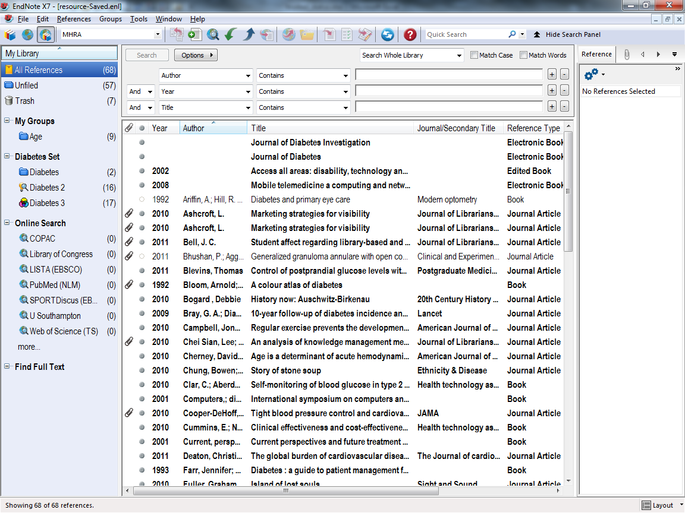
It may be necessary to edit the existing reference style
Notes:
Some schools require variations to standard referencing styles. Harvard in particular is used in a number of slightly differing formats. Footnoting styles such as MHRA may have quite complex referencing requirements.

Slide 5
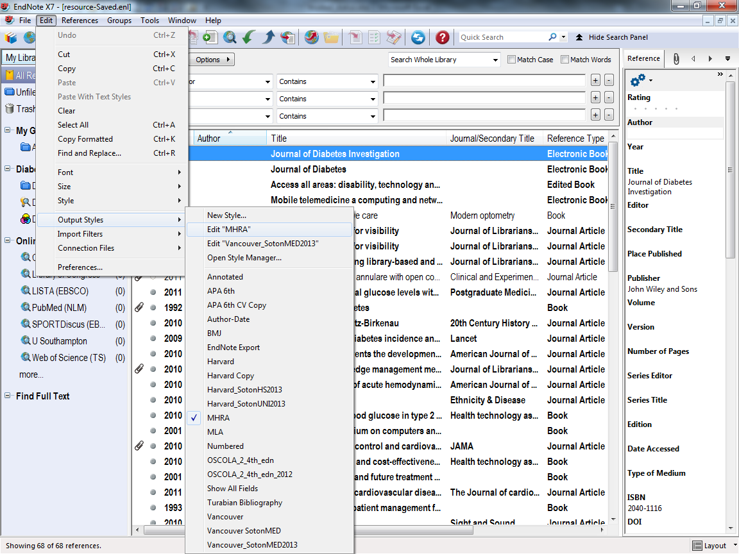
To format the bibliography, go to 'Edit  Output Styles  Edit 'MHRA''
Notes:
To access the referencing style formatting window, go to Edit, Output Styles, Edit 'Reference Style' in this case MHRA.

Slide 6
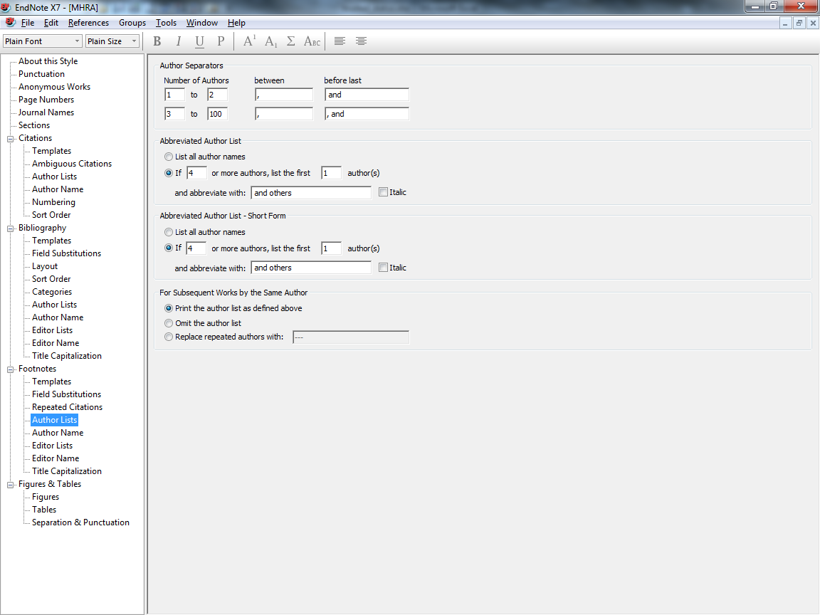
This section allows you to change different elements of footnotes
Notes:
The Footnotes section allows you to control the appearance of the various elements in footnotes. The format of these may be different from the bibliography, depending on the reference style.
The Author Lists section allows you to control how many authors are displayed, and the separating punctuation.
Any changes to Author Lists must be replicated in Editor Lists.

Slide 7
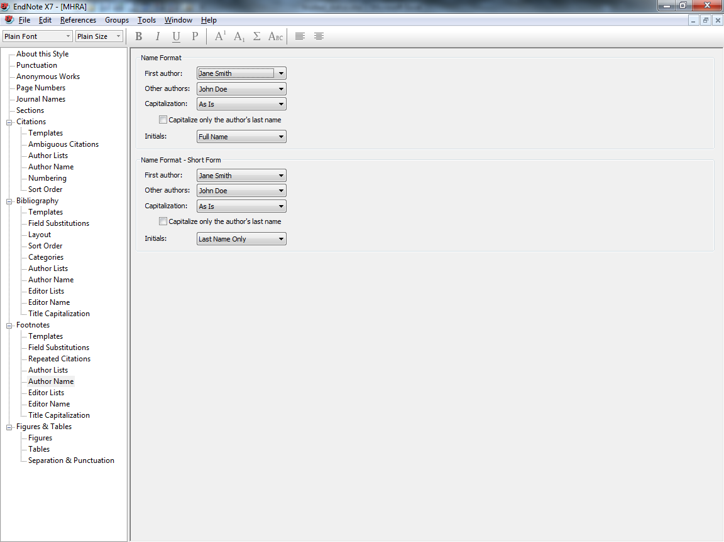
'Author Name' allows choices about capitalisation - choose 'Normal' for names in lower case but with initial capital letters
Notes:
Changes to Author Name must be replicated in Editor Name.
These windows allow you to make choices about capitalisation - the default is As Is. Choose Normal for names in lower case but with initial capital letters.

Slide 8
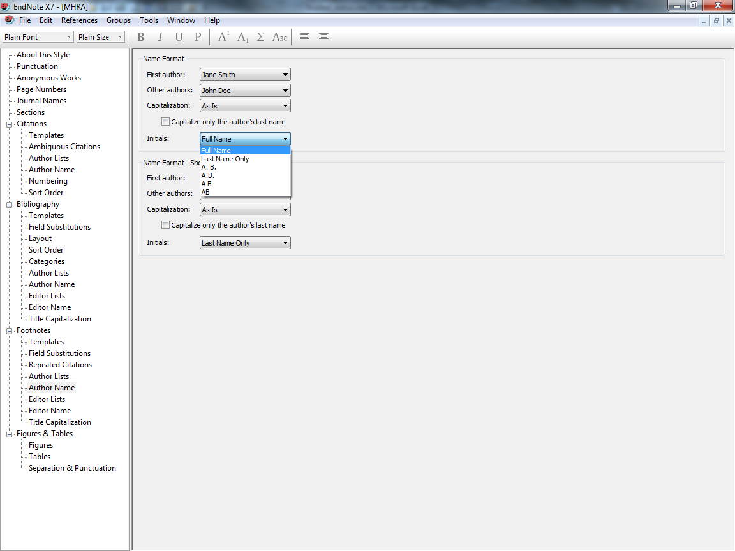
Make choices about the punctuation of initials
Notes:
Choices can also be made about the display of initials: with or without full-stops, with or without spaces between.

Slide 9
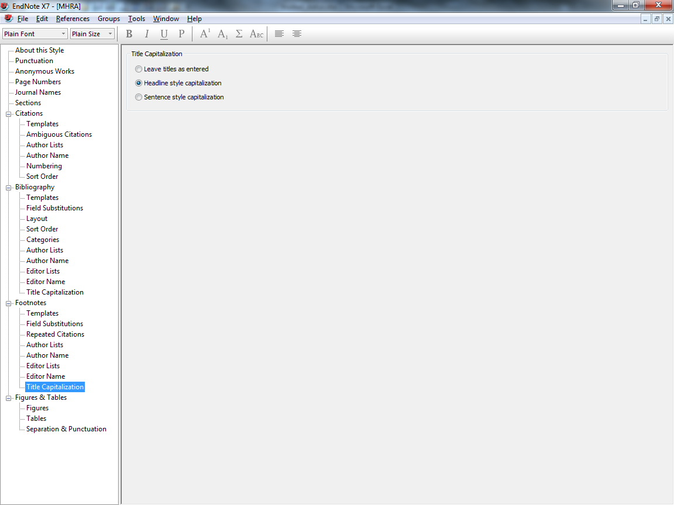
Choose 'Headline Style' to capitalize major words, 'Sentence Style' for initial words only, or leave titles as they were typed in.
Notes:
Choose the style for primary title capitalisation - Headline style will capitalise all major words, Sentence style will capitalise the initial word only.
Note that the same style will be applied to all records in the library: if the conventions for book titles and journal article titles differ, you may wish to leave titles as entered.

Slide 10
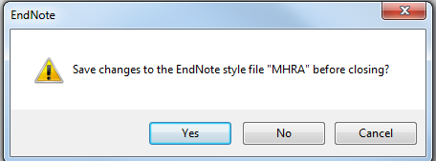
Click 'Yes' to save changes
Notes:
You will be prompted to save the edited style with a new name.

Slide 11
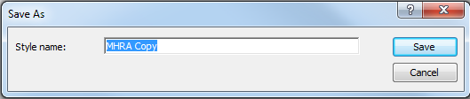
Save with the default Style name or use your own
Notes:
The original reference style remains unchanged, but a variation is created.
This edited style will then appear in EndNote's reference style list and can be applied to any EndNote library. This style is stored in your university My Documents - EndNote folder, so can be accessed at any time from any public workstation and will appear in EndNote's dropdown list of available styles.

Slide 12
Apply an edited reference style

Slide 13
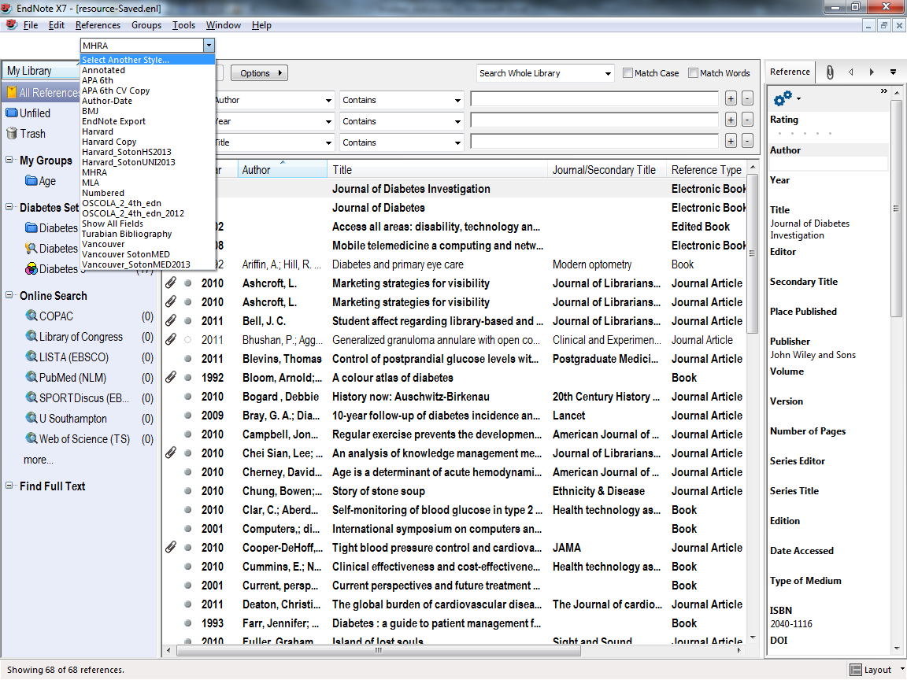
Changes to a Reference Style are not automatically applied:
Go to the Reference Style dropdown menu and choose 'Select Another Style'
Notes:
Changes to the Referencing Style are not automatically applied to the EndNote Library.
To apply changes, go to the Reference Style dropdown menu and choose Select another style.

Slide 14
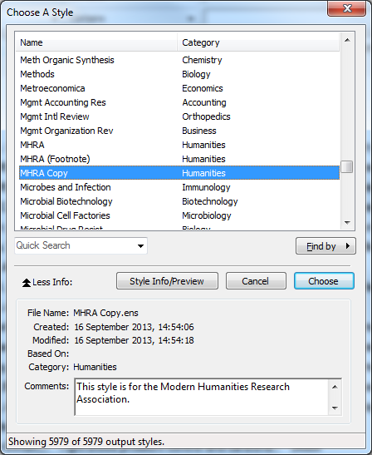
Choose the saved style to apply to the EndNote library
Changes to the Referencing Style are applied
Further edits to the style can be made at any time
Notes:
Choose the saved style to apply edits to the EndNote Library.
Further changes can be made at any time, and the same copy style updated and then applied again to the library concerned. If references from the Library have already been used in a document, new changes can only be applied by using the Format Bibliography option in Word.

Slide 15
Templates - how they work

Slide 16
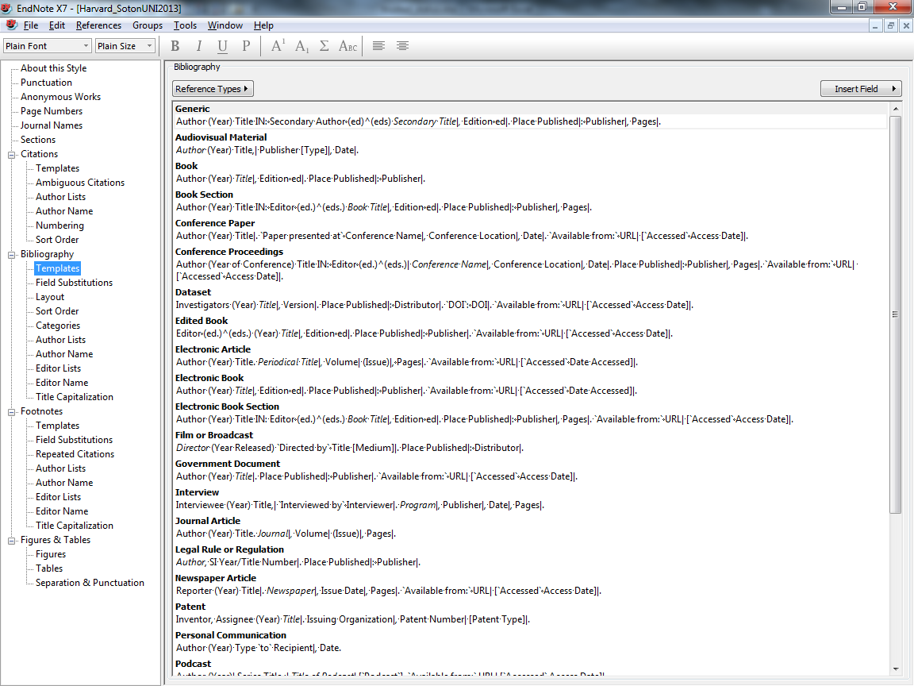
Templates control the appearance of the bibliographic record
A number of templates are already created: use the Reference Types list to create others
Generic is used if there is no template for a given reference type
Notes:
Bibliographic templates control the display of records when EndNote is used with Word documents for citations and references.
Depending on the Reference Style, there are already a number of templates created.
Additional templates can be created by choosing from the Reference Types list.
'Generic' is used when a specific template has not been created for a Reference Type that has been used to create an EndNote record.

Slide 17
Field Names are replaced by the contents of that field in the individual EndNote record
Other characters are displayed 'as is'
Notes:
Templates are created on the basis of Field Names: wherever a Field Name appears, it is replaced by the contents of that field in the bibliographic record. Words or characters that are not field names are displayed 'as is'.
If a template field contains no data, it is omitted from the record: the vertical lines tie the punctuation to the following field so that stray commas and colons do not appear.

Slide 18
Apply Bold, Italic Underline, Superscript or Subscript to the Field Name using the toolbar icons
Fields are displayed with the format used for the Field Name
Notes:
Bold, Italic, Underline, Superscript or Subscript may be required formats within a citation or bibliographic template.
A field is displayed in the format used for the Field Name - hence Journal and Title often appear in italics within the templates.
When an item has editors, EndNote will choose between singular and plural: the circumflex is used.
Templates can be edited at any stage, and the edited reference style applied to the EndNote Library and relevant Word documents.

Slide 19
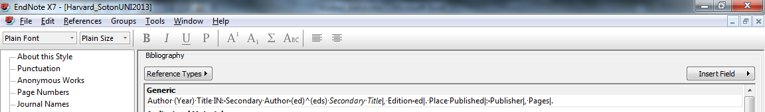
Special characters in templates
EndNote uses special characters to force particular actions within templates
These can be found on the keyboard, or accessed from the 'Insert Field' dropdown menu
Notes:
Some of the templates contain special characters: these are needed for example to avoid stray punctuation in bibliographic records or to manage different numbers of authors/editors.
Use keyboard characters or go to the Insert Field dropdown menu. As well as the special characters, this dropdown lists all the fields that are relevant to the selected reference type, making creation of a new template much easier.

Slide 20
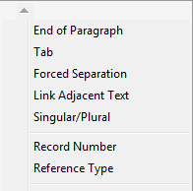
A forced separation | ties following punctuation to the next field
Notes:
Use the forced separation to tie punctuation to the following field: if this field is empty in the EndNote record, the punctuation will not be displayed: in this example, no publisher, no comma.

Slide 21
Use 'Link Adjacent Text'  to tie a word or phrase to the following field
Notes:
The diamond ties plain text to the next field: in this example, the words 'Directed by' will only appear if there are details in the Director field. The grave accents indicate a phrase to be tied to the following field rather than a single character or word.

Slide 22
Use Singular/Plural ^ to choose text for editors or pages
Notes:
The circumflex ^ is used to allow a choice between text linked to the associated field, in this case dependent on the number of entries in the Editor field.

Slide 23
Use accent grave ` at start and end of text which might be confused with a field name, or for a linked phrase
Notes:
Accents grave are used to identify phrases which need to be linked to preceding or following fields, and also to ensure that any text which also appears in an EndNote record as a field name is displayed in the bibliographic record 'as is'

Slide 24
Set some EndNote preferences

Slide 25
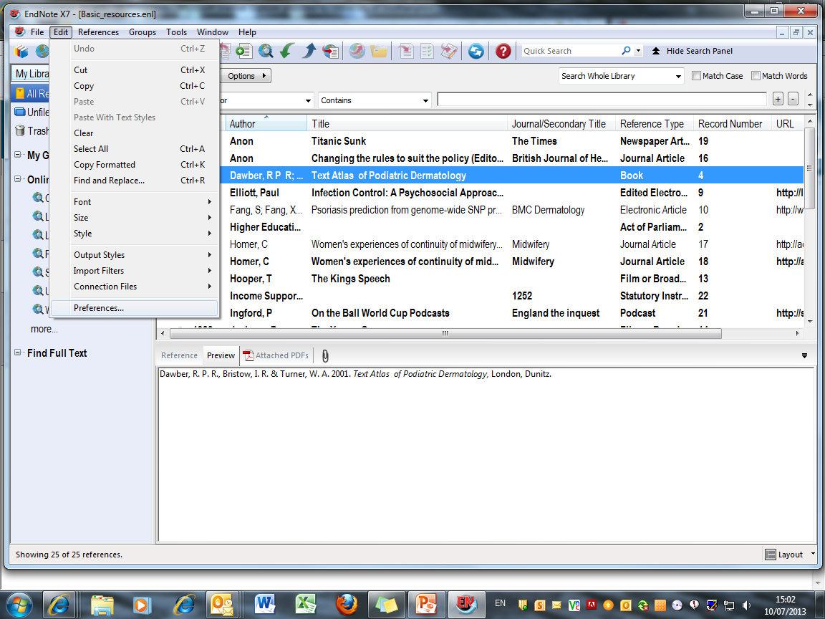
To manage the appearance of the EndNote Library, go to Edit  Preferences…
Notes:
Preferences control how the EndNote Library itself appears, rather than the individual records. To see the options, go to Edit, Preferences.

Slide 26
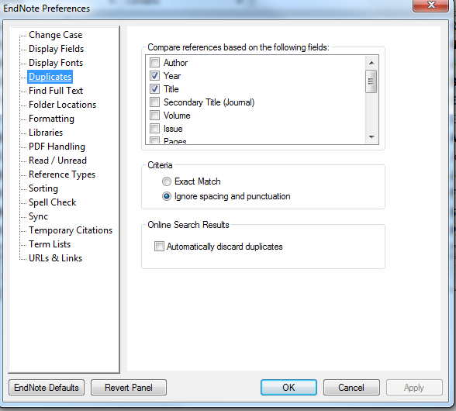
Use the 'Duplicates' option to set criteria for comparing records
Notes:
Use the Duplicates option to set criteria for comparing possible duplicates. The default comparisons are Author, Year, Title and Reference Type. Because databases list author names differently for the same publication, it is best to uncheck the Author option.

Slide 27
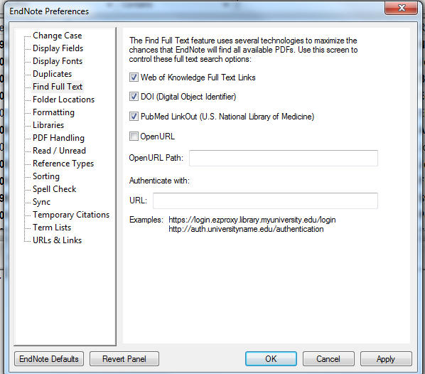
Use the 'Find Full Text' option to optimise full text retrieval: ensure these three options are checked
Notes:
The Find Full Text option searches for the full text of articles already in the EndNote Library. To maximise the number of records retrieved, ensure that Web of Knowledge, DOI and PubMed options are all checked.

Slide 28
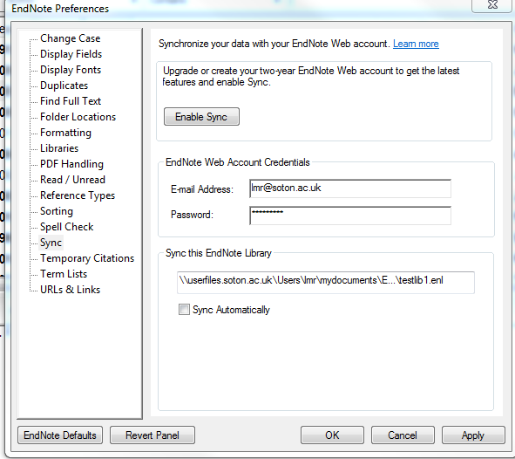
Use your Web of Knowledge login to synchronise the library between desktop and web

Slide 29
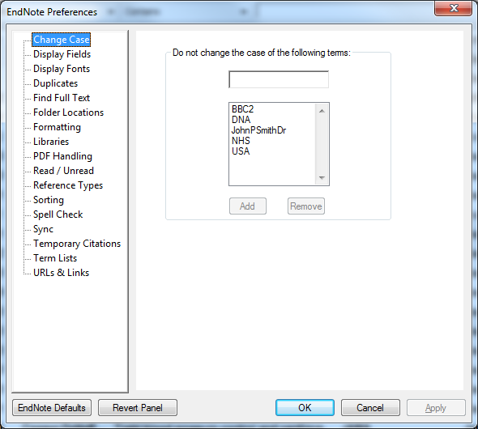
Use the 'Change Case' option to keep abbreviations in all upper case, or for any names with irregular characters or non-standard capitalisation
Notes:
The Change Case option is an important tool: it permits the general rules for bibliographic display to be overridden in special cases e.g. abbreviations, non-English language names and characters. Any character string added to the list will be displayed 'as is' wherever it occurs.

Slide 30
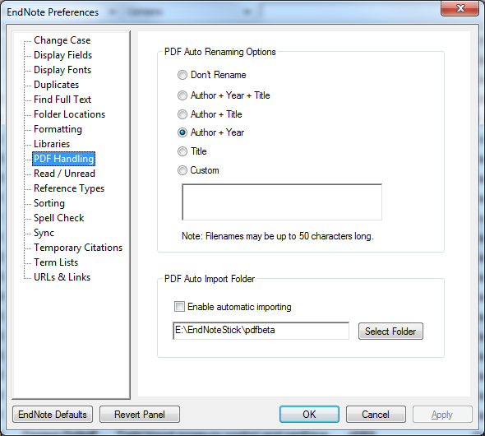
Identify a folder for automatic import
Rename PDF files
Notes:
The PDF handling option allows you to change the description of PDF files to something meaningful, e.g. Author/Year. These changes will not always take place immediately but will be updated when the EndNote library is closed.
Use the Select Folder option to identify a location for PDFs which you would like added to your EndNote library. Check the Enable Automatic Reporting box to enable EndNote to background update periodically. If an EndNote record already exists, the PDF will be added: if there is no record, one will be created and the PDF added. PDFs that have been added to the Library will then be transferred to an archive folder within the selected folder location.

Slide 31
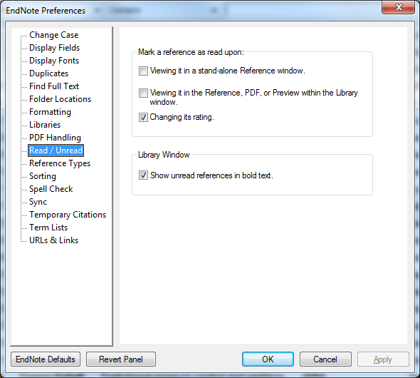
Use the 'Read/Unread' option to control function of record bullets
Notes:
Open the Read/Unread option to use the bullets beside each library entry in the way that suits you best.

Slide 32
Attach PDF files to records

Slide 33
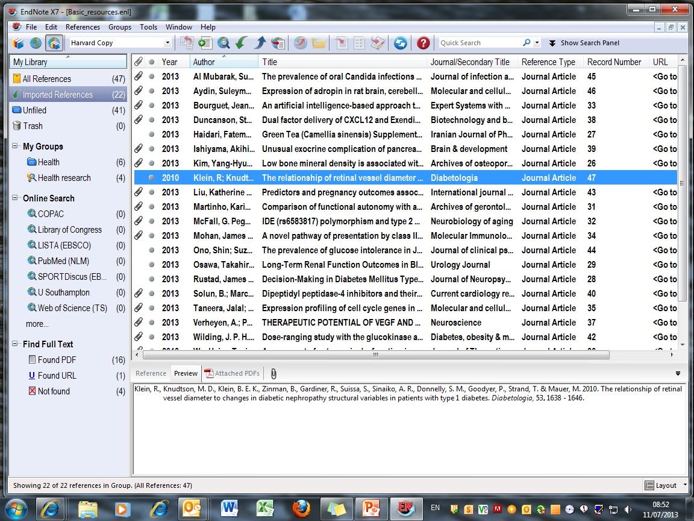
Click the paperclip symbol
Notes:
PDF and other types of file such as word, Excel, graphics, can be attached to the EndNote record, using the File Attachments field.
On the References pane, click the paperclip symbol.

Slide 34
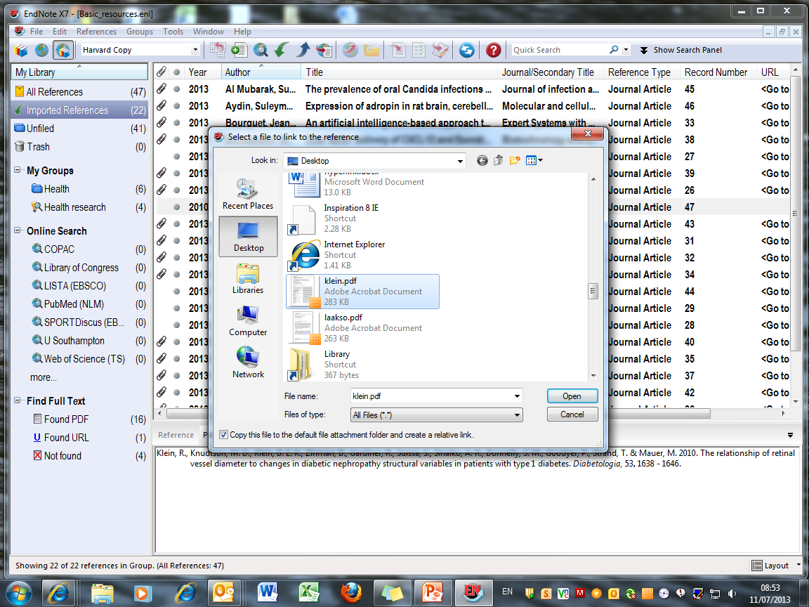
Browse to locate the required file
Notes:
Browse to locate a previously saved PDF file, in this case by Klein. Click Open.
Note that it is helpful to rename PDF files when saving from online resources so that they can be more readily identified for addition to the EndNote records.

Slide 35
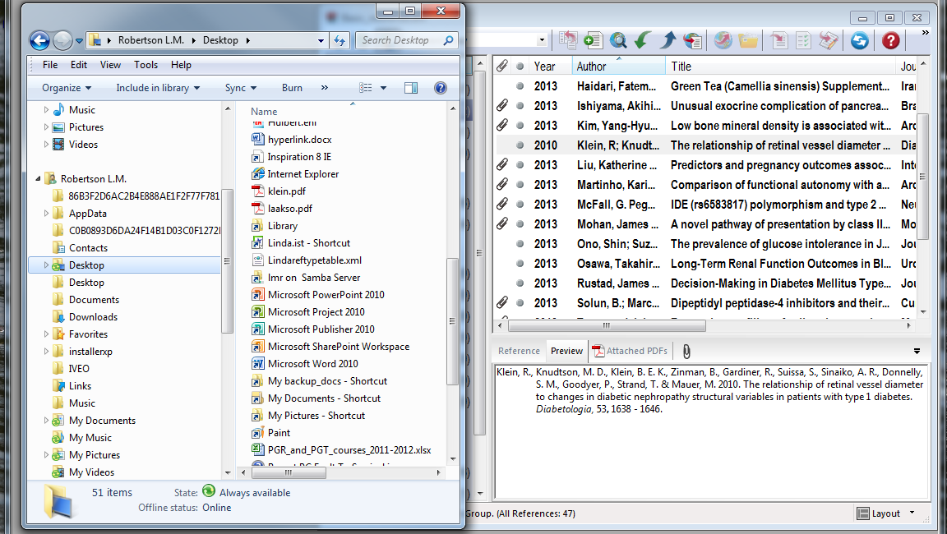
Select and drag the PDF file on to the record in main library view
Notes:
If there are a number of records to be updated, it is helpful to save all the PDFs in a single folder and open this window alongside the EndNote Library.
Select the required PDF file and drag it on to the main library record as displayed in the main library view.

Slide 36
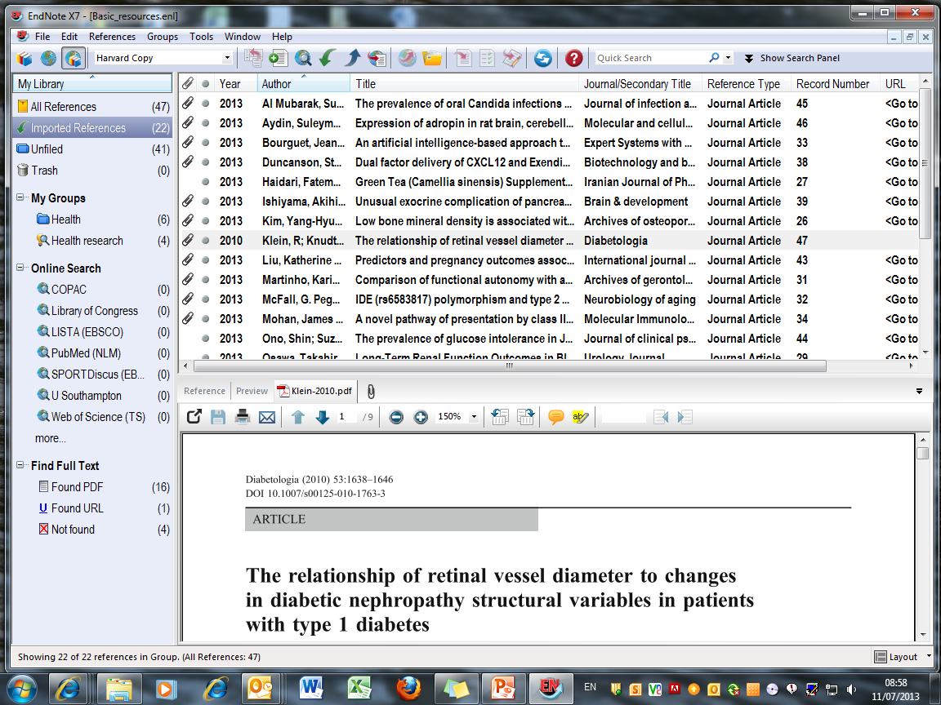
The file attachment symbol displays in the record
Notes:
The File Attachment symbol displays in the library window.

Slide 37
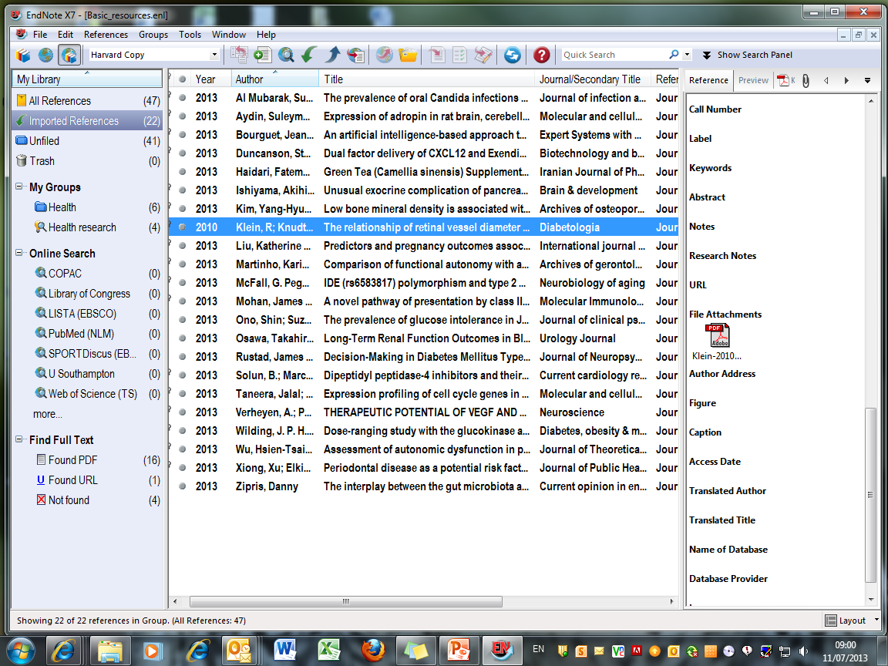
The .pdf file is added to the 'File Attachments' field in the record
Notes:
In either case, the PDF is added to the File Attachments field.

Slide 38
Importing files from a pdf folder containing pdf files
Notes:
This feature allows you to convert existing collections of PDF files into EndNote records with minimal typing and copying by extracting Digital Object identifiers (DOI) from PDF files. The system matches DOI information with data available from CrossRef (www.CrossRef.org) by capturing bibliographic content and creating new EndNote records.

Slide 39
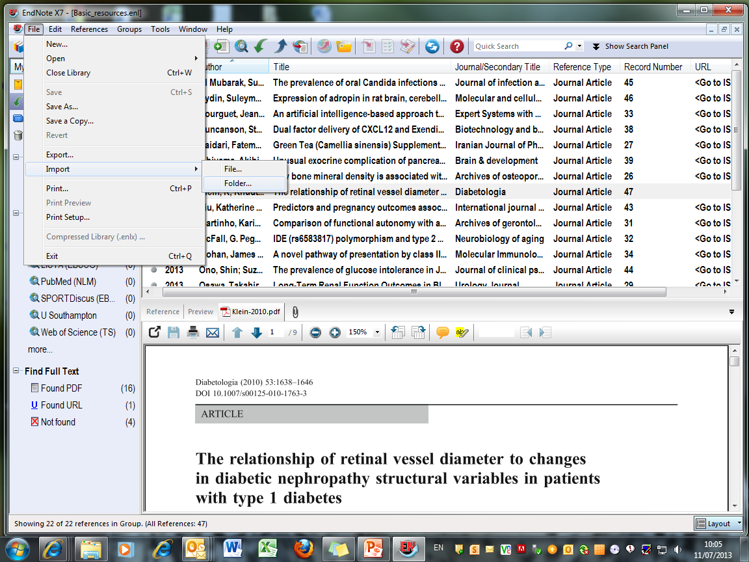
Complete folders of PDF files can also be imported
From the File menu, choose 'Import  Folder…'
Notes:
To import a PDF folder with PDF files begin by opening the library into which you want to import the references. From the File menu, choose Import Folder.

Slide 40
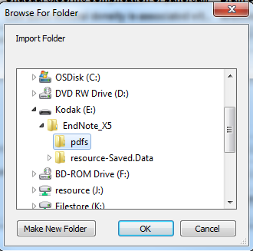
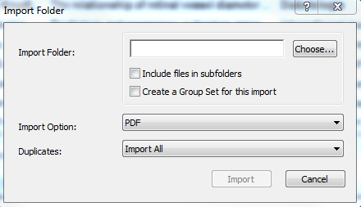
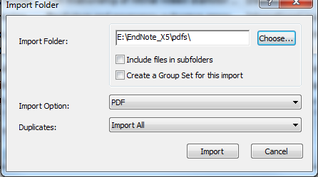
Locate the required folder, and choose the Import Option 'PDF'
Notes:
Click the Choose button to open the Browse for Folder dialog window. Select the needed PDF folder, and then click OK. If the selected folder lists sub-folders, click the Include files in sub-folders button. To maintain a first level set of subfolders, click the Create a Group Set… option. Select the PDF import option from the Import Option list. Leave the Duplicates list unchanged so that it will Import All (see separate section on managing duplicates). Click Import to import the files in the selected folders.

Slide 41
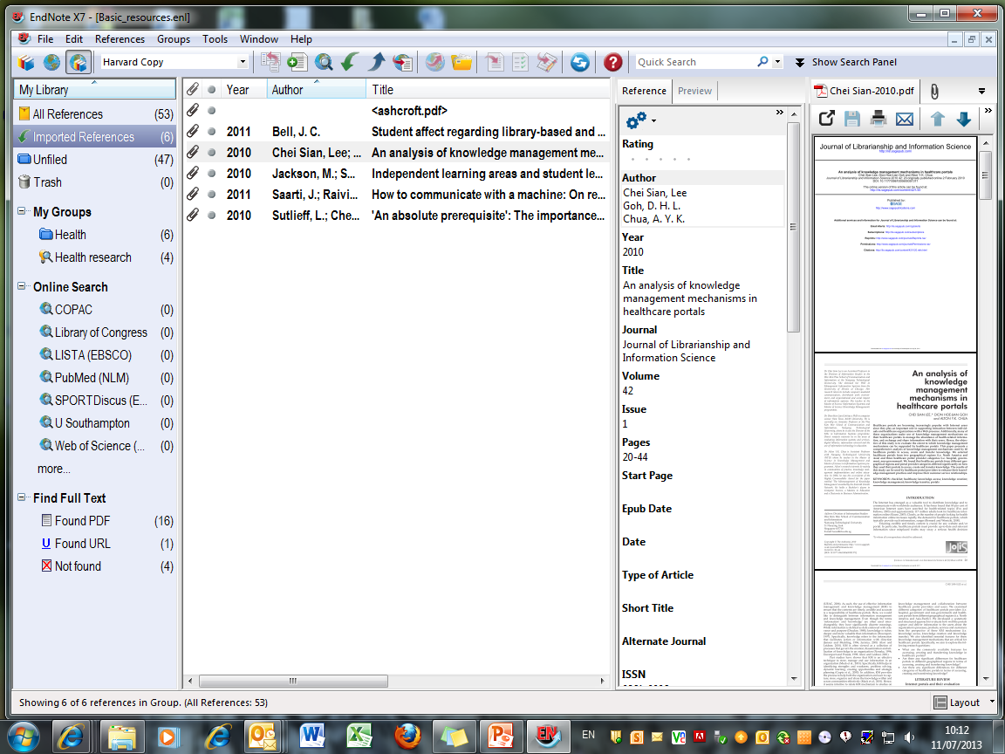
EndNote records are created with the PDF files attached
Notes:
When the import is complete, the new records are stored in the Imported References group, and will include bibliographic information given for the Digital Object Identifier (DOI) mined from the PDF file, such as title, author, volume, issue, page, year, and DOI. Check through the imported data to make sure it has imported as expected. The Imported References group is a temporary group that is replaced each time you import another set of references. It is removed when you exit EndNote (although the references remain in the library). To return all references to the library display (including the newly imported ones), choose Show All References from the References menu or click the All References group.
When more than one DOI appears on the first page of an article, the PDF will be imported and attached to the record, but bibliographic data must be created manually as EndNote cannot identify the primary DOI. You may wish to locate the articles in the relevant database and export from there, attaching the pdf via 'Find Full Text' or manually.

Slide 42
Using special characters

Slide 43
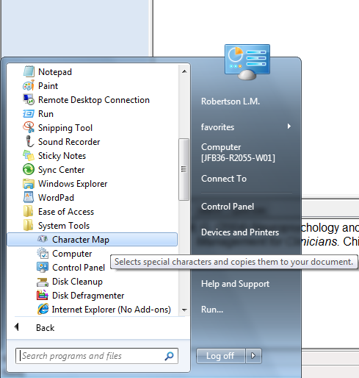
Using special characters
To insert special characters in EndNote records, go to Start  All Programs  Accessories  System Tools  Character Map
Notes:
To edit EndNote records for special characters, for example accented vowels or Greek characters, in any record field, go to Start, All Programs, Accessories, System Tools, Character Map.

Slide 44
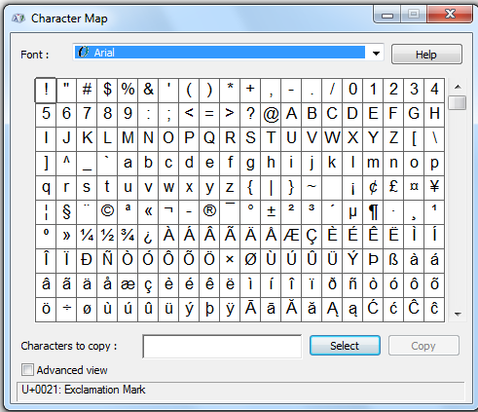
Select and copy required character, and paste in relevant location
Notes:
Select the character required then copy and paste in required location. Character strings can be built if required.

Slide 45
Managing duplicates

Slide 46
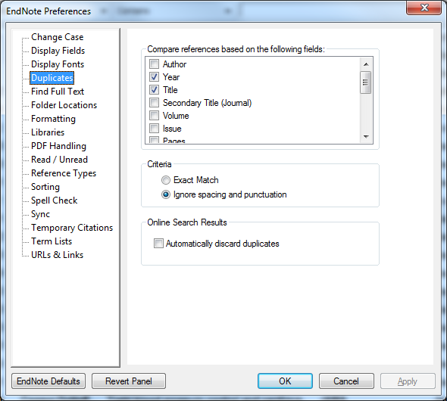
Notes:
Set your duplicate criteria in Edit, Preferences, Duplicates. Tick Automatically discard duplicates if you regularly import references from different sources. You may find it useful not to compare authors, as names can be indexed very differently by different databases.

Slide 47
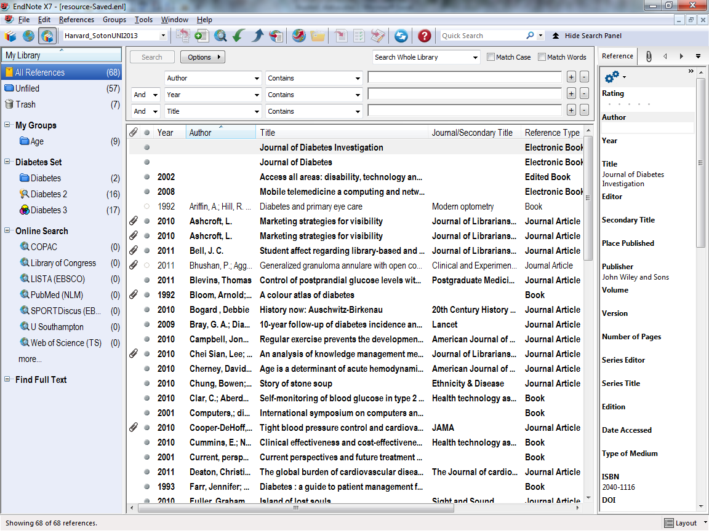
Select 'All References'
Notes:
When an Endnote Library contains references drawn from various sources there is a likelihood that duplication of records will occur.
To look for duplicates within your existing Endnote Library, first of all go to All References.

Slide 48
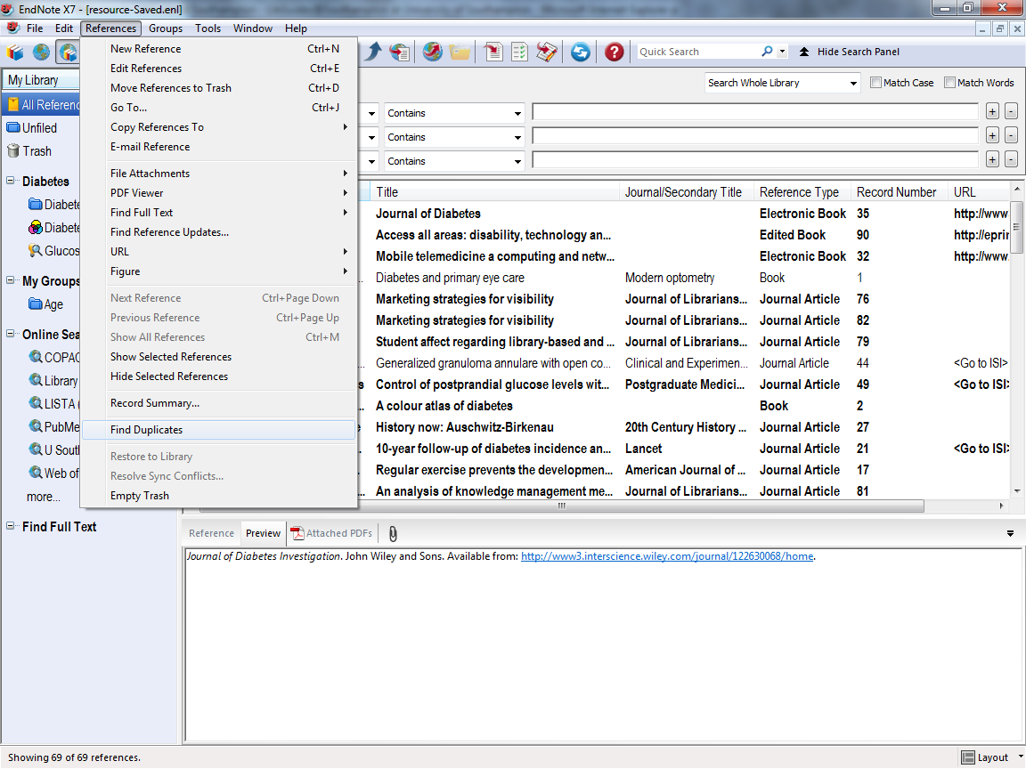
From the 'References' dropdown menu, choose 'Find Duplicates'
Notes:
To check the Endnote Library for duplication, first click on References and then Find Duplicates.

Slide 49
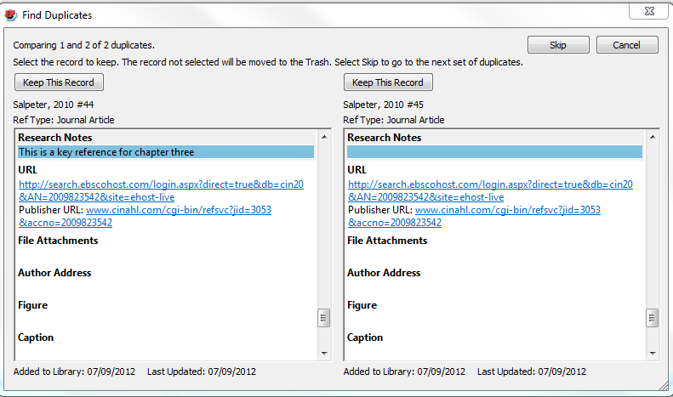
Records are displayed side by side: choose which to keep, or Skip
Notes:
Endnote then carries out a search for duplicates. Each record it finds is displayed alongside its duplicate so that the two can be compared. Check to see whether these two records are indeed duplicates of each other as they may have been matched in error.
If you don’t wish to delete either record then click on the Skip button. Otherwise, click the Keep this Record button above the record that you want to retain: the other is then deleted.
To avoid deleting a reference that you have already cited in a paper, it is advisable that you always delete the duplicate record that was most recently added to Endnote Library.

Slide 50
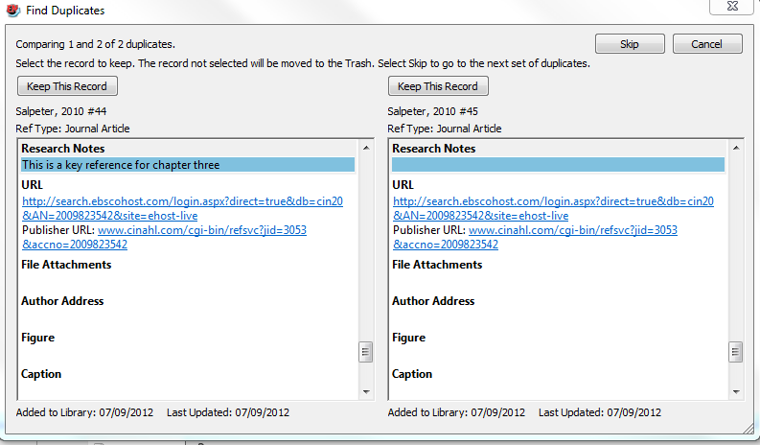
Fields which differ are highlighted
Notes:
For ease of comparison, any fields which differ between the two records are highlighted.

Slide 51
Working with groups

Slide 52
Sort references into groups
Groups can be custom groups or Smart groups
Records can be copied into more than one group
Group sets can be created from a mixture of custom groups and smart groups
New groups can be created from records in existing groups
If syncing with EndNote Online, this will only include custom groups
Notes:
There are a number of methods of sorting references according to your research needs.
Create individual groups for collections of records for particular purposes, collect groups together or combine them with Boolean operators AND, OR, NOT.
If using the EndNote Online sync function, this only operates with custom groups.

Slide 53
Create custom groups

Slide 54
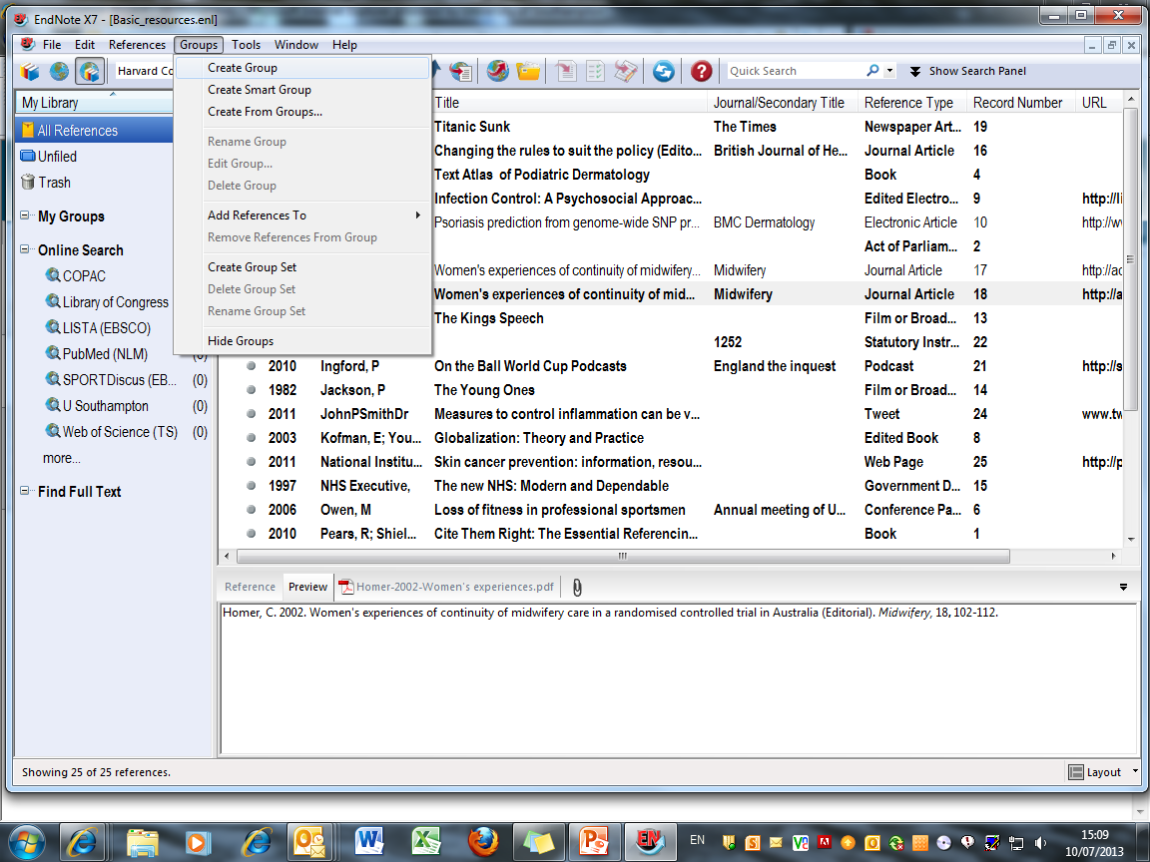
Click to Create a Custom Group
Notes:
The best way of managing a large EndNote Library is to create sub-libraries, or groups. Up to 5000 groups can be attached to a single library.
Groups can be custom groups or Smart groups.
Any item in the main library may be included in a custom group.
Smart groups are given set criteria - any item fulfilling these criteria is automatically added to the group. The criteria can be modified at any time. The criteria for a new Smart group will be applied to the existing EndNote Library, and to any items that are added subsequently.
All entries are included in the main EndNote library: they may be copied into more than one group, or be entries in more than one Smart group.
Deleting a record from a main library removes it from all groups: deleting a record from a custom group does not remove it from the main library or from other groups. It is not possible to delete an item from a Smart group.
To create a Custom group, go to Groups, Create Group.

Slide 55
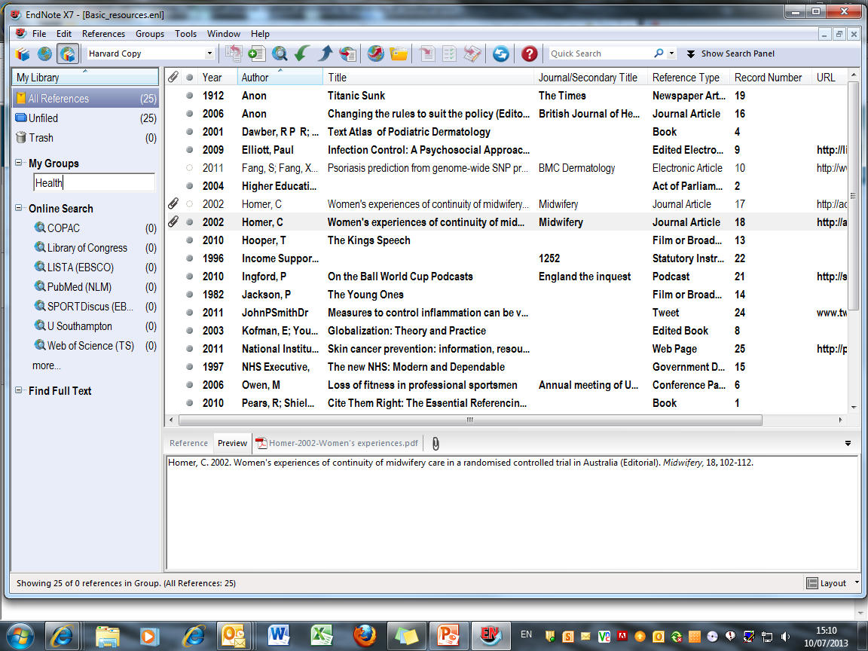
The group can be named, and managed by rightclicking
Notes:
Name the group. The new group is displayed in the My Groups panel. Options to manage the group are available on right-click.

Slide 56
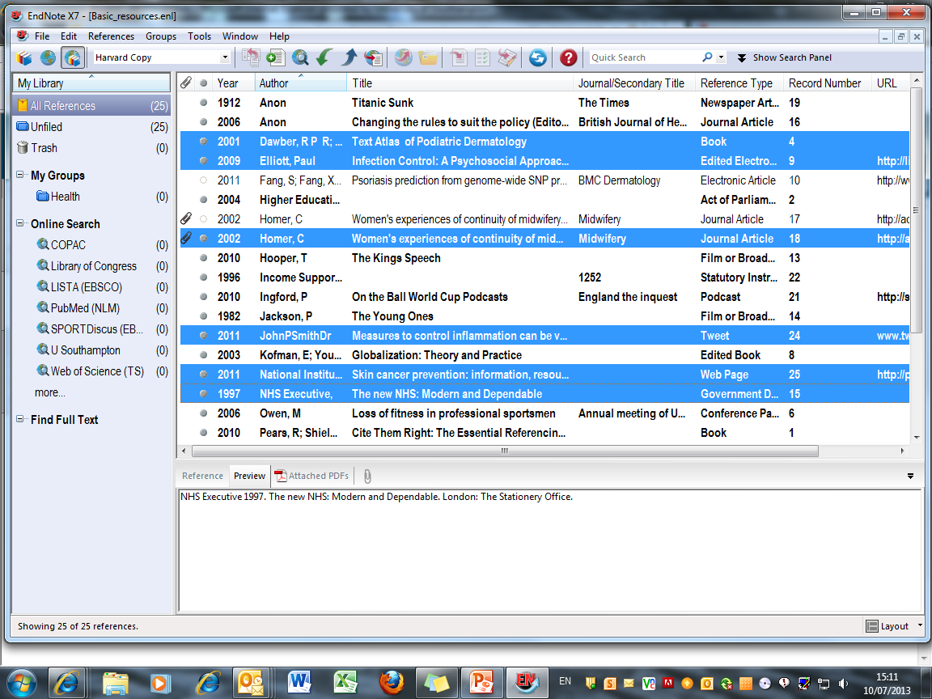
Drag selected records on to the group name to add the records to the group
Notes:
Select the records to be added to the group, and drag on to the group name.

Slide 57
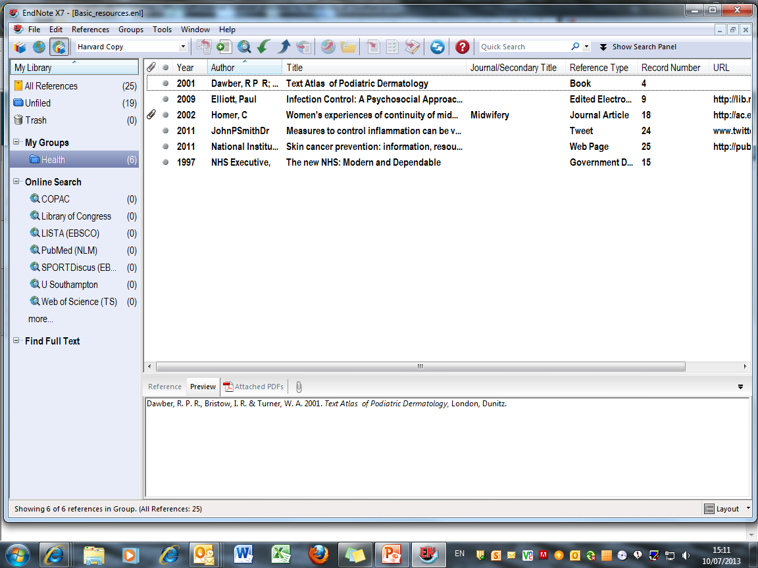
Add or remove records in Custom Groups at any time
Notes:
Custom groups can be populated manually at any time. Records deleted from groups are not deleted from the main library

Slide 58
Create Smart groups

Slide 59
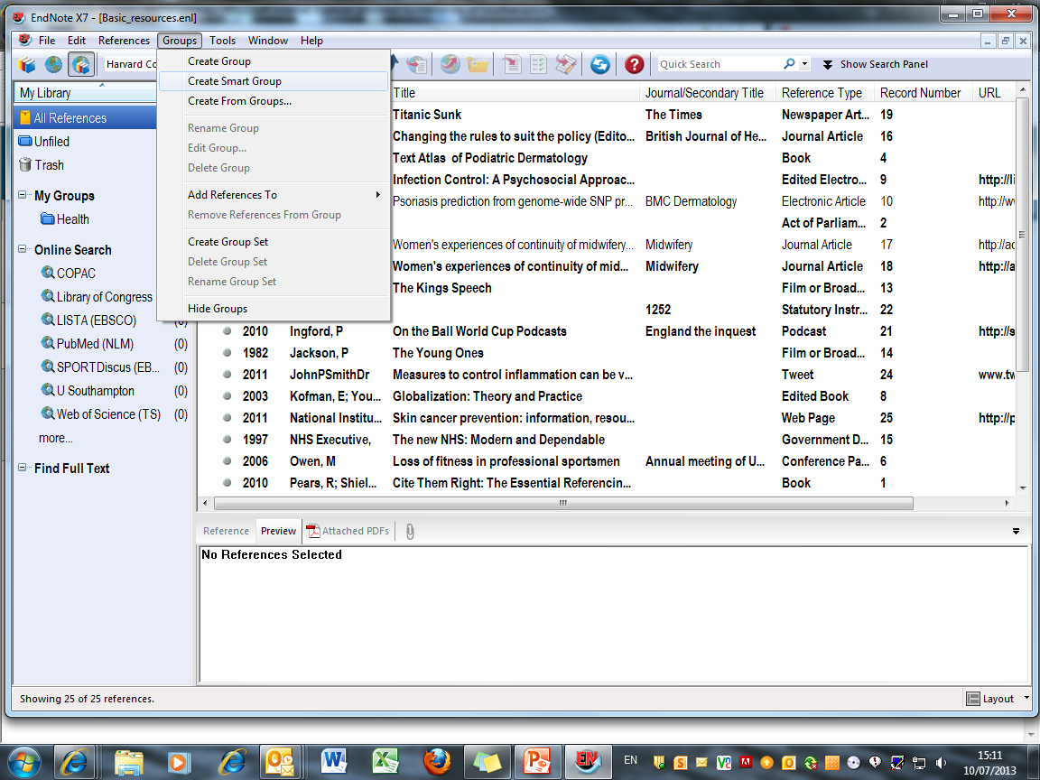
Go to Groups ➔ Create Smart Group
Notes:
Smart groups are created by setting criteria which apply to every item in the group. Go to Groups, Create Smart Group.

Slide 60
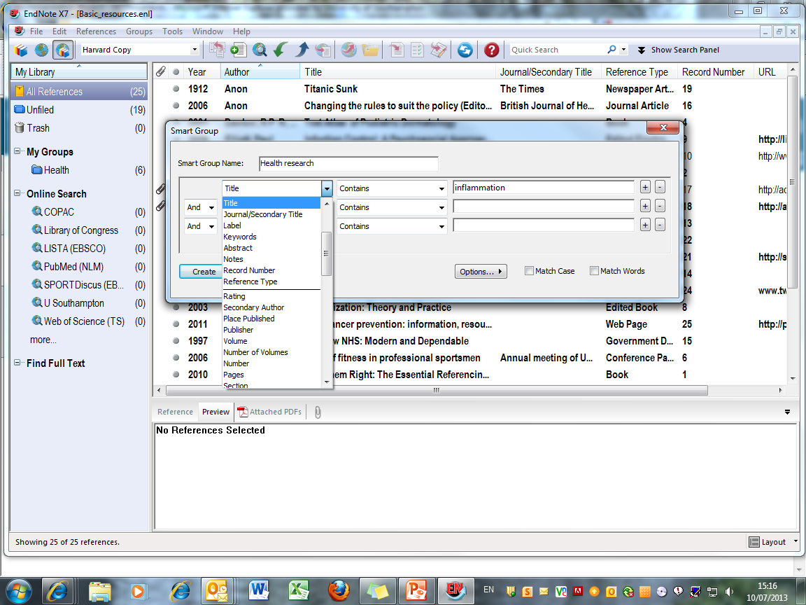
Set criteria for any Endnote field
Notes:
Criteria can be set for any field in the EndNote record, including pdf text and sticky notes.

Slide 61
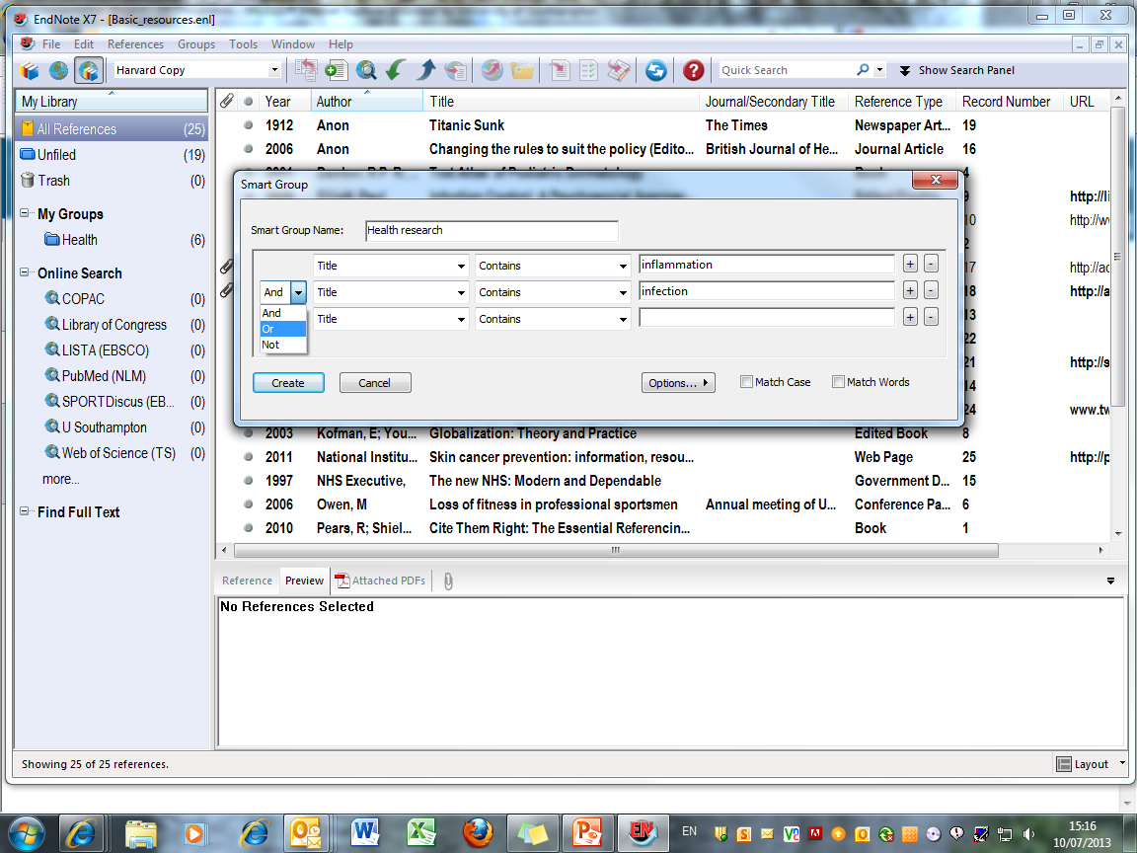
Use Boolean operators to combine search terms
Notes:
Use Boolean operators And/Or/Not to combine search terms. Additional lines for further search terms can be added if required.

Slide 62
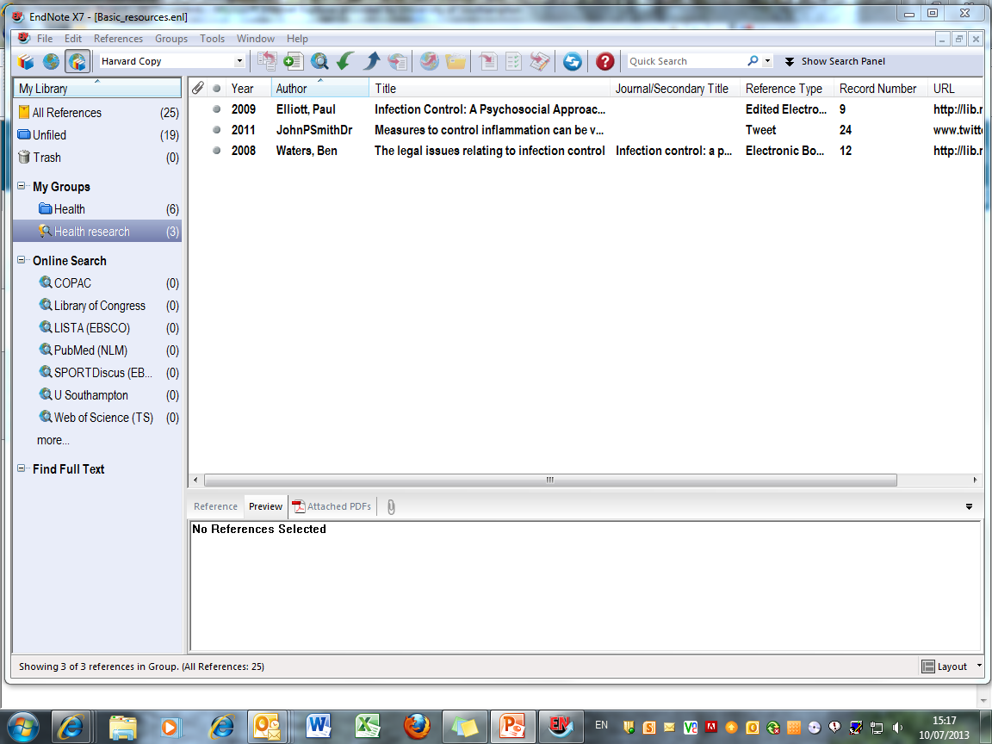
Notes:
Whenever a Smart Group is created, the entire EndNote library and any subsequent entries will be copied automatically into the Smart group. If an individual item is deleted from a Smart group, it will also be deleted from All References. If an entire Smart Group is deleted, the references remain in the EndNote Library.

Slide 63
Group sets
You can further organise your groups:
  Combine selected Custom Groups and
  Smart Groups into a Group Set

Slide 64
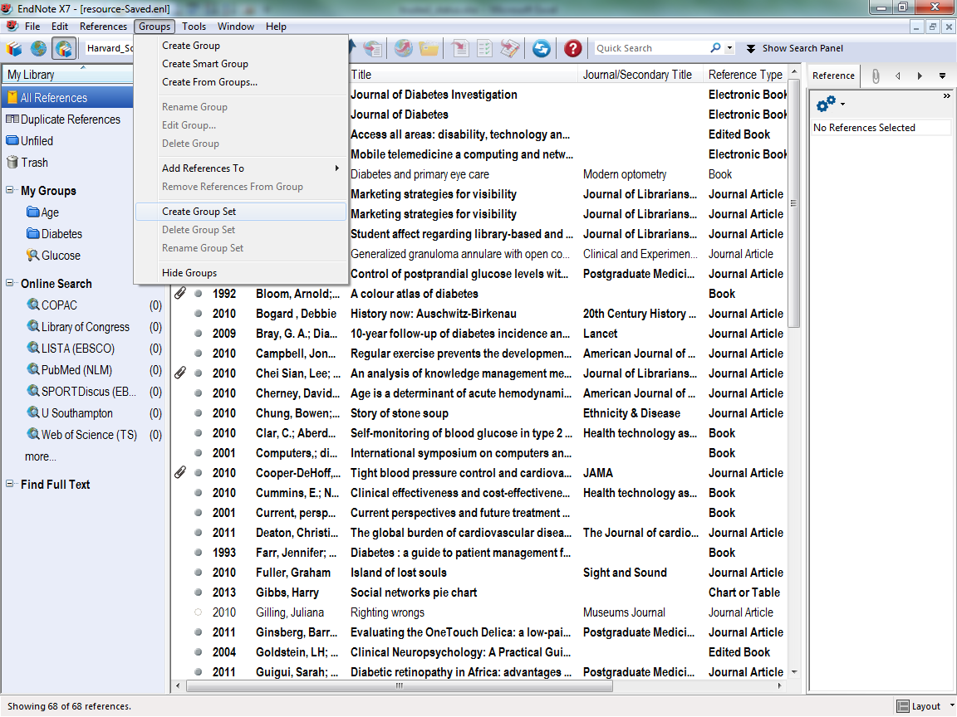
Choose 'Create Group Set'
64
Notes:
Go to Groups then select Create Group Set.
64

Slide 65
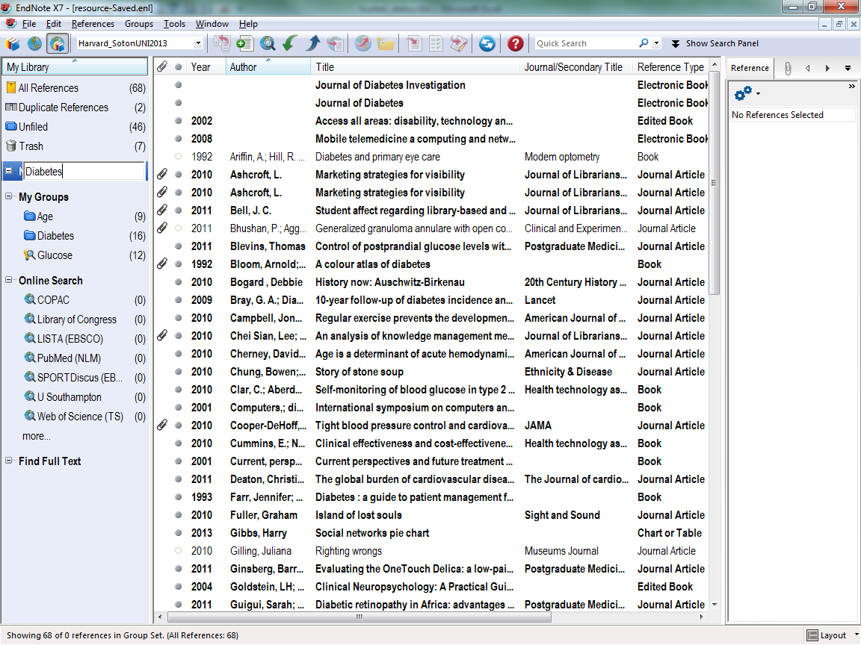
Name the new Group Set
65
Notes:
Right-click to name the new group set.
65

Slide 66
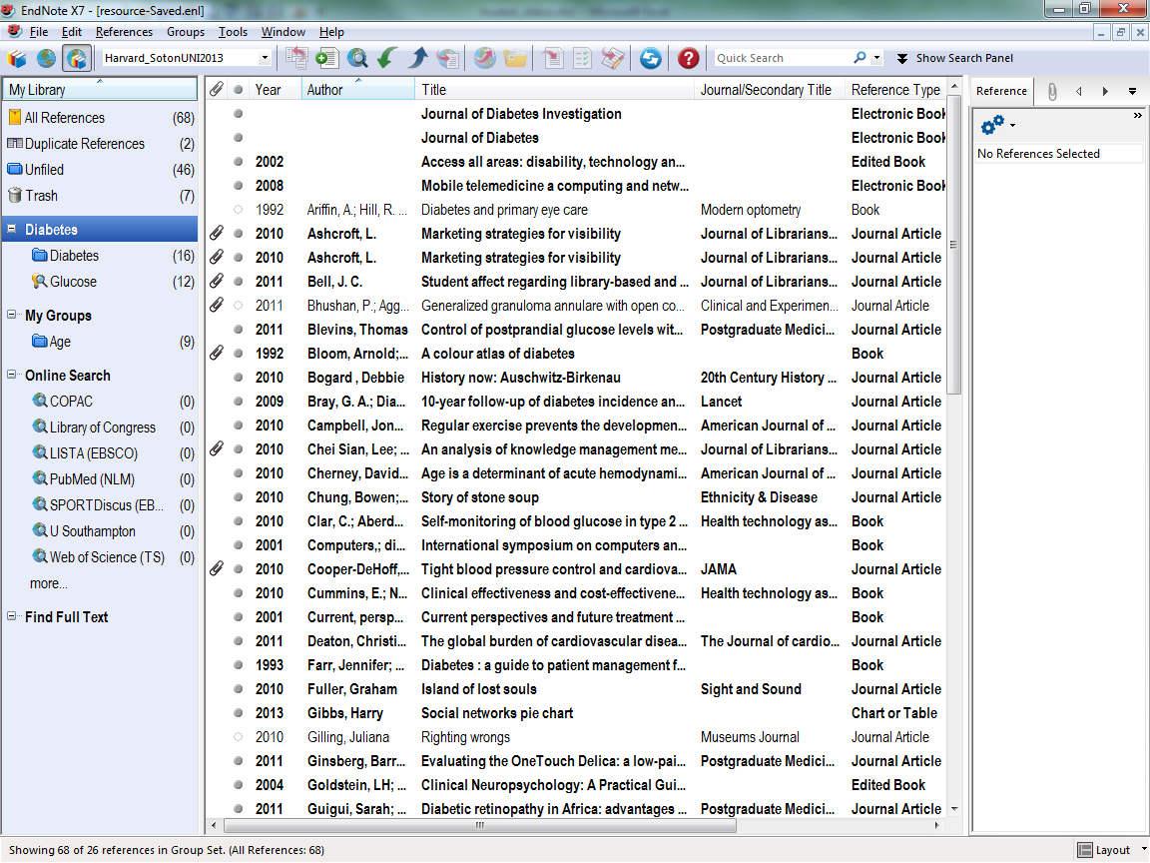
Drag existing groups into the new 'Group Set'
66
Notes:
When you first create a Group Set it will be empty. Drag groups to move them from one Group Set to a new Group Set, or create new 'Custom Groups' and/or 'Smart Groups' under the new heading.
66

Slide 67
Create from groups
Existing groups can be combined with AND/OR operators
Identify records appearing in a particular combination of groups
Identify records appearing in one group but not in another

Slide 68
Create nested searches
For more complex searches
(A or B) AND (C not D)
Use the search panel for elements within brackets (with Convert to Smart Group option if required)
Combine bracketed results using Create from Groups

Slide 69
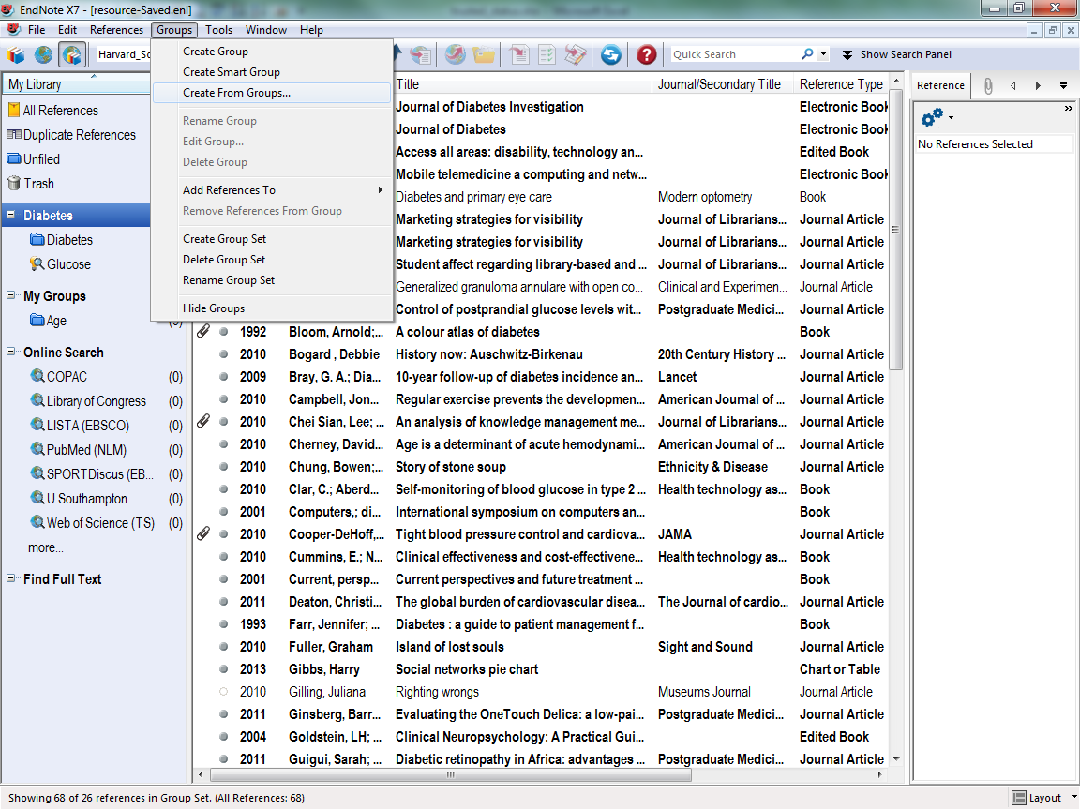
Go to 'Groups ➔ Create From Groups…'
Notes:
On the Groups dropdown menu, go to Groups, Create From Groups.

Slide 70
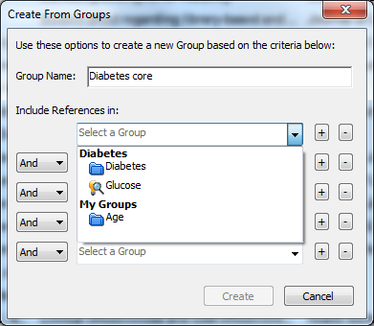
Choose which groups to combine using the dropdown list
Identify the Boolean operator
The new group will contain references that appear in both selected groups. Click 'Create'
Notes:
Existing groups are listed in the dropdown menu. Choose which to combine using the operators And, Or, Not

Slide 71

A new group is created within the group set
Notes:
In this example, only two references were part of the self-selected group Diabetes and also fulfilled the criteria for the smart group Glucose.

Slide 72
Edit an existing reference

Slide 73

There is a formatting error in the title: go to the 'Reference' tab
Notes:
If you are working with your library and you notice that there is an error in one of your references you can easily and quickly correct it.
In this example the record by the author Chung is showing in the Preview section in the right side of the window. The title of the paper appears in upper case.

Slide 74

Click to hide/show all record fields
Notes:
With the reference highlighted in the library, click on the Reference tab to see the full record. Go to the title field and click to correct. Choose whether to see all fields or to hide empty fields in the Reference window. Click on the Settings option in the top left corner of the reference to select. When you have finished editing the record click on the next record in the library section of the screen.

Slide 75

When all edits are complete, click the next record in the library pane
The 'Save' prompt displays
Notes:
A box will open which gives you the opportunity to save the changes made to the reference, choose Yes if the edits are correct.

Slide 76

The edited record is displayed
Notes:
The edited record is displayed.

Slide 77
Edit a group of references
Make changes to any field in all references or a group of references
Useful for adding keywords, or research notes, to a group of references

Slide 78

Select the references to be edited and create a separate group if necessary
Notes:
Select the group of references to be edited - if necessary create a new group for these. The group can be deleted later - the changes will remain in the individual library records. In this case, the same changes will be made to all the records in the new group 'glucose'.

Slide 79

Go to 'Tools  Change/Move/Copy Fields…'
Notes:
Go to Tools, Change/Move/Copy Fields…

Slide 80

Use the 'Change Fields' tab
Notes:
Click on the Change Fields tab. Choose where in the selected field the new text will appear.

Slide 81

Select the field to modify
Notes:
Select the field to modify, for example to add a term to the Keywords field of selected records.

Slide 82

This adds the term 'Chapter 3' to selected records as the first term in the keyword field
Notes:
Add the required text and click OK. Use the Insert Special dropdown menu to add a carriage return for following text to appear on a new line.

Slide 83

A popup window confirms the number of records selected
Notes:
A popup window confirms the number of records being edited.

Slide 84

The text is added to the chosen field in the selected records
Notes:
The text appears in the chosen field for each record in the selection.

Slide 85
Using the Search Panel
Notes:
Quick search - searches everything

Slide 86

Search all fields with Quick Search
…or show the full search panel
Notes:
Use the Quick Search box to search every field in all EndNote records, including PDF text and Sticky Notes.
For a more specific search click to show the full search panel. You will also need to use the full search panel if you are working with nested searches.

Slide 87

Choose which record field to search
Notes:
Use the dropdown menus to define the search. Limit the search to PDF and/or Sticky Notes if required.

Slide 88

Choose appropriate limiters
Notes:
Choose limiters from the dropdown menu. Note that EndNote does not recognise truncation characters such as *, so it is best to choose 'contains', then enter the stem of the term for this type of search.

Slide 89

Select Boolean operators And, Or, Not
Notes:
Select the required Boolean Operators. To perform more complex, nested searches, use this function in conjunction with the Create from Groups option.

Slide 90

Numeric options are also available

Slide 91

…and there are options to save the search, or to convert the results into a Smart Group
Notes:
Use the Options menu to save the Search or create a Smart Group for the results.

Slide 92

Search results are a temporary group
Notes:
Note that search results are a temporary group, so need to be saved, or a permanent group created, in order to be retained.

Slide 93
Create nested searches
For more complex searches
(A or B) AND (C not D)
Use the search panel for elements within brackets (with Convert to Smart Group option if required)
Combine bracketed results using Create from Groups

Slide 94
Working with figures

Slide 95
Attach a figure to any reference in the Endnote Library
The 'figure' can be:
an image file (JPEG, GIF, TIFF, BMP)
a multimedia file (MOV, QuickTime)
Audio files can also be added (WAV, MP3)
95
Notes:
95
Note that if required, a figure may have its own EndNote record. A separate record should be created if you wish to include bibliographic details in your reference list.

Slide 96


Open the reference
96
Notes:
96
This image is to be attached to the reference for Patchin. Open the reference by double-clicking on the entry for Patchin.

Slide 97

Scroll down to the 'Figure' field
97
Notes:
97
There are a number of ways of attaching a Figure. In the EndNote Library record, scroll down to the Figure field.

Slide 98

Go to 'References  Figure  Attach Figure' or right-click in the 'Figure' field
98
Notes:
98
Go to the References dropdown menu or right-click in the Figure field. Select Figure and Attach Figure.

Slide 99

Click 'Choose File' to browse for the figure
99
Notes:
99
In the Attach Figure window, find the image by clicking on the Choose File… button.

Slide 100

Locate the image file, and click 'Open'
100
Notes:
100
Locate the image and then click Open.

Slide 101

A thumbnail of the image is inserted in the 'Figure' field
Enter a title for the figure in the 'Caption' field
101
Notes:
101
A thumbnail of the image is then added to the figure field. Only one figure can be attached to a reference. If you attempt to add any more, the original image will be deleted.
Always enter some text in the Caption field. This will be included if the image is cited in a Word document.
Close the record to save the changes.

Slide 102
Insert figures in Word documents

Slide 103

Endnote X7
103
Notes:
Figures are inserted in a similar way to text references. Insert the Facebook image into this Word document as an in-text citation.
Put the cursor at the point in the text for the citation to appear. Then click the Endnote X7 tab on the EndNote toolbar.
103

Slide 104

Go to 'Insert Citation ➔ Find Figure'
104
Notes:
Click the Insert Citation button and select Insert Figure from the drop-down menu.
104

Slide 105

Enter keywords from the caption text, and click 'Find'
105
Notes:
Enter part of the Caption Name that was given to the image in the Endnote Library and click Find.
105

Slide 106
Select the required image, and click 'Insert'
106
Notes:
Select the correct image from the list that appears and then click Insert.
106

Slide 107

The image, with caption, is inserted at the next paragraph break following the insertion point
107
Notes:
The image is then inserted in the next paragraph break just under the insertion point. The caption is now a Word object and can be edited with Word tools. The output style for this document is Harvard; other output styles may place the image at the end of the document in a 'List of Figures'. Make choices about location for a given Reference Style using the EndNote 'Edit Style' function. A list of figures can also be created using tools on the References tab in Word.
107

Slide 108
Working with tables and charts

Slide 109
Charts or tables cannot be inserted into existing references in Endnote
A separate reference must be created for each table or chart that you want to add.
109
Notes:
109
Charts or tables have their own reference type: to attach files create a separate record, and ensure that a bibliographic template is created for the Chart or Table Reference Type in the referencing style you are using.

Slide 110


Go to 'Add New Reference'
This pie chart is in an Excel spreadsheet
Notes:
This pie chart is stored in an Excel file. Add a separate record for this to the Endnote Library. First of all click the Add New Reference button.

Slide 111

Choose the Reference Type 'Chart or Table'
Notes:
Choose the reference type Chart or Table.

Slide 112

Click to attach figure
Insert the bibliographic details
Notes:
Enter as much information as possible about the chart. Then insert the Excel file using the Attach Figure button.

Slide 113

Browse to locate the file
Notes:
In the popup window, find the file by clicking on the Choose File… button.

Slide 114

Locate the file containing the chart, and click 'Open'
Notes:
Locate the file containing the chart and click Open.

Slide 115

The file is added to the 'Figure' field
Enter descriptive text in the 'Caption' field
Notes:
The file is added to the Figure field. Only one table or chart can be attached to a reference. Each new table or chart must be saved as a separate EndNote record.
Always enter a piece of text in the Caption field. This label will make it easier to identify the chart to add to a Word document at a later stage.

Slide 116

Select 'Insert Citation' and choose 'Insert Figure…' from the dropdown list
116
Notes:
Tables and charts are inserted in a similar way to text references.
Locate the cursor at the chosen insertion point in the text. Click the Endnote X7 tab to display EndNote tools.
Then click on the Insert Citation button and select Insert Figure… from the drop-down menu.
116

Slide 117

Enter part of the Caption name, and click 'Find'
Select the correct entry, and click 'Insert'
117
Notes:
Enter part of the Caption Name that was given to the image in the Endnote Library and click Find.
Select the correct entry from the list that appears and then click Insert.
117

Slide 118

The chart is inserted at the next paragraph break beyond the insertion point
118
Notes:
The chart is then inserted in the next paragraph break just under the insertion point. The output style for this document is Harvard, but other output styles may place the image at the end of the document in a ‘List of Figures’. Manage the location of the caption using the Edit (Style) function in EndNote.
118

Slide 119
Manage caption layout for tables and figures

Slide 120

Go to 'Edit ➔ Output Style ➔ Edit "Style"'
Notes:
On the Edit dropdown menu, go to Output Styles, Edit 'Style', in this case a version of Harvard.

Slide 121

Choose the 'Figures' or 'Tables' option
Notes:
Choose the Figures or Tables option.

Slide 122

Choose the location for the figure
Choose the location for the caption
Notes:
In the Figure window, choose the location of the figure and its caption.

Slide 123

Choose the location for the table
Choose the location for the caption
Notes:
In the Tables window choose the location for the table and placement of the caption.

Slide 124
Bibliographic templates for figures and tables

Slide 125

Go to 'Edit ➔ Output Styles ➔ Edit 'Style''
Notes:
Bibliographic templates must be created for figures. charts and tables if citation details are to appear in the reference list. Go to Edit, Output Styles, Edit 'Style' in this case a version of Harvard.

Slide 126

Click Reference Types to view existing templates
Notes:
Go to Bibliography, Templates. Click the Reference Types down arrow to view existing templates.

Slide 127

Create templates using available fields for each reference type
Notes:
Create your own template, using the available fields for the Figure or Chart or Table reference type.

Slide 128
The templates should be similar to these
Notes:
Note that if the image is from a journal, the Title field will have to contain the relevant volume, issue and page information as the Figure and Chart or Table Reference Types do not support fields for this content.

Slide 129
Attach non-PDF files to records

Slide 130
Files of any type can be added to an EndNote record:
.docx .xlsx .wav .tiff etc
Up to 50 file attachments can be made if required.
Notes:
Attach files in any format to an EndNote record: these might be related notes, results or images.
Multiple files can be attached and there are no automatic caption options, unlike the Figure field, which can only hold one file and can have a linked caption.

Slide 131

Go to References ➔ File Attachments ➔ Attach File…
Notes:
To attach a file, open the chosen reference and go to References, File Attachments, Attach File… or right-click in the File Attachments field.

Slide 132

Find the file to be attached and click 'Open'
Notes:
Browse to locate required file and click Open.

Slide 133

The full file is attached to the EndNote record
Notes:
The full file, not a shortcut, is attached to the EndNote record.

Slide 134
Use EndNote with Word

Slide 135
Insert footnote references into Word

Slide 136

On the 'References' tab, go to 'Insert Footnote'
Notes:
With footnoting referencing styles such as MHRA, a combination of EndNote citation and the Footnote tool in Word is used. Click the required point of insertion in the document. On the References tab in Word, go to Insert Footnote

Slide 137

A footnote location is created at the bottom of the current page
Click in the footnote then 'Go to EndNote' on the X7 tab
Notes:
A numbered footnote displays at the bottom of the current page. Move the insertion point to the footnote, and then click Go to EndNote on the X7 tab.

Slide 138

Select the reference to be inserted in the footnote, and click the 'Insert' icon
Notes:
In the EndNote Library, select the reference to be cited, and click the Insert icon.

Slide 139

The citation is inserted in the footnote in the required format
Notes:
The citation is inserted in the footnote according to the format set in the Footnote template in EndNote.

Slide 140

Open the menu to format footnotes and endnotes
An end of document bibliography may also be created
Notes:
Multiple footnotes can also be formatted in Word: click the Footnotes menu button to see options.
According to the Reference Style chosen, an end of document bibliography may also be created.

Slide 141
Adding pages to an Author(Year) citation
Notes:
In the current version of EndNote, when using the Author (Year) format, individual pages cited using the Edit Citations Suffix field will be displayed outside the brackets.

Slide 142
Add pages to a citation: EndNote displays like this:
(Patchin,2010 p23)
but
Patchin (2010) p23
The page citation should look like this:
Patchin (2010, p23)
Notes:
There are differences in formatting in text citations between the US and the UK: most in-text citation referencing styles used in the UK would expect any specific page references to be included within the brackets as shown.
Problems arise when the Author (Year) format is being used, and modifications must be made to the citation template within the chosen reference style.

Slide 143

Go to 'Edit ➔ Output Styles ➔ Edit (Style)'
Notes:
To modify the style, go to Edit, Output Styles, Edit (Reference Style) in this case Harvard.

Slide 144

Click in the template to modify
Notes:
There is a separate citation template for the Author (Year) style - click in the template to modify.

Slide 145

The Citation - Author(Year) template must be modified according to the style requirements, typically:
Notes:
An element for Cited Pages must be added, and structured so that the Citation still displays correctly when there is no page information added. Save changes to the style in the usual way.

Slide 146

Go to Edit & Manage Citations
Notes:
To insert pages in the Author (Year) citation, on the EndNote tab, go to Edit & Manage Citations.

Slide 147

Enter the required page number(s) in the 'Pages' field
Notes:
Enter the required page in the Pages field: no 'p' prefix is needed here, as it is within the template for Author (Year).
Note that in the default format, (Author, Year), the suffix field should be used for page numbers, with any prefix required such as leading spaces or 'p'

Slide 148

The page number is now included within the brackets
Notes:
The page number is now correctly included within the citation.

Slide 149
Working with unformatted citations

Slide 150
Everyone works differently..
Do you like to write quickly without waiting for EndNote to update each citation?
Use unformatted citations, and update all references together later.
Notes:
If you know the author/year details of the reference, you can choose to have EndNote update the citations automatically, or do them together later. This also works for numbered referencing styles.

Slide 151

Turn Instant Formatting Off
Notes:
Use the Instant Formatting tool. Insert your references in temporary citation format: if instant formatting is turned on, then the citations are automatically updated whilst you are writing, and the bibliographic details inserted, but although the process is quicker, you may find this is distracting whilst you are writing. It is probably better to turn instant formatting off, and then update all of your citations and bibliography automatically together later.

Slide 152

Go to 'Edit ➔ Preferences'
Notes:
To see how temporary citations work, or make changes, go to Edit, Preferences.

Slide 153

Temporary citation delimiters are usually curly brackets { }
Notes:
The important thing to note here is that temporary citation delimiters are curly brackets. You might need to make a change if your own document uses these for other purposes. They can be replaced with other special characters which are also a reflection of one another: to do this you might need to combine two, e.g. &% and %&

Slide 154

Type the citation in normal text in the format: {Author, Year}
Notes:
Type the citation in normal text at the required location: use the format { Author, Year}. As with the EndNote record, the comma is vital, otherwise the year will not be displayed when the citations are updated.

Slide 155

Turn Instant Formatting On or Update Citations and Bibliography to generate citations and create bibliography
Notes:
Turn instant formatting on, or choose Update Citations and Bibliography to update all the temporary citations and create the end of document bibliography.

Slide 156

Right-click to change the citation format
Notes:
Some citations may need to be in Author (Year) format: use Edit and Manage Citations in the usual way, or right click on the citation.

Slide 157

Go to 'Edit Citations ➔ Display as Author (Year)'
Notes:
Right-click in the citation and go to Edit Citations, Display as Author (Year)

Slide 158

Notes:
The individual citation is reformatted as required.

Slide 159
Manage the bibliography layout

Slide 160

Expand the 'Bibliography' pane to see all options and use the 'Layout' tab
Notes:
Click to expand the Bibliography menu.
To make changes to the physical layout of the bibliography, go to the Format Bibliography window and click the Layout tab.

Slide 161

… or remove the hanging indent
Insert a line space between references if required …
Click OK when all choices have been made
Notes:
This window lets you manage indents, the line spacing within a reference, and the line spacing between references.
To insert a single space between references, go to the Space after drop down list and choose Single
Remove the hanging indent by changing to 0cm. Click OK when all choices have been made.

Slide 162

Expand the 'Bibliography' pane to see all options and use the 'Format Bibliography' tab
Click 'Browse' to select a new reference style
Then click OK to format the document in the new style
Notes:
EndNote contains reference styles for many popular academic journals. An existing document created with one reference style can be reformatted for a specific publication.
Expand the Bibliography pane to access the Format Bibliography window. Click the Format Bibliography tab.
Browse to choose a new reference style, and click OK. This will change all the citations and bibliographic references to the new format. Note that the reference style of the EndNote Library must also be changed if further citations are to be inserted.

Slide 163

The document displays in the selected reference style
Notes:
The document is reformatted in the selected reference style.

Slide 164
Bibliography categories

Slide 165

Divide your bibliography into sections…
Notes:
On the EndNote X7 tab, use the Categorize References option to subdivide your bibliography when required. There is a default and it is possible to customise and structure your own headings too

Slide 166

Click 'Configure Categories' to see all references and current headings
Notes:
Click Configure Categories. All references used in the document are displayed. The left hand panel shows all references, and uncategorized references that have not yet been added to a Category Heading. Default headings are Primary Sources and Secondary Sources

Slide 167

Select and drag references to each heading
Notes:
Select the references to be added to a particular category and drag on to that heading

Slide 168

Click to view included references
Notes:
Click on the heading to see included references.

Slide 169

Click 'Uncategorized References' to see those still unassigned to headings
Notes:
Click on Uncategorized References to show references still unassigned to Category Headings. If you decide to move a previously allocated reference to a new category, it will automatically be deleted from the old one.

Slide 170

Choose Title for a main heading
Rename Category if required
Notes:
You can also change the category headings and level of importance. Right -click the heading to be changed, and rename, or change priority. Choose Title for a centralised heading.

Slide 171

'Primary Sources' becomes a main heading

Slide 172

Choose 'Category' for a subheading and rename the group if required
Notes:
Right-click on any group and choose Category, to display contents as a subgroup in the Bibliography. Rename if required.

Slide 173

Click to add more categories
Notes:
Click on + Category Headings to add a new category. The new category can be changed to a Title if required, and Title and Category groups renamed and reordered as wished.

Slide 174

Titles are centred, categories are left-justified

Slide 175


Select and drag any item to move to a new group
Notes:
References may be moved to a different category at any time: select and drag to the new category: it will then be displayed in this group.

Slide 176

Uncheck 'Group References by Custom Categories' to revert to a single list at any time
Notes:
If a single reference list is required, go to the Categorize References dropdown menu and uncheck the Group References by Custom Categories option. Custom category choices are retained for future use.

Slide 177

A single reference list is displayed.

Slide 178
Remove field codes

Slide 179
Create a plain text document
A completed Word document carries all EndNote field codes
For publication, a 'plain copy' is required
Make a copy of the Word document before creating the plain text version - if you make a mistake there is no way back to the original
Notes:
A Word document with EndNote citations carries hidden field codes. If the paper is to be submitted for publication, a plain copy is usually required. It is good practice to make a backup copy of the document before starting this process

Slide 180

Go to 'Convert Citations and Bibliography' and choose the 'Convert to Plain Text' option
Notes:
In the Bibliography toolbar section, go to Convert Citations and Bibliography and choose the Convert to Plain Text option.

Slide 181
Creating a subject bibliography

Slide 182

Select the references to be included in the Subject Bibliography
182
Notes:
Make sure that you are viewing All References before you create your Subject Bibliography.
A subject bibliography can be created in several ways. This example demonstrates the creation of a Subject Bibliography by choosing references from the All References list; use the Ctrl key to help with the selection.

Slide 183

Choose 'Show Selected References'
183
Notes:
From the References menu choose Show Selected References.

Slide 184

Selected references are displayed
Notes:
The selection is displayed.

Slide 185

Choose 'Subject Bibliography'
185
Notes:
Go to the Tools menu, then select Subject Bibliography.

Slide 186

Choose the subject field
…then click OK
186
Notes:
Choose how to display references in the Subject Bibliography; for this example Reference Type (eg. Book, journal article, etc) has been selected.

Slide 187

Choose 'Select All'
187
Notes:
To use all the Selected Terms choose Select All and click OK.

Slide 188

Change the 'Output Style' and 'Layout' if needed
Print or Save…
188
Notes:
Make changes to the Output Style and Layout as required. Then Print or Save the Subject Bibliography

Slide 189

Control the subject bibliography layout by using the tabs
Notes:
Use the Subject Bibliography Setup tabs to vary the layout. To omit the numbers beside the Subject Term headings, uncheck the Subject Term Counts box.

Slide 190

190

Slide 191
Use abbreviated journal titles
Notes:
Some departments and publications require the use of abbreviated rather than full journal titles.

Slide 192

Go to 'Tools  Open Term Lists  Journals Term List'
Notes:
There are three stages to this process: first the existing journal term list must be deleted, then a list of titles and abbreviations imported, and then EndNote must be instructed to use the abbreviation field when inserting the reference.
To delete the existing Journals Term List, with any record selected, go to Tools, Open Term Lists, Journals Term List

Slide 193

Go to the 'Terms' tab: titles of journals currently listed in the EndNote Library are displayed - these must be deleted
Notes:
Go to the Terms tab: this shows only the full titles, with no abbreviations. These existing titles must first be deleted.

Slide 194

Select a single title, right-click and choose 'Select All'
Notes:
Click a single title, then right click to show editing options. Choose Select All.

Slide 195

Click 'Delete Term'
Notes:
When all the journal titles are highlighted, click Delete Term.
All titles are deleted from the list.

Slide 196

Now go to the 'Lists' tab: click 'Import List'
Notes:
Now go to the Lists tab, and click the Import Lists option.

Slide 197
Term lists are located within the EndNote program:
On a personal computer, look for the Terms Lists folder within the program software
On a public workstation, this can be found at:
My Computer  OS disk (C:)  Program Files (x86)  EndNote X7  Terms Lists
Notes:
Browse to locate the Terms List folder which is contained within the EndNote Program software on the C drive.
On university public workstations, this can be found at My Computer, OS disk (C:), Program Files (x86), EndNote X7, Terms Lists

Slide 198

Select the Terms List for the relevant subject area, and click 'Open'
Notes:
Select the Terms List for the general subject area, in this case Medicine, and click Open.

Slide 199

A new 'Journals' term list is created
Notes:
All accepted abbreviations for medical journals are then downloaded to the Journals Term List within the EndNote Library.

Slide 200

The Journals Term List now includes abbreviations as well as full titles
Notes:
Click the Terms tab in the Term Lists window: abbreviated titles now show alongside full titles.

Slide 201

To apply the abbreviations to the current referencing style and library, go to 'Edit  Output Styles  Edit '(Reference Style)'
Notes:
EndNote must be instructed to use the abbreviated titles in bibliographic references: go to Edit, Output Styles, Edit (Reference Style) in this case Harvard_SotonHS2013.

Slide 202

Go to 'Journal Names'
Notes:
On the Reference Style edit window, go to Journal Names

Slide 203

Choose 'Abbreviation 1' and save changes to the reference style
Notes:
Choose Abbreviation 1 and save changes to the reference style in the usual way.

Slide 204

When this reference style is applied to the library, journal titles will show in the Preview pane in abbreviated form
Notes:
When this reference style is applied to the library, and relevant Word documents, the journal titles will be applied in abbreviated form.

Slide 205

The journal title will appear in full in the EndNote Library record
Notes:
Within the EndNote Library, the full journal title continues to appear in the individual EndNote record. The abbreviated form is shown in the Preview pane.

Slide 206
Import references from Google Scholar

Slide 207

Click the cog to go to preferences
Notes:
Unlike the main Google search engine, Google Scholar enables references to be exported to Endnote. However, before any searches are carried out, check that Google Scholar is properly configured to do this. To do this click on the cog wheel to see preferences

Slide 208

In the Bibliography Manager, select 'Show links to import citations into EndNote'
Click 'Save'
Notes:
Near the bottom of the page, is the Bibliography Manager section. Check that the Show links to import citations option is marked and that Endnote is chosen from the drop-down menu beside it. To return to the search screen, click Save.

Slide 209

Open the EndNote Library, and perform the Google Scholar search
Notes:
You can now perform a search. It is recommended that you open the EndNote Library before starting the search on Google Scholar.
This search is for material on the human genome.

Slide 210

Click the 'Import into EndNote' option
Notes:
Google Scholar produces a large number of results for this search. To import information from any of these websites into Endnote, select the Import into EndNote link that appears at the end of each entry.

Slide 211

Choose 'Open' to import the record
Notes:
In the File Download window, select Open.

Slide 212

The record is imported as a temporary group and is added to the main library of all references
Notes:
Bibliographic details are then imported into Endnote. These become a temporary group of Imported References, but are already added to the main library of All References. The temporary group will be overwritten at the next import activity, or when the library is closed.
Click on this reference in order to view its full record.

Slide 213

Bibliographic information is imported to EndNote

Slide 214

Note that only one record at a time can be exported from Google Scholar
Notes:
Google Scholar won’t allow you to import more than one reference at a time. To export more items from the ‘human genome’ search into Endnote then you will need to return to the Google Scholar search page and select the next reference required.

Slide 215
Searching COPAC
COPAC is the merged online library catalogue for many major university, specialist and national libraries in the UK and Ireland.
Individual records can be exported directly from the COPAC database.
Notes:
Use this procedure to search and export multiple selections from WebCat, or from other institution catalogues

Slide 216

In the 'Online Search' section, select 'more…'
Notes:
Go to Online Search and select more….

Slide 217

Select COPAC then click 'Choose'
Notes:
Search for COPAC in the Choose A Connection box, then select Choose.

Slide 218

A link to COPAC will appear in the Online Search list
Notes:
A link to COPAC will appear. Always follow this link in the future to start a COPAC search.

Slide 219

Click 'Search'
Enter the search criteria
Notes:
Add your search criteria. Then click Search.

Slide 220

Click 'OK'
Notes:
The number of results matching the search criteria will be displayed; click OK.

Slide 221

Unwanted results can be deleted from this imported group, and will also be deleted from the main library
Notes:
Your results will be displayed. Unwanted results can be deleted from this group, and will be deleted from All References.

Slide 222
Working with e-prints

Slide 223

Access 'eprints.soton.ac.uk' and carry out a search for relevant papers
Notes:
Search or browse the eprints repository for required items.

Slide 224

This is a simple search for 'holocaust'
The search can be refined if required
Notes:
Note that the only export option is for all results, so use the Refine search option to reduce the number of results if necessary.

Slide 225

Choose to export the results in EndNote format
Notes:
The results must be exported in EndNote format. Click Export.

Slide 226

Click 'Open'
Notes:
This has a .enw extension: click Open

Slide 227

Selected references are imported to the EndNote library
Notes:
The selected references are imported as a temporary group and are also added to All References. Unwanted references can be discarded at this stage if necessary.

Slide 228

Follow the hyperlink…
Notes:
The URL field carries a hyperlink to the eprint record

Slide 229

…to the full eprint record

Slide 230
Synchronising with EndNote Online

Slide 231

Choose the Web of Science
Notes:
To set up an identity on the Web of Science, choose the database from the A - Z list.

Slide 232

Open the Web of Science
Notes:
Follow the Web of Science link.

Slide 233

Register on the Web of Science database…
Notes:
If you have not previously created a user area on Web of Science, follow the Register link.

Slide 234

Sign in to Web of Science
Notes:
On future occasions you can sign in using your email address and the password you have created (it is best not to use your university password, which changes every six months)

Slide 235

Select 'EndNote'
235
Notes:
Select the EndNote link.

Slide 236

Notes:
When the EndNote library has been synchronised, all references, and custom groups, will appear on the My References tab.

Slide 237

Go to 'Edit ➔ Preferences'
Notes:
To set up synchronising, in EndNote X7 go to Edit, Preferences.

Slide 238

Choose whether to enable automatic Syncing options
Notes:
Choose the Sync option.
Input the email address and password as used for Web of Science, and choose when you wish to sync the library automatically.
Then click Apply. If this option is greyed out on future visits, click OK.

Slide 239

Click the sync icon
Notes:
To synchronise the library manually at any time, and to set up sync, click the sync icon

Slide 240

Click 'Yes' to back up the library
Notes:
It is recommended that you backup the library before starting this procedure. This creates a compressed library - note that this will not be automatically updated.

Slide 241

Group and record numbers may not match
Notes:
The first synchronisation will take a long time - even with only a few references. Note that Smart groups are not synchronised.

Slide 242

Check Sync status at any time
Check 'Sync Status' at any time
Notes:
The sync status is displayed in the left hand panel. A blue symbol indicates that synchronisation is complete, red indicates that there are conflicts to be resolved, which might happen if changes had been made to a record in both EndNote and EndNote Web since the last synchronisation.

Slide 243
CWYW with EndNote Online

Slide 244

If you are using your own computer you will need the Cite While You Write Plug-In
Notes:
If you are using EndNote Web on your own computer, you will need to install the correct version of the Cite While You Write plug in. Follow the on-screen instructions.
Alternatively on a public workstation use the Preferences link on the EndNote tab in Word to change the Application to EndNote Web

Slide 245

Click the 'Insert Citations' icon
Identify the point in the text to insert a citation
Notes:
EndNote inserts citations and creates a simultaneous bibliography at the end of the text. It is helpful to insert a page break.
In the Word document, select the point in the text to insert the reference.
Go to Insert Citations to select the required reference.

Slide 246

Insert Author or keyword in the search box and click 'Find'
Select required reference from those listed and click 'Insert'
Notes:
Use Author or Title keywords in the search box and click Find to show the required reference. All matching references are retrieved. Highlight the reference needed and click Insert.

Slide 247

The citation is displayed in the text, with the full reference at the end
Notes:
The citation is inserted at the selected point in the text, and a full bibliographic record created at the end of the document.

Slide 248
Change the reference style here if required
The bibliography is sorted as more citations are added
Notes:
Multiple references can be inserted at a single point in the text: locate the cursor immediately to the right of the close bracket then find the reference from the EndNote Web library as before.
The citation will be included within the brackets and the full reference at the appropriate location in the end of document bibliography. Note that the sort order for citations and bibliography is set within the referencing style.
The Reference style for the document can be changed within Word, or by using the Format tab in the Bibliography window.

Slide 249
Edit citations

Slide 250

Click in the citation, then go to 'Edit Citations'
Notes:
The common forms of editing are to add page numbers to a citation, to remove author and/or year from a citation, or to remove a citation altogether.
It is essential that all these changes are made using the relevant EndNote tools, so that linked field codes are also amended. Click in the citation to highlight it, then go to Edit Citations.

Slide 251

To add page numbers to a citation, type the exact letter string required in the SUFFIX box, then click OK
Notes:
To add page numbers to a citation, select the required citation, then type the exact letter string, including any required leading/following spaces in the Suffix box, note, not in the Pages box. Then click OK.

Slide 252

The suffix text is attached to the citation
Notes:
The suffix text is added to the citation.

Slide 253

To remove a citation completely, go to 'Edit Citation(s)'
Highlight the required reference, and choose 'Remove Citation' from the dropdown menu
Notes:
To remove a record completely, go to Edit Citation(s), select the reference to be removed, click Remove Citation and then OK.
Both the citation and the full reference are removed from the document. Note that if the same source is cited elsewhere in the document, it will not be removed from the bibliography.

Slide 254
Manage the bibliography layout

Slide 255

Click to go to the 'Format Bibliography' tab
Notes:
To make changes to the bibliography layout, go to the Bibliography tab and click to expand.

Slide 256

Use the 'Layout' tab
Notes:
To make changes to the physical layout of the bibliography, go to the Format Bibliography icon and click the Layout tab.

Slide 257

Reduce the hanging indent…
… and insert line spaces between references
Notes:
This window lets you manage indents, the line spacing within a reference, and the line spacing between references.
To insert a single space between references, go to the Space after drop down list and choose Single.
Remove the hanging indent by changing to 0cm. Click OK when all choices have been made.

Slide 258


Slide 259
Group management on EndNote Online
Notes:
EndNote Online can be used to share references with others, for example in a research group.

Slide 260

Choose 'Manage Sharing'
260
Notes:
To set up sharing, in EndNote Online, go to the Organize, Manage My Groups tab, and choose Manage Sharing for the specific group.

Slide 261

…followed by 'Start sharing this group'
261
Notes:
Then click on Start sharing this group.

Slide 262

Add email address(es)
Choose access level, then 'Apply'
262
Notes:
Add the email addresses of the people you wish to share your group with; they will need to have an (updated) EndNote Online account. Choose access, Read only or Read & Write, then Apply. Note that for copyright reasons, attachments are not shared.

Slide 263

Sharing permissions can be changed at any time
263
Notes:
Sharing levels can be changed at any time for individual members of a group.

Slide 264

Click to access references that other users are sharing with you
Notes:
Click on Organize, Others' Groups to access references that other people have shared with you in a similar way

Slide 265
Should I write my thesis in one document or in separate chapters?
iSolutions recommend one document to keep formatting consistent
Some students prefer to write separate chapters
Endnote can become slow in large documents (you could request more memory)
Chapters can easily be combined (but you may have problems with Word formatting)
Notes:
iSolutions recommend that you write your thesis in one large document because they’ve found that students tend to put slightly different formatting in each chapter and then have a difficult and time-consuming time combining them in Word.
However, we usually recommend writing in separate chapters because it’s generally easier and some students prefer it. We have also found that Endnote citation insertion etc. can become very slow in large documents. iSolutions have suggested that you request extra memory if Endnote becomes slow on your University of Southampton computer.
It is easy to combine your chapters in Word to create a single list of references from Endnote. But you may find that you have Word formatting problems that are difficult and time-consuming to fix.

Slide 266
Template Options
iSolutions provide two options:
  Single document template
  Front matter, chapter and back matter templates
  See: http://go.soton.ac.uk/thesistemplatespc
Problem with single document template
  references appear under ‘Bibliography’
  For fix see: http://www.edshare.soton.ac.uk/12006/
Notes:
The thesis templates are available on Edshare but easier to find via the iSolutions pages at:
http://www.southampton.ac.uk/isolutions/services/it_support_for_writing_thesis/how_do_i.php
The options are at the top of the list on this page.
There are really two options:
- A single template for those who wish to write their thesis in one large document
- Separate templates for front matter (i.e. abstract, Table of Contents etc.), Chapters, and End Matter (i.e. references, bibliography etc.) – for those who wish to write the sections in separate docs and combine them at the end
On the single document template, Endnote references appear at the end of the document under the Bibliography heading instead of under the References heading (they are rquired to appear under ‘References’). iSolutions have found a solution for this and have created a video to demonstrate the process. The video is on Edshare.

Slide 267
Combine chapters into a single document
Separate Word documents with their own reference list can be combined into a single document
Choose whether to have:
  a reference list at the end of each chapter
  a combined reference list at the end of the complete new document
  or both!
Notes:
Large documents such as theses may be created as individual chapters, each with their own set of cited references. At some stage, these chapters need to be combined into a single document. EndNote tools are available for various configurations.

Slide 268

First create a new Word document
Notes:
Create a new Word document.

Slide 269

These chapters currently have separate reference lists
Notes:
Open the chapters to be combined.

Slide 270

Copy and paste the text from each chapter in turn into the new Word document
Notes:
For each chapter, copy and paste the text section only into the new document (All the bibliographic information required later is in the field codes attached to each citation).

Slide 271

Go to 'Page Layout ➔ Breaks ➔ Next Page'
Insert a section break at the end of each chapter text
Notes:
Insert a section break after each chapter: this would normally be Next Page but Continuous is used in this example for ease of illustration. Go to Page Layout, Breaks, Section Breaks, Next Page

Slide 272

Repeat for each chapter
Notes:
Repeat for each chapter, including a Section Break at the end of the final chapter.

Slide 273

Go to 'Edit ➔ Output Styles ➔ Edit "Reference Style"'
Notes:
To create the new bibliography, in EndNote, go to Edit, Edit 'Reference Style', (in this case Harvard_SOTONUNI2013)

Slide 274

Choose the 'Sections' tab
Notes:
Choose the Sections tab to view options. Make choices and save selection to the current reference style. In this case a single bibliography will be created at the end of the whole document. These changes must be reselected if a different reference style is used.

Slide 275

Choose this option for a single Reference List at the end of the new document

Slide 276

Click 'OK' to create bibliography
Notes:
In the Word document, use the small arrow in the Bibliography tab to open the Format Bibliography pane. Reformat in the chosen reference style to apply changes. A single bibliography is created at the end of the whole document.

Slide 277


Slide 278

Use this option to create both section and end of document bibliographies
Notes:
It is also possible to create end of chapter and end of document bibliographies. Apply the saved reference style to the document to make changes.

Slide 279

End of section bibliographies are created….
Notes:
End of section bibliographies are created, together with an end of document full bibliography.

Slide 280
Working with Powerpoint
Notes:
EndNote X7 can be used with PowerPoint, however, it is not yet a full CWYW function: the reference style must be chosen first, and the citations inserted and reference list created as separate operations.

Slide 281
Inserting citations

Slide 282

Use the EndNote X7 tab

Slide 283

Click to insert the selected citation
Notes:
Select the required reference in the EndNote library, place the insertion point in the correct location in the PowerPoint textbox, then click Insert Selected Citation. It is also possible to use the Insert Citation icon to locate a particular reference in the EndNote library.

Slide 284

Notes:
References are inserted on the slide in the Reference style chosen in the EndNote Library. To remove a citation from a slide, simply delete it as you would ordinary text.

Slide 285


Slide 286
Creating reference lists

Slide 287

Select the required references
Notes:
Select the references to be included in the reference list from the EndNote library. These can be selected together or individually.

Slide 288

Click 'Insert Selected References'
Notes:
On a separate slide, click in the text box, then click the Insert Selected Reference(s) icon. The Insert Reference icon also links to all references in the EndNote library to provide a simple search function. References are displayed in the style selected in the EndNote Library. To remove a reference, delete the text in the usual way. There is no electronic link between citations and references in Powerpoint.

Slide 289
Get more help
Find library guides at:
http://library.soton.ac.uk/endnote
These slides are available on EdShare
www.edshare.soton.ac.uk

