Slide 1
Political Economy of the Web.
WEBS6201
Kieron O’Hara
19 October 2015
Notes:
Please use the dd month yyyy format for the date for example 11 January 2008. The main title can be one or two lines long.

Slide 2
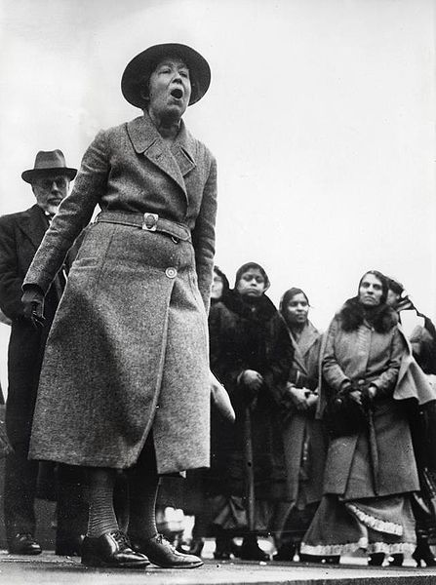
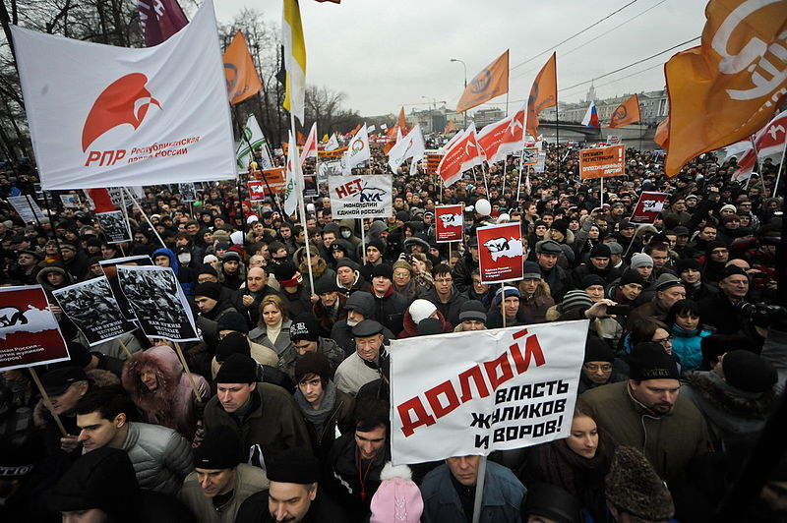
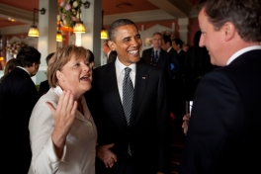
Political Economy of the Web?
Political
  Power
  Governance
  Peaceful conflict resolution
https://commons.wikimedia.org/wiki/File:Moscow_rally_at_the_Bolotnaya_square_10_Dec_2011_1.jpg
http://www.whitehouse.gov/photos-and-video/photogallery/may-2011-photo-day
Spaarnestad Photo, via Nationaal Archief

Slide 3

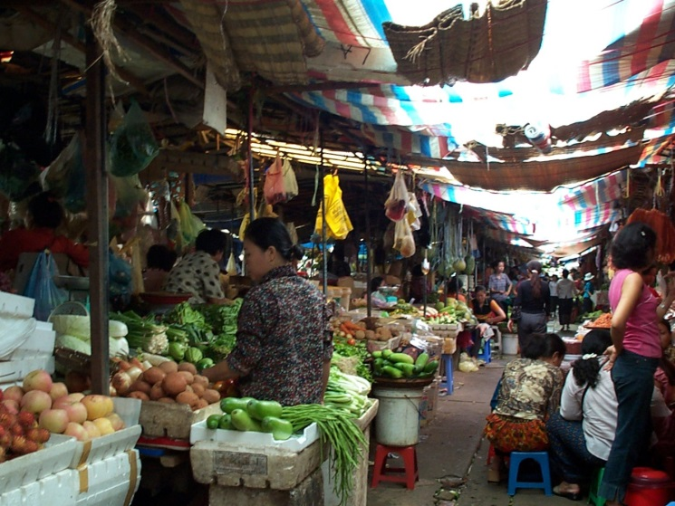
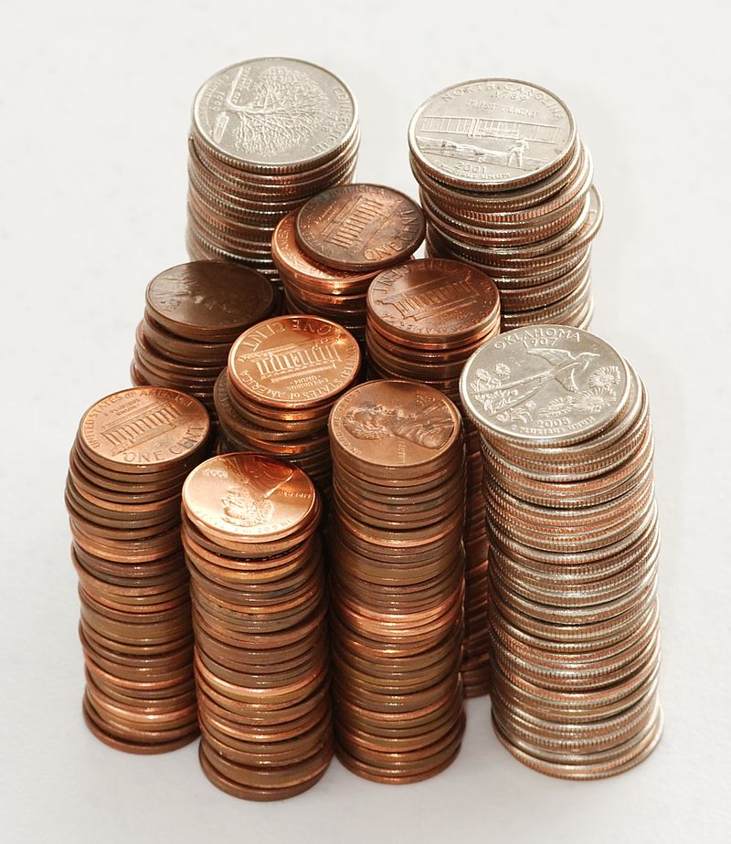
Political Economy of the Web?
Economy
  Resource allocation/distribution
  Exchange
Carlos Latuff - http://latuff2.deviantart.com/art/War-2-27832944
Dori - File:Stack of coins 0214.jpg
https://commons.wikimedia.org/wiki/File:Market_in_Cambodia.jpg

Slide 4
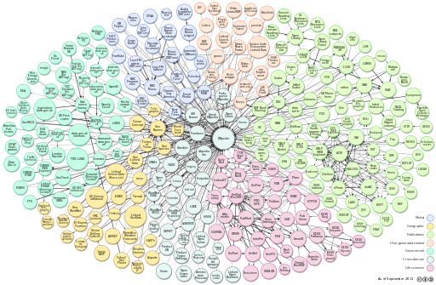
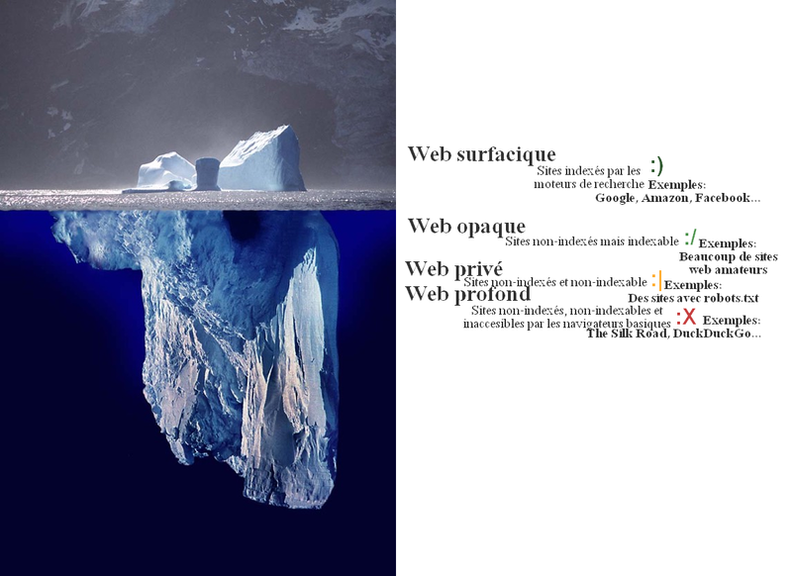
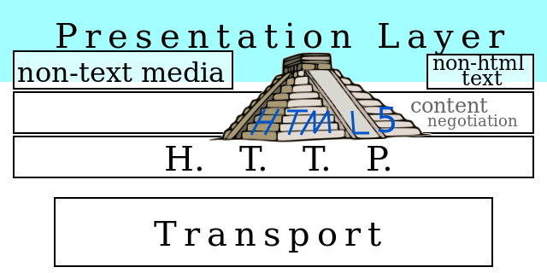
Political Economy of the Web?
Web
  URI abstract namespace
  Technically engineered
  Relation to Internet?
File:Iceberg.jpg (Work by Uwe Kils) http://www.ecoscope.com/iceberg/
Incnis Mrsi
Richard Cyganiak Anja Jentzsch - http://richard.cyganiak.de/2007/10/lod/

Slide 5
Plenty of Methods
Institutions, inc. international relations (Keohane, DiNardis, Schmidt)
Public choice theory – utility-maximising agents (Arrow, Buchanan, Olsen)
Ideology (Morozov, Castells)
Concepts of liquidity, liquid modernity (Bauman)
Marxian, role of capital (Harvey, Zuboff)
Empirical micro studies – A/B testing, Web observatories (Contractor, Dutton, Menczer)
Normative studies (Rawls, Halpin)
Law/regulation – code (Lessig, Solove, Nissenbaum)
Economic theory – networks, interaction costs, disintermediation (Coase, Cowen, Anderson)
Social network theory (Granovetter, Kleinberg)
Actor/network theory (Latour)

Slide 6
Plenty of Problems
Sharing economy, sweating of assets, unemployment – Uber, Airbnb, Mechanical Turk
Governance – who runs the Web?
Government, e-government, transparency – how has the Web transformed government and the delivery of services?
Citizenship, democracy – has the Web facilitated meaningful citizenship? Devolved powers?
Privacy and social networks – do people care? Does that matter? Can we realise the value of big data?
Data – who controls it? Why is it not portable? Where is the cloud, and whose laws regulate it?
Digital divides – are specific groups of people disadvantaged by the Web?
Public spaces – is there an online public space? Or a myriad privatised spaces?
Decline of expertise – has knowledge been democratised? Or have experts been inappropriately marginalised?
Crime – what is a cybercrime? Who decides? What level of policing/surveillance is appropriate?
Intellectual property – is copying good or bad? Who wins, who loses?

Slide 7
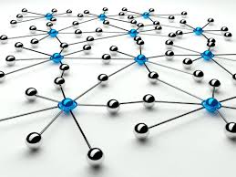
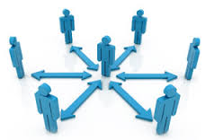
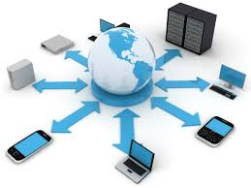
Three Layers of Relevance
Web centric
Web user centric
Non-Web centric

Slide 8
Example: Governance and Standards Setting
Role of W3C
  Other stakeholders? ICANN? IETF?
  Who is excluded?
Legitimacy
  Technical expertise
  History
  Principles – openness, accountability, participation
  Importance of interoperability
Government roles? Centralisation? Multi-stakeholders?

Slide 9
Example: Echo Chambers
Filter technology and filter bubbles (Sunstein, Pariser)
  Recommendations
  News filtering
  Search
How does opinion grow?
Where/how do people consume news?
  How many influences?
  How many networks?
Do closed networks tend towards polarised opinion?

Slide 10
Example: The Right to be Forgotten
Privacy v free expression (Mayer-Schönberger)
Truth, partial truth, outdated, excessive
Google Spain judgment – right to be de-listed
  Jurisdiction
  Activist court (cf. Schrems, Safe Harbor)
  WP29, data protection authorities
Can/should censorship be privatised?
Transparency, accountability

Slide 11
Investigating Political Economy
Who are the actors?
  Their goals? Their incentives?
  Their constraints?
  Voice? Exit?
Where does power lie?
What matters?
  An equitable system?
  A functioning system?
How does the technical influence the social/political/economic?
How political is the technology?

Slide 12
Disclaimer
Texts, marks, logos, names, graphics, images, photographs, illustrations, artwork, audio clips, video clips, and software copyrighted by their respective owners are used on these slides for non-commercial, educational and personal purposes only. Use of any copyrighted material is not authorized without the written consent of the copyright holder. Every effort has been made to respect the copyrights of other parties. If you believe that your copyright has been misused, please direct your correspondence to: kmo@ecs.soton.ac.uk stating your position and I shall endeavour to correct any misuse as early as possible.

