Slide 1
WEBS2002
Posters

Slide 2
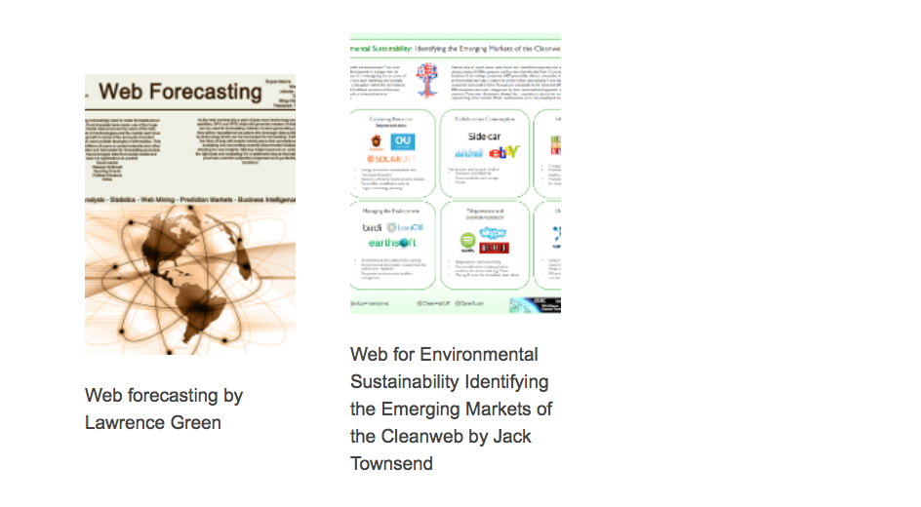

Slide 3
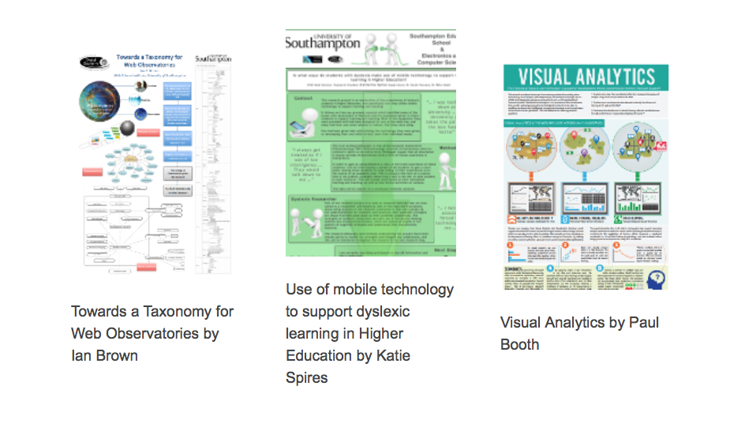

Slide 4
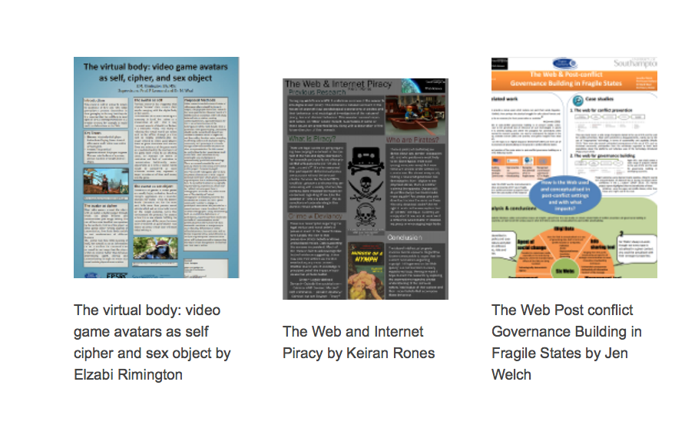

Slide 5
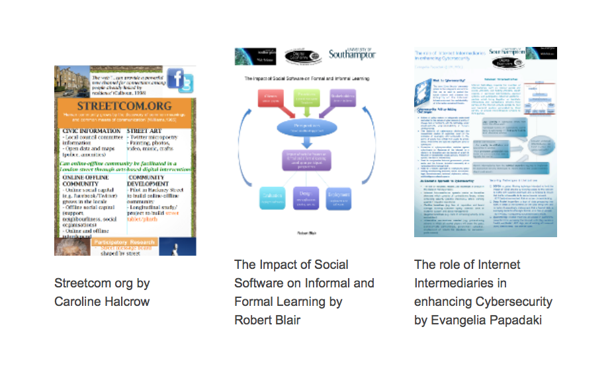

Slide 6
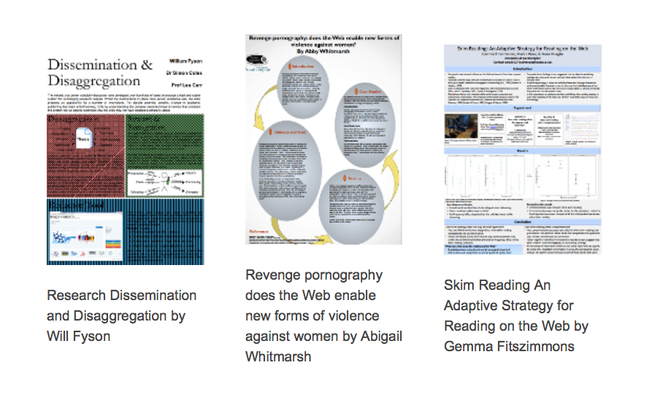

Slide 7
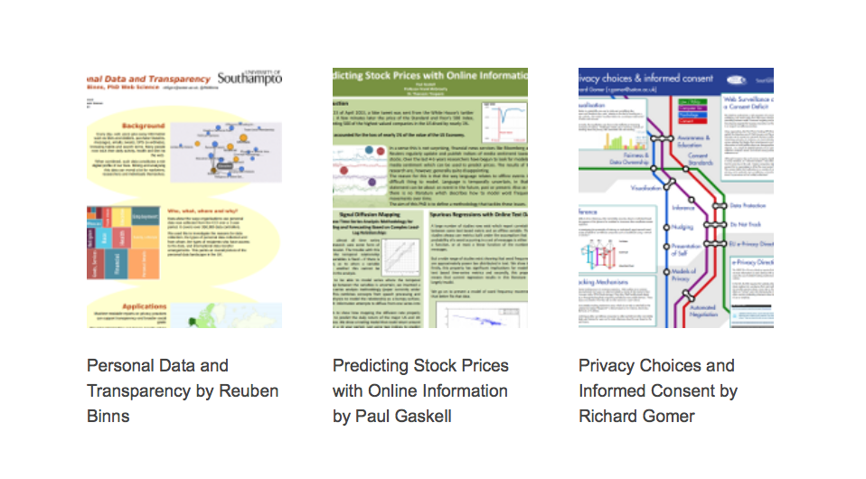

Slide 8


Slide 9


Slide 10
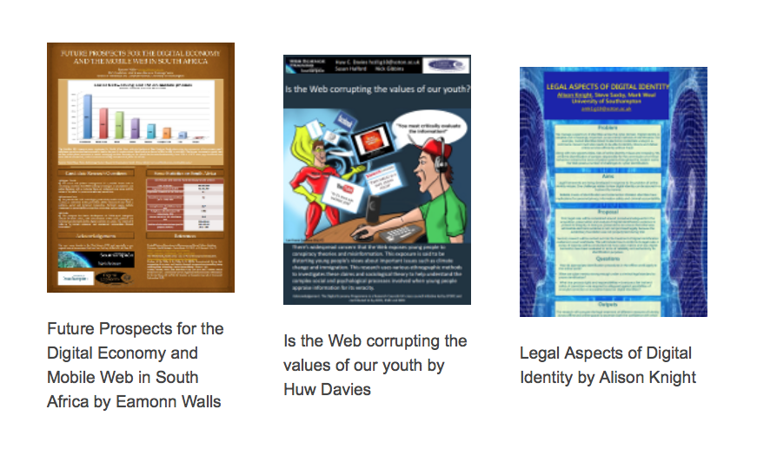

Slide 11


Slide 12


Slide 13
Possible activities
Posters

Slide 14

Quick preview: group projects
While you are looking at the posters go by
Use them to help you think your own groups’ ideas
Reflect on them
Posters are available in a slide set http://www.edshare.soton.ac.uk/13359/
Or you can look at them on the web site pdf downloads available
http://dtc.webscience.ecs.soton.ac.uk/people-and-partners/list-of-students/student-research-interests/web-science-posters/

Slide 15
Quick preview: individual reports
While you are looking at the posters go by
Use them to help you think your own ideas
Reflect on them
Posters are available in a slide set http://www.edshare.soton.ac.uk/13359/
Or you can look at them on the web site pdf downloads available
http://dtc.webscience.ecs.soton.ac.uk/people-and-partners/list-of-students/student-research-interests/web-science-posters/

Slide 16
Quick preview: poster preparation
While you are looking at the posters go by
Which ones are most visually appealing?
Which ones can you actually read?
How useful are the titles?
Posters are available in a slide set http://www.edshare.soton.ac.uk/13359/
Or you can look at them on the web site pdf downloads available
http://dtc.webscience.ecs.soton.ac.uk/people-and-partners/list-of-students/student-research-interests/web-science-posters/

Slide 17
Class exercise: thinking about interdisciplinarity
Individually
Look at the posters
Identify the (possible) contributory disciplines
In Pairs
Discuss your analysis
Expand the list of contributory views
Share
In a round
Tell the class what you learnt
How useful are the titles?
think
share
pair
Notes:
There is a handout, make notes during the feedback

