Slide 1
Envisioning and Engagement
David Millard
dem@soton.ac.uk | @hoosfoos | davidmillard.org

Slide 2
Envisioning and engagement
SSM as part of a Software Engineering
Stakeholder Analysis
Storyboarding
Information gathering techniques
Interviews, Focus Groups, and Research Questions
Ethics of engagement

Slide 3
The Big Software Engineering Picture

Slide 4
Software Engineering: Big Picture
Requirements Gathering
Surveys
Specification
UML
Implementation
Software code
Stakeholder Analysis
Focus groups
Use Cases
Scenarios and Personas
Storyboards
APIs
Document formats
Testing
Unit Tests
Black Box Tests
Etc…
Deployment
Configuration
Bug Tracking
User Support
Design
UML
Class Diagrams
Activity Diagrams
Sequence Diagrams
Etc…
SSM
This is rarely a straightforward progression – in reality there are lots of iterations and points of feedback

Slide 5
Software Engineering: Big Picture
Requirements Gathering
Surveys
Specification
UML
Implementation
Software code
Stakeholder Analysis
Focus groups
Use Cases
Scenarios and Personas
Storyboards
APIs
Document formats
Testing
Unit Tests
Black Box Tests
Etc…
Deployment
Configuration
Bug Tracking
User Support
Design
UML
Class Diagrams
Activity Diagrams
Sequence Diagrams
Etc…
SSM
From a problem statement to starting to find a solution – Requirements Capture
This is rarely a straightforward progression – in reality there are lots of iterations and points of feedback

Slide 6
Requirements Capture: What is the Challenge?
Requirements Gathering
Surveys
Specification
Storyboards
Scenarios and Personas
Use Cases
UML
SSM
Focus groups
Stakeholder Analysis

Slide 7
Requirements Gathering
Surveys
Specification
Storyboards
Scenarios and Personas
Use Cases
UML
SSM
Focus groups
Stakeholder Analysis
Users don’t always know what they want
They often need help to innovate
They may have conflicting requirements
They may not have a complete picture
They use the language of their mini-world (domain)
Not necessarily the same language as technologists
It may be imprecise and contextual

Slide 8
Requirements Gathering
Surveys
Specification
Storyboards
Scenarios and Personas
Use Cases
UML
SSM
Focus groups
Stakeholder Analysis
We have already seen:
Soft Systems Models
Scenarios and Personas
Next we will look at:
Stakeholder Analysis
Storyboards

Slide 9
Stakeholder Analysis

Slide 10
Stakeholder Analysis: Who are the users?
Primary Stakeholders
People who actually use the system
Primary

Slide 11
Stakeholder Analysis: Who are the users?
Primary Stakeholders
People who actually use the system
Secondary Stakeholders
People who do not directly interact with the system, but provide input to it, or receive output from it
Primary
Secondary

Slide 12
Stakeholder Analysis: Who are the users?
Primary Stakeholders
People who actually use the system
Secondary Stakeholders
People who do not directly interact with the system, but provide input to it, or receive output from it
Tertiary stakeholders
People who do not directly interact with the system, but are affected by it
Primary
Secondary
Tertiary

Slide 13
Stakeholder Analysis: Who are the users?
Primary Stakeholders
People who actually use the system
Secondary Stakeholders
People who do not directly interact with the system, but provide input to it, or receive output from it
Tertiary stakeholders
People who do not directly interact with the system, but are affected by it
Facilitating
People who are involved in the design, development and maintenance of the system
Primary
Secondary
Tertiary

Slide 14
Activity: Stakeholder Analysis example
Who are the stakeholders for the checkout system of a large supermarket?
Identify possible primary, secondary and tertiary stakeholders.
What are their roles?
Stakeholder type | Stakeholder | Role/description

Slide 15
Storyboards
A visual guide to how software will look and feel
Can be sketches, digital sketches (wireframes), or prototypes (i.e real interfaces but with no functionality)
Help communicate:
spatial layout and structure
workflow through an application
availability or non-availability of functionality at different points

Slide 16
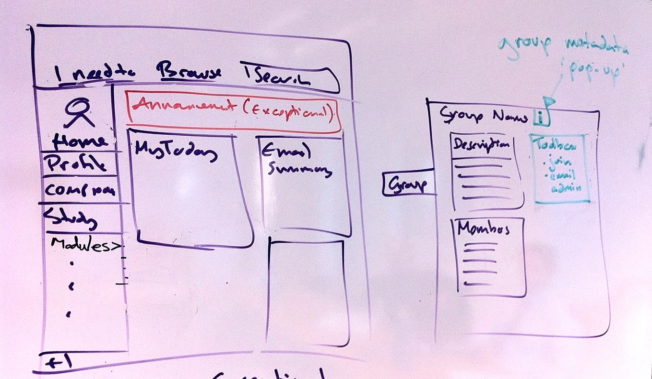
Storyboard: May start as a literal sketch

Slide 17
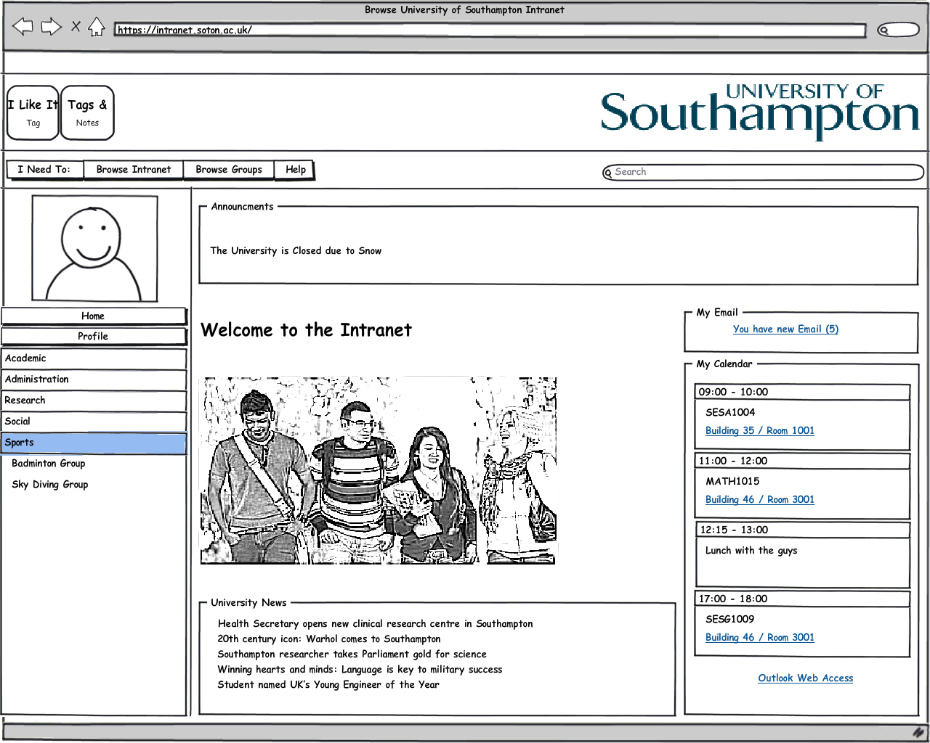
Evolves into a digital mockup (wireframe)

Slide 18
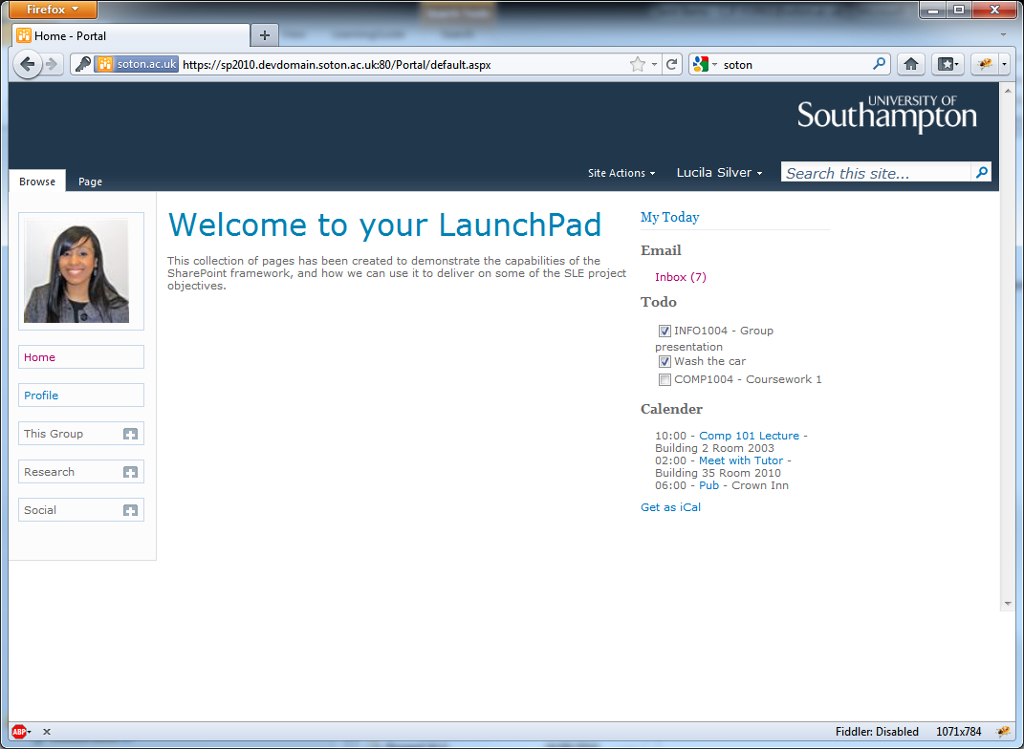
And finally into a prototype (or interactive mock-up)

Slide 19
Gathering Information

Slide 20
Where do you get your evidence?
SSM
Stakeholder Analysis
Personas and Scenarios
(and eventually your UML Diagrams)
All require primary evidence from the business
What are the techniques you can use to get that evidence?

Slide 21
A Successful Information Gathering Campaign
Who will provide you with information?
Identify participants from your stakeholder analysis
What information gathering techniques will give you the information you need?
Interview
Focus group
Questionnaires
Triangulation
Using more than one method to make sure that you gain data from different perspectives - do the results agree?

Slide 22
Interviews
Structured
Semi-Structured
Unstructured
Ask all participants the same predetermined questions
The questions need to be short and clearly worded
Typically closed questions
Features of both structured and unstructured interviews
Closed and open questions
The interviewer has a script for guidance so that all topics are covered with each interviewee
Exploratory conversations around a topic
Open ended questions
But the interviewer needs to steer the conversation to ensure that the goal of the interview is met
Closed : Is Wordpress a good website tool?
Open : What are the pros and cons of using Wordpress?

Slide 23
Interview Questions
Structured (closed)
Do you consider lectures an important part of your University learning?
Photo by CollegeDegrees360 via Flickr.com
We are interviewing a student and what to get information on their world view around lectures

Slide 24
Interview Questions
Structured (closed)
Do you consider lectures an important part of your University learning?
Unstructured (open)
What are the most important ways in which you learn at University?
Photo by CollegeDegrees360 via Flickr.com
We are interviewing a student and what to get information on their world view around lectures

Slide 25
Interview Questions
Structured (closed)
Do you consider lectures an important part of your University learning?
Unstructured (open)
What are the most important ways in which you learn at University?
Semi-structured (mediated)
What are the most important ways in which you learn at University?
Photo by CollegeDegrees360 via Flickr.com
We are interviewing a student and what to get information on their world view around lectures

Slide 26
Interview Questions
Structured (closed)
Do you consider lectures an important part of your University learning?
Unstructured (open)
What are the most important ways in which you learn at University?
Semi-structured (mediated)
What are the most important ways in which you learn at University?
What about lectures?
Is that true for all subjects?
Photo by CollegeDegrees360 via Flickr.com
We are interviewing a student and what to get information on their world view around lectures

Slide 27
Focus Groups
Interviewing groups of people together
3 to 10 members of a focus group are typical
Can help to identify conflicts of terminology, expectations or lack of a shared understanding
Can allow diverse or sensitive issues to be raised
Enables people to put forward their opinions in a supportive environment
The interviewer (facilitator) guides and prompts discussion and encourages quieter people to contribute
The facilitator plans a loose agenda to ensure the objectives of the session are covered (like a semi-structured interview)

Slide 28
Activity: Planning information gathering
Scenario: You are looking at building a system to manage the information during University Admissions. You have access to the Admissions Tutors, Admin Team and Recent Applicants and want to gather information for your SSM.
What methods might be appropriate?
What ways could you record the data?

Slide 29
Activity: Planning information gathering
Scenario: You are looking at building a system to manage the information during University Admissions. You have access to the Admissions Tutors, Admin Team and Recent Applicants and want to gather information for your SSM.
What methods might be appropriate?
What ways could you record the data?
Assuming you went ahead with a semi-structured interview with the Admissions Tutor – what questions would you ask?

Slide 30
What to Ask?
Use the SSM CATWOE framework
Client, Actors, Transformations, World Views, Owners, Environment
Consider the other elements from SSM
Scope
Inputs and outputs
Processes that transform inputs to outputs
Resources Authorities and emergent properties

Slide 31
Ensuring Coverage
Colour code each section of the study materials according to research q’s
Write research questions
Design materials
Assign a colour to each research question
Are all of the research q’s accounted for?
Conduct study

Slide 32
Ethics of engagement
Before the study
During the study
After the study
Risk of harm
Truthfulness/ openness/ communication
Protection of data
Privacy/ confidentiality
Be careful to only ask for what you need
Don’t waste time
Absolute right to withdraw

Slide 33
Royal Academy of Engineering statement of ethical principles
Accuracy and Rigour
Honesty and Integrity
Respect for Life, Law and the Public Good
Responsible Leadership: Listening and Informing
http://www.raeng.org.uk/news/publications/list/reports/Statement_of_Ethical_Principles.pdf

Slide 34
Summary
SSM as part of a Software Engineering
Stakeholder Analysis
Storyboarding
Information gathering techniques
Interviews, Focus Groups, and Research Questions
Ethics of engagement

