Slide 1
CINAHL Keyword Searching

Slide 2
This presentation will take you through the procedure of finding reliable information which can be used in your academic work using the CINAHL bibliographic database.

Slide 3
Bibliographic databases
Each database is produced by a different organisation and has a different emphasis; this means that you can choose which ones to use depending on what topic you are looking at.
They may not immediately give you the full-text of the article, but they do give you the references of articles so you will need to use one of the full-text links or the link to TDNet, our journal catalogue to see if the University buys the journal.
CINAHL is one of the best databases covering Health subjects and the one which we will be teaching you to use. Another useful database MEDLINE has the same interface.

Slide 4
Planning your search
1. Identify the keywords in your essay title and think of synonyms for those words e.g.
stroke - cerebrovascular accident, cva etc.
2. Also think of American spellings or differences in terminology e.g. physiotherapy/physical therapy, foetus/fetus
3. Use truncation e.g.
child* will find child, children, childhood, childs etc.
Let’s look at the term physiotherapy – where should we place the truncation symbol?
Click here for the answer
4. Use quotes at the beginning and end if you are using a phrase e.g.
“mental health” it will then search it as a phrase and not as individual words
physiotherap*

Slide 5
Using Boolean
Operator | Example search | The search will find
or | stroke or cerebrovascular accident or cva | Articles where the author has used any of the terms Remember or broadens a search, resulting in more hits
and | rehabilitation and stroke | Articles containing both rehabilitation and stroke Remember and narrows a search, resulting in fewer hits
5

Slide 6
Using these tools will help you to create an audit trail of your literature search
An audit trail will allow the person marking your piece of work to follow through step-by-step your literature search.
It will also allow you to manage your time more effectively because you won’t be wasting time searching for material that you have lost because of poor record keeping.

Slide 7
An audit trail will show all of the stages of the search procedures, such as:
Determining key terms, including synonyms and alternative spellings
The databases used
The date range used
The dates of access
The search history
The justification for excluding data

Slide 8
In order to search effectively:
You need a question and a search strategy
Can you write your question in one sentence?
Have you listed all the relevant terms/ideas to show you have really thought about your research project?

Slide 9
Consider the following question:
“What research evidence is there to support the theory that exercise or exercise programmes help in the prevention of falls in the elderly?”

Slide 10
The key topics are obvious
“What research evidence is there to support the theory that exercise or exercise programmes help to prevent falls in the elderly?”
falls
elderly
exercise
prevention
But how else can these topics be described and do we need to include them all?

Slide 11
old
elderly
aged
trip
falls
accident
stumble
physical activity
exercise
work out
stop
prevent
avoid

Slide 12
Search 1
fall*
or
trip*
or
accident*
12

Slide 13
Search 2
elder*
or
old*

Slide 14
Search 3
exercis*
or
active*
14

Slide 15
Search 4
prevent*

Slide 16
To find them go to the library web pages:
www.soton.ac.uk/library

Slide 17
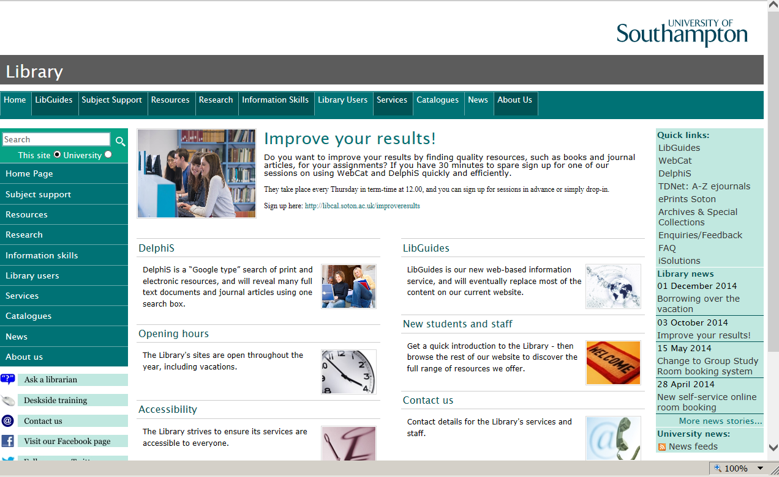

Slide 18
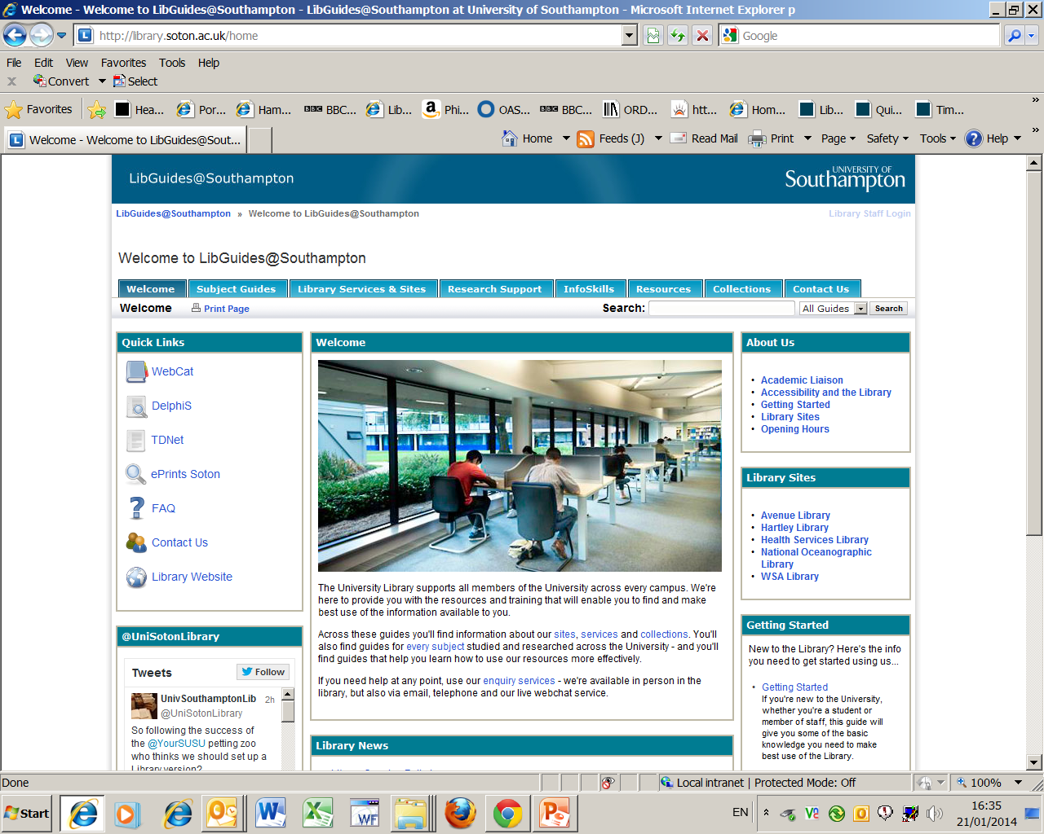

Slide 19
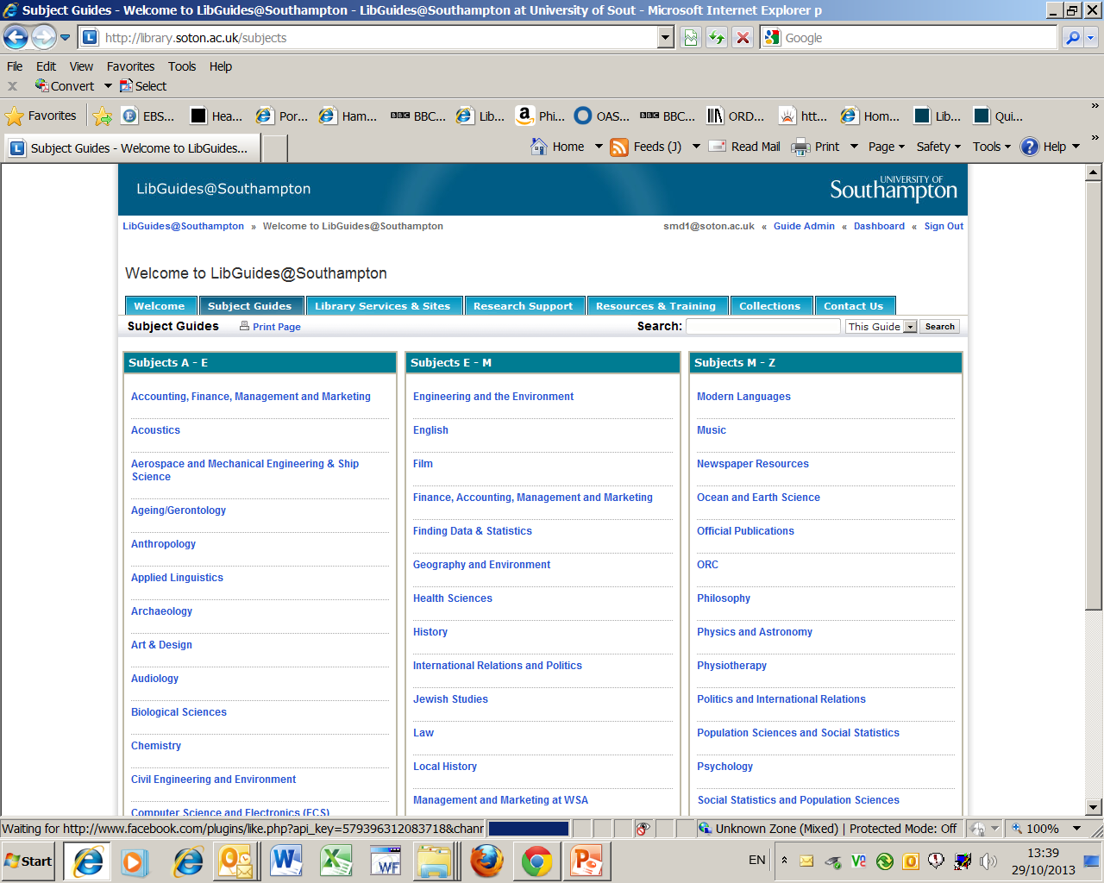
Select the relevant subject link
Notes:
Select the correct subject link – they all take you to the same place the library Health Sciences web pages

Slide 20
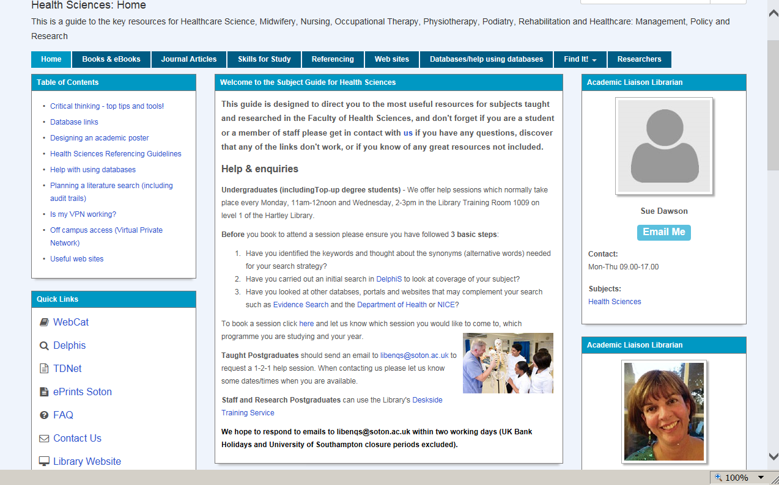
Or here
Here

Slide 21
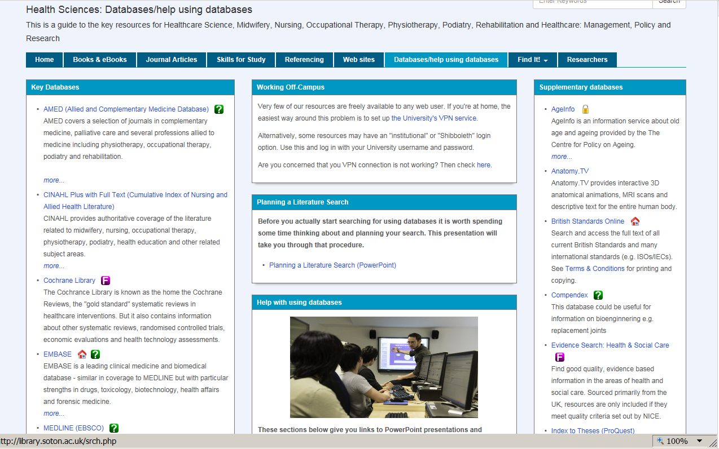
Link to open CINAHL
Help with using the most popular databases
can be found in this column

Slide 22
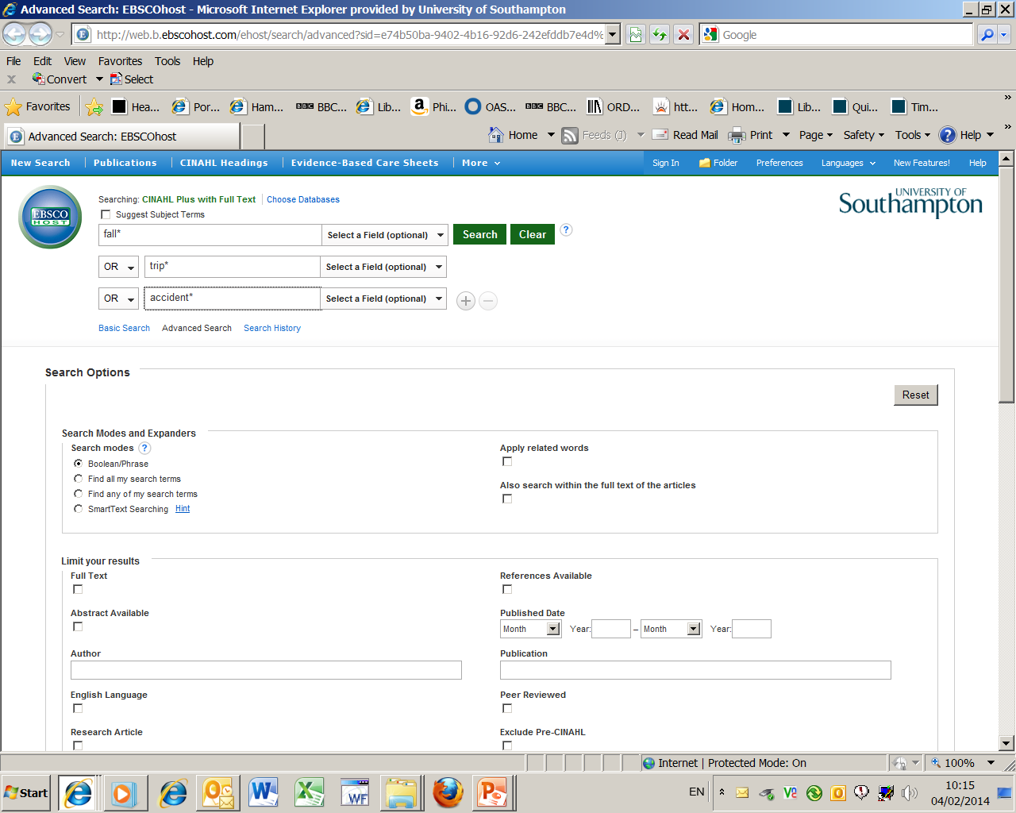
1. Enter your search term/s
3. Activate your search
2. Remember to change the drop-down
option from AND to OR

Slide 23
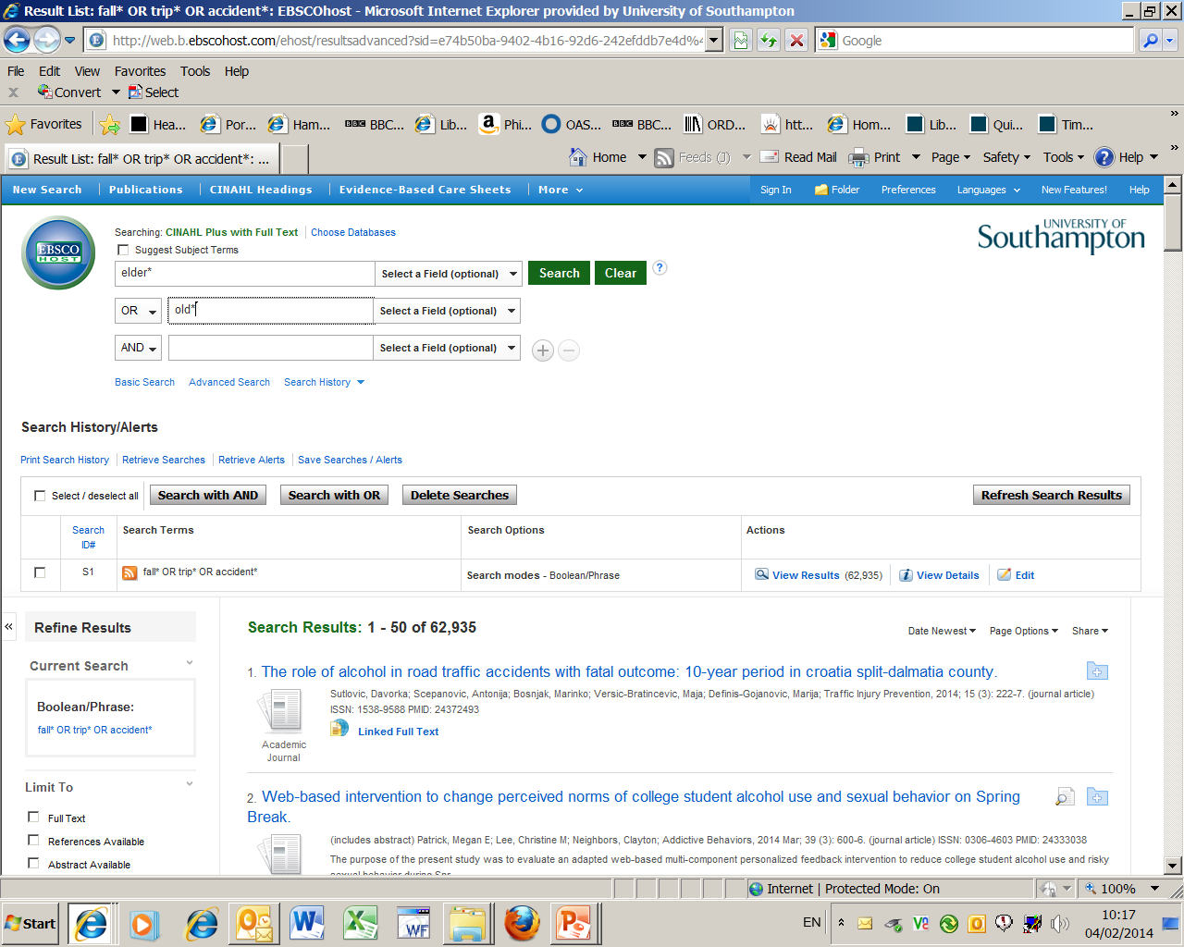
2. Enter next search term/s
4. Activate your search
3. Remember to change the
drop-down option from
AND to OR
1. Results of first search

Slide 24
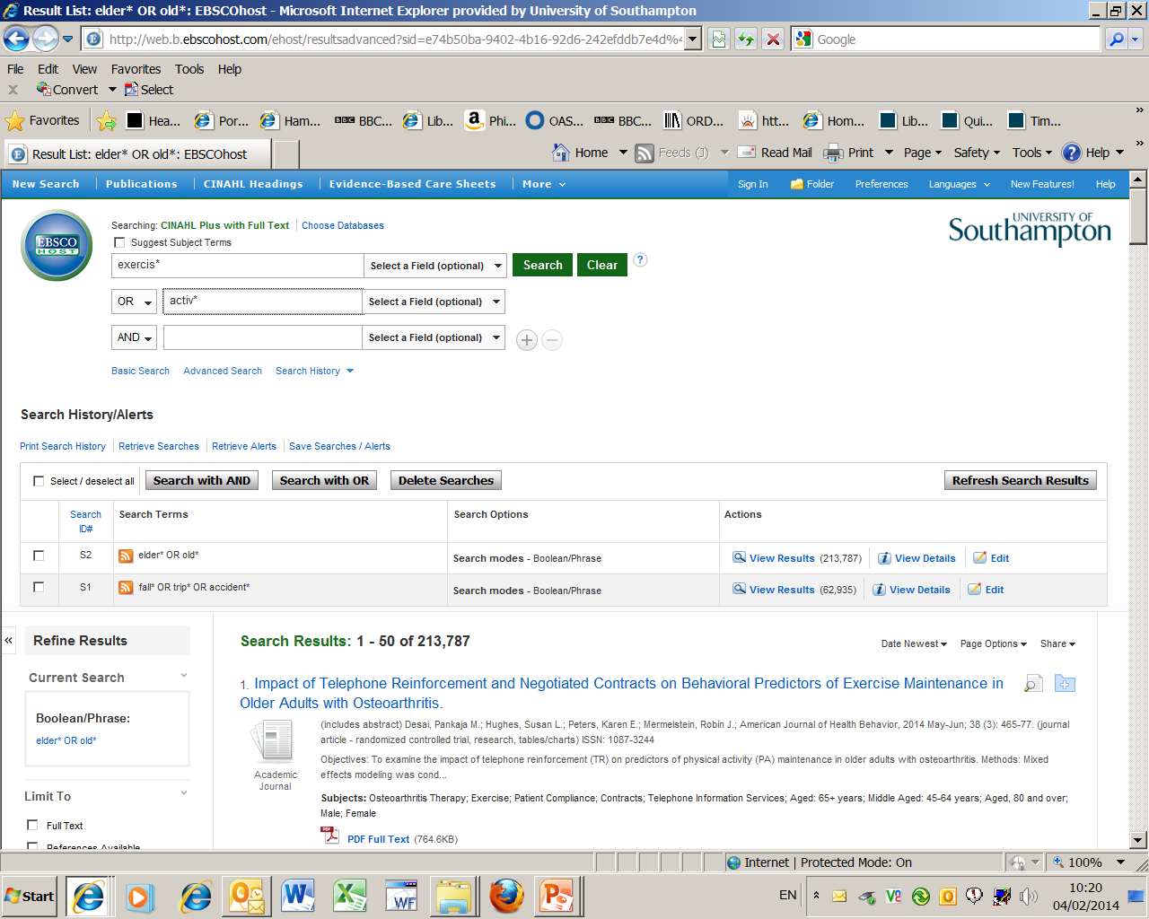
2. Enter the next set of
search term/s
4. Activate your search
3. Remember to change
the drop-down
option from AND to OR
1. Results of second search

Slide 25
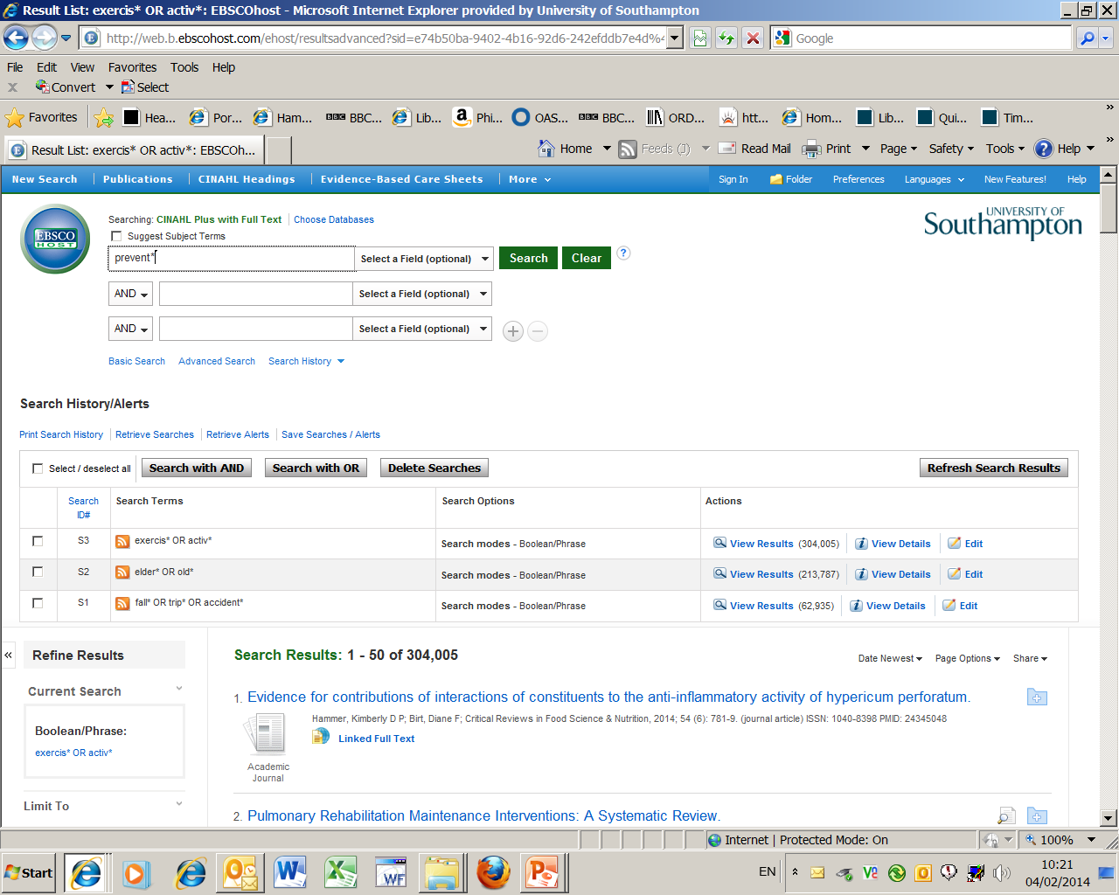
2. Enter the final
search term/s
3. Activate your search
1. Results of third search

Slide 26
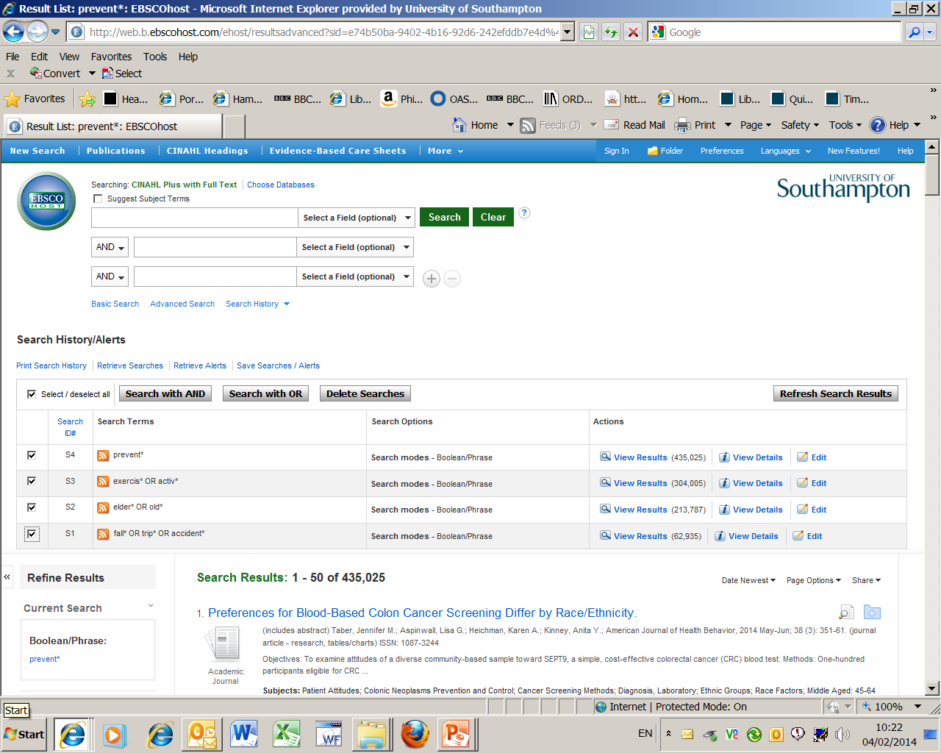
3. Then choose AND because we want
the results to include all the concepts
1. Results of final search
2. To combine searches
tick boxes

Slide 27
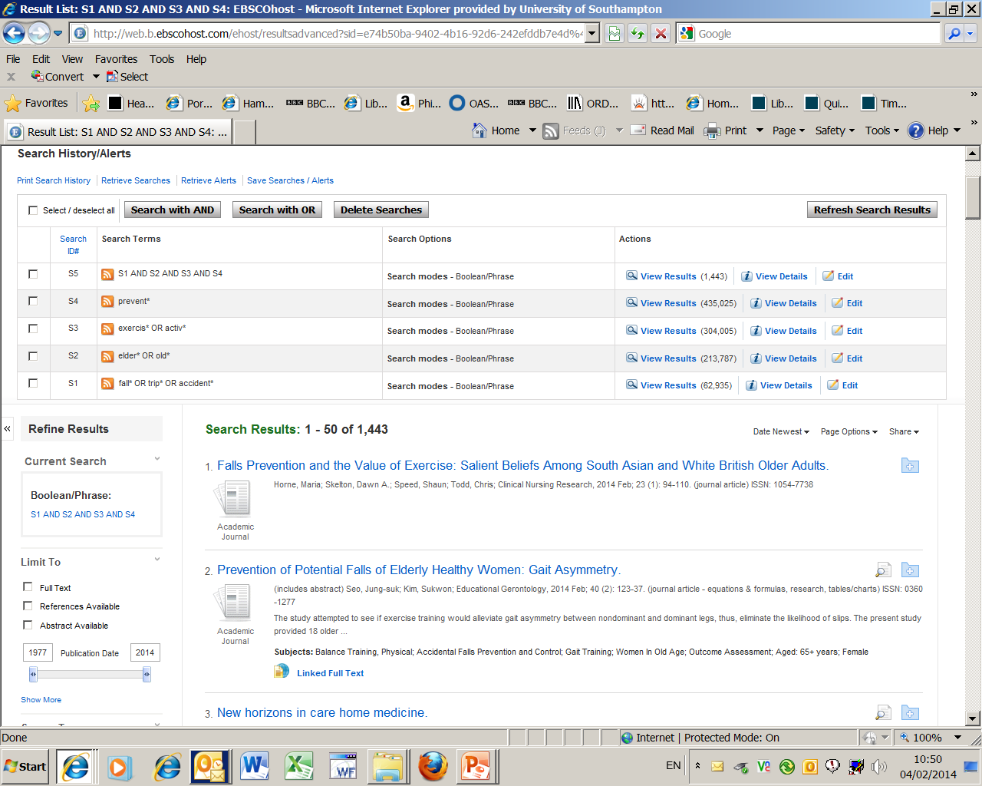
1. Result of the four combined searches
2. To reduce the number of results
use the Show More link

Slide 28
Refining (limiting) your search
You can choose limits such as:
Date of publication
Language
Age Group/s
Gender
Publication type i.e. journal
Journal subset i.e. English & Ireland journals

Slide 29
We will narrow our search:
1. By year of publication
2. Geographical Subset – Great Britain
3. Abstract available
4. English language

Slide 30
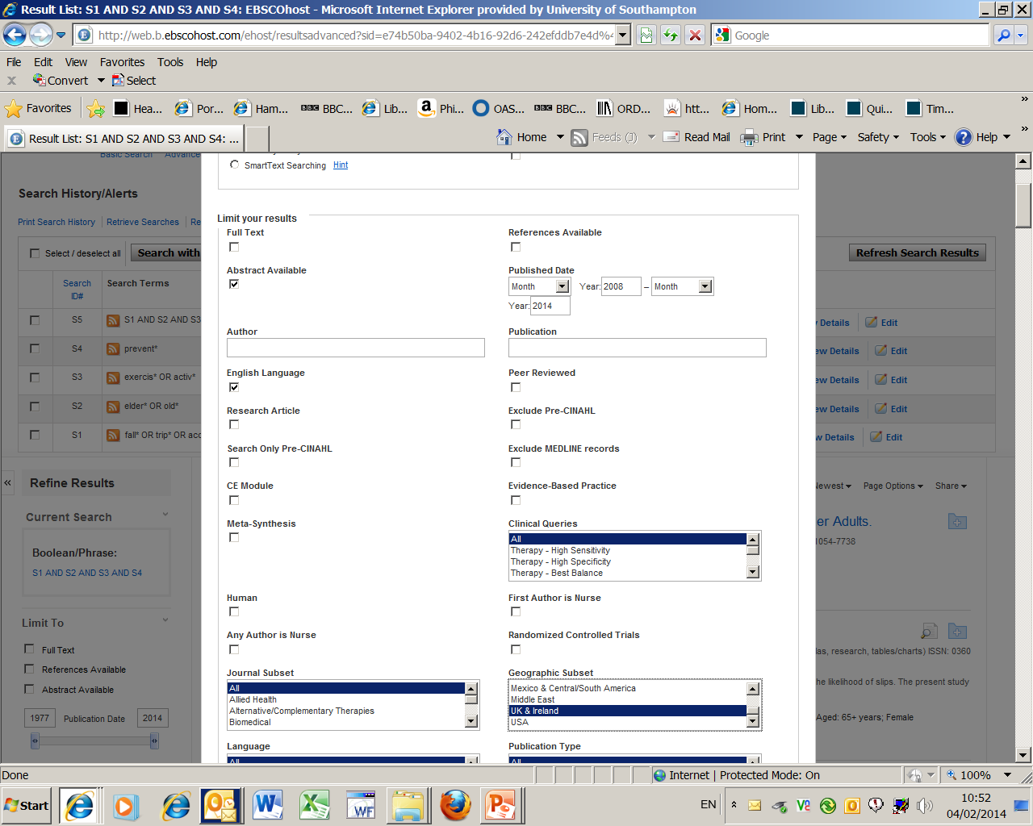
We will be using these
then activate the
button at the top
or bottom of the page

Slide 31
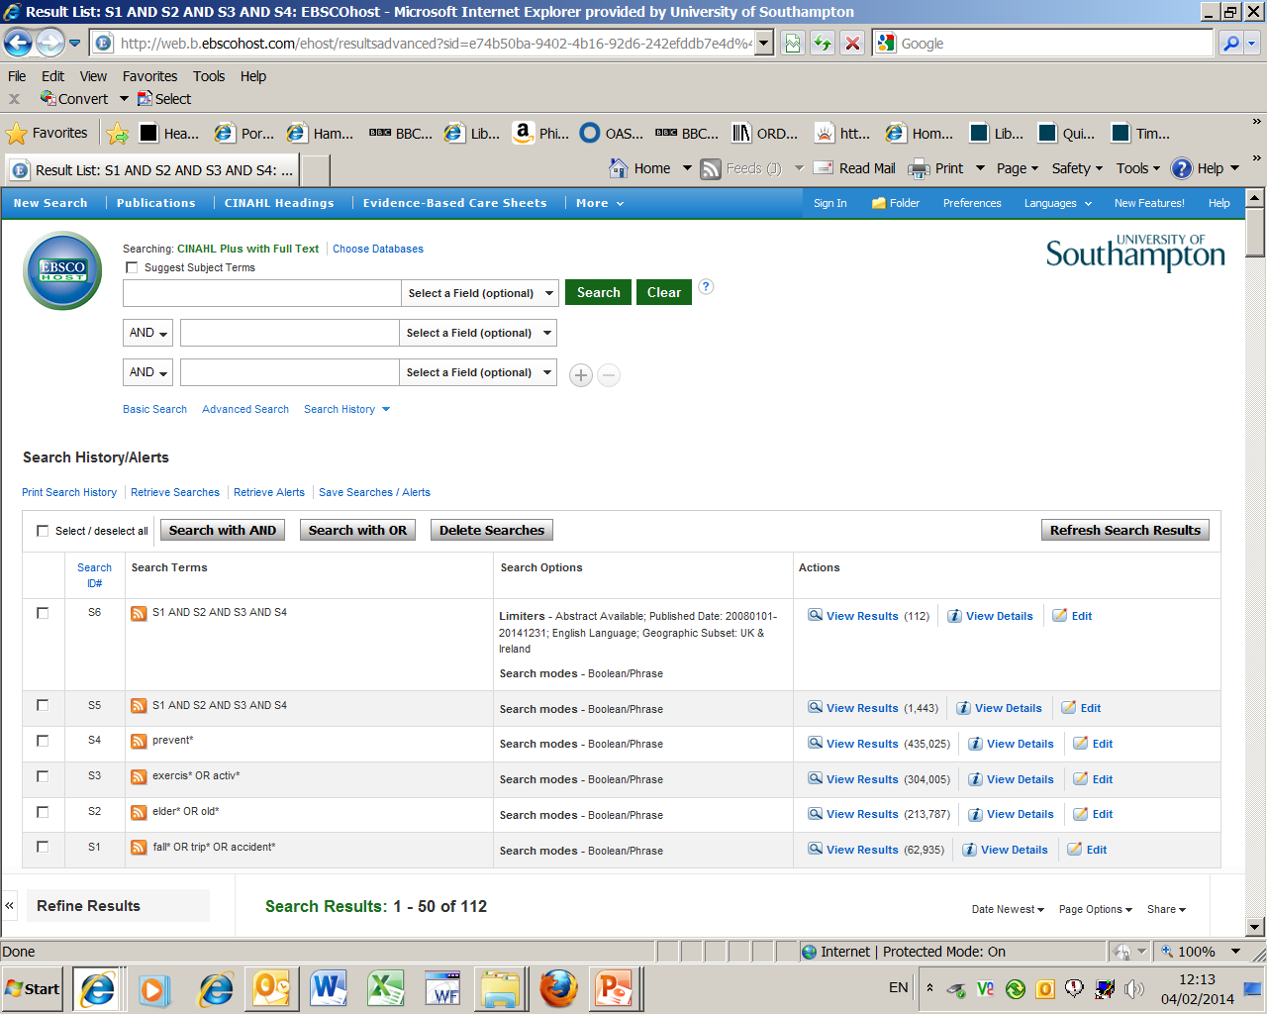
Final result

Slide 33
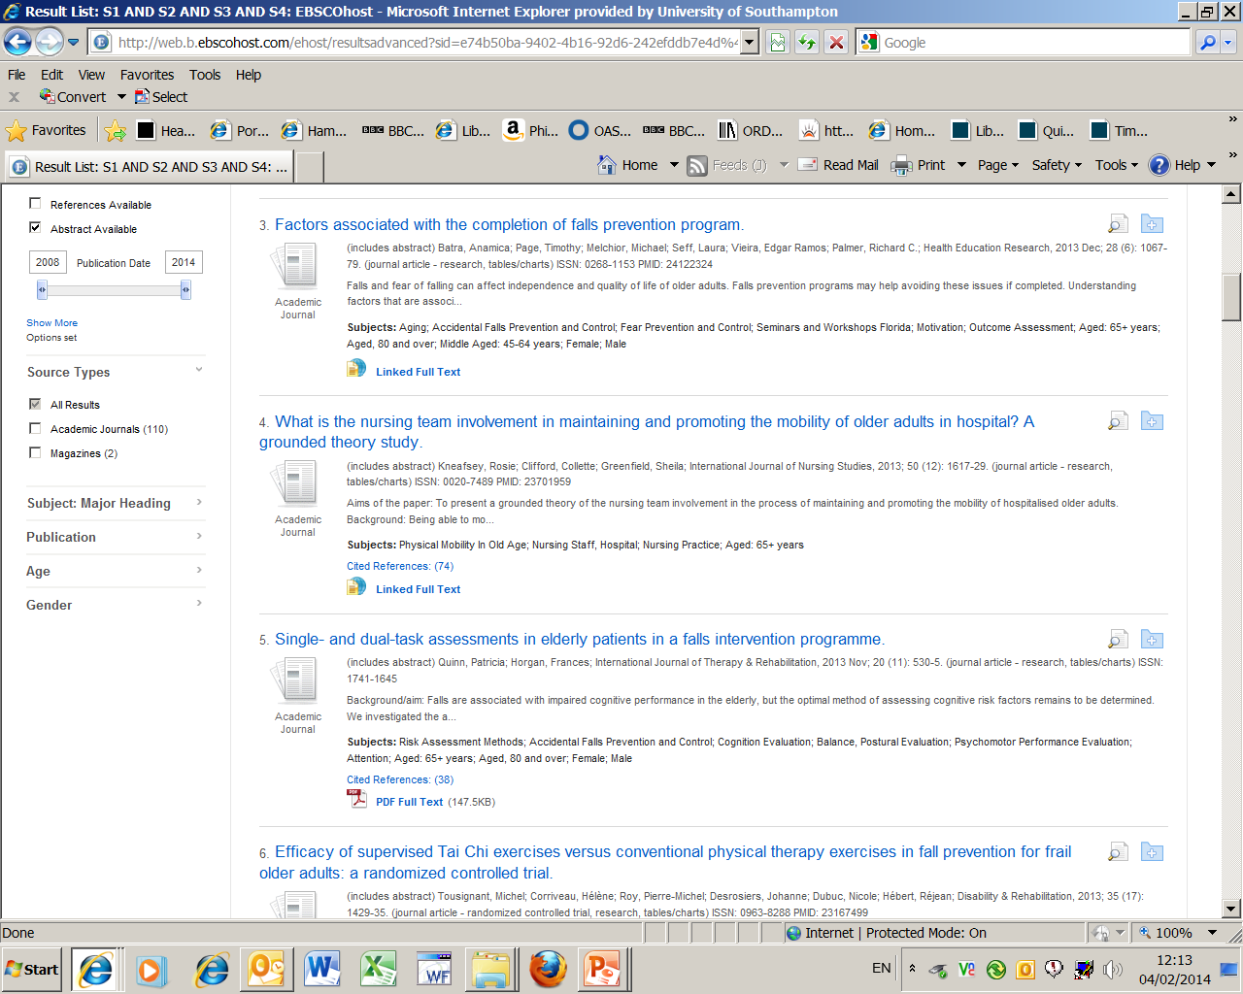
2. See full details of the reference by using this title link
1. If you just want to look at the abstract
hold mouse over magnifying glass

Slide 34
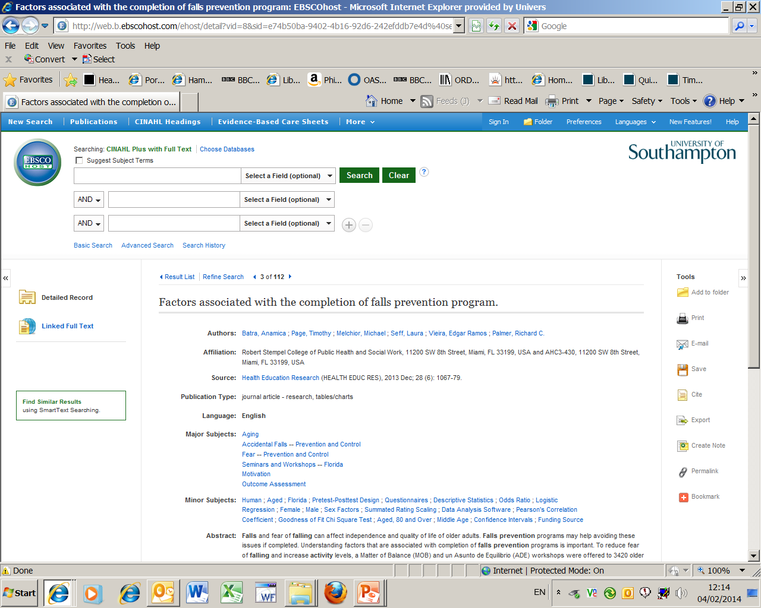
2. Return to results link at the top of the page
1. Full details of the reference

Slide 35
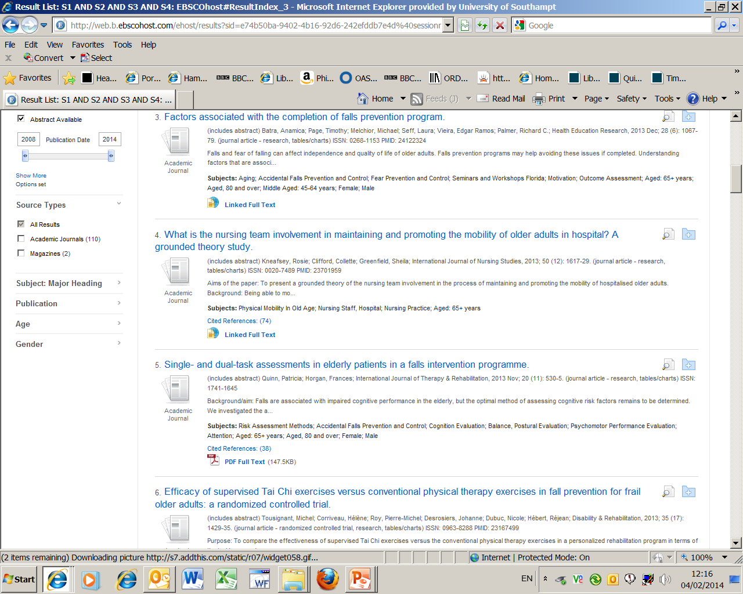
Either of these two links
will take you to the
full text of the article

Slide 36
To save, print or email article use
one of these options

Slide 37
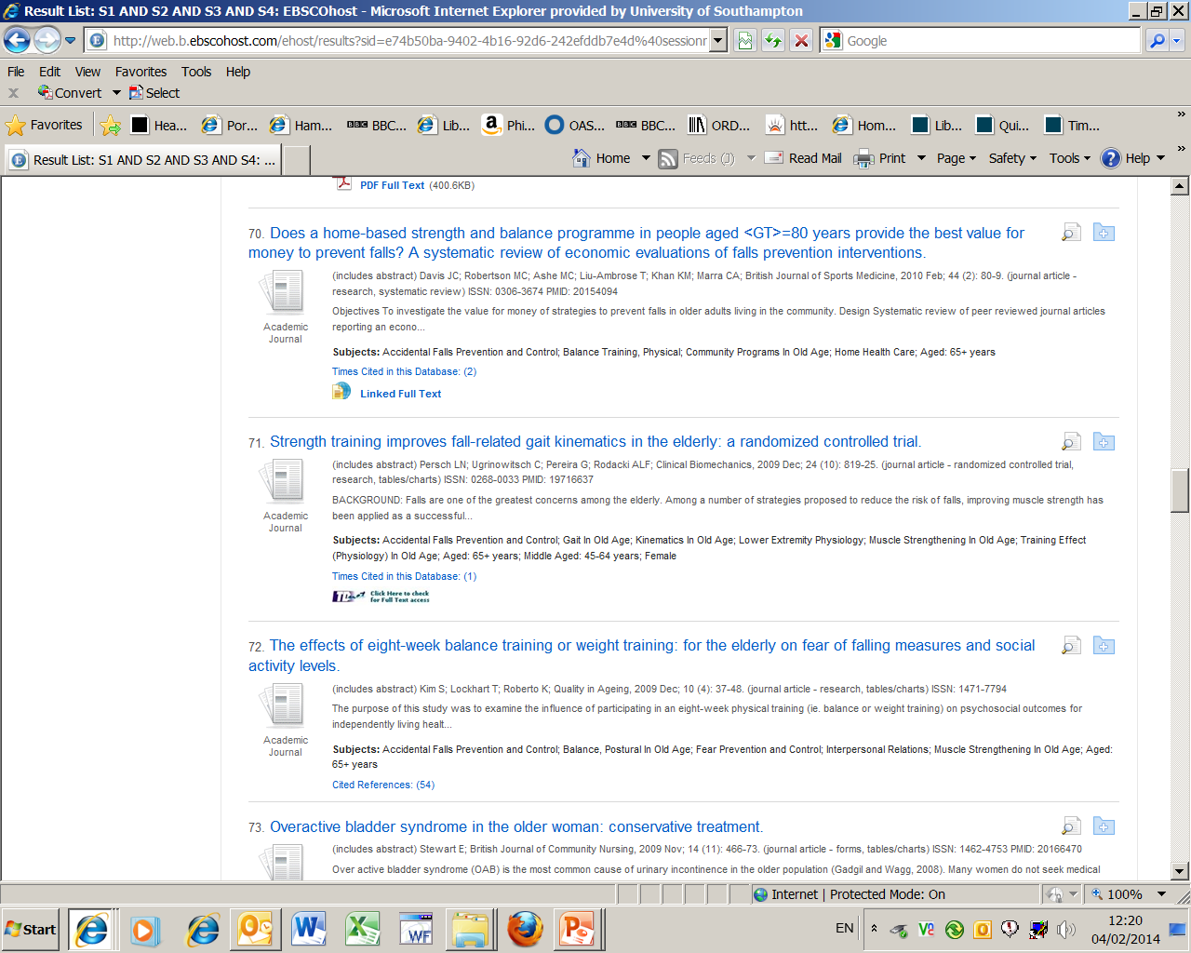
This TDNet link will also take
you to the full text

Slide 38
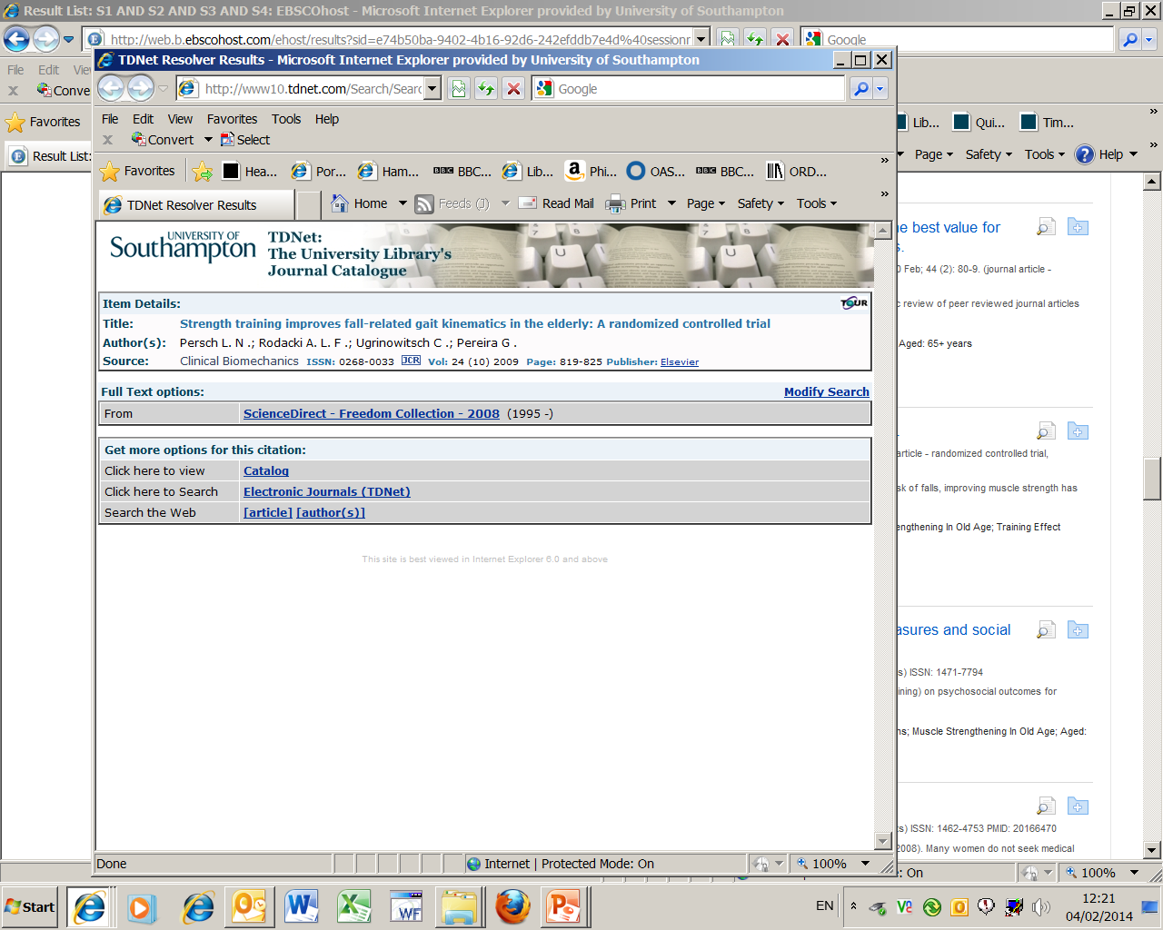
Use this link to open the full-text

Slide 39
If there is no link the library
does not subscribe to the journal

Slide 40
If we don’t have access to a reference which is really important then use our Inter-Library Loans service:
Login to WebCat
Go to:
Requests: inter-library loans and stack
Inter-library loan requests
Choose the relevant form for the item you are requesting, complete the form then submit
To check to see how many request you are entitled to go to: www.soton.ac.uk/library/services/ill.html

Slide 41
Copying and Copyright
You should assume that everything is subject to copyright law, unless this is clearly stated otherwise
You should save, print or email only one copy of an article from an issue of a magazine or journal. In the case of a book, pamphlet or report, you should make single copies of not more than one chapter, or extracts amounting to no more than 5% of the entire work
For more information see:
www.soton.ac.uk/library/about/regulations/ copyrightphotocopying. html

Slide 42
Saving your references & search history

Slide 43
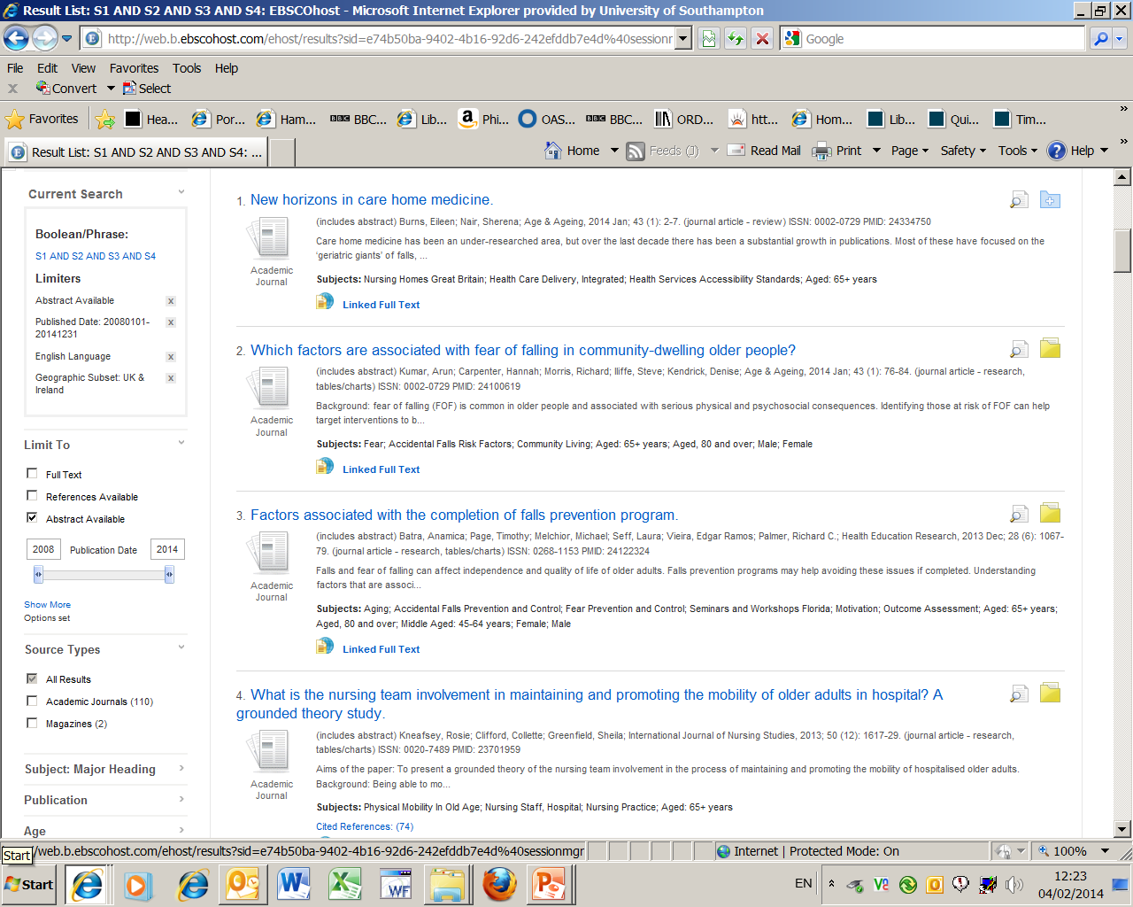
Then go to the
at the top of the page
1. Add to folder those
references you want
to save, page by page…..

Slide 44
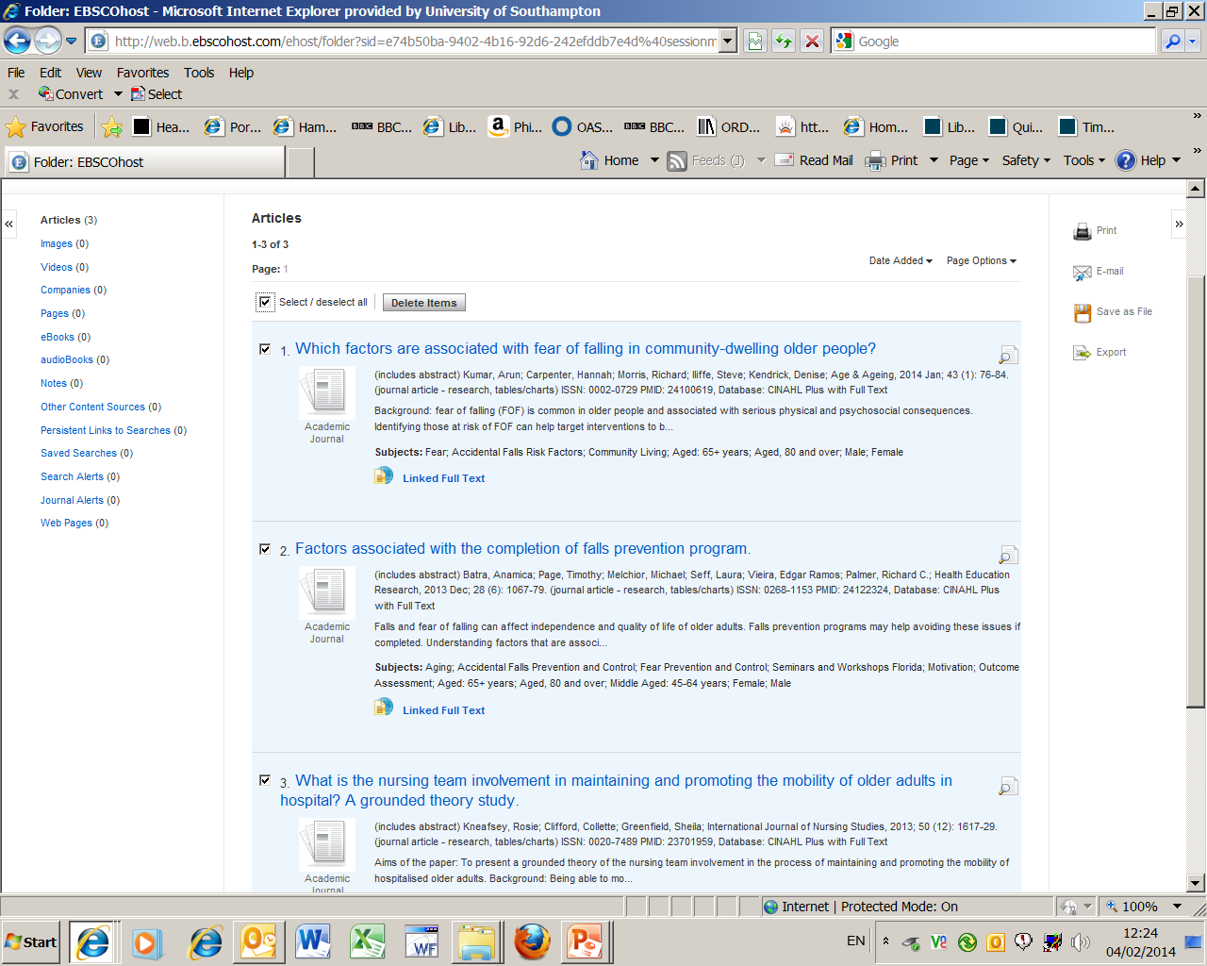
2. Choose your
method of output
1. Select your
references again

Slide 45
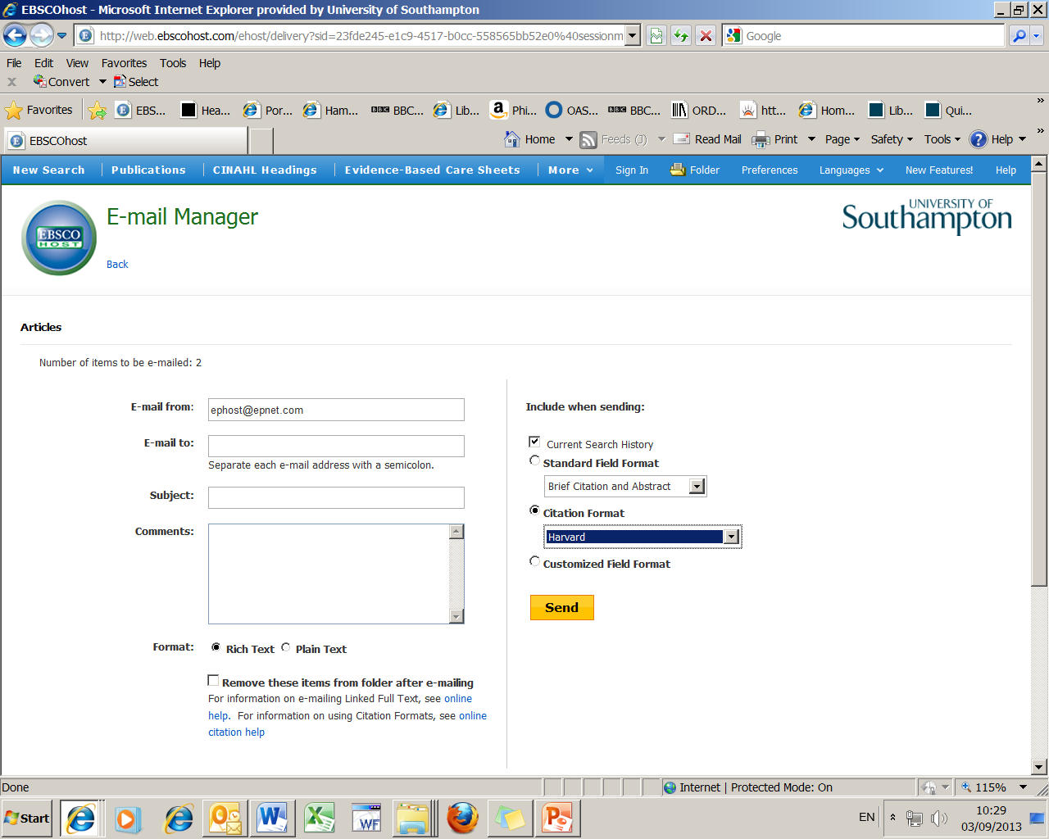
Change citation format
to Harvard as it is the
closest to the Health Sciences
Referencing guidelines
45

Slide 46
For more help go to: http://library.soton.ac.uk/healthsciences

Slide 47
Undergraduates (including top-up students) should book into one of our twice weekly help sessions.
These sessions take place every Monday, 11am-12noon and Wednesday, 2-3pm in the Hartley Library. To attend one of these sessions you must book before-hand, when booking please state:
Which session you would like to come to and which date.
Which programme you are studying (nursing, occupational therapy, top-up etc.).
Which year you are in.
We will reply to confirm if you have a place.

Slide 48
Taught Postgraduates should send an email to libenqs@soton.ac.uk to request a 1-2-1 help session. When contacting us please let us know some dates/times when you are available.
Staff and Research Postgraduates can use the Library's Deskside Training Service via our LibGuides pages.

