Slide 1
Streaming Semantic Data
COMP6215 Semantic Web Technologies
Dr Nicholas Gibbins – nmg@ecs.soton.ac.uk
2014-2015

Slide 2
From Knowledge Bases to Semantic Streams
Common Semantic Web assumptions:
persistent data storage
relatively static data
complex one-off queries
expressive reasoning

Slide 3
From Knowledge Bases to Semantic Streams
Some applications have very different requirements:
data arrives in real-time
too much data to store!
data never stops coming
ongoing lightweight analysis of rapidly changing data

Slide 4
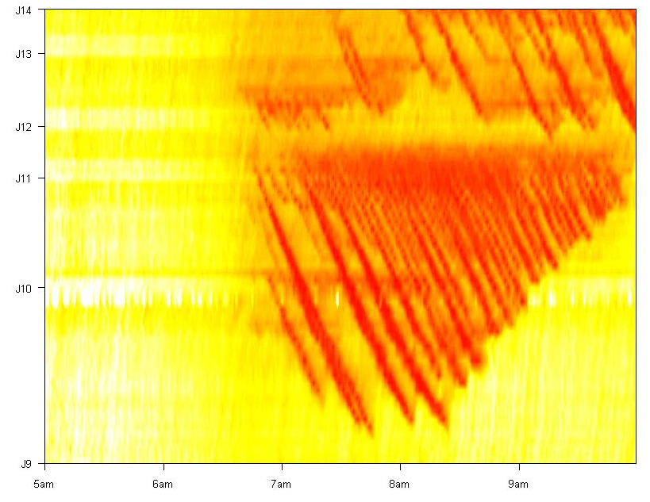
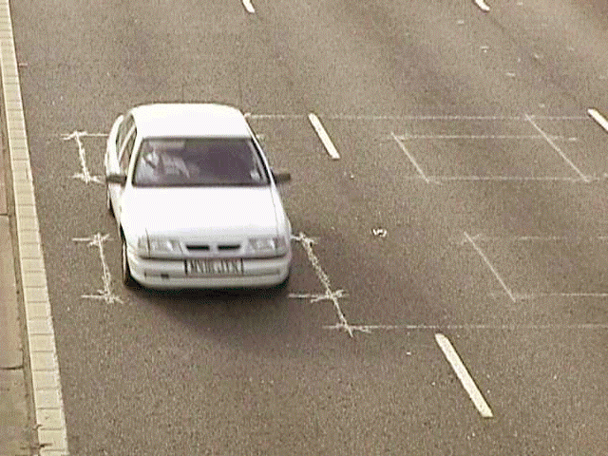
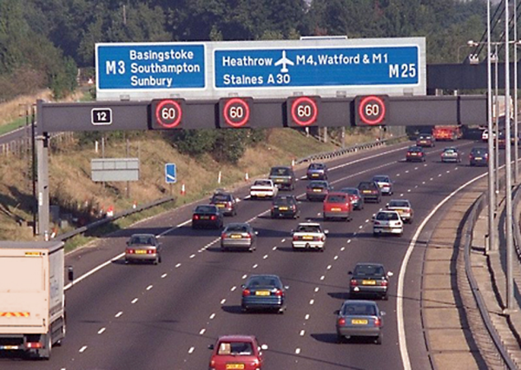
Example Application: MIDAS
Notes:
Motorway Incident Detection and Automatic Signalling
M25, M42, Birmingham Box (M42, M5, M6)
~1000km as of 2006
Figure shows M25 (M23 to M4 clockwise)

Slide 5
Application Domains
Network monitoring and traffic engineering
Sensor networks, RFID tags
Telecommunications call records
Financial applications
Web logs and click-streams
Manufacturing processes

Slide 6
Data Streams
Relatively recent development in the database community
A (potentially unbounded) sequence of tuples (triples)
Transactional data streams: log interactions between entities
Credit card: purchases by consumers from merchants
Telecommunications: phone calls by callers to dialed parties
Measurement data streams: monitor evolution of entity states
Sensor networks: physical phenomena, road traffic
IP network: traffic at router interfaces

Slide 7
One-Time versus Continuous Queries
One-time queries
Run once to completion over the current data set
Continuous queries
Issued once and then continuously evaluated over a data stream
“Notify me when the temperature drops below X”
“Tell me when prices of stock Y > 300”

Slide 8
Conventional Triplestore
query
results
SPARQL Engine
stored triples

Slide 9
Semantic Stream Management System
continuous
query
stream of
results
stream
of
triples
query processor

Slide 10
Stream Reasoning
Continuous queries generate new results as new data is added
Continuous reasoning generates new entailments as new data is added
What can we infer from the new data?
What is no longer true?

Slide 11
Conventional Reasoner
triples
entailed triples
Reasoner
stored triples

Slide 12
Stream Reasoner
ontologies
stream
of
triples
query processor
stream of
entailed
triples

Slide 13
Stream Reasoning Systems
C-SPARQL
SPARQL_{stream}
CQELS
INSTANS
ETALIS
Sparkwave
...

Slide 14
Query Processing

Slide 15
Example: C-SPARQL
Queries produce/refer to relations and streams
Based on SPARQL, with the addition of:
Streams as new data type (c.f. graphs)
Windows on streams
Registration of streams
Notes:
Developed for the Stanford STREAM system

Slide 16
Windows
Mechanism for extracting a finite set of triples from an infinite stream
Various approaches:
Windows based on ordering attribute (e.g. last 5 minutes of tuples)
Windows based on tuple counts (e.g. last 1000 tuples)

Slide 17
Window Behaviour
data stream
windows
time
t₋₄
t₋₃
t₋₂
t₋₁
t₀
t₁
t₂
t₃
t₄

Slide 18
Example C-SPARQL Query
SELECT DISTINCT ?topic FROM STREAM <http://streamingsocialdata.org/interact.trdf> [RANGE 15m STEP 1m] WHERE { ?user sd:accesses ?document . ?user foaf:knows ?john . ?john foaf:name "John" . ?document t:describes ?topic . ?topic skos:subject yago:Movies . }

Slide 19
Example C-SPARQL Query
REGISTER STREAM MoviesJohnsFriendsLike COMPUTED EVERY 5m AS CONSTRUCT { ?user sd:likes ?document } FROM STREAM <http://streamingsocialdata.org/interact.trdf> [RANGE 30m STEP 5m] WHERE { ?user sd:likes ?document . ?user foaf:knows ?john . ?john foat:name "John" . ?document sd:describes ?topic . ?topic skos:subject yago:Movies . }

Slide 20
Example C-SPARQL Query
REGISTER QUERY GlobalCountOfInteractions COMPUTED EVERY 5m AS SELECT ?user COUNT (?document) as ?numberOfMovies FROM STREAM <http://streamingsocialdata.org/MoviesJohnsFriendsLike.trdf> [RANGE 30m STEP 5m] WHERE { ?user sd:likes ?document } GROUP BY { ?user }

Slide 21
Scalability and Completeness
SPARQL deals with finite graphs
query evaluation should produce all results for a given query
C-SPARQL deals with unbounded data streams
may not be possible to return all results for a given query
trade-off between resource use and completeness of result set
size of buffers used for windows is one example of a parameter that affects resource use and completeness
can further reduce resource use by randomly sampling from streams

