Slide 1
Ontology Design Patterns
COMP6215 Semantic Web Technologies
Dr Nicholas Gibbins – nmg@ecs.soton.ac.uk
2014-2015

Slide 2
Topics
N-ary relations
  How can we say more about a relation instance?
  How do we represent an ordered sequence of relations?
Value partitions and value sets
  How do we represent a fixed list of values?
Part-whole hierarchies
  How do we represent hierarchies other than the subclass hierarchy?
Classes as property values
  What do we do if we need to use a Class as a property value in OWL?

Slide 3
N-ary Relations

Slide 4
Binary Relations
In RDF and OWL, binary relations link two individuals, or an individual and a value
The properties year-of-birth and father-of are binary relations
Holbein the Elder
year-of-birth
1460
father_of
Holbein the Younger

Slide 5
Relations with additional info
In some cases, we need to associate additional info with a binary relation
  e.g. certainty, strength, dates
For example, Holbein the Elder’s date of birth is unconfirmed
  He was born in either 1460 or 1465
  How can we represent this uncertainty?
Holbein the Elder
year-of-birth
1460
certainty-level
certainty-level
40%
year-of-birth
1465
60%

Slide 6
N-ary Relations
N-ary relations link an individual to more than a one value
Use cases:
  A relation needs additional info
  e.g. a relation with a rating value
  Two binary relations are related to each other
  e.g. body_temp (high, normal, low), and trend (rising, falling)
  A relation between several individuals
  e.g. someone buys a book from a bookstore
  Linking from, or to, an ordered list of individuals
  e.g. an airline flight visiting a sequence of airports

Slide 7
N-ary Relation Patterns
Pattern 1: Creating a new class or relation
  Use for cases 1, 2, and 3 above
Pattern 2: Sequence of arguments
  For case 4

Slide 8
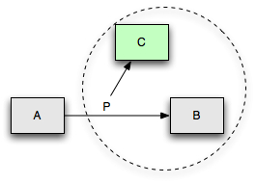
Pattern 1: Creating a new class or relation
To represent additional information about a relations:
  We can create a new class to represent the relation
  The individuals of this class are instances of the relation
  This class can have additional properties to describe more information about the relation

Slide 9
Use case 1: additional information
Jack has given the film ‘I Am Legend’ a rating of 8
  We need to represent a quantitative value to describe the rating relation
Film
What is wrong with this representation?
What will happen when Jack rates other films?
Person
I am Legend
film
Jack
Rating
film_rating
8/10

Slide 10
Solution for use case 1
I am Legend
rated_object
Jack
issued_rating
_:Rating_1
rating
8
bNode
Film
rated_object
(someValuesFrom, functional)
Person
issued_rating
(allValuesFrom)
Rating_Relation
rating_value
(allValuesFrom, functional)
Rating

Slide 11
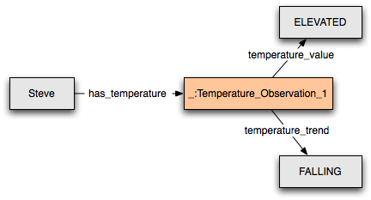
Use case 2: different aspects of a relation
Steve has a temperature which is high, but falling
  We need to represent different aspects of the temperature that Steve has
Source: W3C

Slide 12
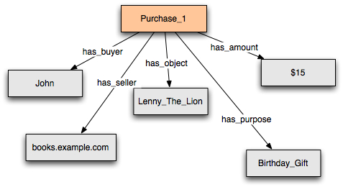
Use case 3: no distinguished participant
John buys a “Lenny the Lion” book from books.example.com for $15 as a birthday gift
  No distinguished subject for the relation
  i.e. no primary relation to convert into a Relation Class as in cases 1 and 2
Source: W3C

Slide 13
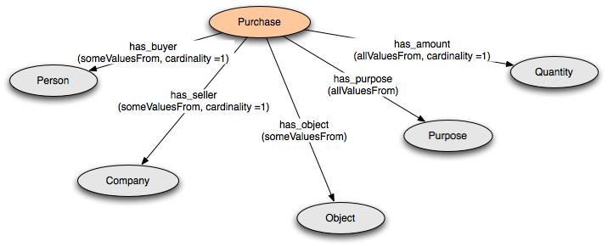
Solution for use case 3

Slide 14
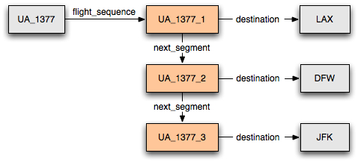
Pattern 2: Sequence of arguments
United Airlines, flight 1377 visits the following airports: LAX, DFW, and JFK
  For such an example, we need to represent a sequence of arguments

Slide 15
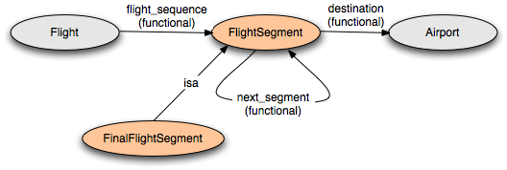
Pattern 2: Sequence of arguments
:FinalFlightSegment a owl:Class ;
rdfs:comment "The last flight segment has no next_segment";
rdfs:subClassOf :FlightSegment ;
rdfs:subClassOf
[ a owl:Restriction ; owl:maxCardinality "0";
owl:onProperty :next_segment] .
Notes:
OWL Lite

Slide 16
Value Partitions and Value Sets

Slide 17
Value Partitions and Value Sets
Descriptive features are quite common in ontologies
Examples:
  Size {small, medium, large}
  Risk {dangerous, risky, safe}
  Health status {good health, medium health, poor health}
Also called “qualities”, “modifiers”, “attributes”
  A property can have only one value for each feature to ensure consistency

Slide 18
Value Sets and Value Partitions
Such descriptive features can be represented as:
  Enumerated individuals
  Disjoint classes
  Datatype values

Slide 19
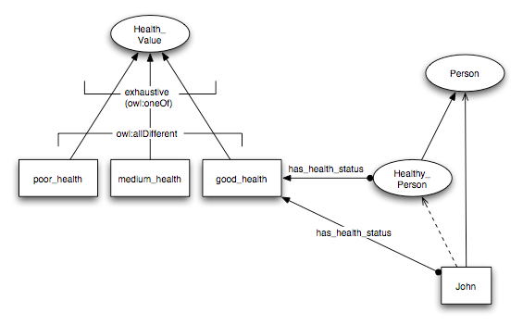
Approach 1: Values as sets of individuals
Class Health_Value is an enumeration of three individuals

Slide 20
Approach 1: Values as sets of individuals

Slide 21
Notes on Approach 1
Need an axiom to set the three health values to be different from each other
  This way, a person cannot have more than one health value at a time
Values cannot be further partitioned
  e.g. cannot have fairly_good_health as a subtype of good_health
  Only equality and difference between individuals is allowed in OWL
Only one set of values is allowed for a feature
  The class cannot be equivalent to more than one set of distinct values
  Doing so will cause inconsistencies
OWL DL compatible
Notes:
Owl:differentFrom can be set from the individual editor. Click on the individual purple icon and select this property and a value from the ontology

Slide 22
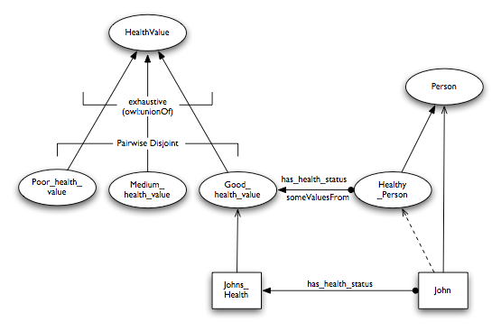
Approach 2: Value Partition
Values are disjoint subclasses

Slide 23
Approach 2: Values as disjoint subclasses

Slide 24
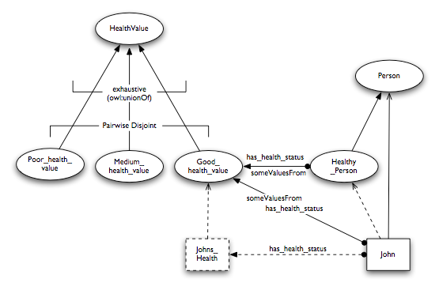
Approach 2: Values as disjoint subclasses
The instance Johns_Health can be made anonymous

Slide 25
Notes on Approach 2
OWL DL compatible
DL reasoners can classify the ontology
Values can be further partitioned
  Simply add subclasses to the value classes
Can have alternative partitioning of the same feature

Slide 26
Part-Whole Hierarchies

Slide 27
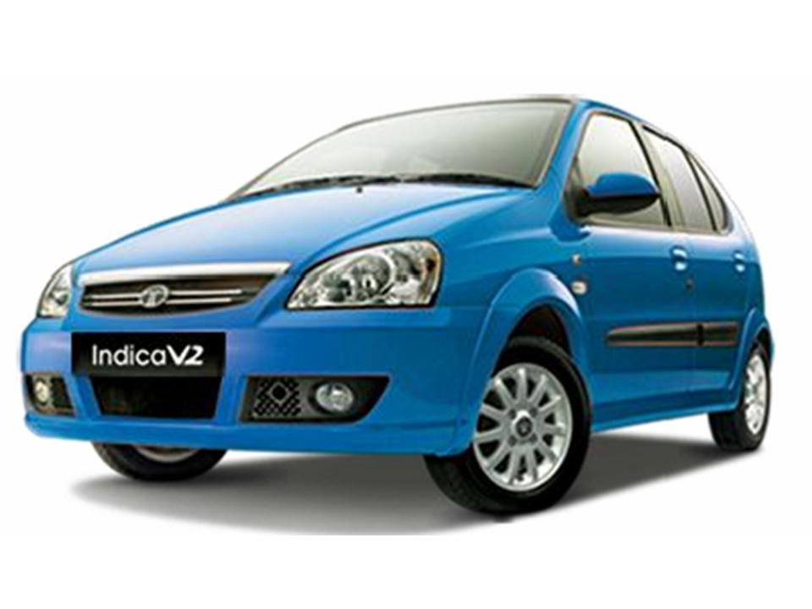
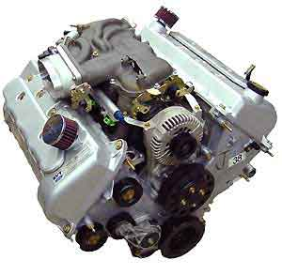
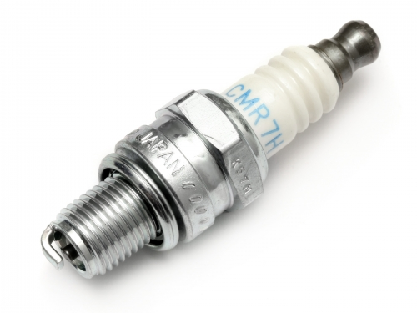
Meronymies (part-whole relations)
Taxonomies are not the only hierarchical relation that we wish to model
  A spark plug isn’t a kind of engine (class-instance)
  A spark plug is a part of an engine

Slide 28
Simple Part-Whole Representation
We need two properties:
  partOf (a transitive property)
  directPartOf (a subproperty of partOf)

Slide 29
Part-Whole Hierarchies
Represent part-whole relationships between classes using someValuesFrom restrictions

Slide 30
Defining Classes of Parts
Extend the ontology with classes of parts for each level
  Reasoner can automatically derive a class hierarchy

Slide 31
Fault location
Allows reasoner to conclude that a fault in a part is a fault in a whole
  Need a new property for the location of a fault: hasLocus
  Need a new class for faults: Fault

Slide 32
Classes as
Property Values

Slide 33
Classes as property values
In some cases, it is convenient to put a class as a value of some property
  Classes can be property values in RDFS, OWL Full and OWL2 with no restrictions
In OWL DL and OWL Lite, classes cannot be property values
  Because nothing can be both a class and an individual
  Need to use alternative mechanisms

Slide 34
Use case example
Represent two books about lions, one is about the species of lion, and the other about the species of African lion
Retrieve both books when asking for books about lions
Book
Animal
Lion
dc:subject
Lions: Life
in the Pride
AfricanLion
The African
Lion
dc:subject

Slide 35
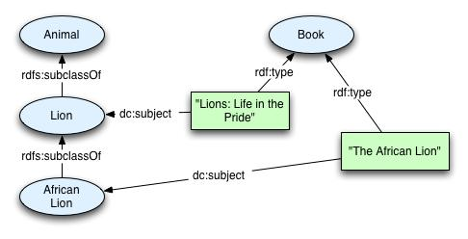
Approach 1
Use classes directly as property values
  The property dc:subject has the Animal classes as values
  Ontology is OWL Full

Slide 36
Notes on Approach 1
This approach is the most intuitive
  Resulting ontology is compatible with RDFS and OWL Full, but not OWL DL or OWL Lite
The subjects are in a hierarchy (AfricanLion isA Lion isA Animal)
  Application can use this hierarchy to find books about Lion as well as books about its sub-subject; AfricanLion
Good approach if you:
  Want to keep things simple
  Don’t mind being in OWL Full
  Don’t mind using the class hierarchy as book subject

Slide 37
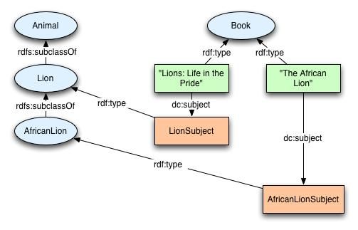
Approach 2: Using special instances
Use instances of classes as property values

Slide 38
Notes on Approach 2
Classes are not used as values directly
  Using their instances as property values instead
Ontology is compatible with OWL DL and OWL Lite
We used the class Lion for the subject lion
  Need a different one to refer to actual lions!
  Shouldn’t use the same concept for two conceptually different things
  We need to be extra careful if the Animal ontology is important
    Changing the meaning of classes may cause some interpretation problems

Slide 39
Notes on Approach 2
No direct relation between the subjects
  But the instance AfricanLionSubject is also an instance of Lion
Use this approach if you:
  Want to stick to OWL DL or OWL Lite
  Won’t be changing the original meaning of any of the classes
  Not concerned with the subjects not having direct links

Slide 40
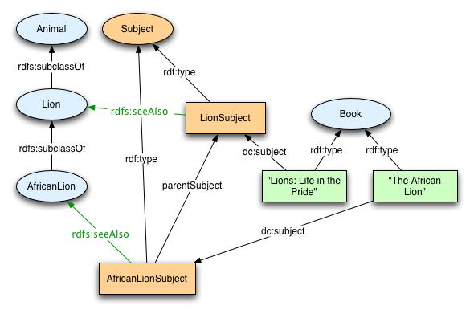
Approach 3: Use a parallel instance hierarchy
Create a separate subject class

Slide 41
Notes on Approach 3
Compatible with OWL DL and OWL Lite
  Using classes as values for annotation properties (eg rdfs:seeAlso) does not change OWL DL compatibility
The subject hierarchy can be recreated using the parentSubject
  This property is transitive
  Most reasoners can infer the parentSubject transitive property
    But they won’t be able to infer that a book about LionSubject is also about Animals
Semantics for Lion and for the Lion subject are preserved

Slide 42
Notes on Approach 3
The Animal and Subject hierarchies are independent of each other
Maintenance is increased
  Need to make sure all these classes and instances are consistent
Use this approach if you:
  Need to stay in OWL DL
  Need to reason over the subject hierarchy
  Are not bothered by having parallel hierarchies

Slide 43
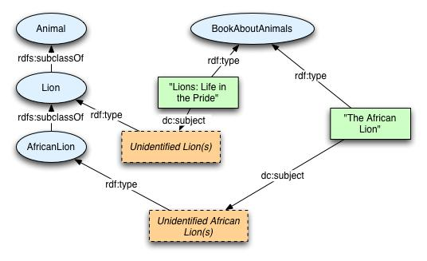
Approach 4: Use special restrictions
Restrictions are used instead of specific values

Slide 44
Notes on Approach 4
A reasoner can infer that a book with subject Lion also has the subject Animal
  Can use a DL reasoner to classify specific books
Subjects are assigned to books by creating instances of the relevant book subject class
  No need to explicitly set any subject values
  Can also use unspecified individuals of the class as property values, rather than the class itself
  Interpretation: the subject is a prototypical lion, rather than the Lion class

Slide 45
Notes on Approach 4
Use this approach if you:
  Want to be in OWL DL
  Want to use DL reasoners to classify your ontology

Slide 46
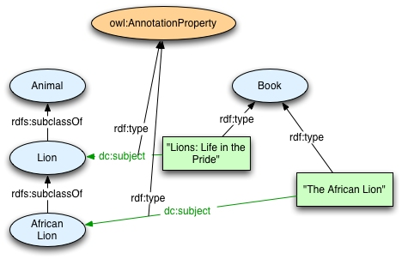
Approach 5: Use annotation properties
Link individuals of Book with subjects using an annotation property

Slide 47
Notes on Approach 5
Compatible with OWL DL
  Annotation properties can have classes as values in OWL DL
Annotation properties cannot have different types
  dc:subject cannot be an annotation property and an object or datatype property
  This will render the ontology OWL FULL
Restrictions cannot be applied to annotation properties
DL reasoners don’t use annotation values

Slide 48
Further Reading

Slide 49
SWBP Notes
Defining N-ary Relations on the Semantic Web
http://www.w3.org/TR/swbp-n-aryRelations
Representing Specified Values in OWL
http://www.w3.org/TR/swbp-specified-values
Simple part-whole relations in OWL Ontologies
http://www.w3.org/2001/sw/BestPractices/OEP/SimplePartWhole/
Representing Classes As Property Values
http://www.w3.org/TR/swbp-classes-as-values

