Slide 1
A Description Logic Primer
COMP6215 Semantic Web Technologies
Dr Nicholas Gibbins - nmg@ecs.soton.ac.uk
2014-2015

Slide 2
Why do we need Description Logics?
RDF Schema isn’t sufficient for all tasks
There are things you can’t express
There are things you can’t infer

Slide 3
Description Logics
A family of knowledge representation formalisms
A subset of first order predicate logic (FOPL)
Decidable – trade-off of expressivity against algorithmic complexity
Well understood – derived from work in the mid-80s to early 90s
Model-theoretic formal semantics
Simpler syntax than FOPL
Notes:
KL-ONE – 1985
LOOM – 1987
CLASSIC – 1991

Slide 4
Description Logics
Description logics restrict the predicate types that can be used
Unary predicates denote class membership
Binary predicates denote relations (roles) between instances

Slide 5
Defining ontologies with Description Logics
Describe classes (concepts) in terms of their necessary and sufficient attributes (roles)
Consider an attribute A of a class C:
A is a necessary attribute of C
If an object is an instance of C, then it has A
A is a sufficient attribute of C
If an object has A, then it is an instance of C

Slide 6
Description Logic Reasoning Tasks
Satisfaction
“Can this class have any instances?"
Subsumption
"Is every instance of class A necessarily an instance of class B?"
Classification
"What classes is this object an instance of?"

Slide 7
Classes as sets
Δ
A
v
w
x
y
z
B

Slide 8
Syntax

Slide 9
Concept Constructors
Boolean class constructors
Restrictions on role successors
Number restrictions (cardinality constraints) on roles
Nominals (singleton concepts)
Universal class, top
Contradiction, bottom

Slide 10
Role Constructors
Concrete domains (datatypes)
Inverse roles
Transitive roles
Role composition

Slide 11
OWL and Description Logics
Not every description logic supports all constructors
More constructors = more expressive = higher complexity
OWL DL is equivalent to the logic
Atomic concepts and roles
Boolean operators
Universal, existential restrictions
Role hierarchies
Nominals
Inverse and transitive roles (but not role composition)
Number restrictions

Slide 12
Boolean Class Operations
The class of things which are both children and happy
The class of things which are rich or famous (or both)
The class of things which are not happy

Slide 13
Universal Restriction
The class of things all of whose pets are cats
Or, which only have pets that are cats
Note: includes those things which have no pets

Slide 14
Existential Restriction
The class of things which have some pet that is a cat
Note: must have at least one pet

Slide 15
Cardinality Restrictions
The class of things with more than one country of origin
The class of quadrapeds

Slide 16
Knowledge Bases
A description logic knowledge base (KB) has two parts:
TBox: terminology
A set of axioms describing the structure of the domain (i.e., a conceptual schema)
Concepts, roles
ABox: assertions
A set of axioms describing a concrete situation (data)
Instances

Slide 17
TBox Axioms
Concept inclusion
(C is a subclass of D)
Concept equivalence
(C is equivalent to D)
Role inclusion
(R is a subproperty of S)
Role equivalence
(R is equivalent to S)
Role transitivity
(R composed with itself is a subproperty of R)

Slide 18
ABox Axioms
Concept instantiation
x:D
x is of type D
Role instantiation
<x,y>:R
x has R of y

Slide 19
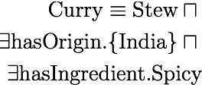
Axiom Exercises
Every person is either living or dead
Every successful man has a beautiful wife
No elephants can fly
A curry is an Indian stew with a spicy ingredient
All Englishmen are mad

Slide 20
Tips for Creating Class Expressions
Don’t Panic!
No single ‘correct’ answer - different modelling choices possible
Break sentence down into pieces
e.g. “successful man”, “spicy ingredient” etc
Look for indicators of axiom type:
“Every X is Y” - inclusion axiom
“X is Y” - equivalence axiom
Remember that ∀R.C is satisfied by instances which have no value for R

Slide 21
Semantics

Slide 22
Description Logics and Predicate Logic
Description Logics are a subset of first order Predicate Logic with a simplified syntax
Every DL expression can be converted into an equivalent FOPL expression

Slide 23
Description Logics and Predicate logic
Every concept is translated to a formula
Boolean class constructors
Restrictions

Slide 24
Description Logics and Predicate logic
Concept inclusion
Concept equivalence
Notes:
EXAMPLE: Every person is male or female

Slide 25
Description Logic Semantics
is the domain (non-empty set of individuals)
Interpretation function (or ext() ) maps:
Concept expressions to their extensions (set of instances of that concept, subset of )
Roles to subset of
Individuals to elements of
Examples:
is the set of instances of
is the set of instances of either or

Slide 26
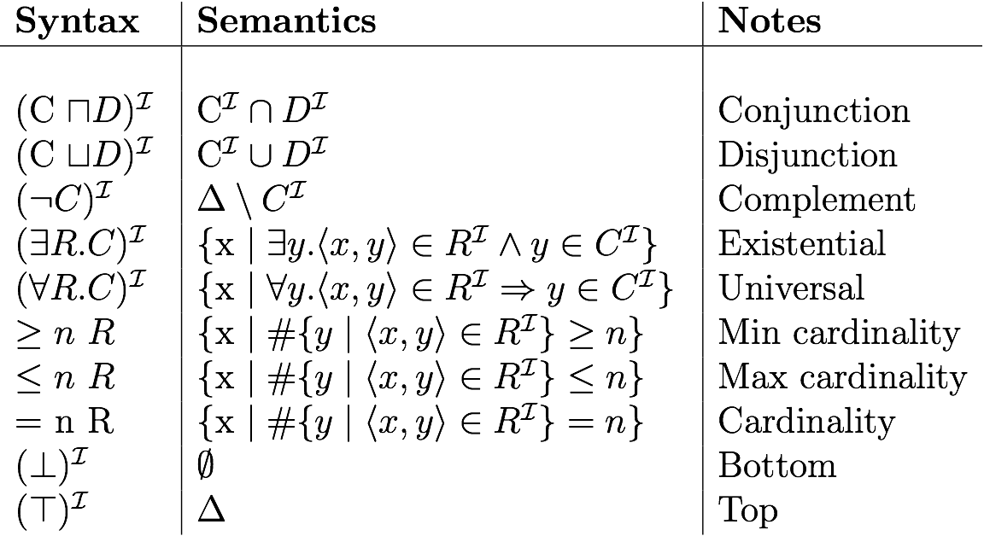
Description Logic Semantics

Slide 27
Interpretation Example
Δ
Δ = {v, w, x, y, z}
A^{I} = {v, w, x}
B^{I} = {x, y}
R^{I} = {(v, w), (v, x), (y, x), (x, z)}
A^{I}
v
w
x
y
z
B^{I}

Slide 28
Interpretation Example
Δ
(¬B)^{I} =
(A ⊔ B)^{I} =
(¬A ⊓ B)^{I} =
(∃R.B)^{I} =
(∀ R.B)^{I} =
(∃ R. (∃ R.A))^{I} =
(∃ R. ¬(A ⊓ B))^{I} =
A^{I}
v
w
x
y
z
B^{I}

Slide 29
Answers
Δ
(¬B)^{I} = {v, w, z}
(A ⊔ B)^{I} = {v, w, x, y}
(¬A ⊓ B)^{I} = {y}
(∃R.B)^{I} = {v, y}
(∀ R.B)^{I} = {y, w, z}
(∃ R. (∃ R.A))^{I} = {}
(∃ R. ¬(A ⊓ B))^{I} = {v, x}
A^{I}
v
w
x
y
z
B^{I}

Slide 30
DL Reasoning Revisited: Satisfaction
“Can this class have any instances?”
C is satisfiable w.r.t. K iff there exists some model I of K, C^{I} ≠ ∅
where K is a knowledge base, I is an interpretation of K

Slide 31
DL Reasoning Revisited: Subsumption
“Is every instance of this class necessarily an instance of this other class?”
C subsumes D w.r.t. K iff for every model I of K, C^{I} ⊇ D^{I}
where K is a knowledge base, I is an interpretation of K

Slide 32
DL Reasoning Revisited: Equivalence
“Is every instance of this class necessarily an instance of this other class, and vice versa?”
C is equivalent to D w.r.t. K iff for every model I of K, C^{I} = D^{I}
where K is a knowledge base, I is an interpretation of K

Slide 33
DL Reasoning Revisited: Classification
“Is this individual necessarily an instance of this class?”
x is an instance of C w.r.t. K iff for every model I of K, x^{I} ∈ C^{I}
where K is a knowledge base, I is an interpretation of K

