Slide 1
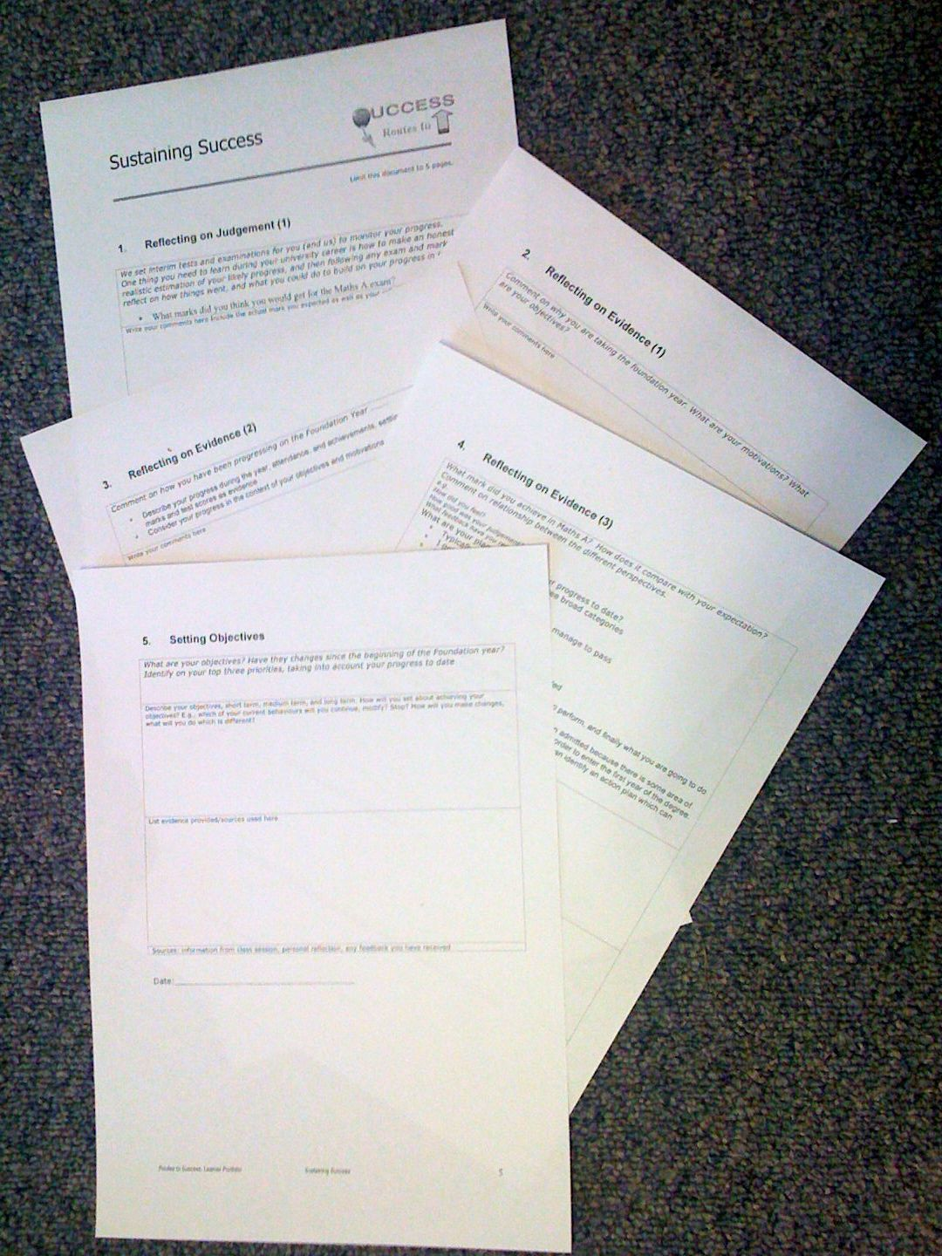
Foundation Year
Routes to Success
Part III - Sustaining Success
Su White
Semester 2
Before you hand in
Resource set in Edshare http://www.edshare.soton.ac.uk/14075
Notes:
Objective to get to know the each other and establish framework for future sessions
Introduce think pair share
Establish expectations for portfolio contribution for this part of the course
Much of the session will be run via discussion and question and answer
The slides will be used according to need, but can form a useful note for review and revision.
They can also be used as reference by students who do not attend the session.

Slide 2
How to use these slides
the slides are the basis for a before you hand-in lecture
You can refer to them remind yourself of what still have to do
It will help you if you read them in conjunction
  with other materials provided to you
  Your existing draft submission
  Checking the links provided via Blackboard/EdShare
Resource set for first lecture in EdShare (all basic materials) http://www.edshare.soton.ac.uk/13885/
This set of resources in EdShare
http://www.edshare.soton.ac.uk/14075/

Slide 3
What we expect you to have done
Independently learn about techniques and methods that can be used to effectively gain new knowledge in your subject.
Develop appropriate study skills, strategies, and habits to sustain you in your future studies.
Through reflection:
  Develop awareness of learning processes
  and control over those processes (metacognition).
  Develop a knowledge of and appreciation for your subject.

Slide 4
The process
Portfolio…
you will need to write something
My job is to help you with this task.
Your job is to do the very best you can
A task to help you
Answer specific questions
Reflect on your answers
Evaluate your motivations

Slide 5
Intros: The big picture themes
learning
reflection
Using feedback
Future planning
self knowledge
Assessment
Interviews
Engineering FY
tbc
Assessment
Interviews
Science FY
tbc
Handin
w/c 2nd March
Wed 4th March
Notes:
1) Exam
2) Your motivations
3) Your progress
4) Self knowledge
5) Future Objectives
Explaining how the classes will be used to to fill out the portfolio

Slide 6
I will help you
Supporting tasks
Videos to watch
surveys to complete
drafts before the final version
Videos are designed to get you to see the bigger picture
Surveys are designed to pace you through the reflection which goes with the course
Drafts are designed to help you produce an excellent final version
Student work improved after we introduced the surveys and videos
Complete the tasks: they can help you get better marks!

Slide 7
Reassurance
We ask you to trust us
We will respect your confidence
Be honest in what you write in the portfolio
However
  You can have insights and reflections which you can choose to keep private
  You can learn from private reflections as well as ‘public’ reflections
Always do your best but…
You will not be marked down if your writing is not perfect
It is OK to make points via bullets – does not have to be lots of prose
We are looking for evidence of reflection
  Be realistic in your reflections
we want you to help yourself to make changes that work

Slide 8
Remember
Studying is not simply about transferring a set of facts from lecturer to students
This module is designed to assist you in the process of:
  Developing yourself as an individual
  Recognising how you can be responsible for your own learning
  Learning how to become a resilient learner
  Developing skills so you
    Understand how you best learn
    Reflect on how you can improve
This module aims to actively engage you with this process ☺

Slide 9
What we expect
Work independently and study independently
Discuss the task with your fellow students
  Face-to-face is often better than online
  find time over a coffee or in a social context
complete the surveys regularly
  you will get email invitations
  … And reminders
write your reflective portfolio
Reflective Portfolio
remember why it will be useful:
Mastering independent study is a skill which will
  Persist
  And be useful throughout your degree
Surveys act as a prompt to help you reflect
  they will help you manage
    your time
    and the workload
The portfolio provides a framework for you to reflect and learn from your progress
the best students always manage to right excellent portfolios
but you don’t have to be a great author just write the answers to the questions

Slide 10
Have you used the resources?
The videos, readings and tasks are designed to build a scaffolding for you to use
When you are doing the coursework
In the immediate future, helping you make good decisions about your study habits
In the longer term during your degree studies
photo by Anne Roberts
Notes:
photo by photo by Anne Roberts

Slide 11
Have you watched the videos?
http://www/edshare.soton.ac.uk/14045
http://www/edshare.soton.ac.uk/14046
http://www/edshare.soton.ac.uk/14047

Slide 12
Have your read the suggested materials?
They are linked/referenced in the materials for week 1
http://www/edshare.soton.ac.uk/13885
Carol Dweck, Mindset
Matt Syed, Bounce the myth of talent
Malcolm Gladwell, Outliers

Slide 13
Have you completed the surveys?
Introduction https://www.isurvey.soton.ac.uk/14313
Critical thinking https://www.isurvey.soton.ac.uk/14691
My skills https://www.isurvey.soton.ac.uk/14757
Behaviours https://www.isurvey.soton.ac.uk/14759
Progress review https://www.isurvey.soton.ac.uk/14760
Before Handin https://www.isurvey.soton.ac.uk/14761

Slide 14
Any Questions before the hand in?
Over to you….

