Slide 1

COMP1205
Professional Development
Legal, professional and ethical perspectives
Legislation 2
Dr. Su White
http://www.edshare.soton.ac.uk/12707/

Slide 2
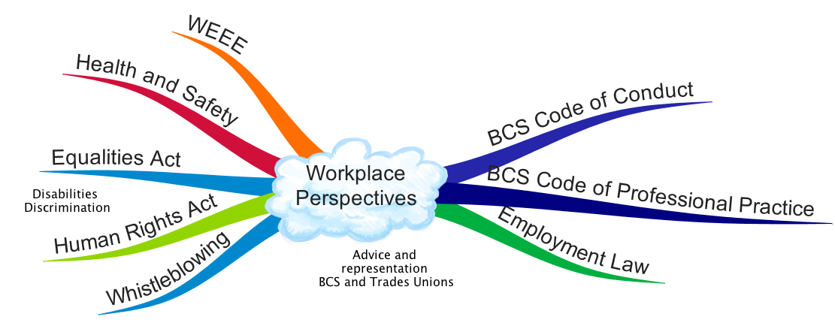
Workplace Perspectives

Slide 3
What is important…
Based on module needs and past experience

Slide 4
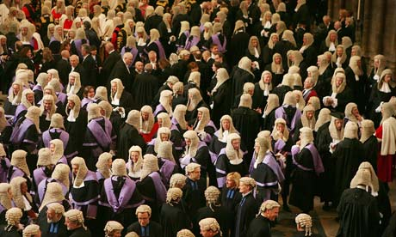
You are not learning to be a lawyer
But with this module
develop some legal awareness
think about your rights
think about your responsibilities
Law in the workplace
Contracted to/retained by your employer
Employed in your organisation
Membership benefit
Professional bodies
Trades Unions

Slide 5
Understand the extent of the area
legal
ethical
workplace

Slide 6
Example: power & responsibility
Info
Security
Data
Privacy
common
factors

Slide 7
professional and legal issues might include
creative
commons
e-commerce
environment
intellectual
property
freedom
of
information
green
ICT
professionalism
code of
conduct
open
data
open
source
digital
futures
accessibility
employment
rights
employment
rights
e-government
equality
globalisation
security
file-sharing
defamation
academic
ethics
semantic
web
inclusivity
outsourcing
linked
data
computer
crime
localisation
professional
bodies
civic
duty
free
speech
libel
digital
rights management
health
and
safety
social
enterprises
surveillance
hacking
responsibility
pornography
data
protection
privacy
digital
divide
censorship
copyright
discrimination
ethics
morals

Slide 8
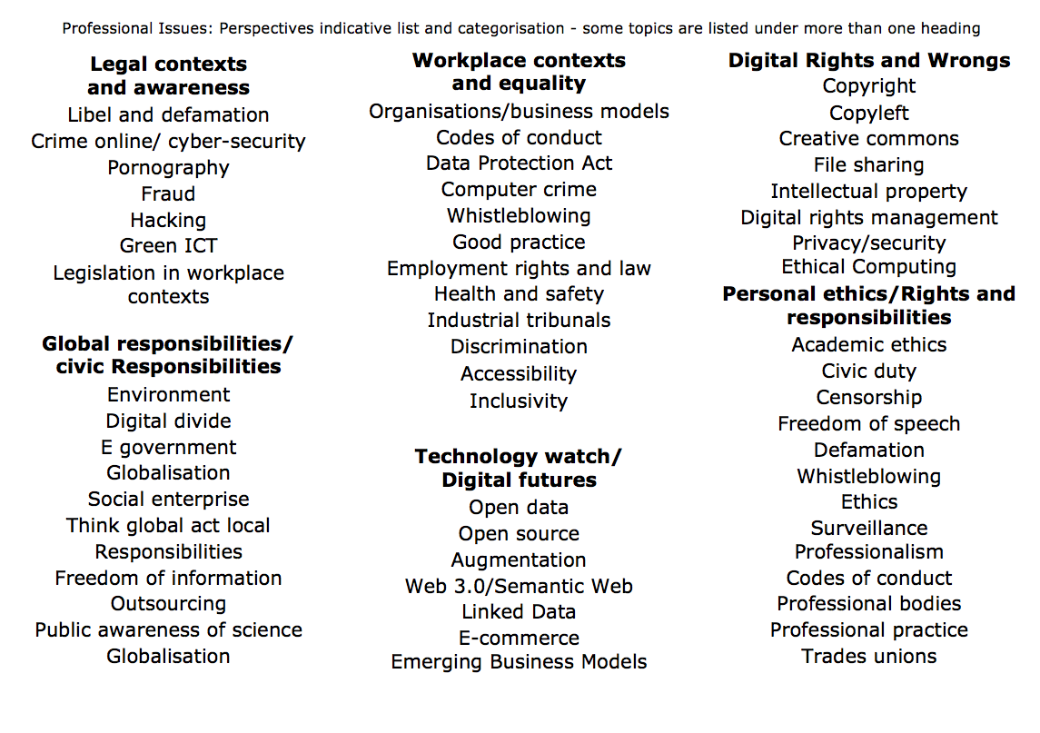

Slide 9
Workplace Issues
These slides are the content of this week’s material

Slide 10
Overview:
Workplace rights
Workplace responsibilities
Respecting others’ work

Slide 11
Key legal areas
Communications Act 2003 section 127 (Came into force 25th July 2003 replaced s43 Telecommunications Act 1984)
Computer Misuse Act 1990
Copyright design and patents 1988
Data Protection Act 1998
Defamation Act 1996
Disabilities Discrimination Act
Digital economy act 2010
Electronic Commerce
(EC Directive) Regulations 2002
Electronic waste disposal
Equalities Act 2010
Health and Safety at work 1974
Harassment protection act 1997
Human rights act 1998
Malicious Communications Act 1988 section 1
Postal Services Act 2000 section 85 (commenced 26th March 2001)
Regulation of Investigatory Powers Act 2000
Which topics are relevant in the work context ?
Notes:
Which topics are relevant today?
They are identified on next slide

Slide 12
Workplace specific Areas
Communications Act 2003 section 127 (Came into force 25th July 2003 replaced s43 Telecommunications Act 1984)
Computer Misuse Act 1990
Copyright design and patents 1988
Data Protection Act 1998
Defamation Act 1996
Disabilities Discrimination Act
Digital economy act 2010
Electronic Commerce
(EC Directive) Regulations 2002
Electronic waste disposal
Equalities Act 2010
Health and Safety at work 1974
Harassment protection act 1997
Human rights act 1998
Malicious Communications Act 1988 section 1
Postal Services Act 2000 section 85 (commenced 26th March 2001)
Regulation of Investigatory Powers Act 2000
Which topics are relevant today?
Notes:
Which topics are relevant today?
They are identified on next slide

Slide 13
Broad Scope
Employment Legislation
  Getting a job
  Keeping a job
  Your rights whilst working
Equality in the workplace
  Equality Act 2010
  Sex Discrimination Act 1975
  Equal Pay Act 1970
  Disabilities Discrimination Act 1995
  Agency Workers Regulations 2010
Trades Unions
ACAS, and Employment Disputes
Harassment and Bullying
Whistleblowing
Health and Safety at Work
Professional Bodies
  Working Practice
  Codes of conduct

Slide 14
Can include…
Working time regulations
Trades Unions and Collective Rights
Part time Work
Fixed Term Work
Employment Tribunals and Dispute Resolution
Work and Parents/Care duties
Maternity
Parental Leave
Time off for Dependents
Employment Act 2002
Equality Act 2010

Slide 15
Employment….
Pay
National Minimum Wage
Employment Contracts and Conditions
Time off and Holidays
Flexible Working
Working Hours
Sickness Absence
Business transfers and takeovers
Starting a new job
Employment terms and conditions incorporate

Slide 16
Find out for yourself
Employers
Expect you to be aware
You are making decisions about your future
  Equip yourself with the information to make informed personal decisions
Our Module
Expect you to be aware
You are going to take an exam
  Equip yourself with the information to answer the questions
  Work collaboratively
  Research and prepare

Slide 17
TAKING A
Workplace perspective
Walkthough some new areas

Slide 18
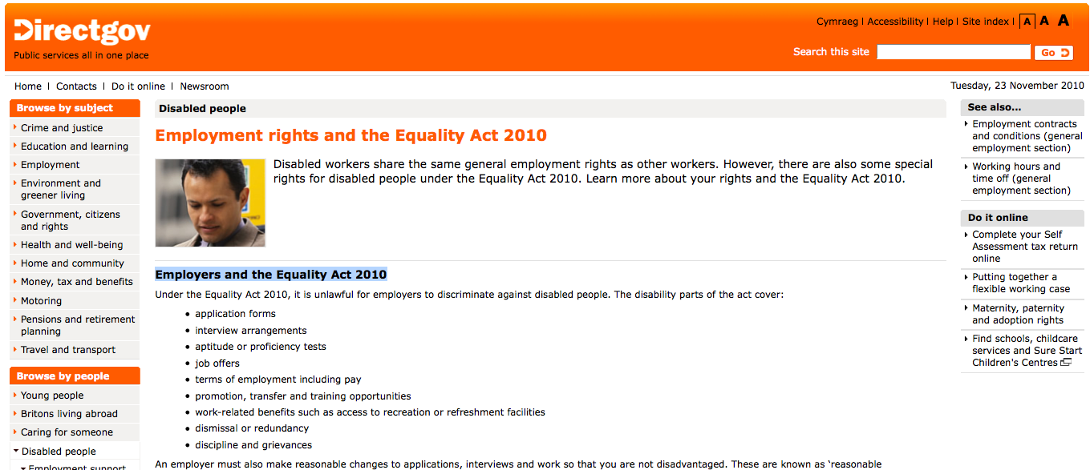
The Equality Act 2010
http://bit.ly/eqact2010

Slide 19
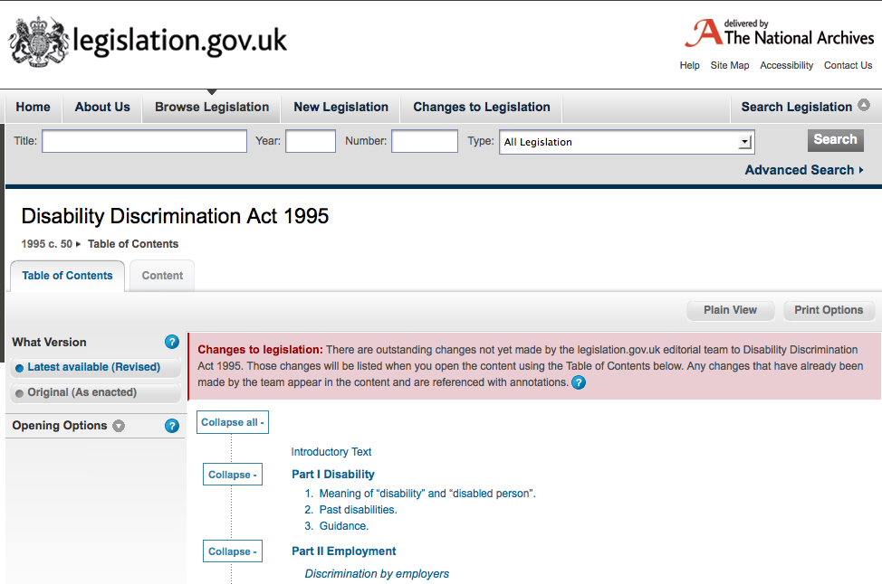
Disability Discrimination Act 1995
More notes see http://www.edshare.soton.ac.uk/10686/
Notes:
10686
See http://www.edshare.soton.ac.uk/10686/

Slide 20
Harassment
unwanted conduct related to a relevant protected characteristic, which has the purpose or effect of violating an individual’s dignity or creating and intimidating, hostile, degrading, humiliating or offensive environment for that individual
The Equality Act 2010

Slide 21
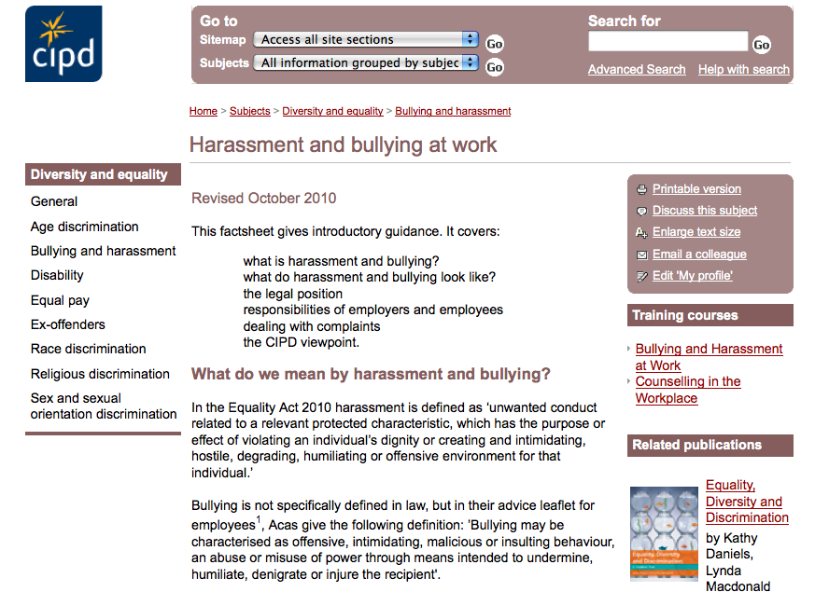
Chartered Institute of Personnel and Development
http://www.cipd.co.uk

Slide 22
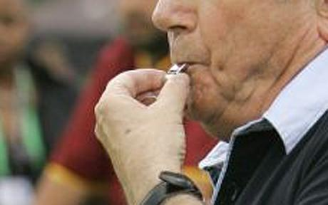
Whistleblowers…
an informant who exposes wrongdoing within an organization in the hope of stopping it; "the law gives little protection to … wordnetweb.princeton.edu/perl/webwn
A whistleblower is a person who alleges misconduct. More complex definitions may be used, but the issue is that the whistleblower usually faces reprisal. …en.wikipedia.org/wiki/Whistleblower
whistle-blower - One who reports a problem or violation to the authorities; especially, an employee or former employee who reports a violation by an employer
en.wiktionary.org/wiki/whistle-blower
whistleblowing - the disclosure to the public or to authorities, usually by an employee, of wrongdoing in a company or government department en.wiktionary.org/wiki/whistleblowing
whistle blower - An employee who has inside knowledge of illegal activities occurring within his or her organization and reports these to the public. investor.lilly.com/glossary.cfm
Any person who makes a disclosure about improper conduct by public bodies and public officers under the Whistleblowers Protection Act 2001 www.ombudsman.vic.gov.au/www/default.asp

Slide 23
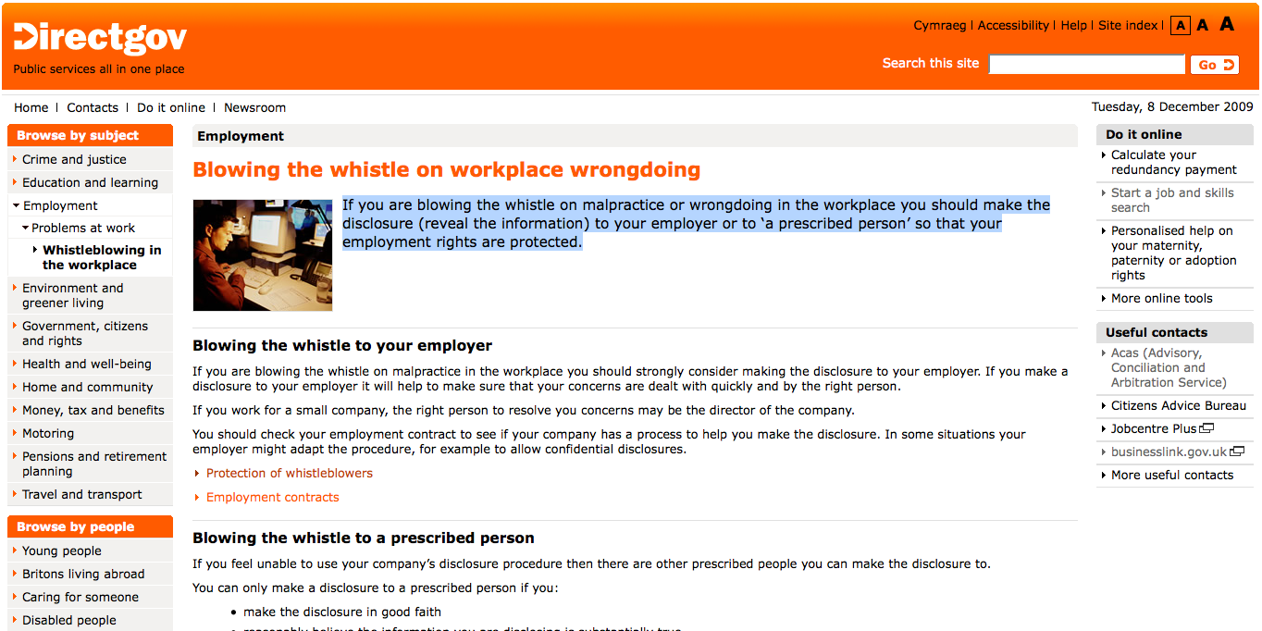
Whistleblowing rights
http://www.direct.gov.uk/en/Employment/ResolvingWorkplaceDisputes/Whistleblowingintheworkplace/DG_175821

Slide 24
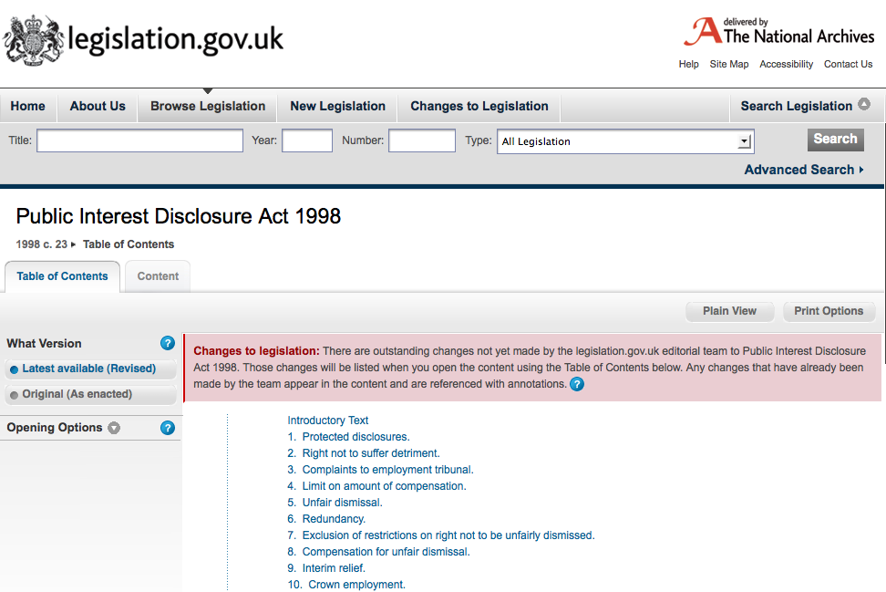
Public Interest Disclosure Act 1998
http://www.legislation.gov.uk/ukpga/1998/23/contents

Slide 25

Employment Tribunals
http://www.employmenttribunals.gov.uk/

Slide 26
Tribunals can consider….
CEC 1975 | Colleges of Education (Compensation) Regulations 1975
COMAH 1999 | Control of Major Accident Hazards Regulations 1999
DCOA 1994 | Deregulation and Contracting Out Act 1994
DDA 1995 | Disability Discrimination Act 1995
DRC 1999 | Disability Rights Commission Act 1999
EE(Age) Regs 2006 | Employment Equality (Age) Regulations 2006
EE (Religion or Belief) Regs 2003 | Employment Equality (Religion or Belief) Regulations 2003
EE (Sexual Orientation) Regs 2003 | Employment Equality (Sexual Orientation) Regulations 2003
EPA 1970 | Equal Pay Act 1970
ERA 1996 | Employment Rights Act 1996
ERelA1999 | Employment Relations Act 1999

Slide 27
Tribunals can consider….
ETA 1996 | Employment (Industrial) Tribunals Act 1996
FTE 2002 | Fixed Term Employees (Prevention of Less Favourable Treatment) Regulations 2002
FWR 2002 | Flexible Working (Procedural Requirements) Regulations 2002 and Flexible Working (Eligibility, Complaints and Remedy) Regulations 2002
HSCE 1996 | Health and Safety Consultation with Employee Regulations 1996
HSWA 1974 | Health and Safety at Work Act 1974
MPL 1999 | Maternity and Parental Leave Regulations 1999
MPL 2002 | Maternity and Parental Leave (Amendment) Regulations 2002
NESE 1994 | Notification of Existing Substances (Enforcement) Regulations 1994
NMWA 1998 | National Minimum Wage Act 1998
PAL 2002 | Paternity and Adoption Leave Regulations 2002
PIDA 1998 | Public Interest Disclosure Act 1998
PTW 2000 | Part Time Worker (Prevention of Less Favourable Treatment) Regulations 2000

Slide 28
Tribunals can consider….
RRA 1976 | Race Relations Act 1976
SDA 1975 | Sex Discrimination Act 1975
SRSC 1977 | Safety Representatives and Safety Committees Regulations 1977
SSPA 1975 | Social Security Pensions Act 1975
STA 1994 | Sunday Trading Act 1994
TCA 2002 | Tax Credits Act 2002
TULR(C) 1992 | Trade Union and Labour Relations (Consolidation) Act 1992
TUPE 1981 | Transfer of Undertakings (Protection of Employment) Regulations 1981
TURER 1993 | Trade Union Reform and Employment Rights Act 1993
WTR 1998 | Working Time Regulations 1998
RT (WT) R 2005 | Road Transport (Working Time) Regulations 2005

Slide 29
Agencies and interest groups

Slide 30
Such as…
Government agencies
Charities and action groups
Professional bodies
Trades Unions
The next few slides give some examples, you need to familiarise yourself with these sources
Opportunities
  Revision for the stage test
  Preparation for the case study

Slide 31
Also useful sources of information
Be aware of agencies
Which can be useful for revision

Slide 32
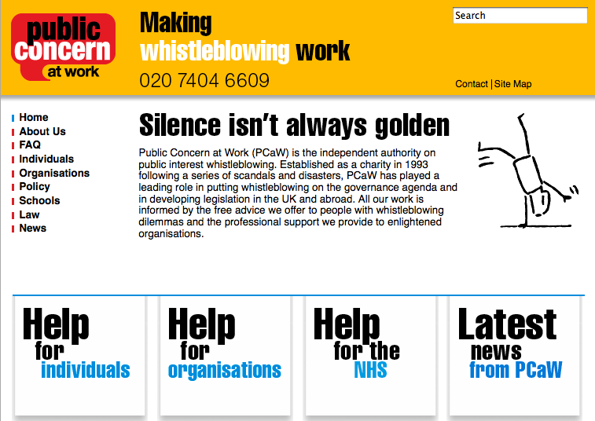
Public Concern at Work
http://www.pcaw.co.uk/

Slide 33
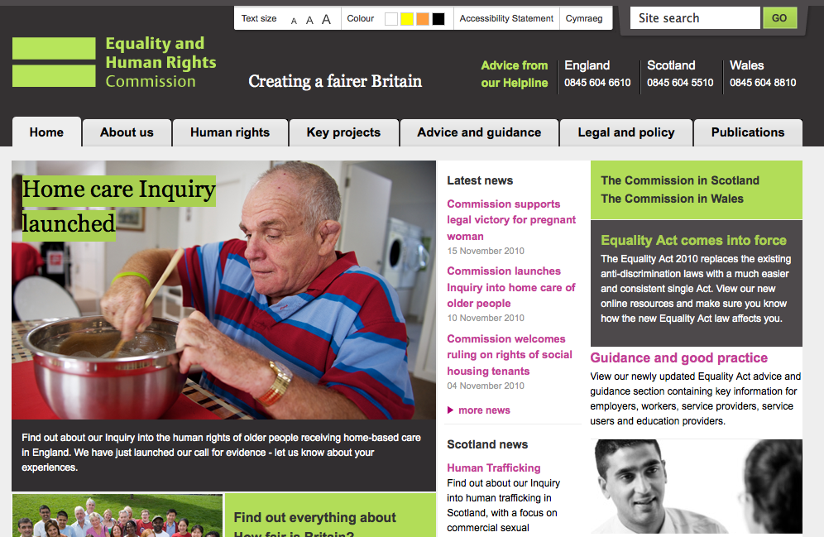
Equality and Human Rights Commission
http://www.equalityhumanrights.com/

Slide 34
Public Concern at Work
http://www.pcaw.co.uk/

Slide 35
Trades Unions
May be active in your workplace
There may be some kind of local workers group
May not be usual in your workplace
Like professional bodies they require a subscription
  They also are afforded some (limited) recognition in workplace law

Slide 36
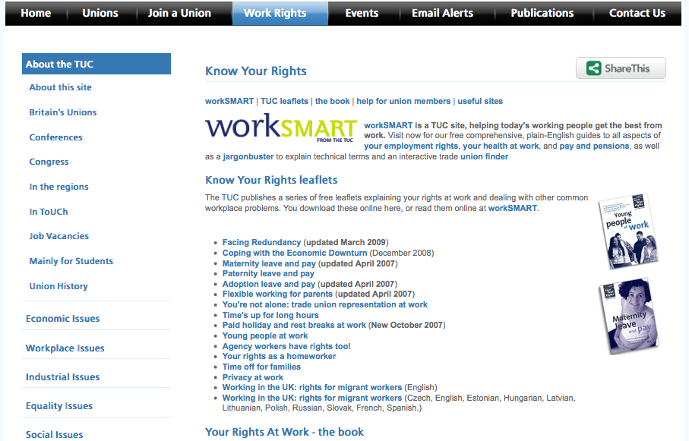
TUC
http://bit.ly/tucrights

Slide 37
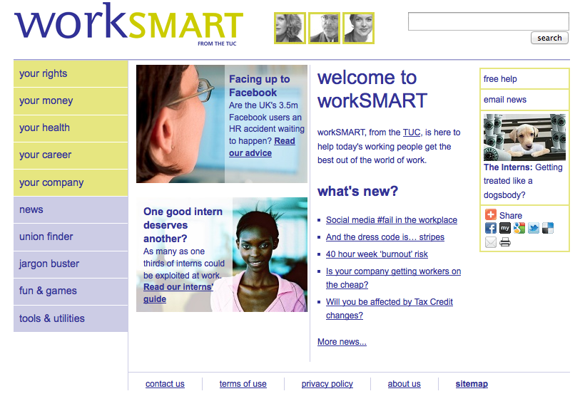
Worksmart (TUC)

Slide 38
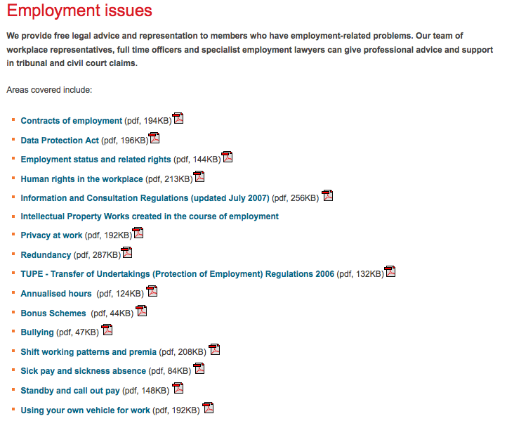

Employment Issues
Notes:
Typical areas in which a union might provide support

Slide 39

Arbitration and Conciliation
http://www.acas.org.uk/

Slide 40
Professional Bodies
Professional Bodies – and codes of conduct
- we covered codes of conduct and good practice
But they also usually offer the services of their legal departments

Slide 41
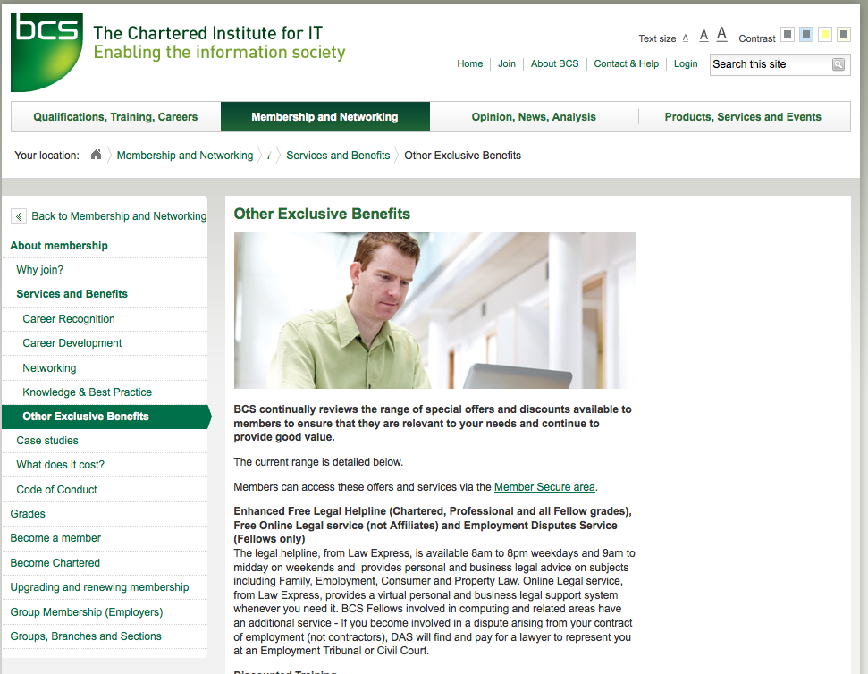
BCS Legal
http://www.bcs.org/category/9234

Slide 42
BCS - legal
“Enhanced Free Legal Helpline (Chartered, Professional and all Fellow grades), Free Online Legal service (not Affiliates) and Employment Disputes Service (Fellows only)
The legal helpline… provides personal and business legal advice on subjects including Family, Employment, Consumer and Property Law.
Online Legal service, from Law Express, provides a virtual personal and business legal support system whenever you need it.
BCS Fellows involved in computing and related areas have an additional service - If you become involved in a dispute arising from your contract of employment (not contractors), DAS will find and pay for a lawyer to represent you at an Employment Tribunal or Civil Court.

Slide 43
Professional Indemnity Insurance
protects against financially crippling/reputation-damaging claims by dissatisfied clients.
  Negligence: or breach of duty of care
  Intellectual property: unintentionally infringing on others’ copyrights, trademarks, broadcasting rights, any act of passing off
  Loss of documents/data: damaged, lost or stolen data and documents belonging to your clients
  Dishonesty: liability arising from the theft of your clients’ money

Slide 44
CIPD – already shown
http://www.cipd.co.uk

Slide 45
Health and Safety at work
Another important topic area

Slide 46
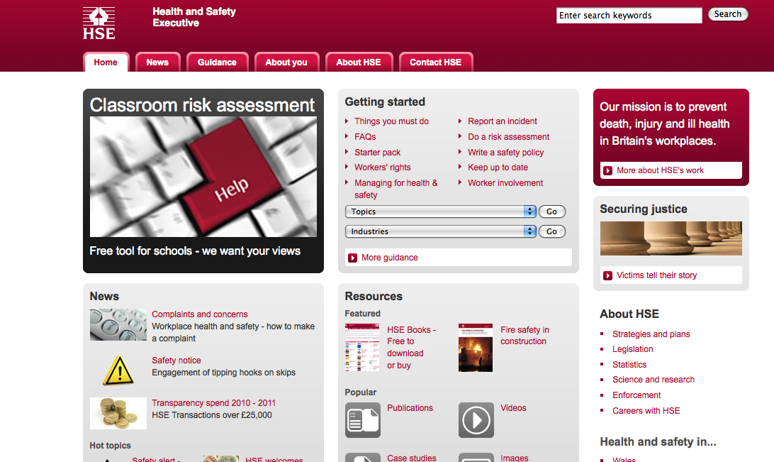
Health and Safety Executive
http://www.hse.gov.uk/
Notes:
Covers information on everything from workplace violence to electrical testing

Slide 47
Health and Safety
General Environment
The Health and Safety at Work Act 1974
Computer Specific Environment
The Health and Safety (DSE) Regulations 1992

Slide 48

The IT workplace/Green IT

Slide 49

European directive
Waste electrical and electronic equipment recycling

Slide 50
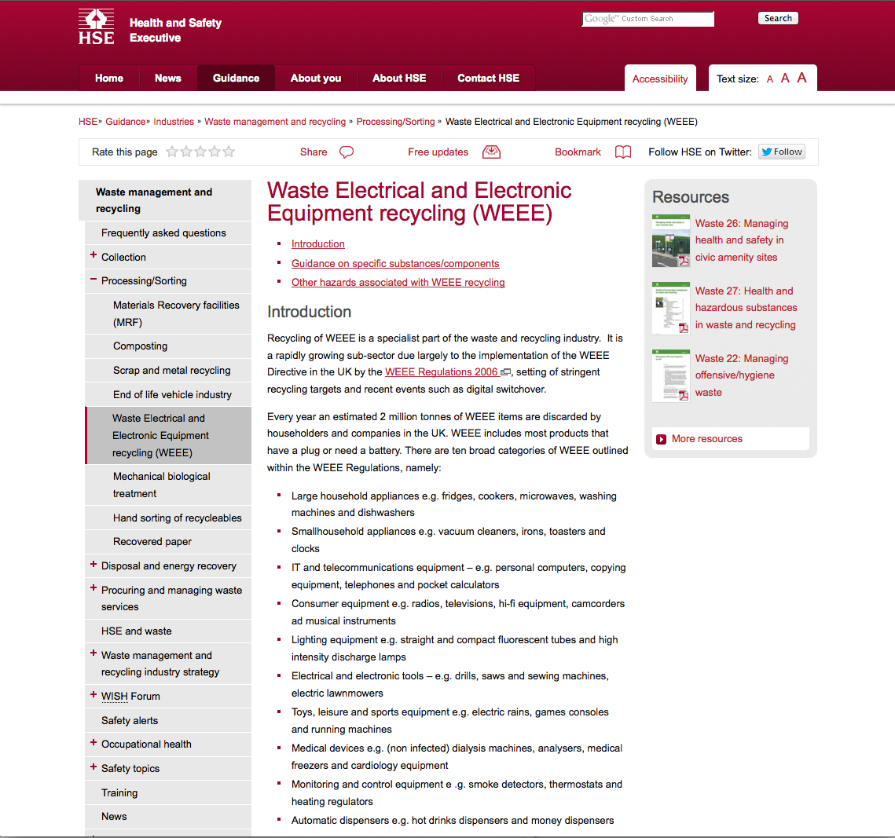
The legislation
http://www.hse.gov.uk/waste/waste-electrical.htm

Slide 51
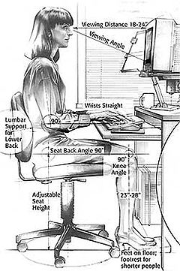
Customising the workplace
Sadly I was unable to obtain any images of male computer workers!

Slide 52
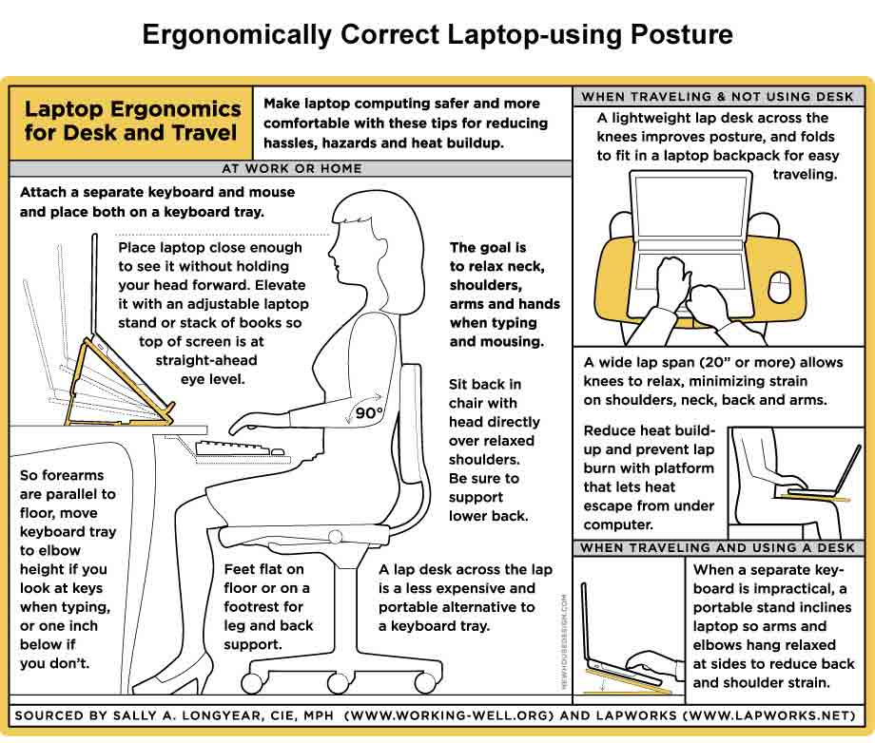
Managing your environment

Slide 53
Reminders:
Module overview
Build up your knowledge step by step

Slide 54
Work smarter not harder
Work smarter not harder
Approaches
Intellectually
  Understand your motivations
Imaginatively
  Develop and use your creativity and imagination
  Make your tasks enjoyable
Intuitively
  Learn to know what works
  for you
Pareto principle
  20% of the effort produces 80% of the result
  … but think about it logically, rationally
One touch
  Capture all the necessary information in a single touch
  Follow up: Dan Pink – RSA Animate, see refs and links

Slide 55
The presentation topics relate to the syllabus..
You will become a specialist
Use your presentation to understand content, context and perspectives as well as develop skills
Many of the other presentations will have content which relates to the exam topics, pay attention ☺

Slide 56
Overview: working method
Formal/timetabled
Informal/un-timetables
  Lecture
    The big picture
    Pacing
  Blackboard
    Links and references
  Out of class
    Search and prepare
    Watch videos
    Read overviews
    Work through tasks
    Think and discuss
    Prepare for examination
Objective:
knowledge, skills and understanding
Notes:
Knowledge, skills and understanding
How you work to understand the big picture..

Slide 57
Reminder: rationale of the structure
Guidance and prompting
Plus… directing you to a realistic/sustainable approach
This is not the same as coding, maths or other ‘hard’ subject areas
But it is very relevant to your degree…
… and the approach is relevant to future study and work
Find out, think about, re-present
Work in groups
Find your strengths
Overcome your weaknesses
Enjoy yourselves

Slide 58
Thank you ;-)
Su White
saw@ecs.soton.ac.uk
+44 (0)23 8059 4471
http://www.ecs.soton.ac.uk/~saw

Slide 59
Notes on the appendices
There are a number of appendices
Copyright and IP
  Notes and links on legislation
Thinking about questions
  Example questions and advice on how to revise for the exam
Awareness issues
  Things you might find useful when applying for work

Slide 60
Tasks: Other key areas
Copyright Design and Patents Act
Review the slides, make notes
Related slides – rights and ownership online
http://www.edshare.soton.ac.uk/9939/
And now incorporated into the slides below

Slide 61
Acknowledgements
Sarosh Kahn and Laura German provided some of the basic material for this set, along with some structure.
Those slides have been modified and various additions and alterations made

Slide 62
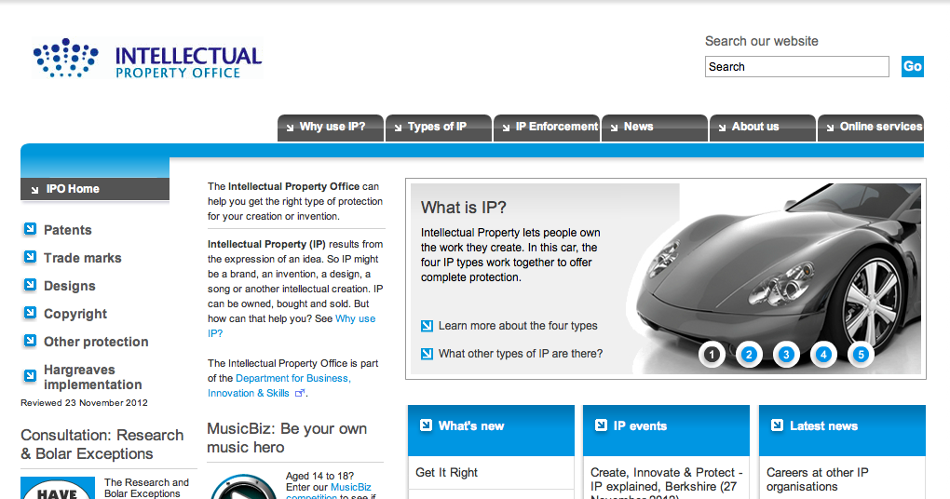
Intellectual Property

Slide 63
Copyright, Designs and Patents Act 1988
The Copyright, Designs and Patents Act 1988 is the current UK copyright law. This act gives the creators of literary, dramatic, musical and artistic works the right to control how their material may be used.
The Act details what types of work can be protected and the rights that a person has.
This Act is an extension to the previous copyright laws covered by the Copyright Act 1956, to encompass a larger scope of work.
Since 1988 the Act has had several amendments made to it.

Slide 64
What is copyright?
Copyright, unlike patents or trademarking is an automatic legal process which comes into effect as soon as a product or piece of work is created.
To qualify, said product or piece of work must be original and 'exhibit a degree of labour, skill or judgement.'
It is interesting to note that copyright comes into effect UPON PUBLICATION of the work, so if someone steals your idea and gets it published before you, you would be in breach of copyrighted work. (Copyright does not protect intangible things such as ideas, and there is no way to prove something ownership of something intangible).

Slide 65
What is copyright?
Copyright is a law that gives the author of certain types of work exclusive rights for a period of time.
It automatically covers your work, no need for registration
Copyright belongs to its author, but it can be sold or licensed to anyone.
  Once sold, the owner looses all rights
  Licensing gives certain rights to the licensees, even though the copyright is still the property of the owner.
  Licensees can also grant licenses to other people. Licences can be granted forever or for some fixed period.
Notes:
Copyright is a form of intellectual property that gives the author of an original work exclusive right for a certain time period in relation to that work, including its publication, distribution and adaptation, after which time the work is said to enter the public domain. Copyright applies to any expressible form of an idea or information that is substantive and discrete and fixed in a medium. Some jurisdictions also recognize "moral rights" of the creator of a work, such as the right to be credited for the work. Copyright is described under the umbrella term intellectual property along with patents and trademarks. http://en.wikipedia.org/wiki/Copyright

Slide 66





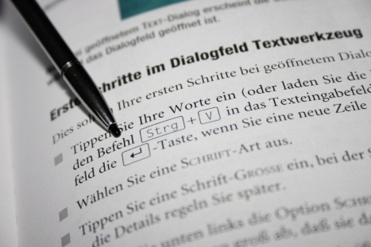
Copyright Law
Original Dramatic
Works
Original Musical
Works
Original Literary Works
Original Artistic
Works
Computer Programs/Databases
The Copyright, Designs and Patents Act 1988 section 1(1) states that copyright subsists in accordance with Part one of the Act in eight categories of works.
The Typographical Arrangement of Published Editions
Broadcasts
Films
Sound Recordings

Slide 67

Exclusive Rights of the Copyright Holder
To Copy the Work
To Communicate the Work to the Public
To Rent or Lend the Work to the Public
To Make an Adaptation of the Work or do any of the Above in Relation to an Adaptation
To Perform, Show or Play the Work in Public
To Issue Copies to the Public
The Copyright, Designs and Patents Act 1988, Section 16.
On the Web we are all used to hearing about widespread copyright infringement, particularly of music and films … But piracy is not new!

Slide 68
Copyright Law
Under official government legislation:
  "Where a literary, dramatic, musical or artistic work [or a film,] is made by an employee in the course of his employment, his employer is the first owner of any copyright in the work subject to any agreement to the contrary."
THIS INCLUDES SOFTWARE. This is very important for people with a future career in the IT industry, as if you create an original program under the instructions of your employer, you have NO claim in regard to the copyright of the work. This can, however, be re-negotiated before you start your employment.

Slide 69
Software copyright
UK copyright law was amended in 1992 to include computer programs under the category of literacy work.
Although there is no formal definition of what constitutes as a computer program, the following are covered under UK law:
  Source code
  Machine code
  Firmware
  Design materials
  Functional specification

Slide 70
Software copyright
A license to use a program is implied in the normal contract of sale, if no express provision is otherwise made.
Stature promises certain acts with regards to computer software as a basic right, which cannot be overwritten by any agreement, and includes:
  Back-up of licensed software
  Decompiling software (reversing the process of compiling)
  Observing and testing software to determines idea, principles and functionality
  Editing software for the purpose of bug fixing

Slide 71
Copyright Infringement
Copyright can be infringed in two ways:
Primary Infringement
  Anyone who performs an exclusive right of the owner, without permission.
Secondary Infringement
  Possessing, spreading or making copies
  Willingly permitting people to make copies
Notes:
In other words, when primary infringement occurs in a business.
This is a much more serious matter, and may result in criminal offence. In a magistrates Court, the penalties for distributing unauthorised files are a maximum fine of £5,000 and/or six months imprisonment. Whilst, on indictment (in the Crown Court) some offences may attract an unlimited fine and up to 10 years imprisonment.¹

Slide 72

Copyright Infringement
CDPA 1988, s.16(2): “Copyright in a work is infringed by a person who without the licence of the copyright owner does, or authorises another to do, any of the acts restricted by the copyright.”
Online Proclamations:
“I don’t own the rights to this – all credit goes to the author ☺!!!!”
- That’s nice, but it’s still infringement!
Permitted Acts

Slide 73
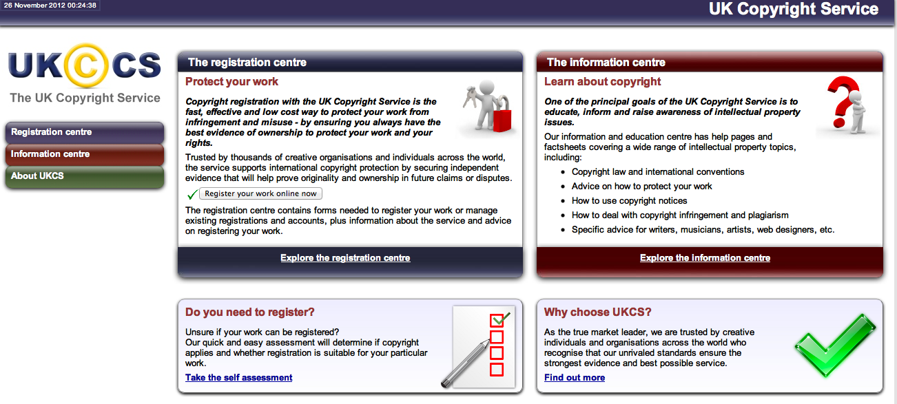
The UK Copyright Service website
http://www.copyrightservice.co.uk

Slide 74
“The Honest Musician's Fear of Accidental Plagiarism”
Available on BBC iPlayer http://www.bbc.co.uk/programmes/b00xw21s
“As Noel Gallagher put it rather bluntly when confronted about his musical influences: "There's twelve notes in a scale and 36 chords and that's the end of it. All the configurations have been done before.”
Singer and songwriter Guy Garvey [from Elbow], with the help of fellow songwriters Sir Tim Rice, Paul Heaton and John Bramwell, explores the legal pitfalls that can befall the honest musician and how to avoid them.”
(- BBC http://www.bbc.co.uk/programmes/b00xw21s.)

Slide 75
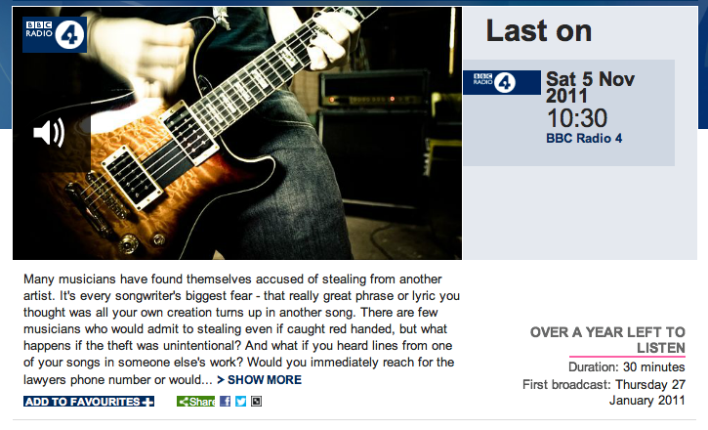
Still available – thank you BBC!
http://www.bbc.co.uk/programmes/b00xw21s

Slide 76
Solutions?

Slide 77

Creative Commons
“Share, Remix, Reuse – Legally”
(http://www.creativecommons.org.uk/ )
Creative Commons licensing is not an alternative to copyright law, but is compliant with the law!

Slide 78
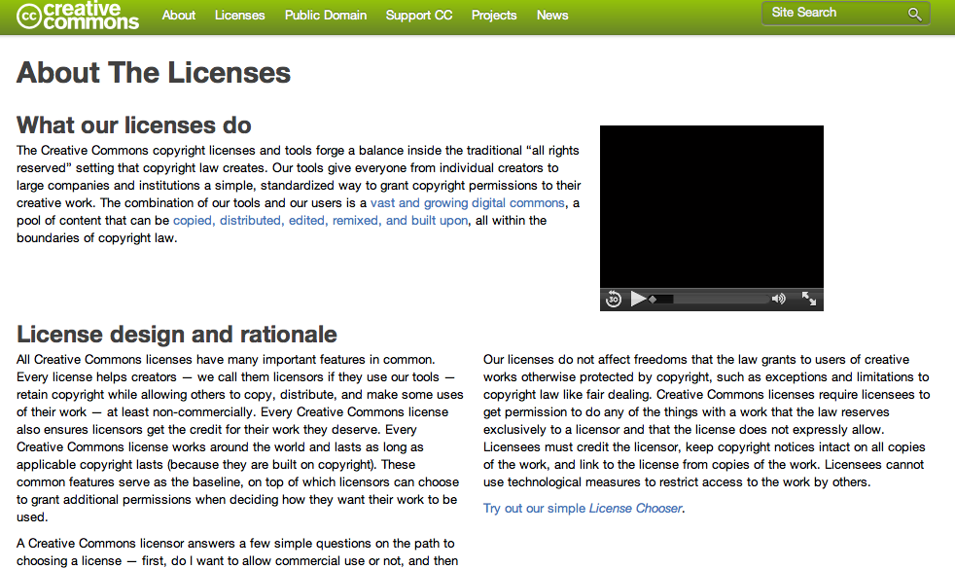
http://www.creativecommons.org/licenses/

Slide 79
Creative Commons
What is it?
  A non-profit organisation devoted to “expanding the range of creative works available for others to build upon legally and share”.
What does it do?
  The organisation has released a number of copyright-licences known as “Creative Commons licences” for free public use.
Who uses these licences?
  Wikipedia is the most well known user.
  Flickr, DeviantArt, xkcd and even Nine Inch Nails are also all users of Creative Commons licences.

Slide 80




The Licences
There are 4 original licenses:
  Attribution (by) – “You let others copy, distribute, display, and perform your copyrighted work - and derivative works based upon it — but only if they give credit the way you request.”
  NonCommerial (nc) – “You let others copy, distribute, display, and perform your work - and derivative works based upon it - but for noncommercial purposes only. “
  ShareAlike (sa) – “You allow others to distribute derivative works only under a license identical to the license that governs your work.”
  No Derivatives (nd) – “You let others copy, distribute, display, and perform only verbatim copies of your work, not derivative works based upon it.”

Slide 81
Combination Licenses
These licences can be combined to create different licenses:
Since NoDerivatives and ShareAlike licenses are mutually exclusive, that means there are 11 valid licenses.
CC found that 98% of users wanted Attribution, so they restricted it to six main licenses:

Slide 82
What can they apply to?
A creative commons license can apply to anything that is protected by copyright law.
Therefore a CC license can be applied to books, websites, blogs, photographs, films, videos, songs and any other audio and visual recordings, for example.
The licenses can theoretically be applied to Software or source code, but this is not recommended by CC since the licenses were not designed to apply to them.

Slide 83
What can they apply to?
A creative commons license can apply to anything that is protected by copyright law.
Therefore a CC license can be applied to books, websites, blogs, photographs, films, videos, songs and any other audio and visual recordings, for example.
The licenses can theoretically be applied to Software or source code, but this is not recommended by CC since the licenses were not designed to apply to them.
Notes:
A creative commons license can apply to anything that is protected by copyright law. Therefore a CC license can be applied to books, websites, blogs, photographs, films, videos, songs and any other audio and visual recordings, for example. The licenses can theoretically be applied to Software or source code, but this is not recommended by CC since the licenses were not designed to apply to them.

Slide 84
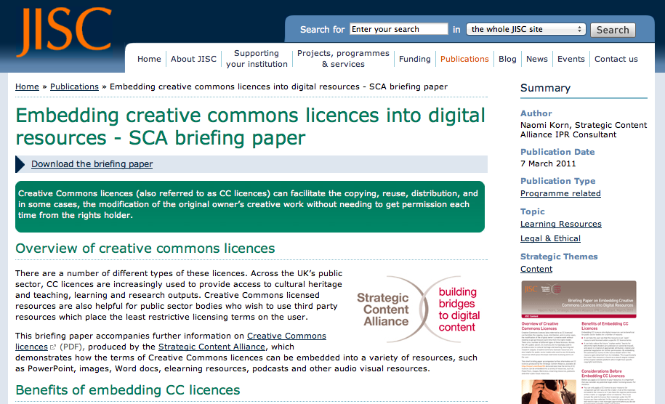
http://bit.ly/JISC-CCguide

Slide 85
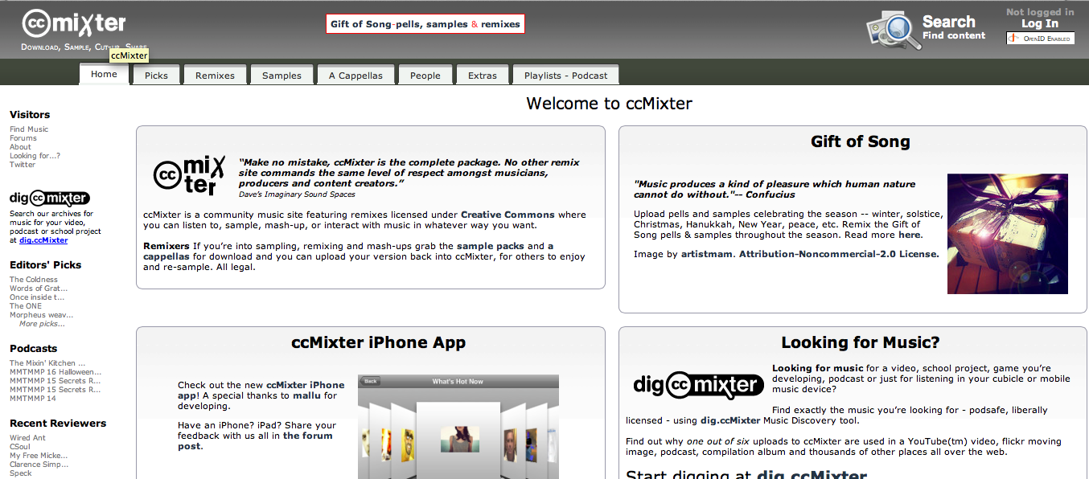
Mixter

Slide 86

http://www.behold.cc

Slide 87
Patents

Slide 88
What is a patent?
A patent is a license granted to an inventor, which gives the inventor the legal right to stop anyone else from making, using or selling the invention without his or her permission.[1]
[1] http://genome.wellcome.ac.uk/doc_WTD021006.html

Slide 89
Patents
Give the inventor the right to stop others from
exploiting their invention
without prior permission
for a fixed period of time typically
  20 years in the UK
  17 years in the USA.

Slide 90
A brief history of patents
The Patent Office, the administrator of patents and trademarks in the UK, was established in 1852 by the Patent Law Amendment Act.
Originally it was established to handle only patents however later in 1875 it was expanded to include industrial designs.
The Patent Act of 1977 updated these standards of the patent process.

Slide 91
What can be patented?
For an invention or idea to be patented it must
  Be capable of industrial application (invention that “can be made or used in any kind of industry, including agriculture”
  Must involve an inventive step (one which “is not obvious to a person skilled in the art”)
  Be an invention that is unique

Slide 92
What cannot be patented?
In comparison, there are a number of forms of invention that cannot be patented:
  Mathematical or scientific theories, methods or discoveries
  A way of doing business
  Method of medical diagnosis or treatment
  Computer programs or a presentation of information or an artistic work
  Any inventions that are “against public policy or morality”
The validity of a patent lasts for 5 years, after this time it must be renewed annually allowing a patent to stay active for a maximum of 20 years[1]
[1] http://www.ehow.co.uk/about_6669094_united-kingdom-patent-act.html

Slide 93
Patents
So…Invention
Can only be patented if
  it is new and demonstrates an inventive step
  has a practical application
  Isn’t in an excluded area.
Patent office will search
Existing patents and documentation
If anything is found
The application will be rejected.

Slide 94
Patents do not
Patents do not automatically cover inventions in the way copyright covers works.
Patents are issued by the state
Each patent only covers the country it was issued in
  In every country that the inventor wants protection
  It must be applied for

Slide 95
Patent Infringement
similar penalties to copyright infringement
Compensation needs to be paid to the owner.
The fine will usually take into consideration
  The amount the infringer would have paid to patent the design himself.
  If it can be proved that the person knew of an existing patent they will have to pay treble the amount.

Slide 96
PerspectiveS

Slide 97

Licences
“Click-wrap” licences;
unequal bargaining power;
Does anyone actually read them?
Can terms be changed unilaterally?

Slide 98

‘Hans Rosling’s New Insights on Poverty’
http://www.ted.com/talks/hans_rosling_reveals_new_insights_on_poverty.html
Available online – TED Talks.
19 mins. May 2007.

Slide 99

Criminality
Some examples:
Identity theft;
Fraud;
Organised Crime (i.e. paedophile rings);
Extremist Groups;
Malware …
Serious Organised Crime Agency
http://www.soca.gov.uk/
‘Smart phone malware highlighted by Get Safe Online Week ‘
http://www.soca.gov.uk/news/364-smart-phone-malware-highlighted-by-get-safe-online-week-

Slide 100
Further Info
The UK Copyright Service website:
  http://www.copyrightservice.co.uk/
The Copyright, Design and Patent Act:
  http://www.legislation.gov.uk/ukpga/1988/48/contents
UK Intellectual Property Office - http://www.ipo.gov.uk/
World Intellectual Property Organization –
http://www.wipo.int/portal/index.html.en
Serious Organised Crime Agency -http://www.soca.gov.uk/
UK Legislation - http://www.legislation.gov.uk/

Slide 101
Appendix thinking about questions
Use these example questions to help plan your revision
Build a set of notes to address important topic areas
When you revise think about what possible mcq’s might be asked on any given topic

Slide 102
Thinking about questions
Appendix

Slide 103
Freedom of Information Act
The Freedom of Information Act entitles an individual to request from a public authority:
  Any information held on the individual
  Any information held in electronic format on the individual
  Any information held in either paper or electronic format on the individual
  Any information at all

Slide 104
Privacy
A privacy issue is most likely raised when:
  Someone reports comments we have made at a public meeting
  Someone reports comments that they overhear us make to a friend in a public bar
  Your employer reads the contents of e-mails sent by you using the company system
  Someone reports the contents of a lecture we have given
  Someone reports comments we make in a private letter to a third party

Slide 105
Software Copyright
The copyright of software in the UK is currently covered by the _____________.
  Copyright Designs and Patents Act alone
  Copyright Designs and Patents Act and subsequent legislation
  The computer misuse act
  Digital Millennium Copyright Act
  The European Union Copyright Directive
Notes:
The copyright of software in the UK is currently covered by the _____________.
Copyright Designs and Patents Act alone
Copyright Designs and Patents Act and subsequent legislation
The computer misuse act
Digital Millennium Copyright Act
The European Union Copyright Directive

Slide 106
Purchase use and disposal
Which of the following does not require institutions to implement policies relating to the purchase, use and disposal of ICT equipment?
  The waste electrical and electronic equipment directive
  The reduction of hazardous substances directive
  The energy using products directive
  The disposal of hazardous substance directive directive
  The landfill reduction and management directive
Notes:
The waste electrical and electronic equipment directive
The reduction of hazardous substances directive
The energy using products directive
The disposal of hazardous substance directive directive
The landfill reduction and management directive
4&5 are not real directives

Slide 107
Copyright
Questions might be constructed around any of the following topics
Can copyright be inherited?Yes. The person who inherits the work will become the new owner.
What happens when a copyright expires?The work will fall into the public domain, making it available to anyone wishing to use, copy or reproduce the work. This is how so many companies can publish works by William Shakespeare,clas
What types of work are protected?
y literary, dramatic, design, musical or artistic work. So long as the work exhibits a degree of skill, labour or judgement.
How long does copyright last?his will depend on the work and nationality, but typically the work will be protected for either, 70 years from the death of the author, or if published 70 years from the date of first publication.sical composers etc.
Does the nationality of the author matter?
Under the terms of the Berne Convention, authors are automatically protected internationally, they may also enjoy additional rights as granted under national laws.
Does format or quality of the work matter?
The format of the work, i.e. Negatives or photographs, computer files or paper documents, does not matter, neither does the quality of the work.
Notes:
Can copyright be inherited?Yes. The person who inherits the work will become the new owner.
What happens when a copyright expires?The work will fall into the public domain, making it available to anyone wishing to use, copy or reproduce the work. This is how so many companies can publish works by William Shakespeare, classical composers etc.
What types of work are protected?Any literary, dramatic, design, musical or artistic work. So long as the work exhibits a degree of skill, labour or judgement.
How long does copyright last?This will depend on the work and nationality, but typically the work will be protected for either, 70 years from the death of the author, or if published 70 years from the date of first publication.
Does the nationality of the author matter?Under the terms of the Berne Convention, authors are automatically protected internationally, they may also enjoy additional rights as granted under national laws.
Does format or quality of the work matter?The format of the work, i.e. Negatives or photographs, computer files or paper documents, does not matter, neither does the quality of the work.

Slide 108
Thinking Task
Think about questions
Questions can be simple
  Testing knowledge
More complex
  Testing understanding
Even more complex
  Providing an opportunity to combine
    Knowledge, understanding and thinking skills
    In your groups design one example of each type of question which draws on the information provided

Slide 109
awareness issues
Appendix

Slide 110
Employment….
Employment terms and conditions incorporate
Pay
National Minimum Wage
Employment Contracts and Conditions
Time off and Holidays
Flexible Working
Working Hours
Sickness Absence
Business transfers and takeovers
Starting a new job

Slide 111
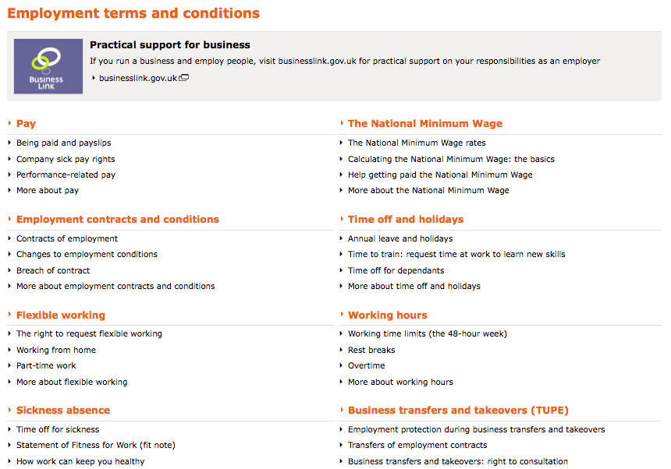
Sources of information…
http://bit.ly/g6jjrE

Slide 112
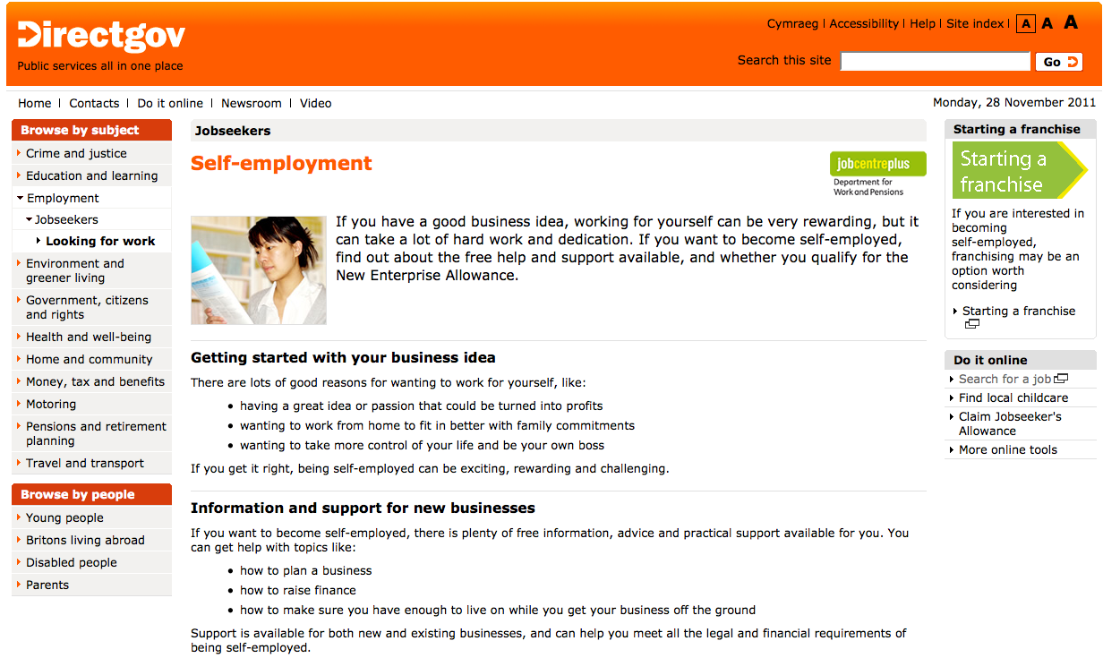
Self Employment

Slide 113
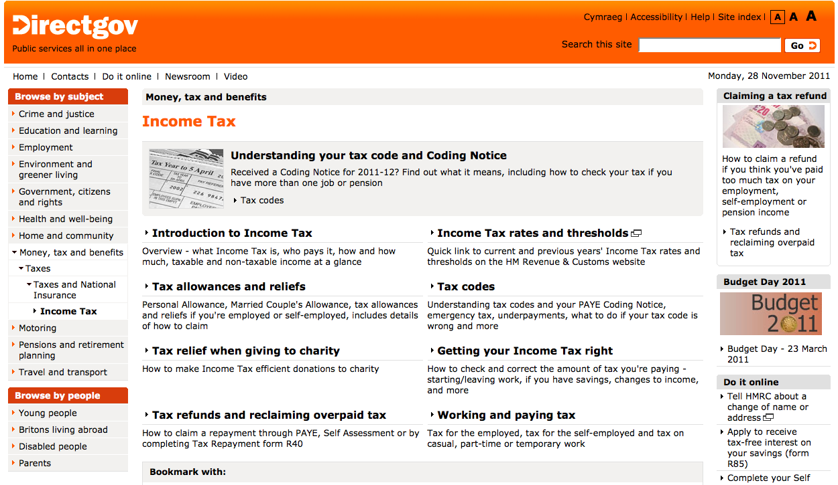
Income Tax

